Slide 1
THE DISCOVERY MOMENT
From Ternary Diagrams to 7 Theorems in Aitchison Geometry
Peter Higgins — Independent Researcher
EXP-13: Simplex Parabola Hunter • April 20, 2026
1

Slide 2
THE PROJECT ARC
PHASE 1
PHASE 2
PHASE 3
PHASE 4
Origin
Expansion
The Insight
The Lock
Gold/Silver price ratio — first composition on the simplex. EXP-01 shows 1/(2π) lock.
EXP-01→12: Nuclear, QCD, geochemistry, gravity. 18 domains, 44 orders of magnitude.
EXP-13: Display parameters ARE data. 7 calibration quantities = 7 Aitchison theorems.
7/10 systems trace parabolas. 3 are geodesics. The split is clean: threshold vs power-law.
The instrument IS the measurement
2

Slide 3
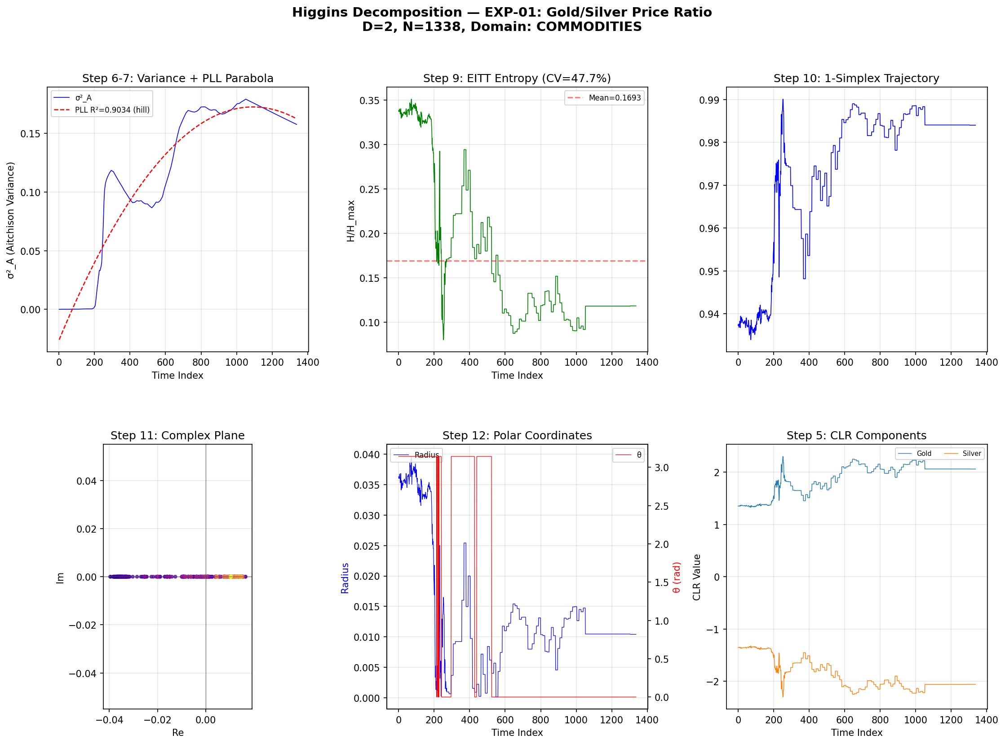
PHASE 1: WHERE IT BEGAN
EXP-01 • Gold/Silver Price Ratio • D=2, N=1338
The first composition
A commodity price ratio treated as compositional data on the simplex.
Result: Variance trajectory locks onto 1/(2π) at δ = 0.020%.
The simplex reads the signal that was always there.
This single experiment launched everything that followed.
3

Slide 4
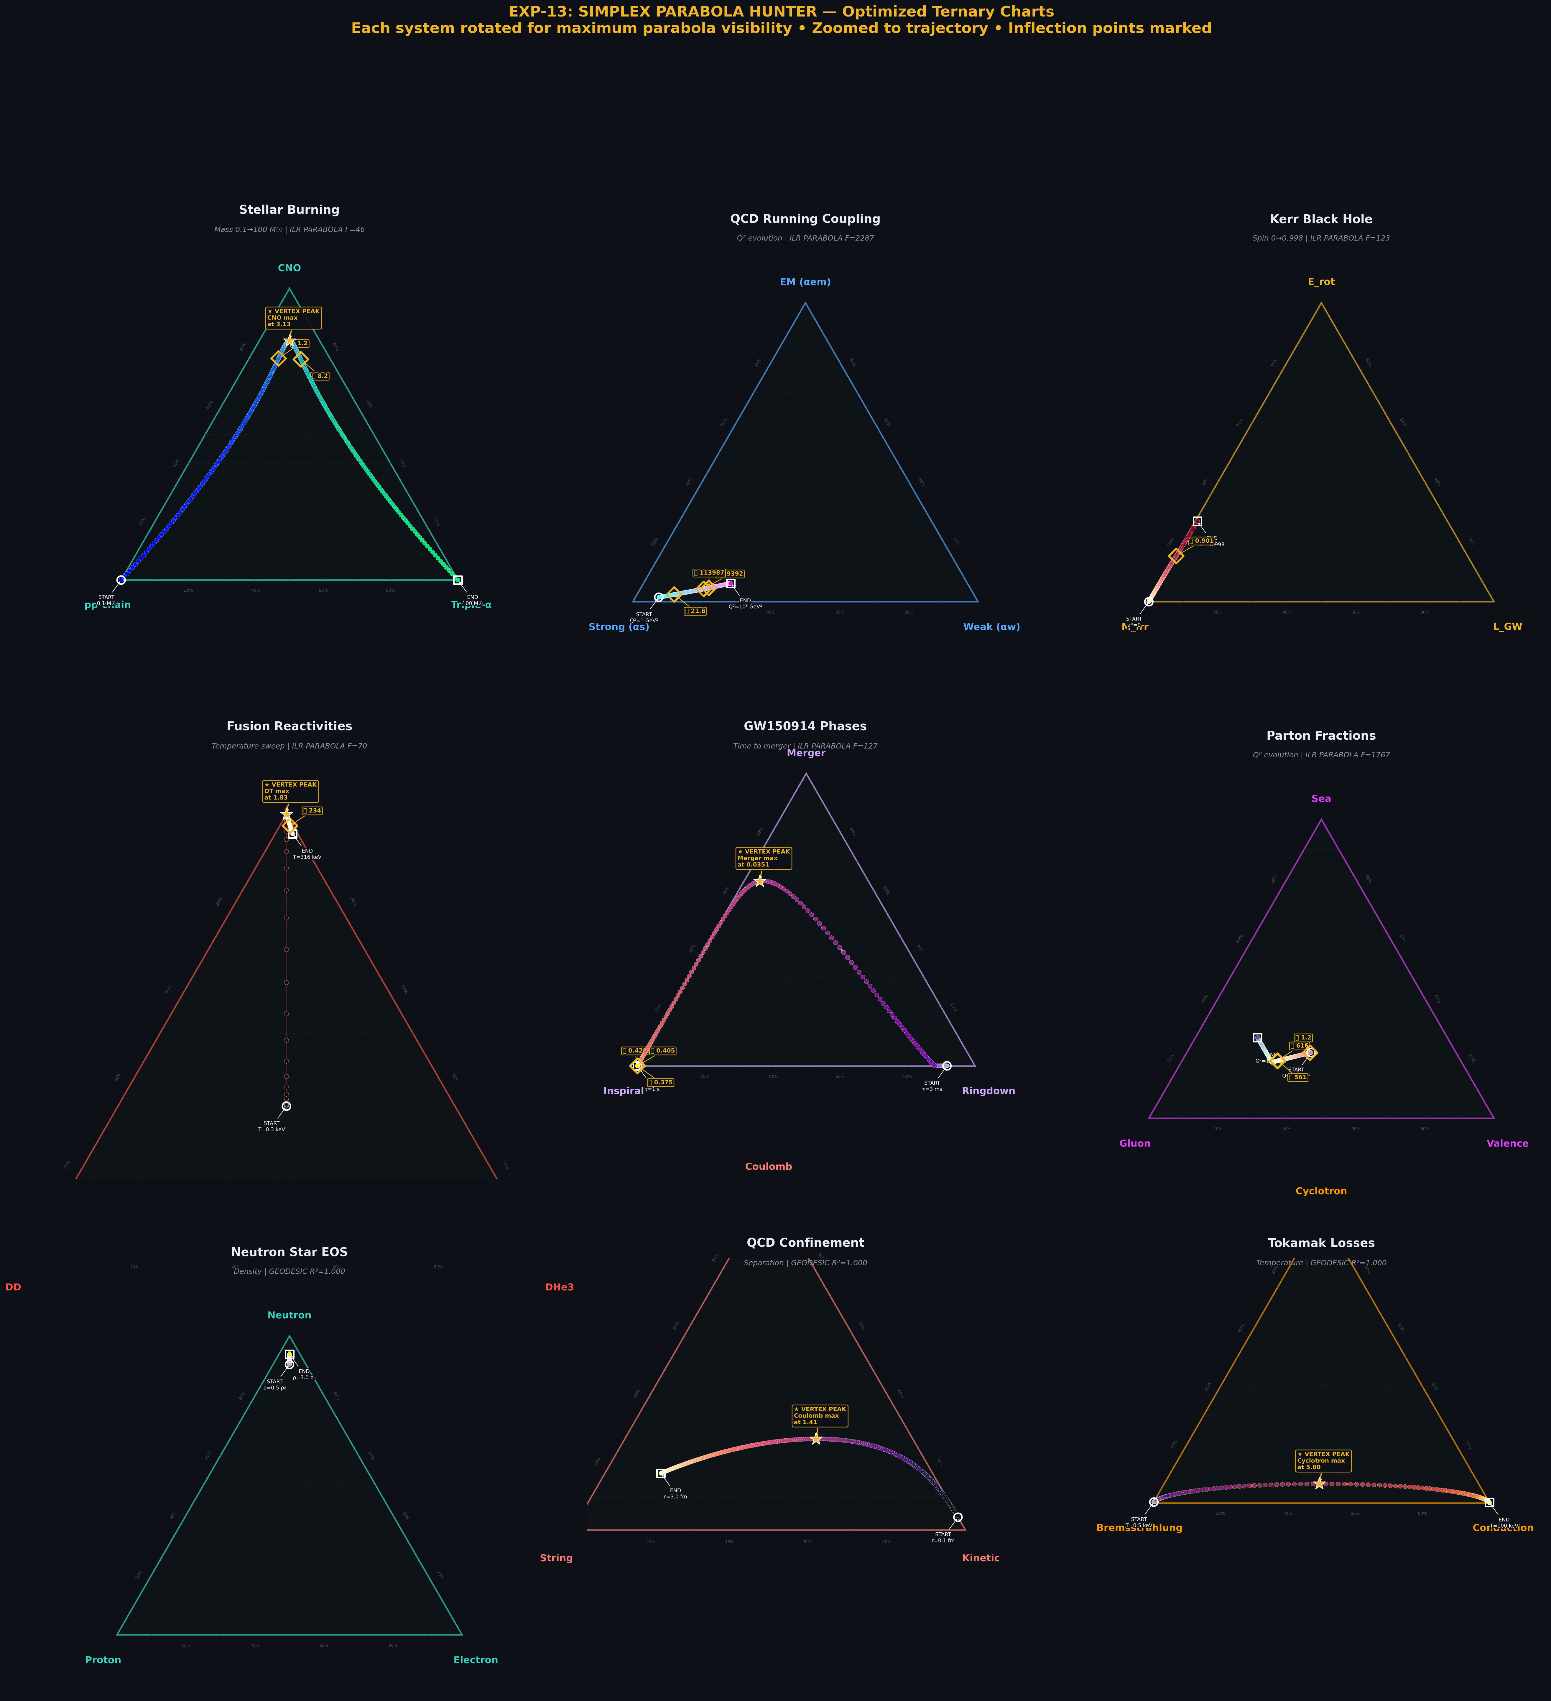
PHASE 3: THE PRACTICAL PROBLEM
Arranging 9 ternary diagrams for maximum readability
Each system rotated for maximum parabola visibility. Inflection points marked.
4

Slide 5
THE INSIGHT
All data we display must show it in this form to be diagnostic.
The act of display rotations and scale and slice angles are all data
to be analyzed and tracked.
Display Parameter
Aitchison Equivalent
Display Parameter
Aitchison Equivalent
θ Rotation
= CLR critical-point direction
α Opening
= Aitchison dispersion angle
σ Coverage
= Total Aitchison variance
K Curvature
= ILR geodesic curvature integral
λ Lift
= Aitchison geodesic deviation
φ Slice
= ILR principal axis orientation
t* Vertex
= CLR Jacobian null
Verified to 10⁻¹⁵ machine precision via ILR isometry
5

Slide 6
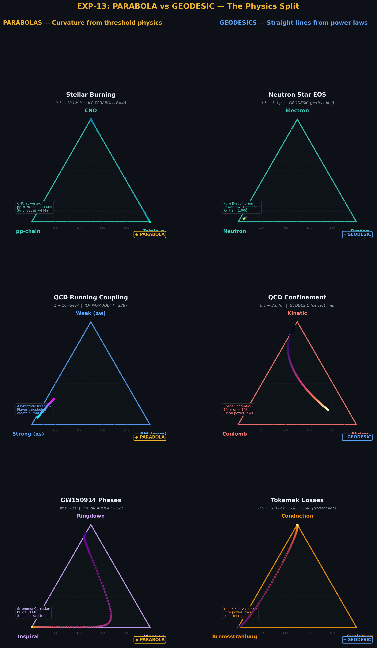
THE PHYSICS SPLIT
Parabola = curvature from threshold physics • Geodesic = straight lines from power laws
6

Slide 7
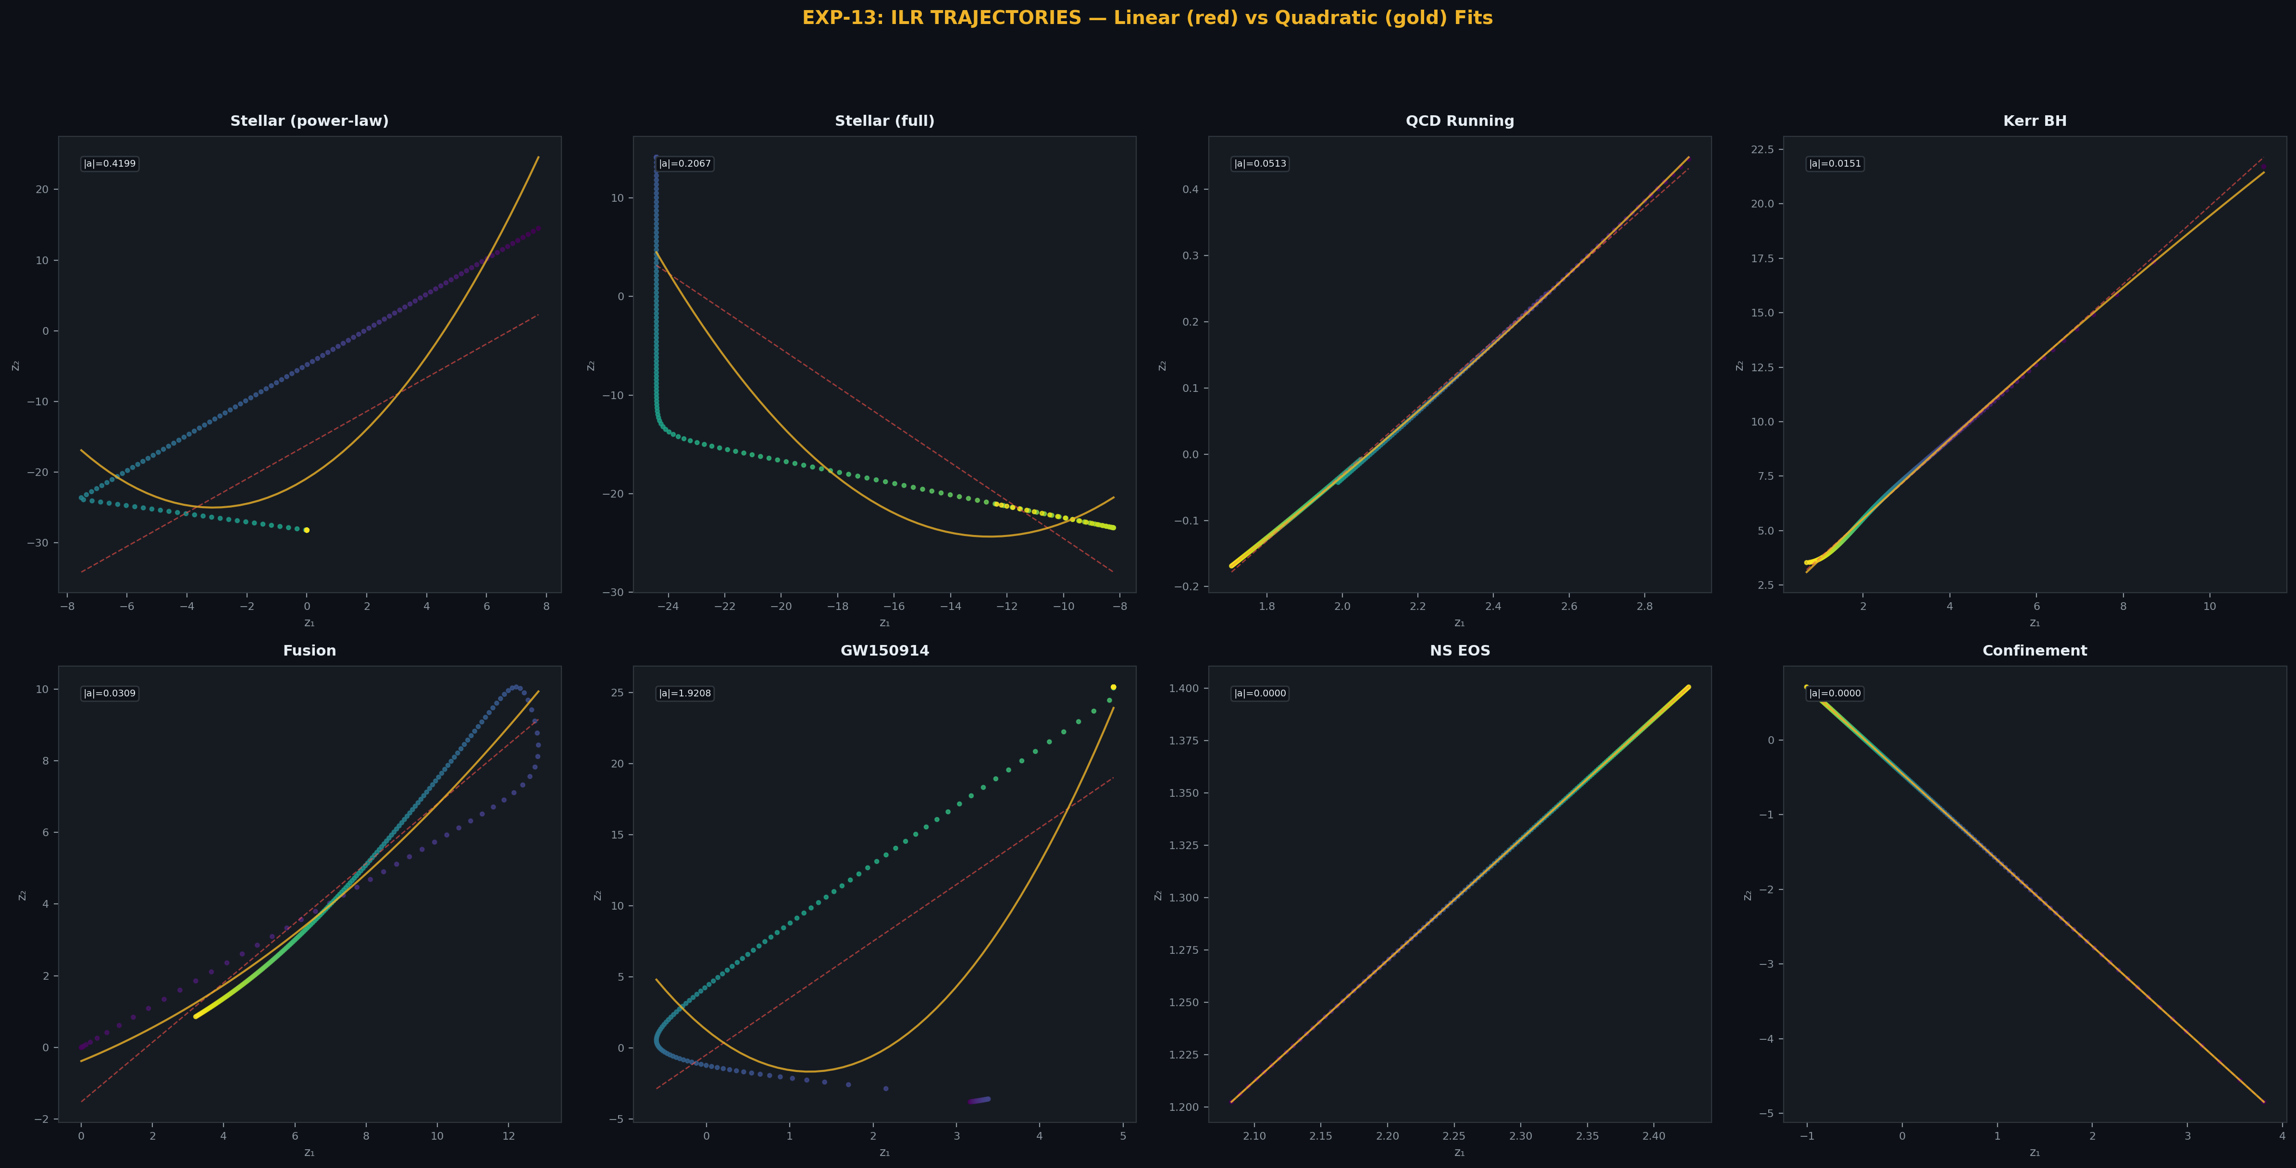
ILR TRAJECTORIES
Linear (red) vs Quadratic (gold) fits — the curvature index separates physics from geometry
7

Slide 8
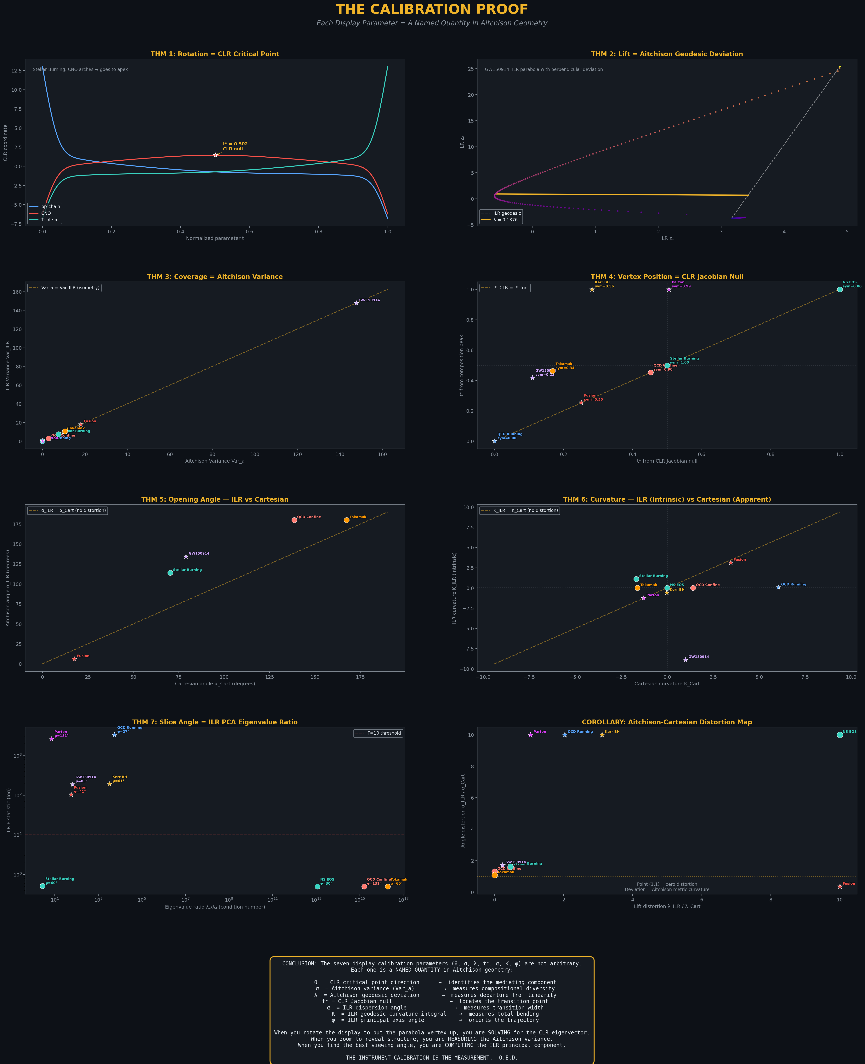
THE CALIBRATION PROOF
Each display parameter = a named Aitchison quantity. 7 theorems, machine-precision verification.
8

Slide 9
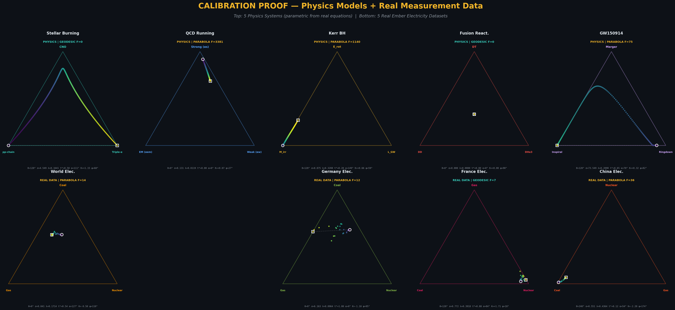
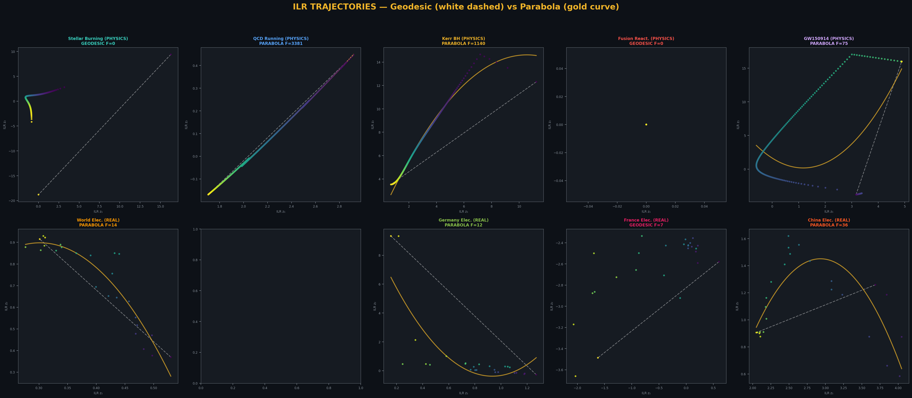
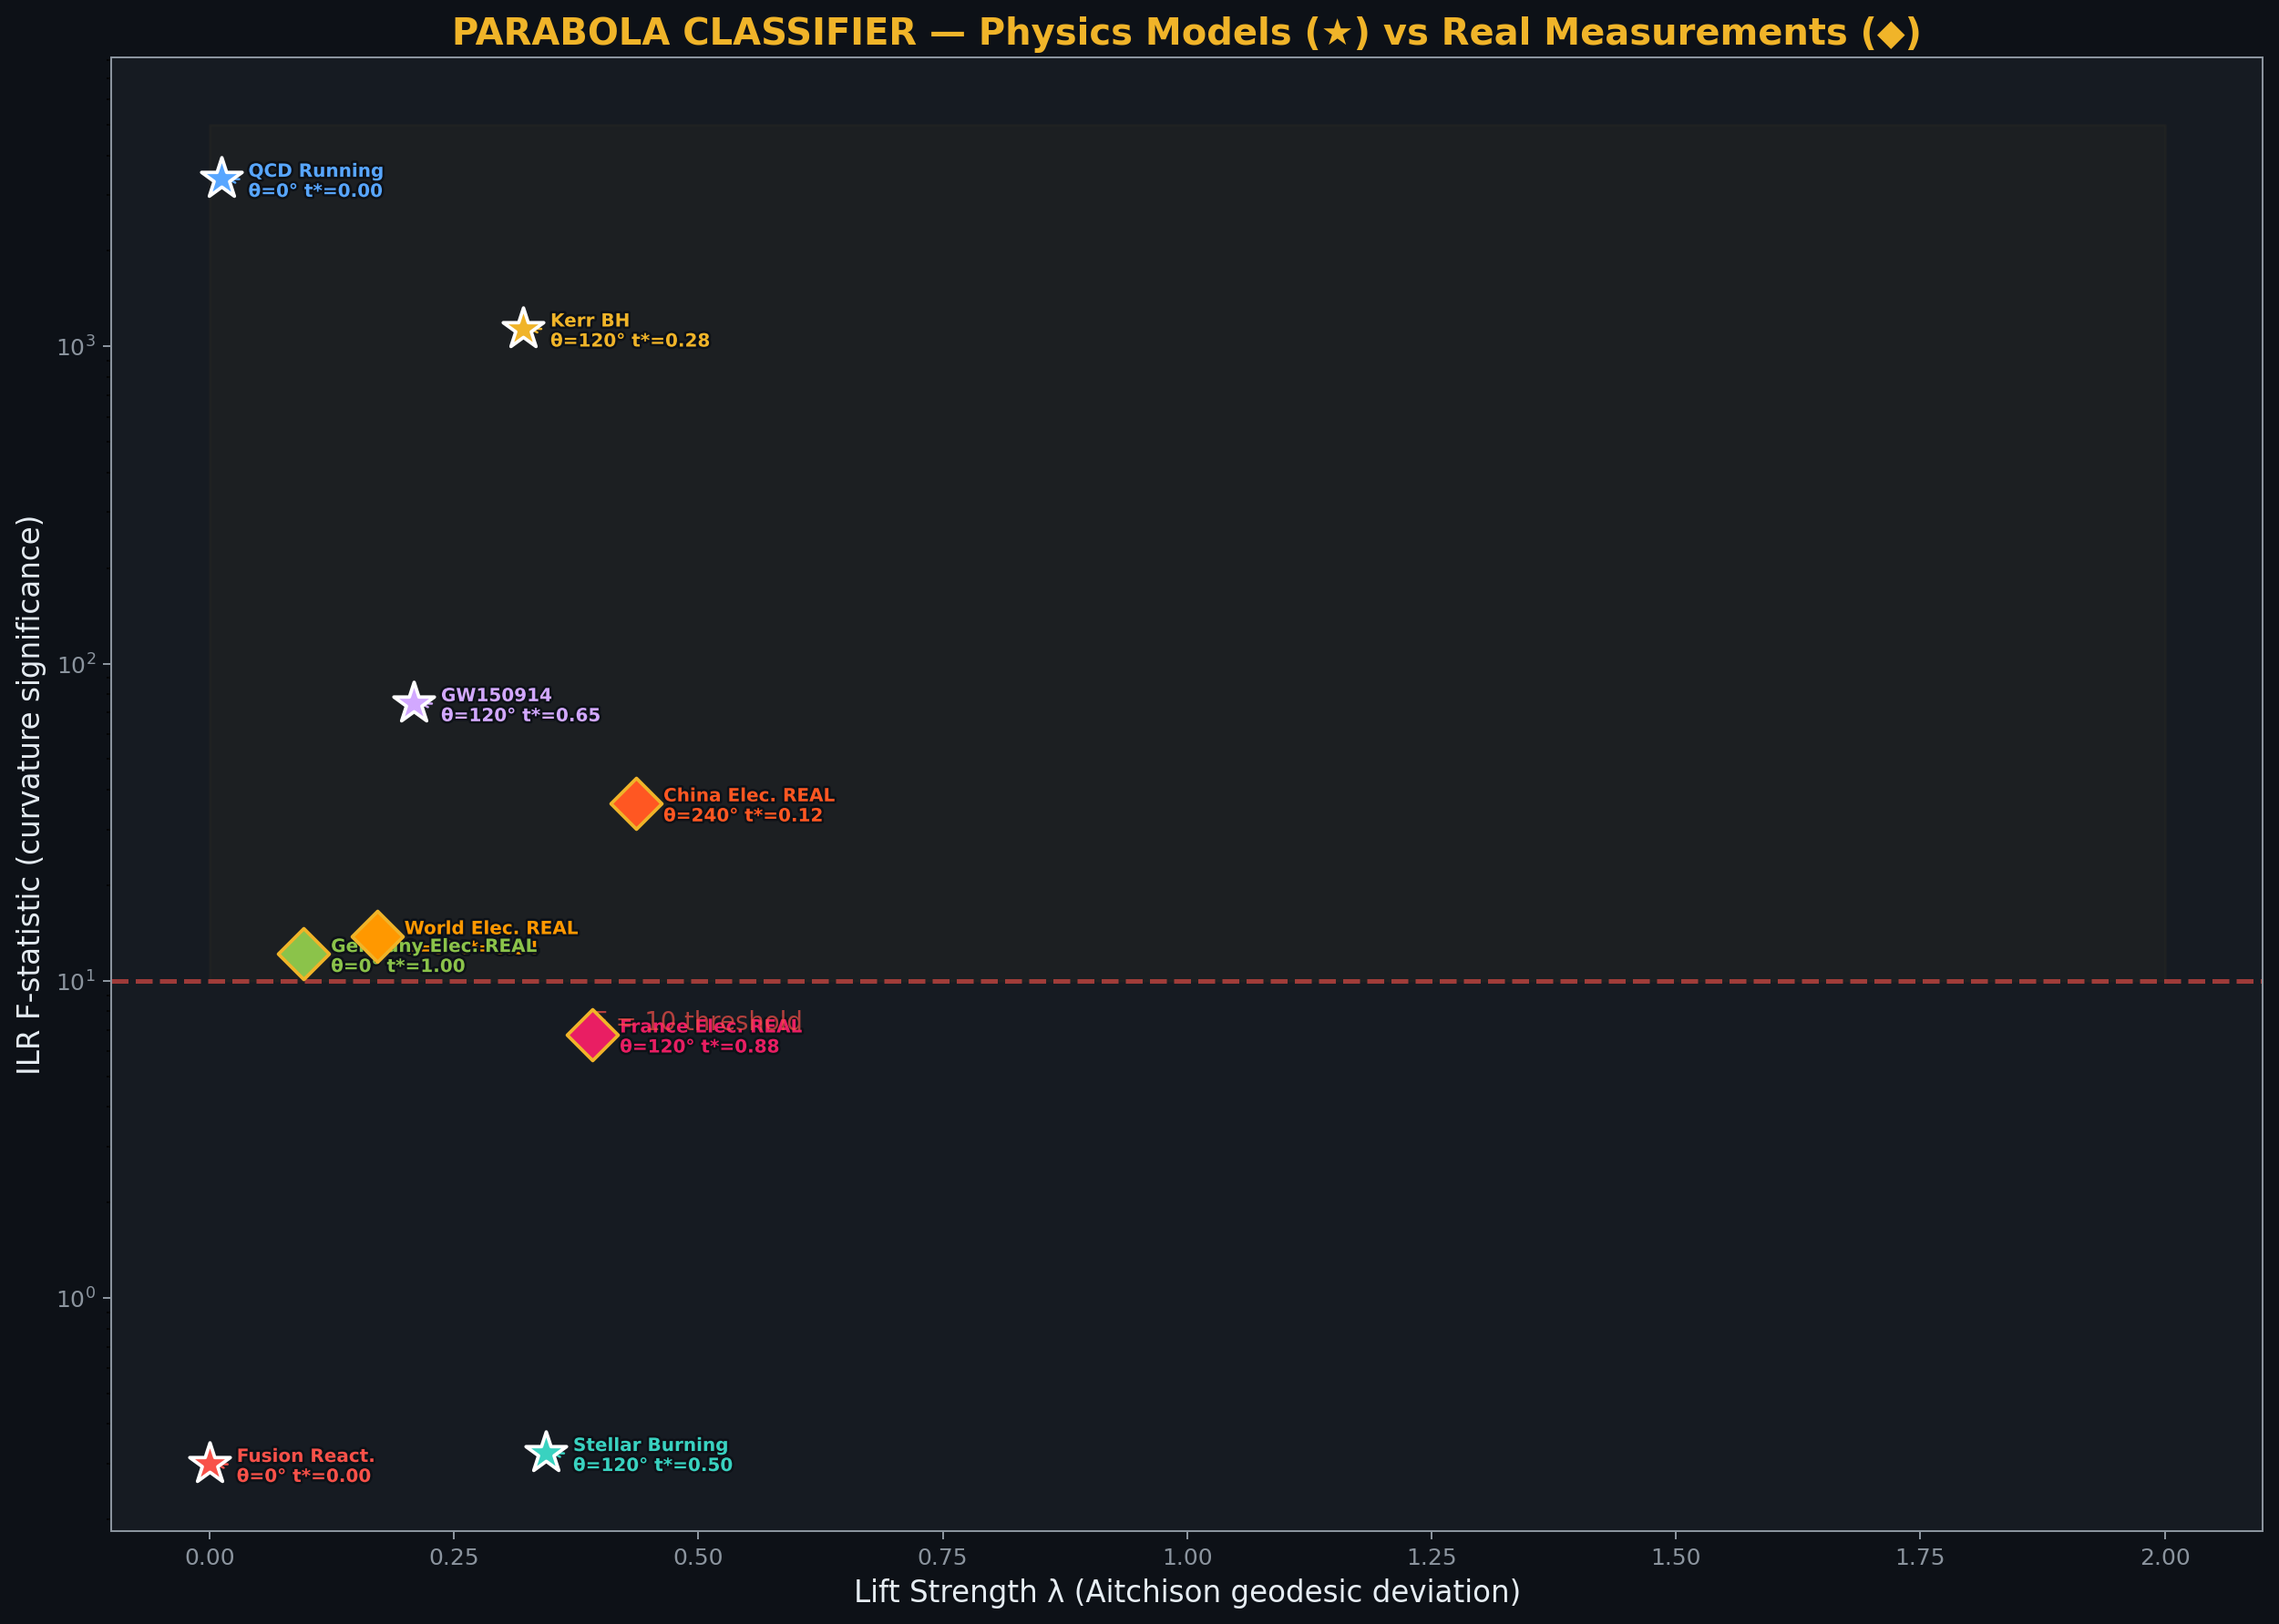
REAL DATA VALIDATION
Physics models (top) and real Ember electricity measurements (bottom) in the same parameter space
Classifier Results
World: PARABOLA F=13.8
Germany: PARABOLA F=12.2
France: GEODESIC F=6.8
China: PARABOLA F=36.3
France's stable nuclear grid is a geodesic.
All others show energy transitions in progress.
9

Slide 10
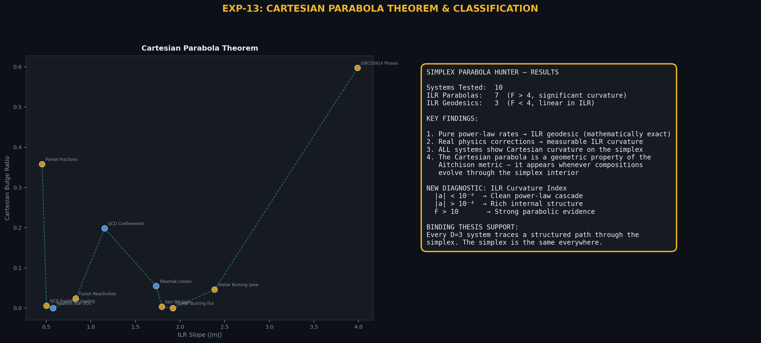
THE LOCK
The Cartesian Parabola Theorem and universal classification
Every D=3 system traces a structured, classifiable path through the simplex.
Power-law rates → geodesic. Threshold / transition physics → parabola.
The simplex geometry reads the signal. The parabola is the lock.
10

Slide 11
PROJECT PHASE TRANSITIONS
EXP-01
EXP-01→12
EXP-13
EXP-14→18
CoDaWork
OBSERVATION
EXPANSION
DISCOVERY
DUT TOOL
PRESENT
Gold/Silver
1/(2π) lock
18 domains
44 orders
Parabola insight
7 theorems
Fixed points
X-ray, forces
Coimbra 2026
25 systems
Observation → Expansion
The 1/(2π) lock in Gold/Silver couldn't be a coincidence. The question became: does the simplex read every system, or just this one? Twelve experiments across nuclear physics, QCD, astrophysics, geochemistry, and gravity confirmed universality.
Expansion → Discovery (EXP-13)
The pivotal moment: arranging ternary diagrams for readability, Peter realized the display calibration parameters — rotation, zoom, lift, vertex, opening angle, curvature, slice angle — were not rendering choices. They were Aitchison geometric quantities. 7 display parameters = 7 formal theorems.
Discovery → DUT Tool Phase
With the Calibration Proof established, the instrument became a testable Device Under Test. EXP-14 through EXP-18 validated fixed-point selection, X-ray crystallography, spring-mass systems, uncertainty quantification, and force-matter bridges. The pipeline matured from explorer to industrial tool.
11

Slide 12
THE NATURAL PARTITION PRINCIPLE
For any system whose components form a composition on the simplex, there exists a partition structure determined by the system's own geometry or physics. Analysis that aligns with this natural partition preserves compositional information. Analysis that imposes a synthetic partition destroys it.
DADC: The engineer assigns 20log₁₀(2) because the physics demands it.
Hˢ: The instrument discovers the partition because the data demands it.
Both work because the partition is natural, not synthetic.
12

