Slide 1
Compositional Navigation Tensor
A hash-traceable instrument for compositional dynamics
CoDaWork 2026
P. Higgins
The instrument reads. The expert decides. The hashes hold the line.
Notes:
Open: 'I'm going to show you an instrument my team built. Classical CoDa toolkit, deterministic engine, trajectory-native operators, hash-chained reports. Verifiable in two minutes. That's the talk.'

Slide 2
What CNT adds on top of the CoDa toolkit
Three additions that complement the established CoDa methods:
Trajectory operators
End-to-end determinism
Cross-dataset inference
bearings, ω, helmsman, period-2 attractor, IR class — first-class objects in the algebra, computed alongside the standard ILR.
raw CSV → JSON → PDF byte-identical. content_sha256 + engine_signature on every page, supporting reproducibility for both pipelines.
Stage 4 reports compare attractor amplitude, depth tower, and IR distribution across multiple datasets in one document.
These ship alongside the classical plates — both languages, one report.
Variation matrix · biplot · balance dendrogram · SBP · ternary · scree — same engine.
Notes:
'This isn't a replacement for ILR or the classical biplot. It's an extension that ships those plates plus the trajectory-native ones in one report. Both languages, one document.'

Slide 3
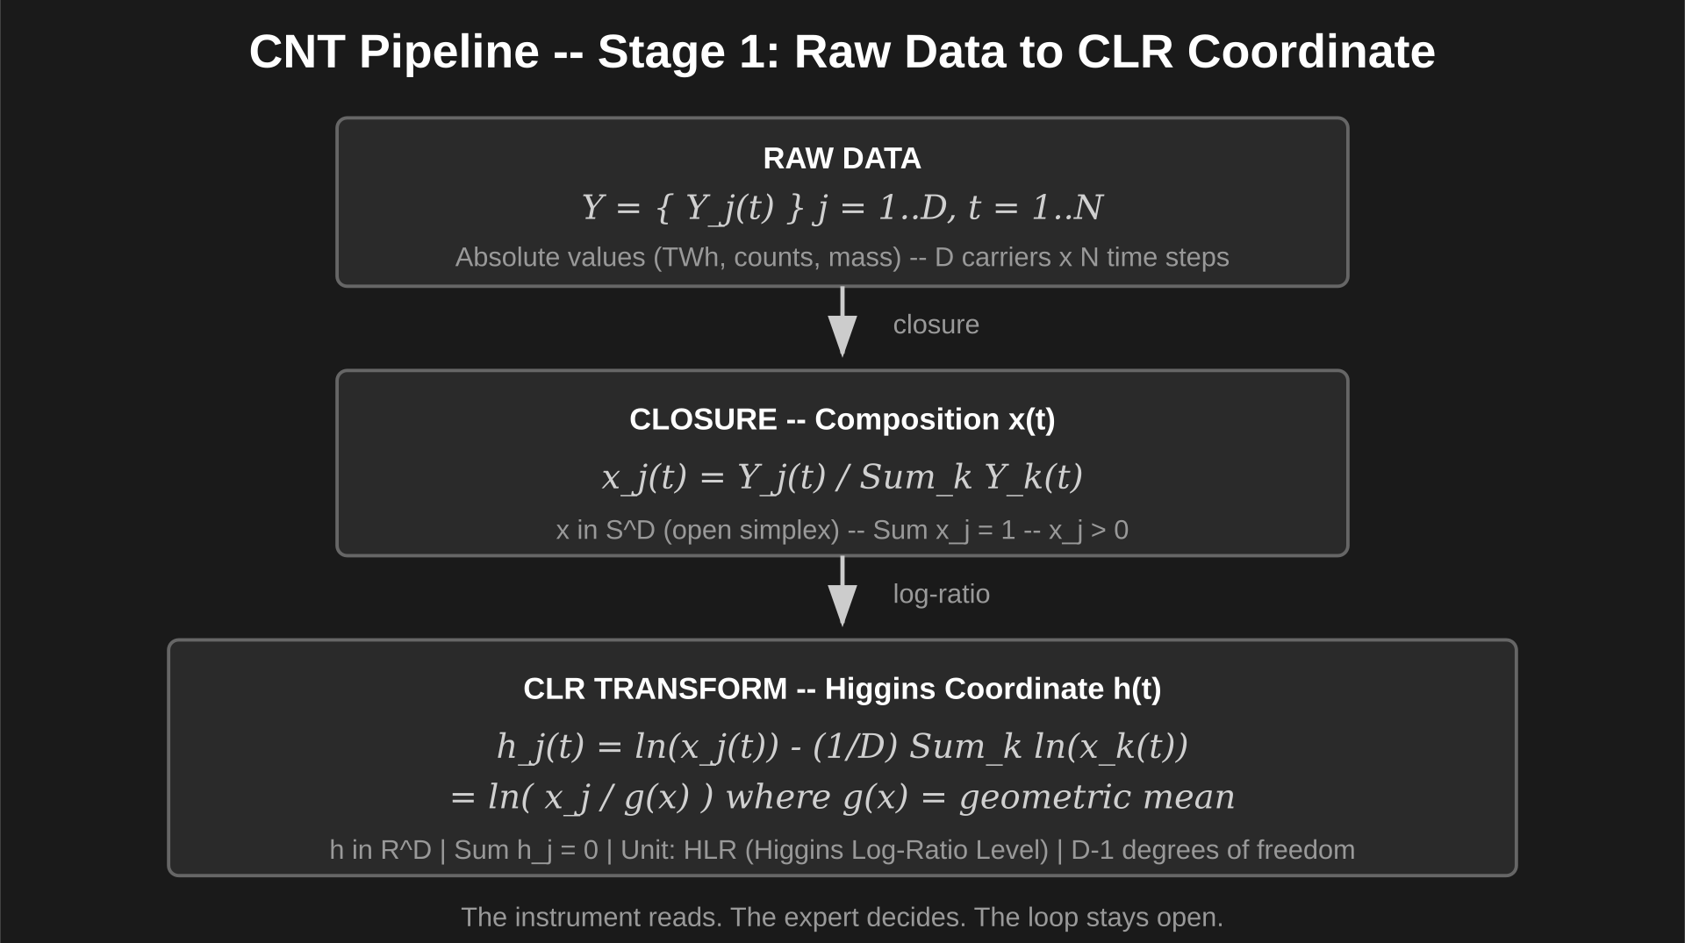
Notes:
Pipeline overview — raw → closed → CLR.

Slide 4
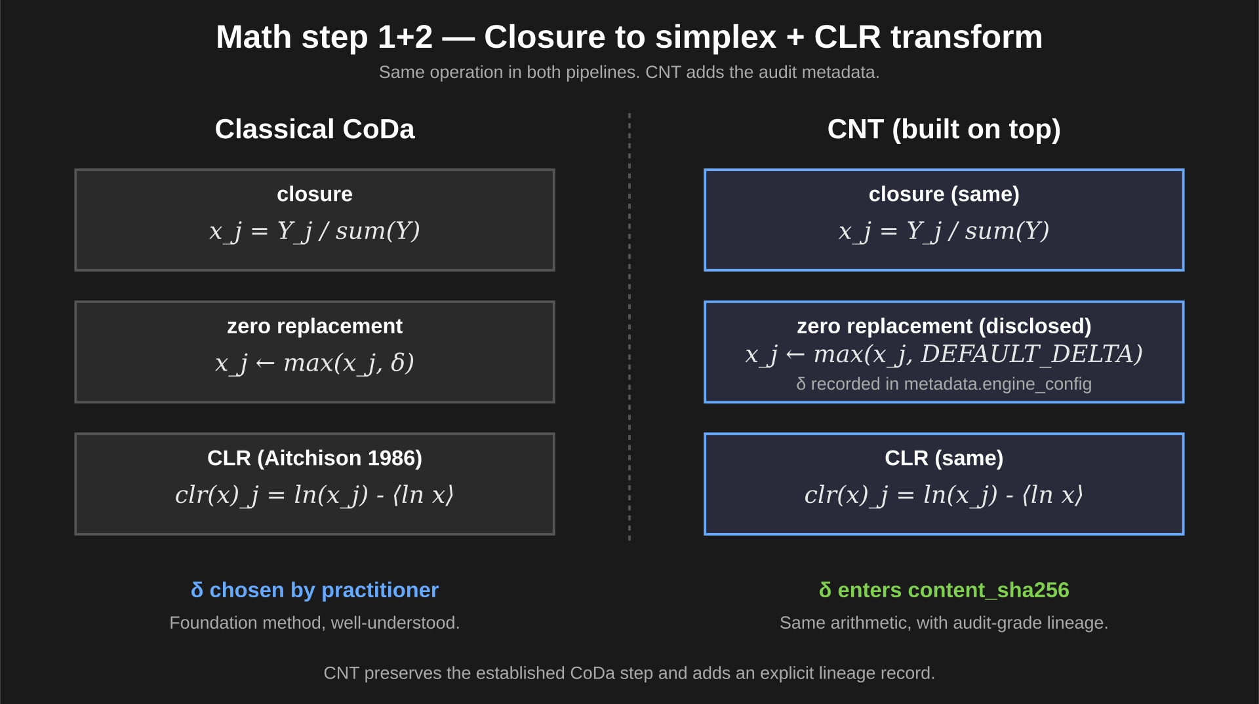
Notes:
Same step in both pipelines. CNT adds the audit metadata.

Slide 5
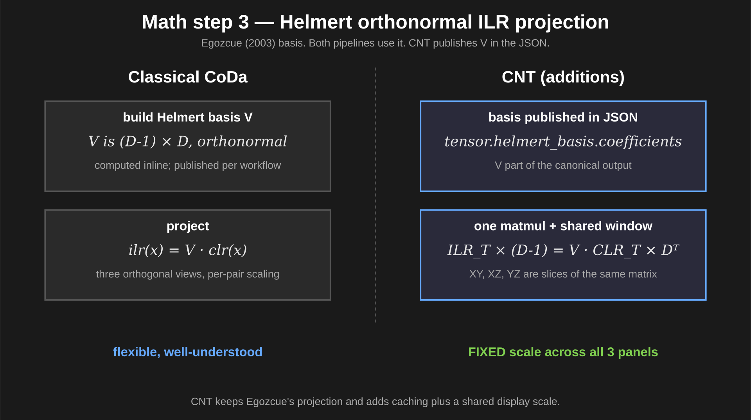
Notes:
Egozcue's projection in both. CNT publishes V in the JSON and uses one shared FIXED window across panels.

Slide 6
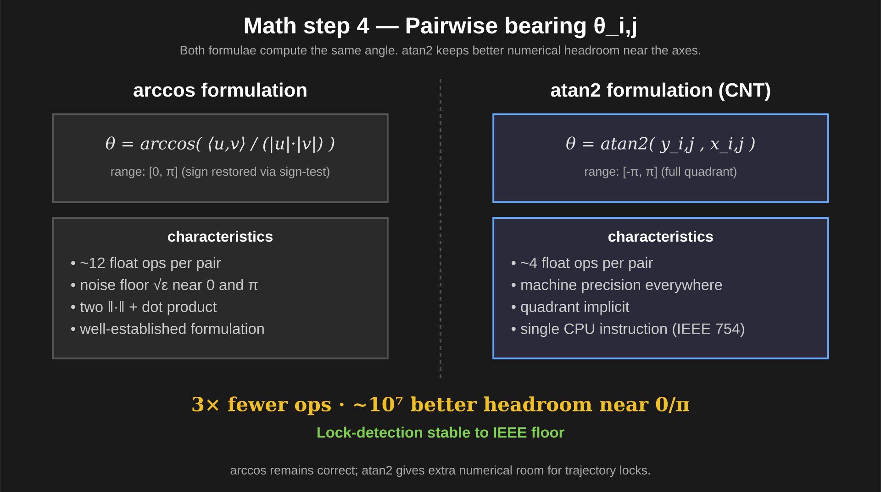
Notes:
Same angle. atan2 keeps extra numerical headroom near the axes — useful for trajectory locks.

Slide 7
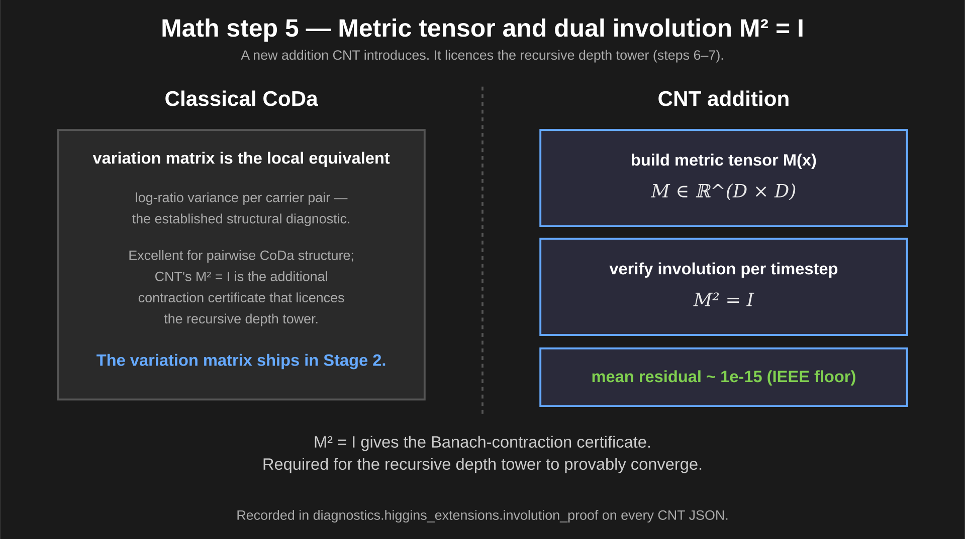
Notes:
CNT addition: M² = I provides the contraction certificate the depth tower needs.

Slide 8
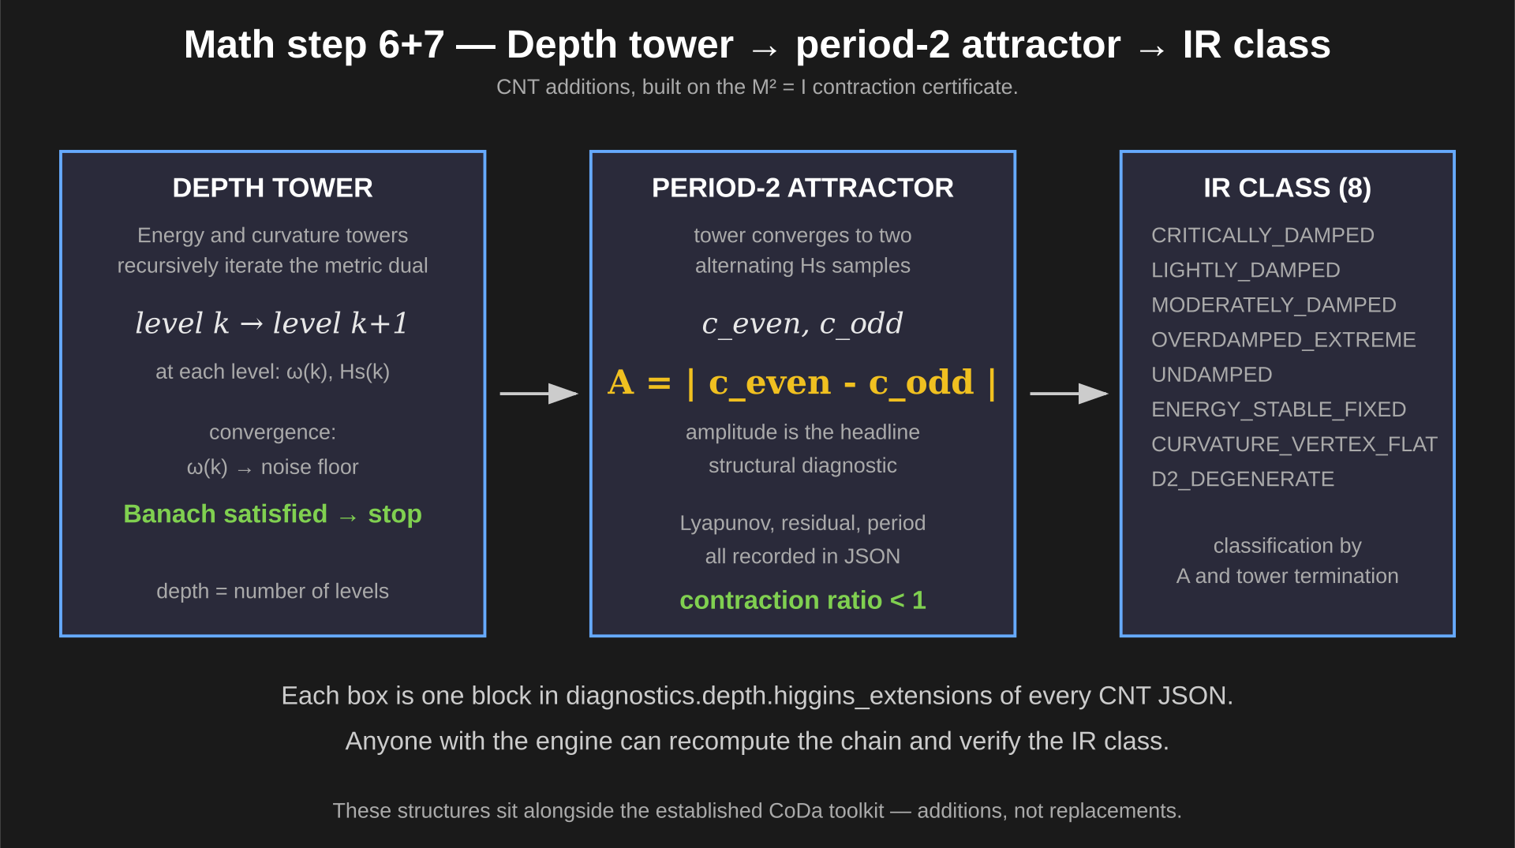
Notes:
CNT additions built on M²=I: recursive depth sounder converging on a period-2 attractor.

Slide 9
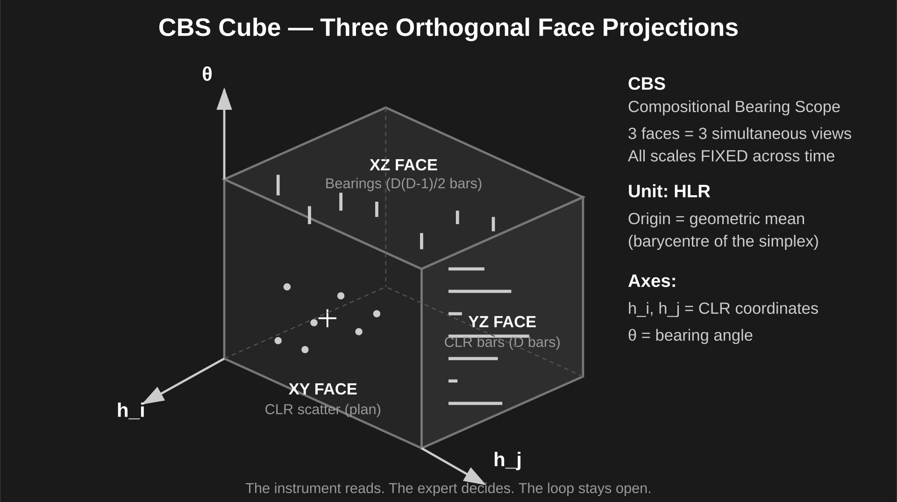
Notes:
CBS — three orthogonal faces of the compositional bearing scope.

Slide 10
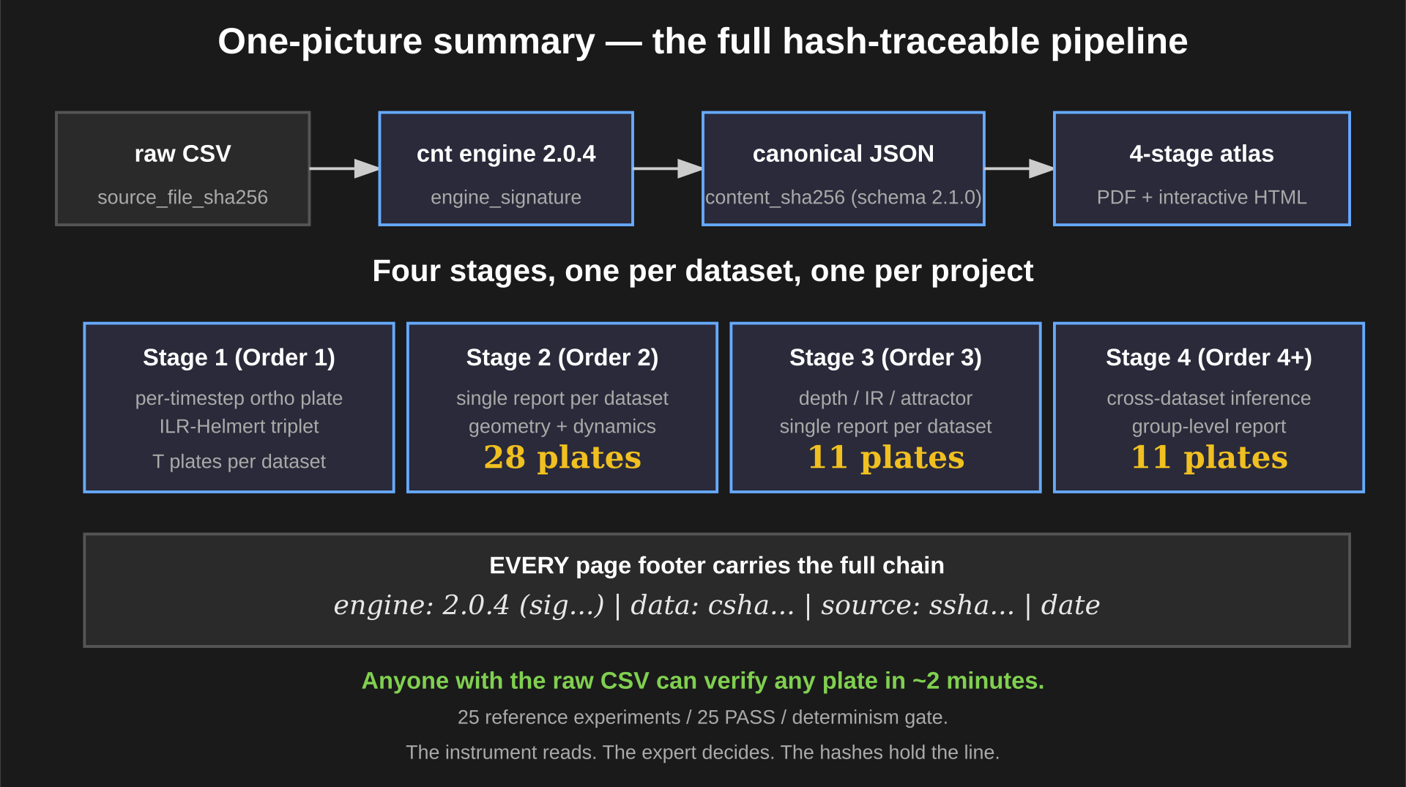
Notes:
Hash chain end-to-end. 25 experiments. Anyone with the raw CSV can verify any plate in ~2 minutes.

