Slide 1
Compositional monitoring of energy-mix drift on the simplex
Which carrier did the structural work?
Not only which carrier got bigger — which carrier moved the composition.
CoDaWork 2026 · Coimbra, Portugal · 1–5 June 2026
P. Higgins · Rogue Wave Audio / Binaural Test Lab · Markham, Ontario, Canada
Operationalizing compositional analysis — a runnable standard for researchers and the AI assistants they choose.
The instrument reads. The expert decides. The hashes carry the receipts. The vocabulary holds the line.

Slide 2
The size view hides the work
A carrier can be small in share and large in structural work.
World electricity, 25 years — the standard stacked-area view
What the size view misses
Coal stays dominant. Gas grows. Nuclear declines.
Solar appears as a thin yellow sliver after 2010.
Wind grows steadily but stays visually small until late.
USA Solar, 2012 → 2013
starting share 0.107 %
structural Power Share 81.7 %
Activation Coefficient ≈ 760 ×
Solar acted at 760 × its size.
No size view shows that.
This talk is the reason that number exists.
Mathematics: standard compositional data analysis. Application: monitoring frame may be new.
2 / 12

Slide 3
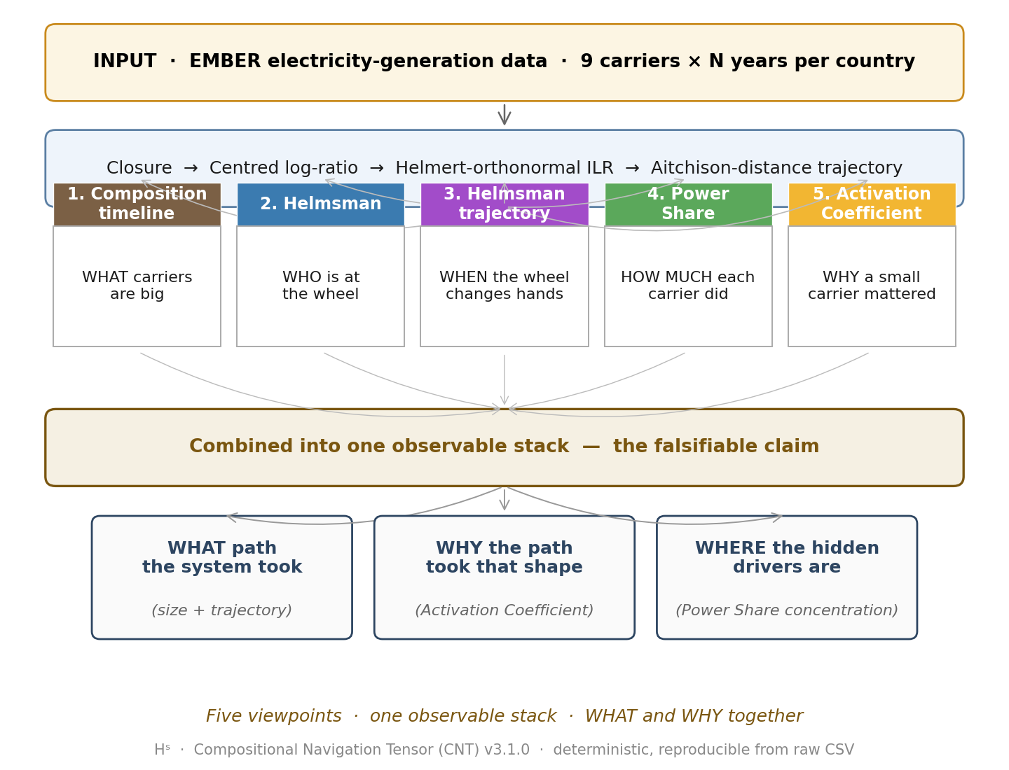
Five viewpoints, one observable stack
Each viewpoint answers one question. Together: an auditable transition event.
Composition
what share each carrier has.
Helmsman
which carrier has the largest CLR move at a step.
Helmsman trajectory
when the steering carrier changes.
Power Share
how much squared CLR motion each carrier did.
Activation Coefficient
Power Share ÷ starting share — the yeast factor.
All five derive from CLR + ILR-Helmert. Pure CoDa geometry; no new mathematics.
3 / 12

Slide 4
The Activation Coefficient — the yeast factor
How much structural work a carrier does, relative to how much of the mix it is.
α_i(t) = Power Share_i(t) ÷ starting share_i(t)
α ≈ 1 carrier does work proportional to its size — ordinary
α ≫ 1 carrier acts far above its size — hidden driver
α < 1 carrier carries less work than its size suggests — coasting
Worked example — USA Solar 2012 → 2013
starting share 0.107 % small
Power Share 81.7 % most of the work
α ≈ 760 × yeast
Yeast is 2% of a loaf by mass and does 100% of the rising. Same shape.
Solar 2010–2015 appears repeatedly as small-share / large-structural-work across the corpus.
4 / 12

Slide 5
Three archetypes — one instrument, three regimes
Same protocol applied to three transitions that look fundamentally different.
Germany
Japan
United Kingdom
deliberate transition
external shock
regime change
continuous arc
loop and reorganise
jump and return
Energiewende
2000 → 2025
solar + wind absorb
structural work
before size dominates.
Fukushima 2011
displaces nuclear,
causes 2011–2013
multi-year compositional
reorganisation.
Coal exit 2012–2020
from > 30 % to < 2 %.
Wind, solar, others
absorb displaced
structural work.
Three different transition regimes. One operational protocol reads them all.
5 / 12

Slide 6
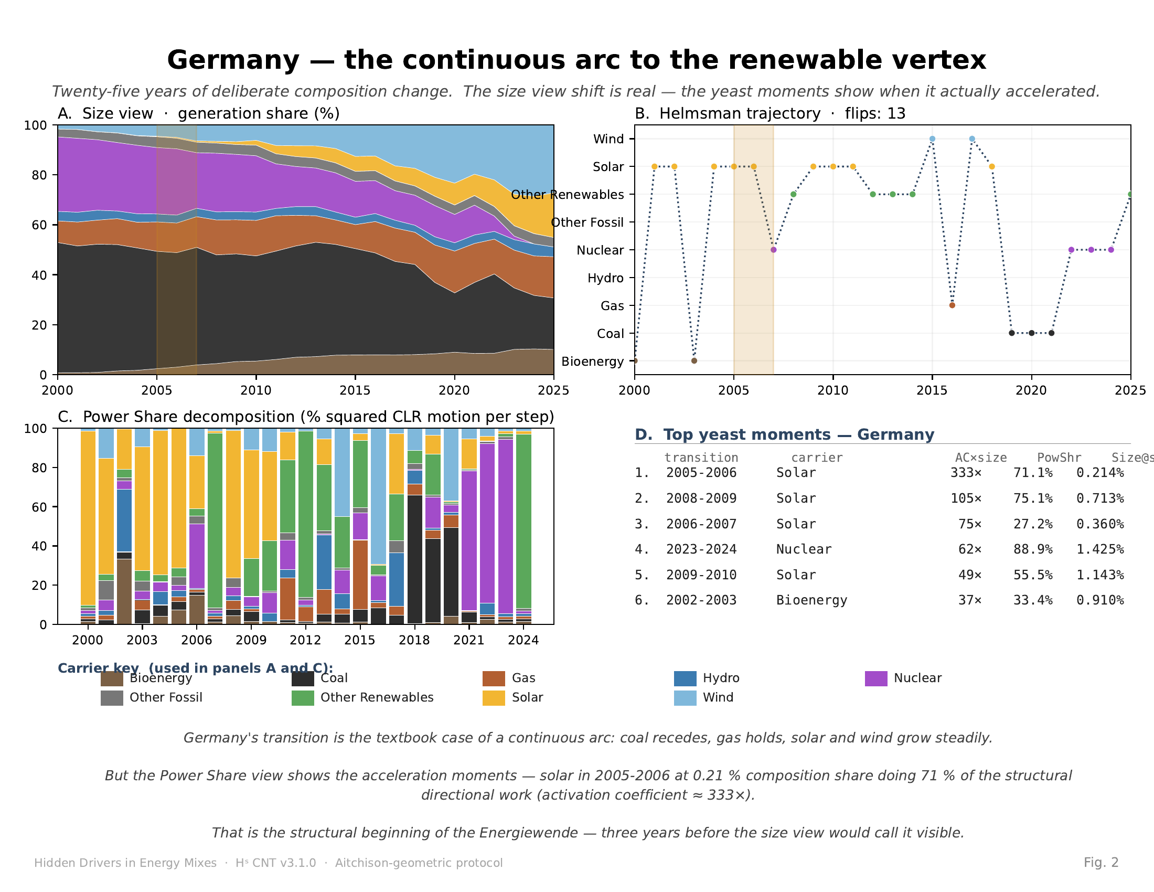
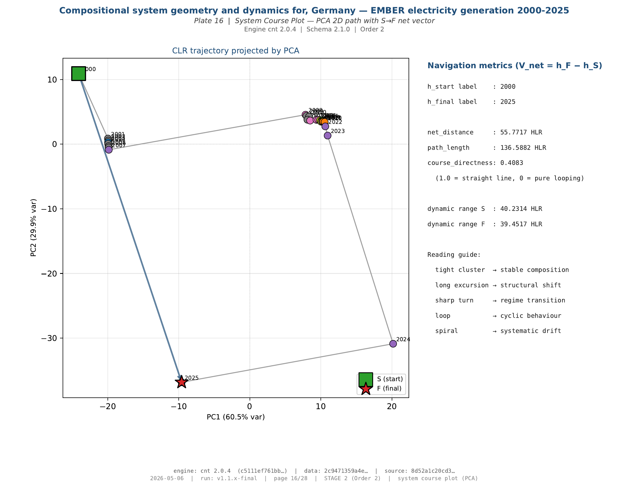
Germany — deliberate transition as continuous course
The Energiewende read as a single smooth arc on the simplex.
Solar 2005–2006: 0.21 % share · 71.1 % structural work · α ≈ 333 ×
Helmsman trajectory: course directness 0.41 — continuous arc to renewable vertex.
6 / 12

Slide 7
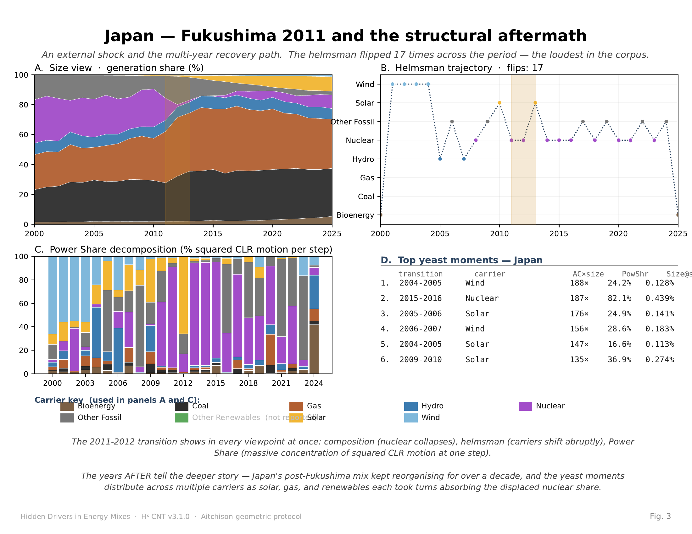
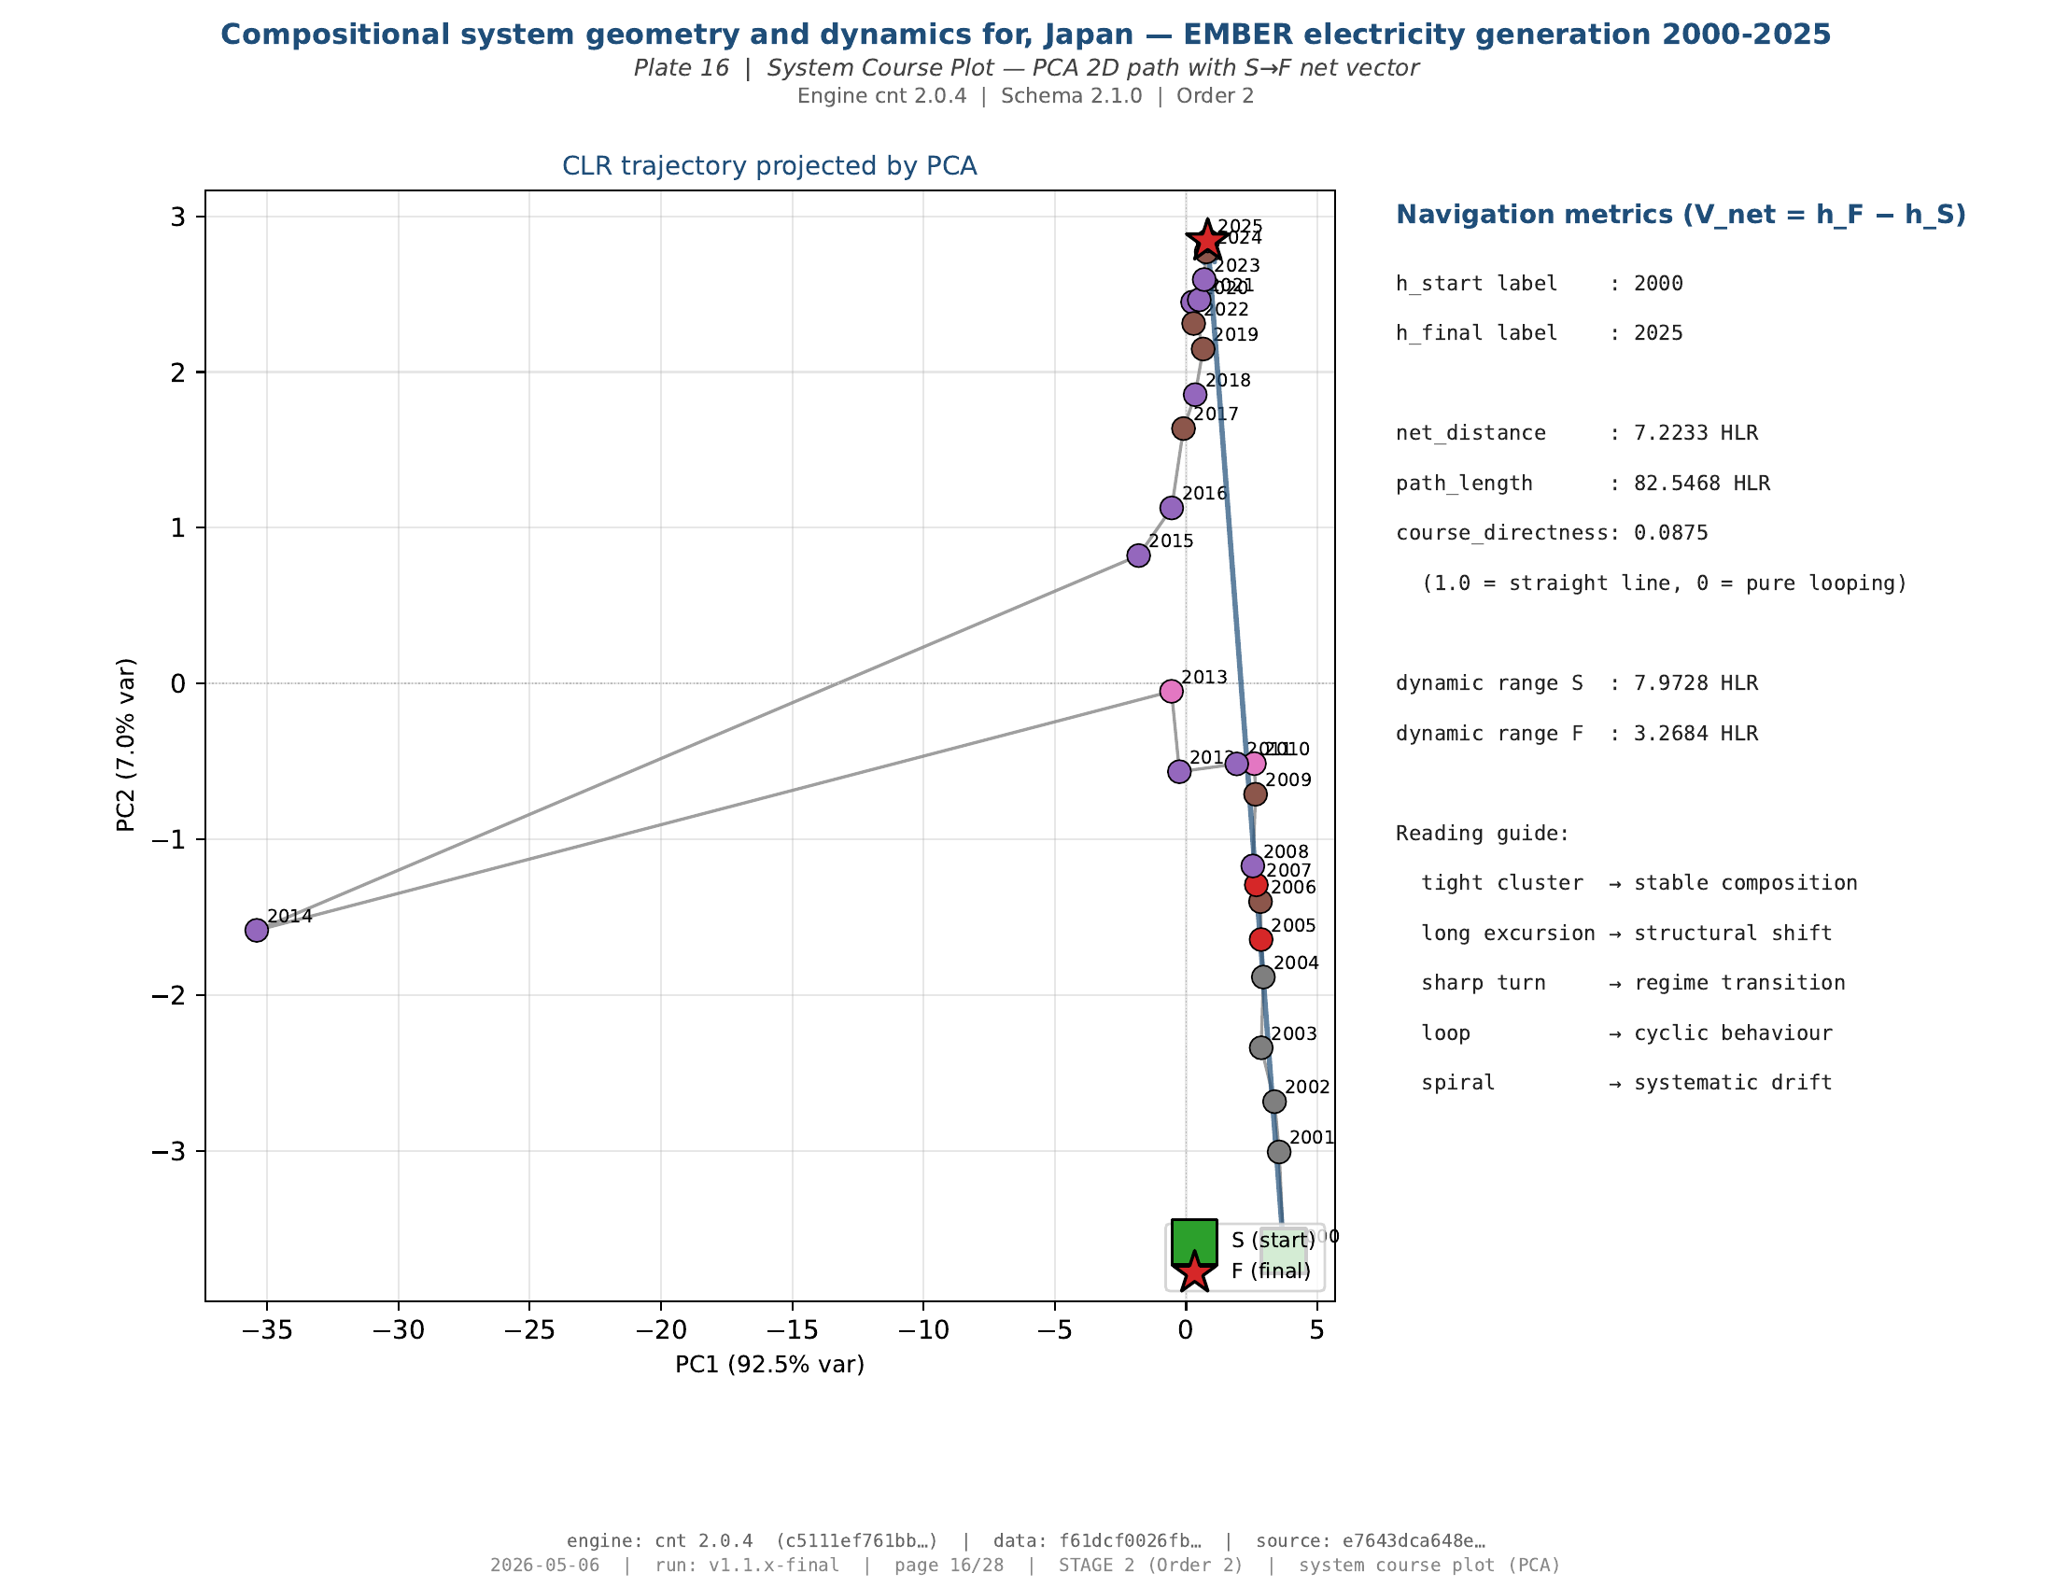
Japan — Fukushima shock and reorganisation
The instrument detects both the shock and the multi-year reorganisation.
Aitchison distance 2011 → 2012 ≈ 3 × neighbouring-year baseline · helmsman flips 17 ×
Course directness 0.09 — looping reorganisation, not a single step.
7 / 12

Slide 8
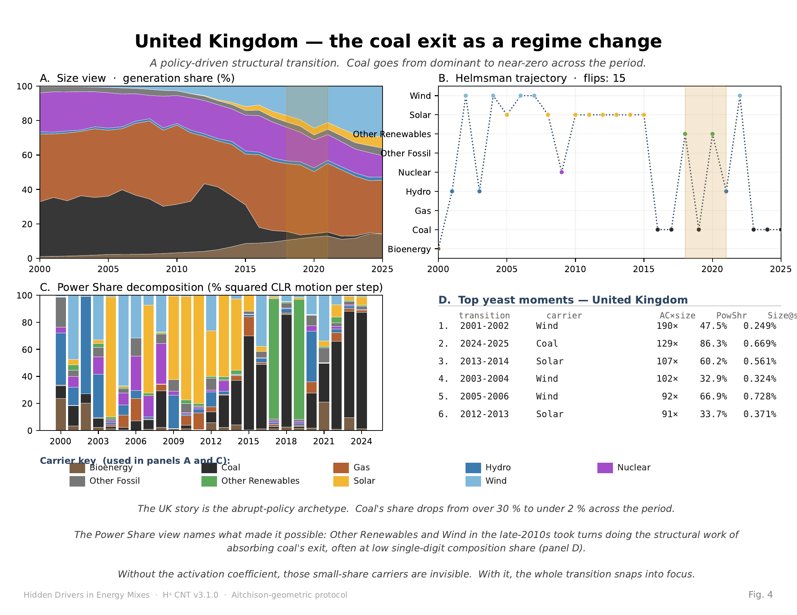
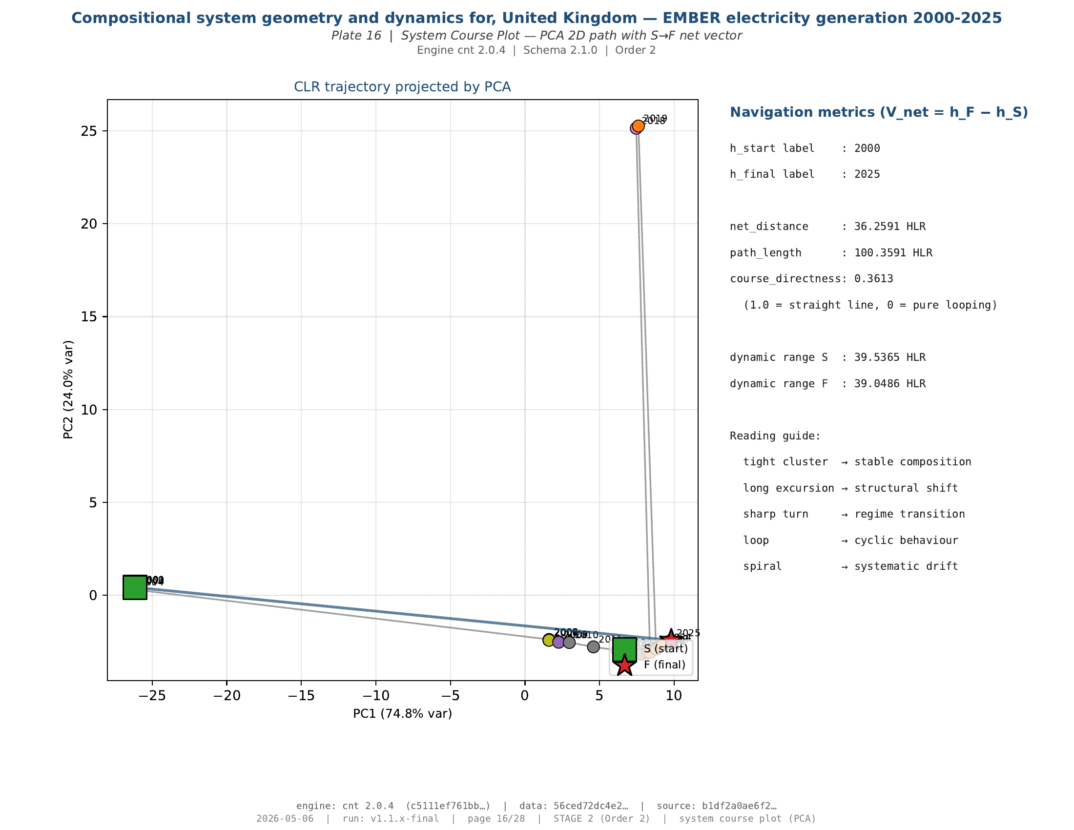
United Kingdom — coal exit as regime change
Policy-driven displacement, absorbed across multiple renewable carriers.
Coal: > 30 % → < 2 %. Wind, solar, and other renewables absorb the displaced structural work.
Course directness 0.36 — jump-and-return archetype.
8 / 12

Slide 9
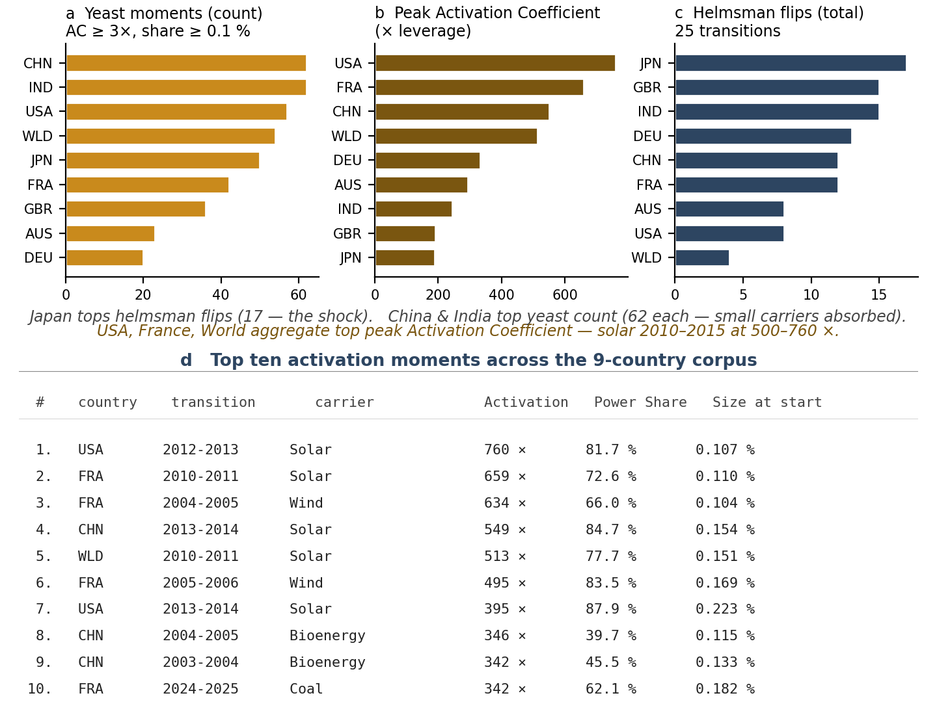
Cross-country signature — 5 of 9 reproduce the pattern
From three case archetypes to a corpus-level result.
fires AUS · CHN · GBR · IND · JPN
quiet DEU (annual) · FRA · USA · WLD
A useful detector should not fire everywhere. Discrimination is itself evidence.
9 / 12

Slide 10
What the stack answers
One observable, five distinct questions, one reproducible object.
WHAT
carriers are big.
size view
WHO
is at the wheel.
Helmsman
WHEN
the steering changes.
Helmsman trajectory
HOW MUCH
work each carrier did.
Power Share
WHY
a small carrier mattered.
Activation Coefficient
The stack does not replace interpretation. It gives interpretation a reproducible object.
10 / 12

Slide 11
MC-4 — the falsifiable claim
Three conjuncts. Four defeat paths. One open invitation to the room.
The claim
Defeat paths (any one falsifies)
Hˢ is the first published protocol that combines:
1. Aitchison-native compositional metrics
2. formal change-point / deceptive-drift detection
3. carrier-level structural-work attribution
A. prior-art path — show all three were already combined.
B. metric path — show a defensible non-Aitchison metric.
C. case path — show a country / year the protocol misreads.
D. category path — show the construct itself is ill-posed.
This is the claim I am asking the CoDa community to test. Take it apart.
INV-051 CANONICAL · 5 of 9 reproduces empirically
11 / 12

Slide 12
Now inspect the instrument
I will not ask you to trust the speaker. The outputs are open for inspection.
Manuscript
Cinema scroll
Projector
25-page paper,
Nature structure,
Supplementary Info,
six figures.
papers/codawork2026/
manuscript/
66-slide reel,
325-page master PDF.
Every plate the engine
produced for the
nine-country EMBER
corpus.
Scroll at speed.
Pause anywhere.
Offline HTML.
RADAR · BARY · ALIGN
+ SHOCK overlay.
Q&A backdrop.
No network call.
Runs in any browser.
github.com / PeterHiggins19 / higgins-decomposition · CODA-Association/ · QR on handout
Hand-out in UN-6 locales (EN · FR · ES · RU · ZH · AR). Operationalization standard, runnable.
AI Use Declaration (HUF-STD-001 v1.1): research design, mathematical content, code, and scientific responsibility remain with the named author. AI assistants (Claude, ChatGPT, Grok) used for drafting, sweeps, and reviews. Author retains full responsibility. Apache-2.0 code · CC BY 4.0 docs.
The instrument reads. The expert decides. The hashes carry the receipts. The vocabulary holds the line. The AI follows the same protocol.

