Slide 1
Compositional monitoring of energy-mix drift on the simplex
Which carrier did the structural work?
Standard compositional data analysis — what happens when we read the simplex (shares that sum to one) forward in time.
Follow along on the repository — the slide deck, manuscript, and live projector are all open.
Hˢ runs any compositional dataset the CoDa community can describe — every view here is reproducible on your data.
CoDaWork 2026 · Coimbra, Portugal · 1–5 June 2026
P. Higgins · Rogue Wave Audio / Binaural Test Lab · Markham, Ontario, Canada
Contact
PeterHiggins@RogueWaveAudio.com
github.com / PeterHiggins19 / higgins-decomposition
Community folder: CODA-Association/ · Hand-out in UN-6 locales (EN · FR · ES · RU · ZH · AR)
The instrument reads. The expert decides. The hashes carry the receipts. The vocabulary holds the line.
1 / 21

Slide 2
The size view hides the work
A carrier can be small in share yet do most of the structural work — its share of the squared compositional motion.
Germany electricity, 25 years
the size view — the standard share / stacked-area chart
What the size view misses
Germany Solar, 2005 → 2006
Coal and lignite recede. Nuclear phases out.
Gas holds. Solar and wind grow steadily.
Wind passes coal in the late 2010s.
starting share 0.21 %
structural Power Share 71.1 %
Activation Coefficient ≈ 333 ×
Solar acted at 333 × its size,
four years before the share view
calls solar visible.
Deceptive drift: the size view hides which carrier did the structural work — here a 0.21 % carrier does 71 % of it.
Mathematics: standard compositional data analysis. Application: monitoring frame may be new.
2 / 21

Slide 3
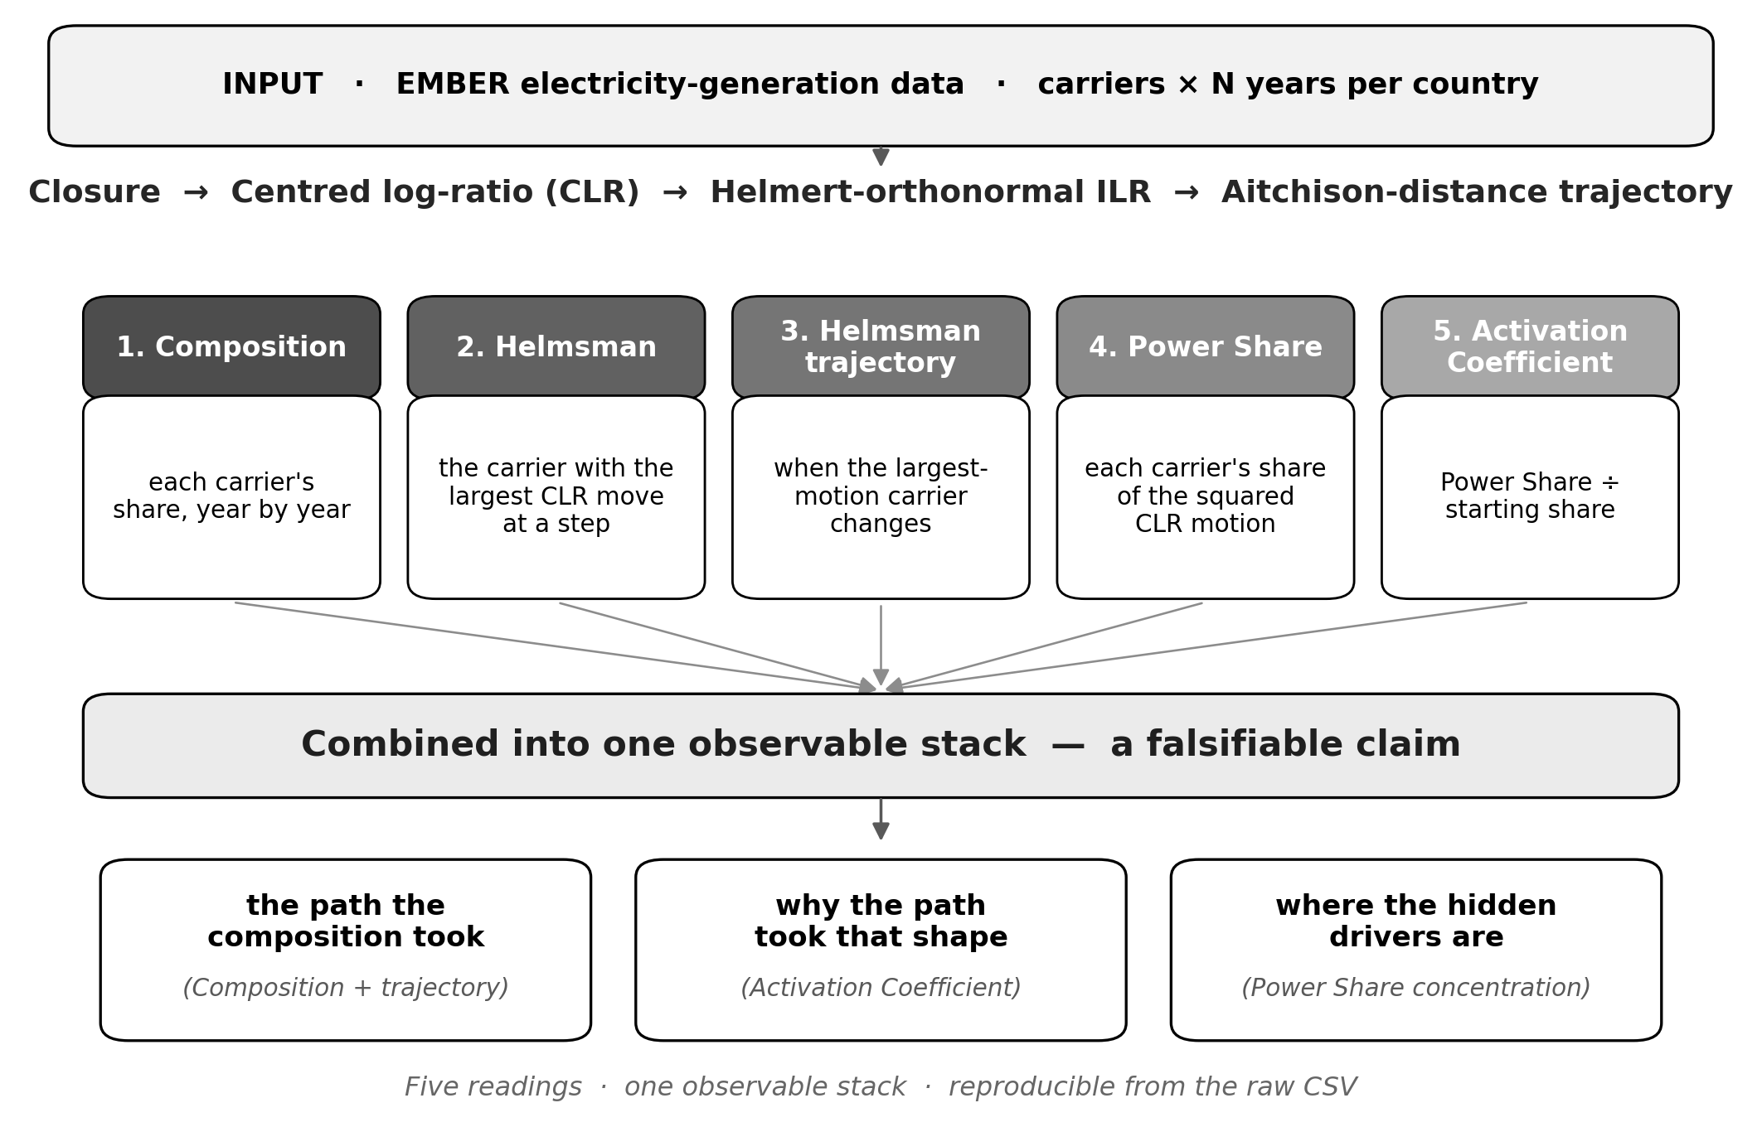
Reading time on the simplex
Standard CoDa geometry, read forward in time — five named readings, each defined below.
3 / 21

Slide 4
The Activation Coefficient
How much structural work a carrier does, relative to how much of the mix it is.
α_i(t) = Power Share_i(t) ÷ starting share_i(t)
α ≈ 1 carrier does work proportional to its size — ordinary
α ≫ 1 carrier acts far above its size — hidden driver
α < 1 carrier carries less work than its size suggests — coasting
Worked example — Germany Solar 2005 → 2006
starting share 0.21 % small
Power Share 71.1 % most of the work
α ≈ 333 × hidden driver
Analogy — yeast is 2 % of a loaf by mass and does 100 % of the rising: the same shape.
The Energiewende's structural beginning — four years before solar appears in the share view.
4 / 21

Slide 5
Three archetypes — one instrument, three regimes
The same protocol on three transitions that look fundamentally different.
Germany
Japan
United Kingdom
deliberate transition
external shock
regime change
continuous arc
loop and reorganise
jump and return
Energiewende
2000 → 2025
solar + wind absorb
structural work
before size dominates.
Fukushima 2011
displaces nuclear,
causes 2011–2013
multi-year
reorganisation.
Coal exit 2012–2020
from > 30 % to < 2 %.
Wind, solar, others
absorb displaced
structural work.
Three different transition regimes. One operational protocol reads them all.
5 / 21

Slide 6
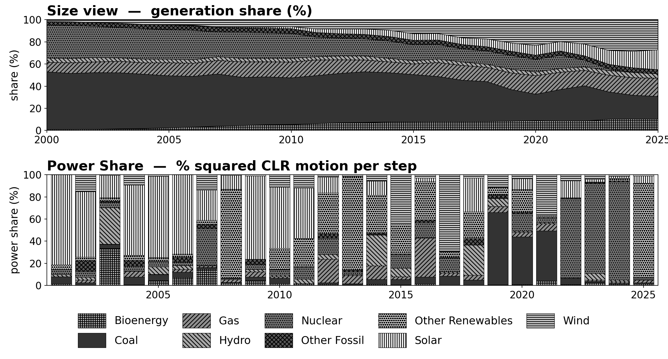
Germany — share and structural work
The Energiewende read as a single smooth arc on the simplex.
Solar 2005–2006: 0.21 % share · 71.1 % structural work · α ≈ 333 ×
Tiny share, dominant work — the deceptive-drift signature, four years before the share view shows anything.
Germany — share + structural work · the trajectory is next
6 / 21

Slide 7
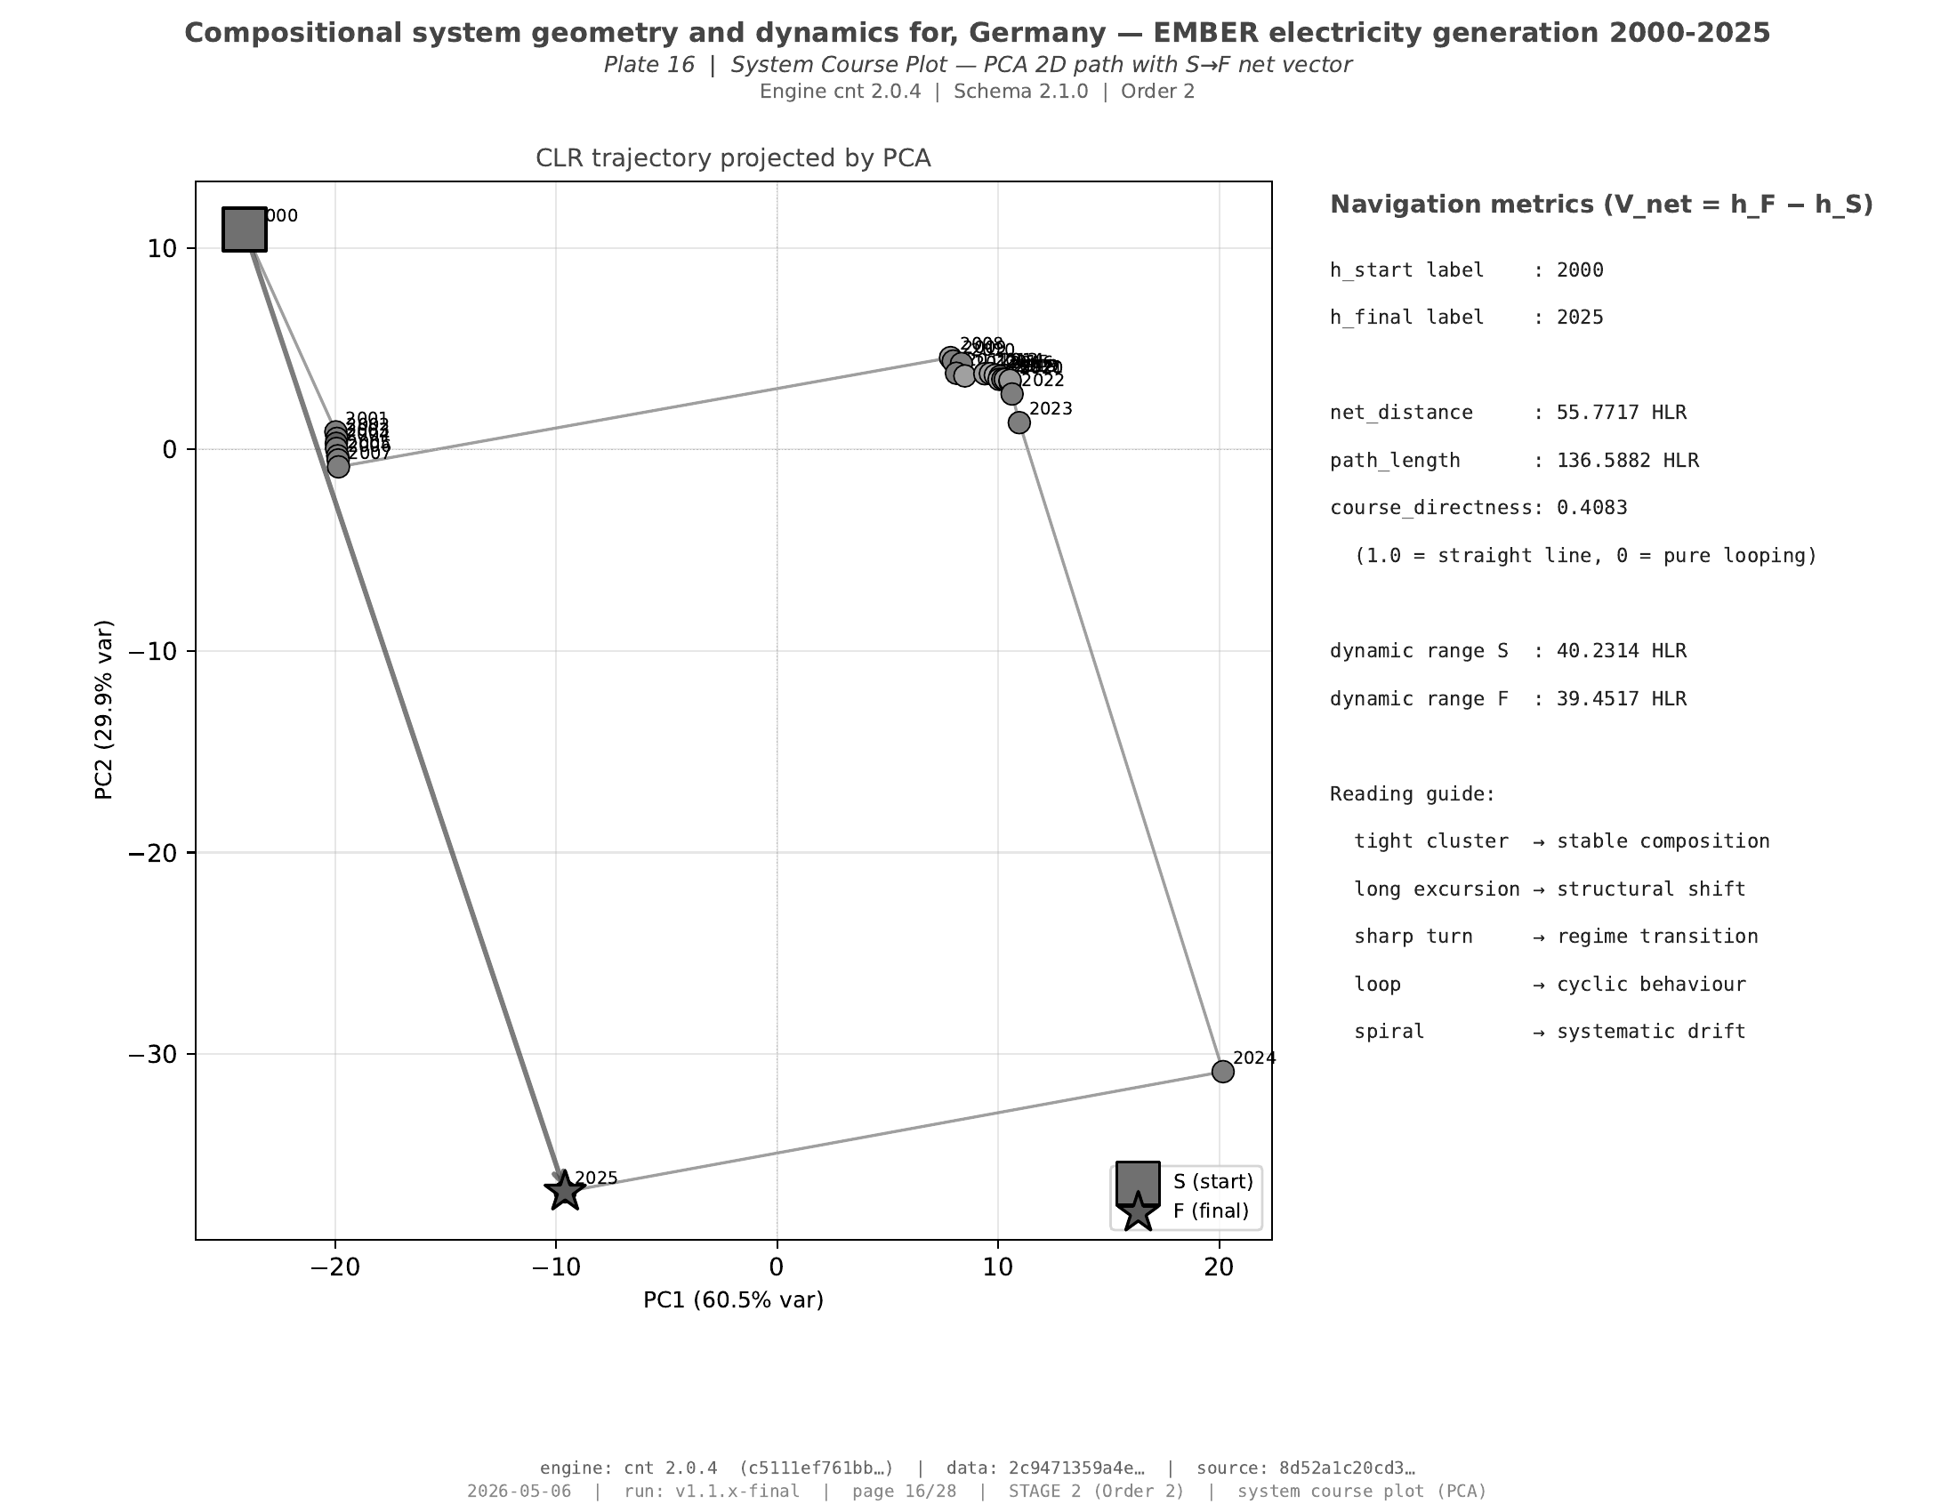
Germany — the trajectory
The Helmsman trajectory: where the composition went, year by year.
Trajectory directness 0.41 (end-to-end distance ÷ path length) — a continuous arc toward the renewable vertex.
Smooth, monotone reorientation — no loops, no flips. Deliberate transition as a sustained trajectory.
Germany — the trajectory
7 / 21

Slide 8
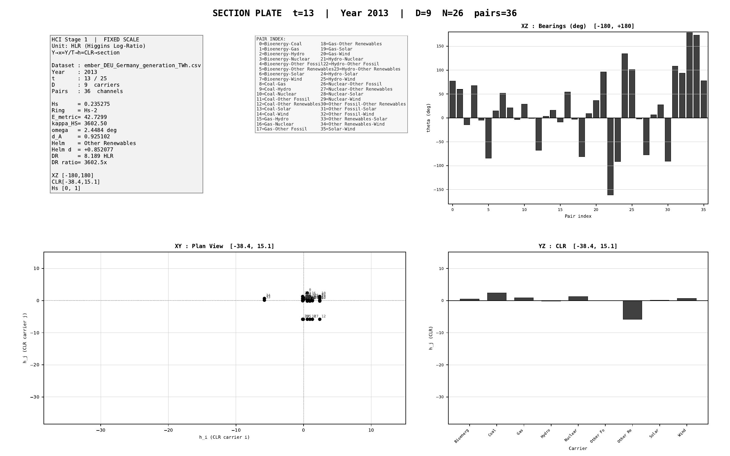
Germany — orthogonal projections (XY / XZ / YZ)
Germany alone gets the complete plate set · the Section view: CLR plan, XZ bearings, and per-carrier CLR for a representative year.
Germany · complete plate set (orthogonal projections)
8 / 21

Slide 9
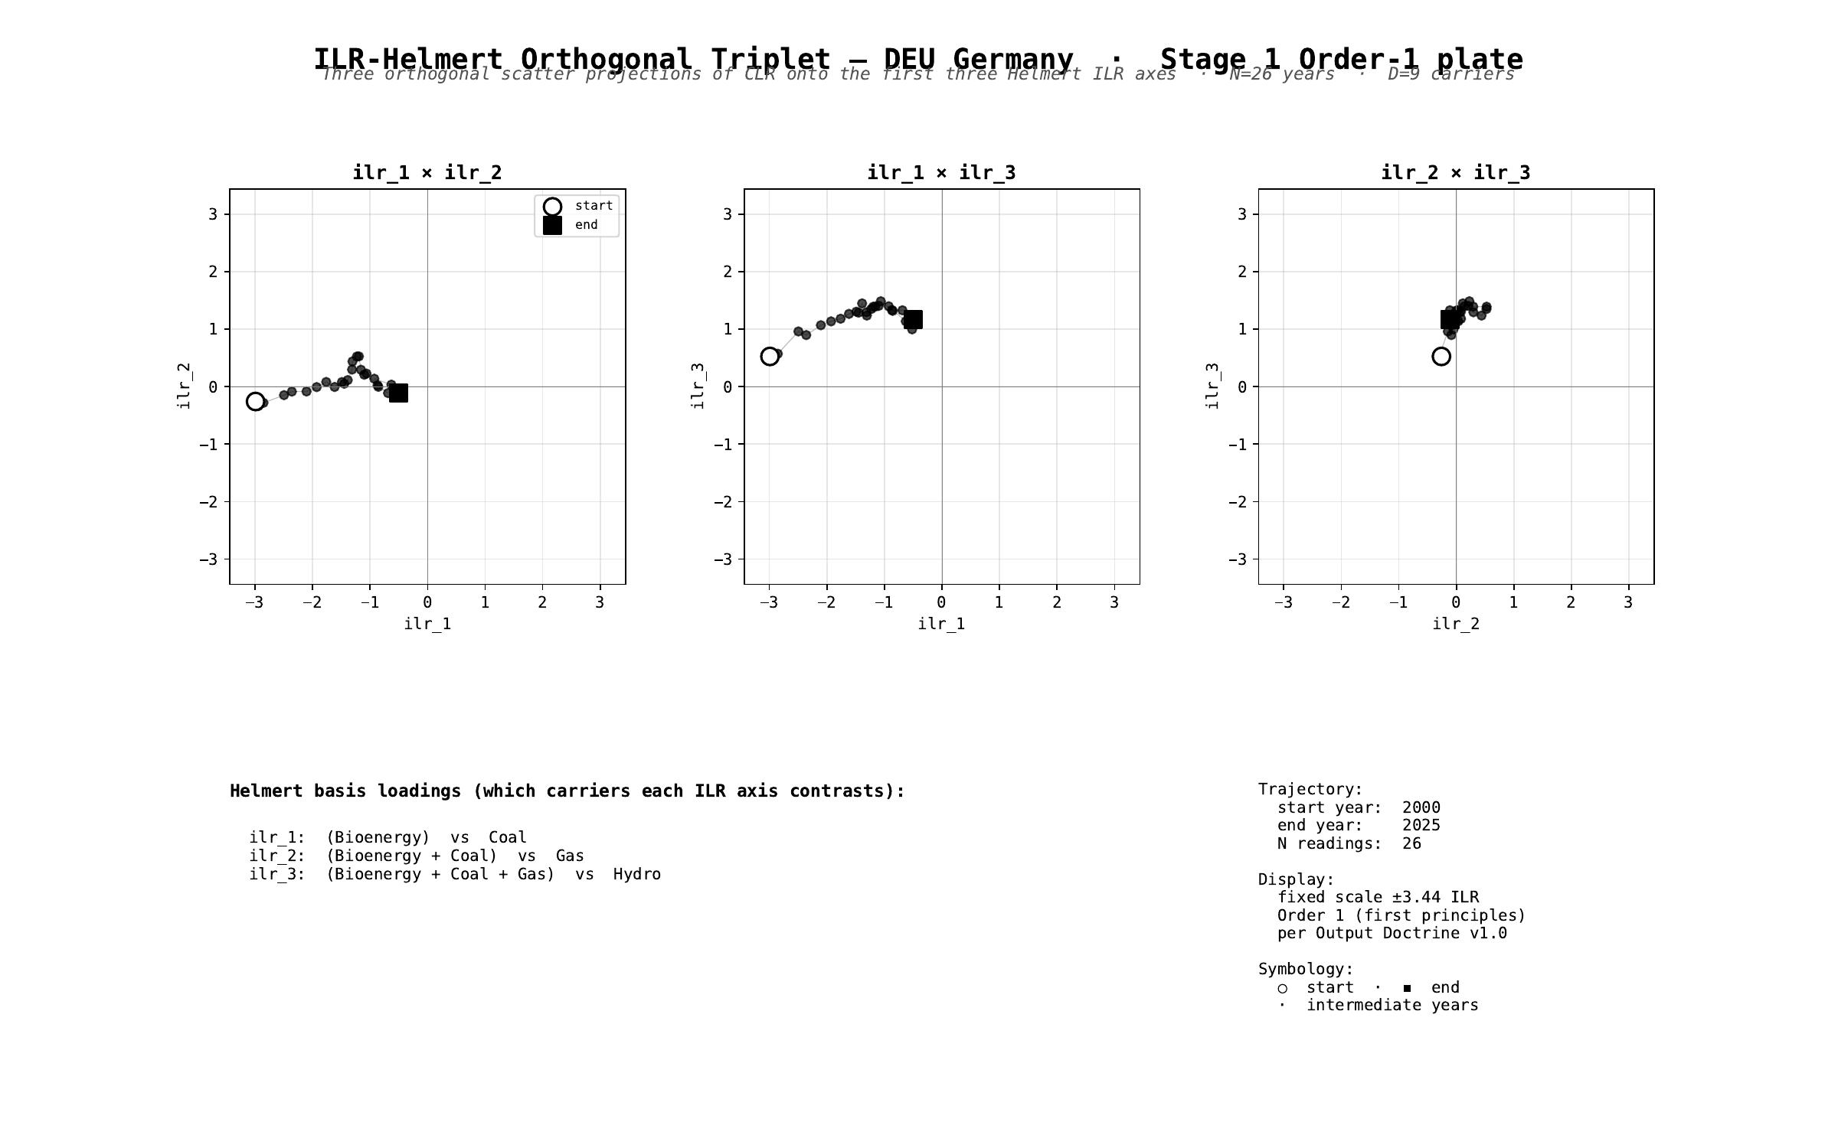
Germany — ILR-Helmert triplet
Germany's complete set · three orthonormal ILR projections of the 2000–2025 trajectory (ilr1×ilr2 · ilr1×ilr3 · ilr2×ilr3).
Germany · complete plate set (ILR-Helmert triplet)
9 / 21

Slide 10
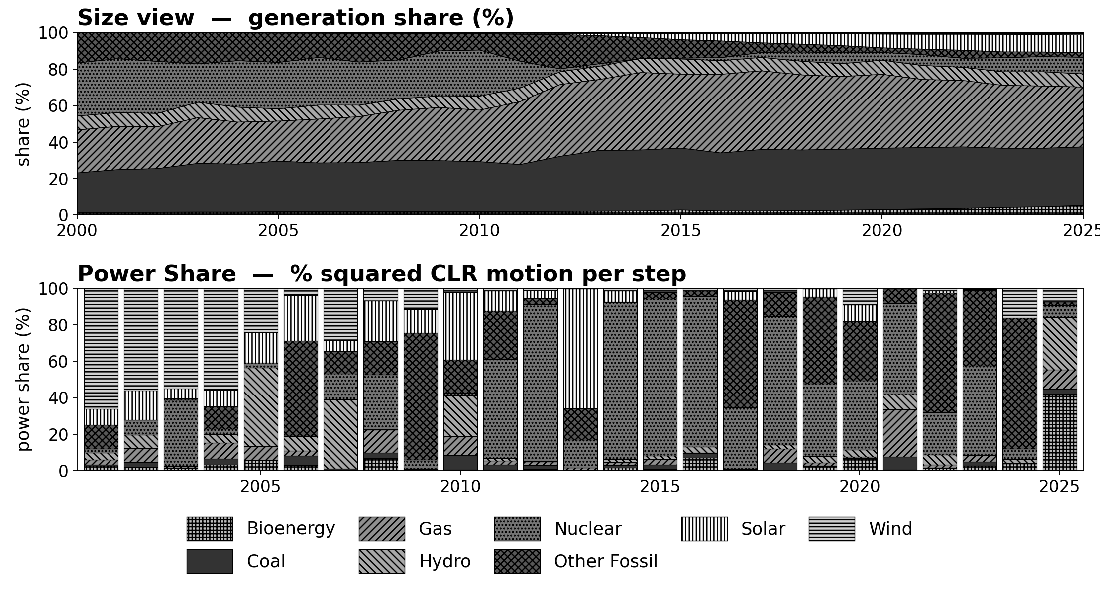
Japan — share and structural work
Fukushima 2011: an external shock displaces nuclear; a multi-year reorganisation follows.
Aitchison distance (distance on the simplex) 2011 → 2012 ≈ 3 × the baseline step · 17 Helmsman flips
The instrument detects both the shock and the multi-year reorganisation that followed.
Japan — share + structural work · the trajectory is next
10 / 21

Slide 11
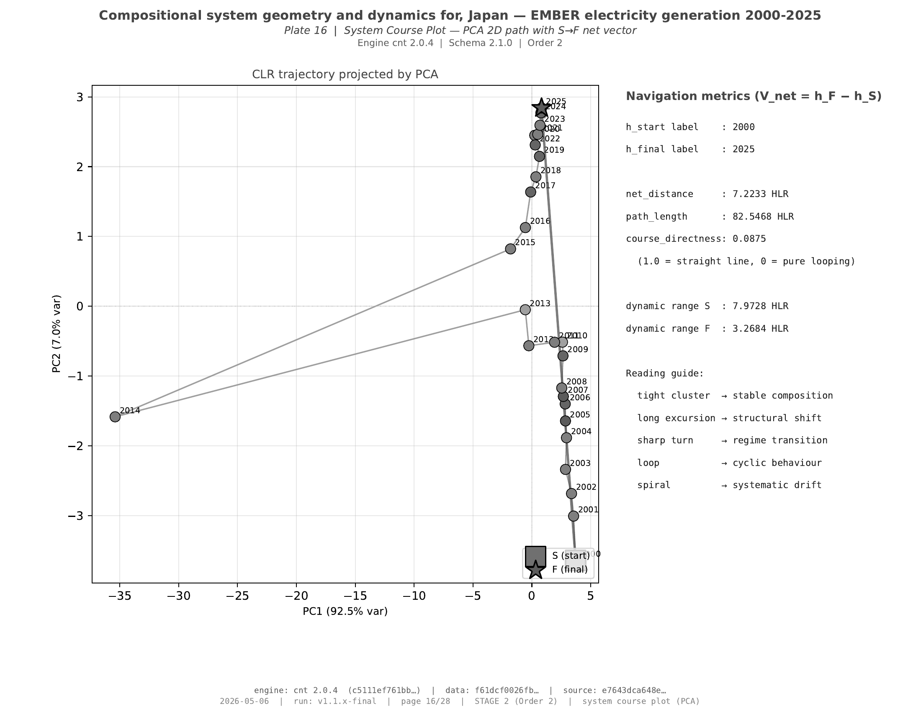
Japan — the trajectory
The Helmsman trajectory: looping reorganisation, not a single step.
Trajectory directness 0.09 — the loop-and-reorganise pattern.
The trajectory revisits and reroutes — the system searches for a new composition, not a planned trajectory.
Japan — the trajectory
11 / 21

Slide 12
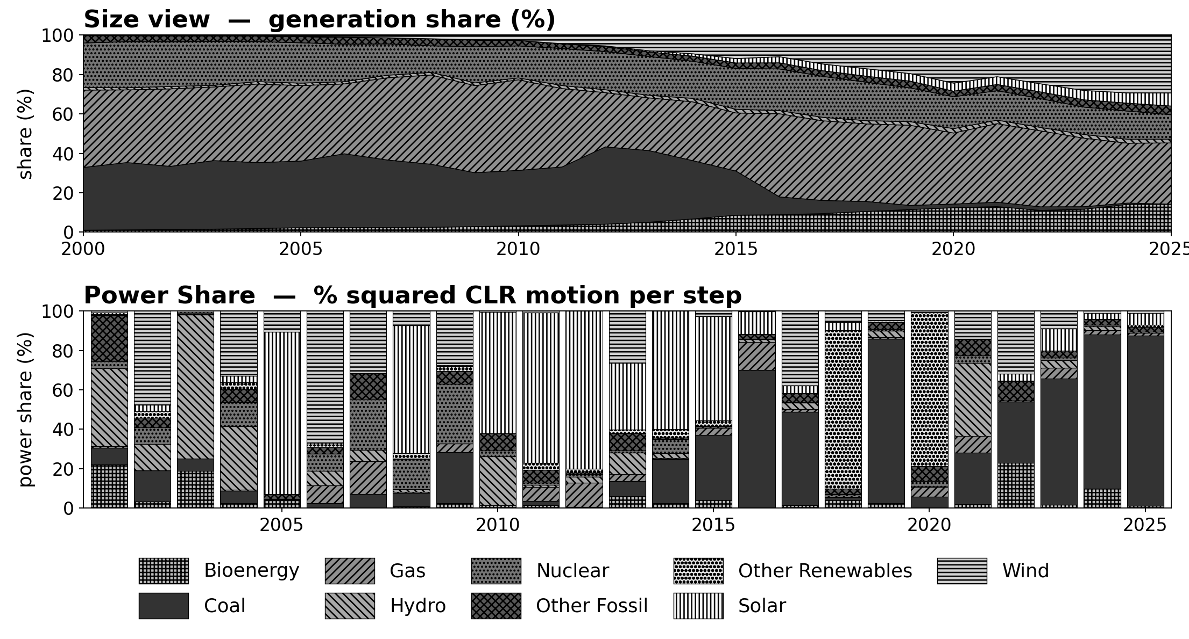
United Kingdom — share and structural work
Coal exit as policy-driven regime change, absorbed across several carriers.
Coal: > 30 % → < 2 %. Wind, solar, and other renewables absorb the displaced work.
Displaced work redistributes across several carriers — not one substitute, but several.
United Kingdom — share + structural work · the trajectory is next
12 / 21

Slide 13
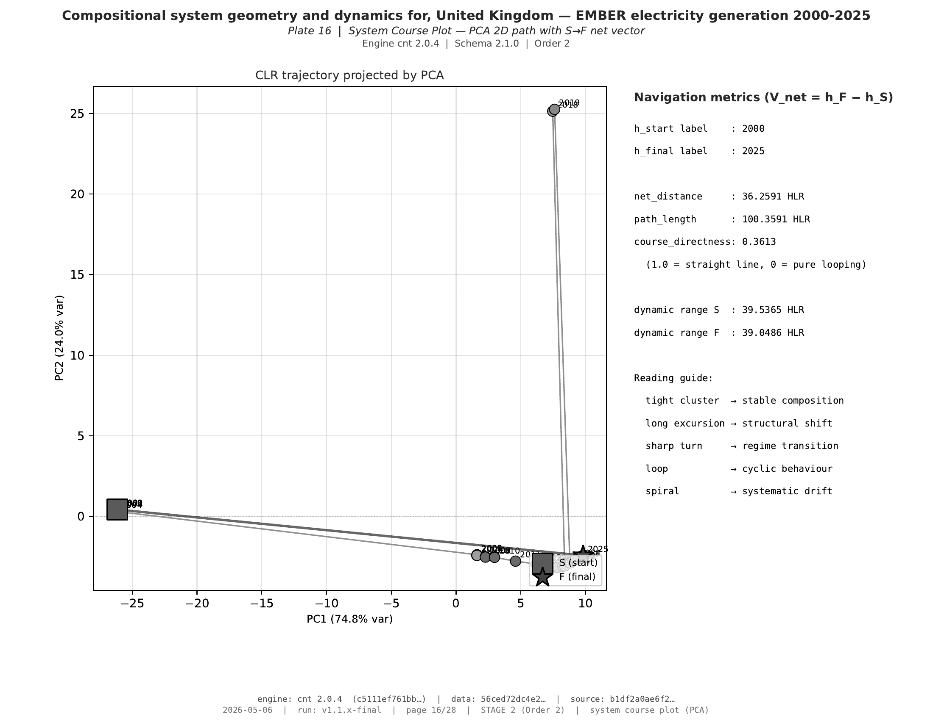
United Kingdom — the trajectory
The Helmsman trajectory: a jump from the coal vertex, then a return toward stability.
Trajectory directness 0.36 — the jump-and-return pattern.
A sharp departure from the coal vertex, then re-stabilisation — regime change as one decisive displacement.
United Kingdom — the trajectory
13 / 21

Slide 14
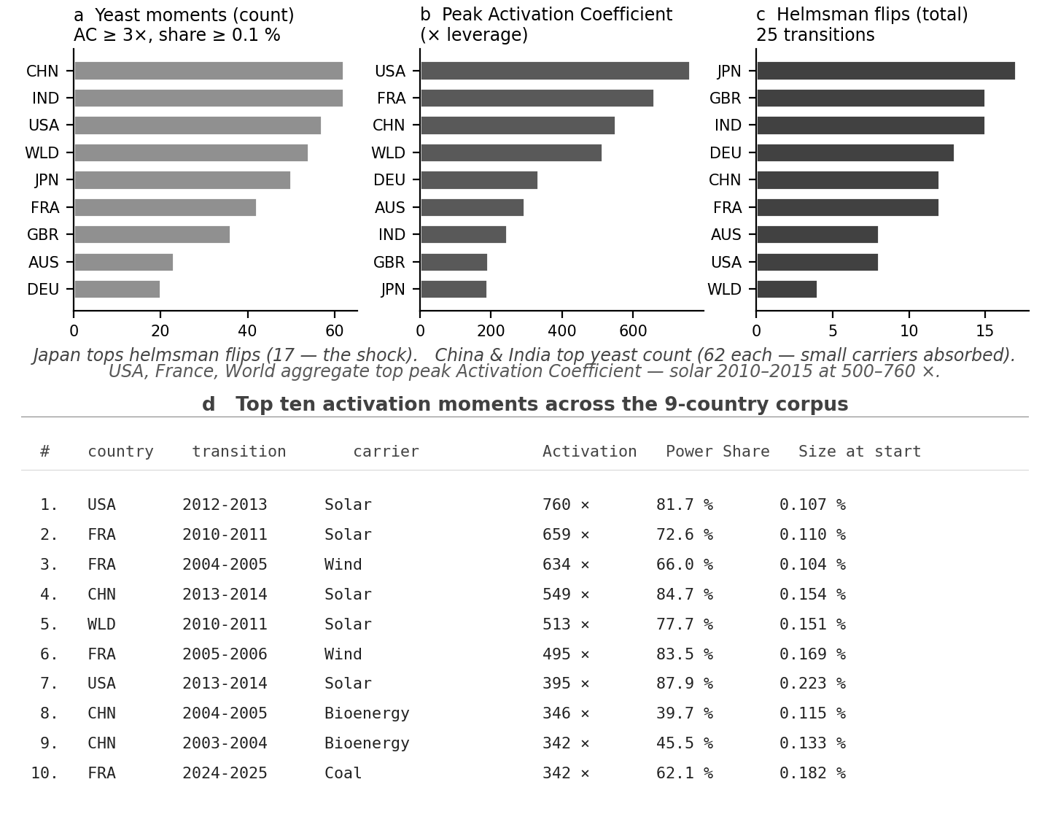
Across the corpus — deceptive drift in 5 of 9
The same protocol applied to all nine EMBER countries.
Deceptive drift: the size (share) view hides which carrier did the structural work — a small carrier carries a large share of the squared compositional motion (Activation Coefficient ≫ 1).
Detected in five of nine countries; absent in four — a detector that reads real structure must not flag every system.
deceptive drift present: AUS · CHN · GBR · IND · JPN
deceptive drift absent: DEU (annual) · FRA · USA · WLD
Discrimination — flagging some systems and not others — is itself evidence the detector reads real structure.
14 / 21

Slide 15
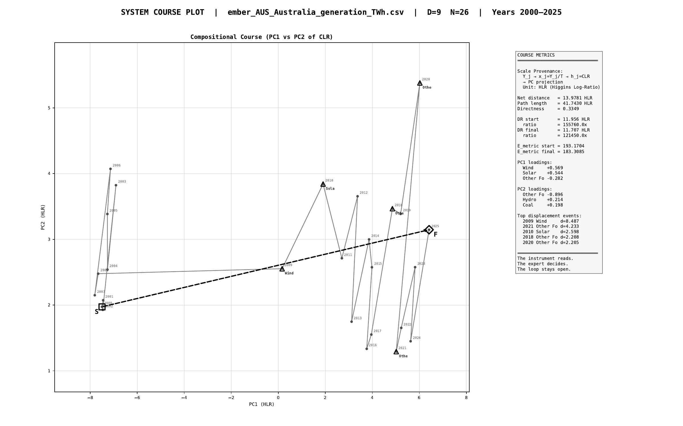
Australia — the trajectory
The rest of the world · deceptive drift present. Australia: the full 2000–2025 trajectory.
rest of the world · deceptive drift present (1 of 3)
15 / 21

Slide 16
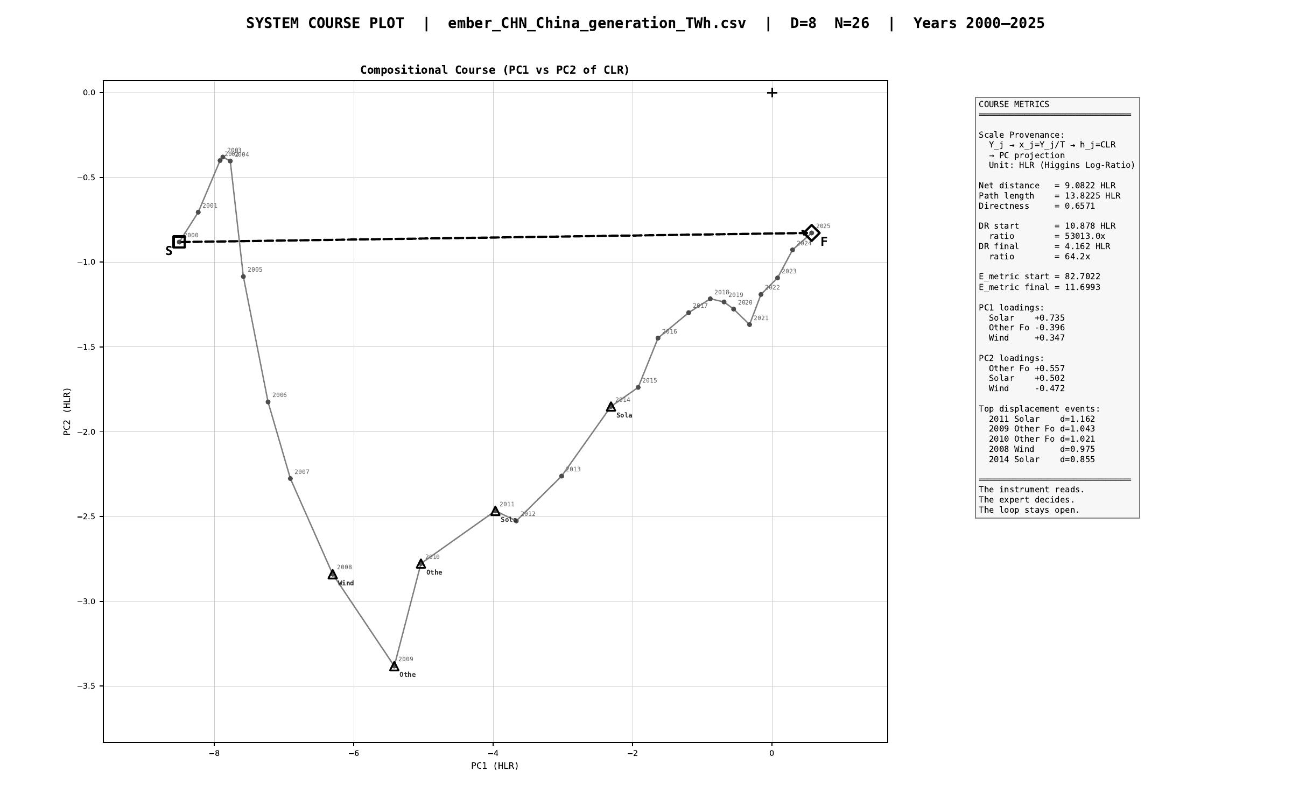
China — the trajectory
China: the full trajectory — coal-era growth, then a turn.
rest of the world · deceptive drift present (2 of 3)
16 / 21

Slide 17
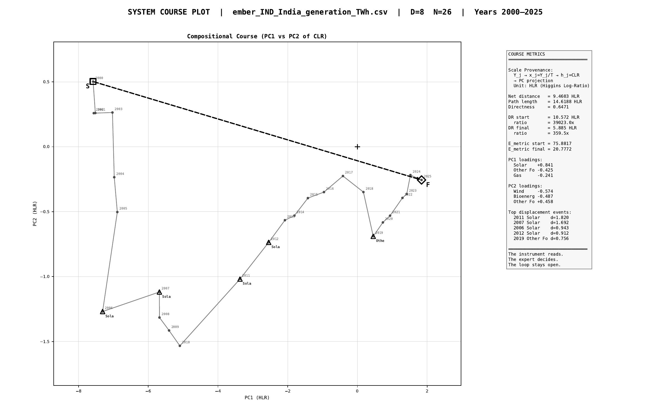
India — the trajectory
India: the full trajectory — the third case where deceptive drift is present.
rest of the world · deceptive drift present (3 of 3)
17 / 21

Slide 18
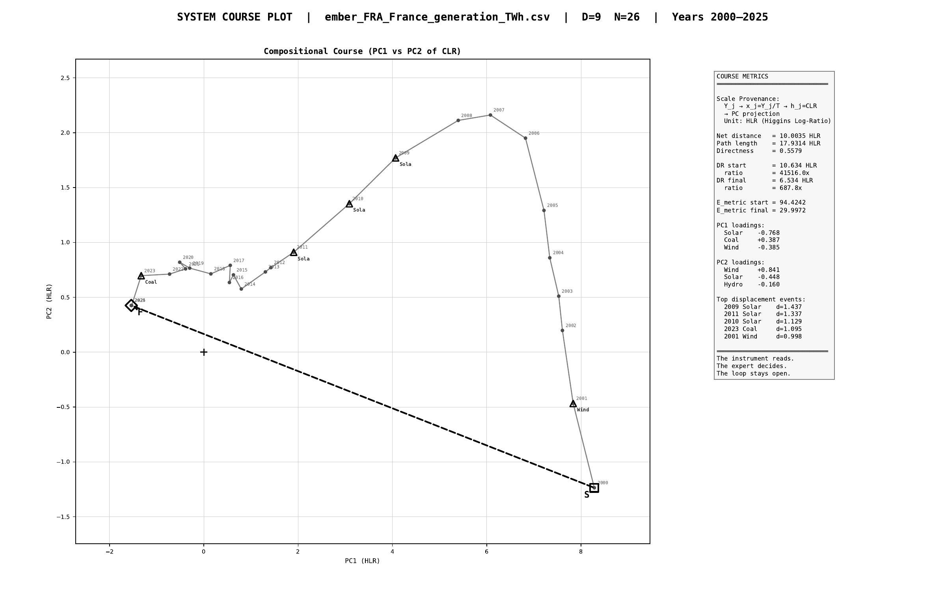
France — the trajectory
Deceptive drift absent. France: the full trajectory — nuclear-stable.
rest of the world · deceptive drift absent (1 of 3)
18 / 21

Slide 19
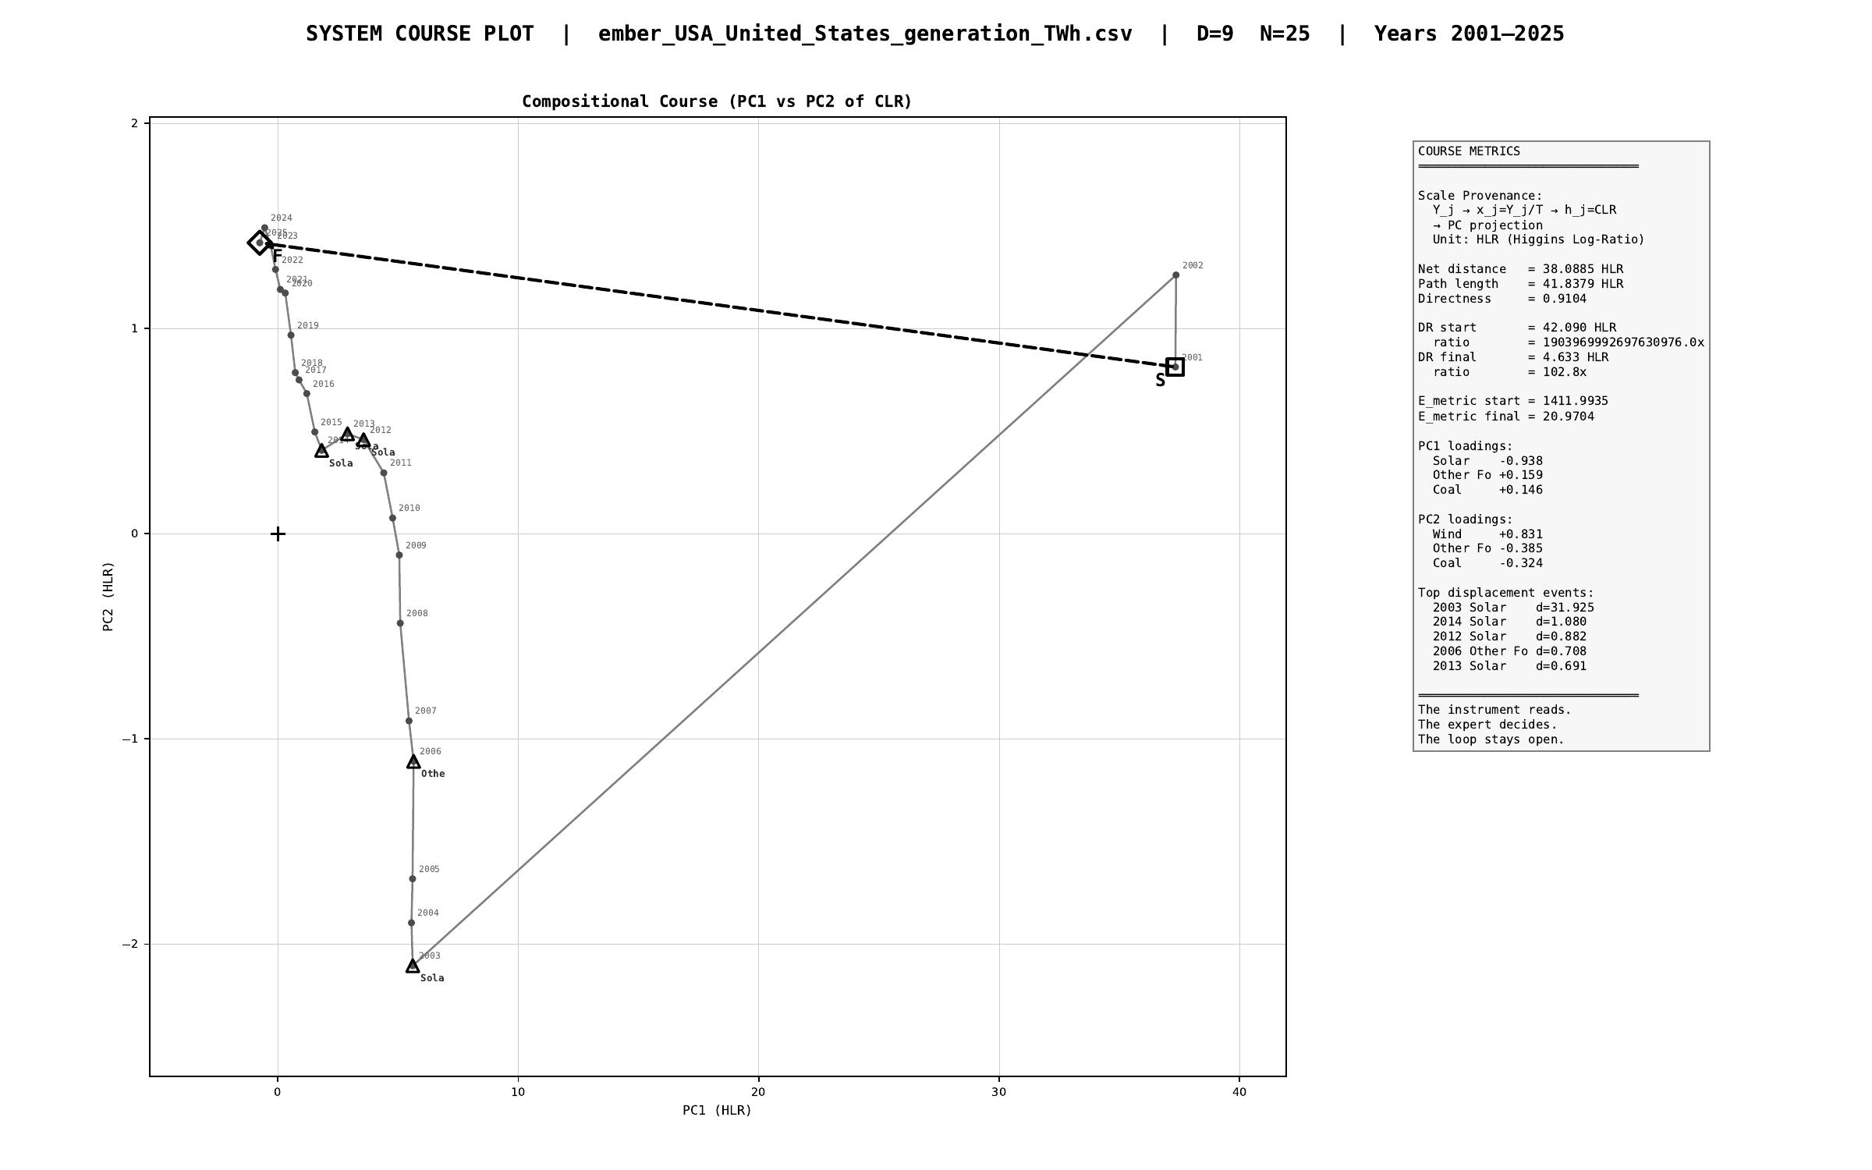
United States — the trajectory
United States: the full trajectory — a large grid; no deceptive drift at annual grain.
rest of the world · deceptive drift absent (2 of 3)
19 / 21

Slide 20
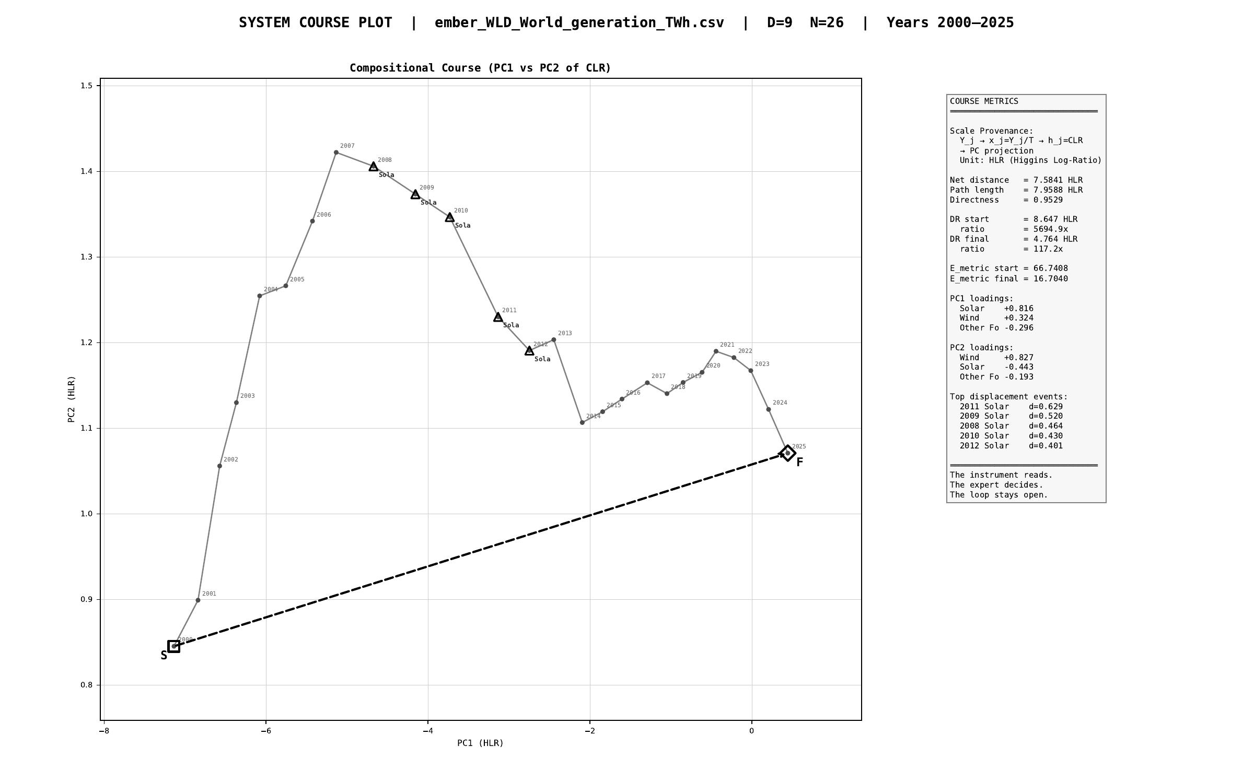
World — the trajectory
World: the aggregate trajectory — large-N smoothing hides the deceptive drift in its constituents.
rest of the world · deceptive drift absent (3 of 3)
20 / 21

Slide 21
What the stack answers
Recap of the five readings — then the live instrument takes over.
WHAT
carriers are big.
size view
WHO
is in largest motion.
Helmsman
WHEN
the largest-motion carrier changes.
Helmsman trajectory
HOW MUCH
structural work each carrier did.
Power Share
WHY
a small carrier mattered.
Activation Coefficient
The stack does not replace interpretation. It gives interpretation a reproducible object.
The live instrument takes it from here → codawork2026_projector.html
AI Use Declaration (HUF-STD-001 v1.1): research design, mathematical content, code, and scientific responsibility remain with the named author. AI assistants (Claude, ChatGPT, Grok) used for drafting, sweeps, and reviews. Author retains full responsibility. Apache-2.0 code · CC BY 4.0 docs.
21 / 21

