Slide 1
Compositional monitoring of energy-mix drift on the simplex
Which carrier did the structural work?
Not only which carrier got bigger — which carrier moved the composition.
Follow along on the repository — the slide deck, manuscript, and live projector are all open.
Hˢ runs any compositional dataset the CoDa community can describe — the views in this talk are reproducible on your data.
Operationalizing compositional analysis — a runnable standard for researchers and the AI assistants they choose.
CoDaWork 2026 · Coimbra, Portugal · 1–5 June 2026
P. Higgins · Rogue Wave Audio / Binaural Test Lab · Markham, Ontario, Canada
Contact
PeterHiggins@RogueWaveAudio.com
github.com / PeterHiggins19 / higgins-decomposition
Community folder: CODA-Association/ · Hand-out in UN-6 locales (EN · FR · ES · RU · ZH · AR)
The instrument reads. The expert decides. The hashes carry the receipts. The vocabulary holds the line.

Slide 2
The size view hides the work
A carrier can be small in share and large in structural work.
Germany electricity, 25 years — the standard stacked-area view
What the size view misses
Coal and lignite recede. Nuclear phases out.
Gas holds. Solar and wind grow steadily.
Wind passes coal in the late 2010s.
Germany Solar, 2005 → 2006
starting share 0.21 %
structural Power Share 71.1 %
Activation Coefficient ≈ 333 ×
Solar acted at 333 × its size,
four years before the share view
calls solar visible.
This talk is the reason that number exists.
Mathematics: standard compositional data analysis. Application: monitoring frame may be new.
2 / 13

Slide 3
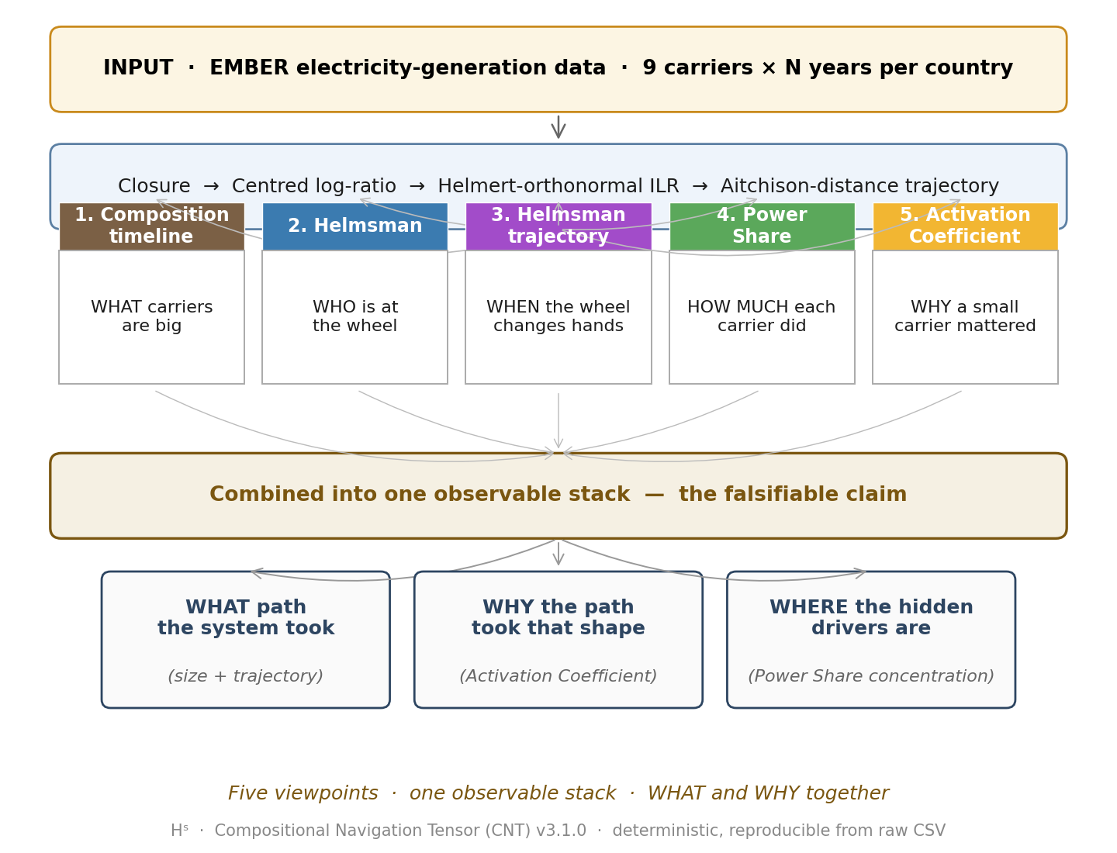
Five viewpoints, one observable stack
Each viewpoint answers one question. Together: an auditable transition event.
Composition
what share each carrier has.
Helmsman
which carrier has the largest CLR move at a step.
Helmsman trajectory
when the steering carrier changes.
Power Share
how much squared CLR motion each carrier did.
Activation Coefficient
Power Share ÷ starting share — the yeast factor.
All five derive from CLR + ILR-Helmert. Pure CoDa geometry; no new mathematics.
3 / 13

Slide 4
The Activation Coefficient — the yeast factor
How much structural work a carrier does, relative to how much of the mix it is.
α_i(t) = Power Share_i(t) ÷ starting share_i(t)
α ≈ 1 carrier does work proportional to its size — ordinary
α ≫ 1 carrier acts far above its size — hidden driver
α < 1 carrier carries less work than its size suggests — coasting
Worked example — Germany Solar 2005 → 2006
starting share 0.21 % small
Power Share 71.1 % most of the work
α ≈ 333 × yeast
Yeast is 2% of a loaf by mass and does 100% of the rising. Same shape.
The Energiewende's structural beginning, four years before solar appears in the share view.
4 / 13

Slide 5
Three archetypes — one instrument, three regimes
Same protocol applied to three transitions that look fundamentally different.
Germany
Japan
United Kingdom
deliberate transition
external shock
regime change
continuous arc
loop and reorganise
jump and return
Energiewende
2000 → 2025
solar + wind absorb
structural work
before size dominates.
Fukushima 2011
displaces nuclear,
causes 2011–2013
multi-year compositional
reorganisation.
Coal exit 2012–2020
from > 30 % to < 2 %.
Wind, solar, others
absorb displaced
structural work.
Three different transition regimes. One operational protocol reads them all.
5 / 13

Slide 6
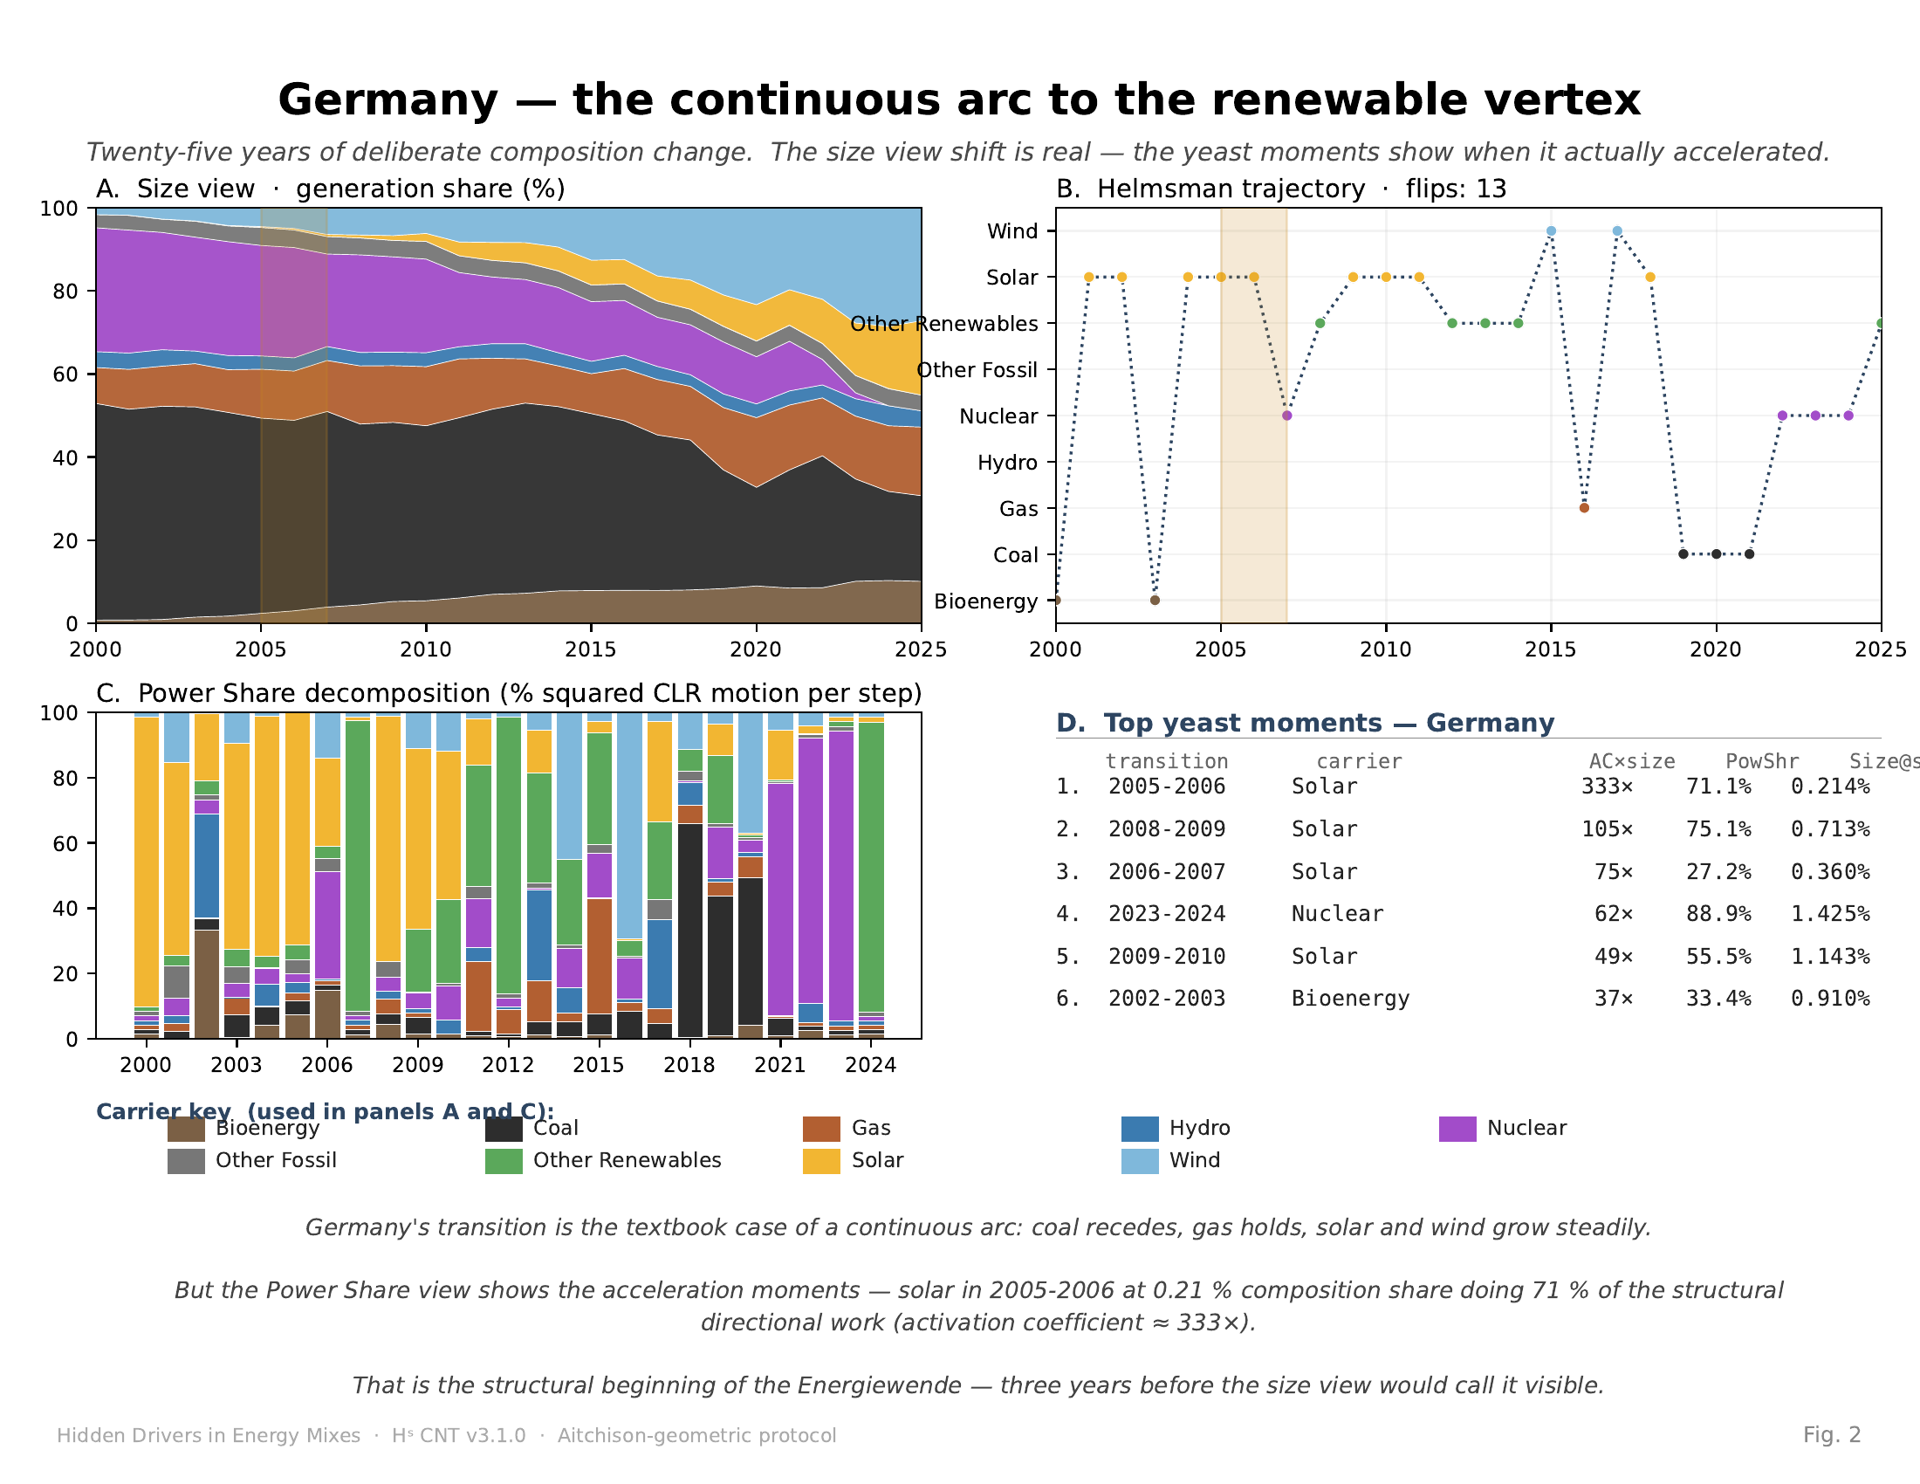
Germany — share-and-work view
Energiewende read as a single smooth arc on the simplex (chart pair: shares + structural work).
Solar 2005–2006: 0.21 % share · 71.1 % structural work · α ≈ 333 ×
Tiny share, dominant work. The yeast-factor signature, four years before the share view shows anything.
Germany — share + work · navigation chart on next slide
6 / 13

Slide 7
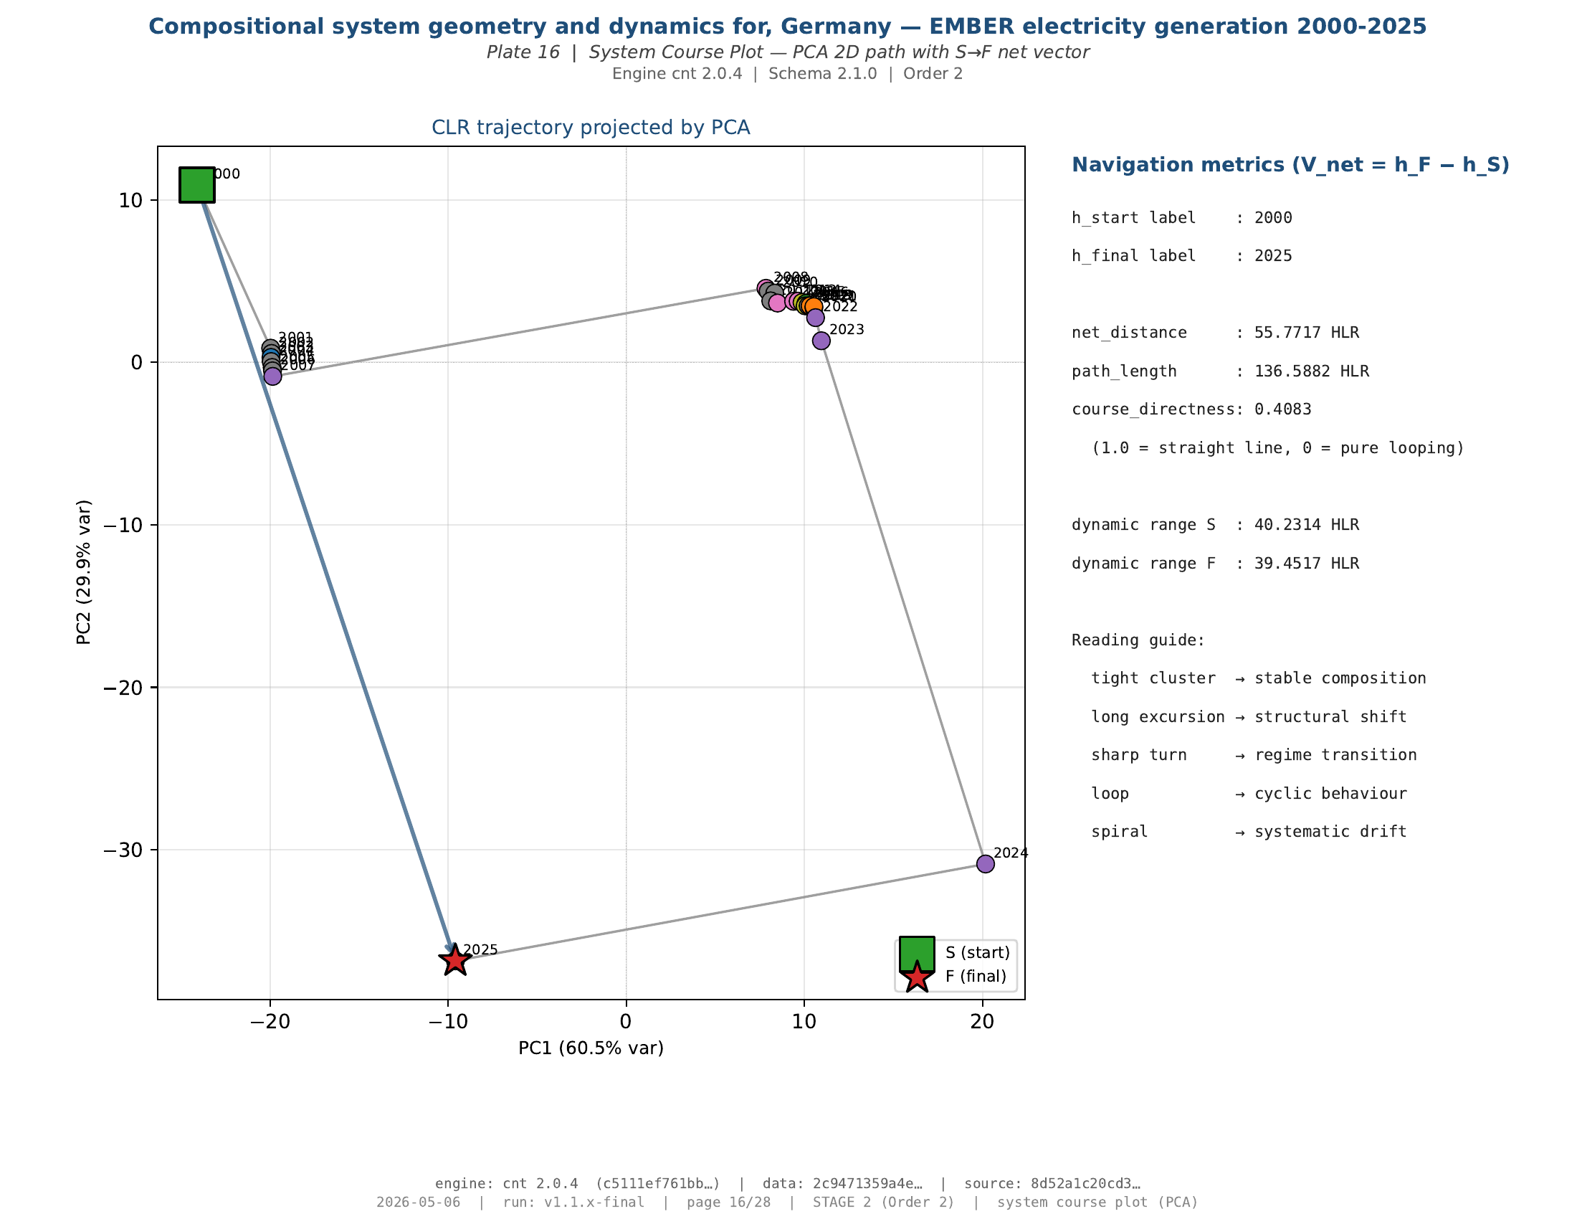
Germany — course on the simplex
The Helmsman trajectory: where the composition went, year by year.
Course directness 0.41 — continuous arc toward the renewable vertex.
Smooth, monotone reorientation — no loops, no flips. Deliberate transition as a sustained course.
Germany — navigation chart
7 / 13

Slide 8
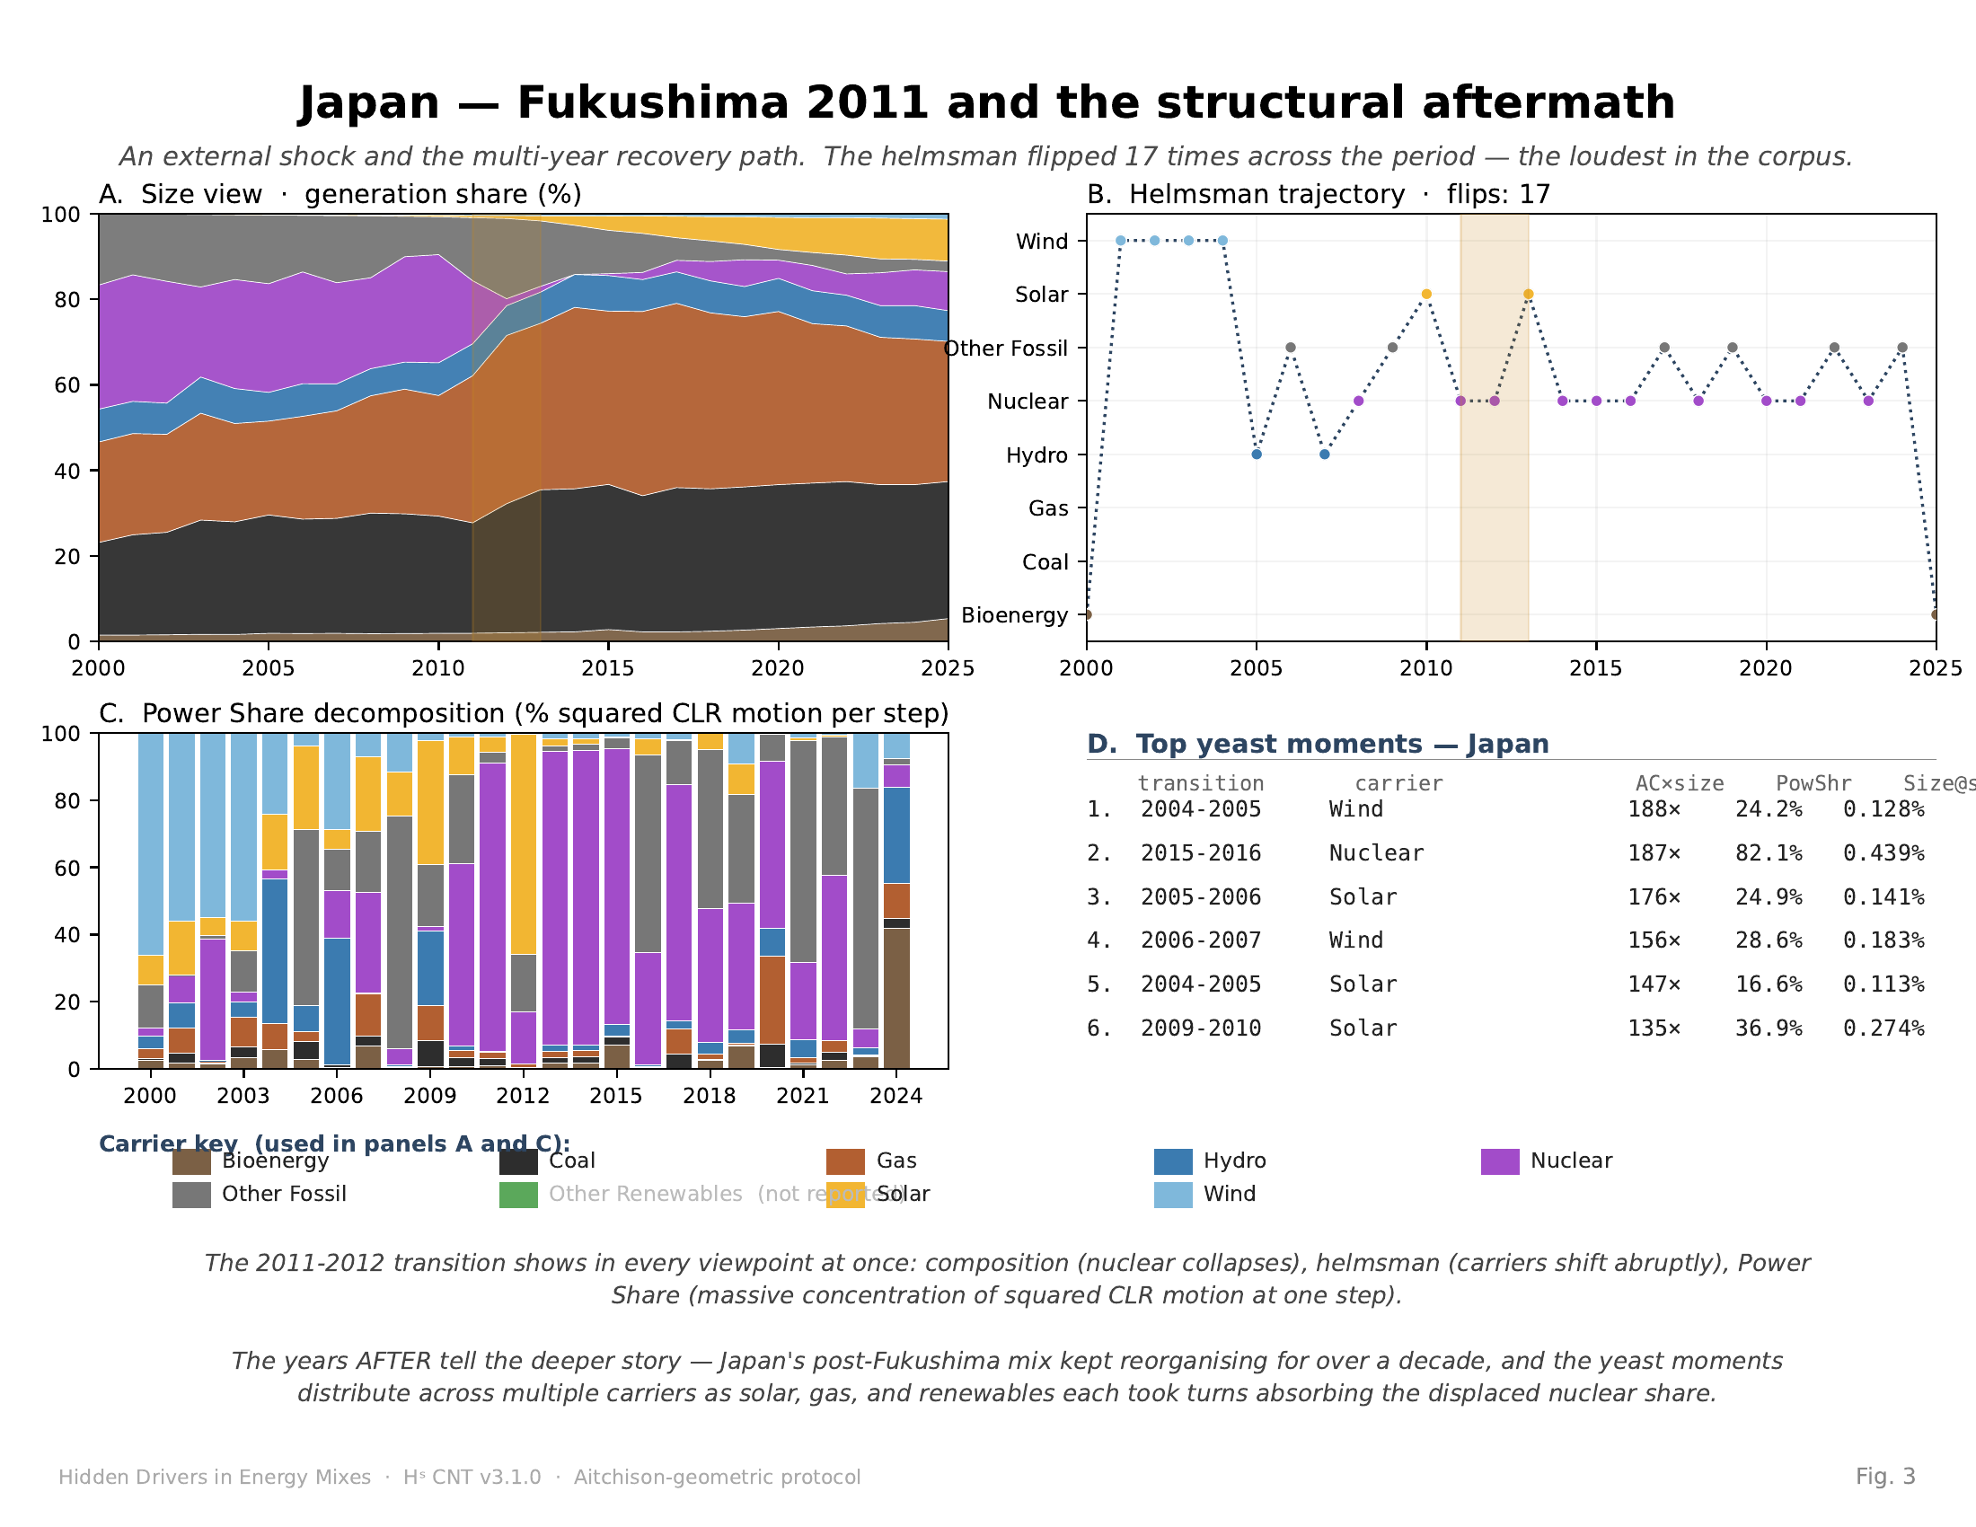
Japan — share-and-work view
Fukushima 2011: external shock displaces nuclear, multi-year compositional reorganisation.
Aitchison distance 2011 → 2012 ≈ 3 × neighbouring-year baseline · helmsman flips 17 ×
The instrument detects both the shock and the multi-year reorganisation that followed.
Japan — share + work · navigation chart on next slide
8 / 13

Slide 9
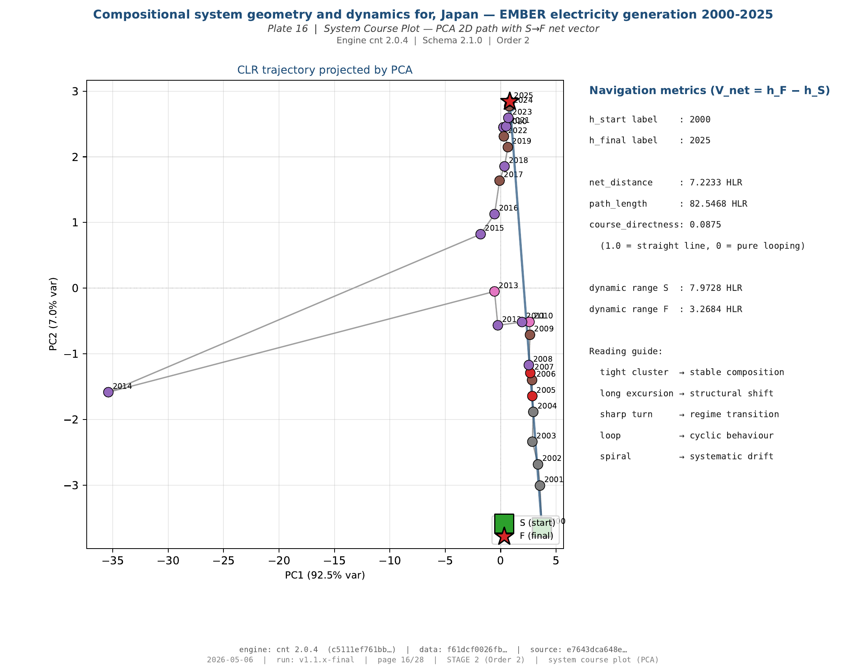
Japan — course on the simplex
The Helmsman trajectory: looping reorganisation, not a single step.
Course directness 0.09 — loop-and-reorganise archetype.
Trajectory revisits and reroutes — the system searches for a new composition, not a planned course.
Japan — navigation chart
9 / 13

Slide 10
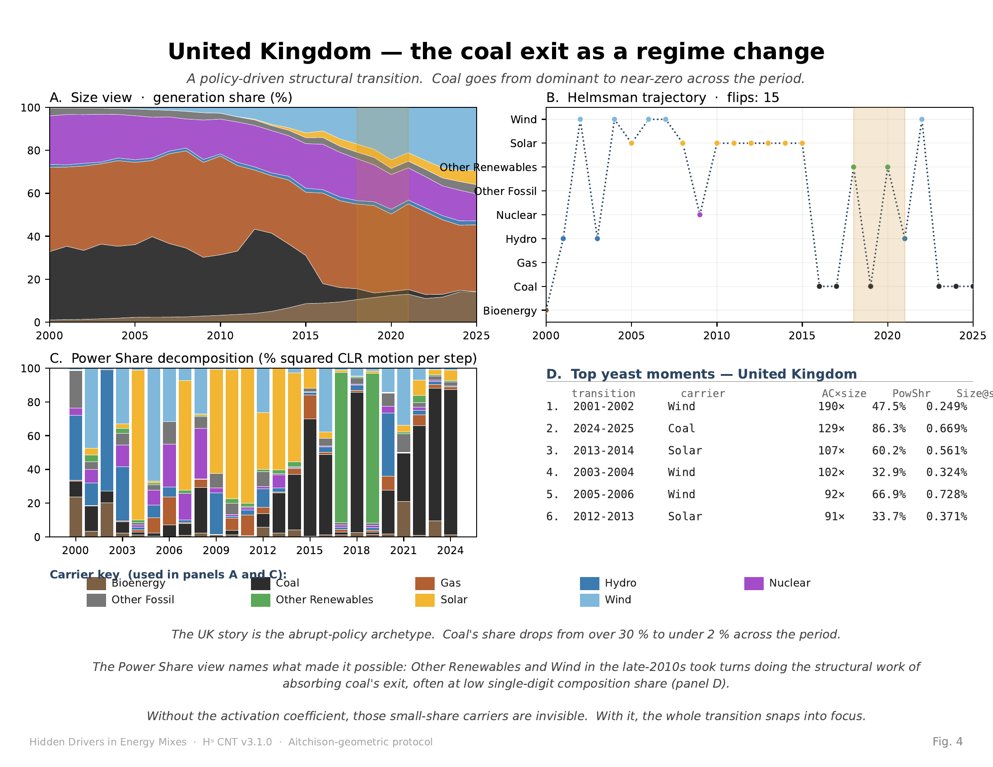
United Kingdom — share-and-work view
Coal exit as policy-driven regime change, absorbed across multiple renewable carriers.
Coal: > 30 % → < 2 %. Wind, solar, and other renewables absorb the displaced structural work.
Displaced work redistributes across several carriers — not one substitute, but several.
United Kingdom — share + work · navigation chart on next slide
10 / 13

Slide 11
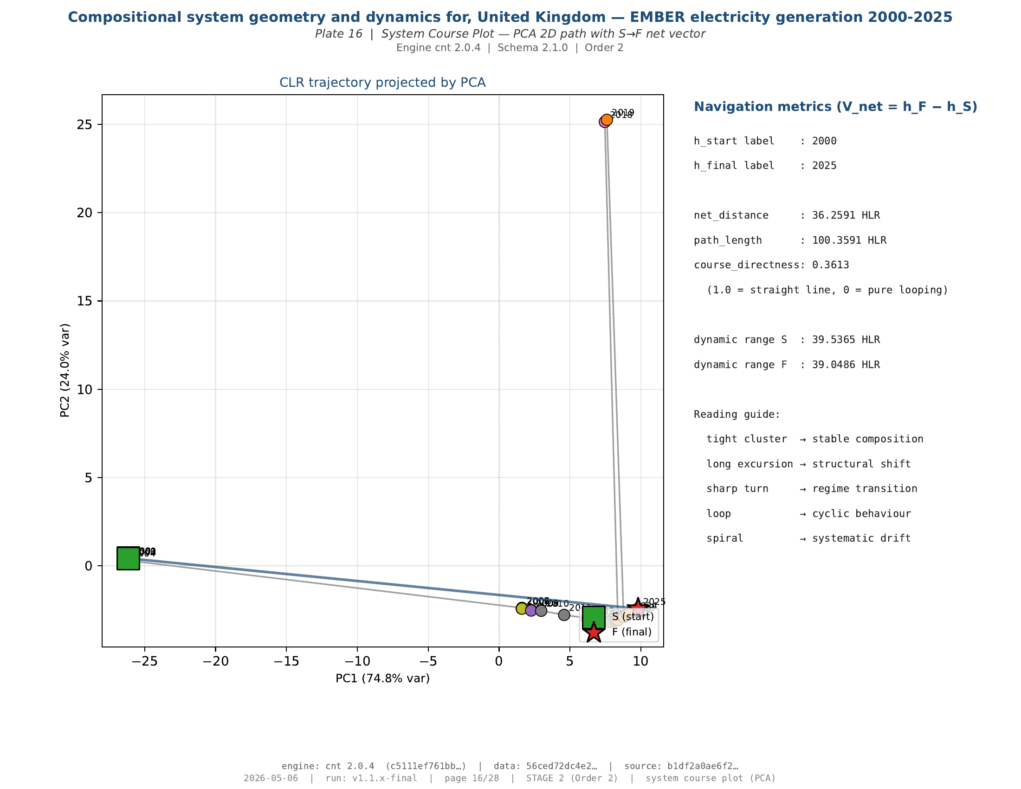
United Kingdom — course on the simplex
The Helmsman trajectory: a jump from the coal vertex, then a return toward stability.
Course directness 0.36 — jump-and-return archetype.
Sharp departure from the coal vertex, then re-stabilisation — regime change as one decisive displacement.
United Kingdom — navigation chart
11 / 13

Slide 12
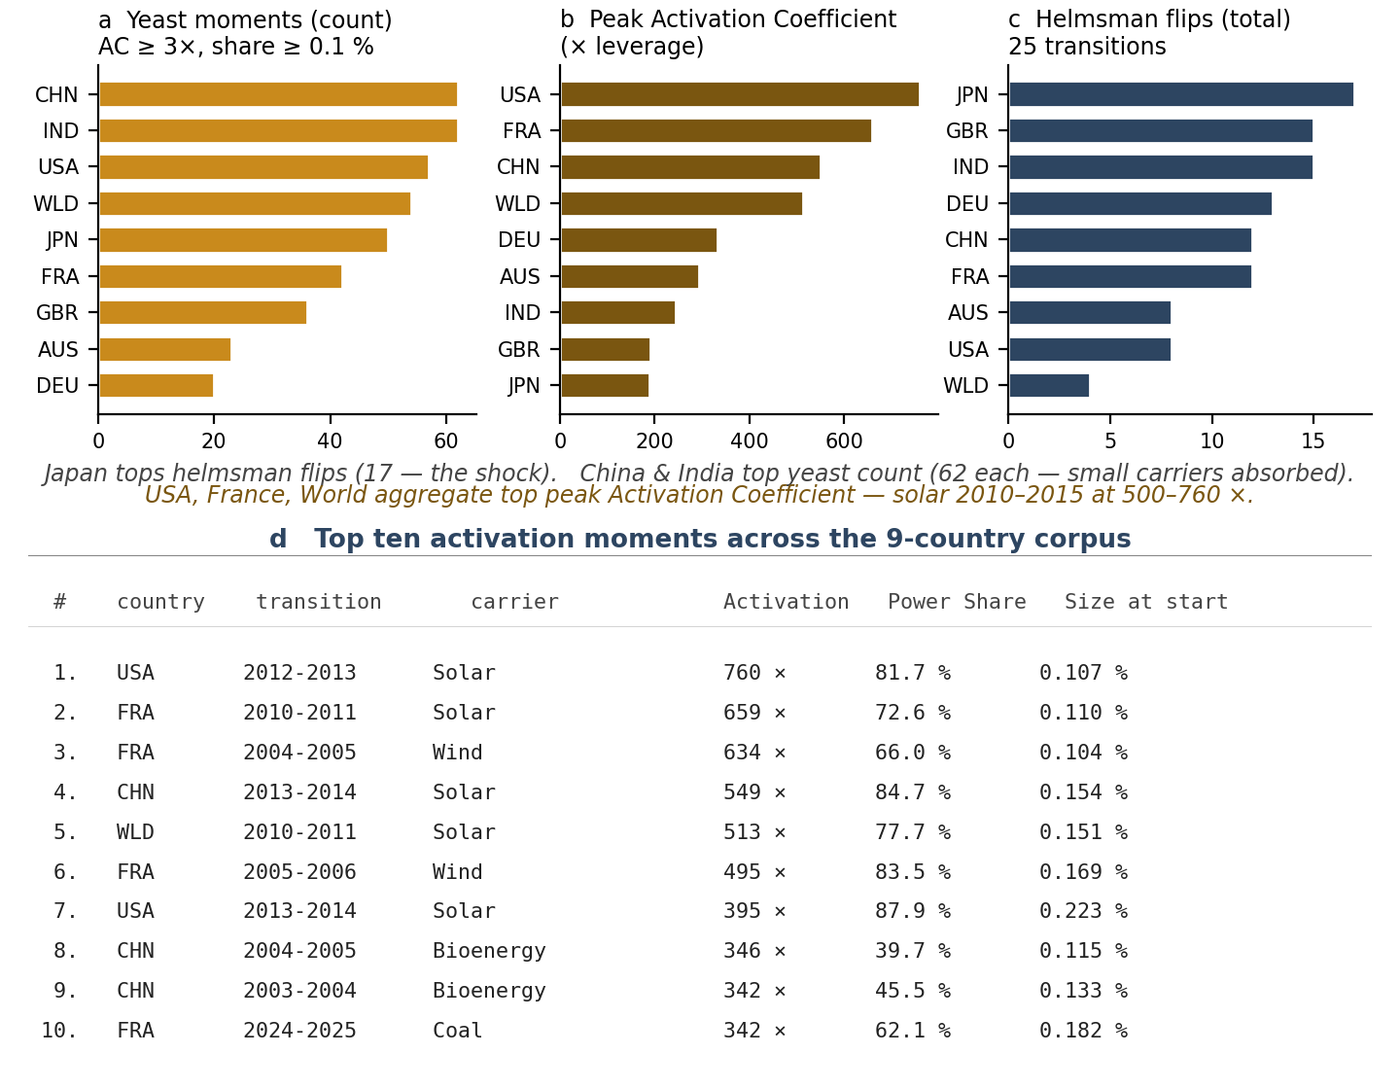
Cross-country signature — 5 of 9 reproduce the pattern
From three case archetypes to a corpus-level result.
fires AUS · CHN · GBR · IND · JPN
quiet DEU (annual) · FRA · USA · WLD
A useful detector should not fire everywhere. Discrimination is itself evidence.
12 / 13

Slide 13
What the stack answers
One observable, five distinct questions, one reproducible object.
WHAT
carriers are big.
size view
WHO
is at the wheel.
Helmsman
WHEN
the steering changes.
Helmsman trajectory
HOW MUCH
work each carrier did.
Power Share
WHY
a small carrier mattered.
Activation Coefficient
The stack does not replace interpretation. It gives interpretation a reproducible object.
AI Use Declaration (HUF-STD-001 v1.1): research design, mathematical content, code, and scientific responsibility remain with the named author. AI assistants (Claude, ChatGPT, Grok) used for drafting, sweeps, and reviews. Author retains full responsibility. Apache-2.0 code · CC BY 4.0 docs.
13 / 13

