Slide 1
CoDaWork 2026 · Coimbra, Portugal · 1-5 June 2026
Compositional Monitoring of
Energy-Mix Drift on the Simplex
Premier Data Output — CNT v3.1.0 + CNQ v2.0.0
9-country EMBER electricity-generation corpus · 2000-2025
P. Higgins, Rogue Wave Audio
Document v2 · 2026-05-14 · AI Use Declaration on final slide · HUF-STD-001 compliant
The instrument reads. The expert decides. The hashes carry the receipts. The vocabulary holds the line.

Slide 2
What is in this deck
For each of the 9 EMBER countries (AUS, CHN, DEU, FRA, GBR, IND, JPN, USA, WLD), 6 key plates:
1. Country cover - input metadata + headline metrics + hash receipts
2. Stage 1 mid-series plate (Section view) - XY scatter + XZ bearings + YZ CLR for representative year
3. Stage 1 course plot - full trajectory overview across 2000-2025
4. Stage 2/3 helmsman analysis - frequency chart + carrier attribution
5. ILR-Helmert Triplet Plate (NEW dual-view companion) - three orthogonal scatter projections
6. CNQ dashboard - Higgins scale Hs(t), angular velocity w(t), K_eff + TV(t),
helmsman s(t), spike detector, diagnostics box
For complete per-year detail (all 27 plates x 9 countries + all 7 stage 2/3 pages + all CNQ panels),
see the companion master PDFs:
CodaWork2026_PremierDataOutput_2026-05-13.pdf (325 pages - Section + Stage 2/3 + CNQ)
dual_view/CodaWork2026_DualViewStage1Output_2026-05-13.pdf (503 pages - Section + Triplet)
Engine versions: CNT v3.1.0 (schema 3.1.0) + CNQ v2.0.0 (schema cnq/2.0.0)
Hash discipline: content_sha256 + engine_signature on every JSON output
Standards: HUF-STD-001 (publication) + HUF-STD-002 (tensor train v1.0)
The instrument reads. The expert decides. The hashes carry the receipts. The vocabulary holds the line.

Slide 3
§ AUS Australia
EMBER electricity-generation series · 2000-2025 · N = 26 · D = 9
Stage 1 plates (Section + Triplet) · Stage 2/3 navigation · CNQ quaternion view

Slide 4
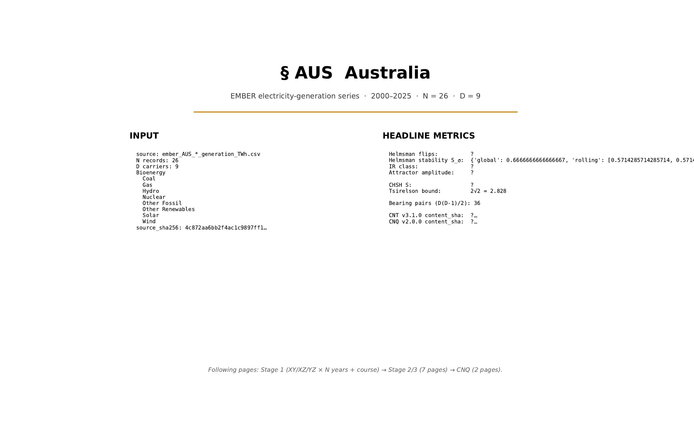
§ AUS Australia · cover
CNT v3.1.0 + CNQ v2.0.0 · AUS · HUF-STD-002 link 4 vector output

Slide 5
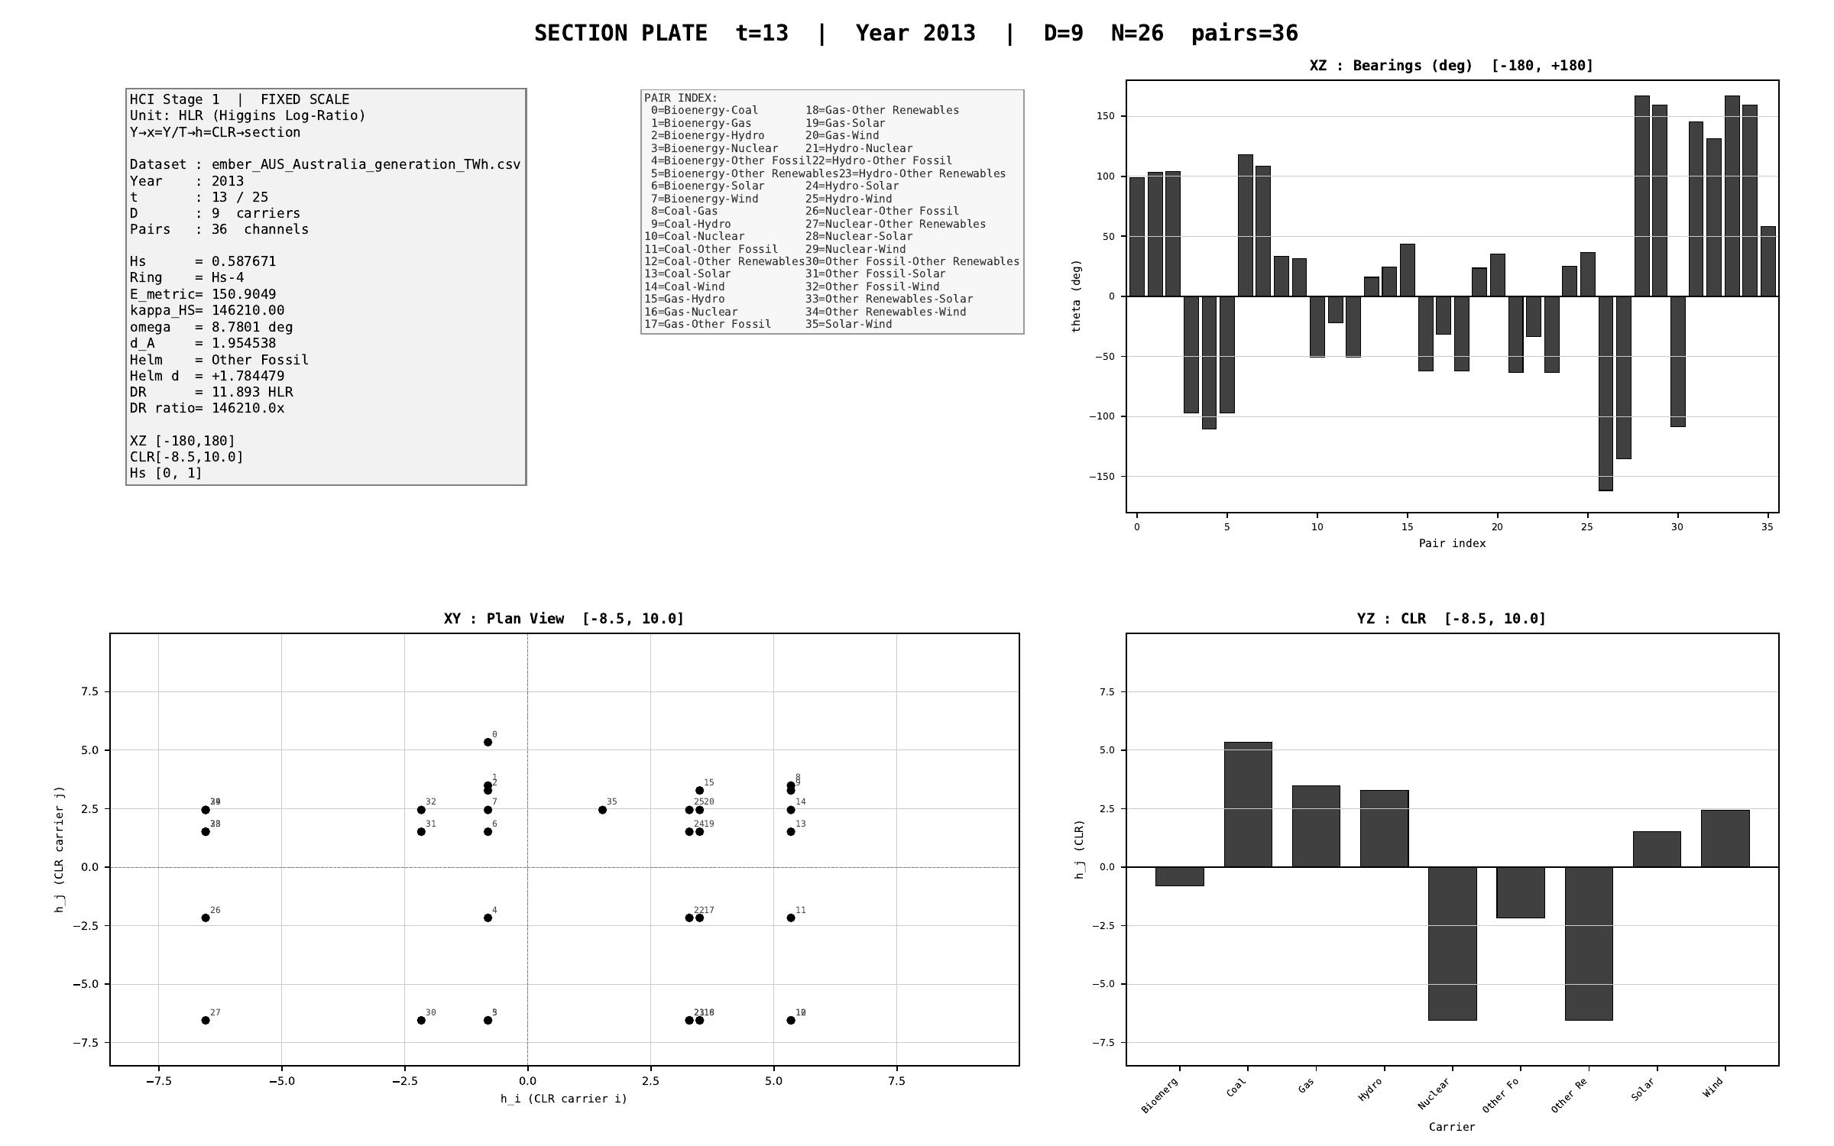
§ AUS Australia · Stage 1 - XY/XZ/YZ orthogonal projections (representative year)
CNT v3.1.0 + CNQ v2.0.0 · AUS · HUF-STD-002 link 4 vector output

Slide 6
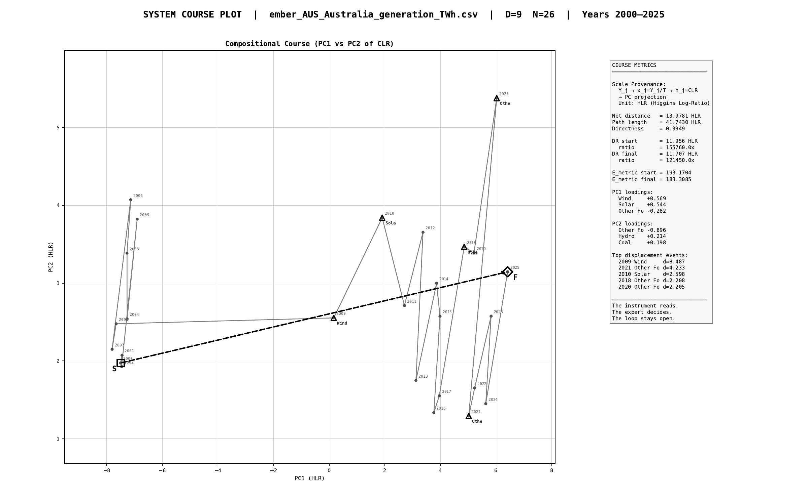
§ AUS Australia · Stage 1 - course plot (full trajectory 2000-2025)
CNT v3.1.0 + CNQ v2.0.0 · AUS · HUF-STD-002 link 4 vector output

Slide 7
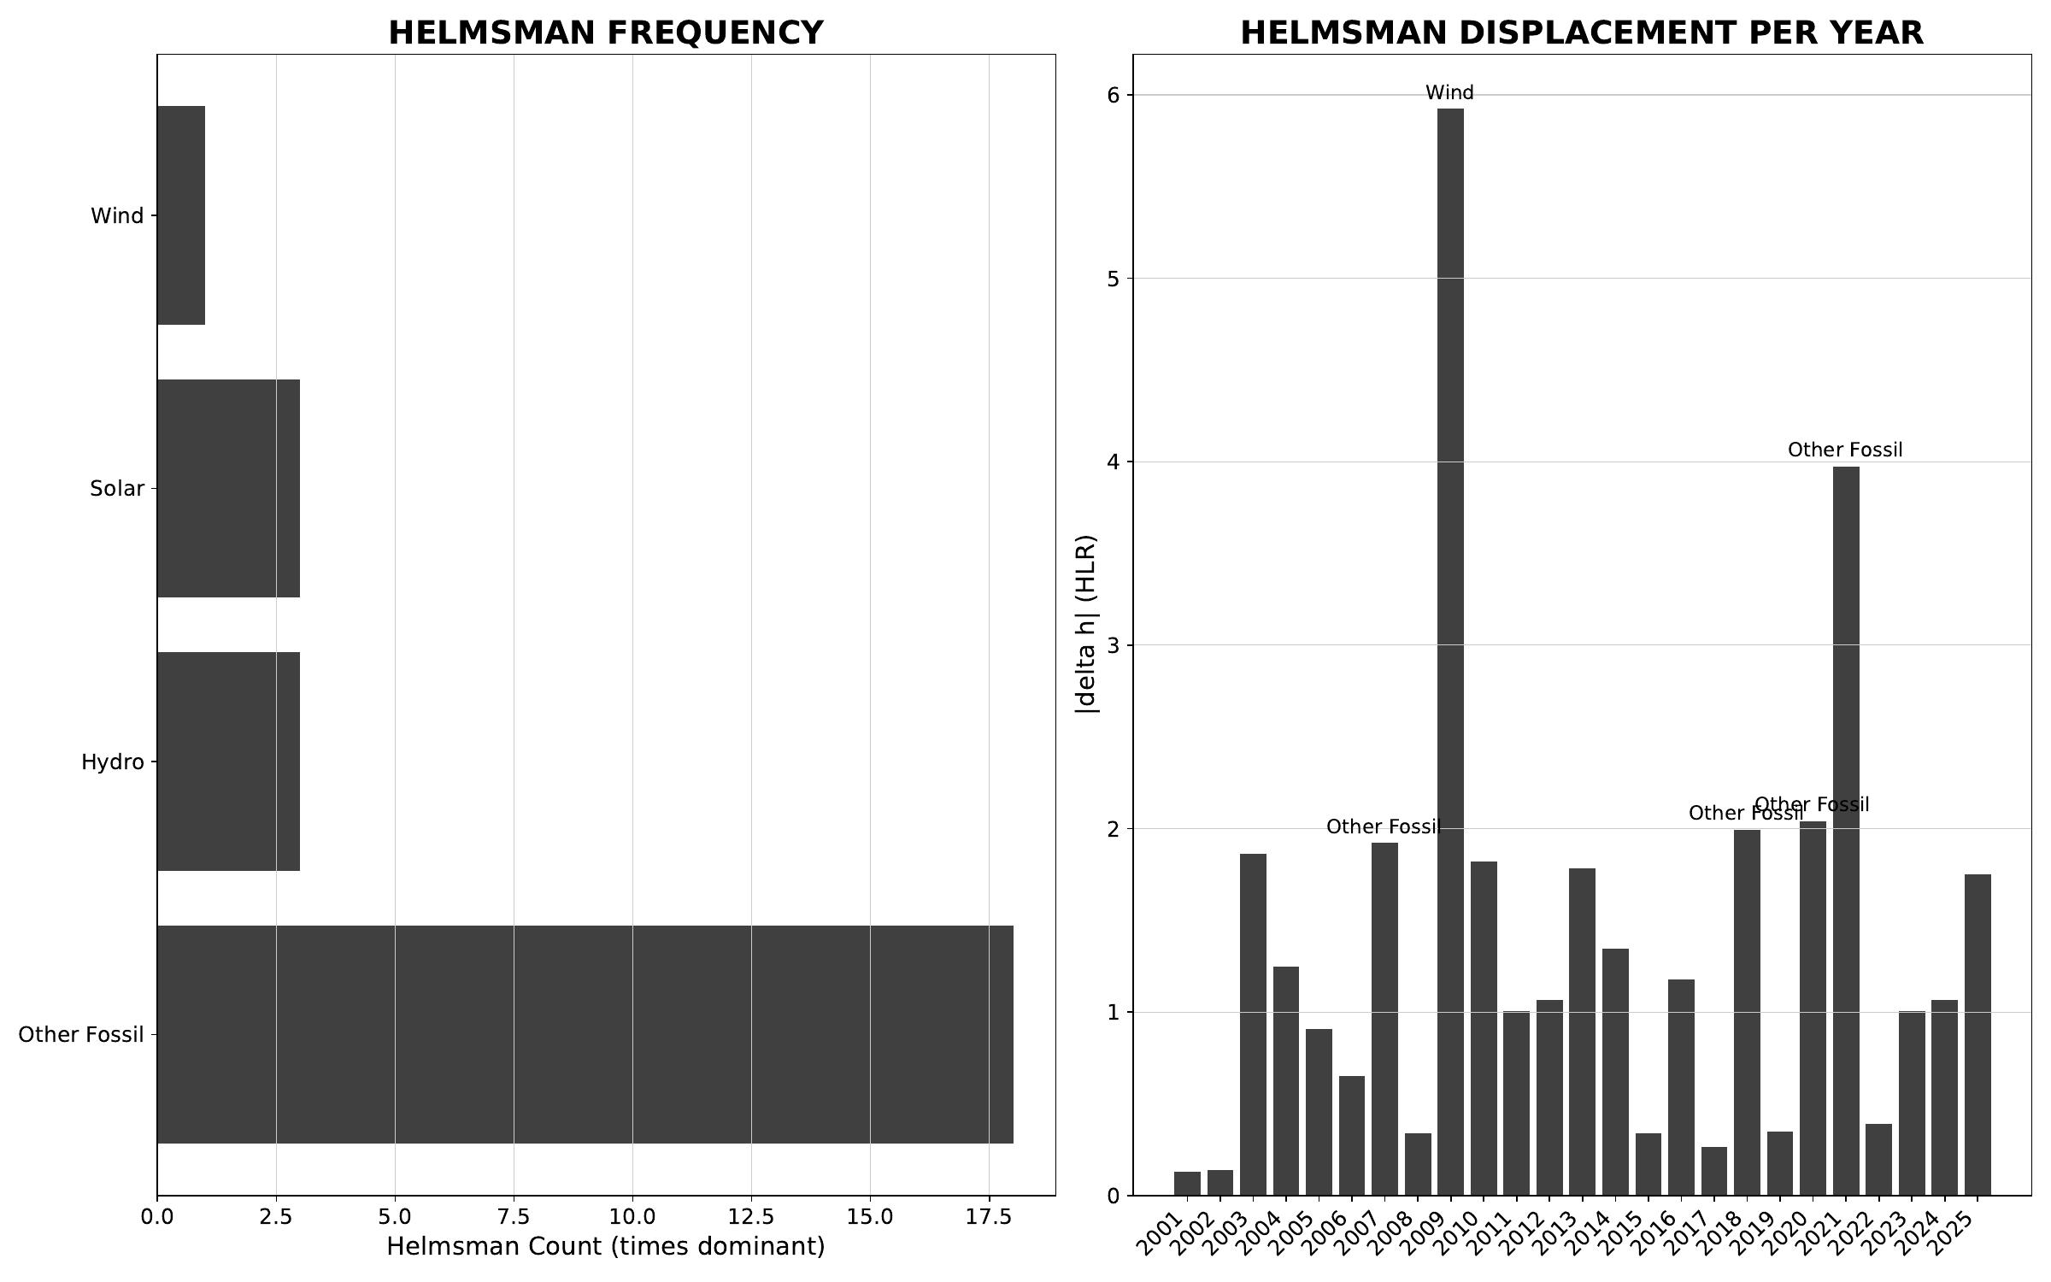
§ AUS Australia · Stage 2/3 - helmsman frequency + carrier attribution
CNT v3.1.0 + CNQ v2.0.0 · AUS · HUF-STD-002 link 4 vector output

Slide 8
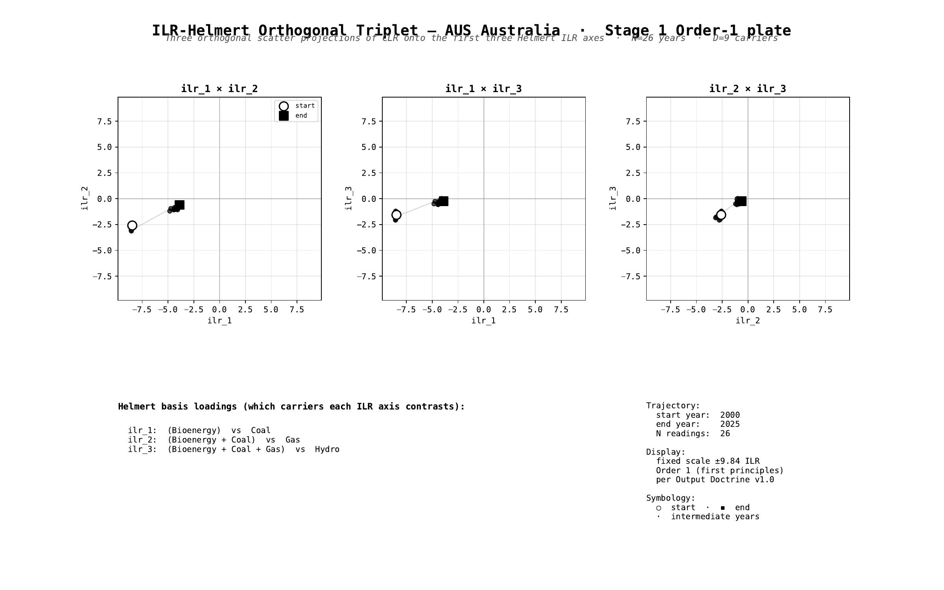
§ AUS Australia · Stage 1 - ILR-Helmert Triplet (orthonormal companion view)
CNT v3.1.0 + CNQ v2.0.0 · AUS · HUF-STD-002 link 4 vector output

Slide 9
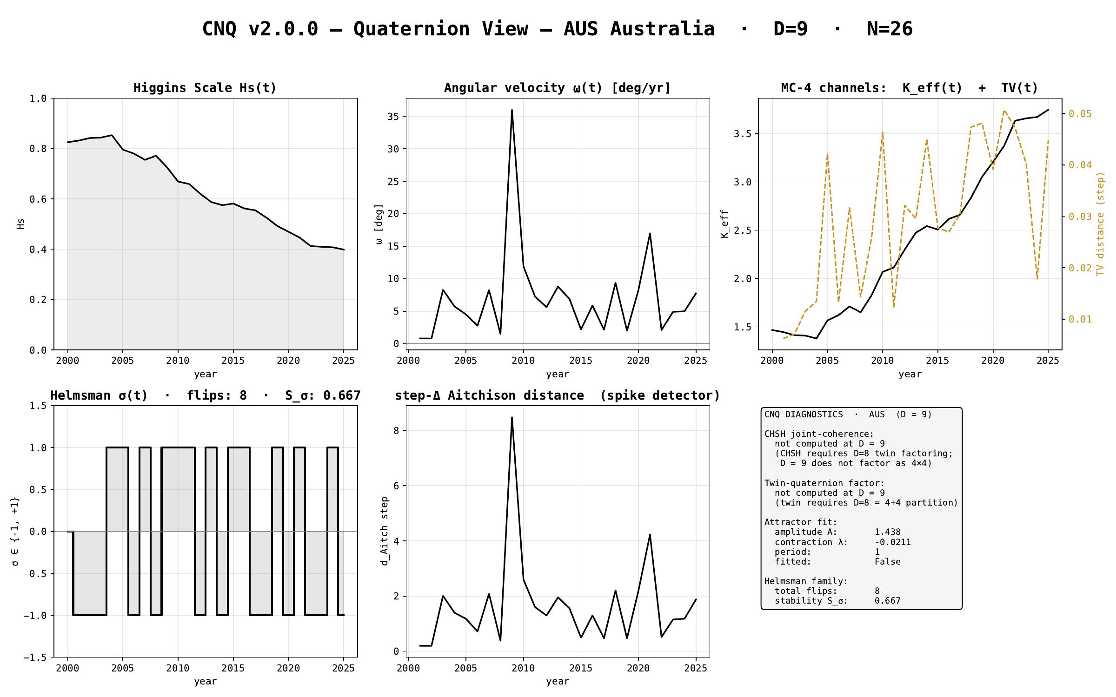
§ AUS Australia · CNQ v2.0.0 - quaternion-view dashboard
CNT v3.1.0 + CNQ v2.0.0 · AUS · HUF-STD-002 link 4 vector output

Slide 10
§ CHN China
EMBER electricity-generation series · 2000-2025 · N = 26 · D = 8
Stage 1 plates (Section + Triplet) · Stage 2/3 navigation · CNQ quaternion view

Slide 11
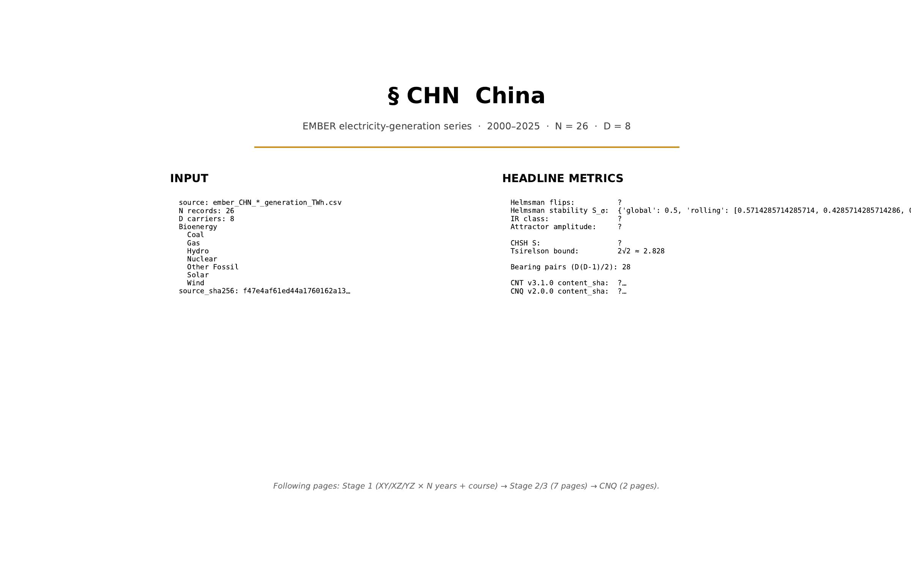
§ CHN China · cover
CNT v3.1.0 + CNQ v2.0.0 · CHN · HUF-STD-002 link 4 vector output

Slide 12
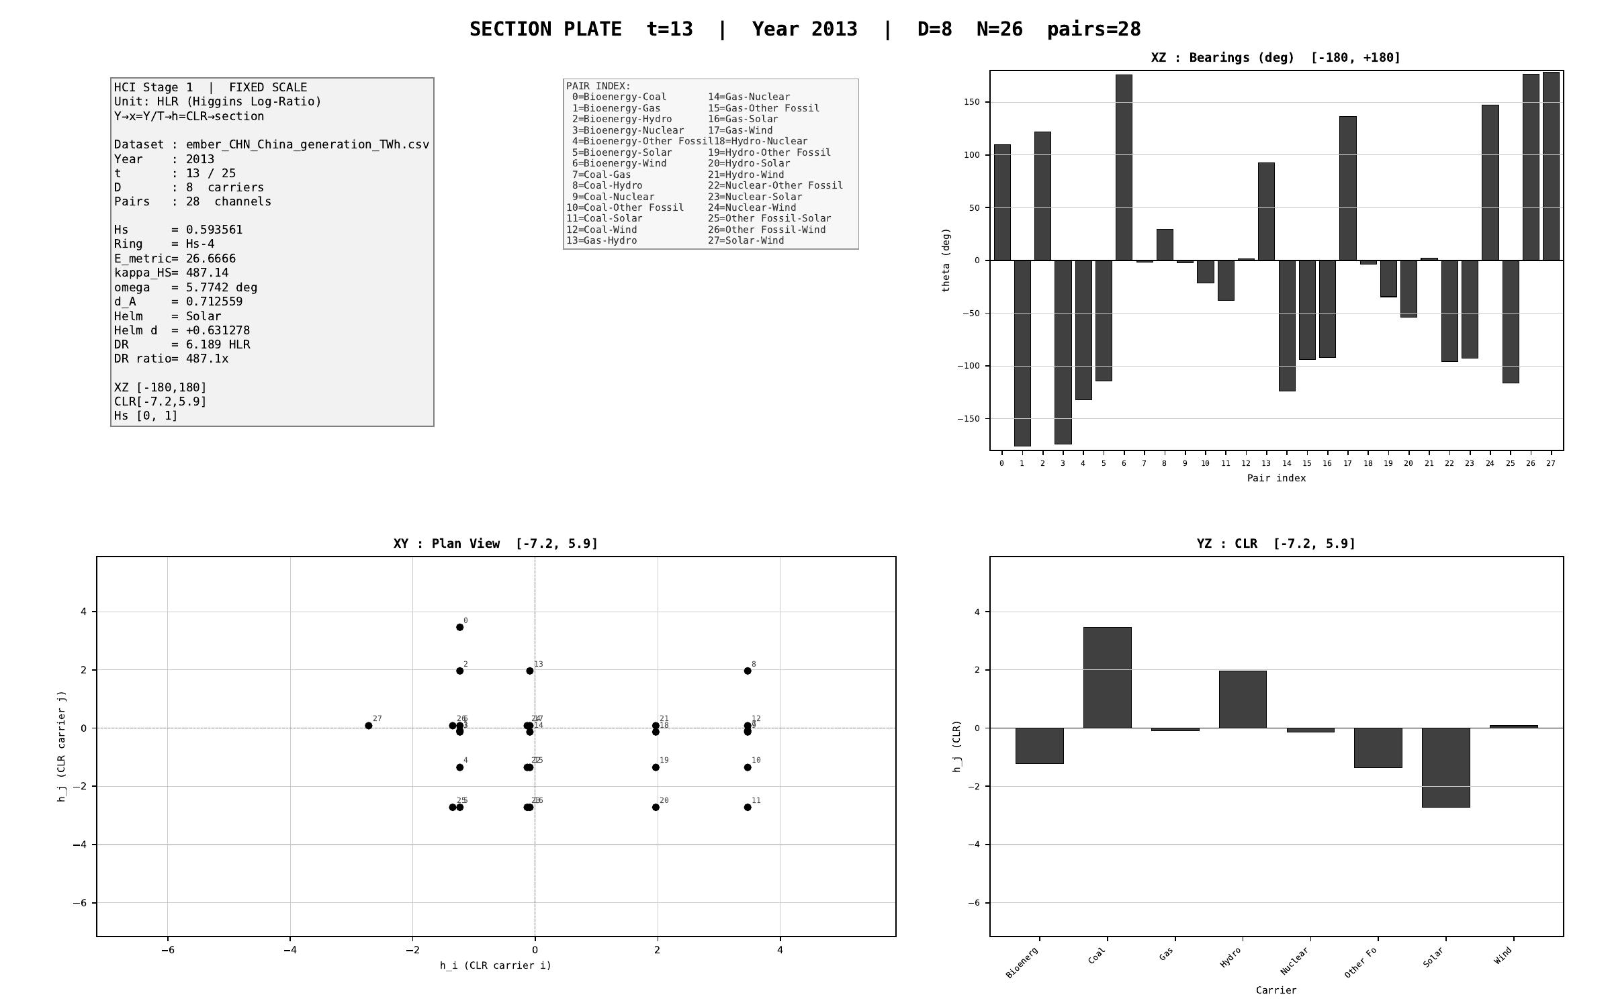
§ CHN China · Stage 1 - XY/XZ/YZ orthogonal projections (representative year)
CNT v3.1.0 + CNQ v2.0.0 · CHN · HUF-STD-002 link 4 vector output

Slide 13
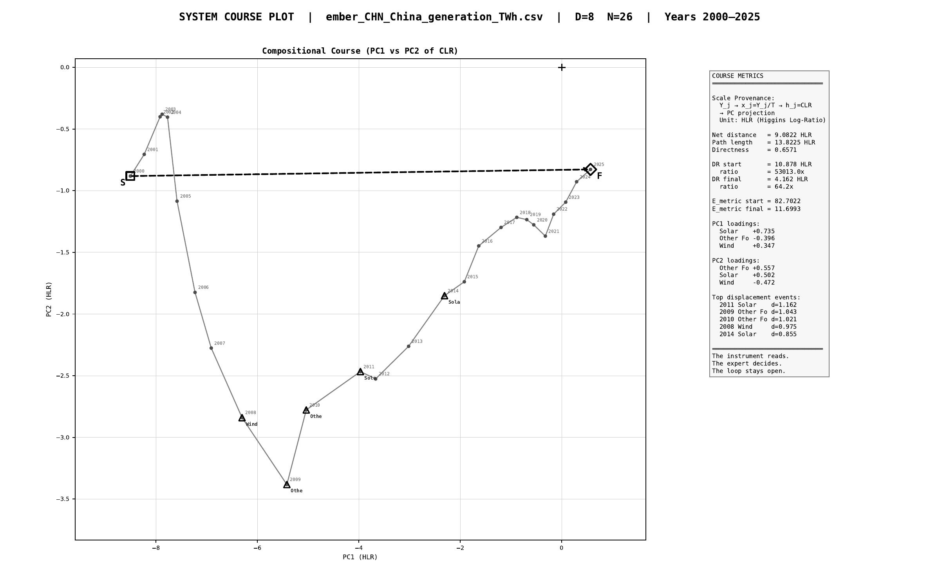
§ CHN China · Stage 1 - course plot (full trajectory 2000-2025)
CNT v3.1.0 + CNQ v2.0.0 · CHN · HUF-STD-002 link 4 vector output

Slide 14
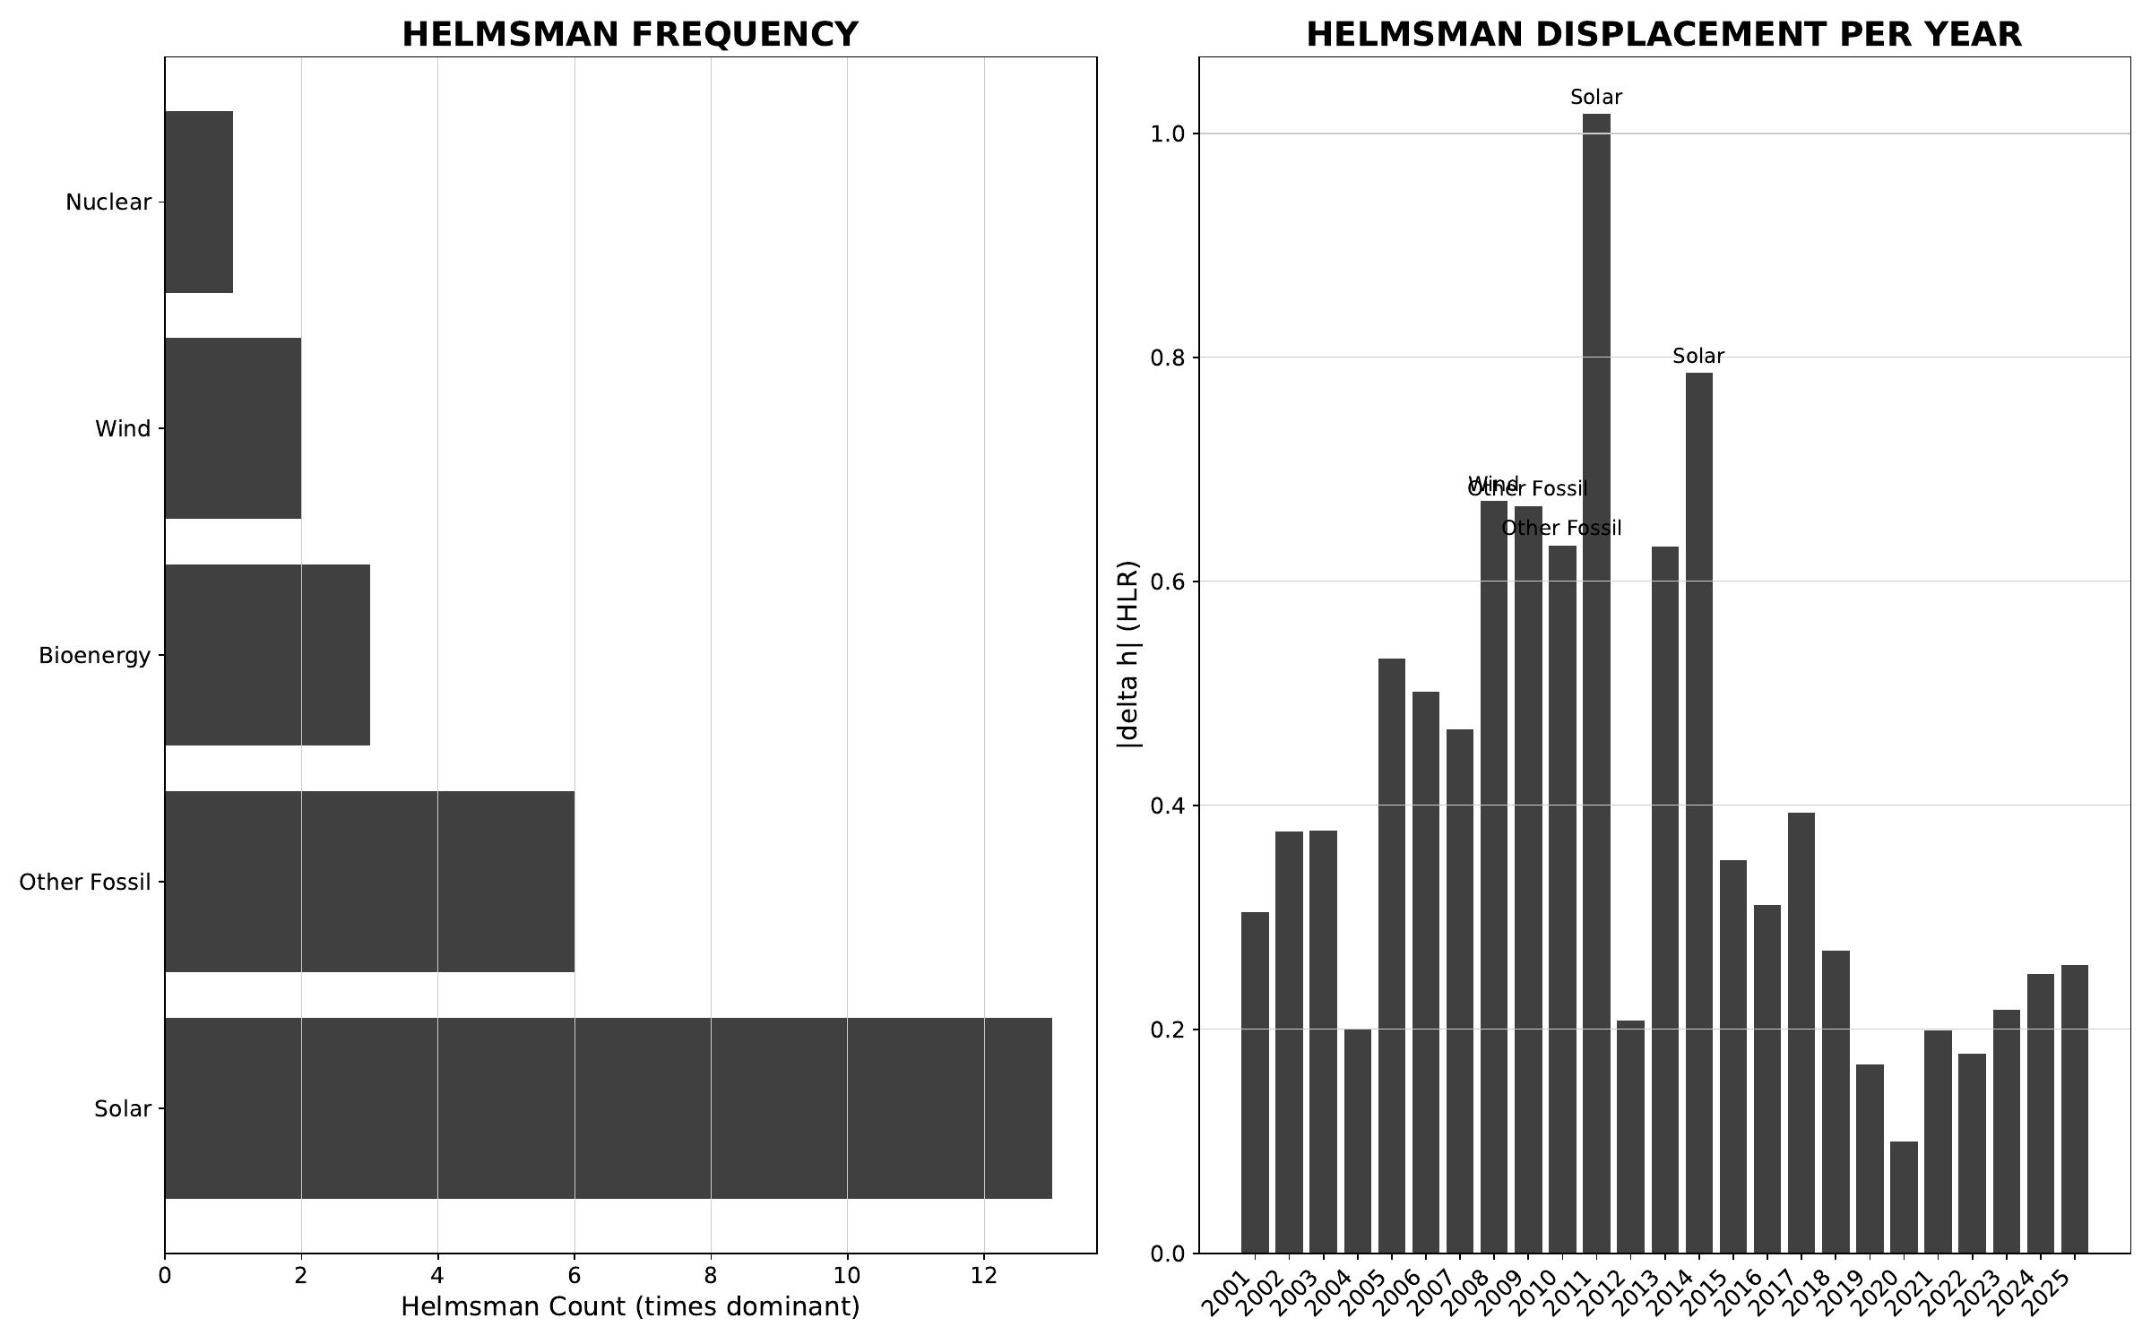
§ CHN China · Stage 2/3 - helmsman frequency + carrier attribution
CNT v3.1.0 + CNQ v2.0.0 · CHN · HUF-STD-002 link 4 vector output

Slide 15
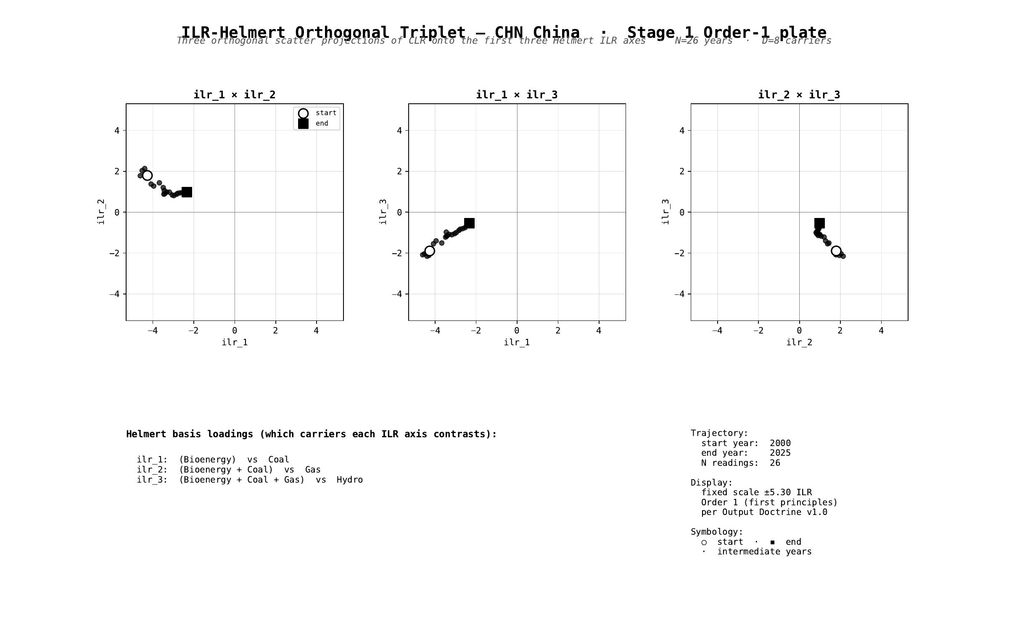
§ CHN China · Stage 1 - ILR-Helmert Triplet (orthonormal companion view)
CNT v3.1.0 + CNQ v2.0.0 · CHN · HUF-STD-002 link 4 vector output

Slide 16
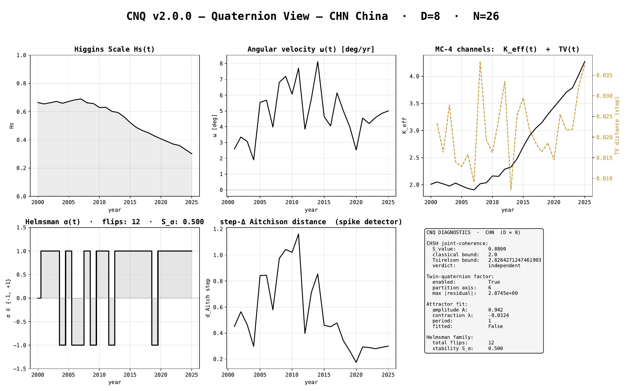
§ CHN China · CNQ v2.0.0 - quaternion-view dashboard
CNT v3.1.0 + CNQ v2.0.0 · CHN · HUF-STD-002 link 4 vector output

Slide 17
§ DEU Germany
EMBER electricity-generation series · 2000-2025 · N = 26 · D = 9
Stage 1 plates (Section + Triplet) · Stage 2/3 navigation · CNQ quaternion view

Slide 18
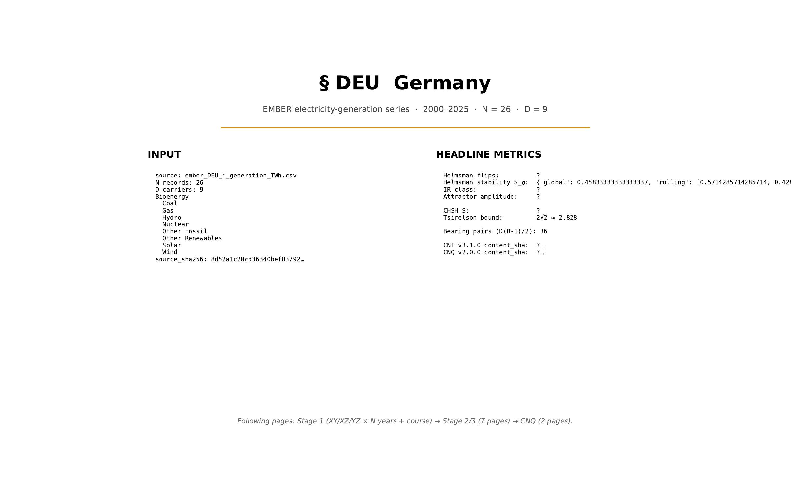
§ DEU Germany · cover
CNT v3.1.0 + CNQ v2.0.0 · DEU · HUF-STD-002 link 4 vector output

Slide 19
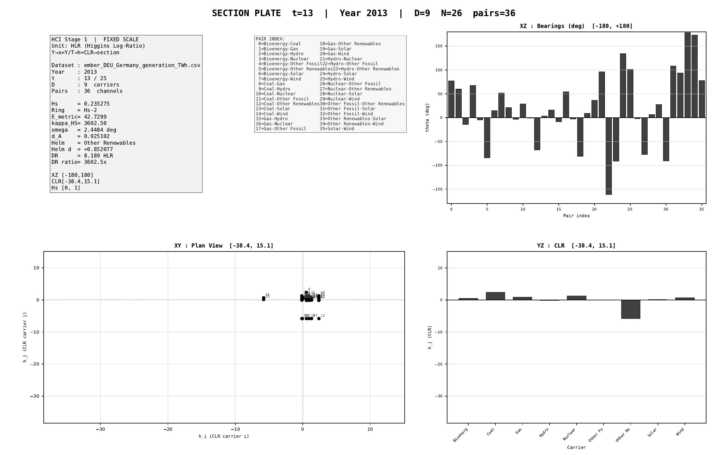
§ DEU Germany · Stage 1 - XY/XZ/YZ orthogonal projections (representative year)
CNT v3.1.0 + CNQ v2.0.0 · DEU · HUF-STD-002 link 4 vector output

Slide 20
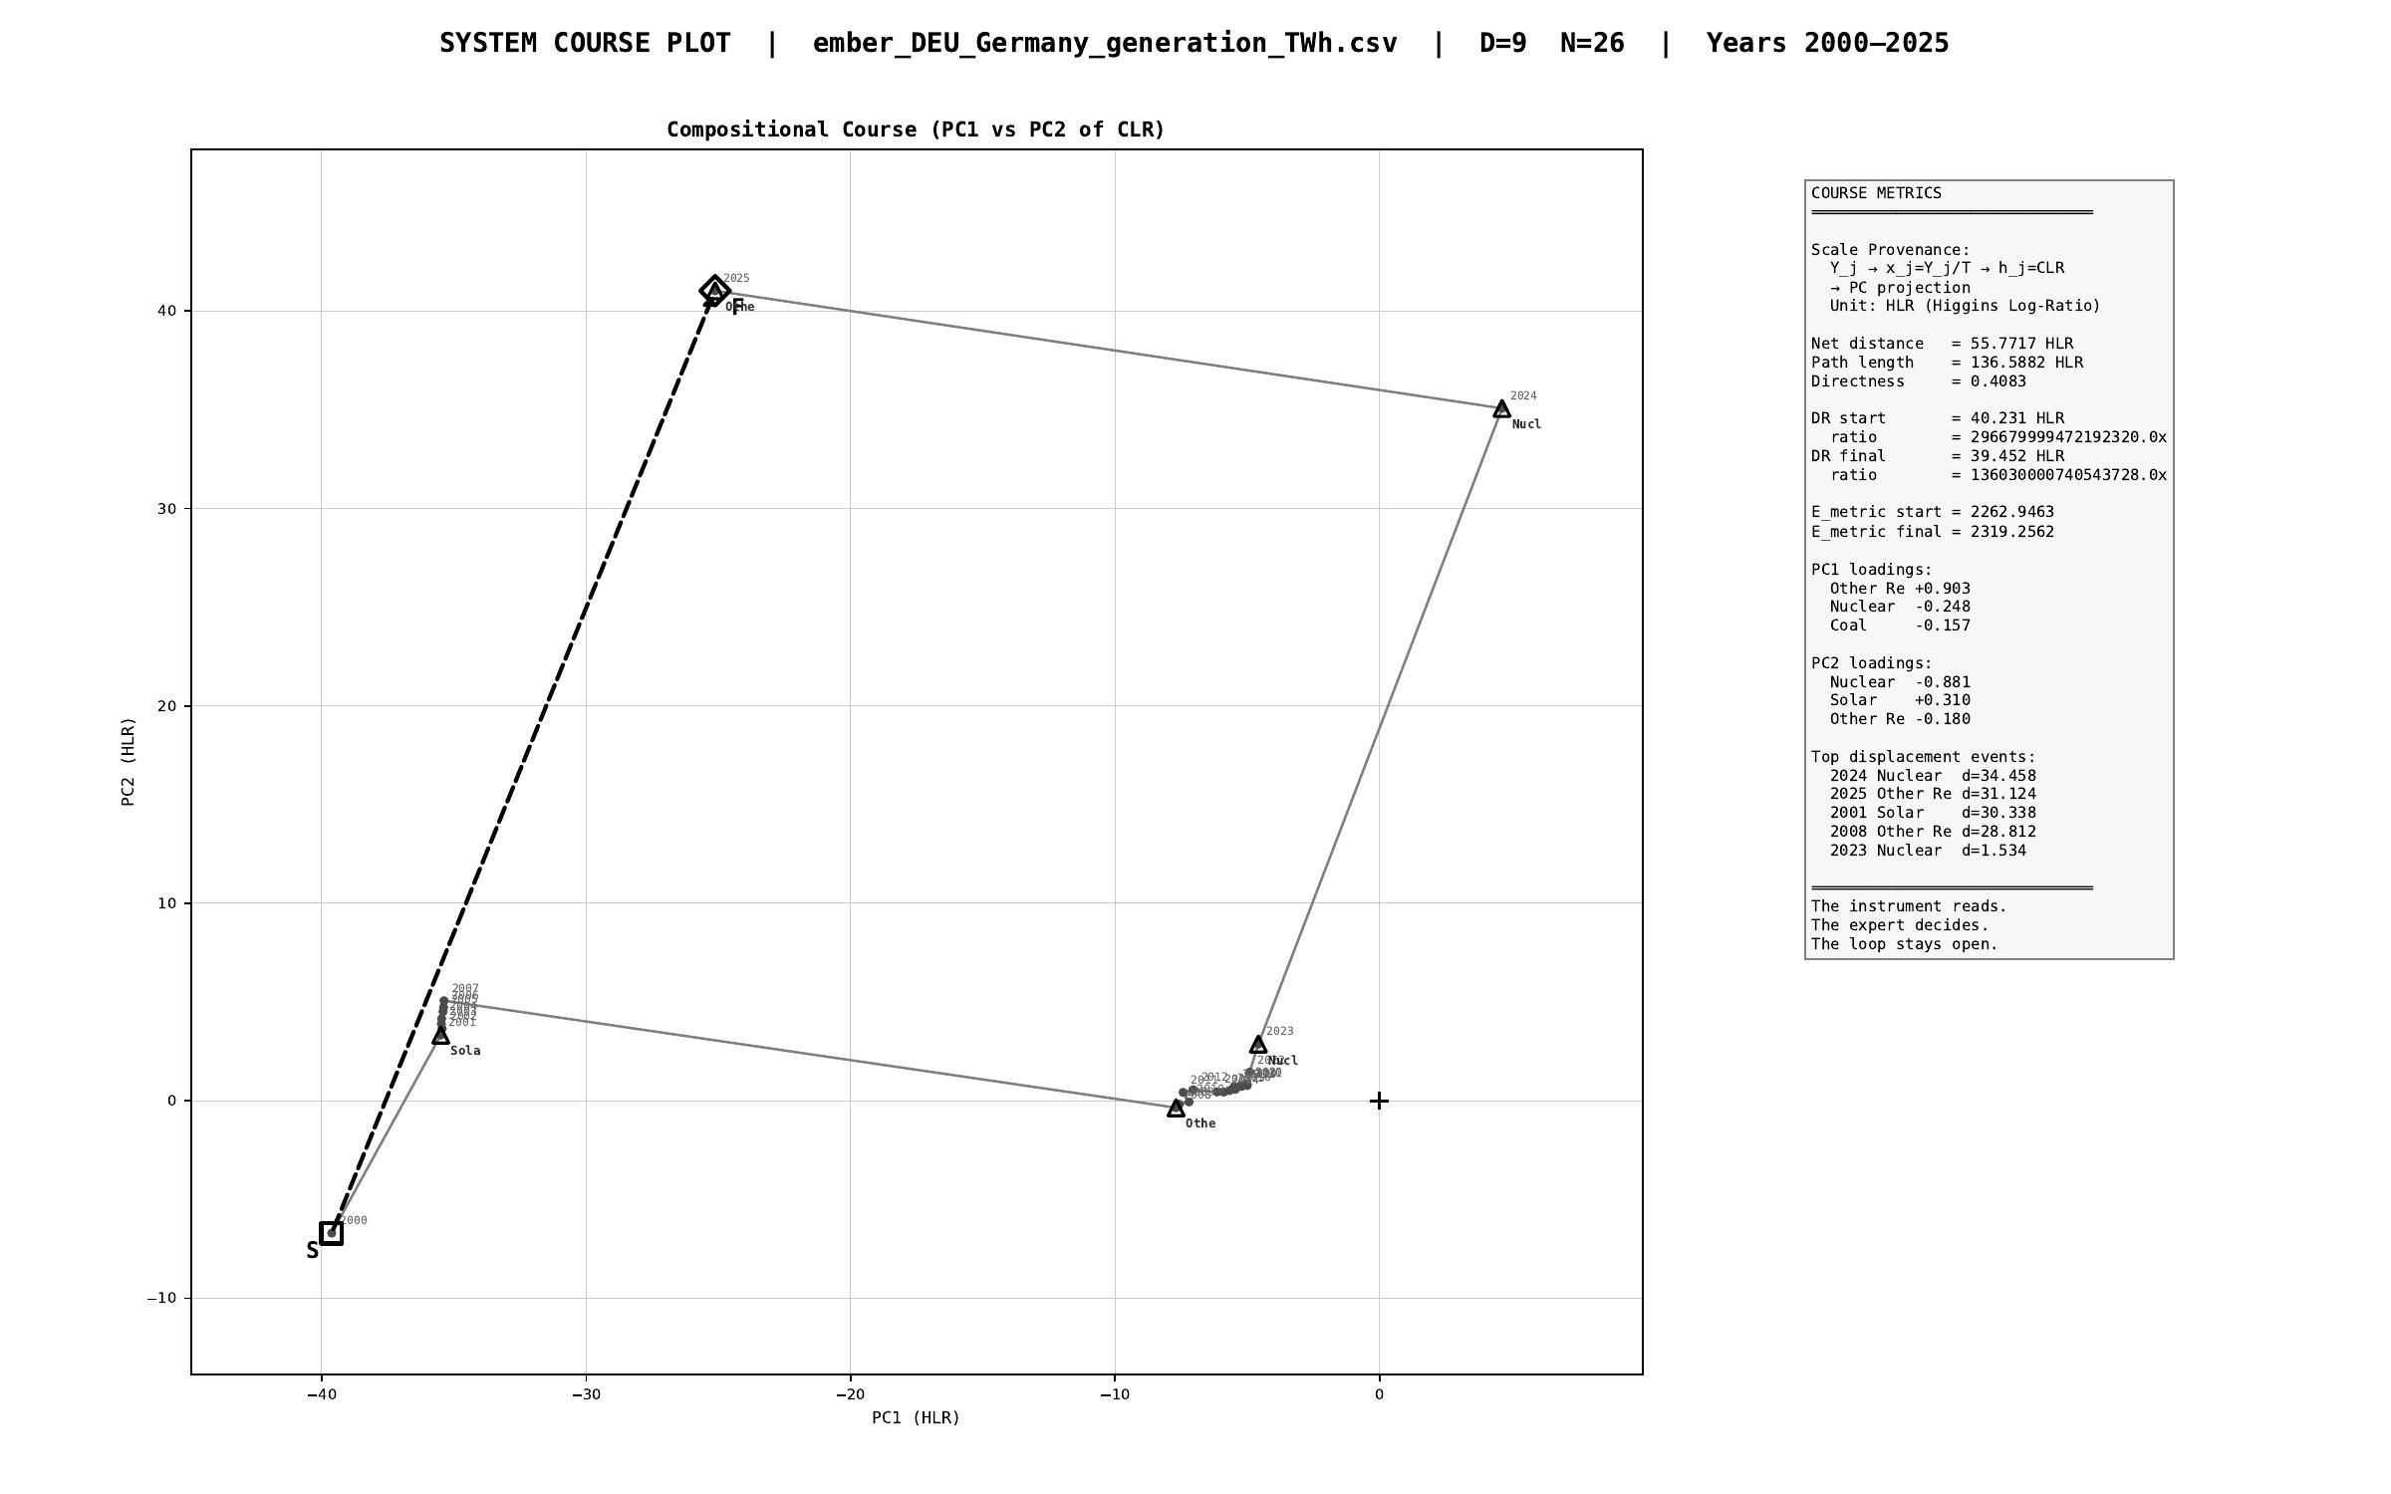
§ DEU Germany · Stage 1 - course plot (full trajectory 2000-2025)
CNT v3.1.0 + CNQ v2.0.0 · DEU · HUF-STD-002 link 4 vector output

Slide 21
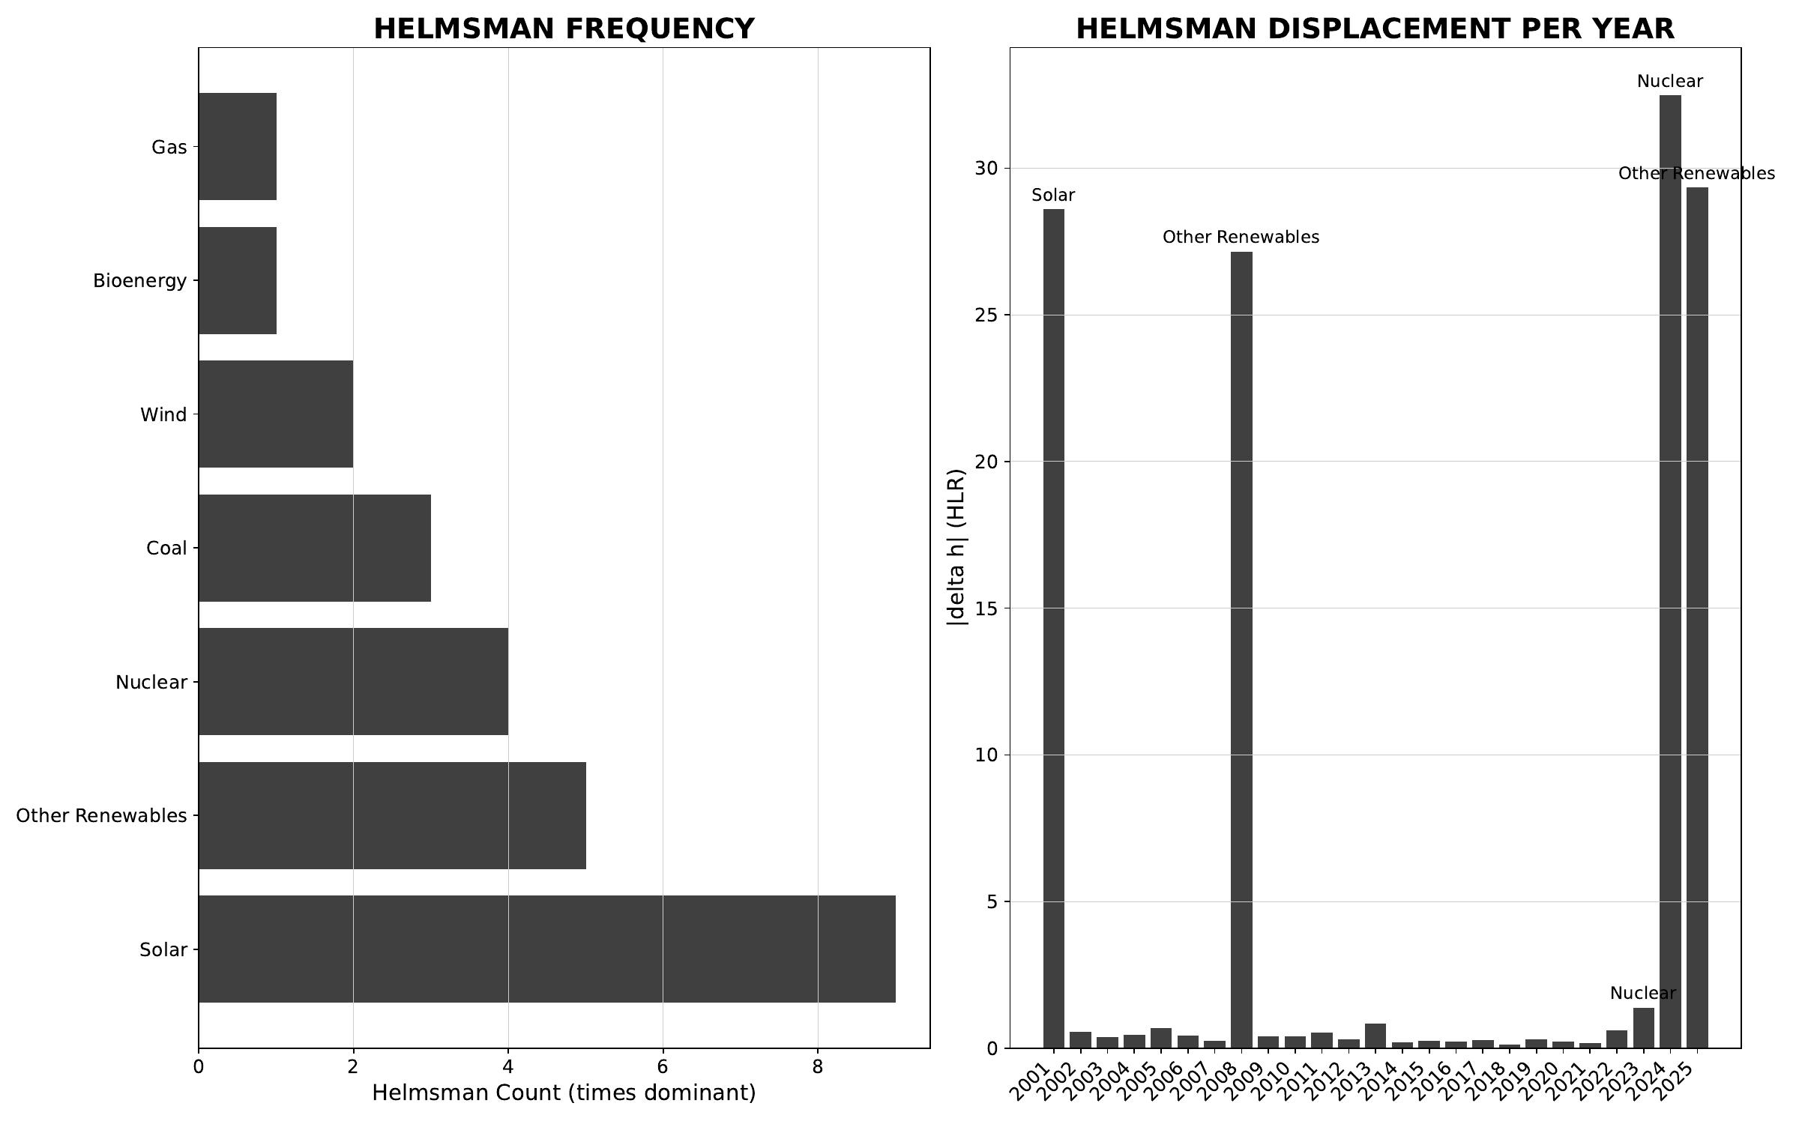
§ DEU Germany · Stage 2/3 - helmsman frequency + carrier attribution
CNT v3.1.0 + CNQ v2.0.0 · DEU · HUF-STD-002 link 4 vector output

Slide 22
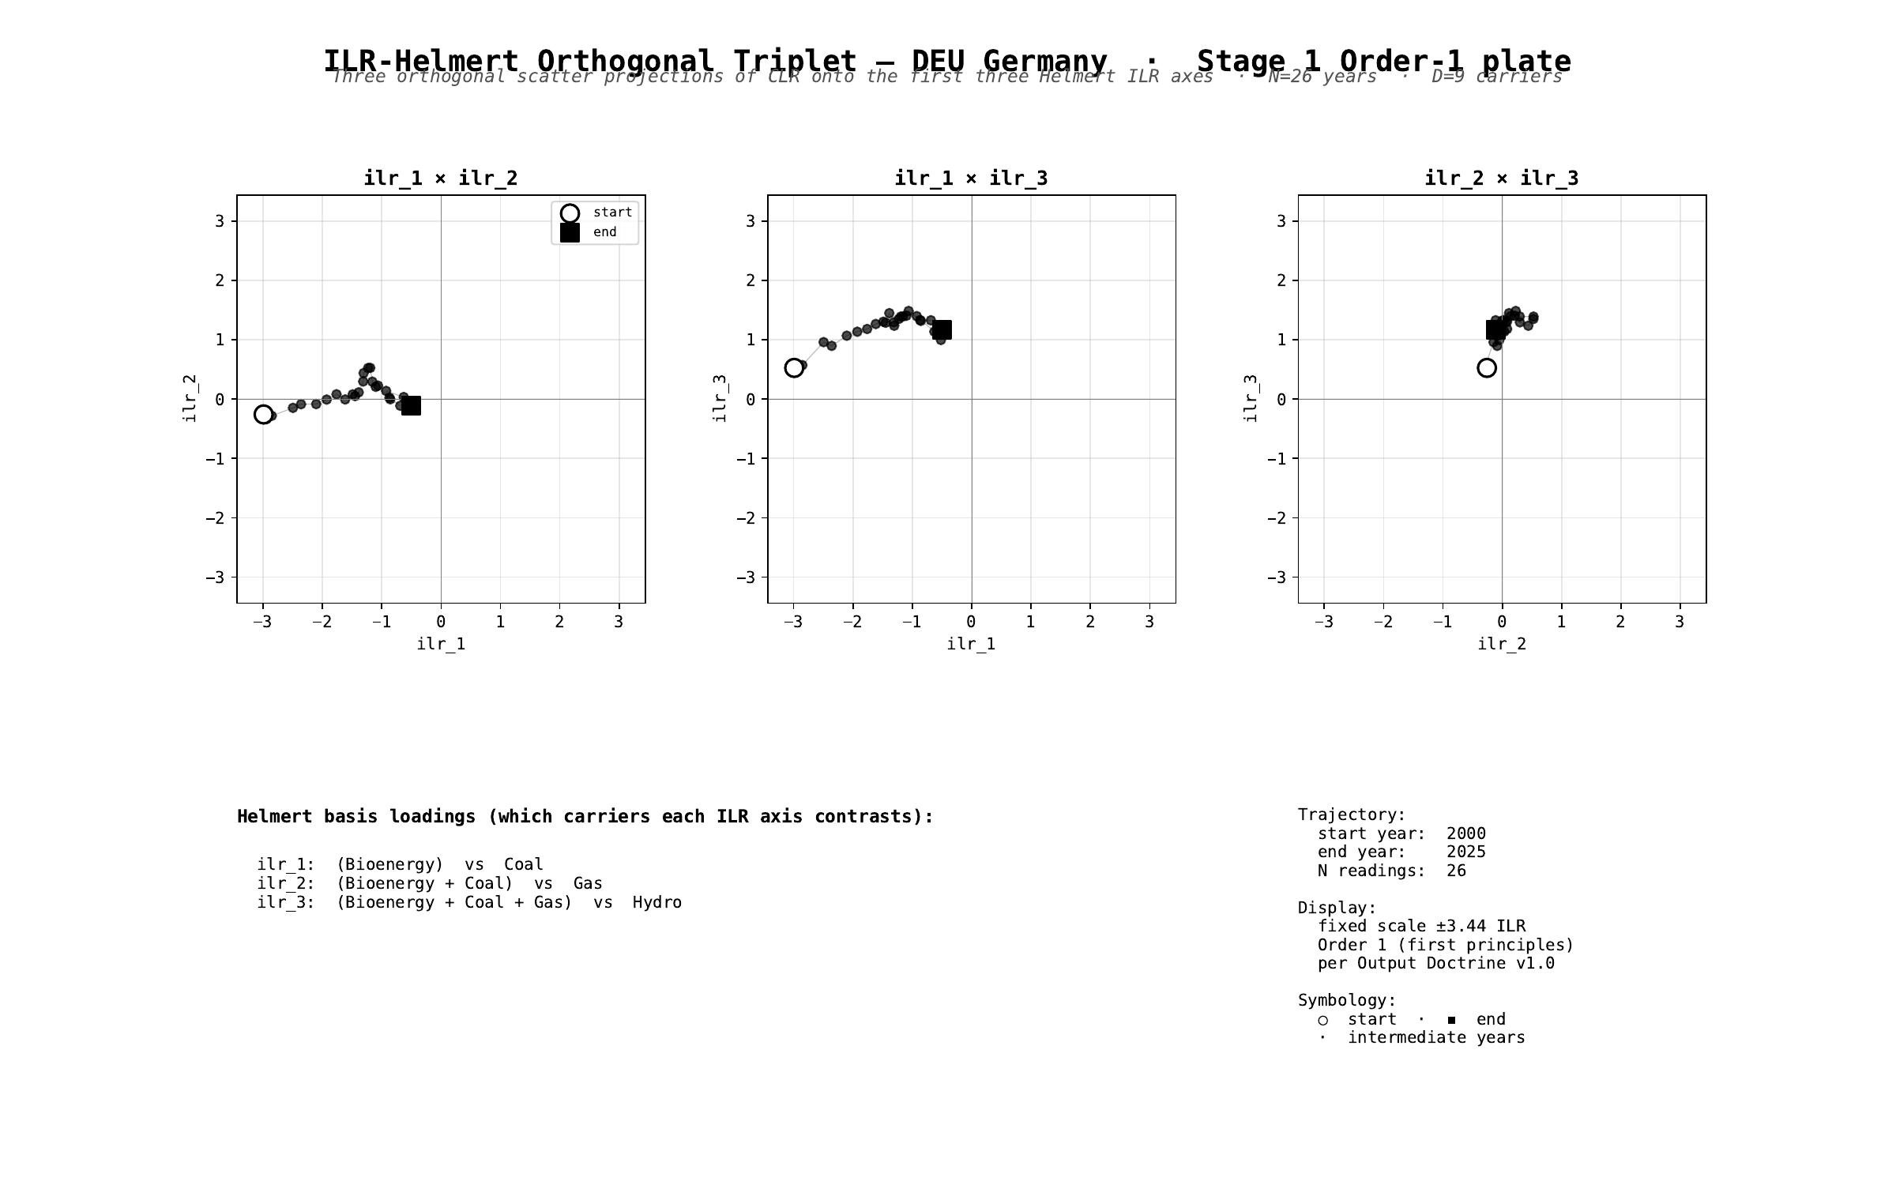
§ DEU Germany · Stage 1 - ILR-Helmert Triplet (orthonormal companion view)
CNT v3.1.0 + CNQ v2.0.0 · DEU · HUF-STD-002 link 4 vector output

Slide 23
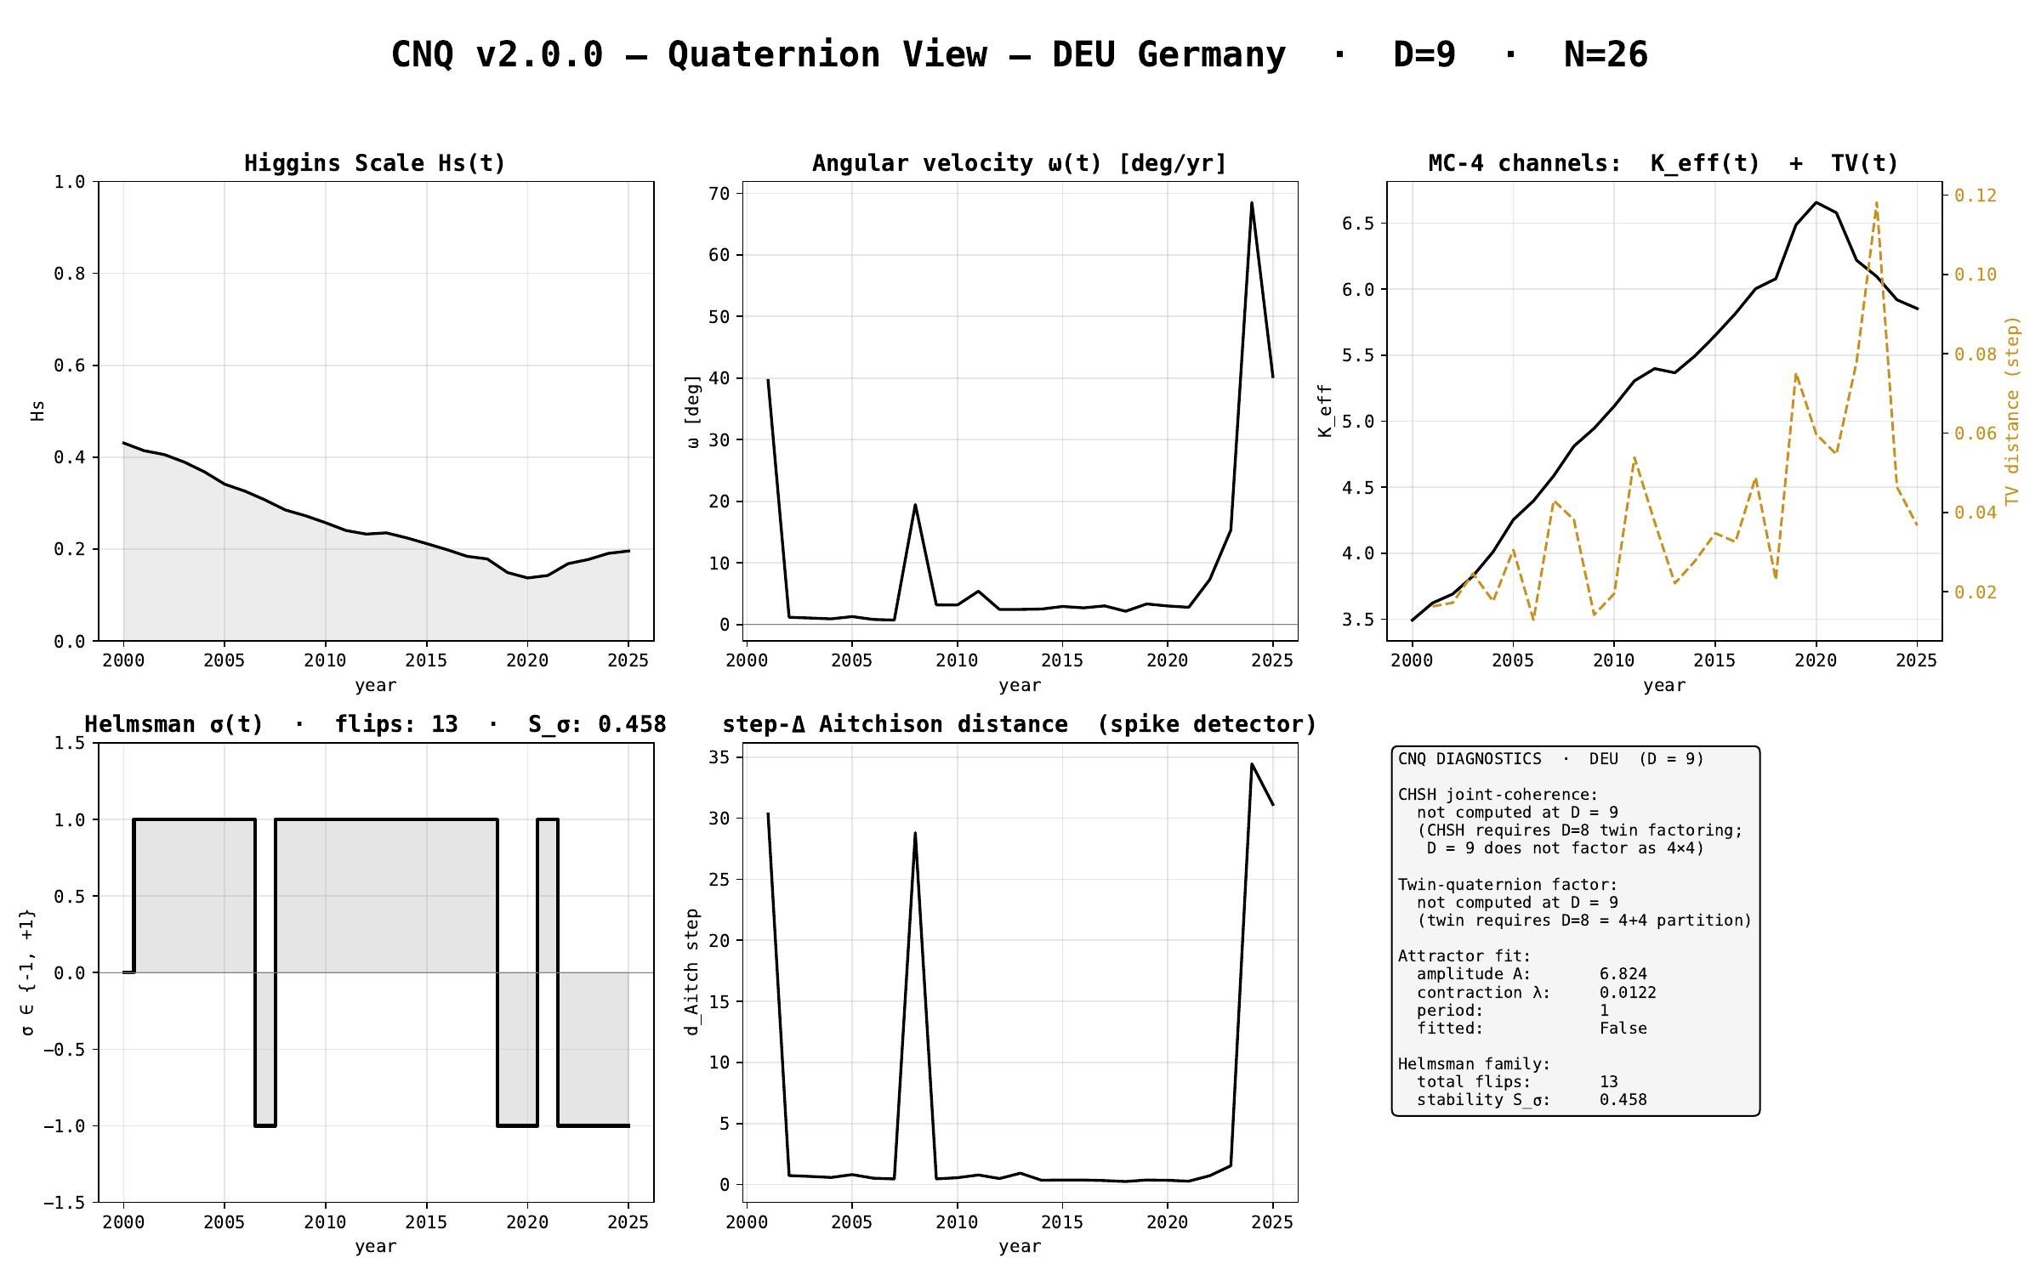
§ DEU Germany · CNQ v2.0.0 - quaternion-view dashboard
CNT v3.1.0 + CNQ v2.0.0 · DEU · HUF-STD-002 link 4 vector output

Slide 24
§ FRA France
EMBER electricity-generation series · 2000-2025 · N = 26 · D = 9
Stage 1 plates (Section + Triplet) · Stage 2/3 navigation · CNQ quaternion view

Slide 25
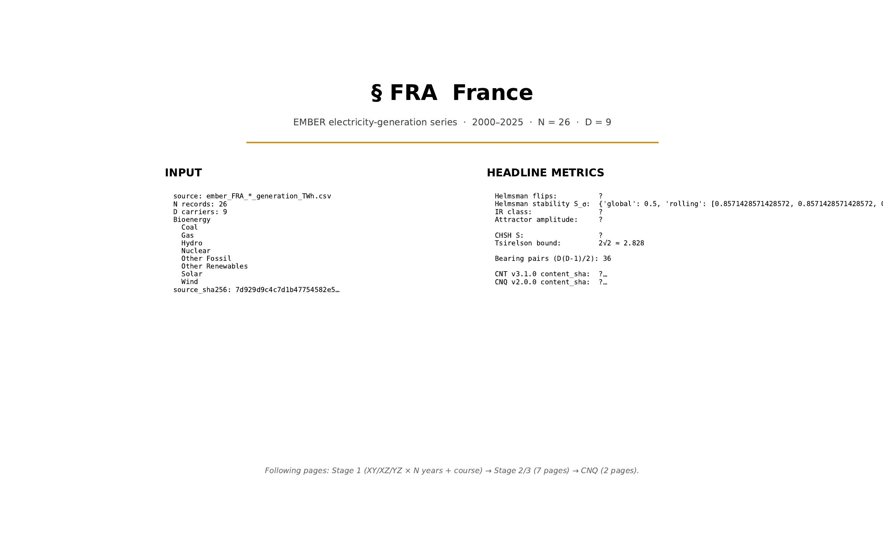
§ FRA France · cover
CNT v3.1.0 + CNQ v2.0.0 · FRA · HUF-STD-002 link 4 vector output

Slide 26
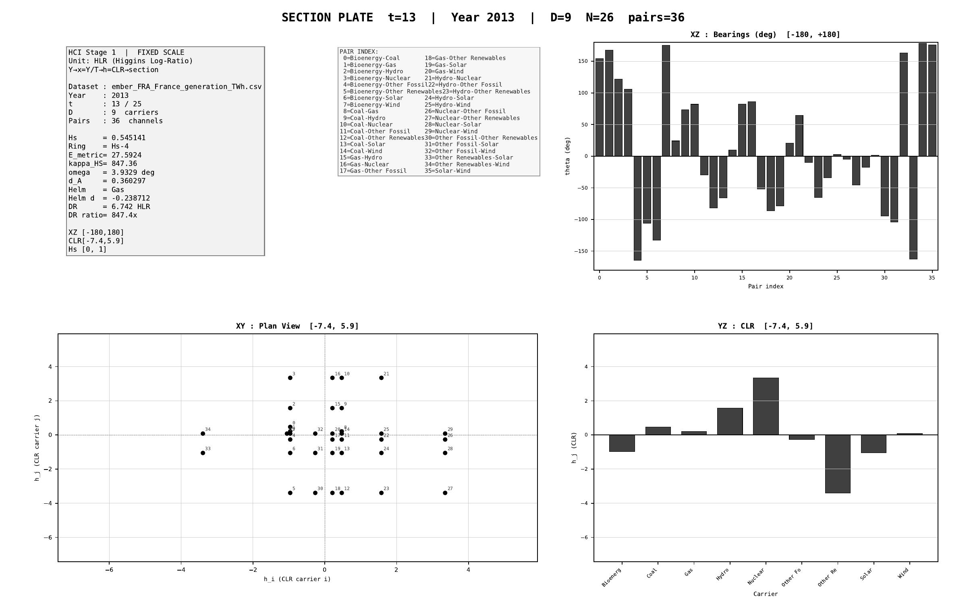
§ FRA France · Stage 1 - XY/XZ/YZ orthogonal projections (representative year)
CNT v3.1.0 + CNQ v2.0.0 · FRA · HUF-STD-002 link 4 vector output

Slide 27
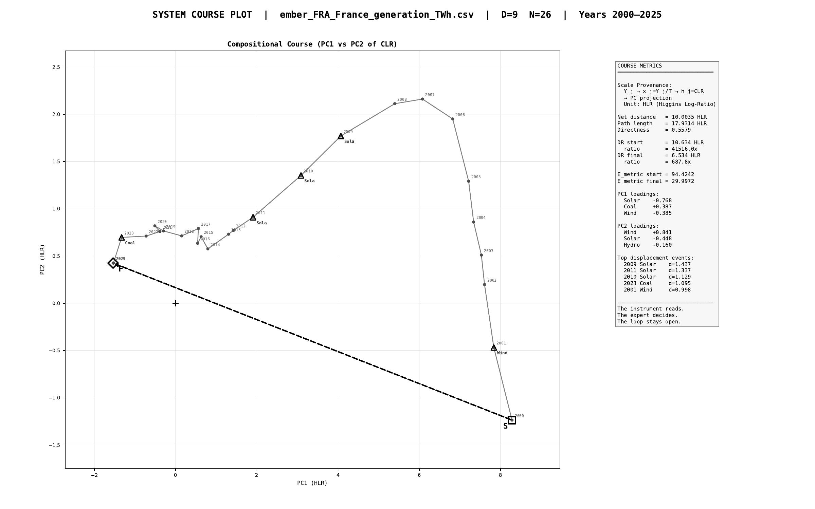
§ FRA France · Stage 1 - course plot (full trajectory 2000-2025)
CNT v3.1.0 + CNQ v2.0.0 · FRA · HUF-STD-002 link 4 vector output

Slide 28
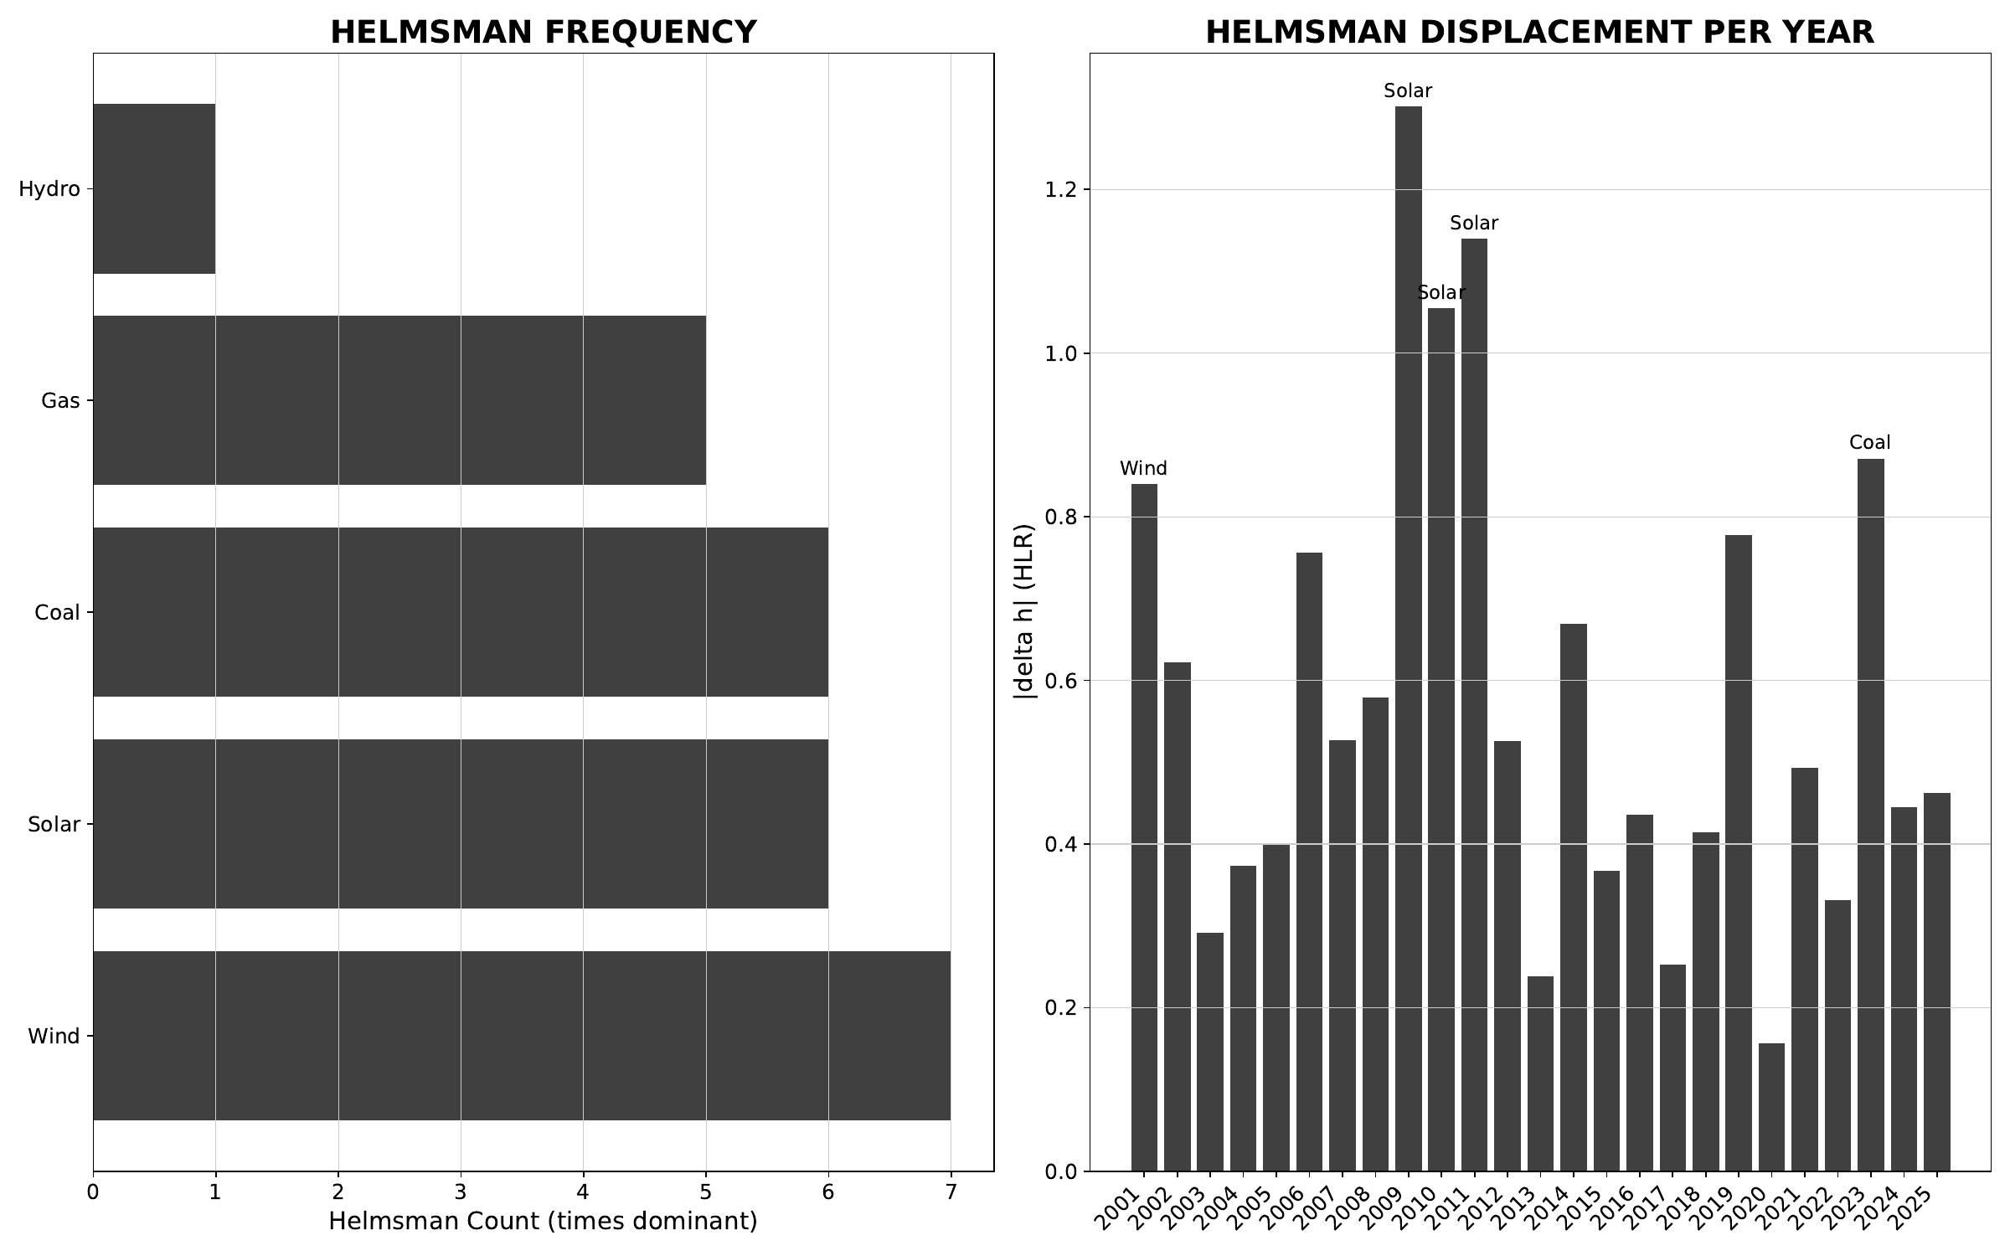
§ FRA France · Stage 2/3 - helmsman frequency + carrier attribution
CNT v3.1.0 + CNQ v2.0.0 · FRA · HUF-STD-002 link 4 vector output

Slide 29
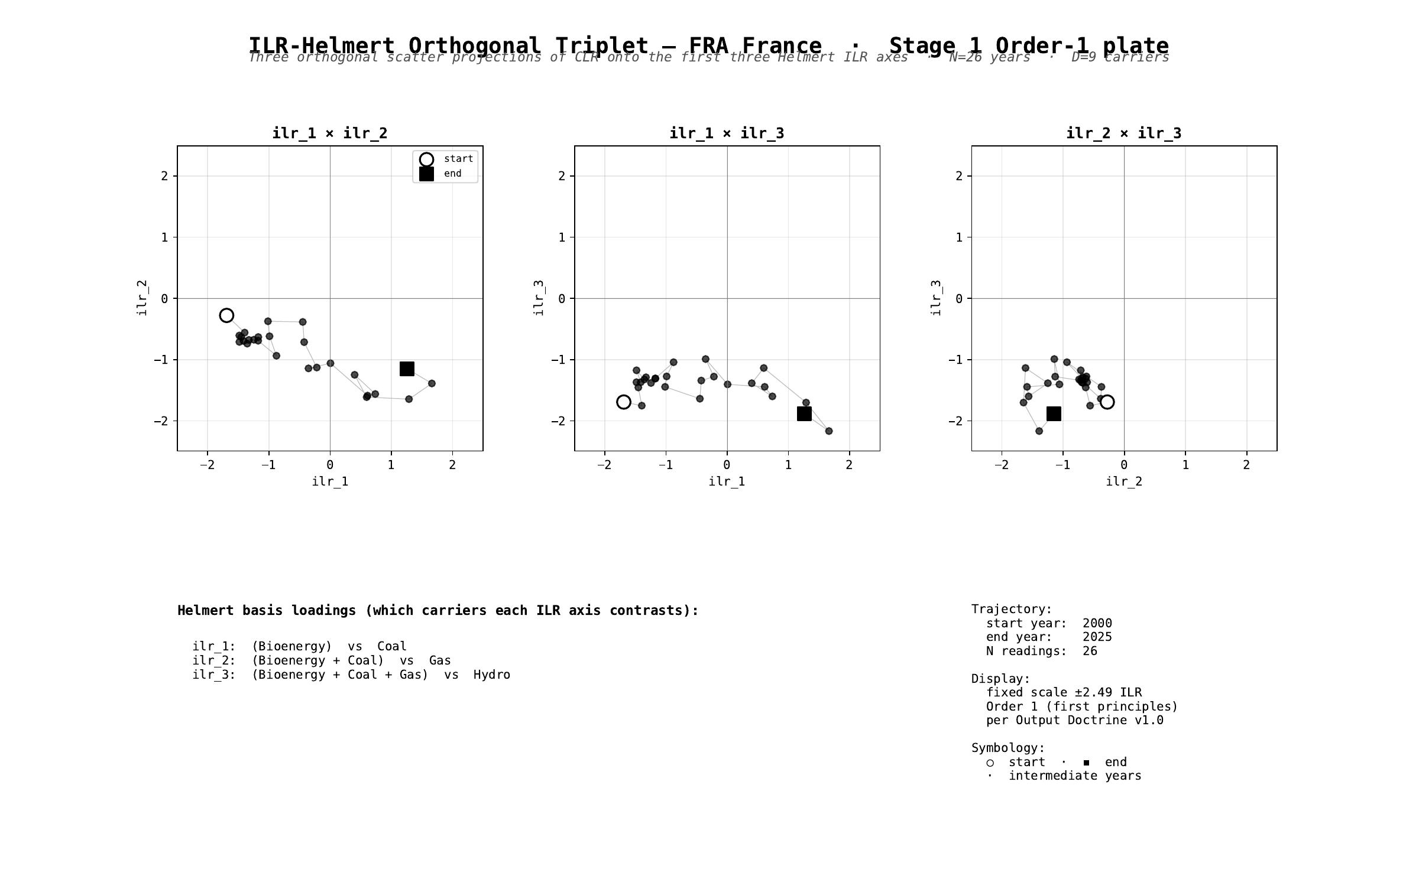
§ FRA France · Stage 1 - ILR-Helmert Triplet (orthonormal companion view)
CNT v3.1.0 + CNQ v2.0.0 · FRA · HUF-STD-002 link 4 vector output

Slide 30
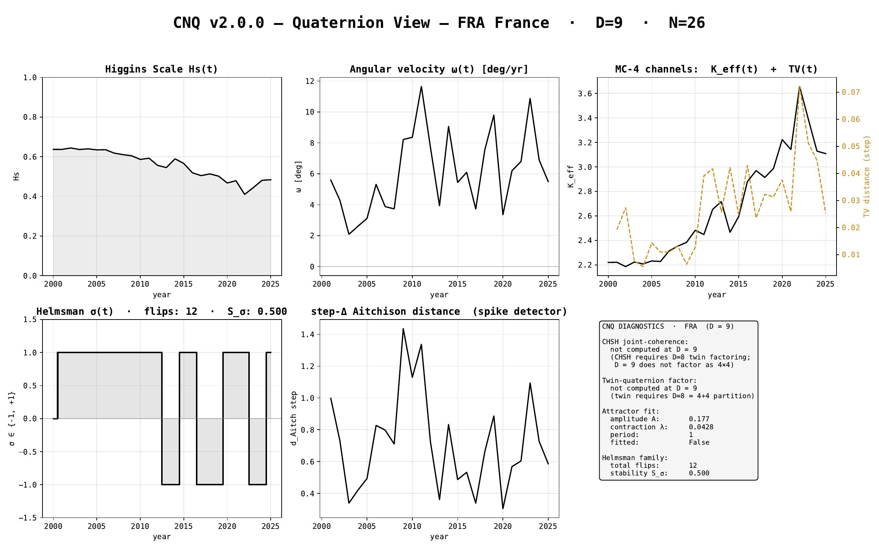
§ FRA France · CNQ v2.0.0 - quaternion-view dashboard
CNT v3.1.0 + CNQ v2.0.0 · FRA · HUF-STD-002 link 4 vector output

Slide 31
§ GBR United Kingdom
EMBER electricity-generation series · 2000-2025 · N = 26 · D = 9
Stage 1 plates (Section + Triplet) · Stage 2/3 navigation · CNQ quaternion view

Slide 32
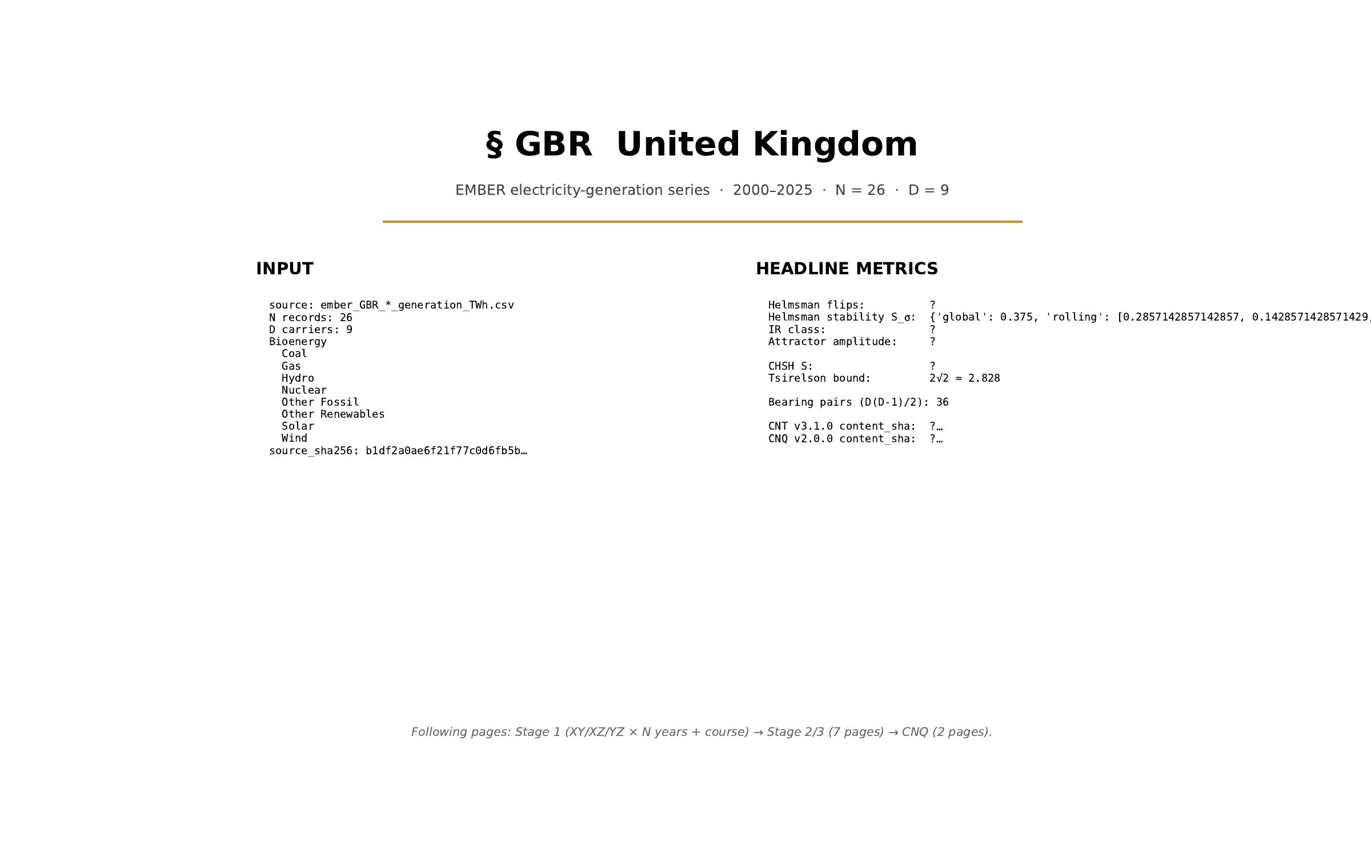
§ GBR United Kingdom · cover
CNT v3.1.0 + CNQ v2.0.0 · GBR · HUF-STD-002 link 4 vector output

Slide 33
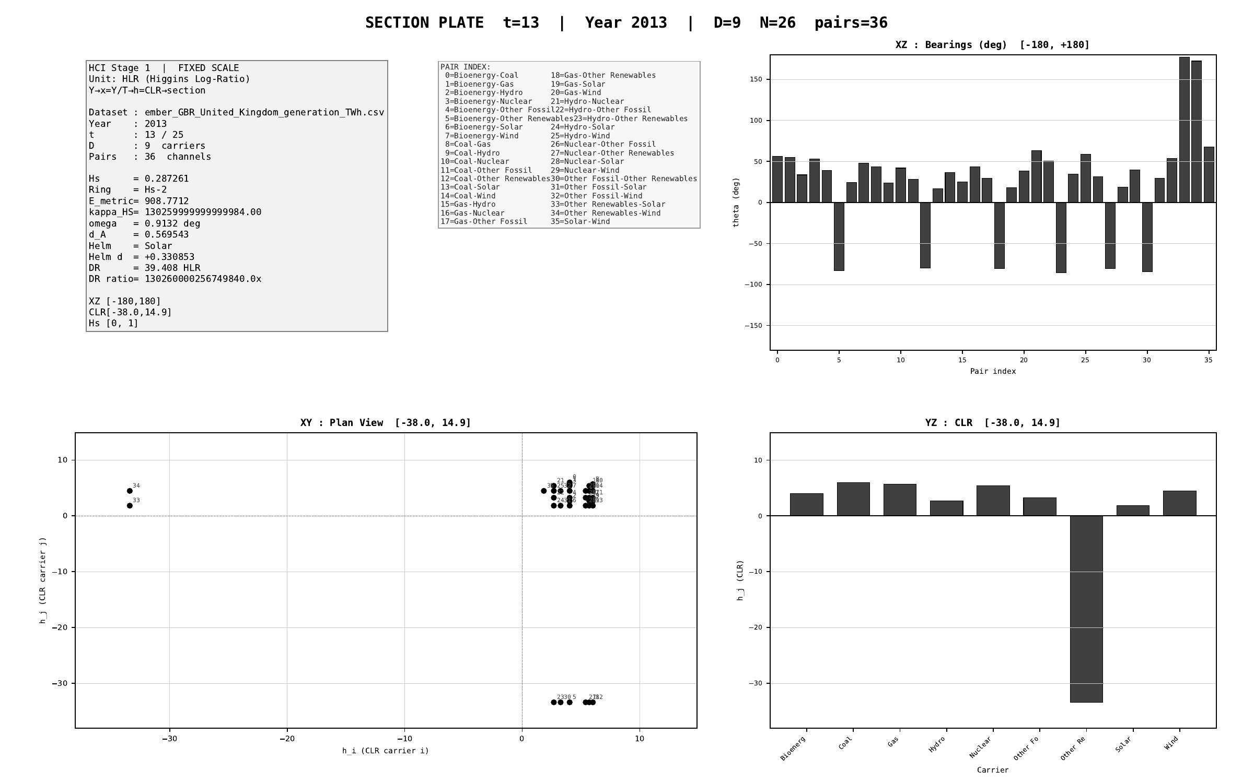
§ GBR United Kingdom · Stage 1 - XY/XZ/YZ orthogonal projections (representative year)
CNT v3.1.0 + CNQ v2.0.0 · GBR · HUF-STD-002 link 4 vector output

Slide 34
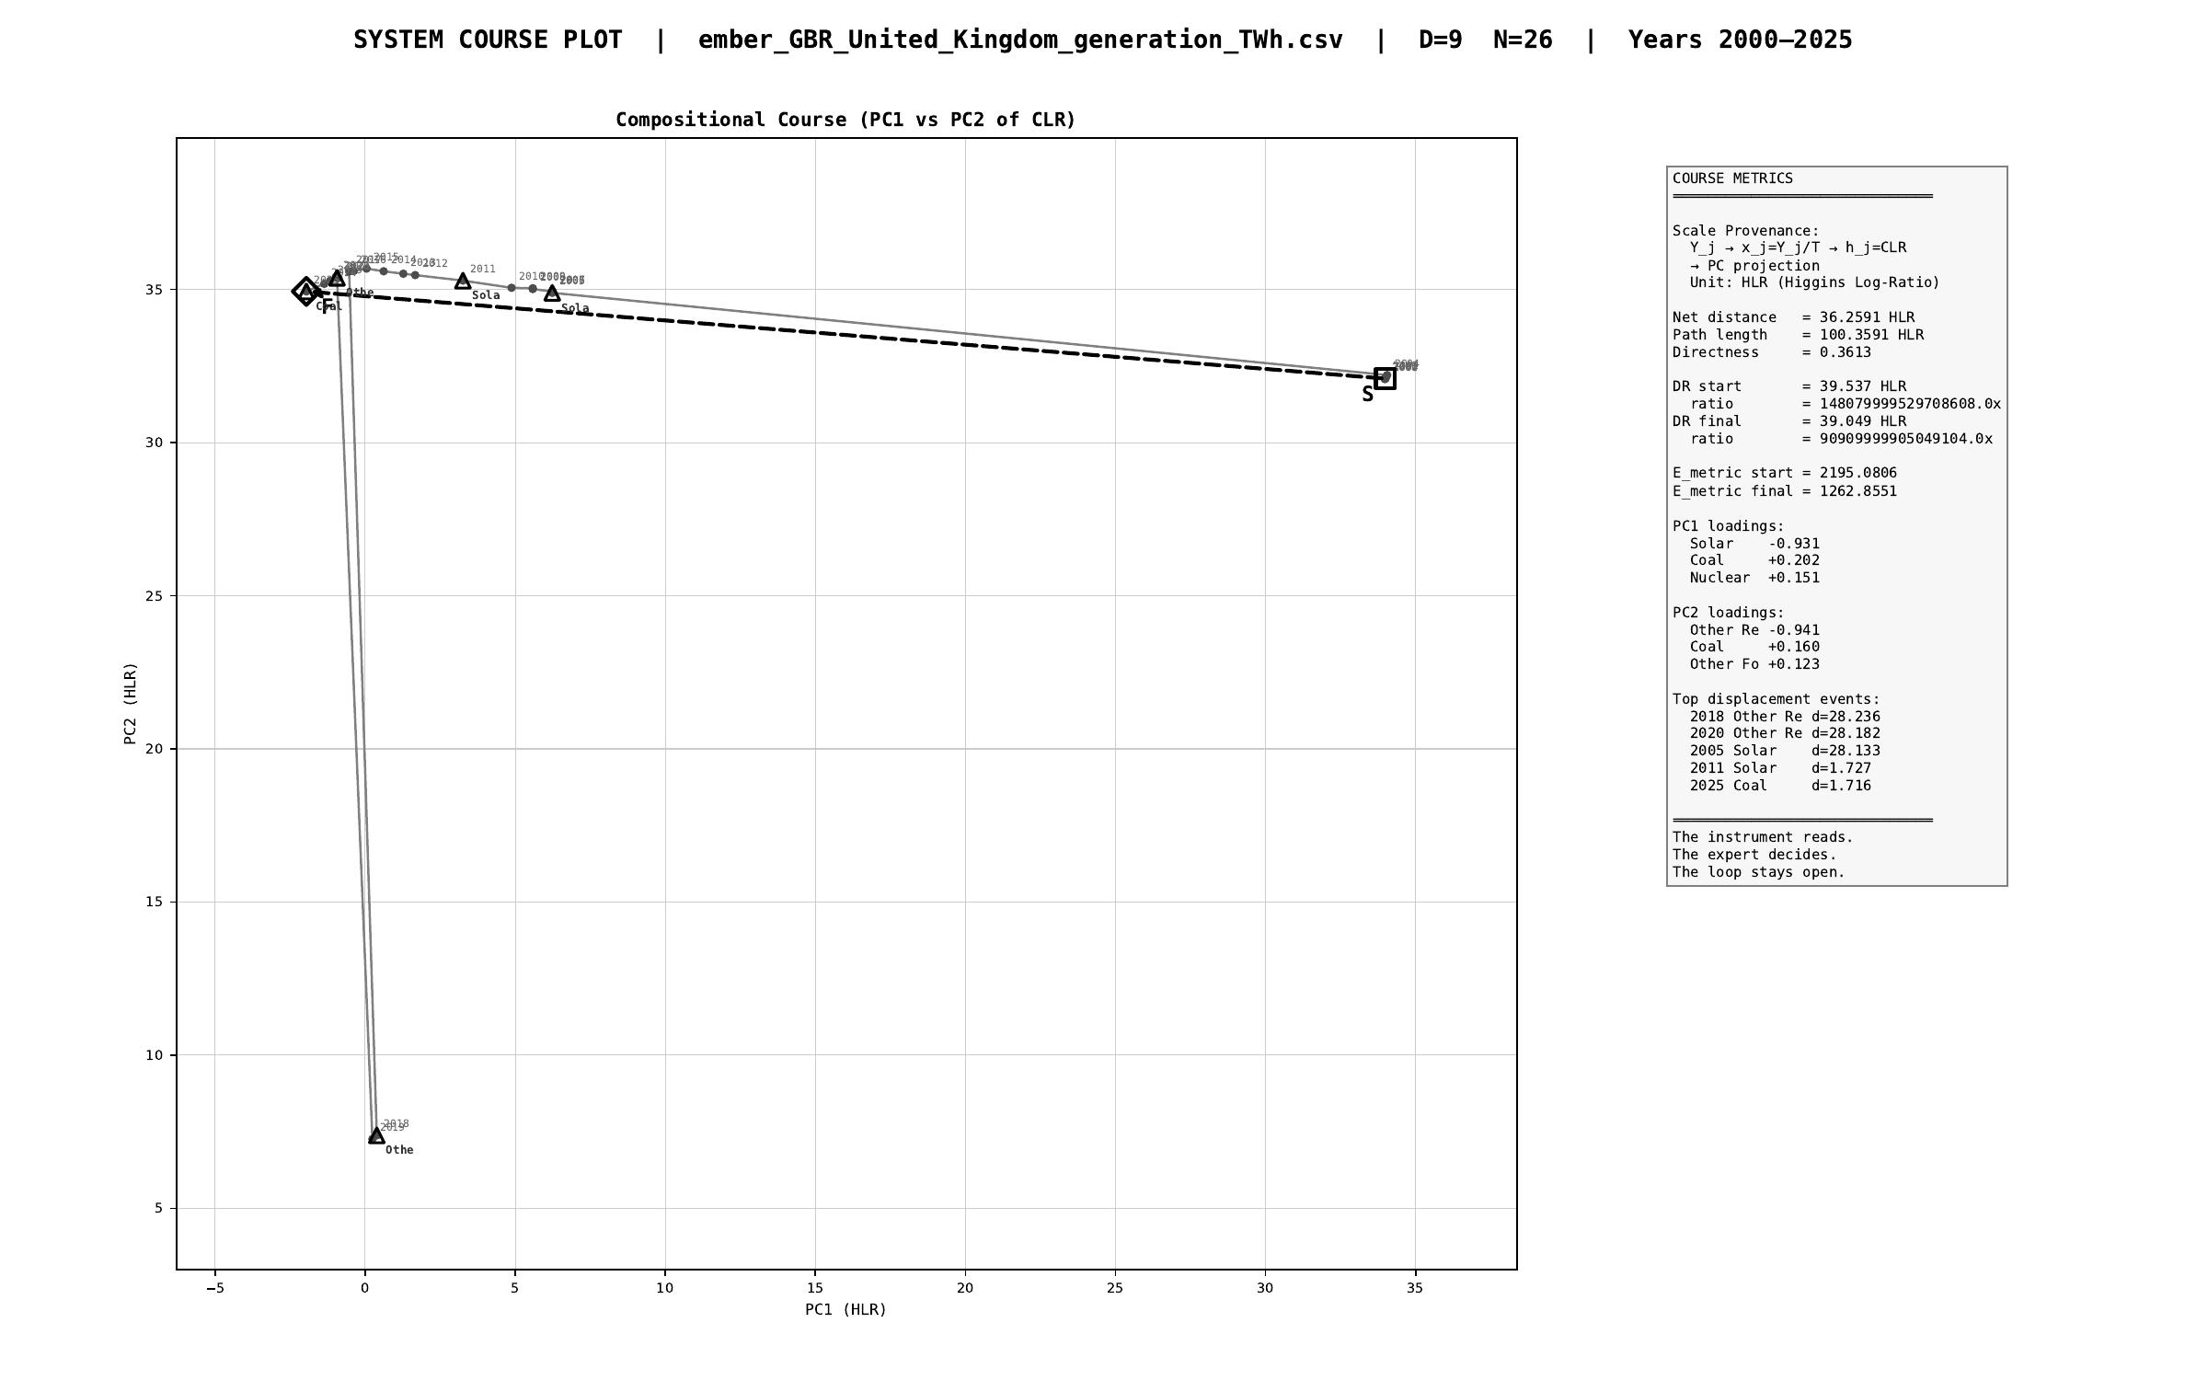
§ GBR United Kingdom · Stage 1 - course plot (full trajectory 2000-2025)
CNT v3.1.0 + CNQ v2.0.0 · GBR · HUF-STD-002 link 4 vector output

Slide 35
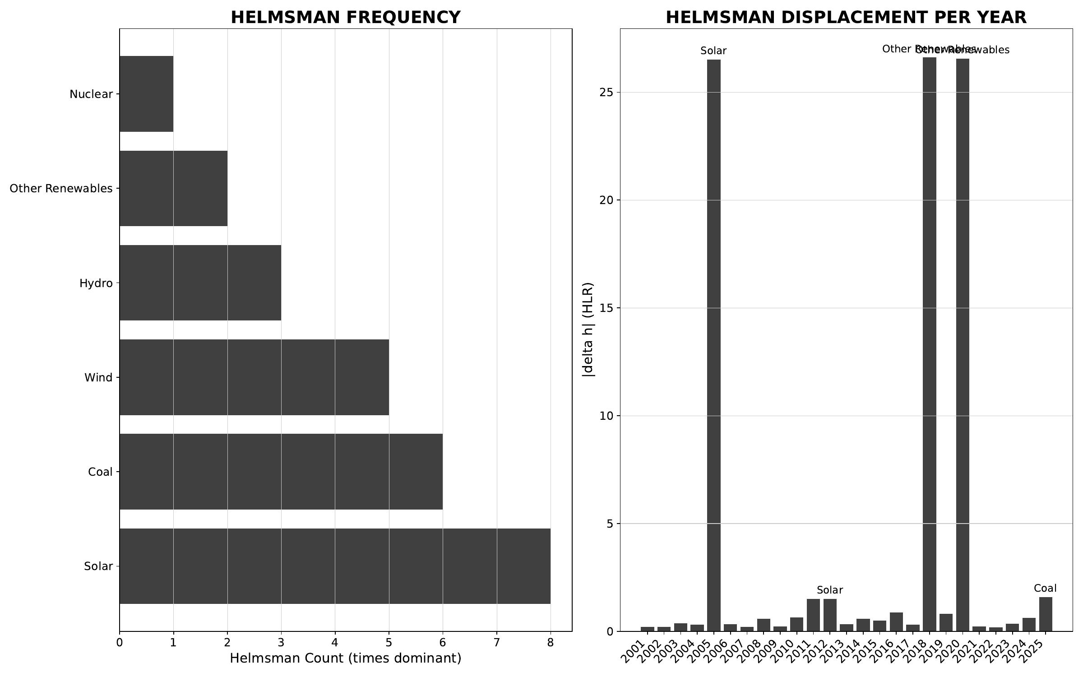
§ GBR United Kingdom · Stage 2/3 - helmsman frequency + carrier attribution
CNT v3.1.0 + CNQ v2.0.0 · GBR · HUF-STD-002 link 4 vector output

Slide 36
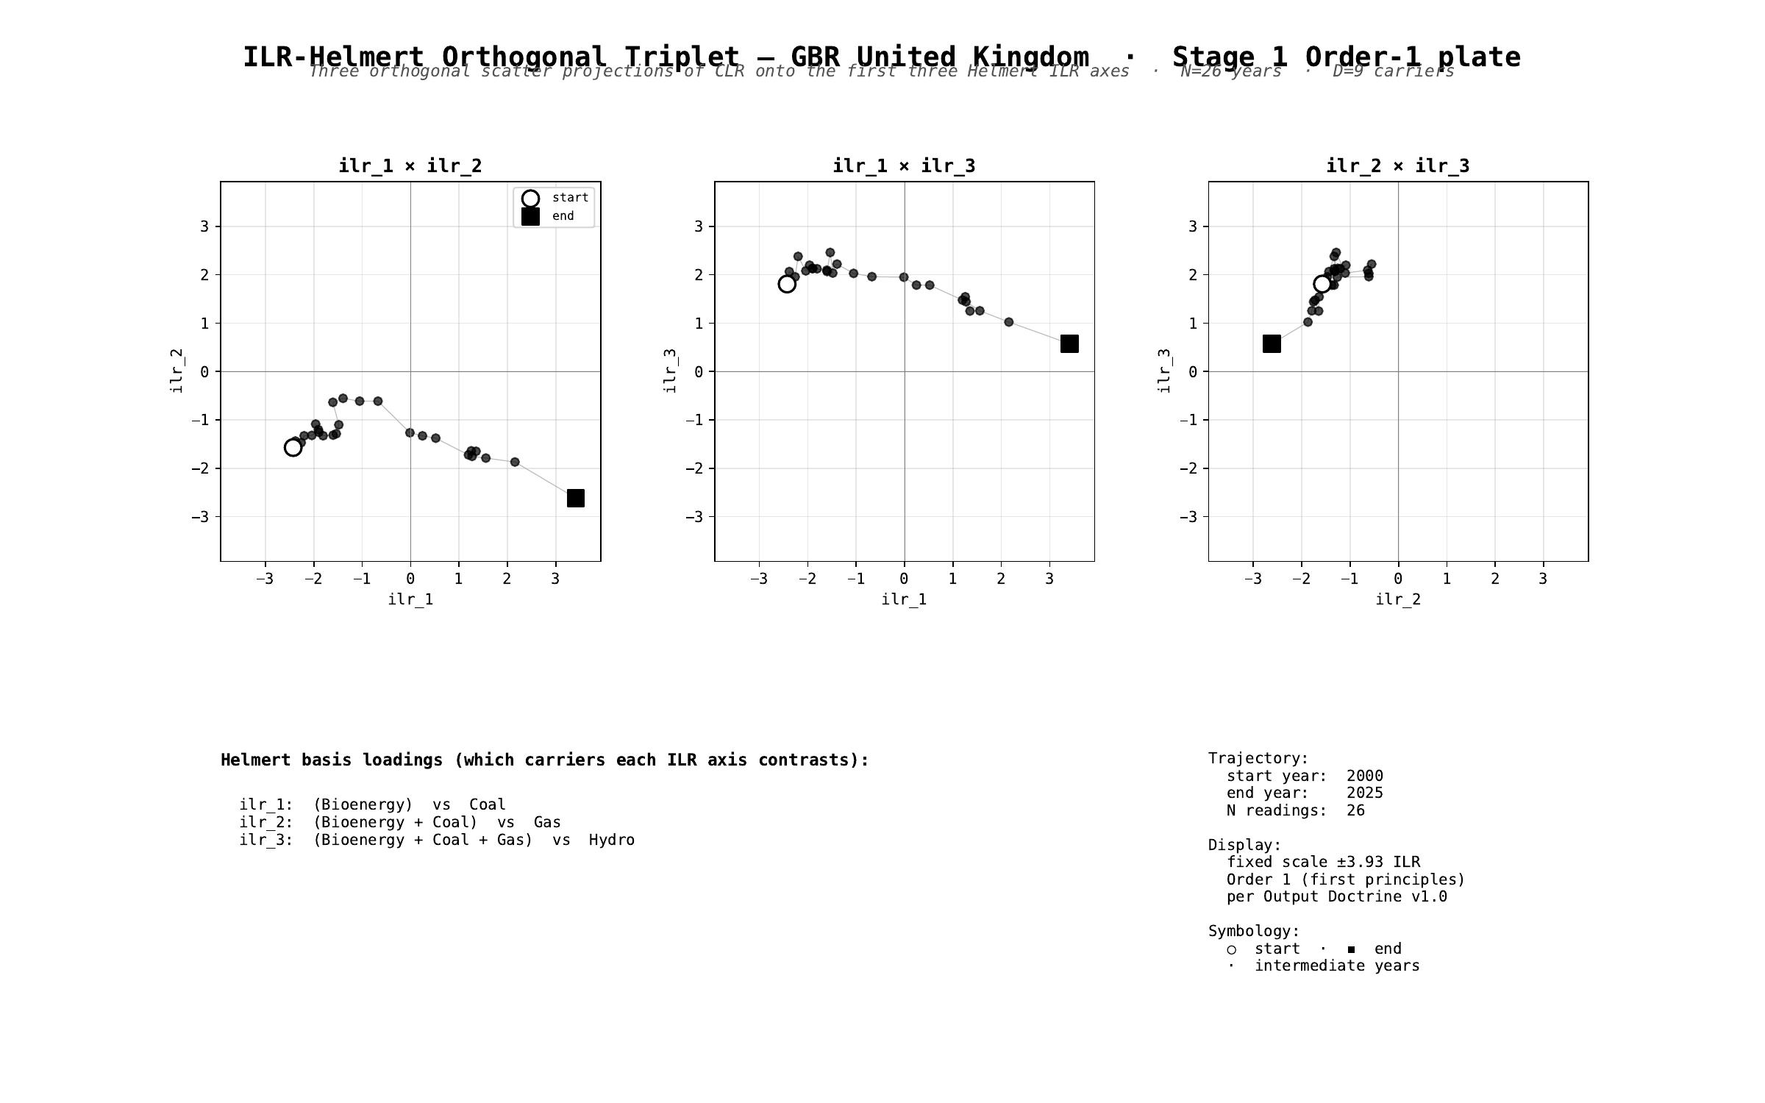
§ GBR United Kingdom · Stage 1 - ILR-Helmert Triplet (orthonormal companion view)
CNT v3.1.0 + CNQ v2.0.0 · GBR · HUF-STD-002 link 4 vector output

Slide 37
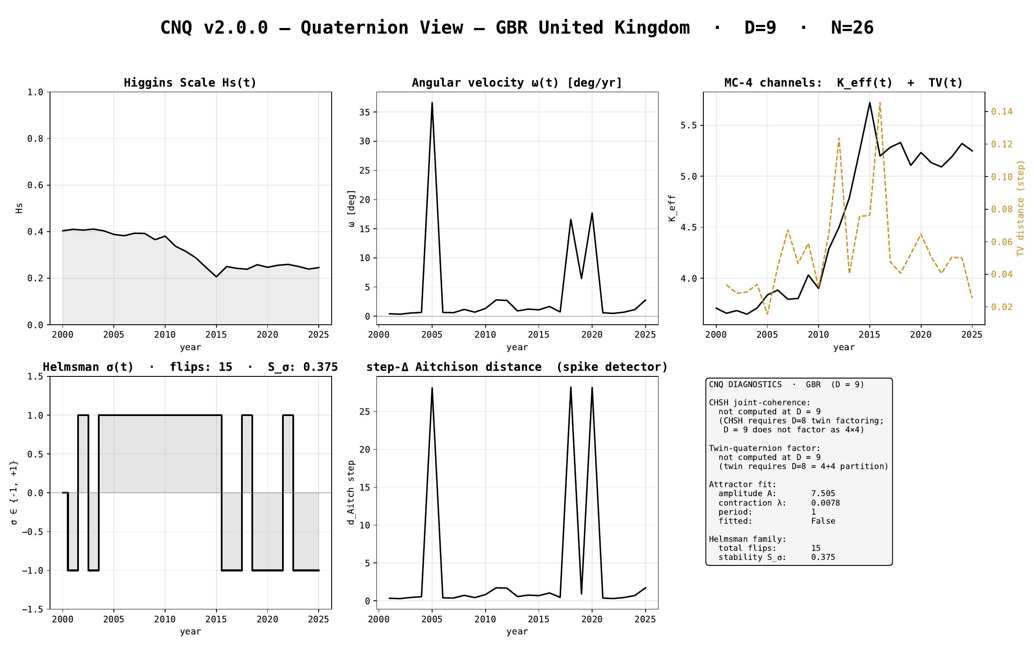
§ GBR United Kingdom · CNQ v2.0.0 - quaternion-view dashboard
CNT v3.1.0 + CNQ v2.0.0 · GBR · HUF-STD-002 link 4 vector output

Slide 38
§ IND India
EMBER electricity-generation series · 2000-2025 · N = 26 · D = 8
Stage 1 plates (Section + Triplet) · Stage 2/3 navigation · CNQ quaternion view

Slide 39

§ IND India · cover
CNT v3.1.0 + CNQ v2.0.0 · IND · HUF-STD-002 link 4 vector output

Slide 40
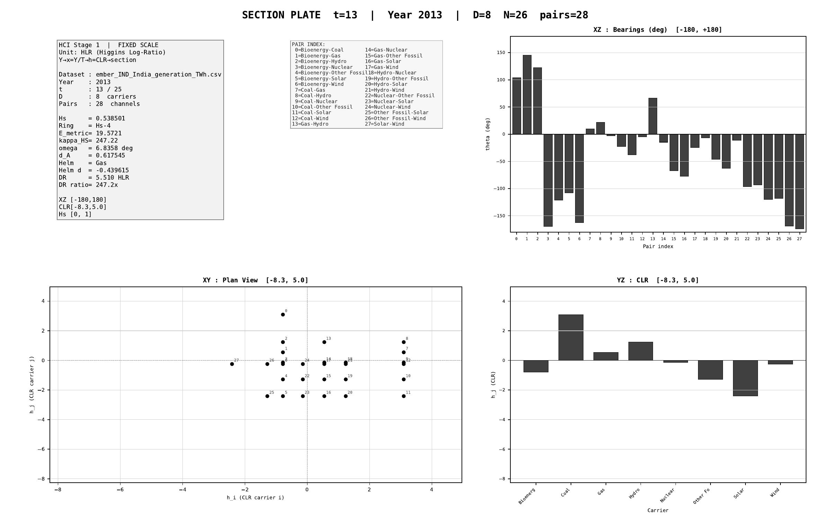
§ IND India · Stage 1 - XY/XZ/YZ orthogonal projections (representative year)
CNT v3.1.0 + CNQ v2.0.0 · IND · HUF-STD-002 link 4 vector output

Slide 41
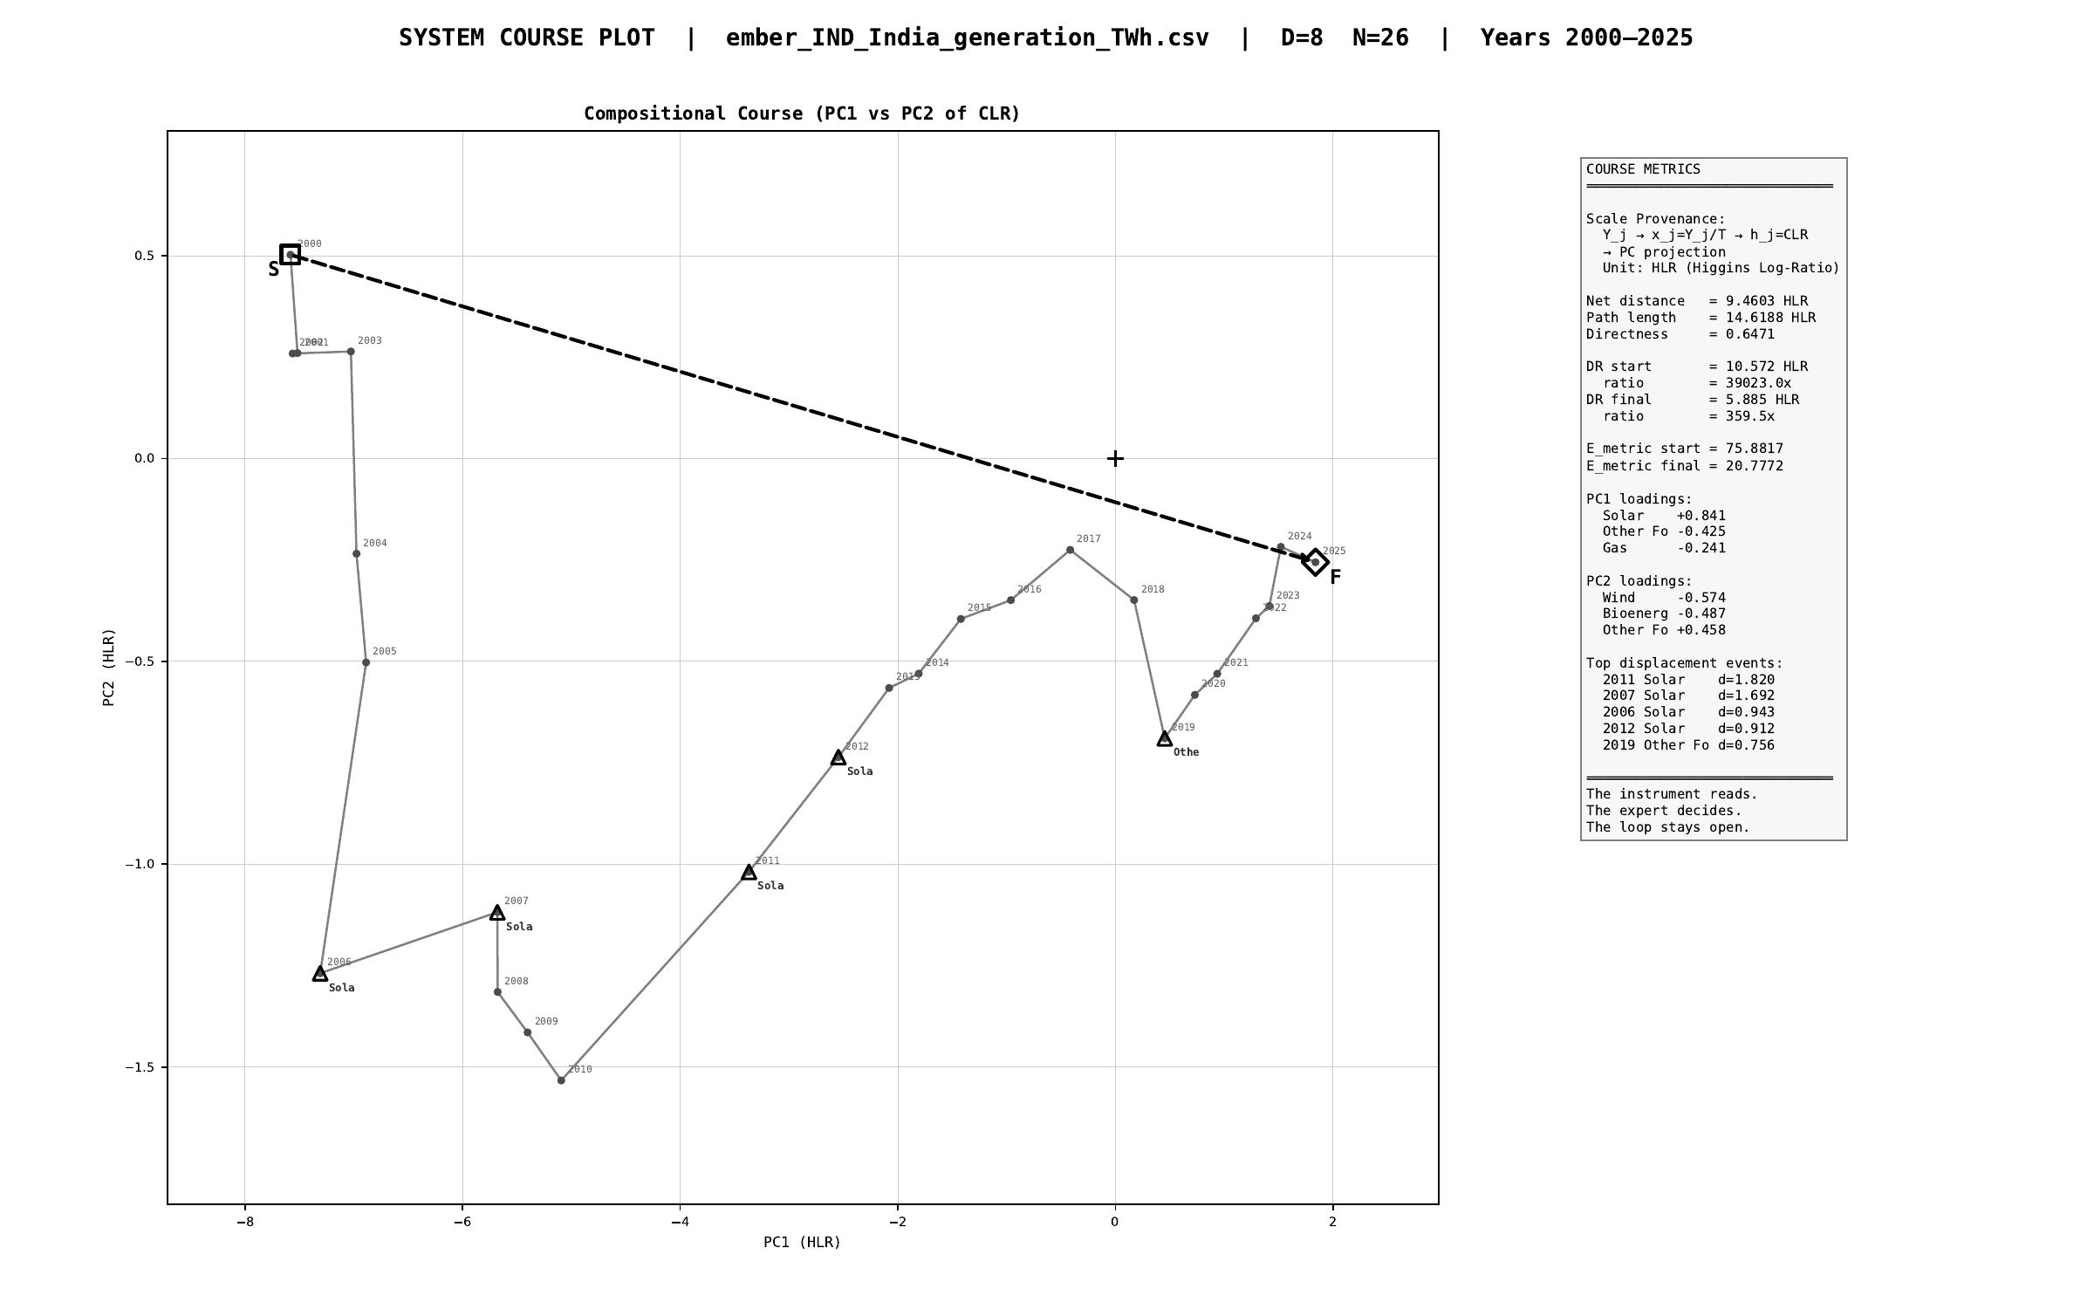
§ IND India · Stage 1 - course plot (full trajectory 2000-2025)
CNT v3.1.0 + CNQ v2.0.0 · IND · HUF-STD-002 link 4 vector output

Slide 42
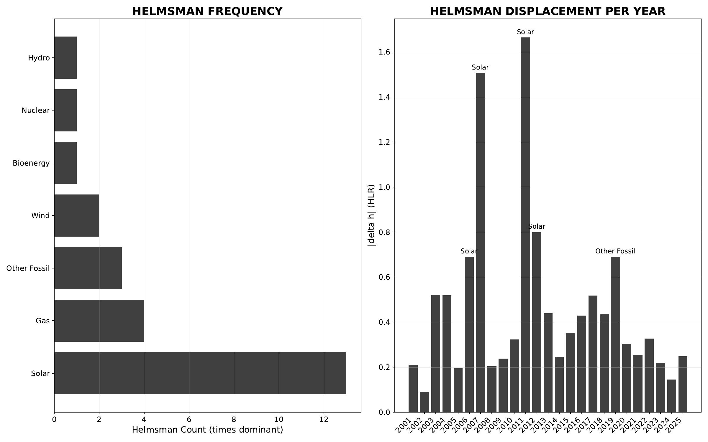
§ IND India · Stage 2/3 - helmsman frequency + carrier attribution
CNT v3.1.0 + CNQ v2.0.0 · IND · HUF-STD-002 link 4 vector output

Slide 43
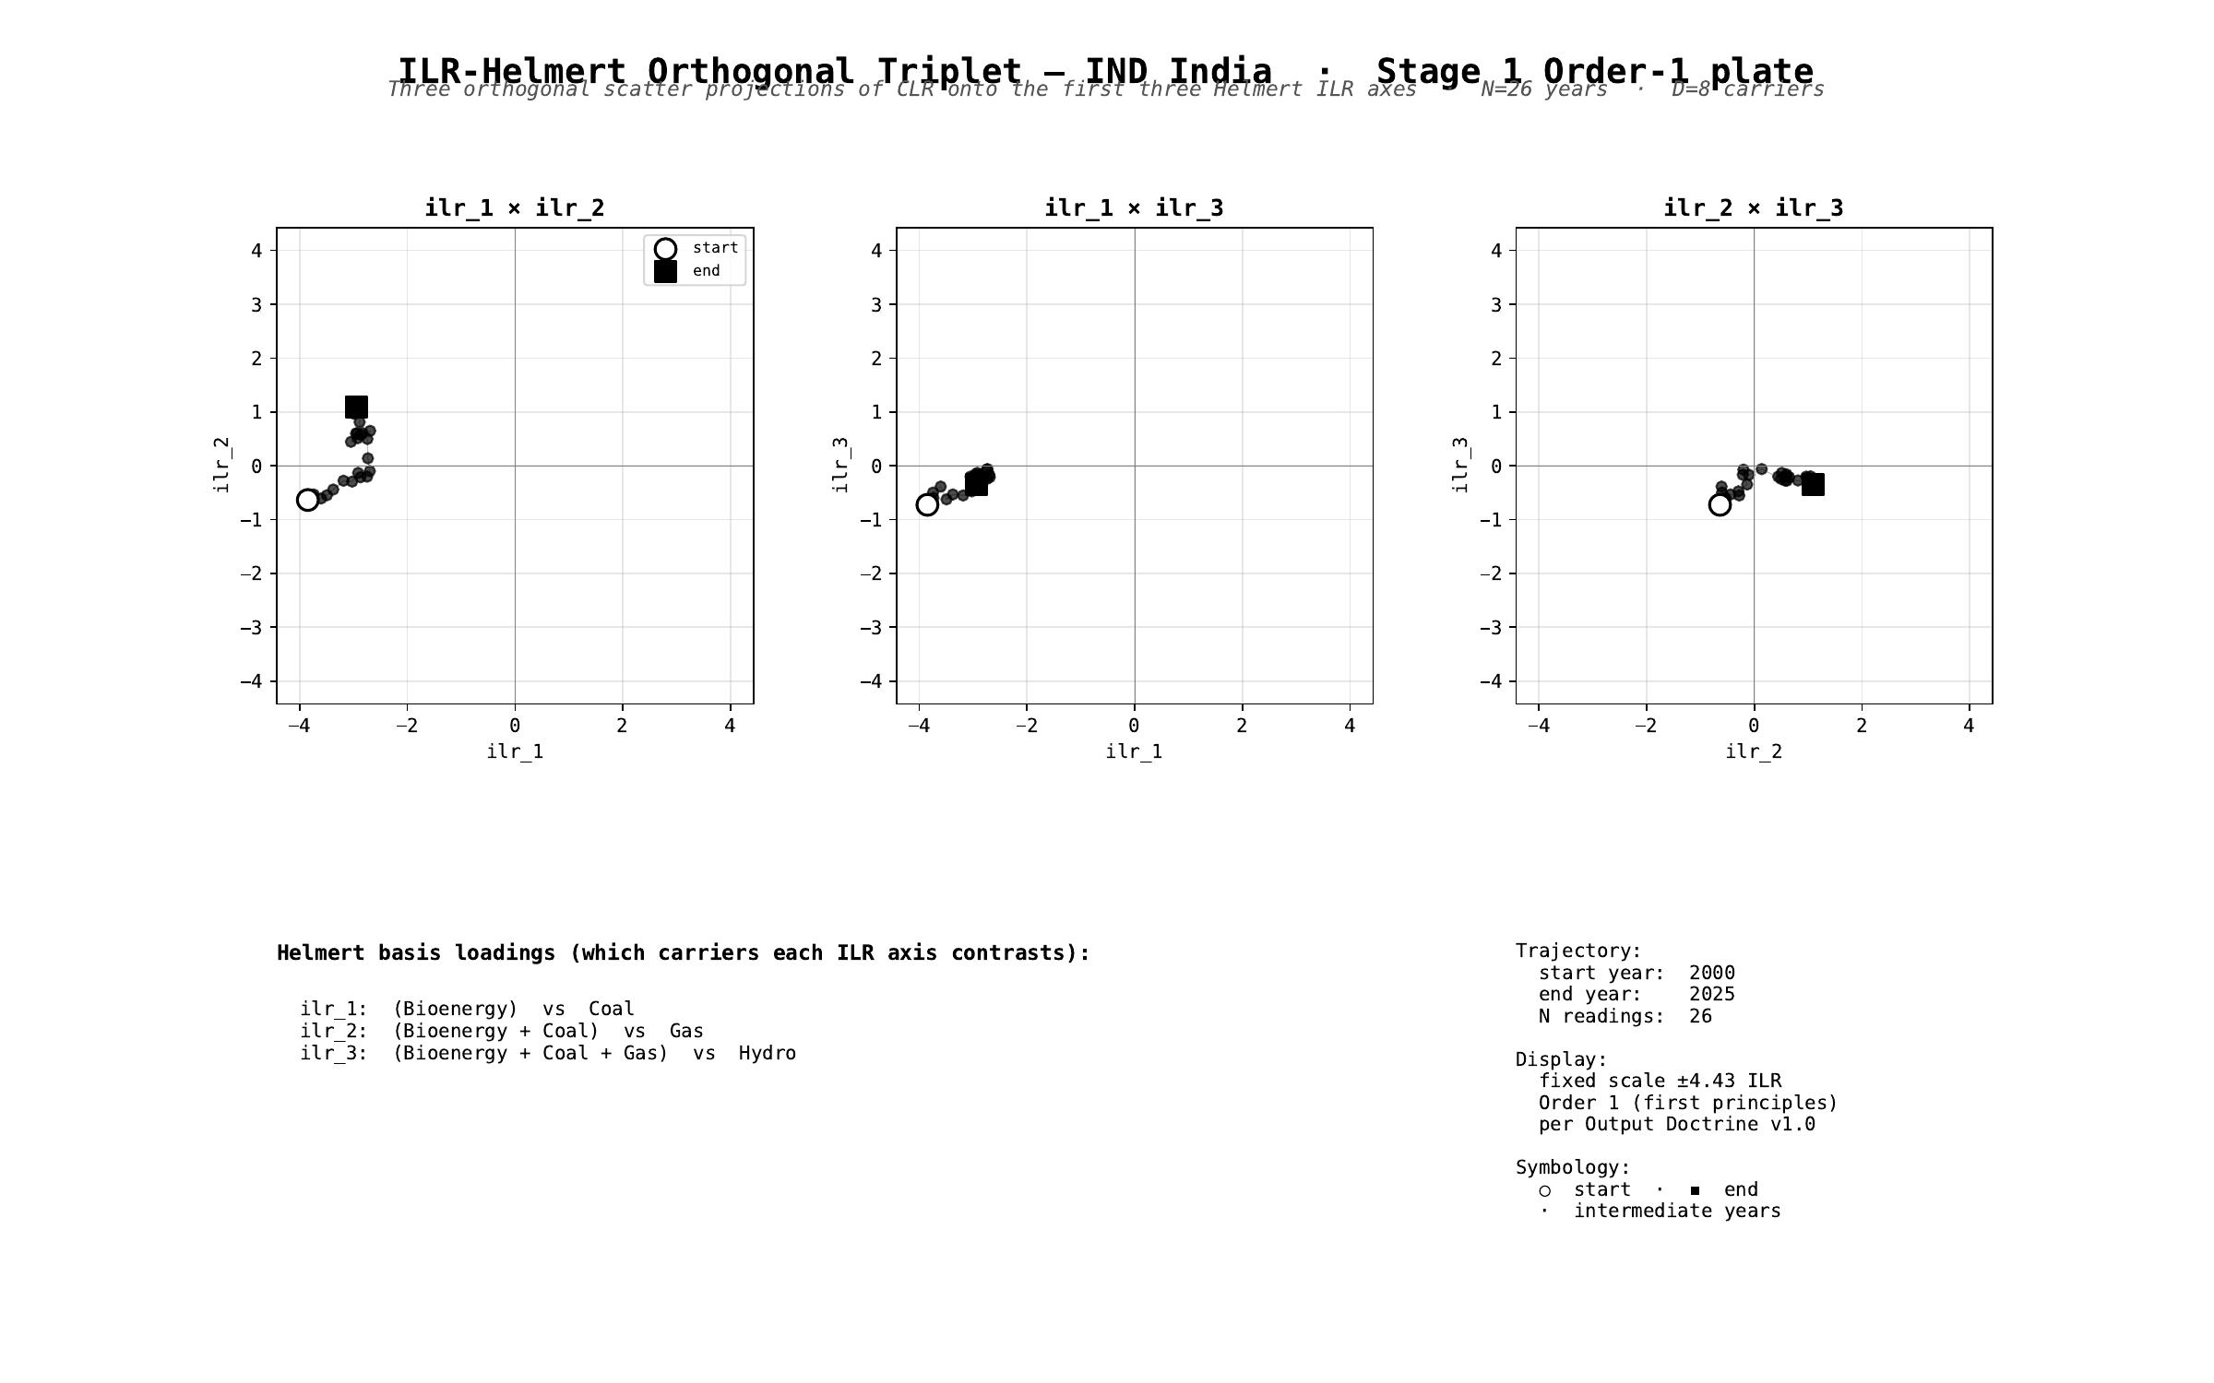
§ IND India · Stage 1 - ILR-Helmert Triplet (orthonormal companion view)
CNT v3.1.0 + CNQ v2.0.0 · IND · HUF-STD-002 link 4 vector output

Slide 44
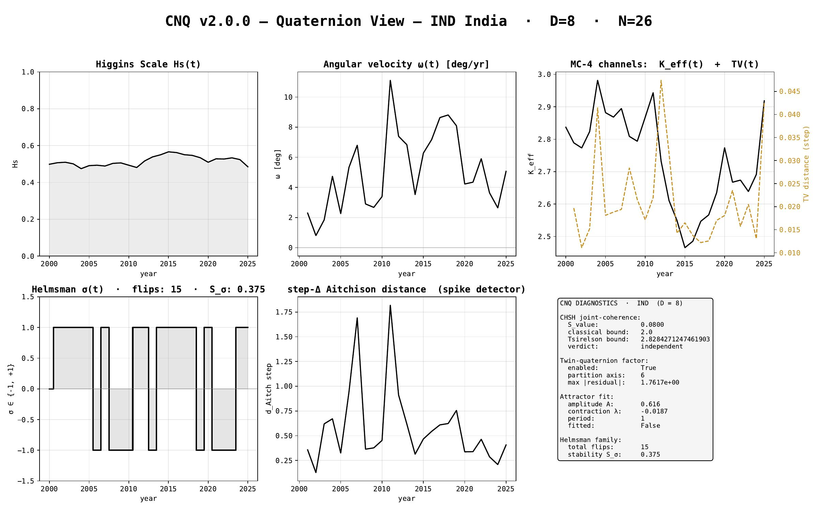
§ IND India · CNQ v2.0.0 - quaternion-view dashboard
CNT v3.1.0 + CNQ v2.0.0 · IND · HUF-STD-002 link 4 vector output

Slide 45
§ JPN Japan
EMBER electricity-generation series · 2000-2025 · N = 26 · D = 8
Stage 1 plates (Section + Triplet) · Stage 2/3 navigation · CNQ quaternion view

Slide 46
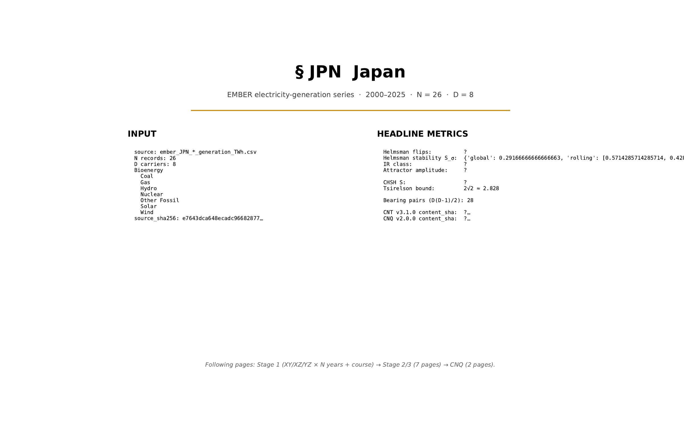
§ JPN Japan · cover
CNT v3.1.0 + CNQ v2.0.0 · JPN · HUF-STD-002 link 4 vector output

Slide 47
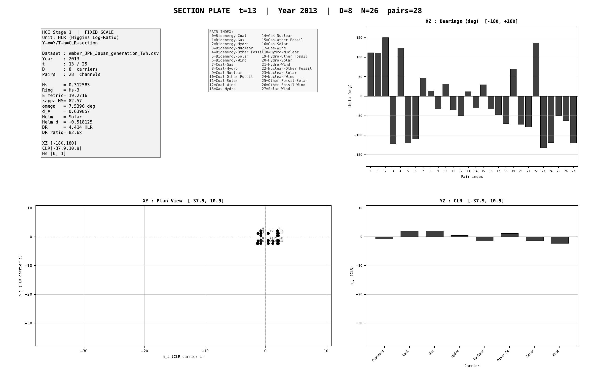
§ JPN Japan · Stage 1 - XY/XZ/YZ orthogonal projections (representative year)
CNT v3.1.0 + CNQ v2.0.0 · JPN · HUF-STD-002 link 4 vector output

Slide 48
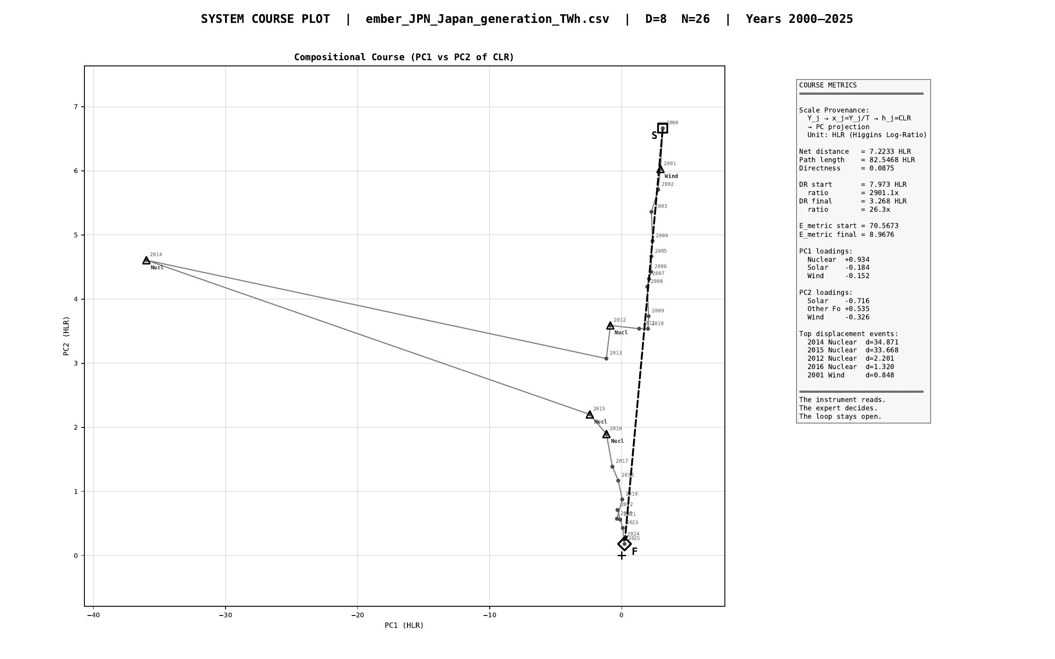
§ JPN Japan · Stage 1 - course plot (full trajectory 2000-2025)
CNT v3.1.0 + CNQ v2.0.0 · JPN · HUF-STD-002 link 4 vector output

Slide 49
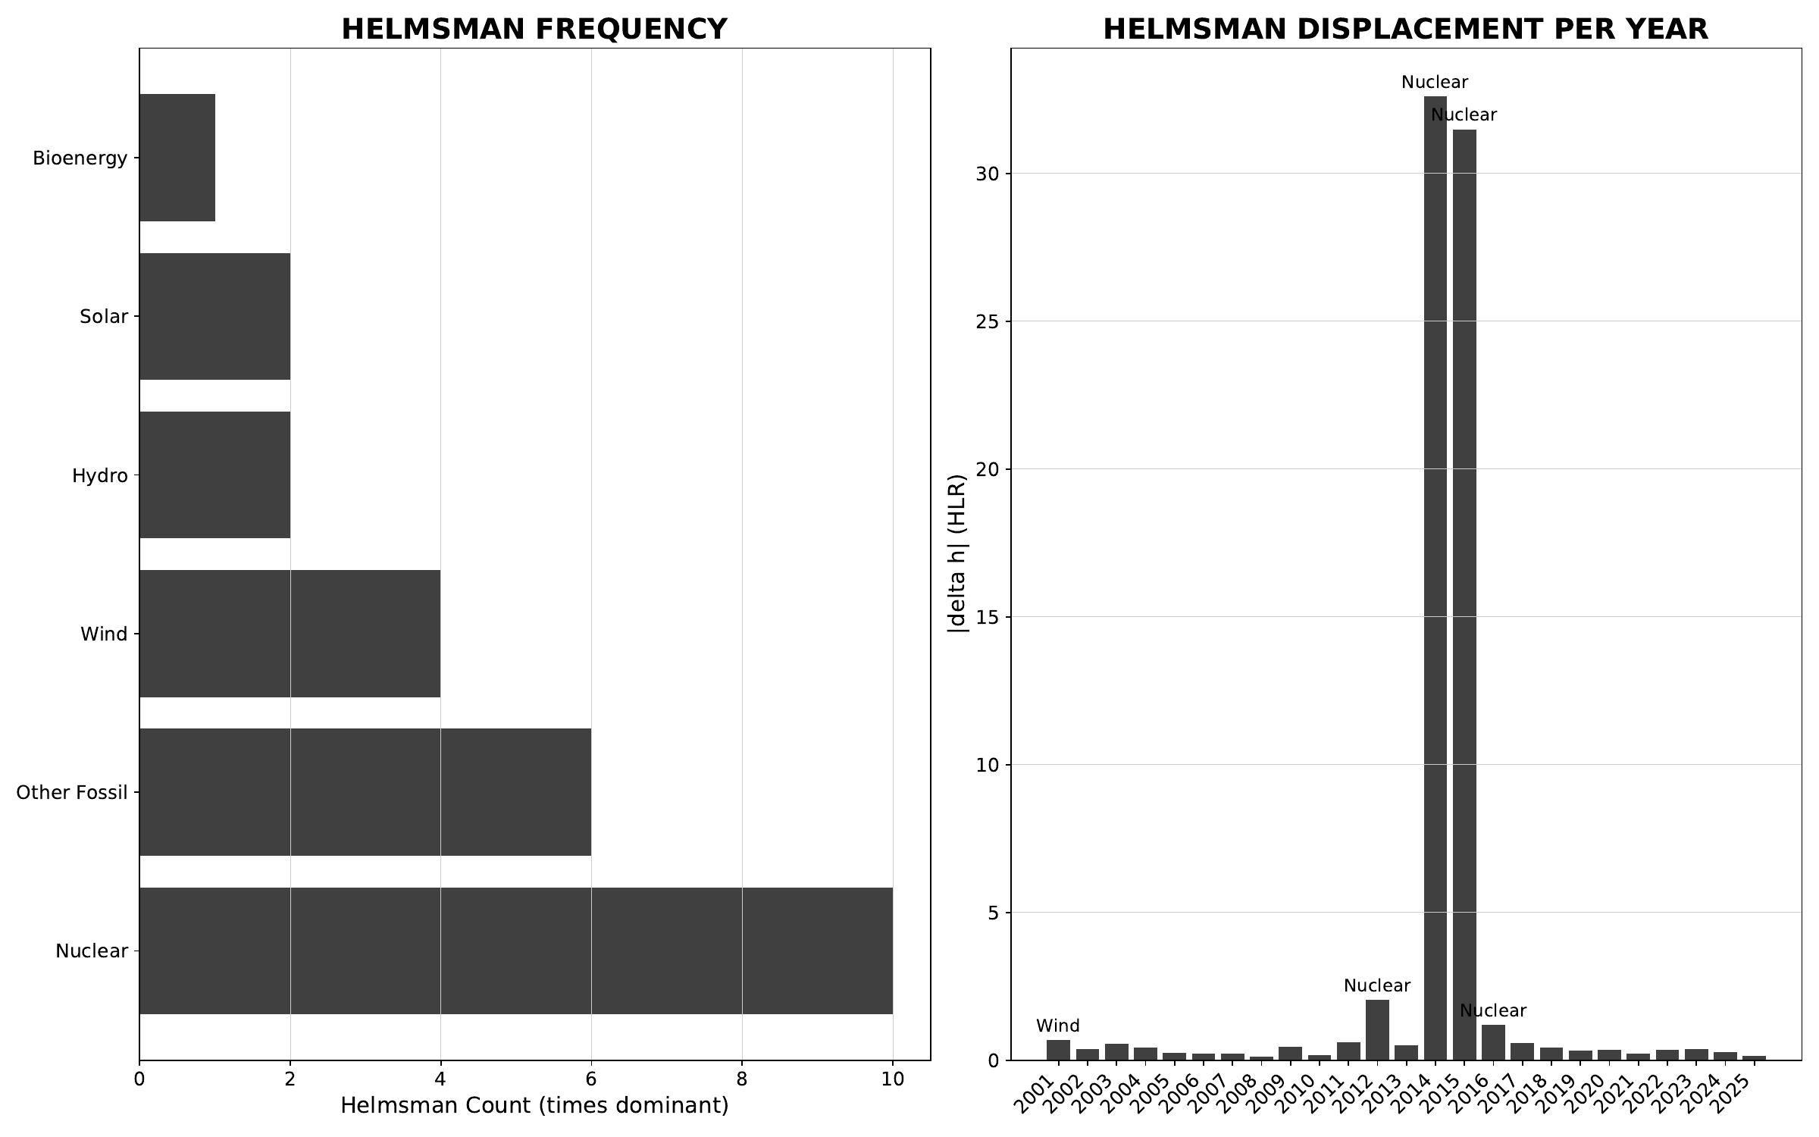
§ JPN Japan · Stage 2/3 - helmsman frequency + carrier attribution
CNT v3.1.0 + CNQ v2.0.0 · JPN · HUF-STD-002 link 4 vector output

Slide 50
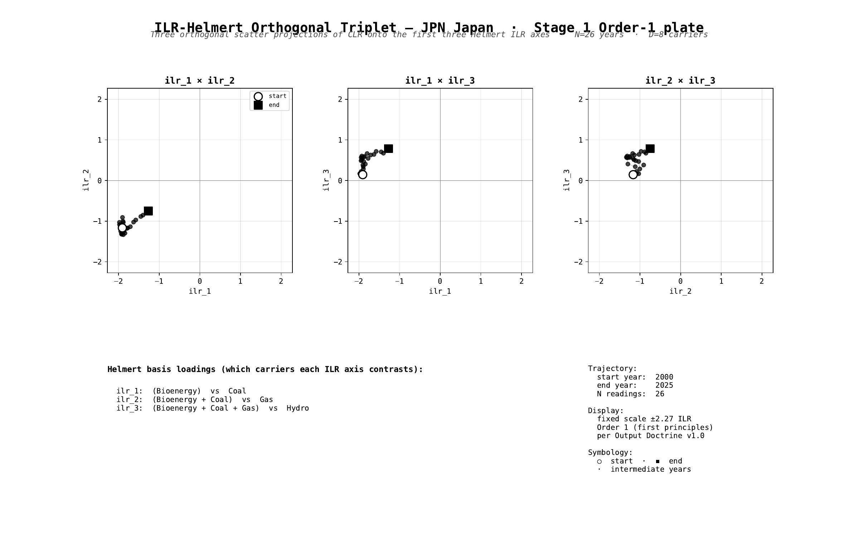
§ JPN Japan · Stage 1 - ILR-Helmert Triplet (orthonormal companion view)
CNT v3.1.0 + CNQ v2.0.0 · JPN · HUF-STD-002 link 4 vector output

Slide 51
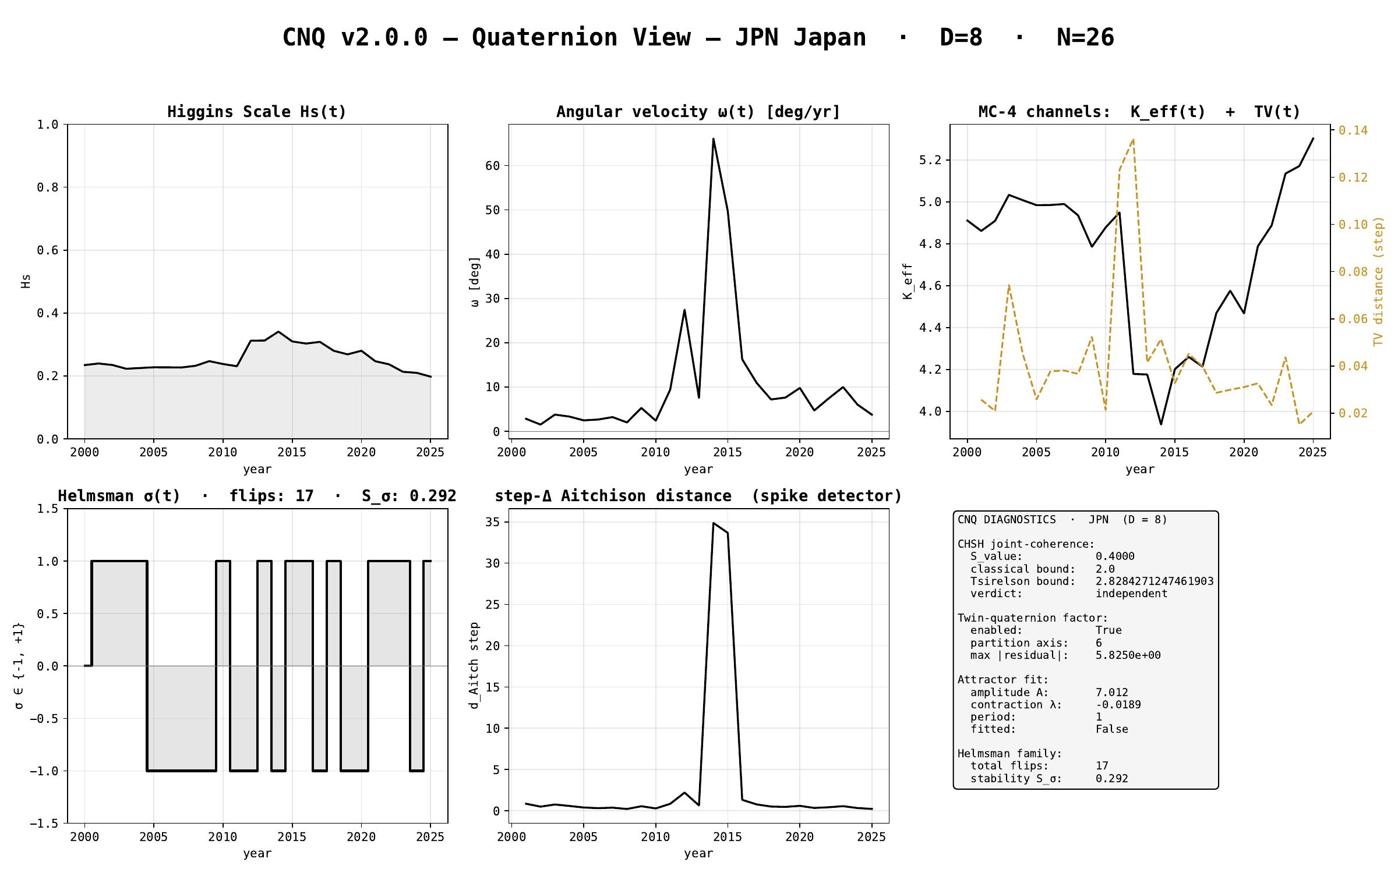
§ JPN Japan · CNQ v2.0.0 - quaternion-view dashboard
CNT v3.1.0 + CNQ v2.0.0 · JPN · HUF-STD-002 link 4 vector output

Slide 52
§ USA United States
EMBER electricity-generation series · 2000-2025 · N = 25 · D = 9
Stage 1 plates (Section + Triplet) · Stage 2/3 navigation · CNQ quaternion view

Slide 53
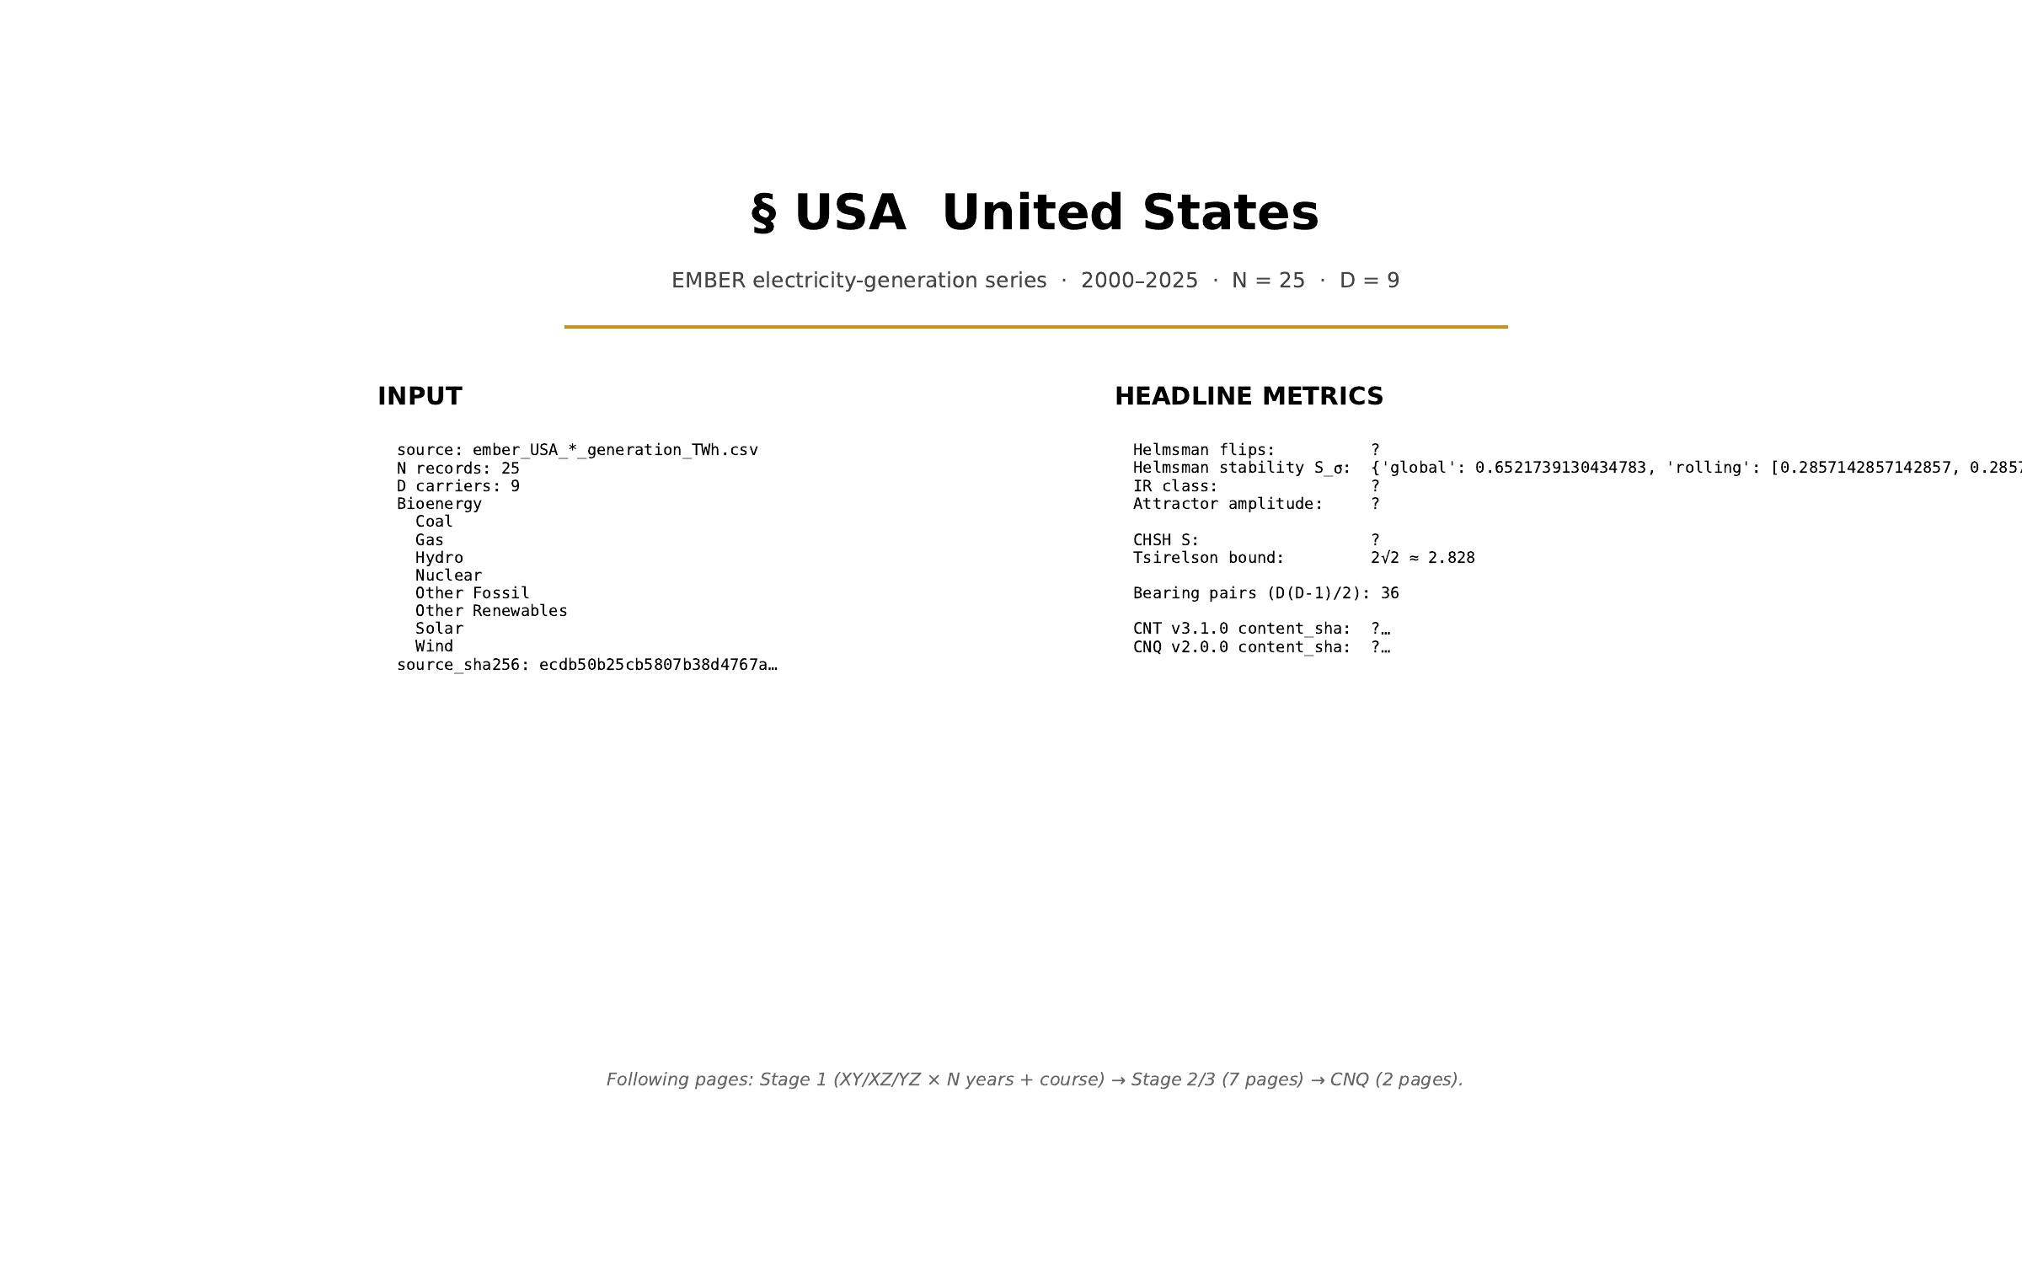
§ USA United States · cover
CNT v3.1.0 + CNQ v2.0.0 · USA · HUF-STD-002 link 4 vector output

Slide 54
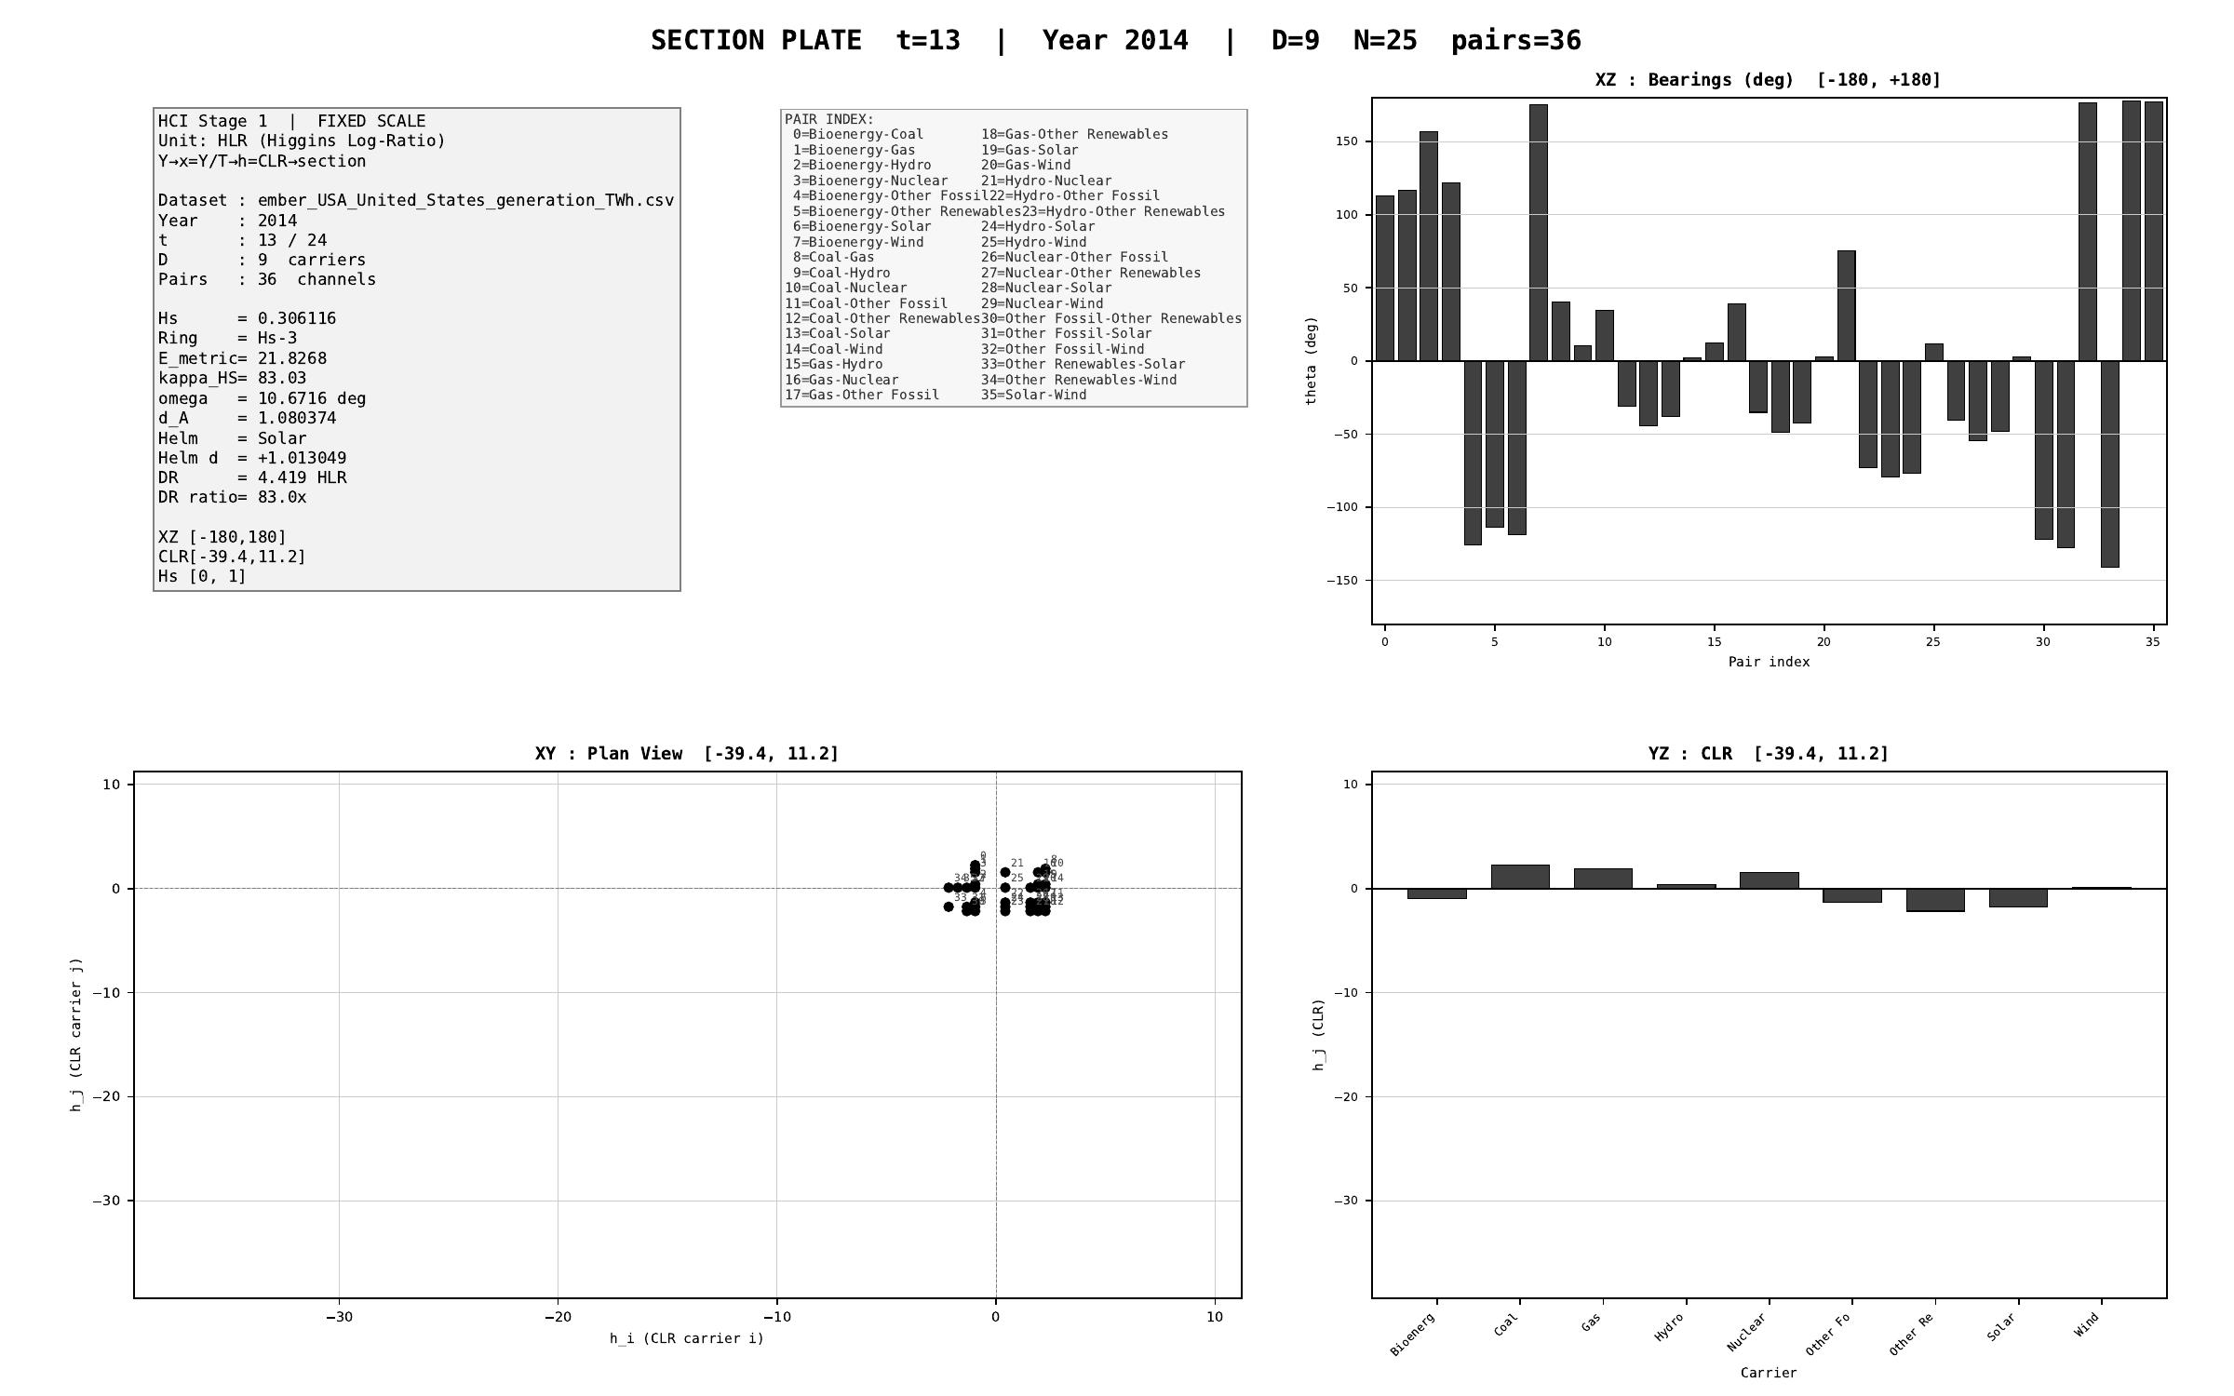
§ USA United States · Stage 1 - XY/XZ/YZ orthogonal projections (representative year)
CNT v3.1.0 + CNQ v2.0.0 · USA · HUF-STD-002 link 4 vector output

Slide 55
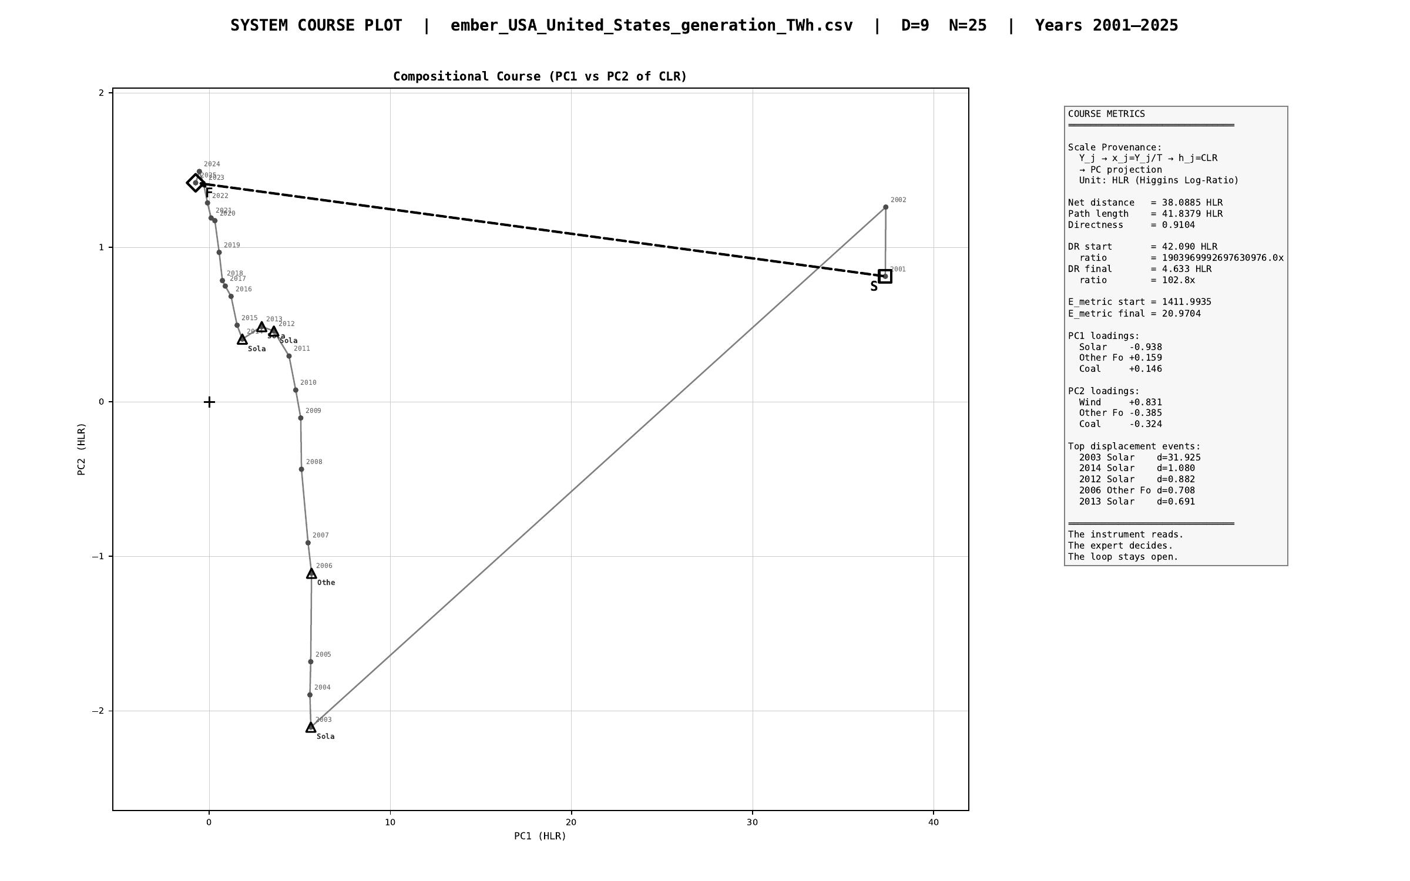
§ USA United States · Stage 1 - course plot (full trajectory 2000-2025)
CNT v3.1.0 + CNQ v2.0.0 · USA · HUF-STD-002 link 4 vector output

Slide 56
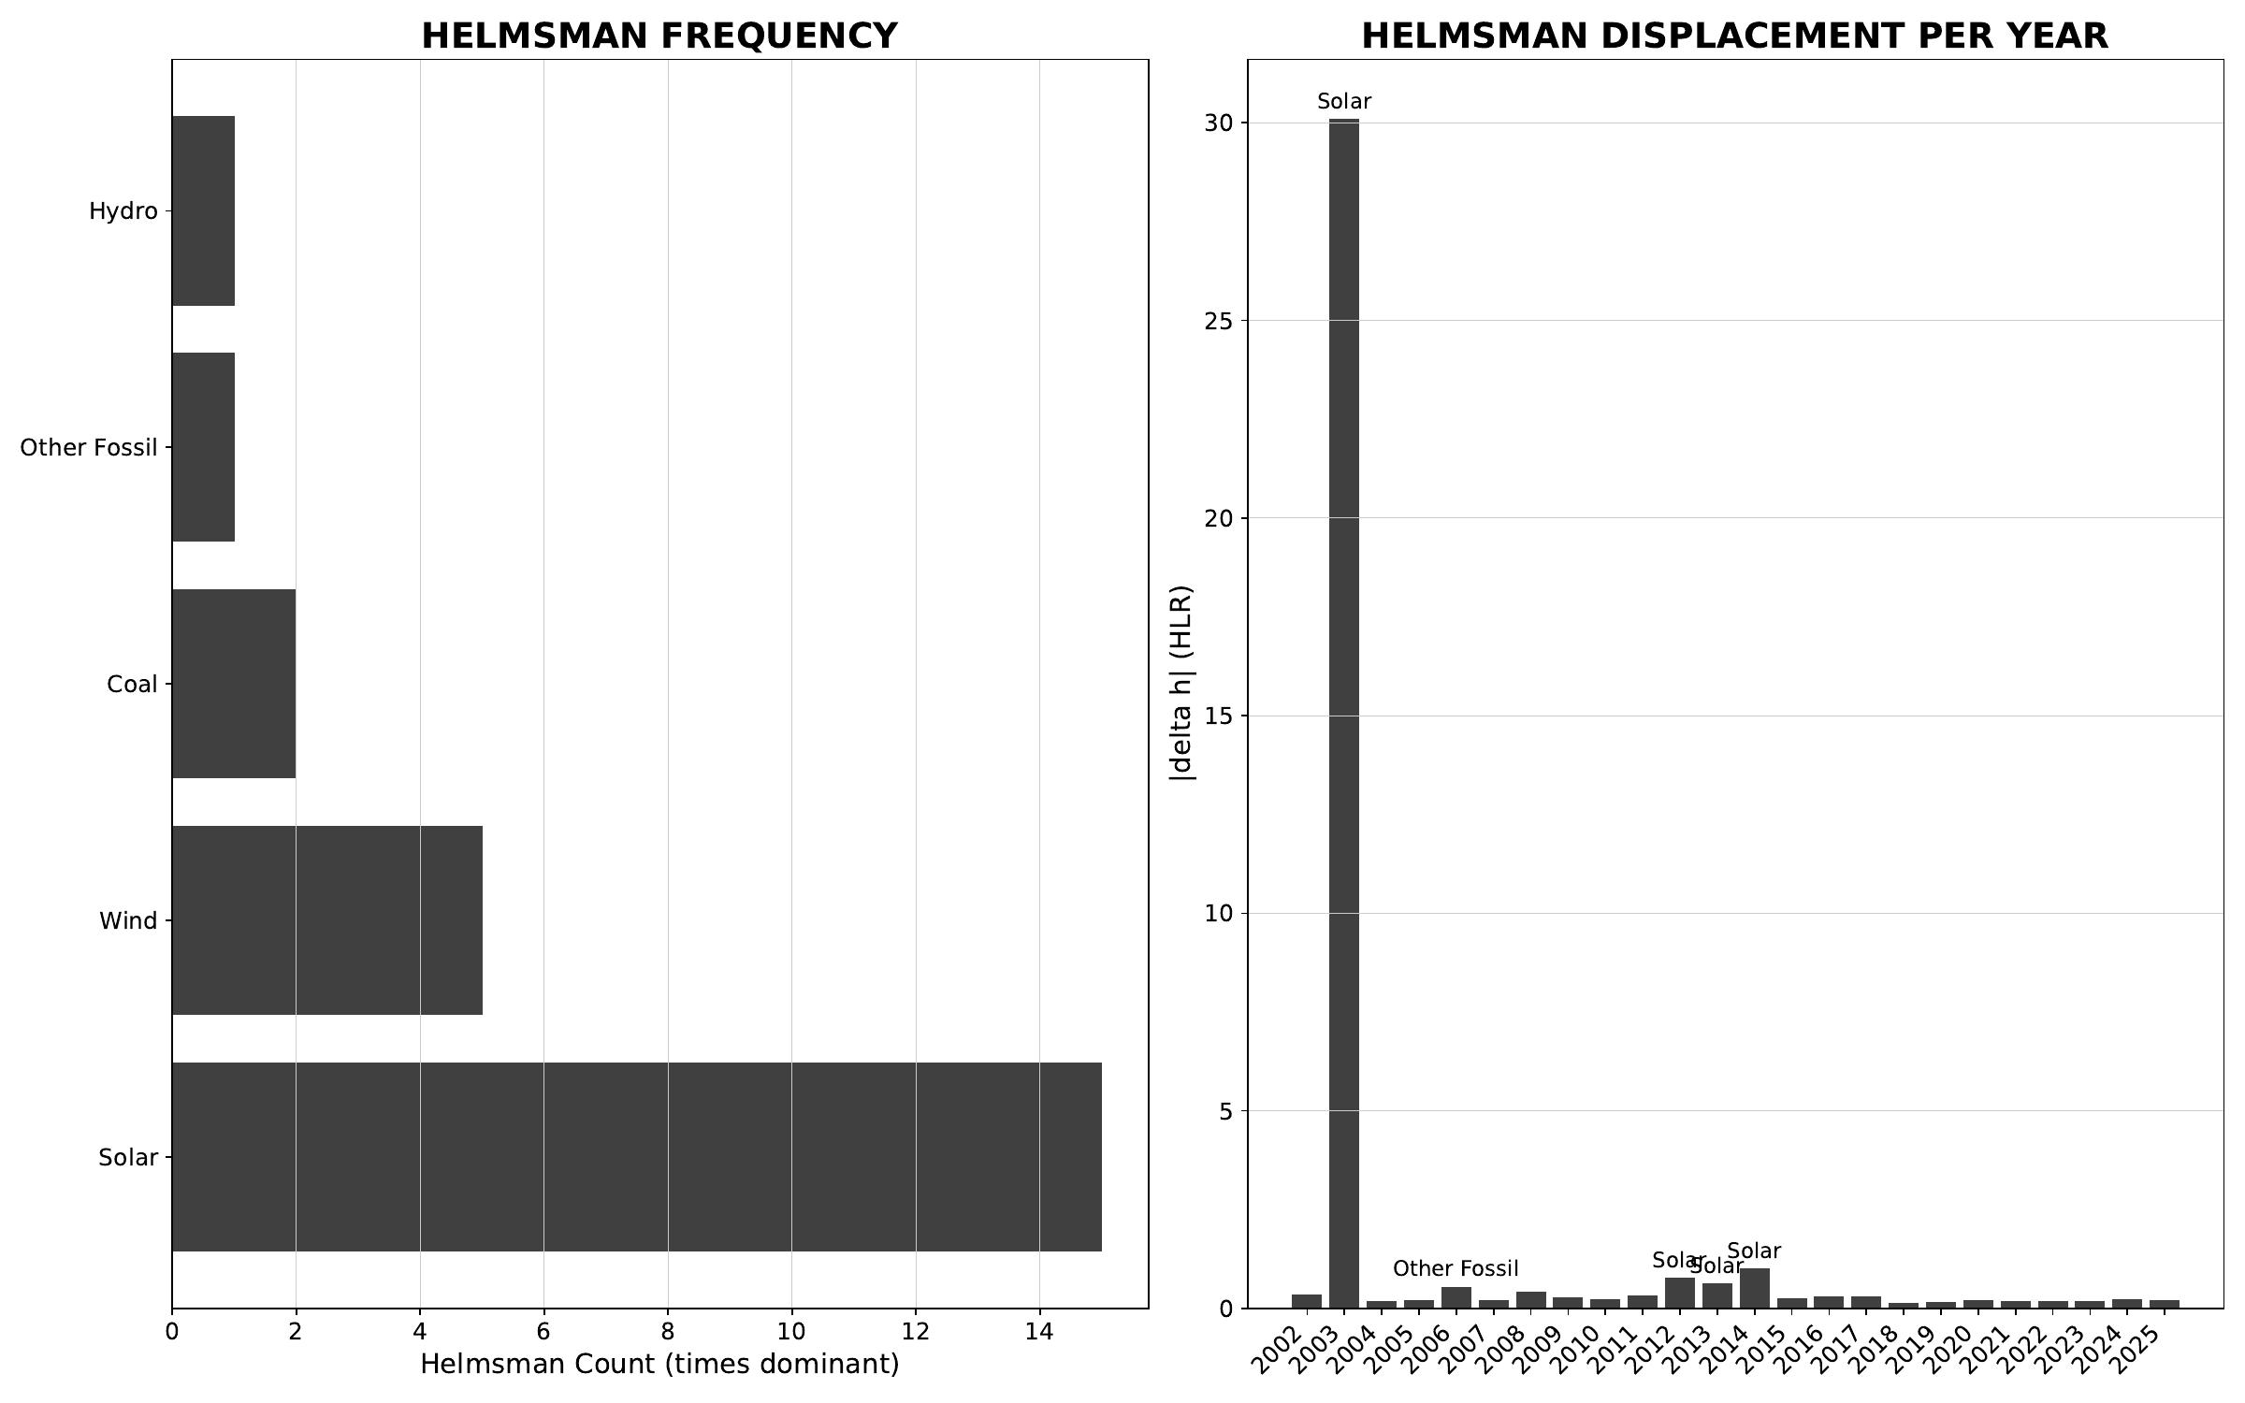
§ USA United States · Stage 2/3 - helmsman frequency + carrier attribution
CNT v3.1.0 + CNQ v2.0.0 · USA · HUF-STD-002 link 4 vector output

Slide 57
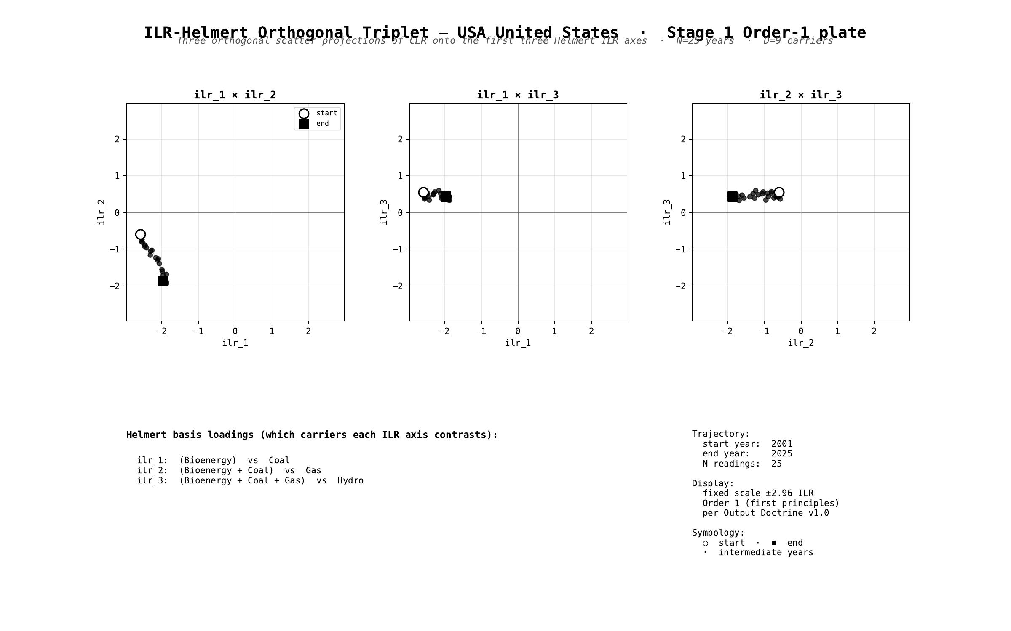
§ USA United States · Stage 1 - ILR-Helmert Triplet (orthonormal companion view)
CNT v3.1.0 + CNQ v2.0.0 · USA · HUF-STD-002 link 4 vector output

Slide 58
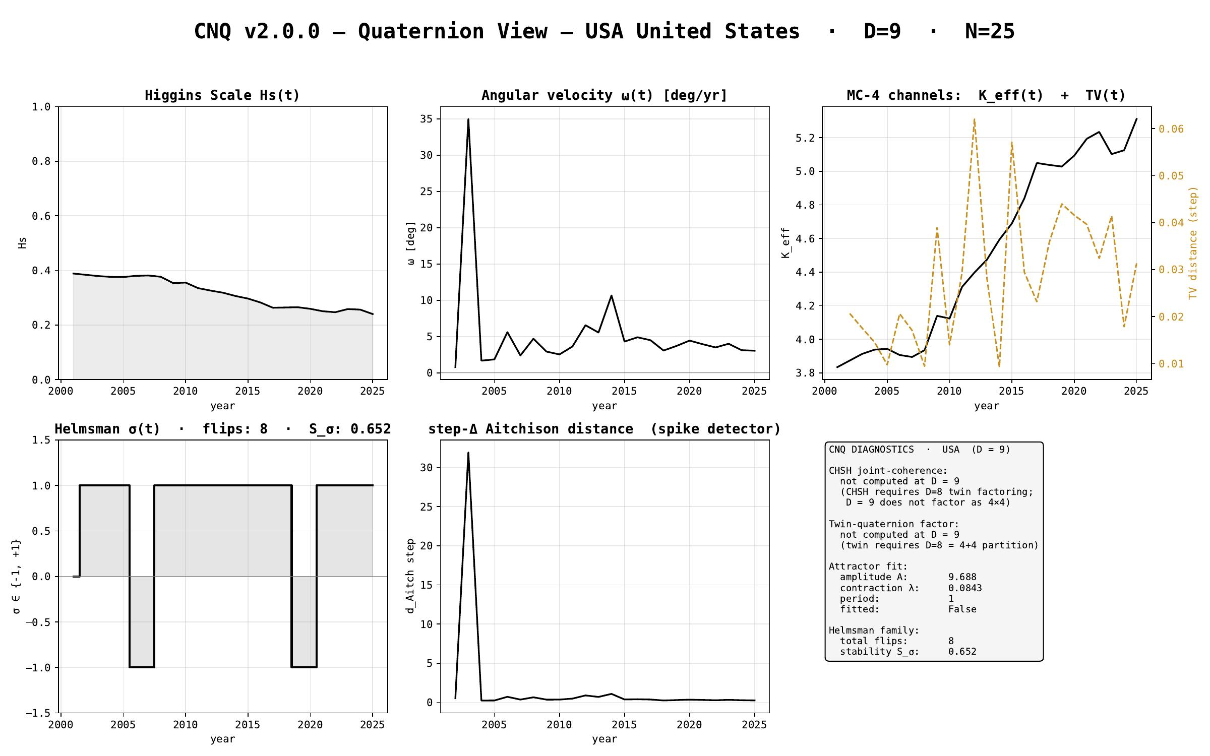
§ USA United States · CNQ v2.0.0 - quaternion-view dashboard
CNT v3.1.0 + CNQ v2.0.0 · USA · HUF-STD-002 link 4 vector output

Slide 59
§ WLD World
EMBER electricity-generation series · 2000-2025 · N = 26 · D = 9
Stage 1 plates (Section + Triplet) · Stage 2/3 navigation · CNQ quaternion view

Slide 60

§ WLD World · cover
CNT v3.1.0 + CNQ v2.0.0 · WLD · HUF-STD-002 link 4 vector output

Slide 61
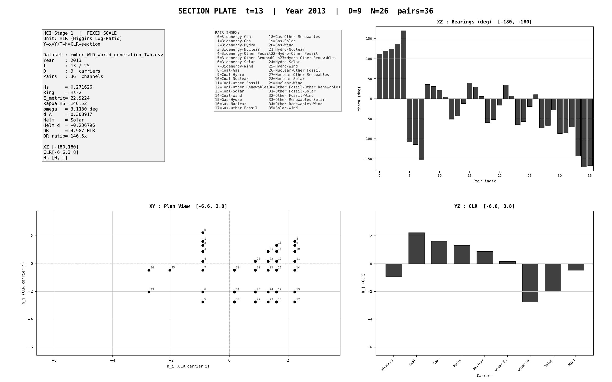
§ WLD World · Stage 1 - XY/XZ/YZ orthogonal projections (representative year)
CNT v3.1.0 + CNQ v2.0.0 · WLD · HUF-STD-002 link 4 vector output

Slide 62
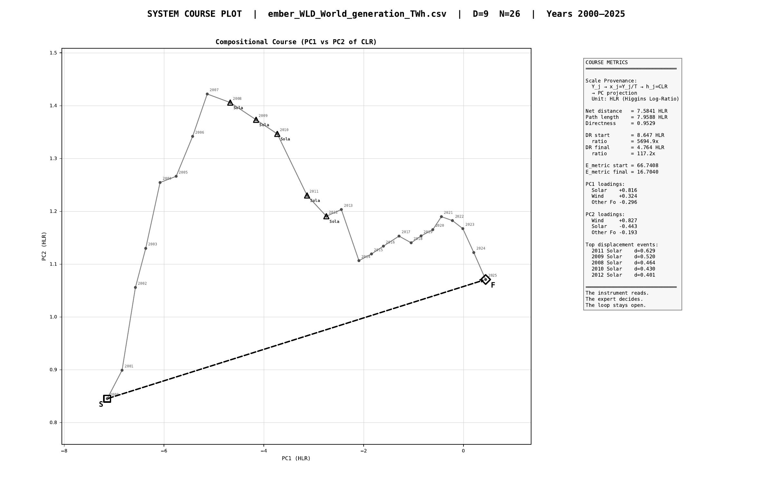
§ WLD World · Stage 1 - course plot (full trajectory 2000-2025)
CNT v3.1.0 + CNQ v2.0.0 · WLD · HUF-STD-002 link 4 vector output

Slide 63
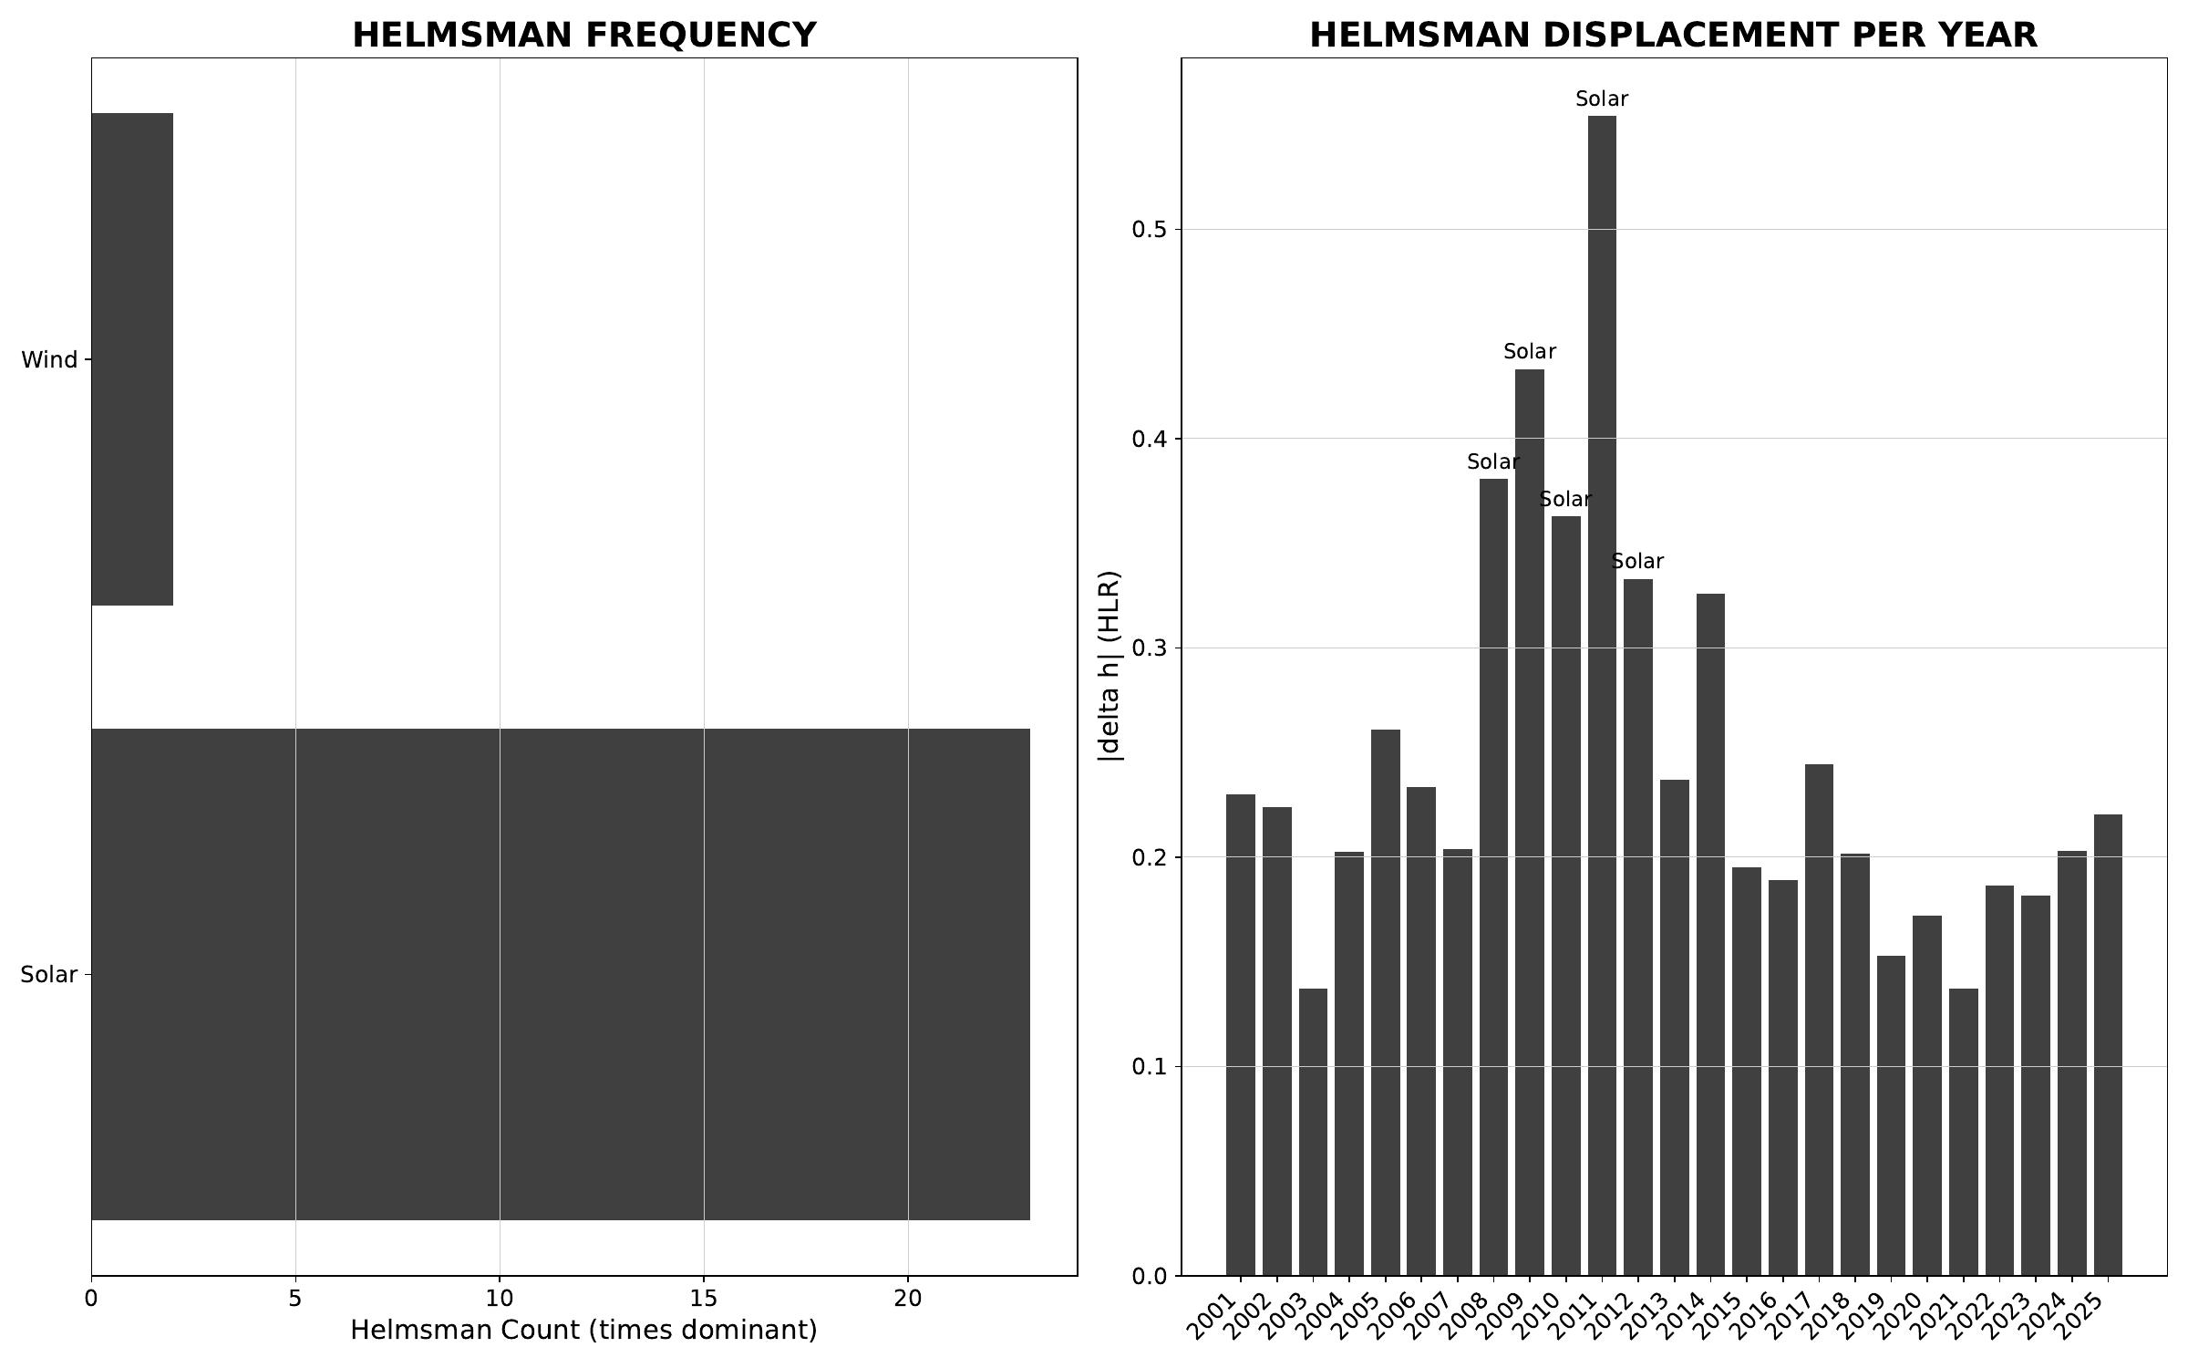
§ WLD World · Stage 2/3 - helmsman frequency + carrier attribution
CNT v3.1.0 + CNQ v2.0.0 · WLD · HUF-STD-002 link 4 vector output

Slide 64

§ WLD World · Stage 1 - ILR-Helmert Triplet (orthonormal companion view)
CNT v3.1.0 + CNQ v2.0.0 · WLD · HUF-STD-002 link 4 vector output

Slide 65

§ WLD World · CNQ v2.0.0 - quaternion-view dashboard
CNT v3.1.0 + CNQ v2.0.0 · WLD · HUF-STD-002 link 4 vector output

Slide 66
AI Use Declaration
per HUF Publication Standards (HUF-STD-001) - conforming to scientific community conventions
ICMJE · COPE · Nature/Springer · Science/AAAS · WAME · EU AI Act 2024 · arXiv · ACM · IEEE
AI tools used: Claude (Anthropic), ChatGPT (OpenAI), Copilot (Microsoft),
Gemini (Google), Grok (xAI) - the HUF AI Collective.
Tasks performed by AI: plate-generator scripting; layout design; consistency editing;
cross-checking engine output against the canonical JSON;
data-output PDF/PPTX assembly; dual-view triplet plate authoring.
Author responsibility: The author (P. Higgins, Rogue Wave Audio) retains full responsibility
for all data interpretation, methodological choices, and conclusions.
All output has been produced by deterministic, hash-chained engines
(CNT v3.1.0 + CNQ v2.0.0). AI tools are NOT listed as authors.
AI use governance: HUF AI Collective cross-check protocol · HUF Governance Charter
Articles II-IV · SAFE-001 cognitive-agent safety doctrine.
Dates of use: March 2026 - May 2026 (conference-preparation arc).
Standards reference: huf-gov/standards/HUF_PUBLICATION_STANDARDS.json · v1.0
huf-gov/standards/HUF_TENSOR_TRAIN_IO_STANDARD.json · v1.0
Data reproducibility: content_sha256 + engine_signature on every JSON
REPRODUCIBILITY_CHECKLIST.md at repo root.
The instrument reads. The expert decides. The hashes carry the receipts. The vocabulary holds the line.

