Slide 1
CNT — Compositional Navigation Tensor
CoDaWork 2026 — Tensor Engine Section
P. Higgins
The instrument reads. The expert decides. The loop stays open.

Slide 2
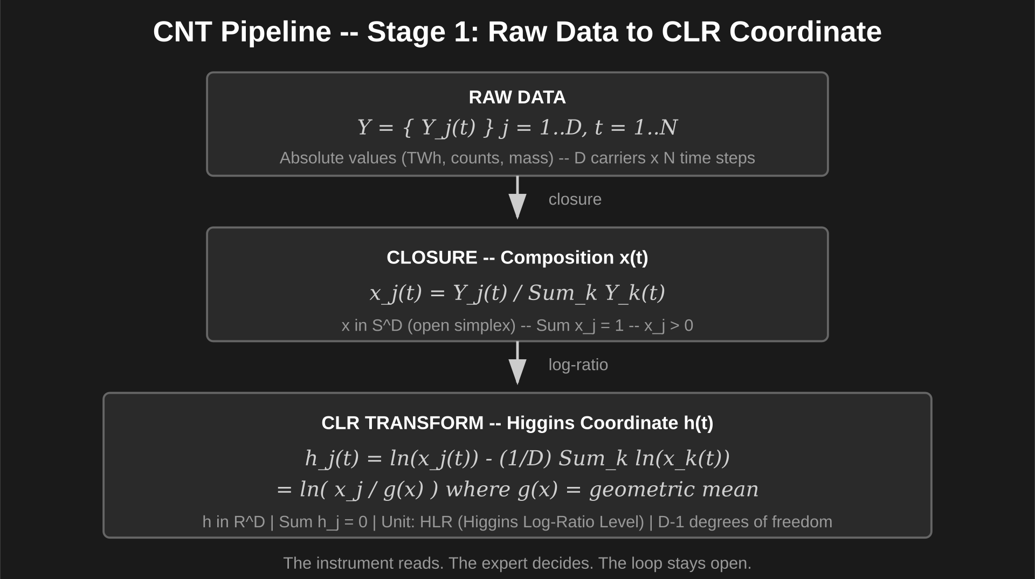

Slide 3
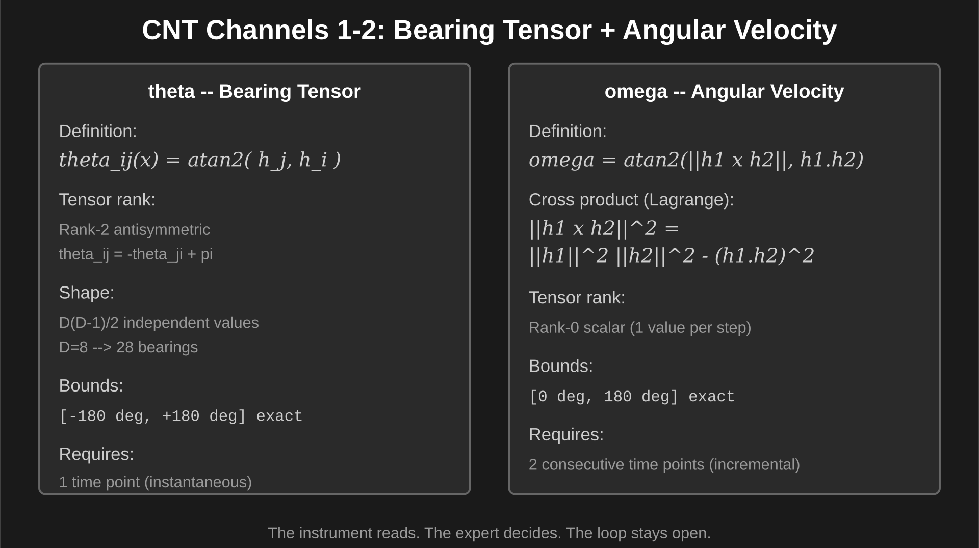

Slide 4
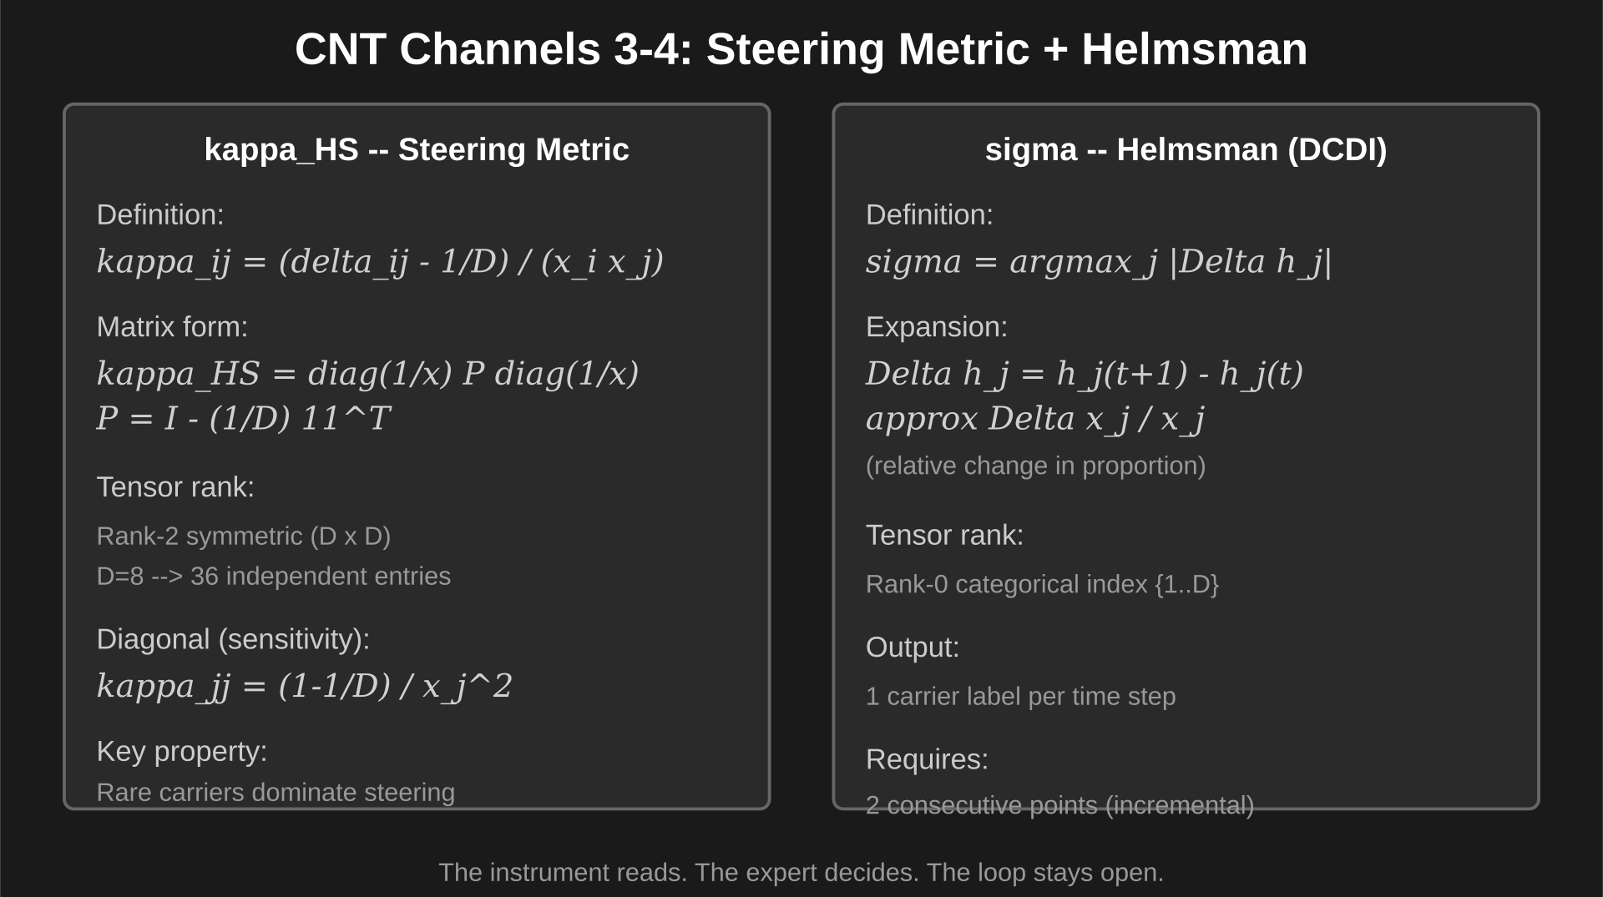

Slide 5
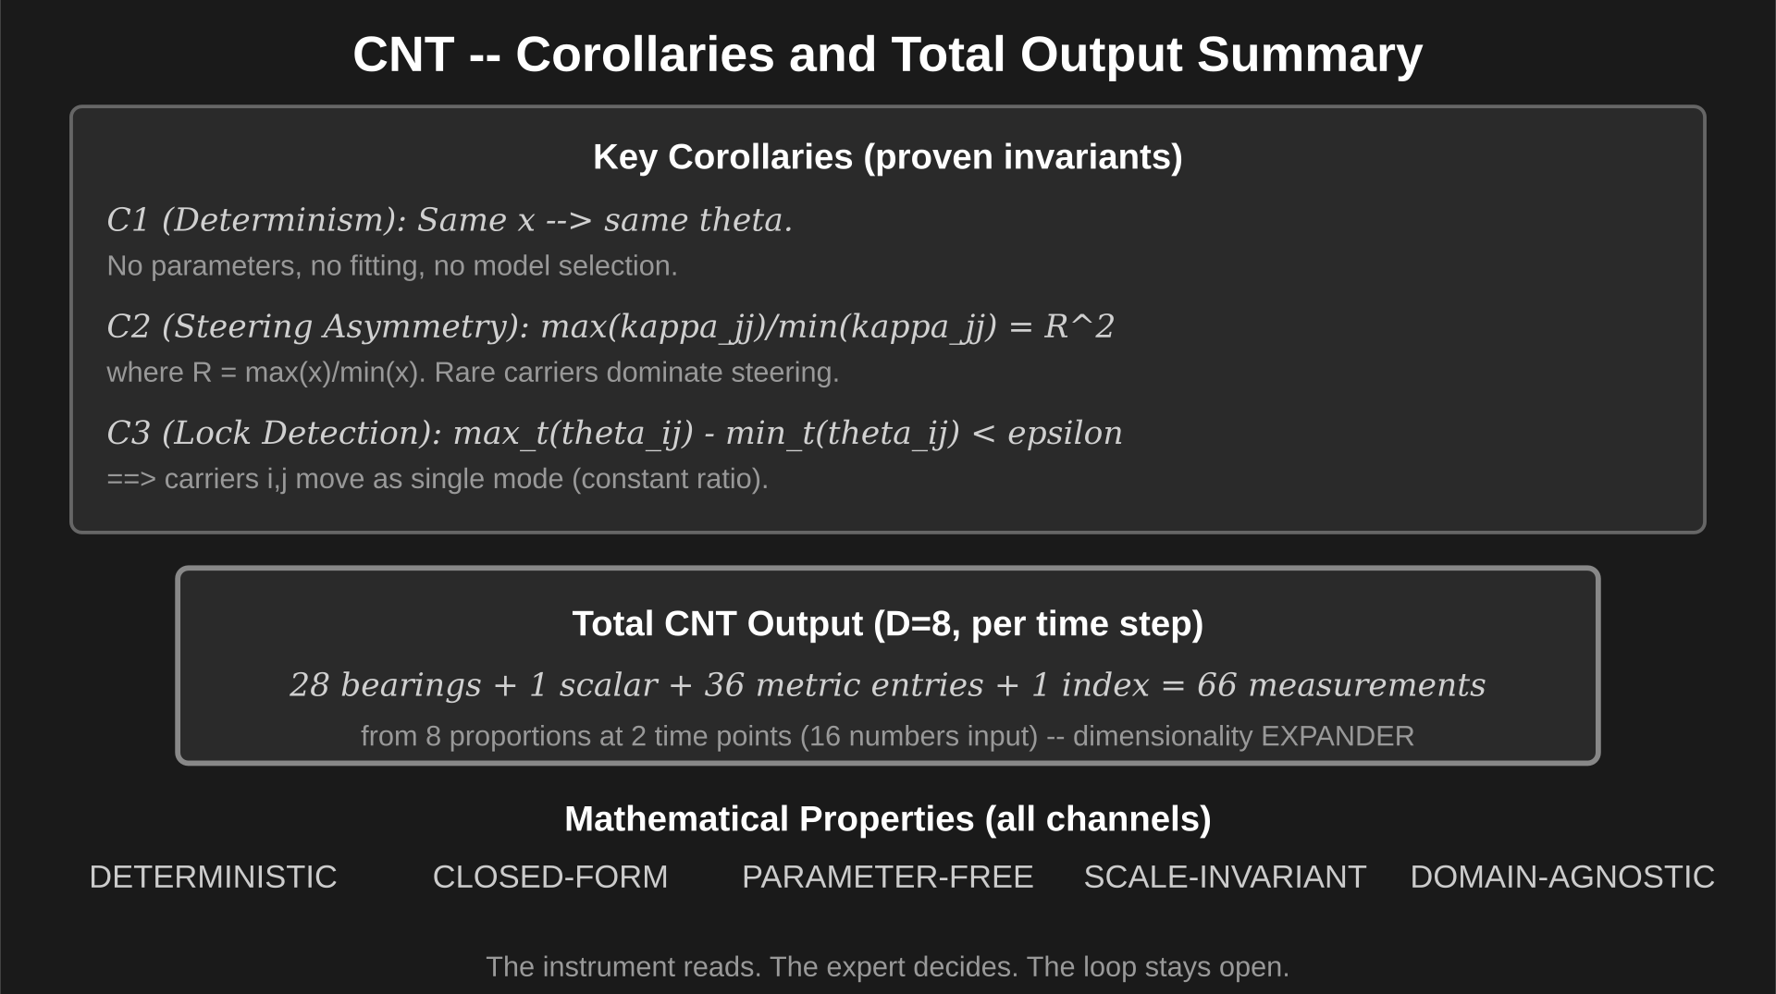

Slide 6
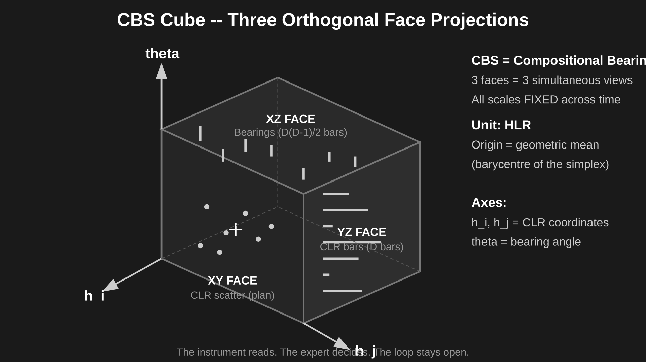

Slide 7
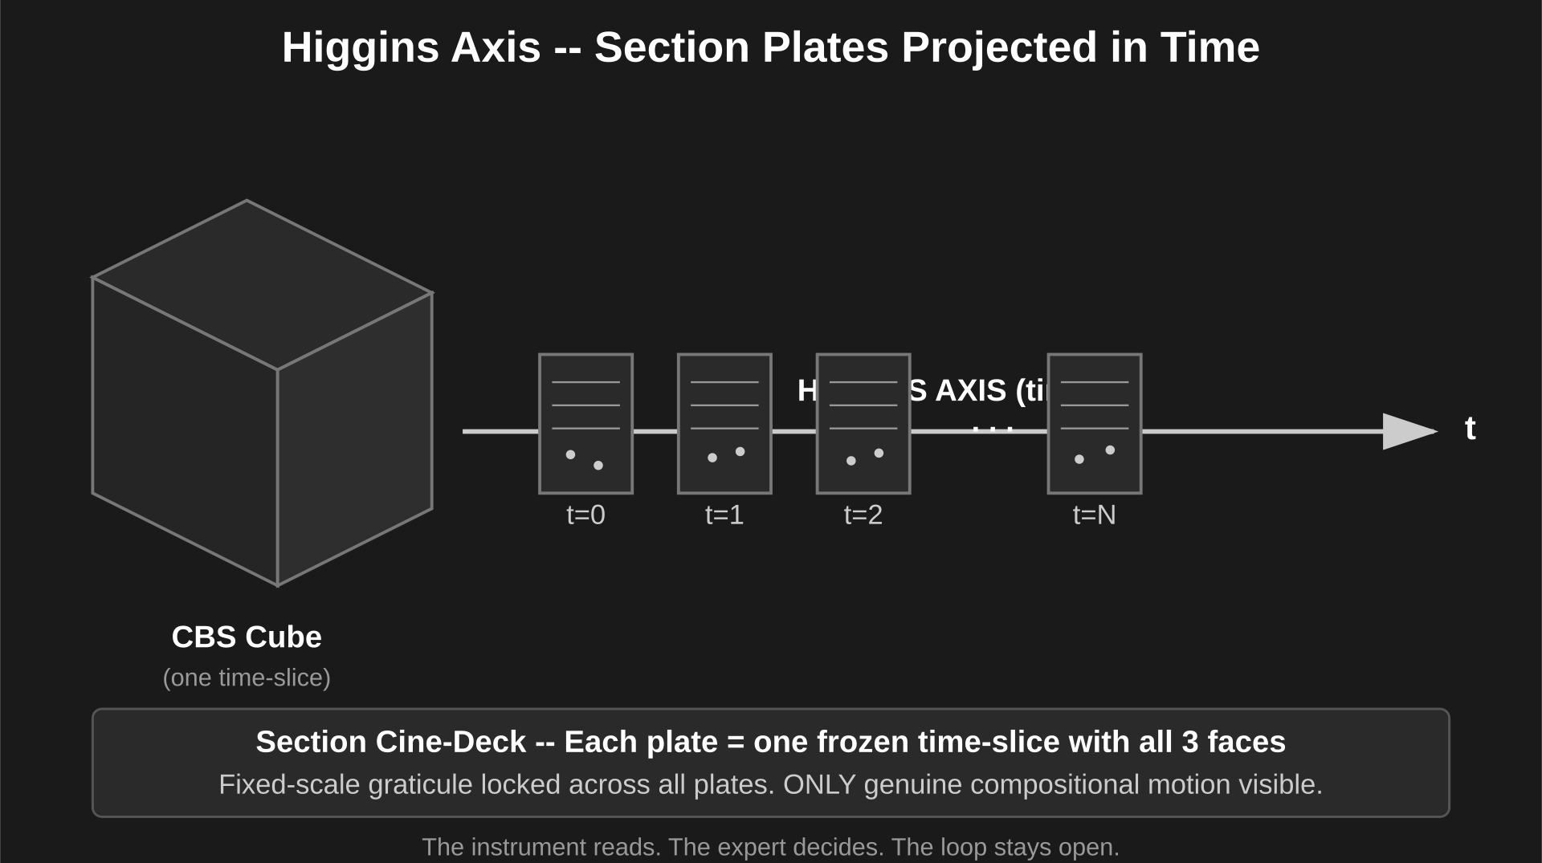

Slide 8
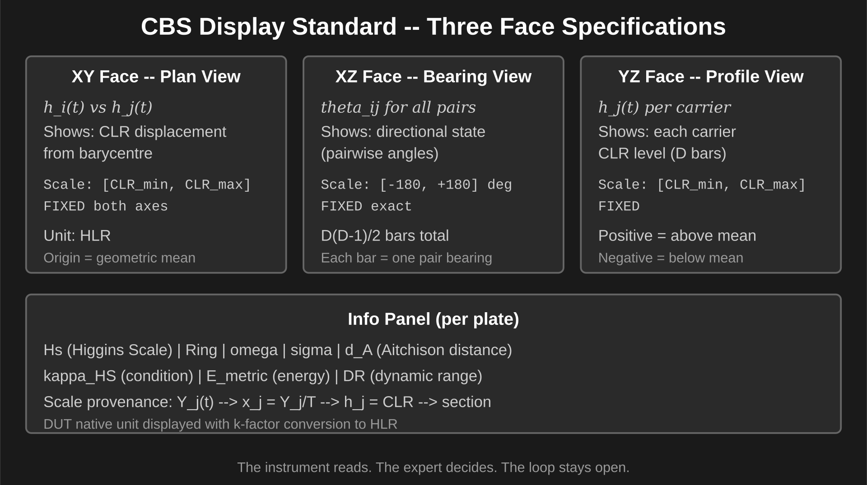

Slide 9
