Slide 1

LOGO
Instacart
Shopper Hiring A/B Testing Solution
Zixuan Huang

Slide 2
Strategy: Initiating background check earlier in hiring process
Goal: Improve Conversion Rate
Application Process Overview
Test Duration: 41 Days
Control Group
Treatment Group
Keep it as it is
# Applicants: 10024
Advance background check
# Applicants: 4958
Apply
↓
Card Mailed
↓
Card Activation
↓
Background Check Initiate
↓
Background Check Complete
↓
First Batch Complete
Apply
↓
Background Check Initiate (immediately after apply)
↓
Card Mailed
↓
Card Activation
↓
Background Check Complete
↓
First Batch Complete
For both group:
Take Orientation (optional)

Slide 3
Evaluate A/B Test Result
 | Control | Treatment
# Applicants | 10024 | 4958
# First Batch Complete | 2678 | 2115
Conversion Rate | 26.72% | 42.66%
Enter title
This Template Is Designed By Zuo An,It Will Help You Make You Report Easy And Fast.
Null hypothesis: Conversion rate is the same in two groups
(H0)
Alternative hypothesis: Conversion rate is different in two groups
(Ha)
Two Sample T-test
Z-score: 19.69
Result: statistically significant at 95% confidence level
Conclusion
Confidence Interval
[0.1520, 0.1669]
Result: True difference does not include 0.
Positive value indicate that conversion rate in treatment group is higher.
If initiate background check earlier:
1. Conversion rate significantly increased (by 59.7%)
2. We are 95% confidence that there is true difference in conversion rate between two groups.

Slide 4
Cost Effectiveness
Here we use dollar efficiency to measure cost effectiveness. Dollar efficiency refers to the average cost needed for one conversion, which is the number of background checks initiated multiplied by the cost per background check, divided by the number of people who completed the first batch.
Is this change worth it?
Control
# of background check initiated: 8582
Cost per background check: $30
First batch completed: 2678
Dollar efficiency: $96.14
$96.14
Treatment
$70.33
# of background check initiated: 4958
Cost per background check: $30
First batch completed: 2115
Dollar efficiency: $70.33
We can see that the dollar efficiency for control group is larger than that for treatment group ($96.14 vs. $70.33). That means for each conversion, Instacart need to spent more money if they keep using their existed hiring process. They could save $25.81 for each conversion by initiating background check earlier in hiring process.
Therefore, we conclude that the change is cost-effective.

Slide 5
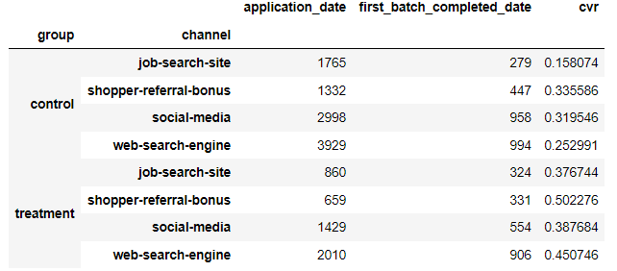
Observations and Recommendations
We Help You Make You Report Easy And Fast!
Job-Search-Site Channel
This channel has the lowest conversion rate in control group but has the highest improvement after treatment. Instacart should consider improving the quality of its recruitment page (e.g. more specific job descriptions, neater formatting) to attract more candidates to apply through this channel.
Social-Media Channel
Conversion rate does not improve much with the change. Instacart should evaluate the ROI to see whether it is cost-effective to invest in this channel. If not lower the budget of paid advertising in this part.
Orientation Options
Instacart could conduct an A/B Test on whether mandatory orientation can improve conversion rate.

Slide 6
THANK YOU

