Slide 1
Background Threads
WPF Thread
LogViewer
Write(message, style)
Write(message, style)
lock(Buffers)
remove last temporary message
write message in active buffer
WPF Timer
Tick()
lock(Buffers)
unlock(Buffers)
switch buffers
Buffer 1
Buffer 2
Start WPF timer if needed
unlock(Buffers)
write content of not active
buffer to GUI

Slide 2
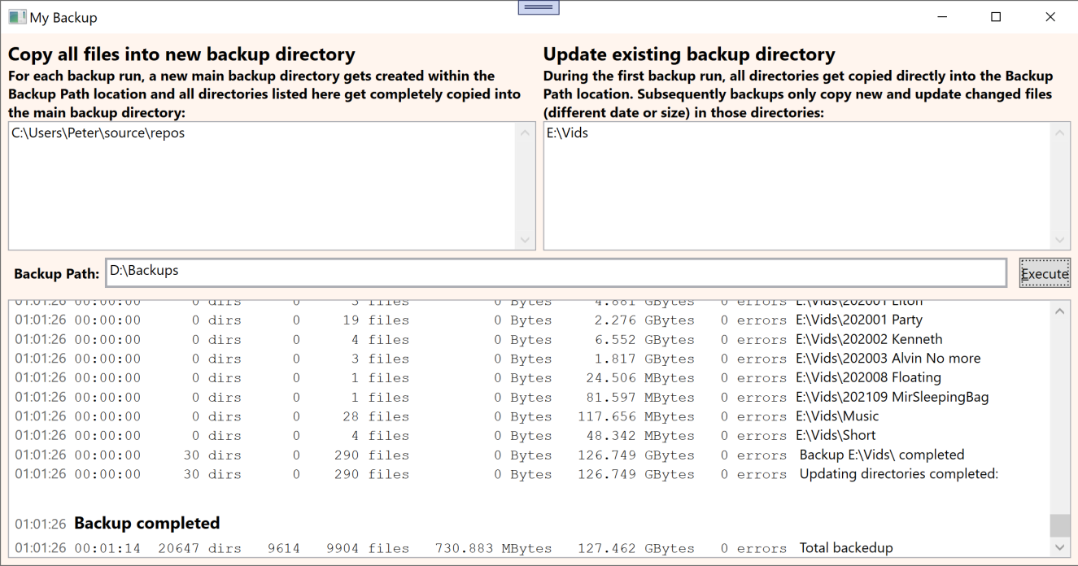
LogViewer

