Slide 1
MainWindow
MapControl
MapOverlayControl
MapInfoWindow
MapFinishedOverlayControl

Slide 2
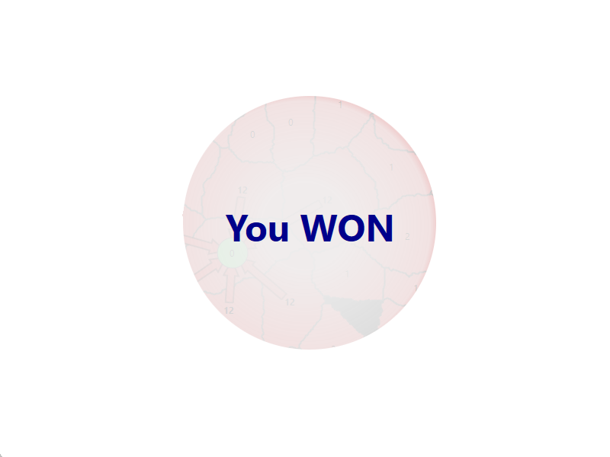
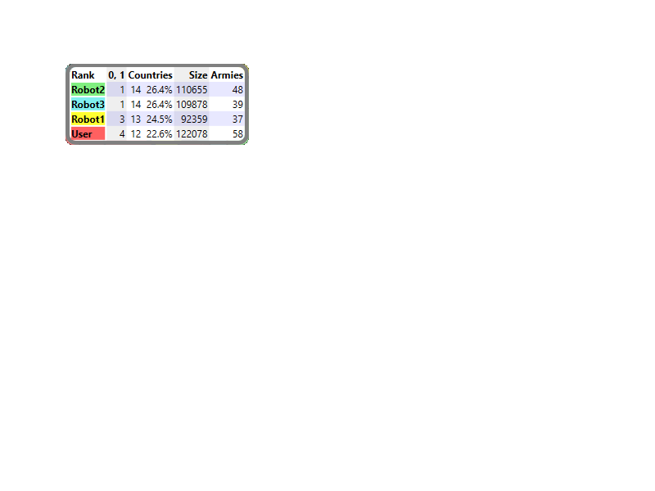
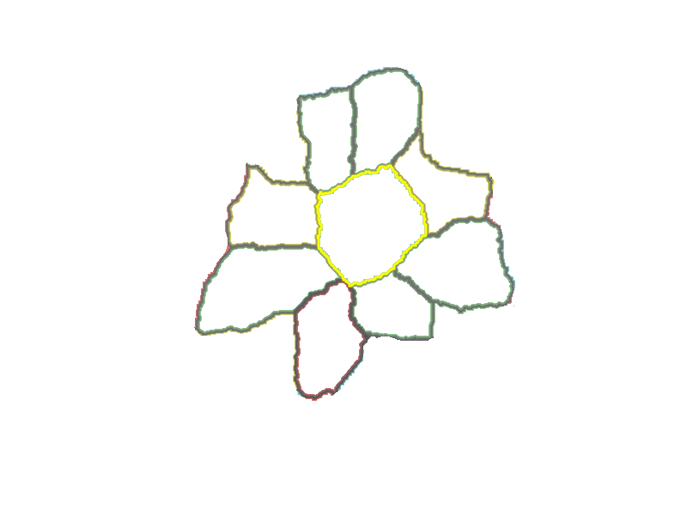
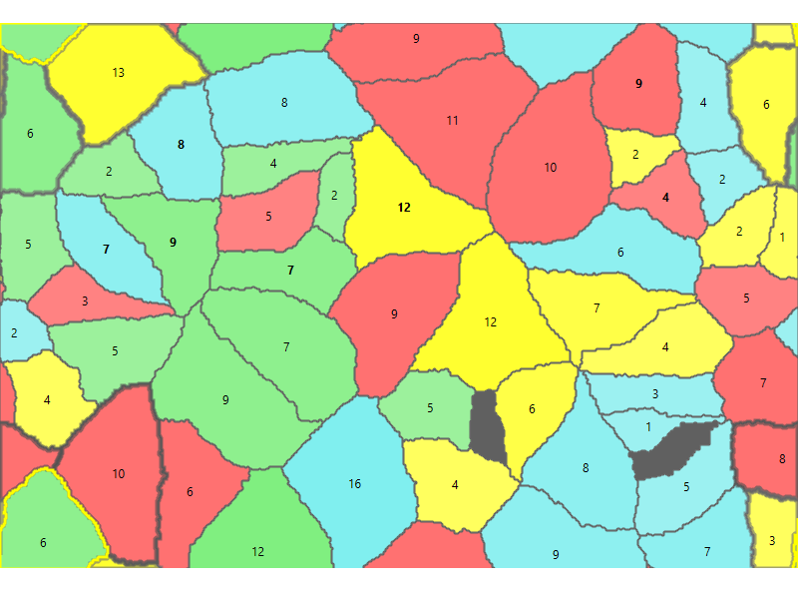
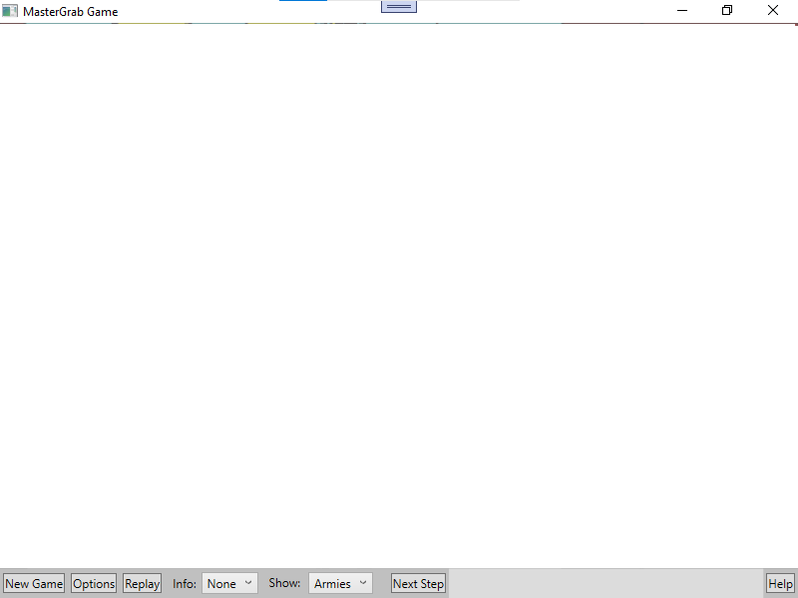
MapFinishedOverlayControl
MapInfoWindow
MapOverlayControl
MapControl
MainWindow

Slide 3
Options
ArmyGrowthFactor
ProtectionFactor
AttackFactor
AttackBenefitFactor
GameFix
Options
PixelMap
CountryFixArray
masterGame
CountryFix
ID
Coordinate
IsMountain
Size
Capacity
Center
NeighbourIds
BorderCoordinates
Robot
Map
Game
Player
RobotCountryIds
Results
Game
Map
Players
Results
ArmyGrowthFact
ProtectionFact
AttackFactor
AttackBenefitFa
Map
Game
Countries
Country
ID
Coordinate
IsMountain
Size
Capacity
Center
NeighbourIds
Map
Owner
PreviousOwnerId
ArmySize
State
Player
ID
Game
CountryIds
 | The values of these classes don’t change during a game. They contain also data the Robots don’t need, like how to draw a country.
 | Each time a Player has made a move, some values of these classes can change during a game. Each Player (GuiPlayer and Robots) get their own copy of these classes, to prevent that Robots can change any information except by making a Move().
 | Forward link from parent to 1 child Forward link from parent to many children
 | Backward link from child to parent
 | These values get copied only once when a new Game starts

Slide 4
GameController.controllerMethod()
executeMove(GameFix.GuiPlayerId) => GameFix.executeMove()
for each robot in Robots
robotMove = robot.PlanMove()
DoPlanMove() => BasicRobot.DoPlanMove()
executeMove(robotMove) => GameFix.executeMove()

Slide 5
Autoplay
ReplayButton_Click
StartButton_Click
OptionsButton_Click
MainWindow_Closing
Is GUI Player active ?
Autoplay
Timer
NextStepButton_Click
mapControl_MouseLeftButtonUp
no
Stop Timer
Is autoplay selected ?
Tick
Controller is busy processing GUI move
yes
no
Is controller waiting ?
Start Timer
yes
IsTimerWaiting = true
Send move to controller
Gui sends
Move to
GameController
Controller is waiting for GUI move
MapChanged event or
GameChangedEvent
Is GUI Player active ?
Is game over?
no
no
yes
Is autoplay selected ?
Is autoplay selected?
IsTimerWaiting ?
yes
yes
Start Timer
StopTimer
IsTimerWaiting = false
Send move to cotroller

Slide 6
Arrow
From.X
x
P1
Width
From
P3
α
Height
α
P2
 | X | Y
α | arc cos (Distance / Distance.X)
P1 | From.X + Width/2 * sin(α) | From.Y - Width/2 * cos(α)
Center | To.X - Height * cos(α) | To.Y - Height * sin(α)
P2 | Center.X + Width/2 * sin(α) | Center.Y - Width/2 * cos(α)
P3 | Center.X + Width * sin(α) | Center.Y - Width * cos(α)
Distance
Center
α
To
y
Distance.X

Slide 7
Centers of Clusters

Slide 8
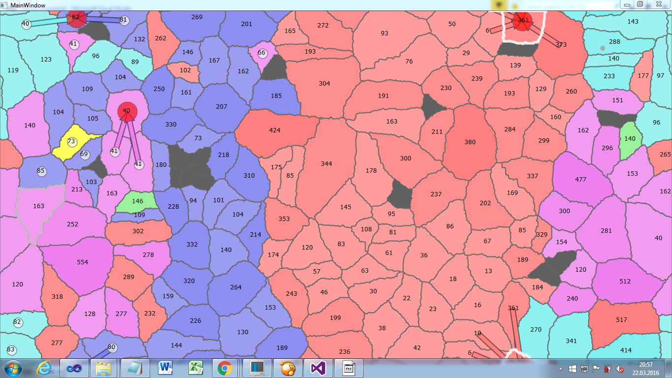

Slide 9
MapFinishedOverlayControl
MapFinishedOverlayControl: Canvas
Circle
mainStackPanel{Orientation=Orientation.Horizontal}
You
TextBlock
Result
TextBlock

