Slide 1
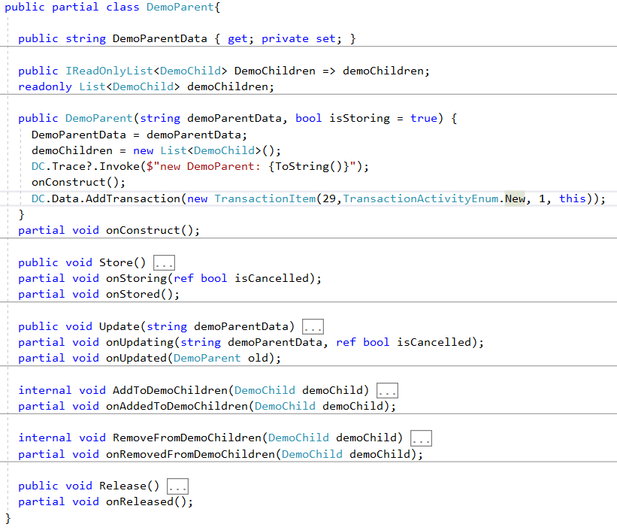
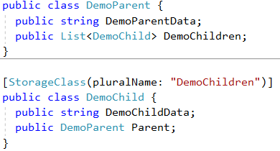
Data Context
StorageClass
Generator
Data Model

Slide 2
New Item()
Store()
Not stored
Key=-1
Stored
Key>=0
Update()
Release()
Update()
Rules for storing and releasing items from Data Contexxt
One Data Context per application holds all stored data in memory and maintains a copy of the data in files.
An item just constructed is not stored, its Key has the value -1.
Item.Store() stores the item in the data context and assigns a unique key value >=0 to the item.
When setting the parameter isStoring: true in the constructer, the item gets constructed and stored at the same time.
As long an item is stored, its latest content is always tracked in a file , also after an Update().
Item.Release() removes the item from the data context and file and sets its key to -1.
Parent
Children
Child
Parent
Child
Parent
Child
Parent
Linking 2 classes (child -> parent relationship)
A relationship between 2 classes defines one as child and the other as parent. Each child property points to 0 or 1 parent, while a parent can have 0 to many children (one to many relationship, 1:mc or 1c:mc).
For each class there is a file storing the data permanently. When the application starts, it is not possible to process 2 files at the same time. All instances (items) of the parent class get read before the child class instances.
A child item gets linked to its parent by assigning the parent to the child.Parent property. This can be done with the constructor or item.Update().
item.Update() can also remove a child from its parent.
Setting a child’s Parent property adds that child to the parent.Children collection. Removing a parent from child.Parent removes the child from the parent.Children. parent.Children.Add(child) is not available.
The parent child relationship gets only permanently stored in the child. When the child gets read at application start and it has a link to a parent, the child gets added to the parents children collection.
It is illegal for a stored child to link to a not stored parent, because an exception would occur during startup if the parent can’t be found. Trying to add a stored child to a not stored parent throws an exception.
Rules for linking children and parents
A not stored child can link to a stored or not stored parent.
A stored child can only link to a stored parent.
A not stored parent can only have not stored children in its children collection
A stored parent can have stored and not stored children in its children collection

Slide 3
Parent Child Relationships
Item Item Parent
List<Item> Items
Directory Directory Parent
List<Directory> Children
Directory Directory Parent
Directory Directory Parent
List<Directory> Children
List<Directory> Children

Slide 4
Child Single Parent Relationships
Parent
List<Child> Children
Child
Parent Parent

Slide 5
Child Multiple Parent Relationships
Parent
List<Child> Children1
List<Child> Children2
Child
Parent Parent1
Parent Parent2
Adr
List<Child> Billings
List<Child> Deliveries
Invoice
Adr Billing
Adr Delivery

Slide 6
Tree
Roots
Branches
Leaves
Node
Node Parent
Node
Node Parent
Node
Node Parent
Node
Node Parent
List<Person> Children
List<Person> Children
List<Person> Children
List<Person> Children
Node
Node Parent
Node
Node Parent
List<Person> Children
List<Person> Children
Node
Node Parent
List<Person> Children
Node
Node Parent
Node
Node Parent
List<Person> Children
List<Person> Children
Node
Node Parent
List<Person> Children

Slide 7
Family
Parents
Children
Person
Person Parent1
Person Parent2
Person Partner
Person
Person Parent1
Person Parent2
Person Partner
List<Person> Children
List<Person> Children
Person
Person Parent1
Person Parent2
Person Partner
Person
Person Parent1
Person Parent2
Person Partner
List<Person> Children
List<Person> Children
Person
Person Parent1
Person Parent2
Person Partner
List<Person> Children

Slide 8
Parent.Release()
P
C
Child | Parent
Not stored | Not stored | Parent.Store(): Parent gets stored.
 |  | Child.Store(): Illegal
Not stored | Stored | Parent.Release(): Parent gets released from store.
 |  | Child.Store(): Child gets stored.
Stored | Stored | Parent.Release(): Illegal
 |  | Child.Release(): Child gets released from store.
Stored | Not stored | Illegal
Child.Store()
Parent stored
Child not stored
Parent.Store()
Parent.Release()
illegal
P
P
C
Child.Store()
illegal
C
Child.Release()
Parent not stored
Child not stored
Parent stored
Child stored
Country
C: Regions
Region
P: Country
C: Cities
City
P: Region
A class can be parent to one class and child of a different class at the same time.
A class can have many parent properties and many collections to different child classes.
Class A
Parent
A parent class cannot become a child of any of his decedents. Reason: At application startup, the oldest generation (A) gets read first from its file. Only then the next generation gets read (B, C and D). While reading that second generation, if the child (B, C, D) can find its Parent (A), it gets added in the parent to the correct children collection. If the parent is missing, an Exception is thrown. If A could be a child of E, it would no longer be possible to decide who is the oldest generation.
Class B
Class C
Illegal
E cannot be
parent of C
Child
Class D
Class E

Slide 9
Parent
Children
createStore(Parent)
createStore(Child(Parent))
adds Child to Parent
Create(Parent)
Create(Child(Parent))
Store(Parent)
Store(Child)
adds Child to Parent
Child
Parent

Slide 10
Parent
Children
Parent
Children
createStore(Parent1)
createStore(Parent2)
createStore(Child(Parent1, Parent2))
adds Child to Parent1 and Parent2
create (Parent1)
store(Parent1)
create (Parent2)
create (Child(Parent1, Parent2))
/*store child not possible*/
store(Parent2)
store(Child)
adds Child to Parent1 and Parent2
Child
Parent1
Parent2
Unfortunately, there are to many strange cases to be solved, when a not stored child can be added to a not stored parent, for example if the child belongs to 2 parents. If it has only 1 parent, the child could get saved when the parent gets saved. But when it has 2 parents and the first parent tries to save the child before the second parent is saved, that wouldn’t work, because parent 2 has to be saved before child 2 can get saved, which needs to know the key of parent 2.

Slide 11
Create Item and store it in DataStore
Item
ItemParent
Properties
Properties
Key
ItemParent has Items
Key
ItemParent
ItemChildren
Event
inherits
Event
HasChanged
DataStore <Item>
DataStoreCSV <Item>
HasChanged
Constructor
Constructor
Item()
Item()
Methods
1
Properties
Methods
Store()
Properties
Store()
Update()
2
StoreKey
CsvConfig
Update()
Release()
Items[]
PathFileName
Release()
Event
Constructor
AddToItemChildren()
Added
DataStore()
RemoveFromItemChildren()
Changed
Methods
4
Removed
OnItemAdded()
Constructor
OnItemHasChanged()
DataStore()
OnItemRemoved()
Methods
3
Add()
ItemHasChanged()
Remove()
CSV-File
Write Add Item
Are there still events in DataStore ?

Slide 12
Update Item and track it in DataStore
Item
ItemParent
Properties
Properties
Properties
aaa
Key
Key
aaa
ItemParent
ItemParent has Items
ItemChildren
aaa
Event
inherits
Event
aaa
HasChanged
HasChanged
aaa
Constructor
DataStore <Item>
DataStoreCSV <Item>
Constructor
aaa
Item()
Item()
aaa
Methods
Methods
aaa
Store()
Properties
Properties
Store()
aaa
1
StoreKey
CsvConfig
aaa
Update()
PathFileName
Update()
Release()
Items[]
Release()
aaa
Event
Constructor
AddToItemChildren()
aaa
Added
DataStore()
RemoveFromItemChildren()
aaa
Changed
Methods
aaa
Removed
OnItemAdded()
3
aaa
Constructor
OnItemHasChanged()
aaa
DataStore()
OnItemRemoved()
aaa
Methods
aaa
Add()
2
aaa
ItemHasChanged()
Remove()
CSV-File
Write Update Item
Are there still events in DataStore ?

Slide 13
Transaction
DataContext
2
IsTransaction
1
StartTransaction()
Item
DataStore <Item>
TransactionStoreFlags
6a
CommitTransaction()
5
Store()
4
Add()
HasChanged Event
Item_HasChanged()
5
Release()
Remove()
TransactionItems
RollbackTransaction()
7a
6b
CommitTransaction()
RollbackItemNew()
RollbackTransaction()
7b
DataStoreCSV <Item>
CsvWriter
RollbackItemStore()
8b
RollbackItemUpdate()
RollbackItem()
RollbackItemRelease()
3
OnStartTransaction()
StartTransaction()
1) Start Transaction
OnCommitTransaction()
8a
CommitTransaction()
4) Change Data
6a) Commit Transaction
OnRollbackTransaction()
RollbackTransaction()
6b) Rollback Transaction
8b
Remove
Data written
during
transaction
9b
Adding data to CSV-File during
transaction is not shown.
CSV-File

