Slide 1
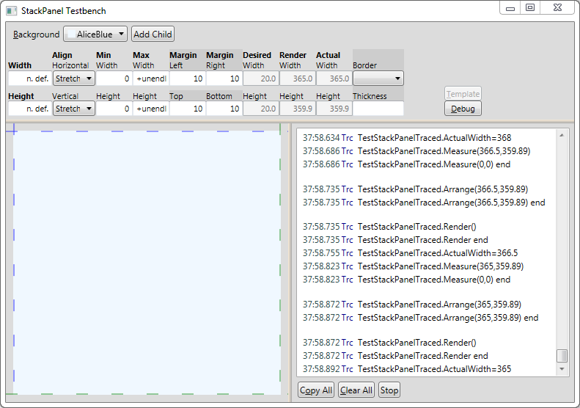

Slide 2
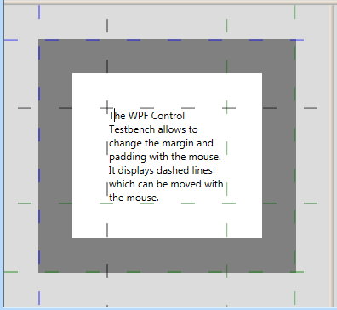
Horizontal Splitter
Margin Top Thickness
Top Margin Line
Border Top Thickness
Padding Top Thickness
Top Padding Line
Bottom Padding Line
Border Thickness
Bottom Margin Line

