Slide 1
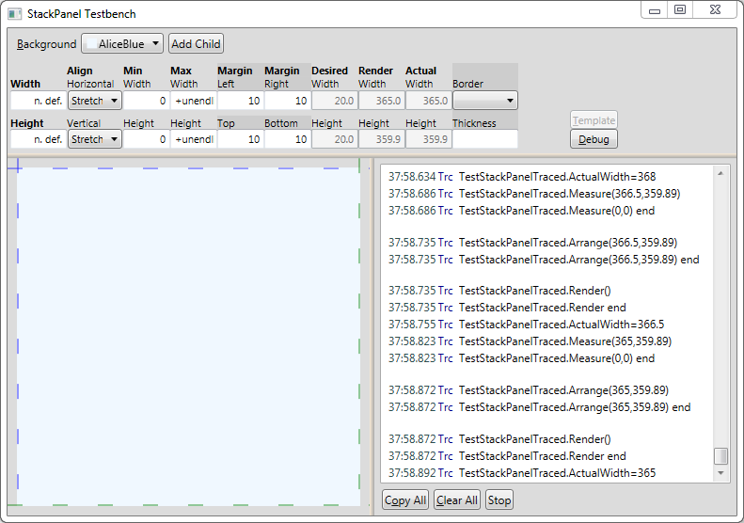

Slide 2
Custom Property
Standard
Property
Custom Control
Trace

Slide 3
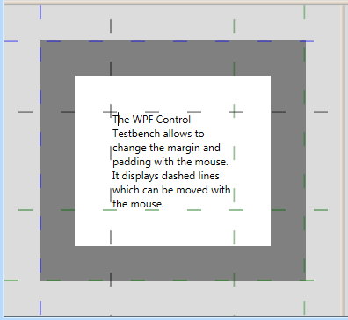
Horizontal Splitter
Top Margin Line
Border Thickness
Top Padding Line
Bottom Padding Line
Border Thickness
Bottom Margin Line

Slide 4
YourControlTestWindow: TestbenchWindow
Testbench
TestProperties
standardPropertyViewer
testControlContainer
TestControl

