Slide 1
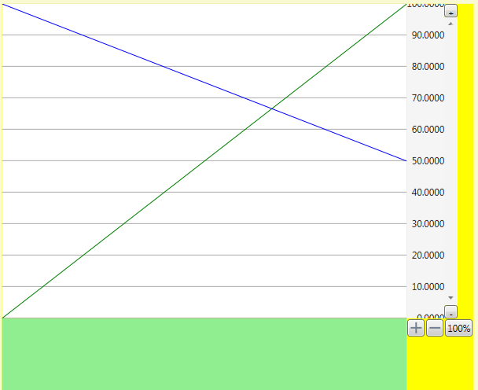
Composition XYGraph
XYGraph
PlotArea
YLegend-
Scroller
Renderers
YLegend
Scro
l
l
b
a
r
XLegendScroller
XLegend
XScrollbar

Slide 2
Calculations YLegend & ScrollBar
FullWidth
YOffset=Scrollbar.Value
ScrollbarHeight = ValueRange + ViewPort
8
7
6
5
4
3
+
ScrollLegend
MinValue |  | 200
MaxValue |  | 800
PageRange |  | 100
ValueRange |  | 600
ScrollRange |  | 500
Scrollbar
Minimum |  | 200
Maximum |  | 700
ViewPort |  | 100
Min + Max |  | 900
Scrollbar |  | ScrollLegend
Position | Value | Yoffset | Yoffset+Page
Low | 700 | 200 | 300
Middle | 450 | 450 | 550
Top | 200 | 700 | 800
Yoffset = MinValue + MaxValue - Value
Full
Height
/
YValue
Range
Page
Height
-
4 5 6 7 8 9 10 11 12
-
+
Width
ValueRange = maxValue-minValue
PixelPerValue = FullHeight / ValueRange
PageRange = Height / PixelPerValue
PageCount = FullHeight / Height
Scrollbar.Minimum = minValue
Scrollbar.Maximum = maxValue - PageRange
Scrollbar.LargeChange = PageRange
Scrollbar.SmallChange = Scrollbar.LargeChange / 10
Scrollbar.ViewPort = PageRange

Slide 3
Interaction of Controls: Creation
XYGraph
PlotArea
Renderer
YLegend-
Scroller
YLegend
Scrollbar
create
create
create
create
measure
Create gridlines renderer
Add gridlines renderer
InvalidateVisual
Add gridlines renderer
Measure
FullHeight
FullHeight
measure
Measure
No Data =>
Use Default for MinMax
InvalidateArrange
Calc Width
MinMax Value & Display
arrange
arrange
arrange
render
LabelCount,
Step
render
arrange
render
Set DisplayRange for gridlines
render
render
arrange
render

Slide 4
Interaction of Controls: Creation & FillData
XYGraph
PlotArea
Renderer
YLegend-
Scroller
YLegend
Scrollbar
create
create
create
create
FillData
clearRenderers
clearRenderers
Create gridlines renderer
Add gridlines renderer
InvalidateVisual
Add gridlines renderer
create
Set MinMaxValue
Set MinMaxFullValue
addRenderers
addRenderers
InvalidateMeasure &Visual
measure
Measure
FullHeight
FullHeight
Measure
No Data =>
Use Default for MinMax
InvalidateArrange
Calc Width
MinMax Value & Display
measure
arrange
arrange
arrange
render
LabelCount,
Step
render
arrange
render
Set DisplayRange for gridlines
render
render
arrange
render

Slide 5
XLegend: DataFlow
Measure
FontFamily
requiredHeight
FontSize
glyphDrawer
timeSpanUnitFormatter
Arrange
Render
Zoom
FullWidth
MinFullDate
MaxFullDate
PixelPerTick
MinDisplayDate
MaxDisplayDate
ActualWidth
Step
timeSpanUnit
MinDisplayLabelDate
MaxDisplayLabelDate
xxx
xxx
xxx

Slide 6
XLegendScroller: DataFlow
Measure
Change of available space, margin, border, padding, font
requiredHeight
FontSize
glyphDrawer
timeSpanUnitFormatter
DisplayIndex
Arrange
DisplayIndexRange
MaxIndex
MinDate
MaxDate
Render
DisplayDate
FullWidth
DisplayDateRange
PixelPerTick
ZoomIn()
IsZoomActive
ZoomOut()
MaxDisplayDate
Step
timeSpanUnit
MinDisplayLabelDate
MaxDisplayLabelDate
updateIndex()

Slide 7
YLegend: DataFlow
Measure
FontFamily
glyphDrawer
FontSize
SignificantDigits
numberFormat,
requiredWidth
MinFullValue
MaxFullValue
Arrange
Render
MinDisplayValue
displayRange
MaxDisplayValue
StepValue
RenderSize.Height
availableHeight
Padding
LabelsCount
LegendStrings

Slide 8
Visual
Zoom
RenderContent is implemented by derived classes to hook up their content. The implementer of this function can assert that the visual is marshaled on the current channel when the function is executed.
internal virtual void RenderContent(RenderContext ctx, bool isOnChannel){
This method is overrided on Visuals that can instantiate IDrawingContext. Currently, DrawingVisual and UIElement
internal virtual void RenderClose(IDrawingContent newContent){
sdf

Slide 9
CustomControlSample: ContentAlignment
Text
Text
Text
Text
Text
Text
Text
Text

