Slide 1
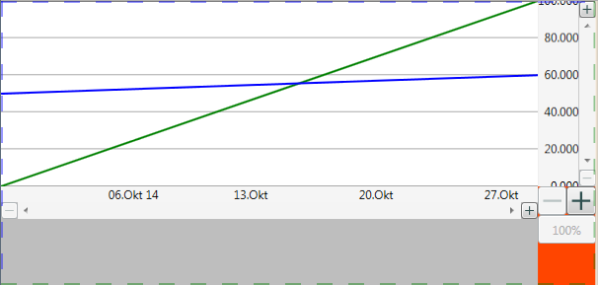
XYGraph
YLegendScroller
PlotArea
ZoomInButton
YLegend
Scrollbar
ZoomOutButton
XLegend-Scroller
totalZoomInButton
totalZoomOutButton
totalZoom100Button
ZoomOut
Button
XLegend
Scrollbar
ZoomIn
Button

Slide 2
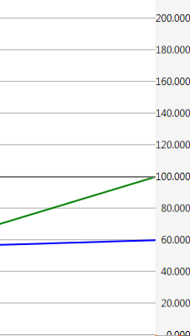
YLegendScroller
MaxValue
MaxValue - DisplayPageHeight
200 - 50 => 150
Scrollbar
MaxDisplayValue
Minimum | 0
Value | 50
Maximum | 150
DisplayPageHeight
MinDisplayValue
MinValue

