Slide 1
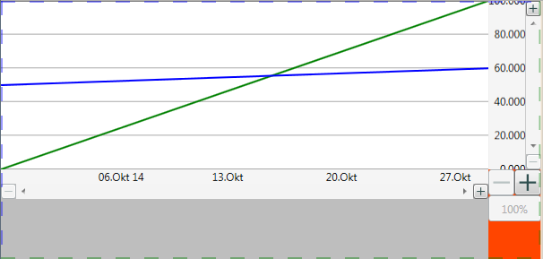
Example for simple Chart
YLegendScroller
PlotArea
ZoomInButton
YLegend
Scrollbar
ZoomOutButton
XLegend-Scroller
totalZoomInButton
totalZoomOutButton
totalZoom100Button
ZoomOut
Button
XLegend
Scrollbar
ZoomIn
Button

Slide 2
Chart
PlotAreas
LegendScrollerYs
LegendScrollerXs
Zoomers
double[][,]? DataSeries
SerieStyleEnum[]? serieStyle
FillData<TRecord>(
IEnumerable<TRecord>
newRecords,
SerieSetting<TRecord>[]
newSerieSettings)
PlotArea
Asks renderer to create Visuals
Renderers
RendererDataSeries
double[] MinValues
double[] MaxValues
double[][,] DataSeries
Renderer1Line
Creates a Visual with 1 line
Renderer2Lines
Creates a Visual with 2 line
Renderer
event Action<Renderer>?
RenderingRequested
double ScaleX
double ScaleY
Visual CreateVisual(
double width, double height)
RendererGridLineX
Creates a Visual for the horizontal grid lines
LegendScrollerY LegendScrollerY
RendererGridLineY
Creates a Visual for the vertical grid lines
LegendScrollerX LegendScrollerX
collection
RendererNotes
Creates a Visual for annotations displayed
over the graphics
LegendScrollerX LegendScrollerX
inheritance

Slide 3
Chart
PlotAreas
LegendScrollerYs
LegendScrollerXs
Zoomers
double[][,]? DataSeries
SerieStyleEnum[]? serieStyle
FillData<TRecord>(
IEnumerable<TRecord>
newRecords,
SerieSetting<TRecord>[]
newSerieSettings)
LegendScroller
double MinValue
double DisplayValue
double DisplayValueRange
double MaxValue
double ZoomFactor
Legend Legend
ZoomButton ZoomInButton
ScrollBar ScrollBar
ZoomButton ZoomOutButton
OnButtonScrollbarCreated()
AddRenderer(Renderer renderer)
LegendScrollerX
Works with LegendX
Controls Legend,
ZoomInButton,
ScrollBar and
ZoomOutButton
double ScrollBarHeight
LegendScrollerY
Works with LegendY
Controls Legend,
ZoomInButton,
ScrollBar and
ZoomOutButton
double ScrollBarWidth
Legend
double MinValue
double DisplayValue
double DisplayValueRange
double MaxValue
void Reset()
virtual void OnReset()
override Size ArrangeContentOverride (Rect arrangeRect)
virtual Size OnLegendArrange (Rect arrangeRect)
override Size MeasureContentOverride(Size availableSize)
virtual void OnFontChanged(bool hasOnlyFontSizeChanged)
virtual Size OnLegendMeasurement(Size requiredSize)
override void OnRenderContent(…)
virtual void OnProvideDefaultValues(…)
virtual Point OnContentAlignment(Size renderContentSize)
LegendX
Calculates which values
get displayed in a
horizontal legend and
the size needed. Used
for doubles.
LegendXDate
Calculates which dates
get displayed in a
horizontal legend and
the size needed.
DateTime DisplayDate
TimeSpan DisplayDateRange
LegendY
Calculates which values
get displayed in a
Vertical legend and
the size needed. Used
for doubles.
LegendXString
Calculates which strings
get displayed in a
horizontal legend and
the size needed.
String[] Strings
collection
inheritance

Slide 4
Data Transformation
Host Application
Creates 1 data sample (measurements) at a time
consisting of an x value (often time stamp) and
several Y values (measurements). It’s up to the
host app how to store the data.
Record Index | Time- Stamp | Value1 | Value2
0 | 08:00 | 10 | 20
1 | 09:00 | 12 | 25
2 | 10:00 | 16 | 18
← TRecord, data sample 0
← TRecord , data sample 1
IEnumerable<TRecord> newRecords
← TRecord , data sample 2
Chart.FillData()
Chart
Stores the data to be drawn in DataSeries:
double[SerieIndex][RecordIndex, ValueIndex]
ValueIndex==0 is always the TimeStamp (X) and
the other indices retrieve one or several Y
values.
It’s easier to draw a line if the line’s data (DataSerie) is stored in one array.
Record Index | 0 | 1 | 2
DataSerie Values 1 | X: 08:00 Y: 10 | X: 09:00 Y: 12 | X: 10:00 Y: 16
DataSerieValues 2 | X: 08:00 Y: 20 | X: 09:00 Y: 25 | X: 10:00 Y: 18
← Timestamp
← Value 1
← Timestamp
← Value 2
Chart.FillData()
Rearranges data stored as data sample (measurement) arrays into arrays where the data is stored per DataSerie. Chart.FillData() has 2 parameters:
IEnumerable<TRecord> newRecords //loops over the data sample (measurements)
SerieSetting<TRecord>[] newSerieSettings //contains some instructions how to get the data:
public class SerieSetting<TRecord> {
public Func<TRecord, double[]> Getter { get; set; }
}
Getter is a function delegate which takes the X (timestamp) and one particular Y from the TRecord and returns an array with X and Y. FillData() uses Getter() to copy to data from IEnumerable<TRecord> to
DataSeries.

Slide 5
Example for complex Chart

Slide 6
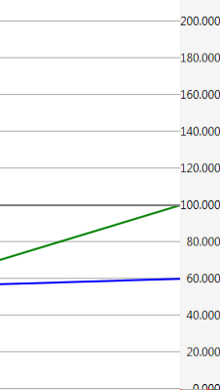
YLegendScroller
MaxValue
MaxValue - DisplayPageHeight
200 - 50 => 150
Scrollbar
MaxDisplayValue
Minimum | 0
Value | 50
Maximum | 150
DisplayPageHeight
MinDisplayValue
MinValue

