Slide 1
Fuel-System Digital Twin
Detecting and diagnosing faults in an aircraft fuel rig with physics, machine learning and honest validation
Avwerosuo Peter Imoniose | Data science project
github.com/PeterImoniose/fuel-system-digital-twin
Notes:
A data-science project on a laboratory fuel-system rig: can we tell from a few sensors whether it is healthy, which component is failing, how badly, and how early, and can we trust the answer?

Slide 2
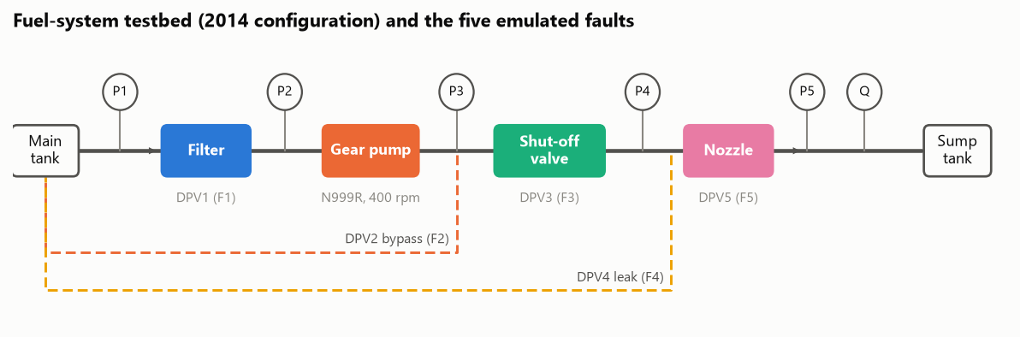
Five ways a fuel system fails, one set of sensors
A gear pump feeds a filter, a shut-off valve and an injector; five valves emulate the faults
1
Is the system healthy?
2
Which component is failing, and how badly?
3
How early, and with what confidence?
2
Notes:
Clogged filter, degraded pump, stuck valve, leaking pipe and clogged injector, each emulated by a proportional valve at increasing severity. Sensors: five pressures, one flow meter at the end of the line, and the pump speed.

Slide 3
The data: 2.8 million sensor readings and 22 pump tests
47
5
2.8 M
22
rig recordings, 60 s each at 1 kHz: 6 healthy, 41 faulty
fault types at up to 9 severities each (10-100 % valve travel)
samples, averaged into 2 820 one-second windows
pump tests at 400-1140 rpm from two campaigns (2021, 2023)
● Data audit first: mixed gauge and absolute pressures, a sensor clipped at zero, mislabelled columns and a header that hides the real start time.
● Python package for loading and cleaning (LabVIEW files, units, derived pressure drops), with unit tests.
● Eight notebooks from audit to live monitoring, all rebuilt from raw data with one command.
3
Notes:
The audit turned up issues that would silently corrupt an analysis: pressures on two different references, a clipped sensor, mislabelled channels. These became data-quality checks in the final system.

Slide 4
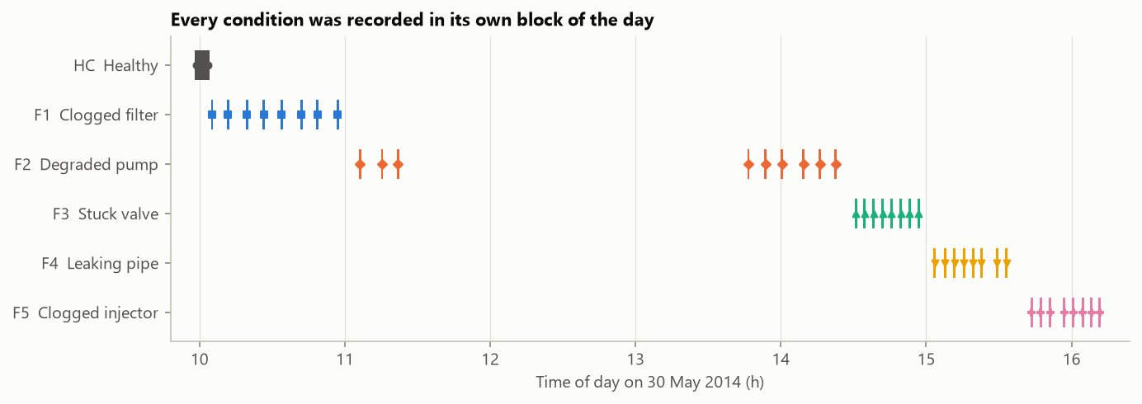
The catch: every fault was recorded at a different time of day
96 %
of windows named correctly by a model that sees only the clock
● Healthy data exists only for 09:58-10:03; faults follow in blocks until 16:11.
● So accuracy alone proves nothing here: the key results come from tests the clock cannot help with.
4
Notes:
A random forest given only the time of day scores 96 % when each recording is held out, better than any sensor model. This is the single most important finding about the data, and it shaped every validation choice.

Slide 5
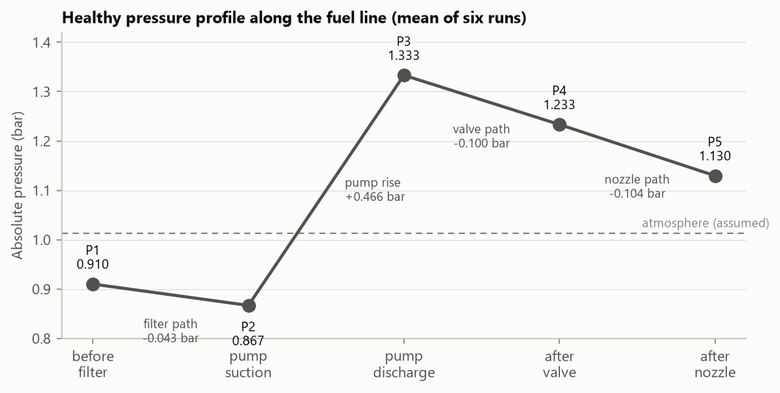
Normal is repeatable, and the noise is the pump itself
0.06 %
variation in flow between healthy runs
~75 %
of pressure fluctuation sits at the pump's shaft frequency and harmonics
1-3.5 %
drop in pump delivery by the afternoon: drift, not a fault
Healthy limits belong on 1 s averages: limits on raw samples are 2-14 times wider and hide small faults.
5
Notes:
Pressure falls along the line through the filter, rises 0.47 bar across the pump, then falls across the valve and nozzle. Frequency analysis shows the noise is pump ripple at 6.7 Hz and a gear-mesh line at 80 Hz. The healthy point also drifts through the day, about as much as the mildest faults.

Slide 6
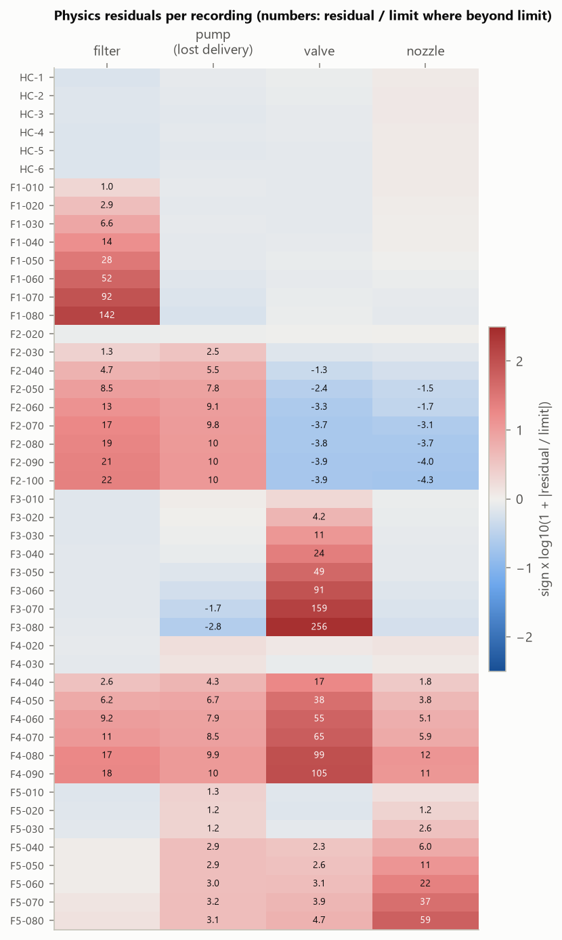
Physics-based indicators tell all five faults apart
● One indicator per pipe section: measured pressure drop against what a healthy section would show at that flow.
● Fitted without the fault being scored (leave-one-fault-out), so no fault ever sees its own data.
● Each fault lights up its own pattern, including filter, pump and leak faults that the rig's expert rules cannot separate.
Key insight: leak flow still passes through the shut-off valve before escaping, so the valve's pressure drop rises for a leak but falls for a pump fault. One physical fact resolves the ambiguity.
6
Notes:
Each section obeys a pressure-flow law while healthy. Residuals against those laws, plus a pump residual for flow that never reaches the meter, give every fault a distinct pattern. The heatmap shows all 47 recordings.

Slide 7
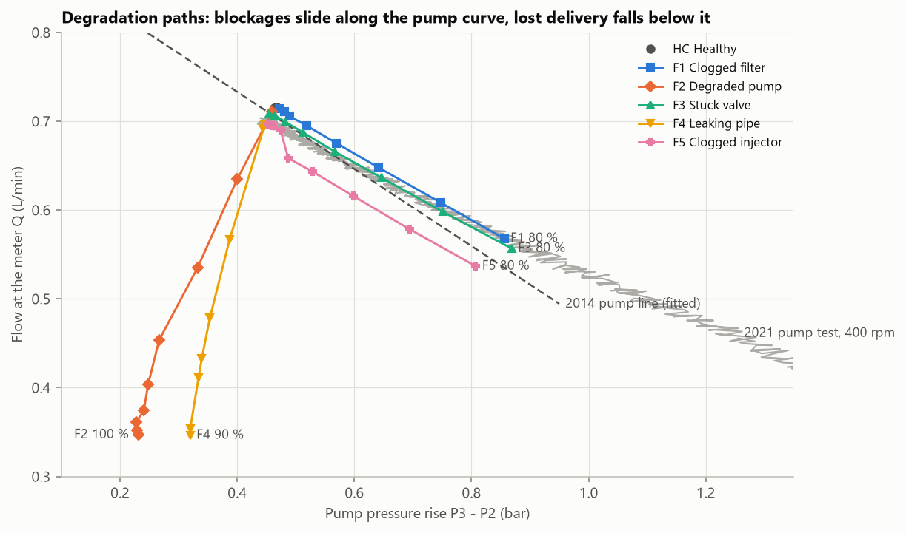
Blockages slide along the pump curve; lost flow falls below it
● Filter, valve, nozzle: higher pressure, lower flow, on the pump's own curve.
● Pump bypass and leak: lower pressure and lower flow: part of the flow never arrives.
● The 2014 pump curve is steeper than in 2021-23, so a pump model must be recalibrated on the asset it monitors.
7
Notes:
Plotting every recording on the pump's pressure-flow plane shows each fault as a path. This view explains why restriction faults and lost-flow faults look different to the pump.

Slide 8
Fault diagnosis: the split matters more than the model
Macro F1 on 1 s windows. Grey: leave one recording out. Amber: train on severe faults, test on mild ones
● Shuffled splits score 1.00 for every tree model: windows of one recording are near copies.
● Standard classifiers collapse on mild faults: they learn distance from healthy, not direction.
● Physics rules hold up with no clock and no data from the fault: the cleanest evidence.
8
Notes:
Leave-one-recording-out scores are high for many models, but the clock alone does as well. Training on clear faults and testing on mild ones separates the approaches: methods that use the direction of a deviation generalise, standard classifiers do not.

Slide 9
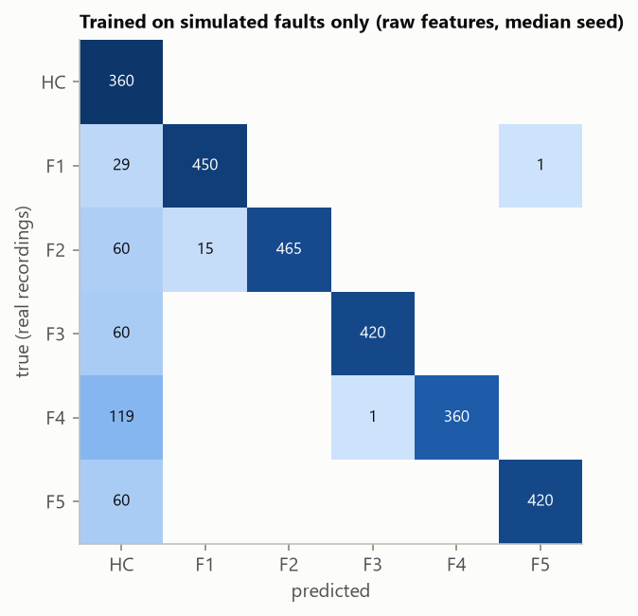
Simulated faults can stand in for real fault data
A classifier trained only on faults generated by a calibrated model of the rig, tested on the real recordings
0.87
● Misses are the mildest settings, called healthy: the safe direction.
● Caveat: the healthy boundary does not transfer yet (some healthy windows flagged, depending on the seed).
● So it runs as a second opinion, never raising an alarm on its own.
macro F1 on real data (+/- 0.03 over five seeds)
40-42 / 47
real recordings named correctly
0
real fault labels used in training
9
Notes:
A steady-state network model joins the identified component laws. Faults are injected over wide ranges with random drift and noise, and a gradient-boosting classifier is trained on the synthetic data only.

Slide 10
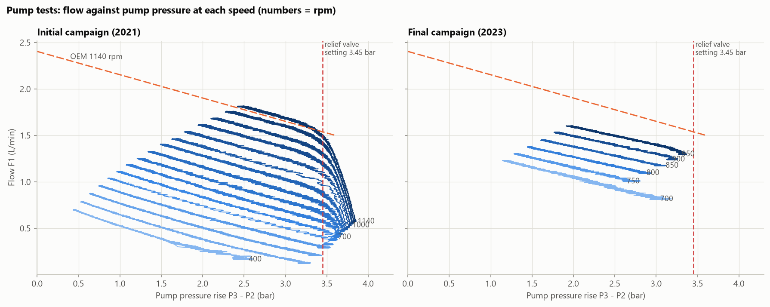
The pump matches its datasheet; a relief valve caps pressure
● 2021 tests closed the valves to 10 % open and pushed past the relief valve; 2023 tests stopped at 25-35 %.
● Displacement is constant (2.1 mL/rev); internal leakage changes from day to day.
● Day-to-day shifts of 3-10 % dominate real error, so the model keeps displacement fixed and re-estimates leakage.
● Found an error in the published verification figures: 3.6 %, not under 1.5 %.
< 2.3 %
3.45 bar
~1 %
from the OEM datasheet at 1140 rpm
built-in relief valve: flow collapses past it
physics model error on an unseen speed
10
Notes:
Straight-line fits per speed give displacement and slip. The pump matches its datasheet; the flow collapse in the first campaign is the relief valve opening at 50 psig.

Slide 11
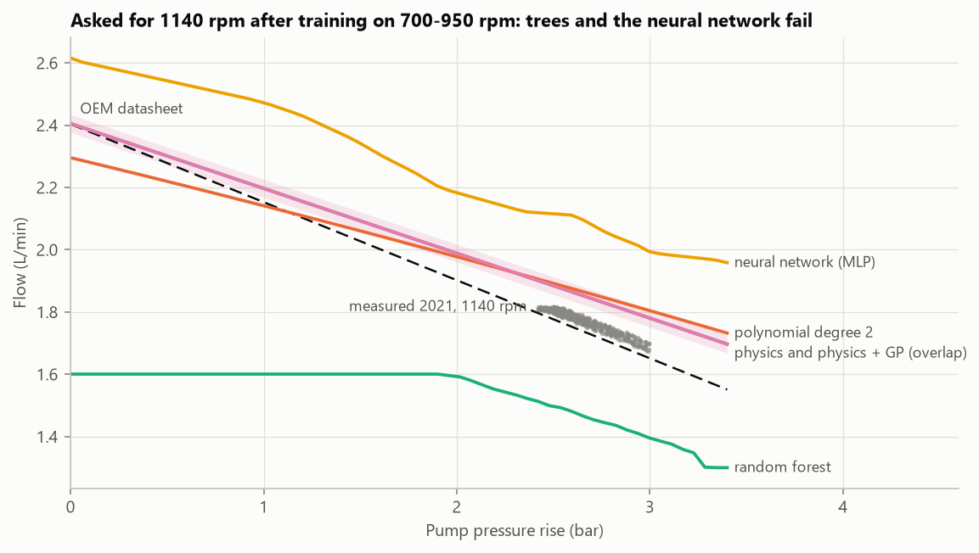
Regression: test on what the model has not seen
Pump flow from speed and pressure; error when a whole pump speed is held out (L/min, lower is better)
● Trees cannot predict an unseen speed: they copy the nearest one.
● Training R² kept rising with polynomial degree while accuracy on new conditions fell.
● The hybrid adds prediction intervals, which hold within a test day but not across days.
11
Notes:
The earlier version of this project reported R-squared 0.997 on a shuffled split. Testing on held-out speeds, independent points and another campaign shows which models really generalise.

Slide 12
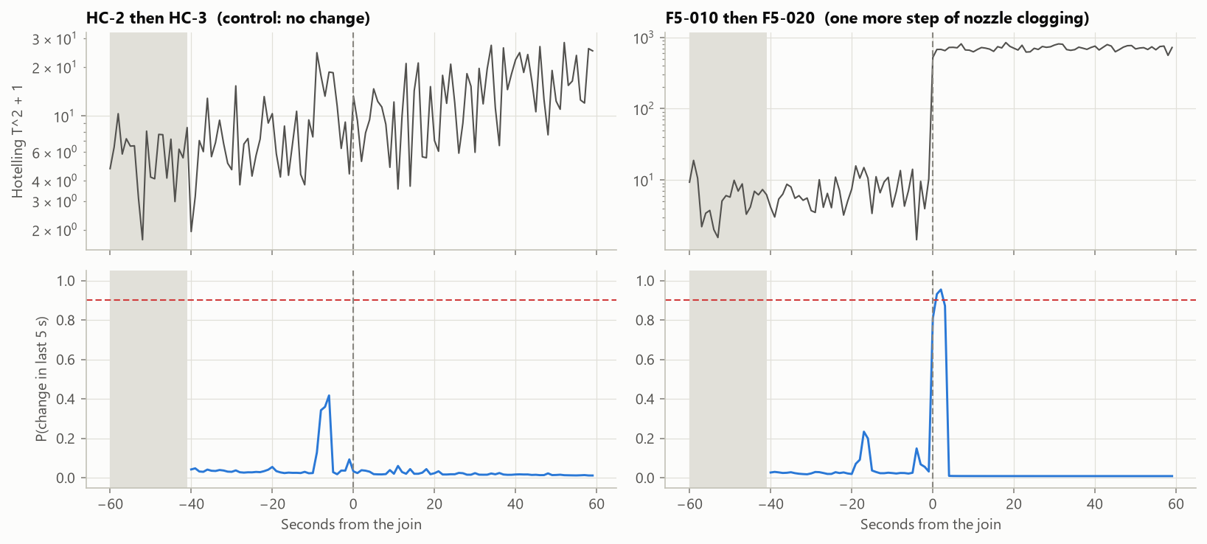
Live monitoring: catch the change, not the anomaly
Calibrated on healthy data only, then run on streams of real recordings
< 1 s
to catch each real step of degradation (CUSUM and Bayesian change points)
1-3 %
extra resistance when a slow, simulated clog is first flagged
● Anomaly detectors trained on 5 minutes of healthy data flag everything that follows (even settings with no fault): a data-coverage limit, not an algorithm one.
● Kalman-smoothed indicators lift accuracy on borderline recordings by 10-15 points.
12
Notes:
Comparing against the recent past works where comparing against a fixed healthy reference fails. The Bayesian detector raised no false alarms on healthy streams.

Slide 13
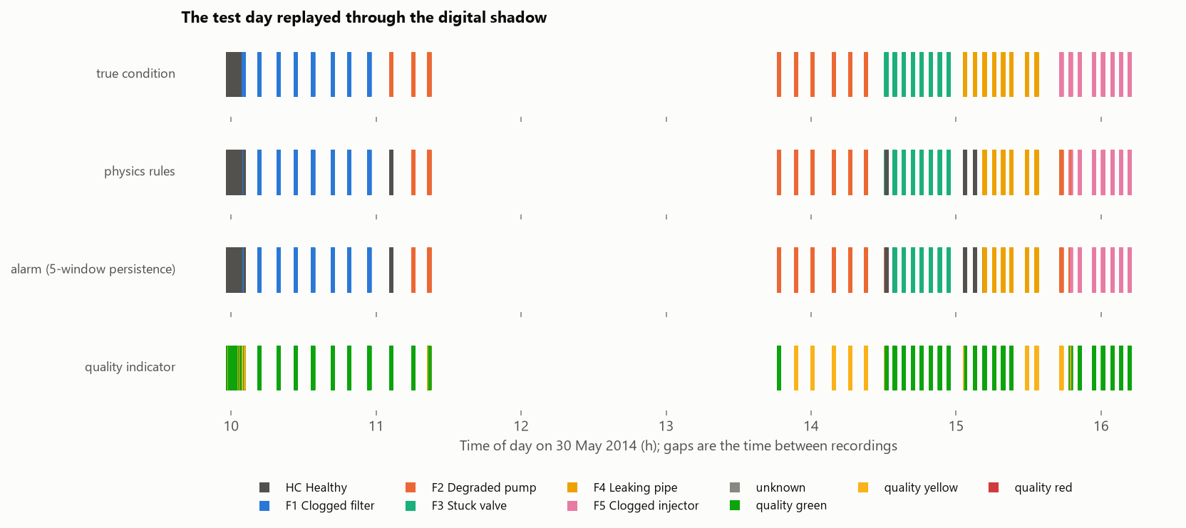
Putting it together: the whole test day replayed live
0
41 / 47
100 %
false alarms on healthy data
recordings end on the right condition
of the one drift-caused mistake flagged as low confidence
13
Notes:
The digital shadow combines the physics indicators, the rules, a simulation-trained second opinion, a 5-second persistence rule and a green/yellow/red quality indicator. The misses are settings with no physical effect, the two mildest blockages, and one case of drift.

Slide 14
What limits it is the data, not the algorithms
Next steps that would turn the digital shadow into a digital twin
1
Measure fluid temperature
2
Record healthy data all day
3
Randomise the fault schedule
It drives the pump drift that mimics faults.
Five minutes cannot define normal.
Removes the time-of-day shortcut.
4
Fix the sensor gaps
5
Add a second flow meter
6
Close the loop
Log air pressure; widen the clipped sensor's range.
Measures lost flow directly at the pump.
Feed actions back, such as pump speed or isolating a leak.
14
Notes:
Every limit met in the project points to a concrete fix, mostly in what data is collected rather than in the models.

Slide 15
Tools and skills
Data engineering
Analysis
Python package, LabVIEW parsing, unit handling, data audit, pytest
pandas, NumPy, SciPy, spectral analysis, physics-based feature design
Machine learning
Validation
scikit-learn classifiers and regressors, Gaussian processes, anomaly detection
leave-one-group-out, shortcut tests, train-severe/test-mild, independent test sets
Monitoring
Delivery
CUSUM, Bayesian change points, Kalman filters, simulation-based training
executed notebooks, Streamlit app, reproducible build, this deck
Code, notebooks and app: github.com/PeterImoniose/fuel-system-digital-twin
Notes:
Everything is reproducible from the raw data with one command; the repository has the notebooks, the package, tests and an interactive app.

