Slide 1

CRISPR/Cas9 guide-RNA Generation and FPGA Technology
Peter Ferrarotto

Slide 2
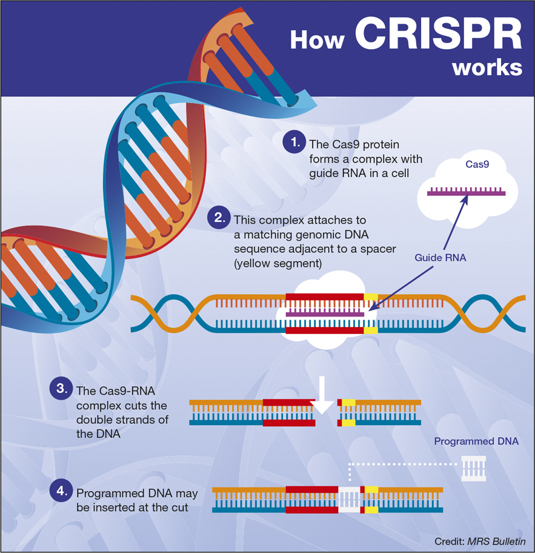
CRISPR/Cas9
Clustered Regularly Interspaced Short Palindromic Repeats
  Bacterial defense/propagation system
CRISPR technology is based upon this system
  Uses Cas9 enzyme to cut DNA, and various other methods to repair it and insert the designed DNA sequence

Slide 3
Guide RNA
Guide RNA tells the Cas9 enzyme where to cut
Cas9 will cut at approximate locations called ‘off-targets’
Guide Sequences generated from relatively small sequence (~500 BP)
Finds PAM sites (specific to the type of enzyme being used – most common is NGG)
Guide Sequence is 20 base pairs and the 3 base pairs in the PAM site
Off-targets found in organism genome
Off-target is sequence that almost matches
Usually the threshold is up to four mismatches
Not actually used as guide, but used to score the guide

Slide 4
Guide Sequence Selection
To select a guide sequence, each of the 23 BP sequences are scored
To do that, each of the off-targets for each sequence must also be scored

Slide 5

Off-Target Scoring (Provided by MIT)
$$S_{hit}=\prod_{e∈M}{\left(1−W\left[e\right]\right)×\frac{1}{\left(\frac{19−\overline{d}}{19}×4+1\right)}×\frac{1}{n_{mm}^{2}}}$$
M = [0, 0, 0.014, 0, 0, 0.395, 0.317, 0, 0.389, 0.079, 0.445, 0.508, 0.613, 0.851, 0.732, 0.828, 0.615, 0.804, 0.685, 0.583]

Slide 6

Sequence Scoring (Provided by MIT)
$$S_{guide}=\frac{100}{100+\sum_{i=1}^{n_{mm}}{S_{hit}(h_{i})} }$$
Off-targets with low scores produce the best results

Slide 7
Guide RNA Generation
The complete Guide RNA is the selected sequence (translated to RNA), and then a variable amount of RNA specific to the organism
This process is usually done by offloading the process to servers
  These servers run BLAST algorithms – very software intensive

Slide 8
Guide RNA Generation, Continued
The software-intensive nature of this means that there is a significant bottleneck
When optimal, still somewhat slow – about 30 minutes to generate guides for an organism with > 1,000,000 BP

Slide 9
An Alternative
Run the algorithm on specialized hardware – much faster than software
Caveat – producing hardware is time-consuming and expensive, and when (not if) the design needs to be reworked, have to repeat process completely
  Solution – FPGA board for prototyping

Slide 10
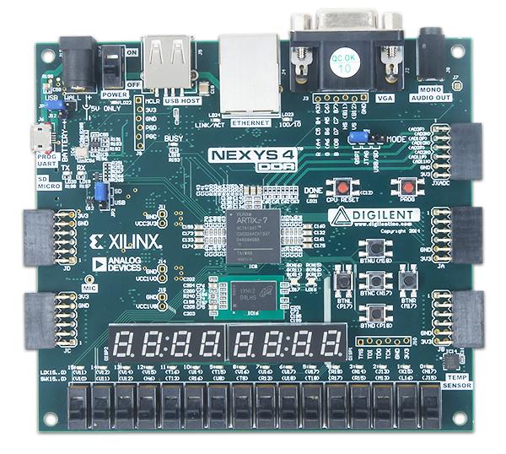
FPGA Board
Nexys 4 DDR
Primary reason used is due to presence of DDR memory and on-board micro-SD card slot
  Can take input from and store ouput on the micro SD card rather than over a USB connection

Slide 11

Specifications
First, needs to be able to find locations in a sequence based on an input
Second, needs to be able to access SD card for I/O
  Has to be able to read the files in a way that it can easily search
Third, search algorithm must be controllable with the ability to accept input and run continuously over a large set of data
Finally, must be able to reliably score guides and off-targets

Slide 12
The First Challenge – The Search Algorithm
Before we begin to work on input and output of data, we must first know what to do with that data
BLAST algorithm would be incredibly difficult to implement in hardware – actually impossible due to sheer complexity
Can’t use a search that requires a sorted set – need to preserve the locations of base pairs in the sequence
As such, two forms of a chunk-based linear search were used

Slide 13
Linear Search in Hardware
Unfortunately, can’t just call “find” and return all the locations in hardware
1
Also unfortunately, for loops don’t work in hardware
2
In hardware languages, for loops are only used to generate repetitive hardware
Finally, need to be able to hold the sequences being searched through/for in a convenient and efficient way
3

Slide 14
First – The Data
Don’t want to store as ASCII characters – eight bits for each nucleotide could introduce significant overhead to both speed and space complexity of algorithm
Instead, translate each nucleotide to 4 bits – positional logic:
A = 0001
G = 0010
C = 0100
T = 1000
Half the overhead, while still containing the same amount of data

Slide 15
Second – The Algorithm Itself
As mentioned, two chunk-based linear search algorithms used
First uses a chunk size of eight bits – used to find the two ‘GG’ nucleotides for a PAM site
The second uses a chunk size of sixteen bits – four nucleotides at a time – to find the off-target sites.
Since we can’t just write C-like code, needs to be done with hardware in mind
Need to design two separate state machines for the two different algorithms
(N refers to any nucleotide, so can be ignored)
Only look for first twenty – last three (PAM) don’t matter in off-target searches
So, five chunks need to be compared
Both algorithms also need various input/output registers, and internal registers for storing input and performing calculations
Also need to select between two languages – VHDL, and Verilog

Slide 16
Language Selection
Initially wanted to use VHDL – familiar with it
1
However, not able to quickly perform calculations like addition, subtraction, or comparisons on registers
2
In contrast, Verilog can perform these calculations on any register (or wire) – as such, chose to code in Verilog
3

Slide 17
PAM Search – Input and Output
Needs to accept input of 500 BP – each represented in 4 bits
  So, needs input register of 2000 bits
Also, because it can only return one value at a time, it needs a position to start at within the larger sequence
  This needs to be able to represent up to 1999 – the final position in the sequence
    Registers are zero-indexed
  So, need to have 11 bits
Same for the output of the position – needs 11 bits
Also needs multiple control bits
  Generic – needs a clock bit and a reset bit
  Input – Needs a ‘Start’ bit
  Output – needs a ‘Done’ and ‘Found’ bit

Slide 18
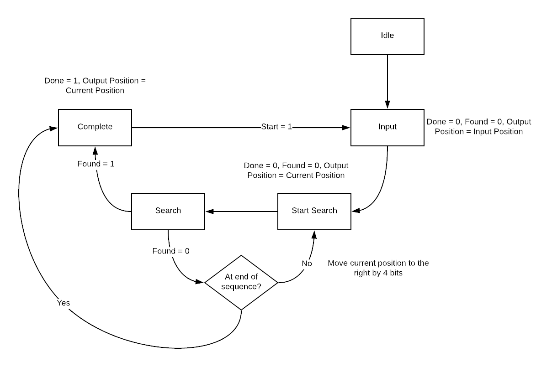
PAM Search State Machine

Slide 19
Off Target Search – Input and Output
Decided to make maximum input 1000 BP due to fear of register overflow
1
Need 4000 bits for organism genome segment (will return to this)
Need input for 20 BP guide sequence
2
Need 80 bits for guide sequence
Need two inputs for position – one for start position in genome, one for location of off target in genome
3
Need 12 bits each for position
Need control signals:
4
Generic – Clock, Reset
Input – Start
Output – Done, Found

Slide 20
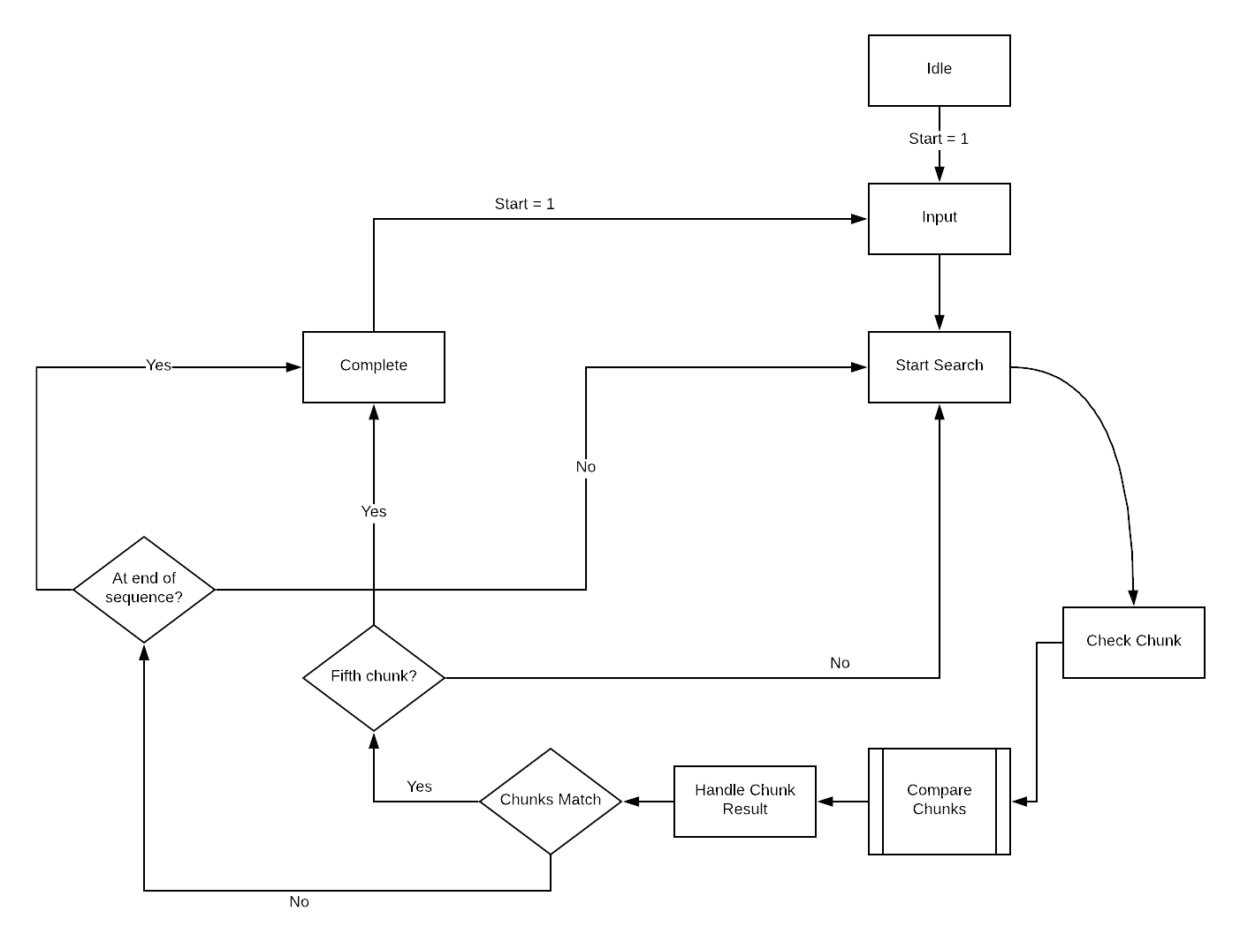
Off Target Search State Machine

Slide 21
The Second Challenge – I/O
Primary challenge is to read from and write to micro SD card
Can use just hardware to read and write – but would have to directly access the memory in the SD card
Better alternative is to use FatFS generic file system
Nearly impossible to replicate through hardware alone – requires complicated assembly instructions to allocate and find locations in memory
Solution – Microblaze
Softcore processor for Nexys 4 DDR written in Verilog
Can tie into generic modules provided by Xilinx – for example, the SD card reading module
Provides basic kernel for executing C/C++ code on

Slide 22
Third Challenge – Control and Parameters
Now that Microblaze is being used, will have to write code in C++ to be able to access SD card
  Need to use C++ to accommodate SD module source code
Search algorithm will also need to be controlled by Microblaze to ensure continuous execution
  Only way to do this is to create IP Modules
  Provide a framework for interaction with VHDL/Verilog code
  Uses registers in memory as input and output – write to registers with Xilinx functions in C++
  Creates a block to be used in the block design with Microblaze

Slide 23
Strict Limitation - IP Module Parameters
Can only have input registers of up to 32 bits each
  Need to segment for use in search algorithms, which require >> 32 bits for each sequence input

Slide 24
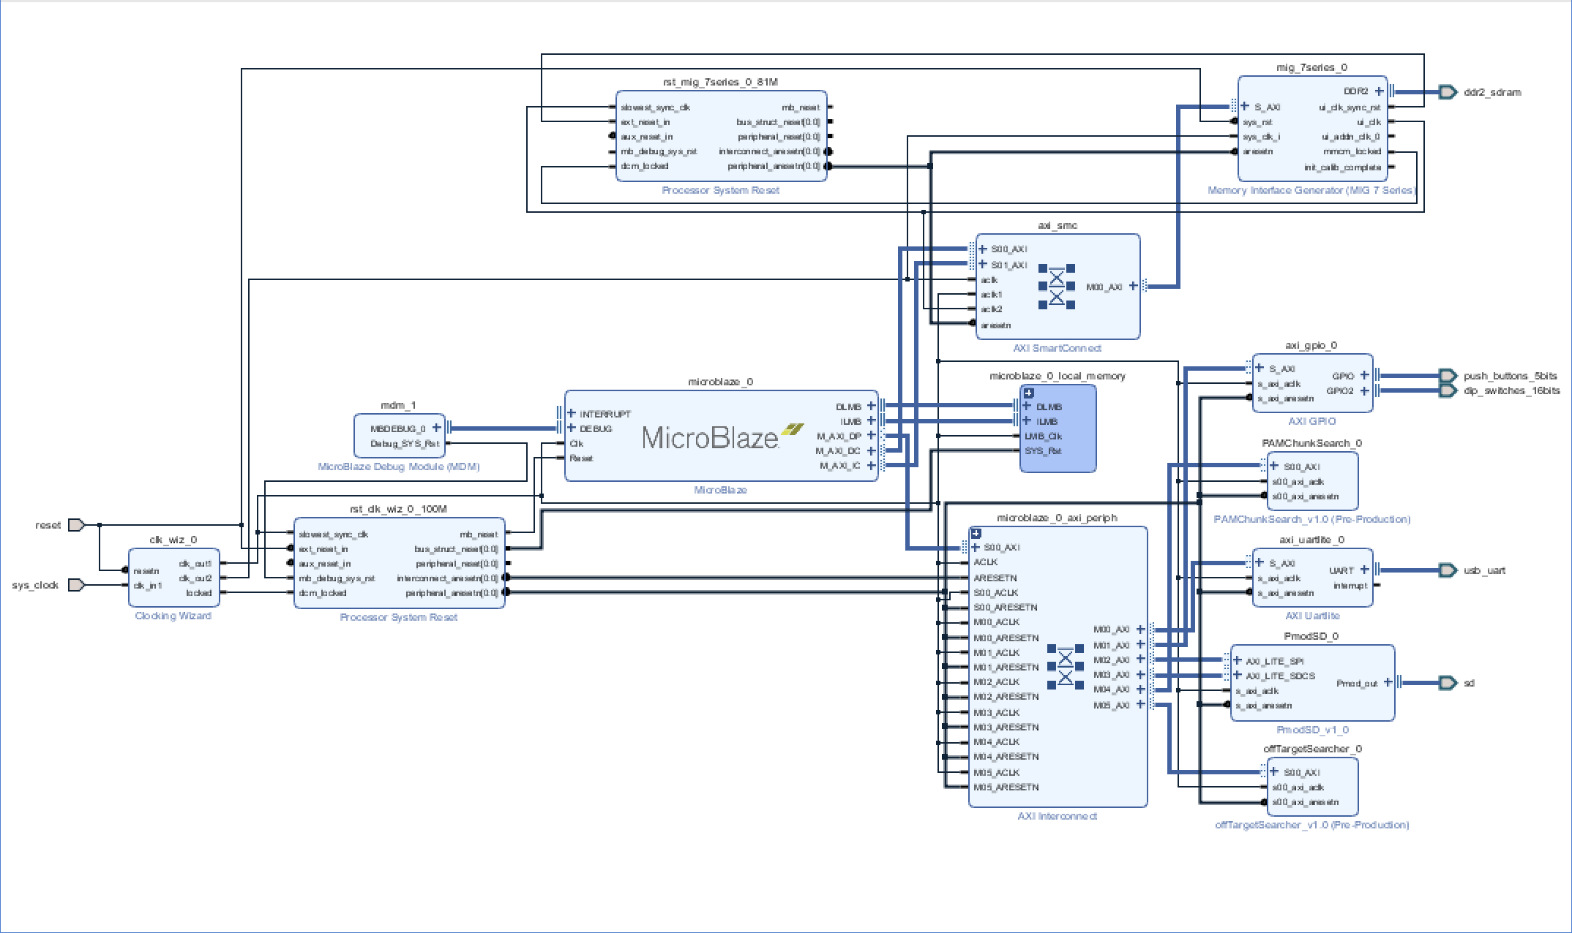
Final Hardware Design

Slide 25
Control and Continuous Execution
VERY BIG ISSUE – Genomes of most organisms are absolutely MASSIVE
Humans have 3.1 Billion base pairs. Mice have 2.7 Billion. Some amoeba have up to 670 Billion base pairs.
Incapable of storing 12.4 Billion bits in FPGA board
As such, utilizing genome of Carsonella Candidatus Raddii, with only about 170,000 base pairs.
However, this still requires about 600,000 bits – and current hardware only accepts 1,000 bit segments for finding off-targets

Slide 26
Control and Continuous Execution, Cont.
Solution is to split text file containing entire genome of Carsonella into separate files, each containing 1000 base pairs.
But need to be sure that any possible off-targets between these 1000 base pairs aren’t missed
As such, split them at every 981 nucleotides – ensuring that if there’s any overlap of up to 20 base pairs, they won’t be missed
Using the C++ code, pre-load all files containing genome into board’s memory
Able to hold up to 4 MB, so this amount of data is feasible
Then, when looking for off-targets, input each sequential segment to the off-target search algorithm once each one is complete, and repeat for every guide sequence found

Slide 27
Final Challenge – Grading Off-Targets and Guides
Could be done in hardware, but would be very difficult due to complexity of operations
  Instead, currently programmed in C++, alongside the code controlling the search algorithms
  May look into remaking in hardware in the future, but for now, the current grading algorithm is sufficient

Slide 28

Remaining Issues
Microblaze is only an emulation of a computer/kernel – as such, it is much slower at executing instructions than an actual computer.
  No multithreading or forking – only one thread and process
There isn’t much to benchmark this against in terms of speed – would need direct access to MIT’s proprietary Crispr gRNA generation suite – even then, it does not offer Carsonella as an organism to use in the generation process
Slight bottleneck when inputting genome sequence segments to the off-target search module

Slide 29
Moving Forward
Can make several changes to address multiple issues
First, can use an FPGA Shield for an Arduino Yun instead of an FPGA board
Yun has on-board Linux
Could simplify hardware significantly
Arduino would allow for larger storage space
Redo hardware for higher volume of data traffic
Have multiple modules for searching for threading/processes
Maybe add ability to off-target search module to hold entirety of organism genome
Would need to include error bits

Slide 30
Acknowledgements
https://www.crispr.mit.edu/about
https://www.cam.ac.uk/subjects/crispr
https://www.addgene.org/crispr/guide/
Dan Paull – New York Stem Cell Foundation

