Slide 1
SOME SIMPLE MANIPULATIONS OF SOUND USING DIGITAL SIGNAL PROCESSING
Richard M. Stern
18-491 demo
January 14, 2013
Department of Electrical and Computer Engineering
and School of Computer Science
Carnegie Mellon University
Pittsburgh, Pennsylvania 15213

Slide 2
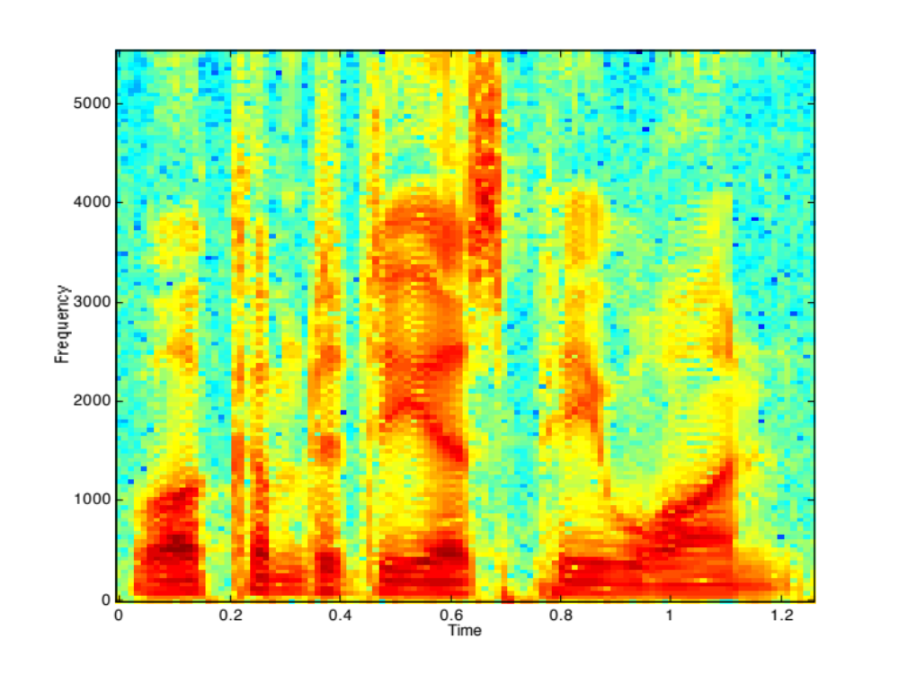

The original sound and its spectrogram

Slide 3
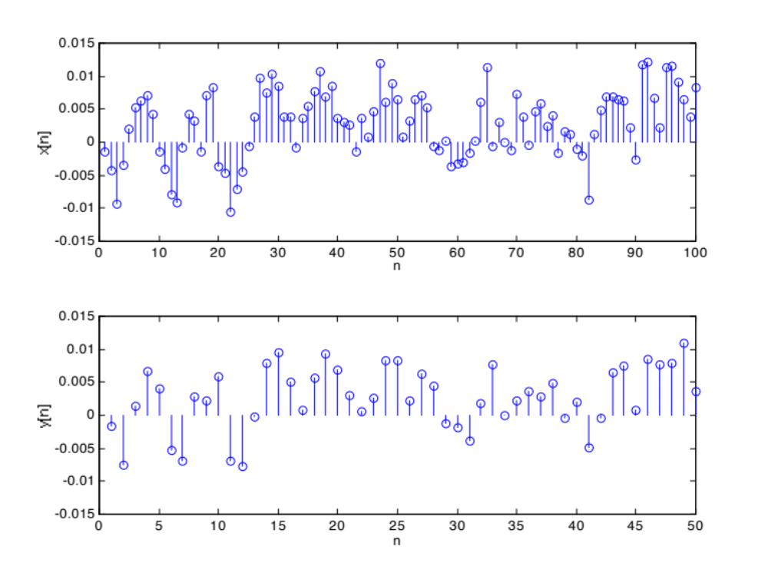
Downsampling the waveform
Downsampling the waveform by factor of 2:

Slide 4
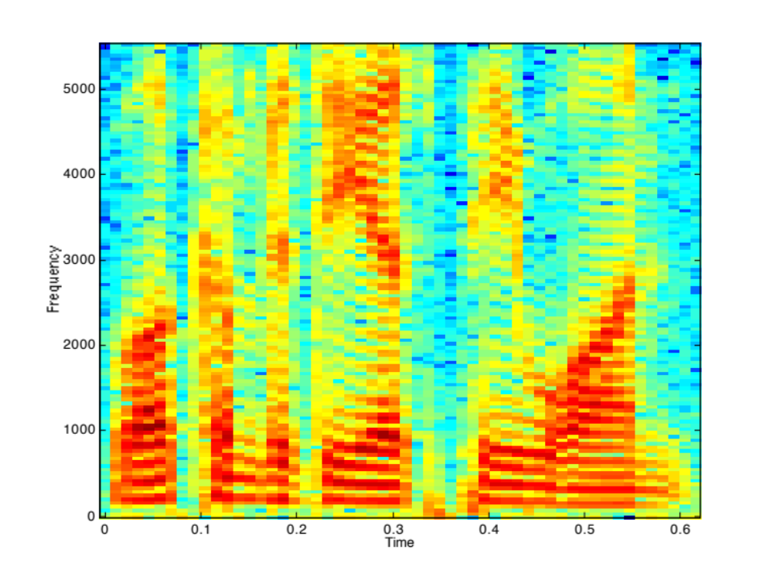
Consequences of downsampling
Downsample
Original:
Downsampled:

Slide 5
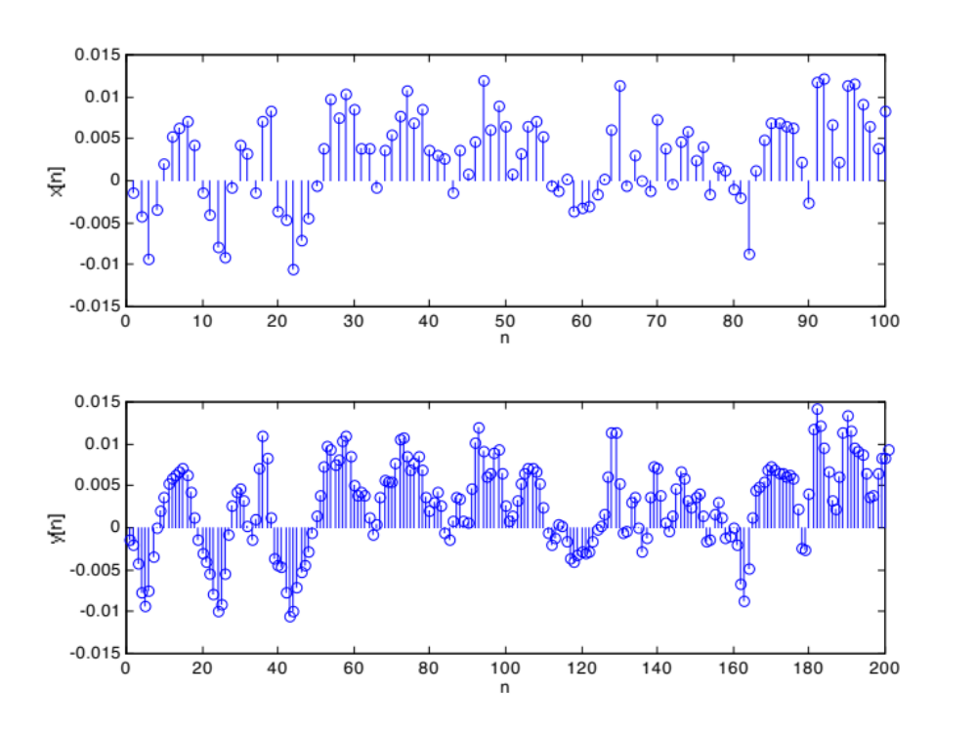
Upsampling the waveform
Upsampling by a factor of 2:

Slide 6
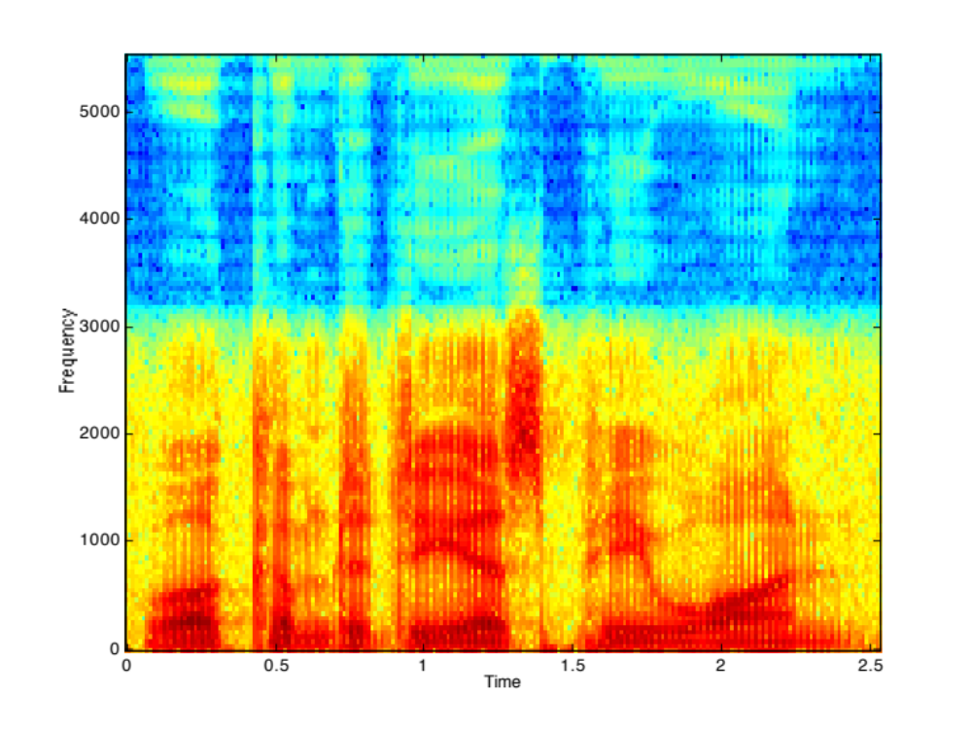
Consequences of upsampling
Original:
Upsampled:

Slide 7
Linear filtering the waveform
x[n]
y[n]
Filter 1:
y[n] = 3.6y[n–1]+5.0y[n–2]–3.2y[n–3]+.82y[n–4]
+.013x[n]–.032x[n–1]+.044x[n–2]–.033x[n–3]+.013x[n–4]
Filter 2:
y[n] = 2.7y[n–1]–3.3y[n–2]+2.0y[n–3–.57y[n–4]
+.35x[n]–1.3x[n–1]+2.0x[n–2]–1.3x[n–3]+.35x[n–4]

Slide 8
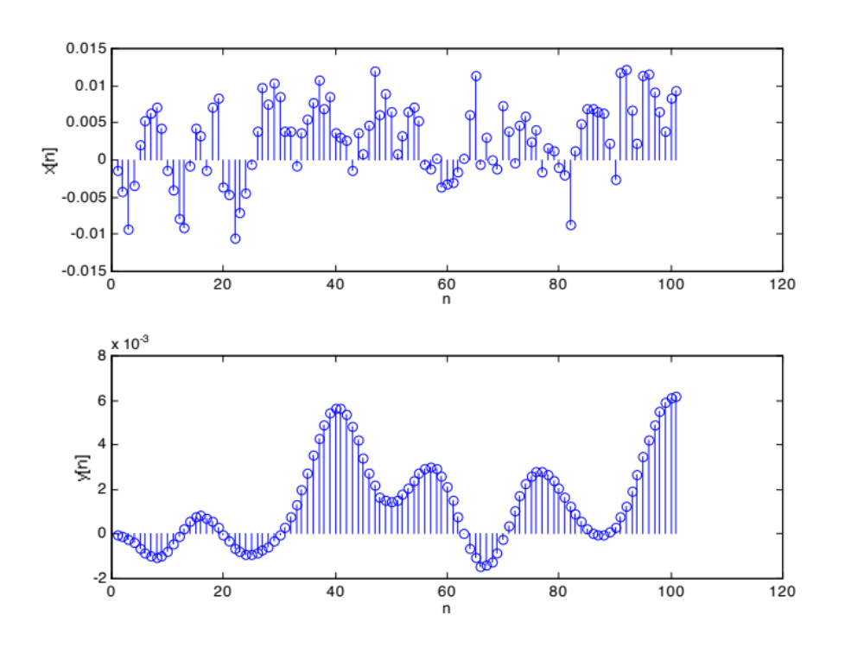
Filter 1 in the time domain

Slide 9
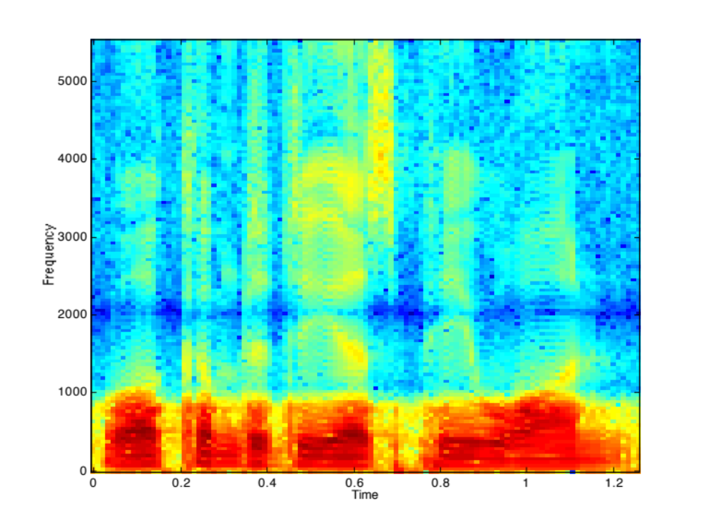
Output of Filter 1 in the frequency domain
Original:
Lowpass:

Slide 10
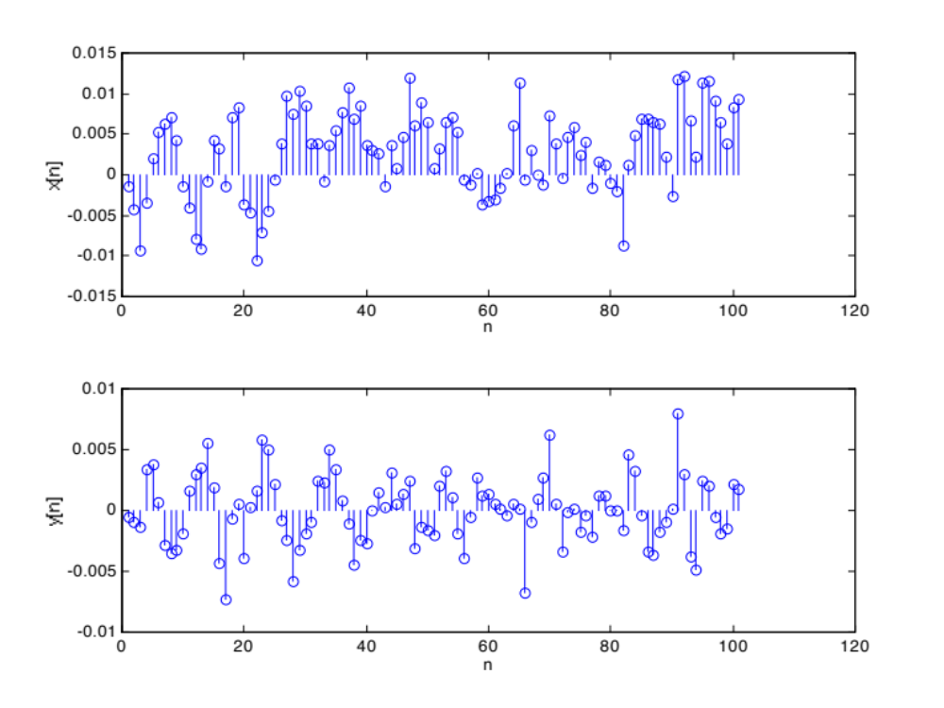
Filter 2 in the time domain

Slide 11
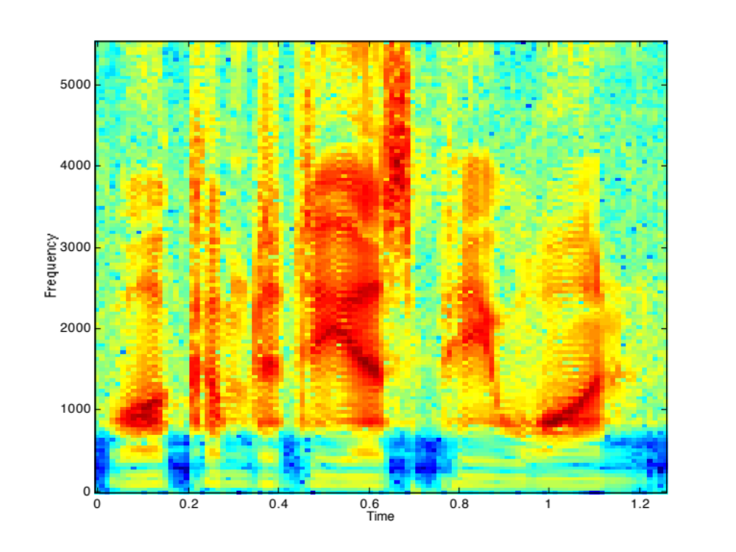
Output of Filter 2 in the frequency domain
Original:
Highpass:

Slide 12
The source-filter model of speech
A useful model for representing the generation of speech sounds:
Pitch
Amplitude
Pulse train source
p[n]
Vocal tract model
Noise source

Slide 13
Separating the vocal-tract excitation from the filter
Original speech:
Speech with 75-Hz excitation:
Speech with 150-Hz excitation:
Speech with noise excitation:

