Slide 1

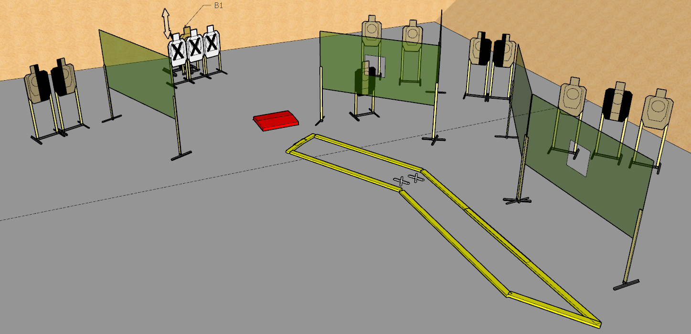
 | Interlake Sporting Association Ignore The Man Behind The Curtain Course Designer: Stanley Lewis
START POSITION: Standing facing squarely downrange with both feet touching indicated marks. Handgun: Loaded & holstered with wrists below belt. PCC: Loaded with stock on belt, muzzle squarely downrange and held below 45 degrees.
STAGE PROCEDURE: On the audible start signal, engage all targets as they become visible. Bobber B1 is a non-disappearing target, is activated via the stomp box and must be activated prior to engagement. |  | SCORING: Comstock, 22 rounds, 110 points TARGETS: 10 metric SCORED HITS: Best 2 per paper START-STOP: Audible - Last shot

Slide 2
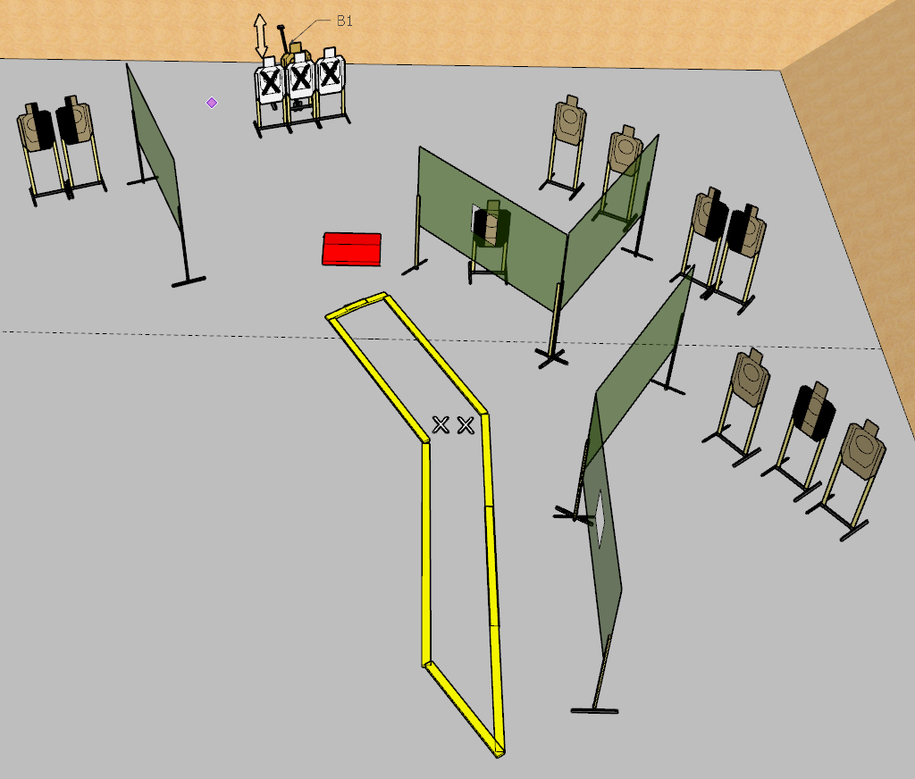

Slide 3
