Slide 1

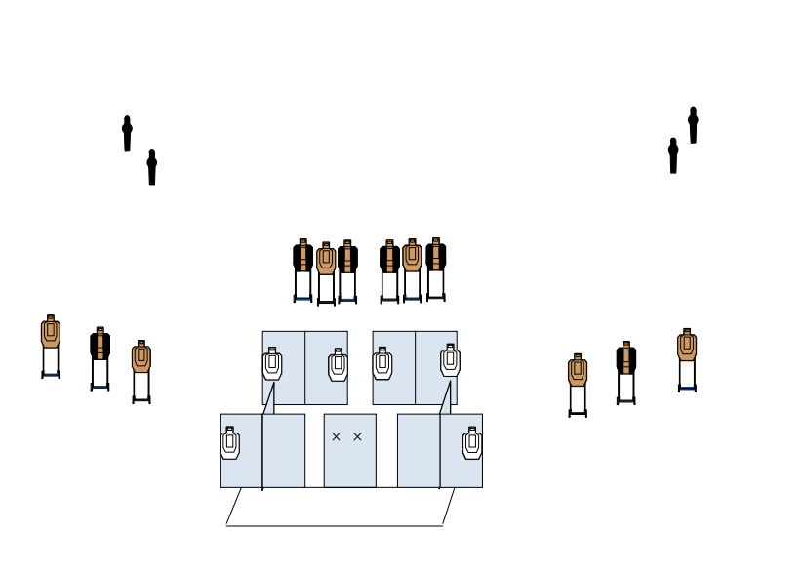
 | Renton Fish and Game Club Bay 3 Stage3: Passages A1 Course Designer: Jim Meade
START POSITION: Standing facing down range hands touching the X’s. Hand gun is loaded and holstered. PCC start standing facing down range, with the muzzle touching the mark.
STAGE PROCEDURE: On signal engage all targets from inside the shooting area. |  | SCORING: Comstock, 28 rounds, 140 points TARGETS: 12 Metric, 4 PP SCORED HITS: Best 2 per paper, KD steel = 1A START-STOP: Audible - Last shot RULES: USPSA current edition

