Slide 1

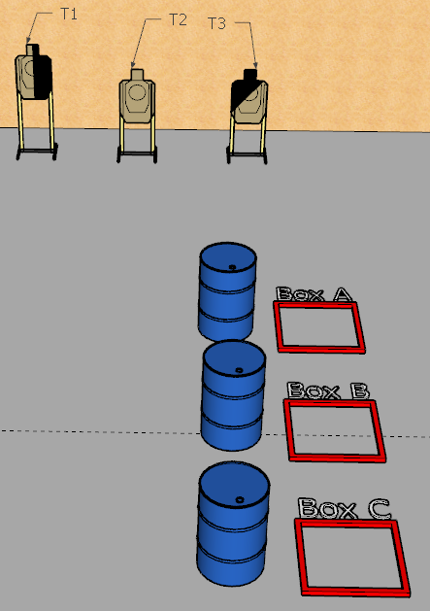
 | Interlake Sporting Association Best Laid Plans Course Designer: Stanley Lewis
START POSITION: String 1: Firearm unloaded and placed on any barrel of competitor’s choice. All managzines to be used on the stage placed on remaining two barrels. Competitor starts anywhere outside of the shooting boxes, facing squarely downrange, fully uprange of the barrel holding the firearm. String 2: Handgun loaded & holstered (pcc: loaded, safety on, stock on belt, muzzle squarely downrange). Competitor standing in final box from string 1. Note: all magazines to be used must come from barrels. No stowing of magazines permitted within or between strings.
STAGE PROCEDURE: String 1: Retrieve and load firearm. Engage T1-T3 with 2 rounds each freestyle, strong-hand only, or weak hand only (shooter’s discretion) from box a,b, or c (shooter’s discretion). Perform a mandatory reload from a barrel and engage T1-T3 with 2 rounds each from any other box, using any other firearm grip not yet used. String 2: Engage T1-T3 from the starting box (final shooting box from string 1), using the remaining grip style not yet used. Perform a mandatory reload from a barrel, then engage T1-T3 from the remaining shooting box freestyle. |  | SCORING: Virginia, 24 rounds, 120 points TARGETS: 3 metric SCORED HITS: Best 2 per paper START-STOP: Audible - Last shot

