Slide 1
Box2D with SIMD in JavaScript
Ningxin Hu
Peter Jensen
Intel Corporation
October 20, 2014
Notes:
Work done with my Collegue Ningxin Hu
I work for Intel
Yes, Intel does software!

Slide 2
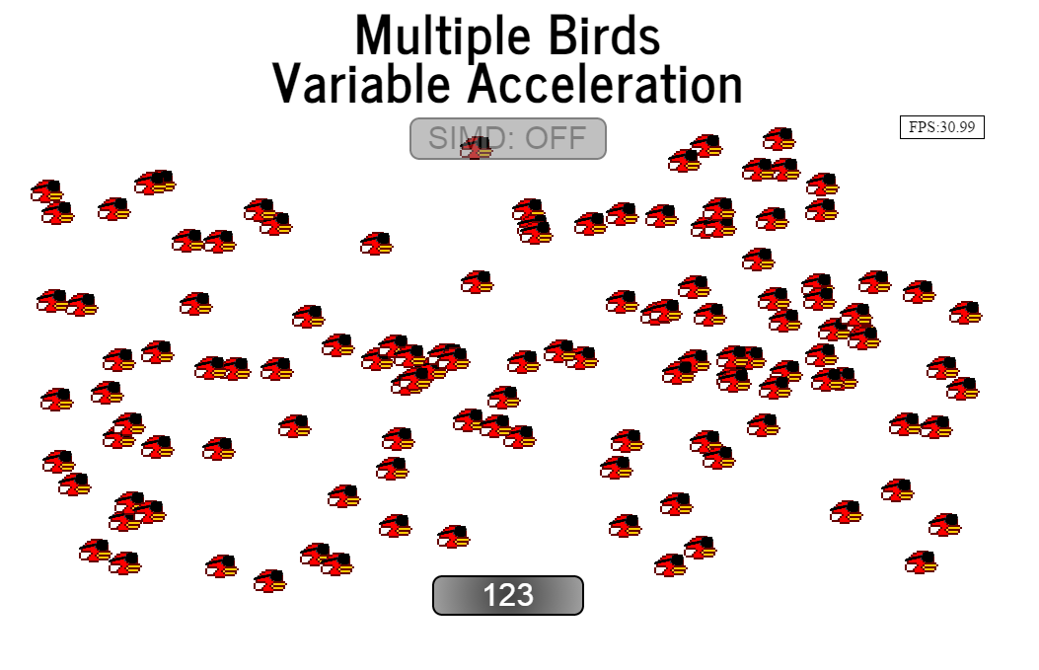
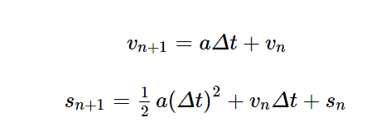
‘SIMD Programming in JavaScript’
Notes:
Followup on presentation from May
How many attended?
How many know what SIMD is?
Very simple physics
Compute the position and velocities of birds while maintaining ~30fps
“Box1D”

Slide 3
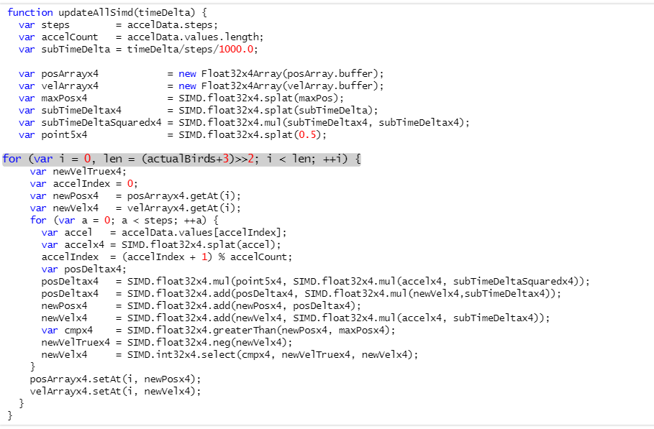
‘SIMD Programming in JavaScript’
Nice ~3x speedup!
Only One dimensional – Box1D
Only one body shape
No body->body collision detection
No rotation
No rotation velocity
Is this applicable to a real physics engine like Box2D?
Notes:
How about applying SIMD to a real physics engine?

Slide 4
Agenda
Box2D
Background
Uses
Basics
Implementations (native and JS)
SIMD in JavaScript
Basics
Availability
Notes:
A collegue of mine, Moh Haghighat, told me that the key to a good presentation is to make sure that the audience learns something.
Hopefully in about 50 minutes you’ll know the basics of creating box2d worlds and how to make them run in the browser

Slide 5
Agenda
Emscripten
Basics. How does it work?
Native SIMD -> JavaScript SIMD
JavaScript Bindings
Box2D SIMD opportunities
Performance profiles
Vector/matrix math
Constraint solvers (position, velocity, time-of-impact)
Summary
What worked and what didn’t
Notes:
Emscripten is the brainchild of Alon Zakai of Mozilla.
It compiles LLVM bit code to JavaScript
It has been used to port existing game engines (Unity, Unreal-Epic) to the web.
No one has used SIMD to speed up box2d before

Slide 6
Box2D Background
Written by Erin Catto
Written in C++
First released as "Box2D Lite", a demonstration engine to accompany a physics presentation given by Erin Catto at GDC 2006.
Released as open source on Sourceforge on September 11, 2007
Version 2.0 launched on March 2008, introducing continuous collision detection and a revamped API.
The latest version is v2.3.1
About ~20,000 lines of C++
Hosted here:
box2d.org

Slide 7
Box2D Uses
Games
Crayon Physics Deluxe, Limbo, Rolando, Fantastic Contraption, Incredibots, Angry Birds, Tiny Wings, Transformice, Happy Wheels, …
Game Engines
Unity2D, Construct2, Cocos2D, Ludei, Corona, libGDX, Godot
Other Uses
LiquidFun

Slide 8
Box2D Basics
Simulates a 2D world with interacting rigid bodies of various shapes
Create the world
Add the bodies
b2Vec2 gravity(0.0f, -10.0f);
b2World world(gravity);
b2BodyDef bd;
bd.type = b2_dynamicBody;
bd.position = b2Vec2(-7.0f, 0.75f);
b2Body *body = world.CreateBody(&bd);
Notes:
Define your gravity for the world
Add bodies (static or dynamics)

Slide 9
Box2D Basics
Add Fixtures to the bodies. Note: A body can have multiple fixtures
Set the world in motion
b2CircleShape shape;
shape.m_radius = 2.0f;
body->CreateFixture(&shape, 5.0f); // 5.0f is density
world.Step(1.0f/60.0f, 3, 3);
// 1. param: time delta
// 2. param: velocityIterations
// 3. param: positionIterations
Notes:
Add fixtures
Start moving things around according to Isaac Newton

Slide 10
Box2D Implementations
Box2D has been ported to many different languages
Flash:
http://www.box2dflash.org/
Java:
http://www.jbox2d.org/
Python:
http://code.google.com/p/pybox2d/
C#:
http://code.google.com/p/box2dx/
Javascript:
Port of box2dFlash
http://code.google.com/p/box2dweb/
JavaScript (asm.js):
Automatic build using Emscripten (by Alon Zakai)
https://github.com/kripken/box2d.js/

Slide 11
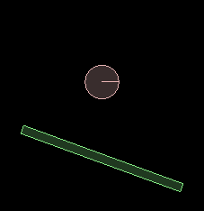
Box2D Using C++
b2BodyDef bd;
// Create a stick body
bd.type = b2_staticBody;
bd.position.Set(0.0f, 2.0f);
b2Body *stick = m_world->CreateBody(&bd);
// Attach a rectangle fixture to the stick
b2PolygonShape rect;
rect.SetAsBox(0.5f, 10.0f, b2Vec2(0.0f, 0.0f),
70.0f * b2_pi/180.0f);
stick->CreateFixture(&rect, 0.0f);
// Create a ball body
bd.type = b2_dynamicBody;
bd.position.Set(0.0f, 20.0f);
b2Body *ball = m_world->CreateBody(&bd);
// Attach a circle fixture to the ball
b2CircleShape circle;
circle.m_radius = 2.0f;
ball->CreateFixture(&circle, 5.0f);
C++
A world consists of bodies
Bodies have positions and types
Bodies are composed of fixtures
Fixtures have shapes and densities
Body placement: center (x,y) and rotation (a)
Body velocity: velocity of center (x,y) and angular speed (w)
Notes:
Note that bodies have both a velocity and angular speed

Slide 12
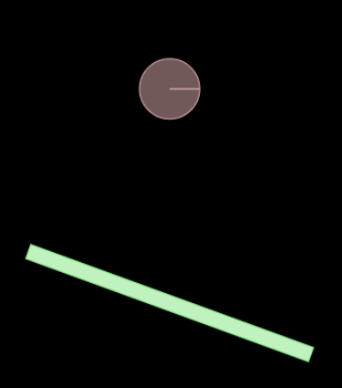
Box2D Using Box2DWeb
var bd = new b2BodyDef();
// Create a stick body
bd.type = b2Body.b2_staticBody;
bd.position.Set(0.0, 0.0);
var stick = world.CreateBody(bd);
// Attach a rectangle fixture to the stick
var rect = new b2PolygonShape();
rect.SetAsOrientedBox(0.5, 10.0, new b2Vec2(0.0, 0.0),
70.0 * Math.PI / 180.0);
stick.CreateFixture2(rect, 0.0);
// Create a ball body
bd.type = b2Body.b2_dynamicBody;
bd.position.Set(0.0, 20.0);
var ball = world.CreateBody(bd);
// Attach a circle fixture to the ball
var circle = new b2CircleShape();
circle.m_radius = 2.0;
ball.CreateFixture2(circle, 5.0);
Box2DWeb
Notes:
box2DWeb is a JS version of a flash implementation. Automatically compiled.
It’s pretty well structured, but API names differs from C++ ones, due to lack of function overloading in JS

Slide 13
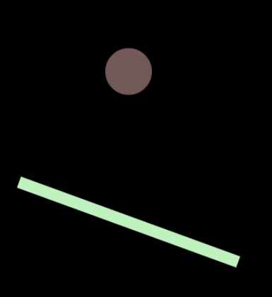
Box2D using box2d.js (asm.js)
var bd = new b2BodyDef();
// Create a stick body
bd.set_type(Box2D.b2_staticBody);
bd.set_position(new b2Vec2(0.0, 0.0));
var stick = world.CreateBody(bd);
// Attach a rectangle fixture to the stick
var rect = new b2PolygonShape();
rect.SetAsBox(0.5, 10.0, new b2Vec2(0.0, 0.0),
70.0 * Math.PI / 180.0);
stick.CreateFixture(rect, 0.0);
// Create a ball body
bd.set_type(Box2D.b2_dynamicBody);
bd.set_position(new b2Vec2(0.0, 20.0));
var ball = world.CreateBody(bd);
// Attach a circle fixture to the ball
var circle = new b2CircleShape();
circle.set_m_radius(2.0);
ball.CreateFixture(circle, 5.0);
Box2d.js (asm.js)
12
Notes:
API names match C++ ones.
No assignments to object properties. Use the .set_ operations instead
There’s a little more to the Box2D API:
Joints and motors

Slide 14
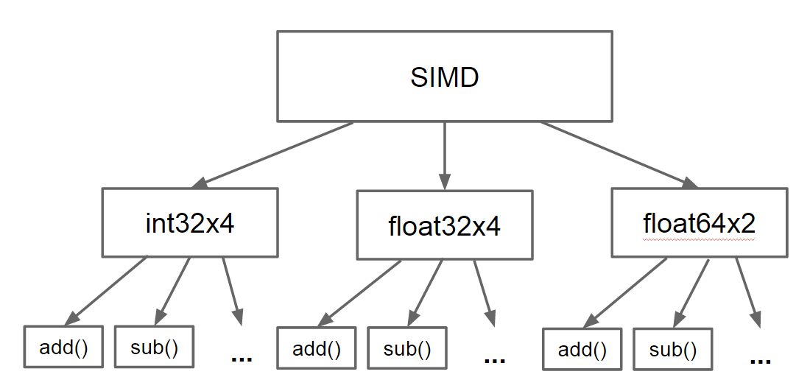
SIMD in JavaScript
Simple set of types and primitives that can be efficiently mapped to CPU instructions:
Notes:
In most cases there’s a simple 1-1 mapping between SIMD instructions and SIMD.JS primitives
We’re planning on adding int8x16 and int16x8
Currently, only 128-bit vectors are supported. Lowest denominator.

Slide 15
SIMD in JavaScript
SIMD in C/C++
SIMD in JavaScript
float simdAverage(float *src, int len) {
__m128 sumx4 = _mm_set_ps1(0.0f);
for (int i = 0; i < len; i += 4) {
sumx4 = _mm_add_ps(
sumx4, _mm_loadu_ps(src));
src += 4;
}
float sumx4_mem[4];
_mm_storeu_ps(sumx4_mem, sumx4);
return (sumx4_mem[0] + sumx4_mem[1] +
sumx4_mem[2] + sumx4_mem[3])/len;
}
function simdAverage(src, len) {
var sumx4 = SIMD.float32x4.splat(0.0);
var srcx4 = new Float32x4Array(src.buffer);
for (var i = 0, n = len/4; i < n; ++i) {
sumx4 = SIMD.float32x4.add(
sumx4, srcx4.getAt(i));
}
return (sumx4.x + sumx4.y +
sumx4.z + sumx4.w)/len;
}
SIMD offers a potential ~4x speedup
Notes:
Most of C++ code that really cares about performance uses intrinsics (assembly programming in C/C++)
Problem is that use of intrinsics is architecture dependent. This loop would look very different with NEON intrinsics
The SIMD JS API provides a common API that will work for both.

Slide 16
SIMD in JavaScript
Active collaboration between Google, Mozilla, Microsoft, ARM, and Intel
Spec/polyfill/benchmarks available here:
github.com/johnmccutchan/ecmascript_simd
1st stage approval for inclusion in ES7 by TC39
Prototypes available for Firefox nightly and Chromium:
peterjensen.github.io/idf2014-simd

Slide 17
Emscripten
function _simdAverage($src, $len) {
$src = $src | 0;
$len = $len | 0;
var $add$i = SIMD_float32x4(0, 0, 0, 0),
$i$011 = 0,
$sumx4$0$lcssa = SIMD_float32x4(0, 0, 0, 0),
$sumx4$010 = SIMD_float32x4(0, 0, 0, 0),
sp = 0;
sp = STACKTOP;
if (($len | 0) > 0) {
$i$011 = 0;
$sumx4$010 = SIMD_float32x4_splat(Math_fround(0));
while (1) {
$add$i = SIMD_float32x4_add(
$sumx4$010,
SIMD_float32x4_load(
buffer, $src + ($i$011 << 2) | 0));
$i$011 = $i$011 + 4 | 0;
if (($i$011 | 0) >= ($len | 0)) {
$sumx4$0$lcssa = $add$i;
break;
} else $sumx4$010 = $add$i;
}
} else
$sumx4$0$lcssa = SIMD_float32x4_splat(Math_fround(0));
STACKTOP = sp;
return +((+$sumx4$0$lcssa.w +
(+$sumx4$0$lcssa.z +
(+$sumx4$0$lcssa.x +
+$sumx4$0$lcssa.y))) / +($len | 0));
}
Developed by Alon Zakai/Mozilla:
github.com/kripken/emscripten
Compiles LLVM bitcode to JavaScript
Supports most of _mm_X_ps() intrinsics
% emcc –O2 –g demo02.c
float simdAverage(float *src, int len) {
__m128 sumx4 = _mm_set_ps1(0.0f);
for (int i = 0; i < len; i += 4) {
__m128 v = _mm_load_ps(src + i);
sumx4 = _mm_add_ps(sumx4, v);
}
float sumx4_mem[4];
_mm_store_ps(sumx4_mem, sumx4);
return (sumx4_mem[0] + sumx4_mem[1] +
sumx4_mem[2] + sumx4_mem[3])/len;
}
Notes:
Using the clang C/C++ Frontend. Handle most of SSE1 intrinsics
Compile with –g to get readable JS output.
Bottom test conversion
Produces asm.js dialect

Slide 18
Emscripten JavaScript -> C++ Bindings
User JavaScript Code
Box2D C++ declarations
var bd = new b2BodyDef();
// Create a stick body
bd.set_type(b2_staticBody);
bd.set_position(new b2Vec2(0.0, 0.0));
enum b2BodyType {
b2_staticBody = 0,
b2_kinematicBody,
b2_dynamicBody
};
struct b2BodyDef {
b2BodyDef();
b2BodyType type;
b2Vec2 position;
…
}
box2d.idl
enum b2BodyType {
"b2_staticBody",
"b2_kinematicBody",
"b2_dynamicBody"
};
interface b2BodyDef {
void b2BodyDef();
attribute b2BodyType type;
attribute b2Vec2 position;
…
}
Emscripten commands to tie it all together
### generate box2d_glue.js and box2d_glue.cpp
% python webidl_binder.py box2d.idl box2d_glue
### generate box2d.js
% em++ box2d.bc box2d_glue.cpp \
--post-js box2d_glue.js \
–o box2d.js
Notes:
Calling into JS code generated by Emscripten requires a some non-trivial glue JS and C++ code
WebIDL language used to define the exposed API from C++ and creates the necessary code.
Box2d_glue.cpp and box2d_glue.js code is generared by the webidl_binder.py script

Slide 19
Box2D SIMD Opportunities
No publicly available use of SIMD in Box2D
At least we couldn’t find any
We knew it was going to be challenging
How to find opportunities
Use a good performance profiler
Low Level approach:
Look for sequences of arithmetic operations that can be combined
High Level approach:
Look for loops where iteration count can be /4
Notes:
All the heavy math is done in float32!
Submitted the abstract before realizing the full scope of the challenge
Pass on some learnings and techniques for creating vectorized versions of non-trivial loops

Slide 20
Box2D SIMD Opportunities – Low Level
inline b2Vec2 b2Mul(const b2Transform& T, const b2Vec2& v) {
b2Vec2 result;
result.x = (T.q.c * v.x - T.q.s * v.y) + T.p.x;
result.y = (T.q.s * v.x + T.q.c * v.y) + T.p.y;
return result;
}
Scalar Totals
4 muls
3 adds
1 sub
8 total ops
shuffle
mul
shuffle
add
shuffle
SIMD Totals
1 mul
2 adds
1 sub
6 shuffles
10 total ops
Temp0
T.q.c
v.x
T.p.x
Temp1
=
T.q.s
*
v.x
+
T.p.y
Temp2
T.q.s
v.y
0.0
Temp3
T.q.c
v.y
0.0
result.x = Temp0 – Temp2 // (1x sub, 1x shuffle)
result.y = Temp1 + Temp3 // (1x add, 2x shuffle)

Slide 21
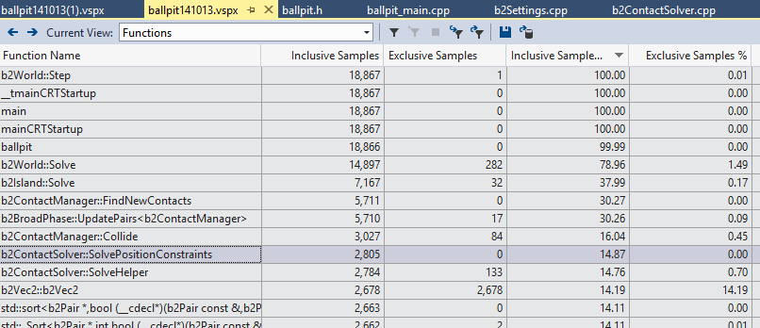
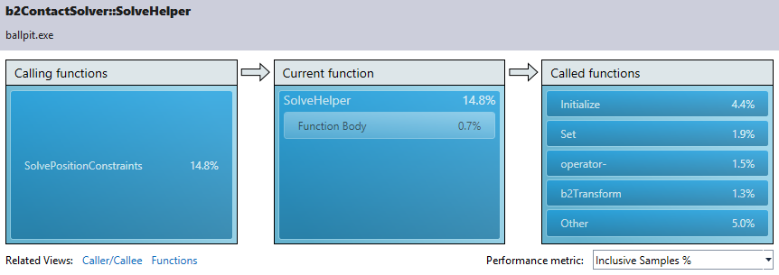
Box2D Profiling
If SolvePositionConstraints can be sped up by 3-4x, we can get an overall ~10%

Slide 22
Position Constraint Solver
Sequential Impulse Solver:
Adjust position of pairwise colliding bodies to eliminate/minimize overlap
Needs to iterate to get the global solution
for each pair of colliding bodies (A, B)
for each contact point between A and B
compute position and rotation adjustment
for A and B, based on:
1) mass/inertia
2) center-of-mass/contact point relation
3) ‘size’ of overlap

Slide 23
Position Constraint Solver - simplified
bool b2ContactSolver::SolvePositionConstraints() {
for (int32 i = 0; i < m_count; ++i) {
b2ContactPositionConstraint* pc = m_positionConstraints + i;
int32 indexA = pc->indexA;
int32 indexB = pc->indexB;
int32 pointCount = pc->pointCount;
b2Vec2 cA = m_positions[indexA].c;
b2Vec2 cB = m_positions[indexB].c;
for (int32 j = 0; j < pointCount; ++j) {
// A bunch of float32 vector math based on
// mass, inertia, center-of-mass positions,
// and contact position
cA -= mA * P;
cB += mB * P;
}
m_positions[indexA].c = cA;
m_positions[indexB].c = cB;
}
}
“Holy Grail of Vectorization”
Reduce iteration count
by vector width (4)
Enemies of Vectorization
Control flow in loop
Data dependencies between iterations
Applied solutions
Specialize
Sort data to minimize dependencies within groups of 4

Slide 24
Position Constraint Solver - specialized
float32 b2ContactSolver::SimdSolvePositionConstraints() {
for (int32 i = 0; i < (m_count-3); i+=4) {
b2ContactPositionConstraint *pc = m_positionConstraints + i;
int32 indexA[4] = {pc->indexA, (pc+1)->indexA, (pc+2)->indexA, (pc+3)->indexA};
int32 indexB[4] = {pc->indexB, (pc+1)->indexB, (pc+2)->indexB, (pc+3)->indexB};
if (IndexOverlap(indexA, indexB)) {
// doesn't deal with aliasing between the 4 lanes
COUNTER_INC(indexOverlap);
float32 minSep = SolveHelper(i, 4);
minSeparation = b2Min(minSeparation, minSep);
continue;
}
else {
COUNTER_INC(noIndexOverlap);
}
…
}
}

Slide 25
Position Constraint Solver – Sorting Constraints
Without sorting constraints
With sorting constraints
$ ./ballpit simd
indexOverlap: 347472
noIndexOverlap: 2970
Cycles:
SolvePositionConstrains: 6448.29M
SimdSolvePositionConstraints: 6440.18M
Benchmark complete.
ms/frame: 56.996094
$ ./ballpit simd sortCon
indexOverlap: 631
noIndexOverlap: 348688
Cycles:
SolvePositionConstrains: 2233.05M
SimdSolvePositionConstraints: 2224.84M
Benchmark complete.
ms/frame: 52.496094
Number of overlaps between groups of 4 reduced significantly reduced!

Slide 26
Position Constraint Solver – Sample conversions
Original Code in loop
b2Cross()
float32 rnA = b2Cross(rA, normal);
float32 b2Cross(const b2Vec2& a, const b2Vec2& b) {
return a.x * b.y - a.y * b.x;
}
After manual unrolling by 4
float32 rnA[4];
rnA[0] = b2Cross(rA[0], normal[0]);
rnA[1] = b2Cross(rA[1], normal[1]);
rnA[2] = b2Cross(rA[2], normal[2]);
rnA[3] = b2Cross(rA[3], normal[3]);
b2Cross4()
__m128 b2Cross4(const __m128 &ax4, const __m128 &ay4,
const __m128 &bx4, const __m128 &by4) {
return _mm_sub_ps(
_mm_mul_ps(ax4, by4), _mm_mul_ps(ay4, bx4));
}
After merging into SIMD
__m128 rnA4 = b2Cross4(
rAx4, rAy4,
normalx4, normaly4);

Slide 27
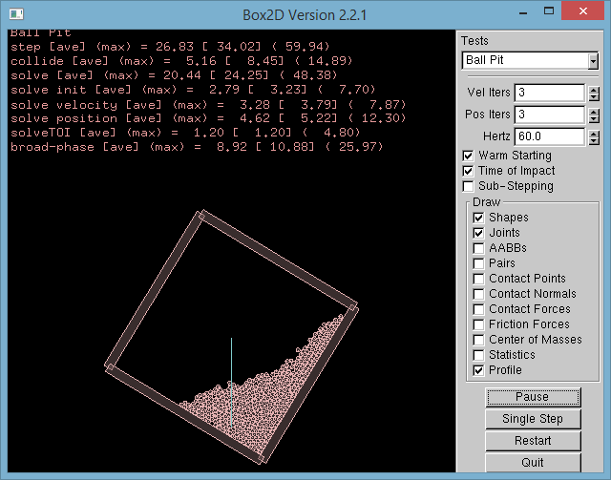
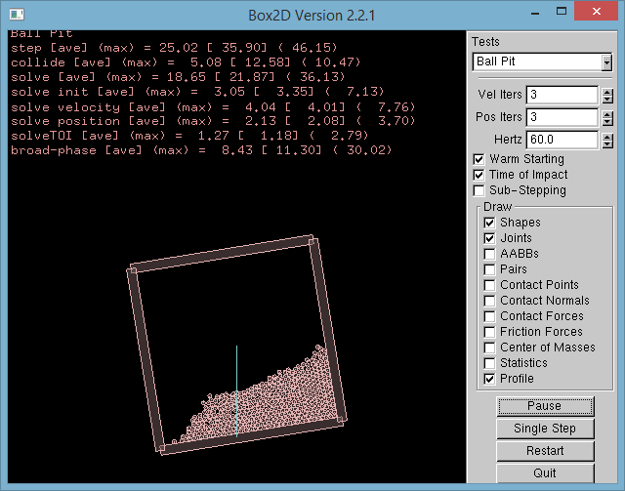
Testbed Profiling
Without SIMD
With SIMD

Slide 28
Putting it all together
Use SIMD enabled Emscripten to generate JS
Run in SIMD enabled browser

Slide 29
Summary
Didn’t Work:
Doing SIMDization on leaf functions
Worked:
Doing SIMDization on Position Constraint Solver, but
It requires data restructuring and specialization
Overall performance gain is limited
Using Emscripten to generate SIMD.JS from C/C++ is a winner!
Get gain from already SIMD optimized C/C++ code
Get portability by using the browser as a platform

Slide 30
Thank You – Questions?
Presentation available here:
http://peterjensen.github.io/html5-box2d

