Slide 1
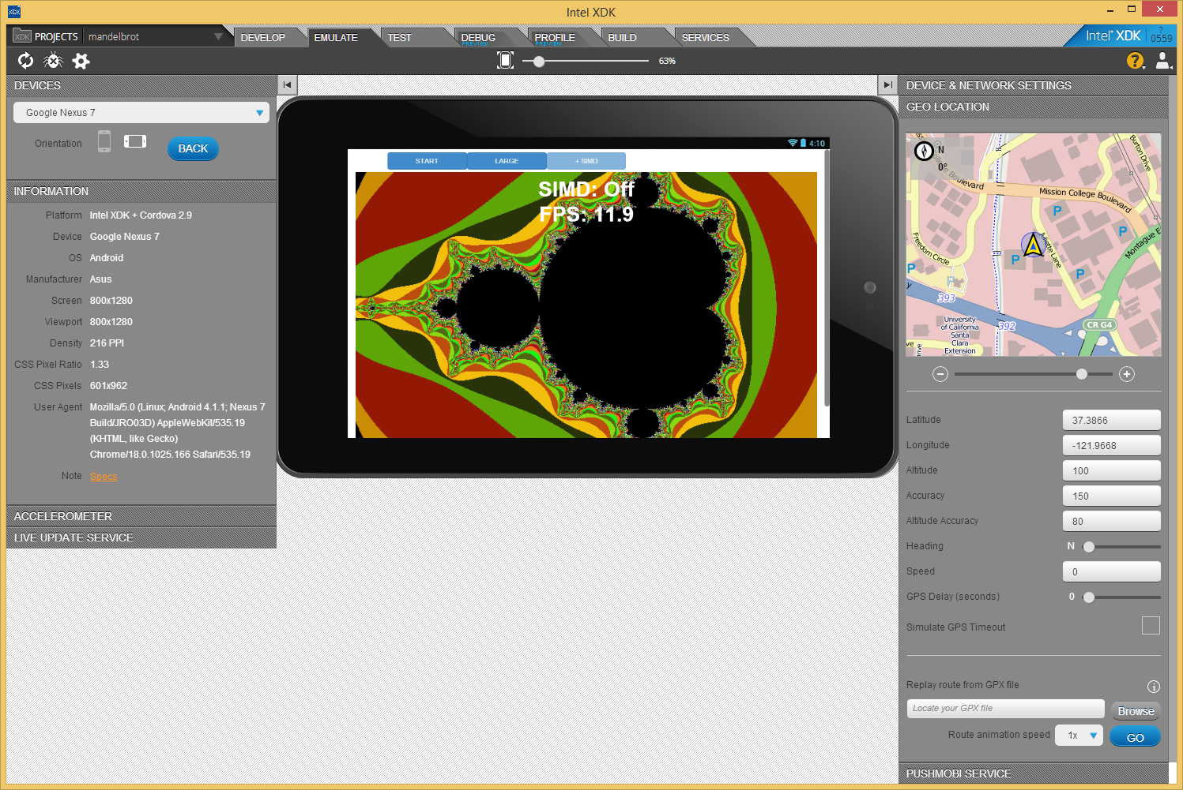
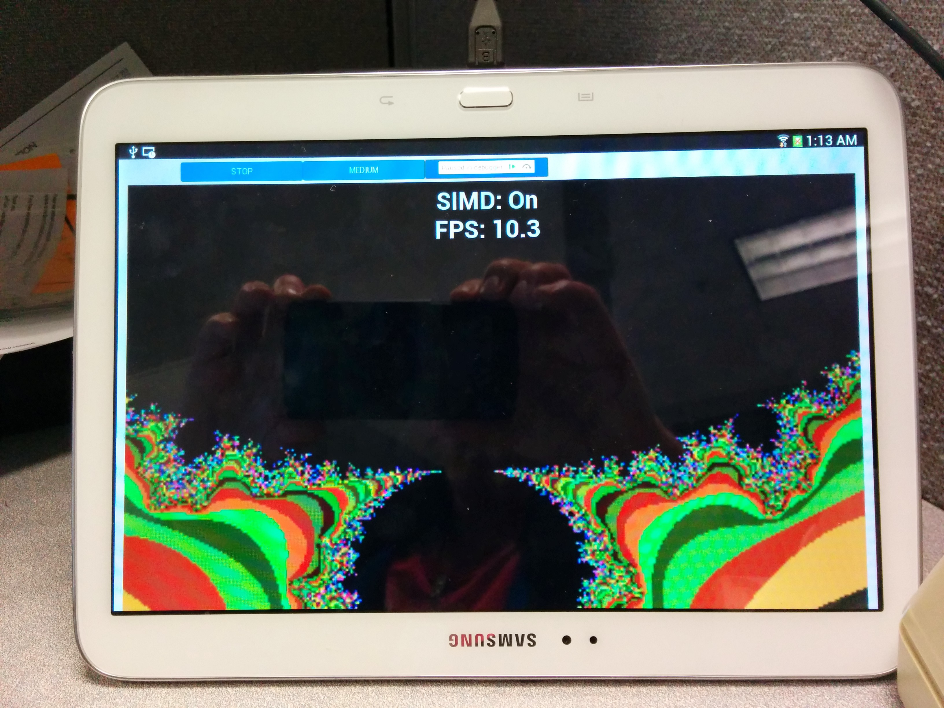
Host PC – Windows/MacOs/Linux
Target Device – Android/iOS/etc
USB
Samsung Galaxy Tab 3® 10.1
Intel Atom Z2560 (CloverTrail +)
1.6GHz – Dual Core with HT

