Slide 1
SIMD in JavaScript via C++ and Emscripten
February 8th, 2015 - Workshop on Programming Models for SIMD/Vector Processing
Peter Jensen, Intel Corporation
Ivan Jibaja, Intel Corporation
Ningxin Hu, Intel Corporation
Dan Gohman, Mozilla
John McCutchan, Google

Slide 2
Agenda
Motivation
Background/History
SIMD.JS
Emscripten
Compiling SIMD C++ code to SIMD.JS JavaScript code
Benchmark Results
Summary

Slide 3
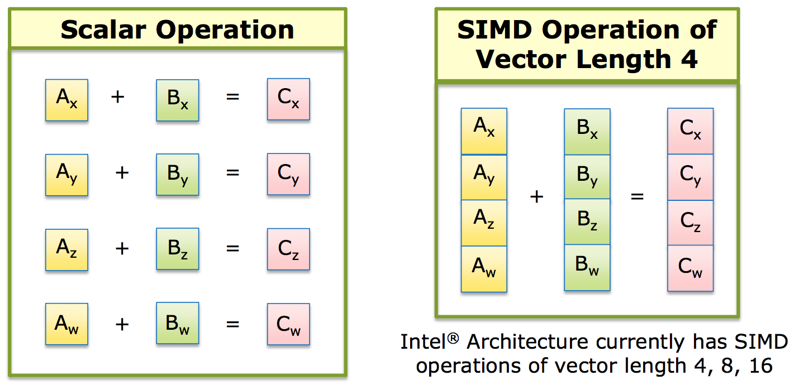
SIMD: Single Instruction, Multiple Data

Slide 4
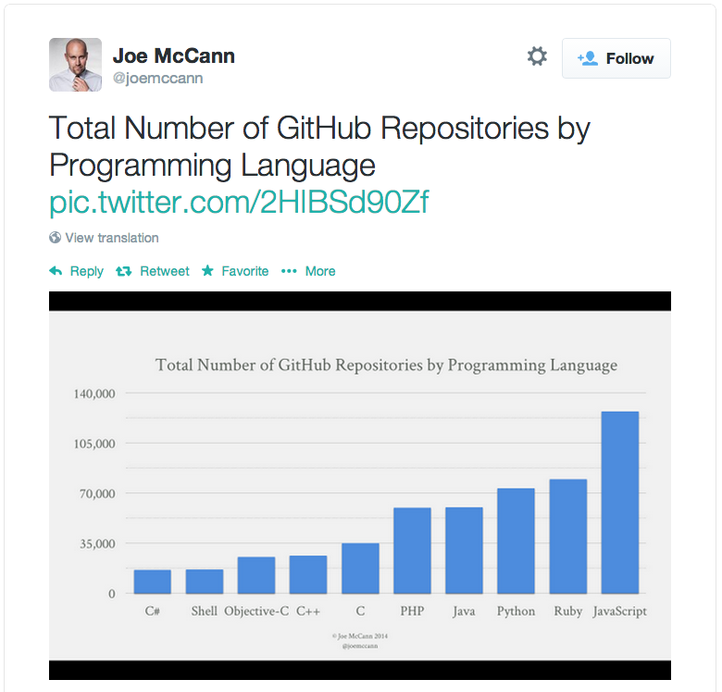
JavaScript’s Popularity and Use on the Rise!
Games (Unreal, Unity) (via Emscripten/asm.js)
Hybrid HTML5/JS apps for cross platform apps on mobile devices
Pure HTML5/JS apps on ChromeOS/FirefoxOS/Tizen
Standalone desktop JavaScript apps via NW.js (formerly node-webkit) (Intel XDK)
Full featured browser based apps (Google Docs/maps, Office 365, …)
Server side logic via node.js/io.js

Slide 5
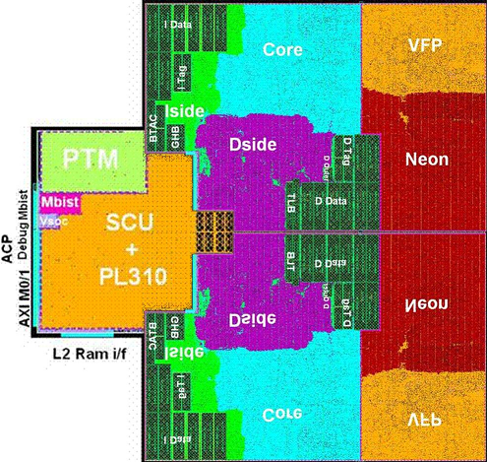
More Silicon Dedicated to Vector Processing

Slide 6
Hardware/Software Gap
SIMD instructions are an increasingly larger portion of instruction set architectures of newer CPUs
Currently, it’s not possible to utilize these powerful instructions from JavaScript programs
SIMD.JS/Emscripten will bridge this gap

Slide 7
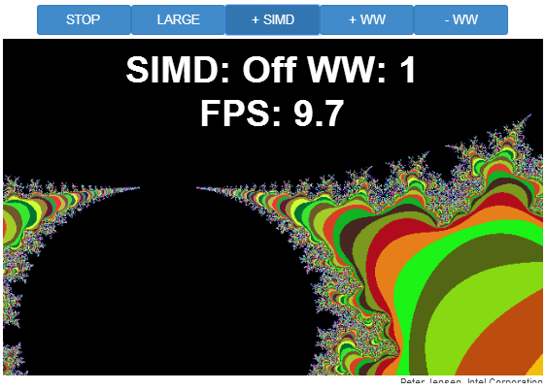
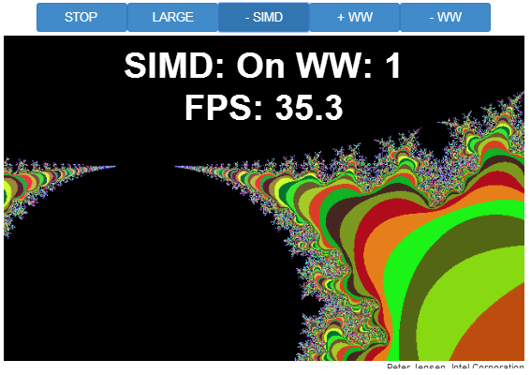
Demo - Mandelbrot

Slide 8
SIMD.JS/Emscripten – Background/History
Intel/Mozilla/Google/Microsoft/ARM collaboration!
Started mid-2013
Initial polyfill spec by John McCutchan (Google’s Dart VM team)
Prototypes for Chromium, Firefox
Available in Intel’s Crossswalk web-runtime (for hybrid HTML5 apps) TODAY!
Emscripten (C++ -> JavaScript compiler) now generates SIMD.JS code from LLVM vector operations and from a subset of x86 SIMD intrinsics
Standardization (TC39) underway for inclusion of SIMD.JS in EcmaScript 7

Slide 9
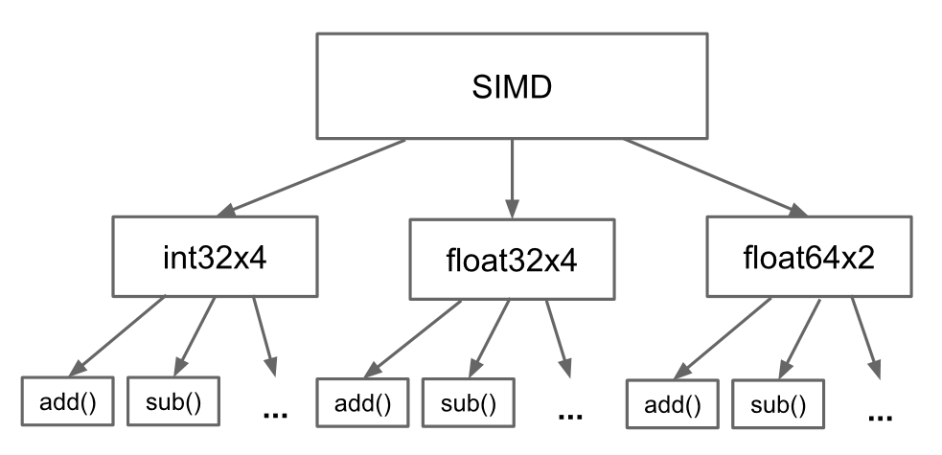
SIMD.JS – Object Hierarchy

Slide 10
SIMD.JS – API Details
Lane accessors, mutators:
Accessors: x, y, z, w
Mutators: withX, withY, withZ, withW
Operators:
Arithmetic: abs, neg, add, sub, mul, div, reciprocal, reciprocalSqrt, sqrt
Shuffle: swizzle (1 operand), shuffle (2 operands)
Logical: and, or, xor, not
Comparison: equal, greaterThan, LessThan
Shifts: shiftRightLogicalByScalar, shiftRightArithmeticByScalar, shiftLeftByScalar
Conversion: fromInt32x4, fromInt32x4Bits, etc.
Min/Max: min, minNum, max, maxNum

Slide 11
SIMD.JS – Example Usage - Mandelbrot
Scalar
SIMD
//
// z(i+1) = z(i)^2 + c
// terminate when |z|^2 > 4.0
// returns 1 iteration count
//
function mandelx1 (c_re, c_im) {
var z_re = c_re, z_im = c_im, i;
for (i = 0; i < max_iterations; ++i) {
var z_re2 = z_re*z_re;
var z_im2 = z_im*z_im;
if (z_re2 + z_im2 > 4.0) {
// iteration has diverged
break;
}
var new_re = z_re2 - z_im2;
var new_im = 2.0 * z_re * z_im;
z_re = c_re + new_re;
z_im = c_im + new_im;
}
return i;
}
function mandelx4(c_re4, c_im4) {
var z_re4 = c_re4,
z_im4 = c_im4,
four4 = SIMD.float32x4.splat (4.0),
two4 = SIMD.float32x4.splat (2.0),
count4 = SIMD.int32x4.splat (0),
one4 = SIMD.int32x4.splat (1),
i, z_re24, z_im24, mi4, new_re4, new_im4;
for (i = 0; i < max_iterations; ++i) {
z_re24 = SIMD.float32x4.mul (z_re4, z_re4);
z_im24 = SIMD.float32x4.mul (z_im4, z_im4);
mi4 = SIMD.float32x4.greaterThan(SIMD.float32x4.add (z_re24, z_im24), four4);
if (SIMD.int32x4.allTrue()) {
// all 4 values have diverged
break;
}
var new_re4 = SIMD.float32x4.sub (z_re24, z_im24);
var new_im4 = SIMD.float32x4.mul (SIMD.float32x4.mul (two4, z_re4), z_im4);
z_re4 = SIMD.float32x4.add (c_re4, new_re4);
z_im4 = SIMD.float32x4.add (c_im4, new_im4);
count4 = SIMD.int32x4.add (count4, SIMD.int32x4.and (mi4, one4));
}
return count4;
}

Slide 12
SIMD.JS – Focus
Initial focus on architecture overlap (128-bit vectors)
Well defined NaN handling
Well defined float32 -> int32 conversions
Well defined shift handling for shift counts > 32
Precision of reciprocalSqrt – left undefined
Architecture specific extensions are being discussed, for example
Fma (NEON, AVX)
Vector shifts (NEON)

Slide 13
Emscripten - Basics
Brainchild of Mozilla’s Alon Zakai
Compiles C/C++ to JavaScript
Uses clang/LLVM for C/C++ front-end and optimizer framework
Models memory with JS TypedArrays
Generates the asm.js subset of JavaScript
Tools available to create bindings between handwritten JS and Emscripten generated JS (webidl_binder)
Several large C/C++ applications/games have been ported to the web platform (e.g., Unity, Unreal, box2D)

Slide 14
Emscripten – C/C++ -> JS Memory Modelling
var buffer = new ArrayBuffer(TOTAL_MEMORY);
HEAP8 = new Int8Array(buffer);
HEAP16 = new Int16Array(buffer);
HEAP32 = new Int32Array(buffer);
HEAPU8 = new Uint8Array(buffer);
HEAPU16 = new Uint16Array(buffer);
HEAPU32 = new Uint32Array(buffer);
HEAPF32 = new Float32Array(buffer);
HEAPF64 = new Float64Array(buffer);
Views over the same memory (buffer) for basic C/C++ types
C/C++ pointers used as indices to access elements of these arrays

Slide 15
Emscripten – Generated Code Example
for (uint32_t j = 0, l = length;
j < l;
j = j + 4) {
sum = sum + *(a++);
}
while (1) {
$add = $sum$04 + +HEAPF32[$a$addr$06 >> 2];
$j$05 = $j$05 + 4 | 0;
if (!($j$05 >>> 0 < $length >>> 0)) {
$sum$0$lcssa = $add;
break;
} else {
$a$addr$06 = $a$addr$06 + 4 | 0;
$sum$04 = $add;
}
}
Unary ‘+’ (+expr) used as hint to JIT compiler to indicate number
Bitwise-Or zero (expr|0) used to indicate 32-bit signed int
Unsigned shift right (>>>) used to indicate 32-bit unsigned int
Addresses are byte addresses. Need to shift right by 2 to get the right index
Type hints and no dynamic allocations allow JIT compilers to generate very efficient code QUICKLY!

Slide 16
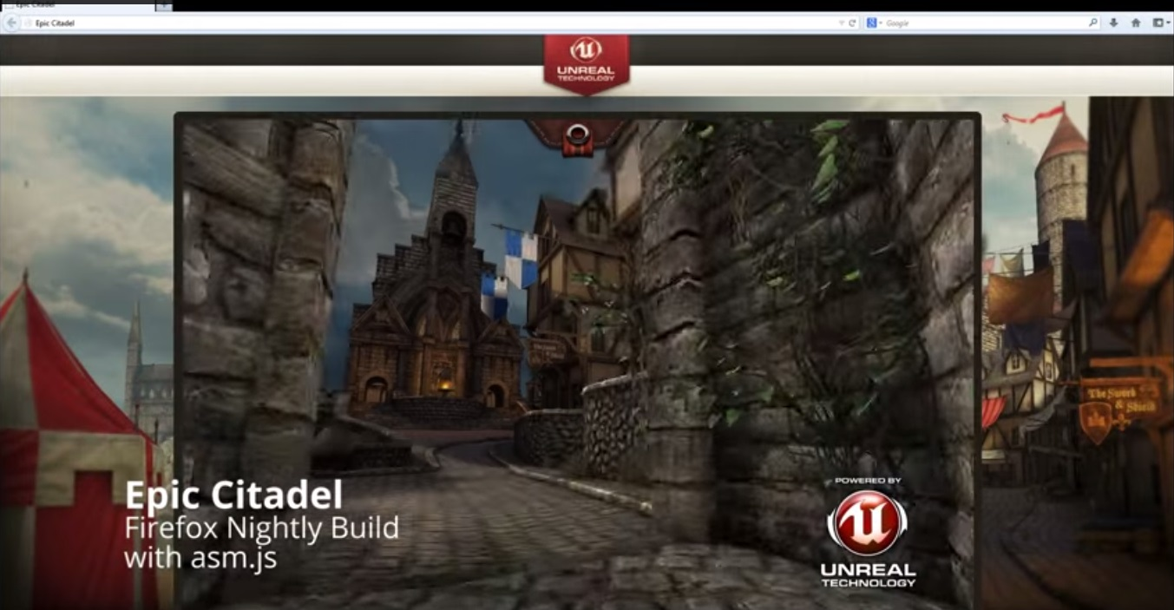
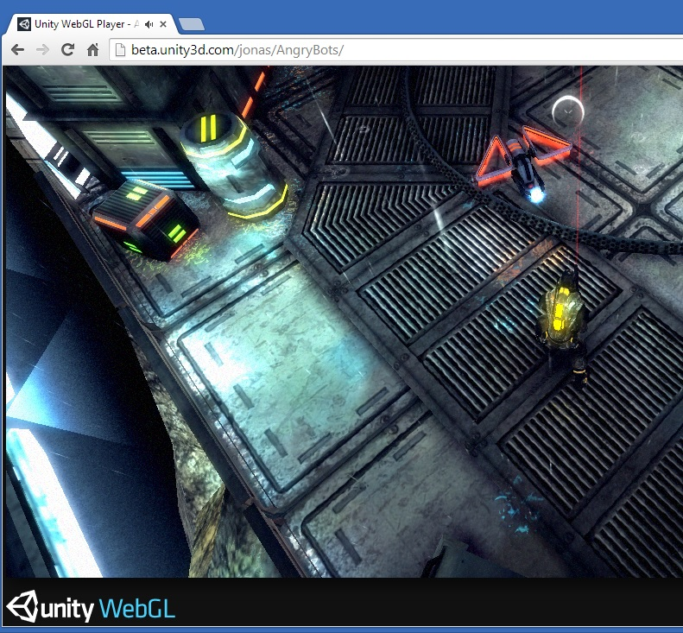
Emscripten – Showcase Uses
Epic Unreal
Unity
Over a million lines of C++ code ported to JS
4 days to port!

Slide 17
SIMD.JS and Emscripten – A Perfect Match!
Performance critical C/C++ code uses SIMD to get acceptable performance
Games, physics, image manipulation, video encoding/decoding, signal processing, etc.
SIMD.JS enables Emscripten to fully utilize these highly optimized C/C++ code sequences

Slide 18
Emscripten – Compiling SIMD C/C++ Code
$ emcc –O2 –g average-intrin.c
C code with x86 intrinsics
asm.js code with SIMD.JS (for loop)
float averageIntrin(float *a,
uint32_t length) {
__m128 sumx4 = _mm_set_ps1(0.0);
for (uint32_t j = 0, l = length;
j < l; j = j + 4) {
sumx4 = _mm_add_ps(
sumx4,_mm_loadu_ps(&(a[j])));
}
float mSumx4[4];
_mm_storeu_ps(mSumx4, sumx4);
return (mSumx4[0] + mSumx4[1] +
mSumx4[2] + mSumx4[3])/length;
}
while (1) {
$add$i = SIMD_float32x4_add(
$sumx4$010,
SIMD_float32x4_load(
buffer, $a + ($j$09 << 2) | 0));
$j$09 = $j$09 + 4 | 0;
if (!($j$09 >>> 0 < $length >>> 0)) {
$sumx4$0$lcssa = $add$i;
break;
} else $sumx4$010 = $add$i;
}

Slide 19
Benchmarks
Handwritten JavaScript benchmark kernels:
Average, Mandelbrot, MatrixMultiplication, VertexTransform, MatrixTranspose, MatrixInverse
Vector/Matrix math important for game/physics
Kernels for both scalar and SIMD implementations
Measure speedup (SIMD/scalar)
Manually converted to C++
Automatically compiled back to JavaScript with Emscripten
JavaScript code executed with both Chromium and Firefox SIMD prototypes
Native clang/LLVM compiler used to compile C++ code

Slide 20
Benchmarks – Handwritten JavaScript
Scalar JavaScript
function average(n) {
for (var i = 0; i < n; ++i) {
var sum = 0.0;
for (var j = 0, l = a.length; j < l; ++j) {
sum += a[j];
}
}
return sum/a.length;
}
SIMD JavaScript
function simdAverage(n) {
for (var i = 0; i < n; ++i) {
var sum4 = SIMD.float32x4.splat(0.0);
for (var j = 0; j < a.length / 4; ++j) {
sum4 = SIMD.float32x4.add(sum4, SIMD.float32x4.load(a, j << 2));
}
}
return (sum4.x + sum4.y + sum4.z + sum4.w)/a.length;
}

Slide 21
Benchmarks – Handwritten C++
Scalar C++
static float nonSimdAverageKernel32() {
float sum = 0.0;
for (uint32_t j = 0, l = length; j < l; ++j) {
sum += a[j];
}
return sum/length;
}
SIMD C++
static float simdAverageKernel() {
__m128 sumx4 = _mm_set_ps1(0.0);
for (uint32_t j = 0, l = length; j < l; j = j + 4) {
sumx4 = _mm_add_ps(sumx4, _mm_loadu_ps(&(a[j])));
}
Base::Lanes<__m128, float> lanes(sumx4);
return (lanes.x() + lanes.y() + lanes.z() + lanes.w())/length;
}

Slide 22
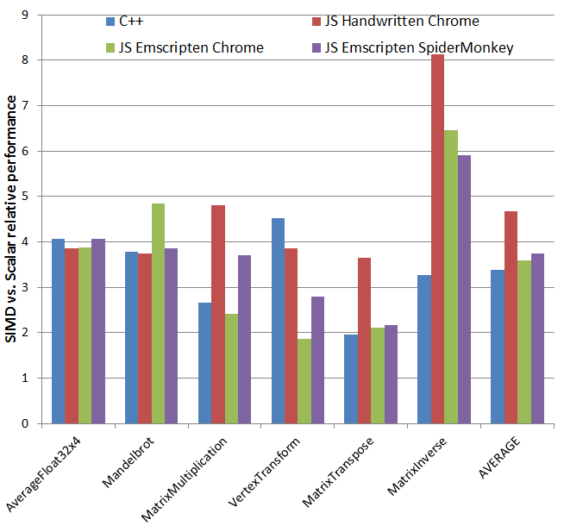
Benchmark Results – SIMD vs. Scalar Speedups
Observations:
Average speedups are in the expected ~4x range
Higher speedups for ‘JS Handwritten Chrome’ is due to slow scalar kernel (64-bit FP operations
Super linear speedups for MatrixInverse most likely due to slower scalar kernel as well.

Slide 23
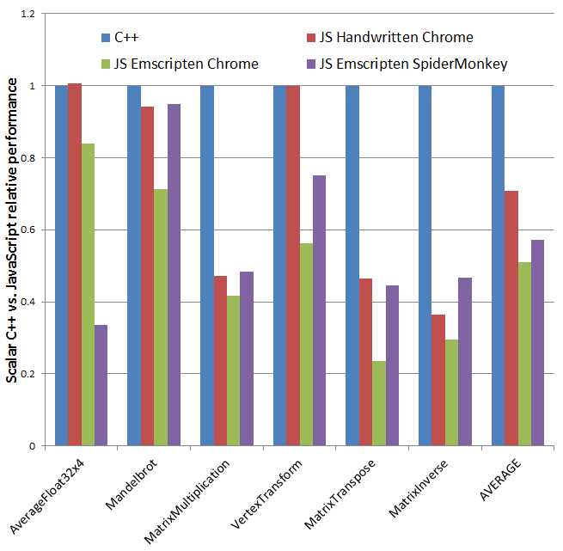
Benchmark Results – Scalar C++ vs. Scalar JS
Observations:
Average JS performance is roughly 60% of native C++
Handwritten JS code is slightly faster than Emscripten generated JS
SpiderMonkey/OdinMonkey is slightly faster than Chromium on Emscripten generated JS
Chromium has ‘slow JIT’ overhead that OdinMonkey doesn’t

Slide 24
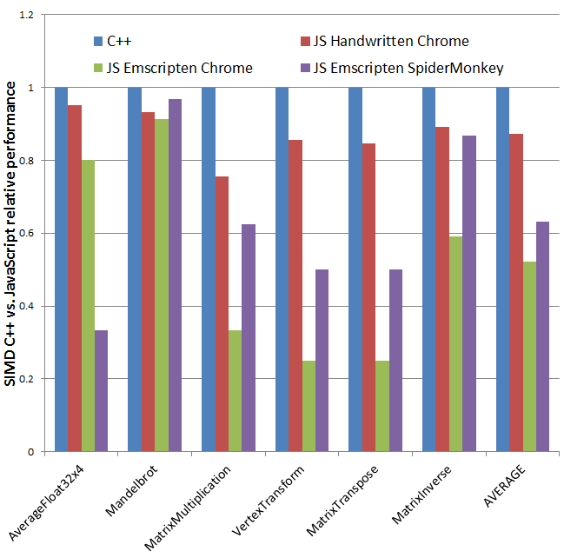
Benchmark Results – SIMD C++ vs. SIMD JS
Observations:
Handwritten JS performance is ~85% of native C++ on Chromium!
Emscripten generated JS performance is ~60% of native C++ on both Chromium and OdinMonkey
C++/JS performance for SIMD code is roughly the same as it is for Scalar code

Slide 25
Summary
SIMD.JS bridges the hardware/software gap for JavaScript programs
SIMD.JS makes ~4x speedup of performance critical code possible
Emscripten now compiles SIMD C++ vector code
The performance gap between native C/C++ code and JavaScript code keeps getting smaller
HTML5/JavaScript becomes an increasingly capable cross platform
THANK YOU

Slide 26
References
SIMD.JS polyfill/spec and handwritten JS benchmarks:
https://github.com/johnmccutchan/ecmascript_simd
Emscripten:
https://github.com/kripken/emscripten/wiki
C++ benchmarks:
https://github.com/PeterJensen/benchcpp
This Presentation and accompanying paper (contact info in paper):
https://github.com/PeterJensen/wpmvp2015

