Slide 1
SIMD in JavaScript* via C++ and Emscripten*
February 8th, 2015 - Workshop on Programming Models for SIMD/Vector Processing
Peter Jensen, Intel Corporation
Ivan Jibaja, Intel Corporation
Ningxin Hu, Intel Corporation
Dan Gohman, Mozilla*
John McCutchan, Google*

Slide 2
Agenda
Motivation
Background/History
SIMD.JS
Emscripten*
Compiling SIMD C++ code to SIMD.JS JavaScript* code
Benchmark Results
Summary

Slide 3
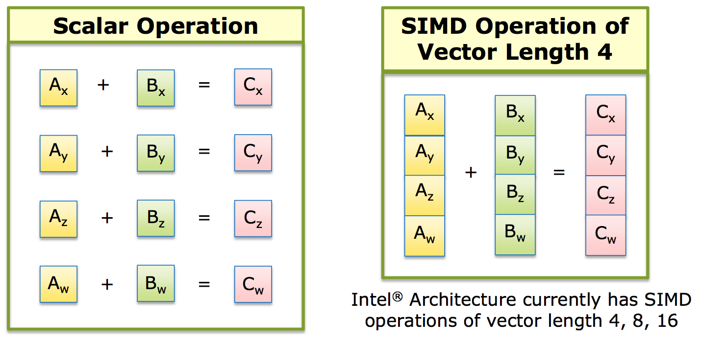
SIMD: Single Instruction, Multiple Data

Slide 4
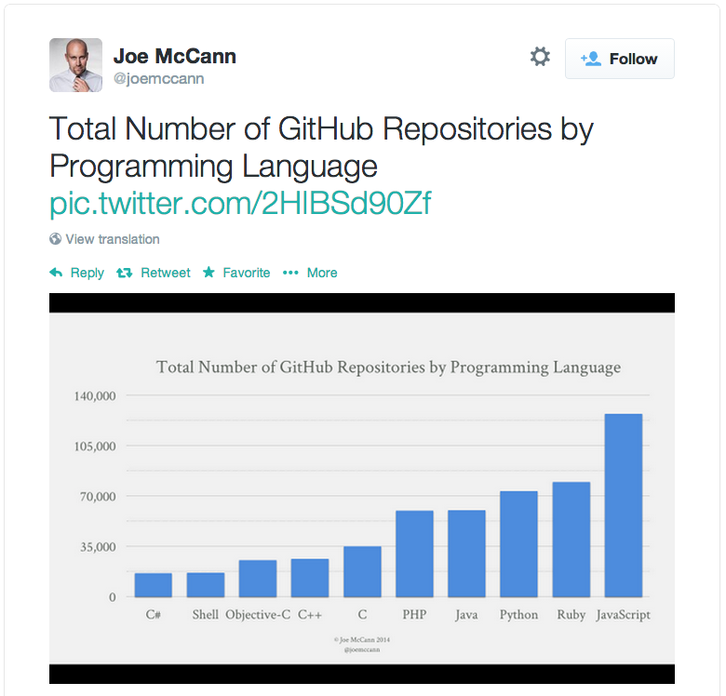
JavaScript*’s Popularity and Use on the Rise!
Games (Unreal*, Unity*) (via Emscripten* /asm.js*)
Hybrid HTML5/JS apps for cross platform apps on mobile devices
Pure HTML5/JS apps on ChromeOS* /FirefoxOS*/Tizen*
Standalone desktop JavaScript* apps via NW.js* (formerly node-webkit*) (Intel® XDK)
Full featured browser based apps (Google* Docs/maps, Office365*, …)
Server side logic via node.js*/io.js*

Slide 5
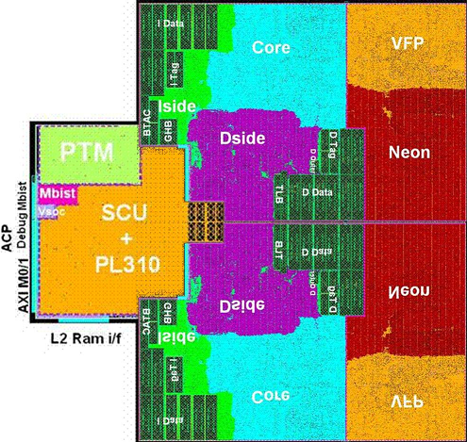
More Silicon Dedicated to Vector Processing

Slide 6
Hardware/Software Gap
SIMD instructions are an increasingly larger portion of instruction set architectures of newer CPUs
Currently, it’s not possible to utilize these powerful instructions from JavaScript* programs
SIMD.JS/Emscripten* will bridge this gap

Slide 7
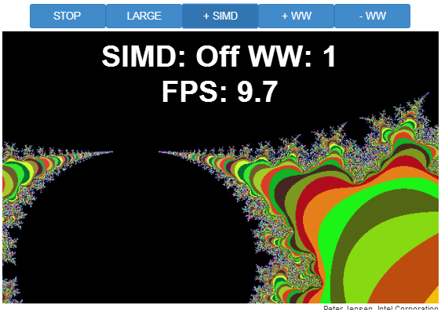
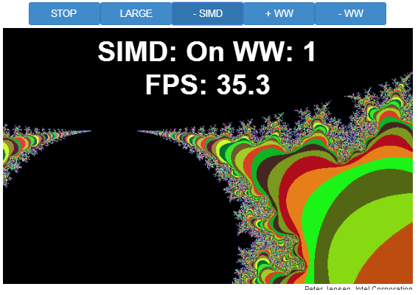
Demo - Mandelbrot

Slide 8
SIMD.JS/Emscripten – Background/History
Intel/Mozilla*/Google*/Microsoft*/ARM*collaboration!
Started mid-2013
Initial polyfill spec by John McCutchan (Google*’s Dart* VM team)
Prototypes for Chromium*, Firefox*
Available in Intel’s Crossswalk* web-runtime (for hybrid HTML5 apps) TODAY!
Emscripten* (C++ -> JavaScript* compiler) now generates SIMD.JS code from LLVM vector operations and from a subset of x86 SIMD intrinsics
Standardization (TC39) underway for inclusion of SIMD.JS in EcmaScript* 7

Slide 9
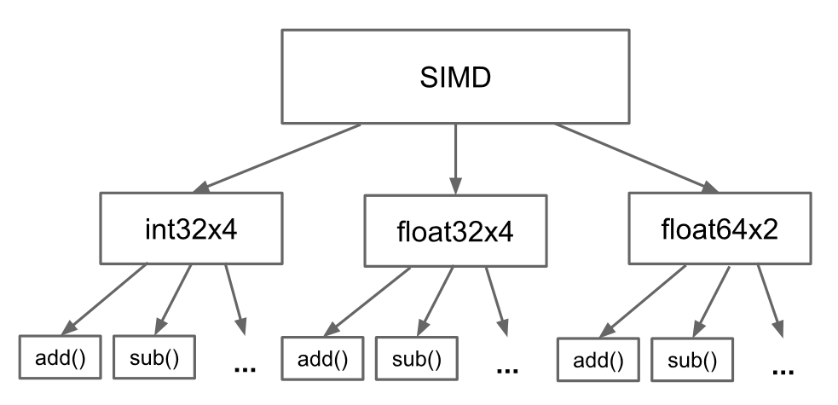
SIMD.JS – Object Hierarchy

Slide 10
SIMD.JS – API Details
Lane accessors, mutators:
Accessors: x, y, z, w
Mutators: withX, withY, withZ, withW
Operators:
Arithmetic: abs, neg, add, sub, mul, div, reciprocal, reciprocalSqrt, sqrt
Shuffle: swizzle (1 operand), shuffle (2 operands)
Logical: and, or, xor, not
Comparison: equal, greaterThan, LessThan
Shifts: shiftRightLogicalByScalar, shiftRightArithmeticByScalar, shiftLeftByScalar
Conversion: fromInt32x4, fromInt32x4Bits, etc.
Min/Max: min, minNum, max, maxNum

Slide 11
SIMD.JS – Example Usage - Mandelbrot
Scalar
SIMD
//
// z(i+1) = z(i)^2 + c
// terminate when |z|^2 > 4.0
// returns 1 iteration count
//
function mandelx1 (c_re, c_im) {
var z_re = c_re, z_im = c_im, i;
for (i = 0; i < max_iterations; ++i) {
var z_re2 = z_re*z_re;
var z_im2 = z_im*z_im;
if (z_re2 + z_im2 > 4.0) {
// iteration has diverged
break;
}
var new_re = z_re2 - z_im2;
var new_im = 2.0 * z_re * z_im;
z_re = c_re + new_re;
z_im = c_im + new_im;
}
return i;
}
function mandelx4(c_re4, c_im4) {
var z_re4 = c_re4,
z_im4 = c_im4,
four4 = SIMD.float32x4.splat (4.0),
two4 = SIMD.float32x4.splat (2.0),
count4 = SIMD.int32x4.splat (0),
one4 = SIMD.int32x4.splat (1),
i, z_re24, z_im24, mi4, new_re4, new_im4;
for (i = 0; i < max_iterations; ++i) {
z_re24 = SIMD.float32x4.mul (z_re4, z_re4);
z_im24 = SIMD.float32x4.mul (z_im4, z_im4);
mi4 = SIMD.float32x4.greaterThan(SIMD.float32x4.add (z_re24, z_im24), four4);
if (SIMD.int32x4.allTrue()) {
// all 4 values have diverged
break;
}
var new_re4 = SIMD.float32x4.sub (z_re24, z_im24);
var new_im4 = SIMD.float32x4.mul (SIMD.float32x4.mul (two4, z_re4), z_im4);
z_re4 = SIMD.float32x4.add (c_re4, new_re4);
z_im4 = SIMD.float32x4.add (c_im4, new_im4);
count4 = SIMD.int32x4.add (count4, SIMD.int32x4.and (mi4, one4));
}
return count4;
}

Slide 12
SIMD.JS – Focus
Initial focus on architecture overlap (128-bit vectors)
Well defined NaN handling
Well defined float32 -> int32 conversions
Well defined shift handling for shift counts > 32
Precision of reciprocalSqrt – left undefined
Architecture specific extensions are being discussed, for example
Fma (NEON*, AVX*)
Vector shifts (NEON*)

Slide 13
Emscripten* - Basics
Brainchild of Mozilla*’s Alon Zakai
Compiles C/C++ to JavaScript*
Uses clang/LLVM for C/C++ front-end and optimizer framework
Models memory with JS TypedArrays
Generates the asm.js subset of JavaScript*
Tools available to create bindings between handwritten JS and Emscripten* generated JS (webidl_binder)
Several large C/C++ applications/games have been ported to the web platform (e.g., Unity*, Unreal*, box2D*)

Slide 14
Emscripten* – C/C++ -> JS Memory Modelling
var buffer = new ArrayBuffer(TOTAL_MEMORY);
HEAP8 = new Int8Array(buffer);
HEAP16 = new Int16Array(buffer);
HEAP32 = new Int32Array(buffer);
HEAPU8 = new Uint8Array(buffer);
HEAPU16 = new Uint16Array(buffer);
HEAPU32 = new Uint32Array(buffer);
HEAPF32 = new Float32Array(buffer);
HEAPF64 = new Float64Array(buffer);
Views over the same memory (buffer) for basic C/C++ types
C/C++ pointers used as indices to access elements of these arrays

Slide 15
Emscripten* – Generated Code Example
for (uint32_t j = 0, l = length;
j < l;
j = j + 4) {
sum = sum + *(a++);
}
while (1) {
$add = $sum$04 + +HEAPF32[$a$addr$06 >> 2];
$j$05 = $j$05 + 4 | 0;
if (!($j$05 >>> 0 < $length >>> 0)) {
$sum$0$lcssa = $add;
break;
} else {
$a$addr$06 = $a$addr$06 + 4 | 0;
$sum$04 = $add;
}
}
Unary ‘+’ (+expr) used as hint to JIT compiler to indicate number
Bitwise-Or zero (expr|0) used to indicate 32-bit signed int
Unsigned shift right (>>>) used to indicate 32-bit unsigned int
Addresses are byte addresses. Need to shift right by 2 to get the right index
Type hints and no dynamic allocations allow JIT compilers to generate very efficient code QUICKLY!

Slide 16
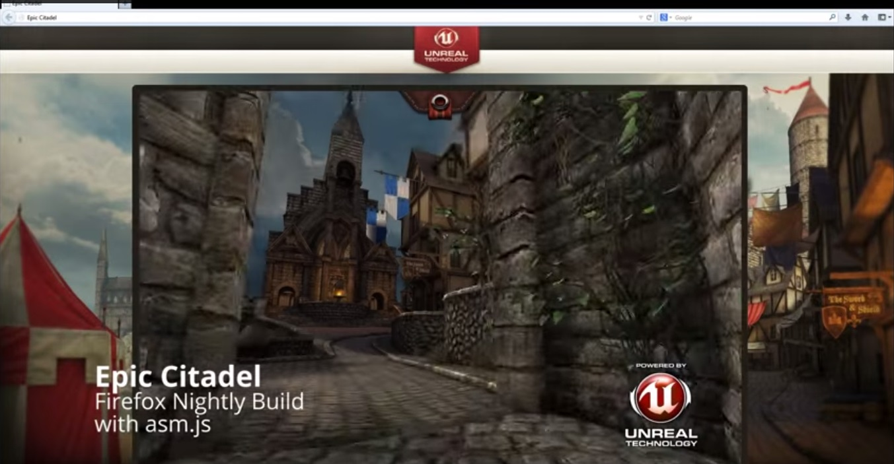
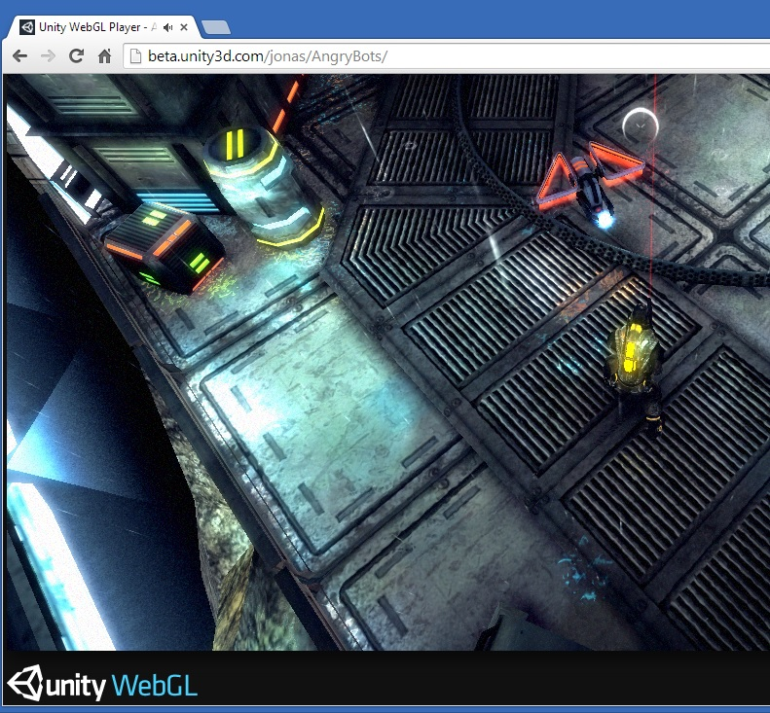
Emscripten* – Showcase Uses
Epic Unreal
Unity
Over a million lines of C++ code ported to JS
4 days to port!

Slide 17
SIMD.JS and Emscripten* – A Perfect Match!
Performance critical C/C++ code uses SIMD to get acceptable performance
Games, physics, image manipulation, video encoding/decoding, signal processing, etc.
SIMD.JS enables Emscripten* to fully utilize these highly optimized C/C++ code sequences

Slide 18
Emscripten* – Compiling SIMD C/C++ Code
$ emcc –O2 –g average-intrin.c
C code with x86 intrinsics
asm.js code with SIMD.JS (for loop)
float averageIntrin(float *a,
uint32_t length) {
__m128 sumx4 = _mm_set_ps1(0.0);
for (uint32_t j = 0, l = length;
j < l; j = j + 4) {
sumx4 = _mm_add_ps(
sumx4,_mm_loadu_ps(&(a[j])));
}
float mSumx4[4];
_mm_storeu_ps(mSumx4, sumx4);
return (mSumx4[0] + mSumx4[1] +
mSumx4[2] + mSumx4[3])/length;
}
while (1) {
$add$i = SIMD_float32x4_add(
$sumx4$010,
SIMD_float32x4_load(
buffer, $a + ($j$09 << 2) | 0));
$j$09 = $j$09 + 4 | 0;
if (!($j$09 >>> 0 < $length >>> 0)) {
$sumx4$0$lcssa = $add$i;
break;
} else $sumx4$010 = $add$i;
}

Slide 19
Benchmarks
Handwritten JavaScript* benchmark kernels:
Average, Mandelbrot, MatrixMultiplication, VertexTransform, MatrixTranspose, MatrixInverse
Vector/Matrix math important for game/physics
Kernels for both scalar and SIMD implementations
Measure speedup (SIMD/scalar)
Manually converted to C++
Automatically compiled back to JavaScript with Emscripten
JavaScript code executed with both Chromium* and Firefox* SIMD prototypes
Native clang/LLVM compiler used to compile C++ code

Slide 20
Benchmarks – Handwritten JavaScript*
Scalar JavaScript
function average(n) {
for (var i = 0; i < n; ++i) {
var sum = 0.0;
for (var j = 0, l = a.length; j < l; ++j) {
sum += a[j];
}
}
return sum/a.length;
}
SIMD JavaScript
function simdAverage(n) {
for (var i = 0; i < n; ++i) {
var sum4 = SIMD.float32x4.splat(0.0);
for (var j = 0; j < a.length / 4; ++j) {
sum4 = SIMD.float32x4.add(sum4, SIMD.float32x4.load(a, j << 2));
}
}
return (sum4.x + sum4.y + sum4.z + sum4.w)/a.length;
}

Slide 21
Benchmarks – Handwritten C++
Scalar C++
static float nonSimdAverageKernel32() {
float sum = 0.0;
for (uint32_t j = 0, l = length; j < l; ++j) {
sum += a[j];
}
return sum/length;
}
SIMD C++
static float simdAverageKernel() {
__m128 sumx4 = _mm_set_ps1(0.0);
for (uint32_t j = 0, l = length; j < l; j = j + 4) {
sumx4 = _mm_add_ps(sumx4, _mm_loadu_ps(&(a[j])));
}
Base::Lanes<__m128, float> lanes(sumx4);
return (lanes.x() + lanes.y() + lanes.z() + lanes.w())/length;
}

Slide 22
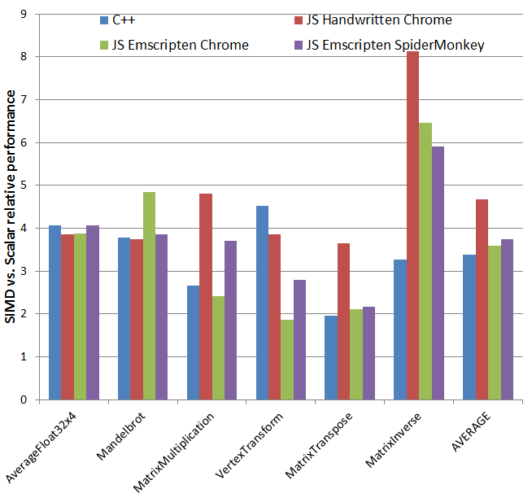
Benchmark Results – SIMD vs. Scalar Speedups
Observations:
Average speedups are in the expected ~4x range
Higher speedups for ‘JS Handwritten Chrome’ is due to slow scalar kernel (64-bit FP operations
Super linear speedups for MatrixInverse most likely due to slower scalar kernel as well.

Slide 23
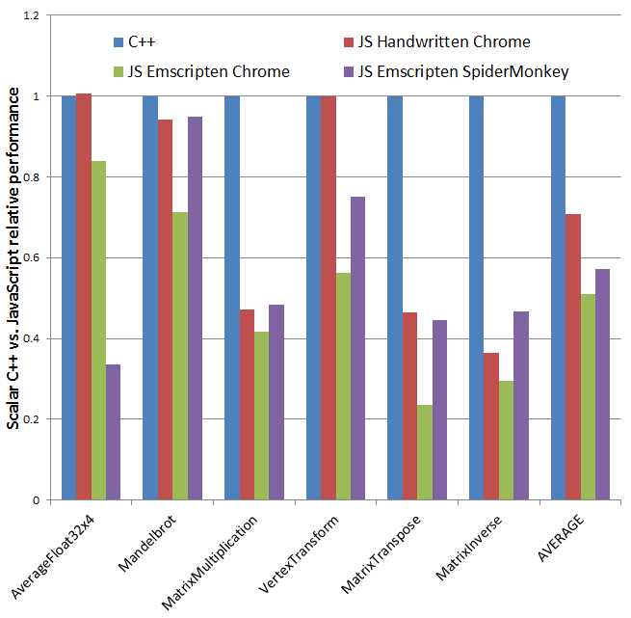
Benchmark Results – Scalar C++ vs. Scalar JS
Observations:
Average JS performance is roughly 60% of native C++
Handwritten JS code is slightly faster than Emscripten* generated JS
SpiderMonkey/OdinMonkey is slightly faster than Chromium on Emscripten generated JS
Chromium* has ‘slow JIT’ overhead that OdinMonkey doesn’t

Slide 24
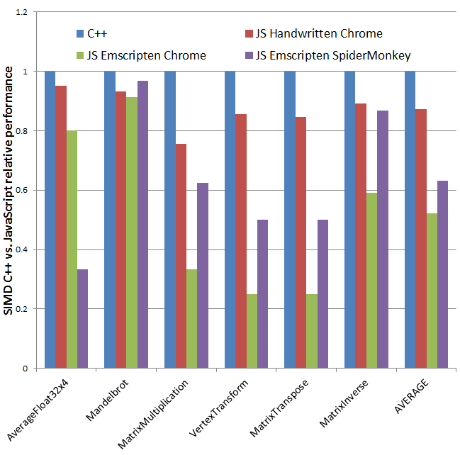
Benchmark Results – SIMD C++ vs. SIMD JS
Observations:
Handwritten JS performance is ~85% of native C++ on Chromium*!
Emscripten generated JS performance is ~60% of native C++ on both Chromium* and OdinMonkey
C++/JS performance for SIMD code is roughly the same as it is for Scalar code

Slide 25
Summary
SIMD.JS bridges the hardware/software gap for JavaScript* programs
SIMD.JS makes ~4x speedup of performance critical code possible
Emscripten* now compiles SIMD C++ vector code
The performance gap between native C/C++ code and JavaScript code keeps getting smaller
HTML5/JavaScript becomes an increasingly capable cross platform
THANK YOU

Slide 26
References
SIMD.JS polyfill/spec and handwritten JS benchmarks:
https://github.com/johnmccutchan/ecmascript_simd
Emscripten*:
https://github.com/kripken/emscripten/wiki
C++ benchmarks:
https://github.com/PeterJensen/benchcpp
This presentation and accompanying paper (contact info in paper):
https://github.com/PeterJensen/wpmvp2015

Slide 27
Legal Disclaimer
INFORMATION IN THIS DOCUMENT IS PROVIDED IN CONNECTION WITH INTEL PRODUCTS. NO LICENSE, EXPRESS OR IMPLIED, BY ESTOPPEL OR OTHERWISE, TO ANY INTELLECTUAL PROPERTY RIGHTS IS GRANTED BY THIS DOCUMENT. EXCEPT AS PROVIDED IN INTEL'S TERMS AND CONDITIONS OF SALE FOR SUCH PRODUCTS, INTEL ASSUMES NO LIABILITY WHATSOEVER AND INTEL DISCLAIMS ANY EXPRESS OR IMPLIED WARRANTY, RELATING TO SALE AND/OR USE OF INTEL PRODUCTS INCLUDING LIABILITY OR WARRANTIES RELATING TO FITNESS FOR A PARTICULAR PURPOSE, MERCHANTABILITY, OR INFRINGEMENT OF ANY PATENT, COPYRIGHT OR OTHER INTELLECTUAL PROPERTY RIGHT.
A "Mission Critical Application" is any application in which failure of the Intel Product could result, directly or indirectly, in personal injury or death. SHOULD YOU PURCHASE OR USE INTEL'S PRODUCTS FOR ANY SUCH MISSION CRITICAL APPLICATION, YOU SHALL INDEMNIFY AND HOLD INTEL AND ITS SUBSIDIARIES, SUBCONTRACTORS AND AFFILIATES, AND THE DIRECTORS, OFFICERS, AND EMPLOYEES OF EACH, HARMLESS AGAINST ALL CLAIMS COSTS, DAMAGES, AND EXPENSES AND REASONABLE ATTORNEYS' FEES ARISING OUT OF, DIRECTLY OR INDIRECTLY, ANY CLAIM OF PRODUCT LIABILITY, PERSONAL INJURY, OR DEATH ARISING IN ANY WAY OUT OF SUCH MISSION CRITICAL APPLICATION, WHETHER OR NOT INTEL OR ITS SUBCONTRACTOR WAS NEGLIGENT IN THE DESIGN, MANUFACTURE, OR WARNING OF THE INTEL PRODUCT OR ANY OF ITS PARTS.
Intel may make changes to specifications and product descriptions at any time, without notice. Designers must not rely on the absence or characteristics of any features or instructions marked "reserved" or "undefined". Intel reserves these for future definition and shall have no responsibility whatsoever for conflicts or incompatibilities arising from future changes to them. The information here is subject to change without notice. Do not finalize a design with this information.
The products described in this document may contain design defects or errors known as errata which may cause the product to deviate from published specifications. Current characterized errata are available on request.
Contact your local Intel sales office or your distributor to obtain the latest specifications and before placing your product order.
Copies of documents which have an order number and are referenced in this document, or other Intel literature, may be obtained by calling 1-800-548-4725, or go to: http://www.intel.com/design/literature.htm
River Trail, Nehalem, and other code names featured are used internally within Intel to identify products that are in development and not yet publicly announced for release. Customers, licensees and other third parties are not authorized by Intel to use code names in advertising, promotion or marketing of any product or services and any such use of Intel's internal code names is at the sole risk of the user.
Intel, Xeon, VTune, Atom, Core, Xeon Phi, Look Inside and the Intel logo are trademarks of Intel Corporation in the United States and other countries.
*Other names and brands may be claimed as the property of others.
Copyright ©2014 Intel Corporation.

Slide 28
Intel's compilers may or may not optimize to the same degree for non-Intel microprocessors for optimizations that are not unique to Intel microprocessors. These optimizations include SSE2, SSE3, and SSE3 instruction sets and other optimizations. Intel does not guarantee the availability, functionality, or effectiveness of any optimization on microprocessors not manufactured by Intel. Microprocessor-dependent optimizations in this product are intended for use with Intel microprocessors. Certain optimizations not specific to Intel microarchitecture are reserved for Intel microprocessors. Please refer to the applicable product User and Reference Guides for more information regarding the specific instruction sets covered by this notice. Notice revision #20110804

Slide 29
Legal Disclaimer
Software and workloads used in performance tests may have been optimized for performance only on Intel microprocessors. Performance tests, such as SYSmark* and MobileMark*, are measured using specific computer systems, components, software, operations and functions. Any change to any of those factors may cause the results to vary. You should consult other information and performance tests to assist you in fully evaluating your contemplated purchases, including the performance of that product when combined with other products. For more information go to http://www.intel.com/performance.
Software Source Code Disclaimer: Any software source code reprinted in this document is furnished under a software license and may only be used or copied in accordance with the terms of that license.
Permission is hereby granted, free of charge, to any person obtaining a copy of this software and associated documentation files (the "Software"), to deal in the Software without restriction, including without limitation the rights to use, copy, modify, merge, publish, distribute, sublicense, and/or sell copies of the Software, and to permit persons to whom the Software is furnished to do so, subject to the following conditions:
THE SOFTWARE IS PROVIDED "AS IS", WITHOUT WARRANTY OF ANY KIND, EXPRESS OR IMPLIED, INCLUDING BUT NOT LIMITED TO THE WARRANTIES OF MERCHANTABILITY, FITNESS FOR A PARTICULAR PURPOSE AND NONINFRINGEMENT. IN NO EVENT SHALL THE AUTHORS OR COPYRIGHT HOLDERS BE LIABLE FOR ANY CLAIM, DAMAGES OR OTHER LIABILITY, WHETHER IN AN ACTION OF CONTRACT, TORT OR OTHERWISE, ARISING FROM, OUT OF OR IN CONNECTION WITH THE SOFTWARE OR THE USE OR OTHER DEALINGS IN THE SOFTWARE.

Slide 30
Risk Factors
The above statements and any others in this document that refer to plans and expectations for the third quarter, the year and the future are forward-looking statements that involve a number of risks and uncertainties. Words such as “anticipates,” “expects,” “intends,” “plans,” “believes,” “seeks,” “estimates,” “may,” “will,” “should” and their variations identify forward-looking statements. Statements that refer to or are based on projections, uncertain events or assumptions also identify forward-looking statements. Many factors could affect Intel’s actual results, and variances from Intel’s current expectations regarding such factors could cause actual results to differ materially from those expressed in these forward-looking statements. Intel presently considers the following to be the important factors that could cause actual results to differ materially from the company’s expectations. Demand could be different from Intel's expectations due to factors including changes in business and economic conditions; customer acceptance of Intel’s and competitors’ products; supply constraints and other disruptions affecting customers; changes in customer order patterns including order cancellations; and changes in the level of inventory at customers. Uncertainty in global economic and financial conditions poses a risk that consumers and businesses may defer purchases in response to negative financial events, which could negatively affect product demand and other related matters. Intel operates in intensely competitive industries that are characterized by a high percentage of costs that are fixed or difficult to reduce in the short term and product demand that is highly variable and difficult to forecast. Revenue and the gross margin percentage are affected by the timing of Intel product introductions and the demand for and market acceptance of Intel's products; actions taken by Intel's competitors, including product offerings and introductions, marketing programs and pricing pressures and Intel’s response to such actions; and Intel’s ability to respond quickly to technological developments and to incorporate new features into its products. The gross margin percentage could vary significantly from expectations based on capacity utilization; variations in inventory valuation, including variations related to the timing of qualifying products for sale; changes in revenue levels; segment product mix; the timing and execution of the manufacturing ramp and associated costs; start-up costs; excess or obsolete inventory; changes in unit costs; defects or disruptions in the supply of materials or resources; product manufacturing quality/yields; and impairments of long-lived assets, including manufacturing, assembly/test and intangible assets. Intel's results could be affected by adverse economic, social, political and physical/infrastructure conditions in countries where Intel, its customers or its suppliers operate, including military conflict and other security risks, natural disasters, infrastructure disruptions, health concerns and fluctuations in currency exchange rates. Expenses, particularly certain marketing and compensation expenses, as well as restructuring and asset impairment charges, vary depending on the level of demand for Intel's products and the level of revenue and profits. Intel’s results could be affected by the timing of closing of acquisitions and divestitures. Intel's results could be affected by adverse effects associated with product defects and errata (deviations from published specifications), and by litigation or regulatory matters involving intellectual property, stockholder, consumer, antitrust, disclosure and other issues, such as the litigation and regulatory matters described in Intel's SEC reports. An unfavorable ruling could include monetary damages or an injunction prohibiting Intel from manufacturing or selling one or more products, precluding particular business practices, impacting Intel’s ability to design its products, or requiring other remedies such as compulsory licensing of intellectual property. A detailed discussion of these and other factors that could affect Intel’s results is included in Intel’s SEC filings, including the company’s most recent reports on Form 10-Q, Form 10-K and earnings release.
Rev. 7/17/13

