Slide 1
SIMD in JavaScript via C++ and Emscripten
February 8th, 2015 - Workshop on Programming Models for SIMD/Vector Processing
Peter Jensen, Intel Corporation
Ivan Jibaja, Intel Corporation
Ningxin Hu, Intel Corporation
Dan Gohman, Mozilla
John McCutchan, Google

Slide 2
Agenda
Motivation
Background/History
SIMD.JS
Emscripten
Compiling SIMD C++ code to SIMD.JS JavaScript code
Results

Slide 3
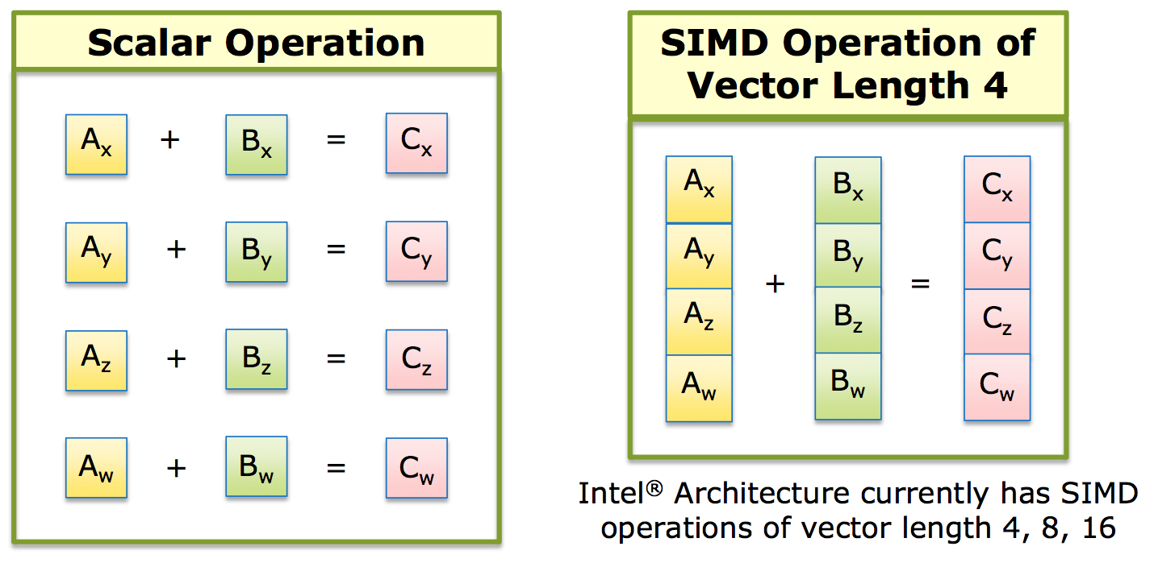
SIMD: Single Instruction, Multiple Data

Slide 4
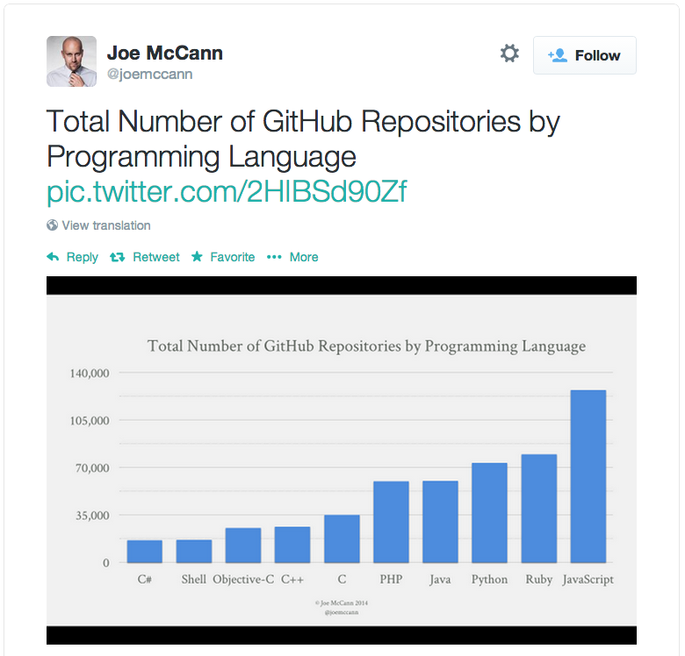
JavaScript’s Popularity and Use on the Rise!
Games (Unreal, Unity) (via Emscripten/asm.js)
Hybrid HTML5/JS apps for cross platform apps on mobile devices
Pure HTML5/JS apps on ChromeOS/FirefoxOS/Tizen
Standalone desktop JavaScript apps via NW.js (formerly node-webkit) (Intel XDK)
Full featured browser based apps (Google Docs/maps, Office 365, …)
Server side logic via node.js/io.js

Slide 5
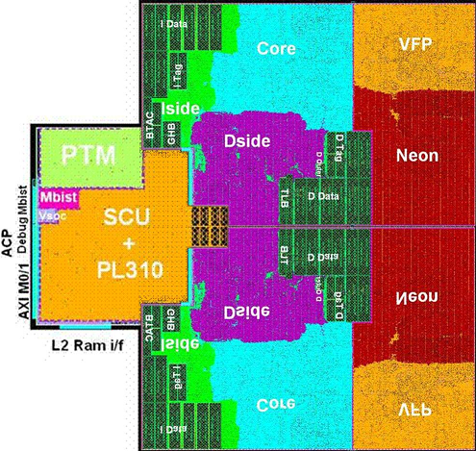
More Silicon Dedicated to Vector Processing

Slide 6
Hardware/Software Gap
SIMD instructions are an increasingly larger portion of instruction set architectures of newer CPUs
Currently, it’s not possible to utilize these powerful instructions from JavaScript programs
SIMD.JS/Emscripten will bridge this gap

Slide 7
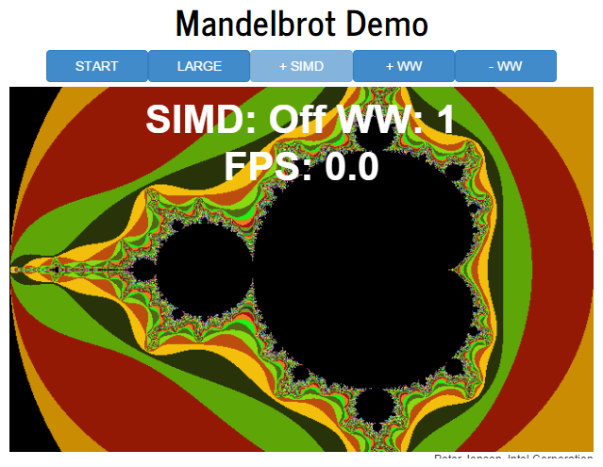
Demo

Slide 8
SIMD.JS/Emscripten – Background/History
Intel/Mozilla/Google/Microsoft/ARM collaboration!
Started mid-2013
Initial polyfill spec by John McCutchan (Google’s Dart VM team)
Prototypes for Chromium, Firefox
Available in Intel’s Crossswalk web-runtime (for hybrid HTML5 apps) TODAY!
Emscripten (C++ -> JavaScript compiler) now generates SIMD.JS code from LLVM vector operations and from a subset of x86 SIMD intrinsics

Slide 9
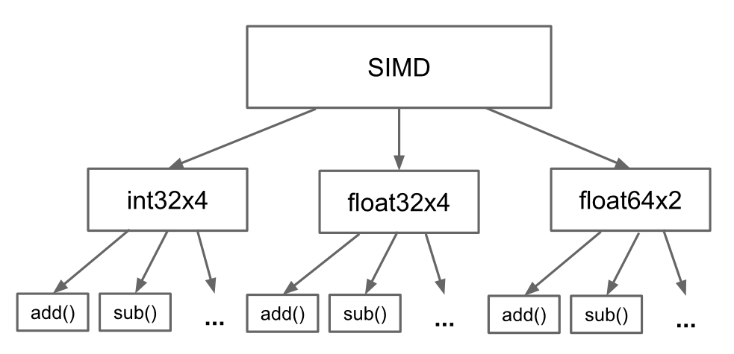
SIMD.JS – Object Hierarchy

Slide 10
SIMD.JS – API Details
Lane accessors, mutators:
Accessors: x, y, z, w
Mutators: withX, withY, withZ, withW
Operators:
Arithmetic: abs, neg, add, sub, mul, div, reciprocal, reciprocalSqrt, sqrt
Shuffle: swizzle (1 operand), shuffle (2 operands)
Logical: and, or, xor, not
Comparison: equal, greaterThan, LessThan
Shifts: shiftRightLogicalByScalar, shiftRightArithmeticByScalar, shiftLeftByScalar
Conversion: fromInt32x4, fromInt32x4Bits, etc.
Min/Max: min, minNum, max, maxNum

Slide 11
SIMD.JS – Example Usage - Mandelbrot
Scalar
SIMD
//
// z(i+1) = z(i)^2 + c
// terminate when |z|^2 > 4.0
// returns 1 iteration count
//
function mandelx1 (c_re, c_im) {
var z_re = c_re, z_im = c_im, i;
for (i = 0; i < max_iterations; ++i) {
var z_re2 = z_re*z_re;
var z_im2 = z_im*z_im;
if (z_re2 + z_im2 > 4.0) {
// iteration has diverged
break;
}
var new_re = z_re2 - z_im2;
var new_im = 2.0 * z_re * z_im;
z_re = c_re + new_re;
z_im = c_im + new_im;
}
return i;
}
function mandelx4(c_re4, c_im4) {
var z_re4 = c_re4,
z_im4 = c_im4,
four4 = SIMD.float32x4.splat (4.0),
two4 = SIMD.float32x4.splat (2.0),
count4 = SIMD.int32x4.splat (0),
one4 = SIMD.int32x4.splat (1),
i, z_re24, z_im24, mi4, new_re4, new_im4;
for (i = 0; i < max_iterations; ++i) {
z_re24 = SIMD.float32x4.mul (z_re4, z_re4);
z_im24 = SIMD.float32x4.mul (z_im4, z_im4);
mi4 = SIMD.float32x4.greaterThan(SIMD.float32x4.add (z_re24, z_im24), four4);
if (SIMD.int32x4.allTrue()) {
// all 4 values have diverged
break;
}
var new_re4 = SIMD.float32x4.sub (z_re24, z_im24);
var new_im4 = SIMD.float32x4.mul (SIMD.float32x4.mul (two4, z_re4), z_im4);
z_re4 = SIMD.float32x4.add (c_re4, new_re4);
z_im4 = SIMD.float32x4.add (c_im4, new_im4);
count4 = SIMD.int32x4.add (count4, SIMD.int32x4.and (mi4, one4));
}
return count4;
}

Slide 12
SIMD.JS – Focus
Initial focus on architecture overlap (128-bit vectors)
Well defined NaN handling
Well defined float32 -> int32 conversions
Well defined shift handling for shift counts > 32
Precision of reciprocalSqrt – left undefined
Architecture specific extensions are in the works, for example
Float64x2 Division (x86)
Fma (NEON, AVX)
Vector shifts (NEON)

