Slide 1
SIMD in JavaScript via C++ and Emscripten
February 8th, 2015 - Workshop on Programming Models for SIMD/Vector Processing
Peter Jensen, Intel Corporation
Ivan Jibaja, Intel Corporation
Ningxin Hu, Intel Corporation
Dan Gohman, Mozilla
John McCutchan, Google

Slide 2
Agenda
Motivation
Background/History
SIMD.JS
Emscripten
Compiling SIMD C++ code to SIMD.JS JavaScript code
Results

Slide 3
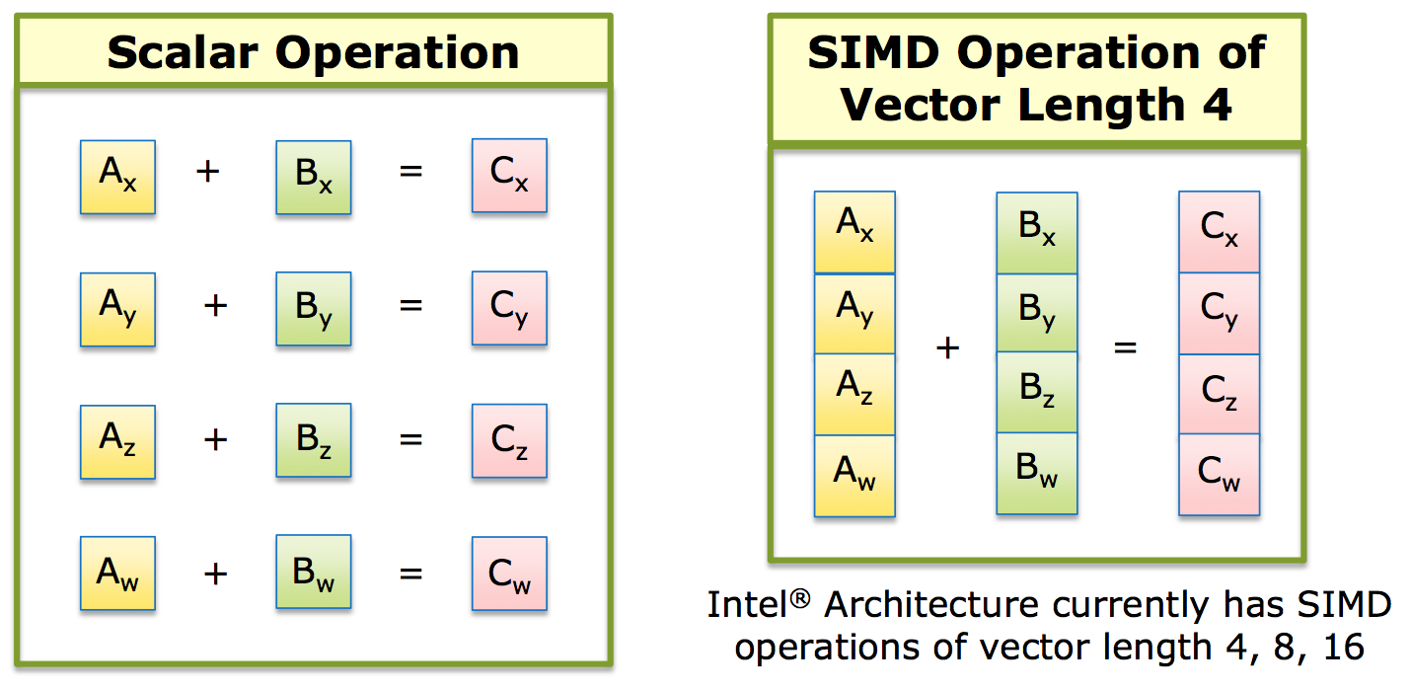
SIMD: Single Instruction, Multiple Data

Slide 4
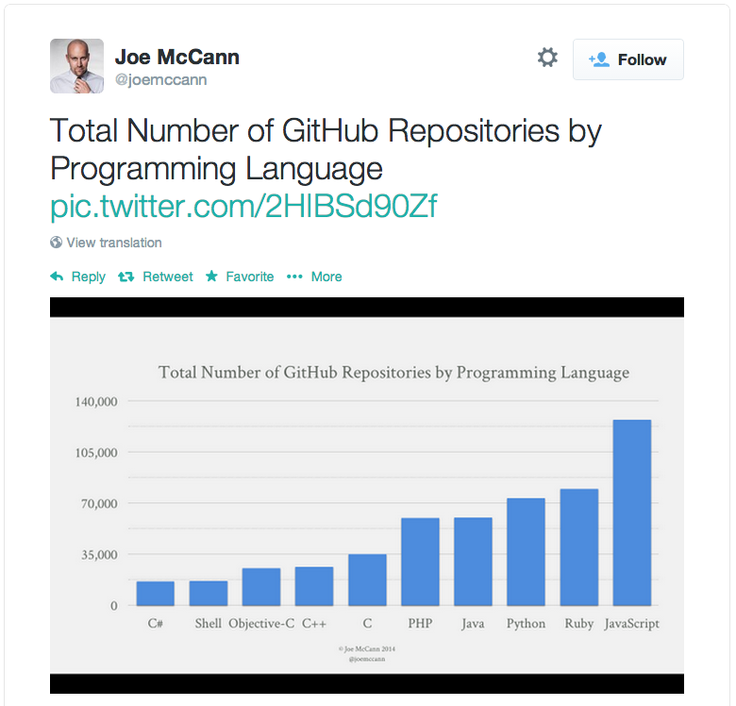
JavaScript’s Popularity and Use on the Rise!
Games (Unreal, Unity) (via Emscripten/asm.js)
Hybrid HTML5/JS apps for cross platform apps on mobile devices
Pure HTML5/JS apps on ChromeOS/FirefoxOS/Tizen
Standalone desktop JavaScript apps via NW.js (formerly node-webkit) (Intel XDK)
Full featured browser based apps (Google Docs/maps, Office 365, …)
Server side logic via node.js/io.js

Slide 5
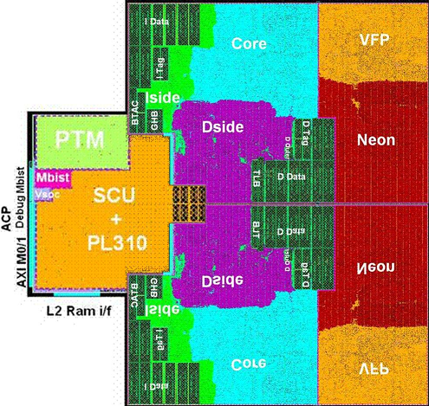
More Silicon Dedicated to Vector Processing

Slide 6
Hardware/Software Gap
SIMD instructions are an increasingly larger portion of instruction set architectures of newer CPUs
Currently, it’s not possible to utilize these powerful instructions from JavaScript programs
SIMD.JS/Emscripten will bridge this gap

Slide 7
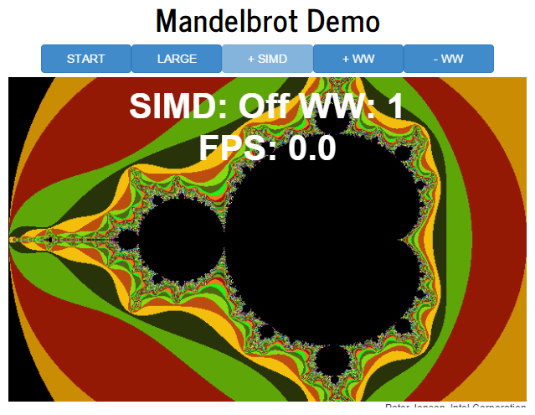
Demo

Slide 8
SIMD.JS/Emscripten – Background/History
Intel/Mozilla/Google/Microsoft/ARM collaboration!
Started mid-2013
Initial polyfill spec by John McCutchan (Google’s Dart VM team)
Prototypes for Chromium, Firefox
Available in Intel’s Crossswalk web-runtime (for hybrid HTML5 apps) TODAY!
Emscripten (C++ -> JavaScript compiler) now generates SIMD.JS code from LLVM vector operations and from a subset of x86 SIMD intrinsics

