Slide 1
U.S. Electricity Generation
State generation profile 1990 – 2019
https://peterliu100.shinyapps.io/us_electricity/

Slide 2
Overview
Investigate the reflection of the national trend at the state level
Intra-state profile comparison between two selected years
Inter-state profile comparison between two selected years
Source: U.S. Energy Information Administration (www.eia.gov)

Slide 3
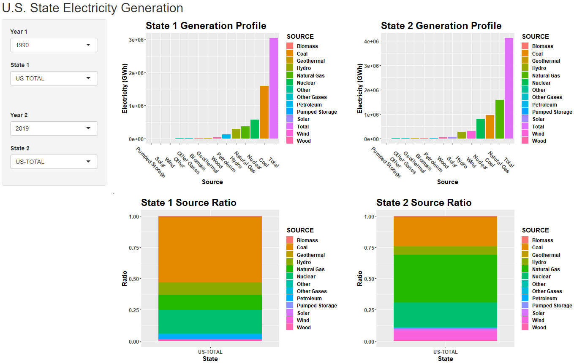

Slide 4
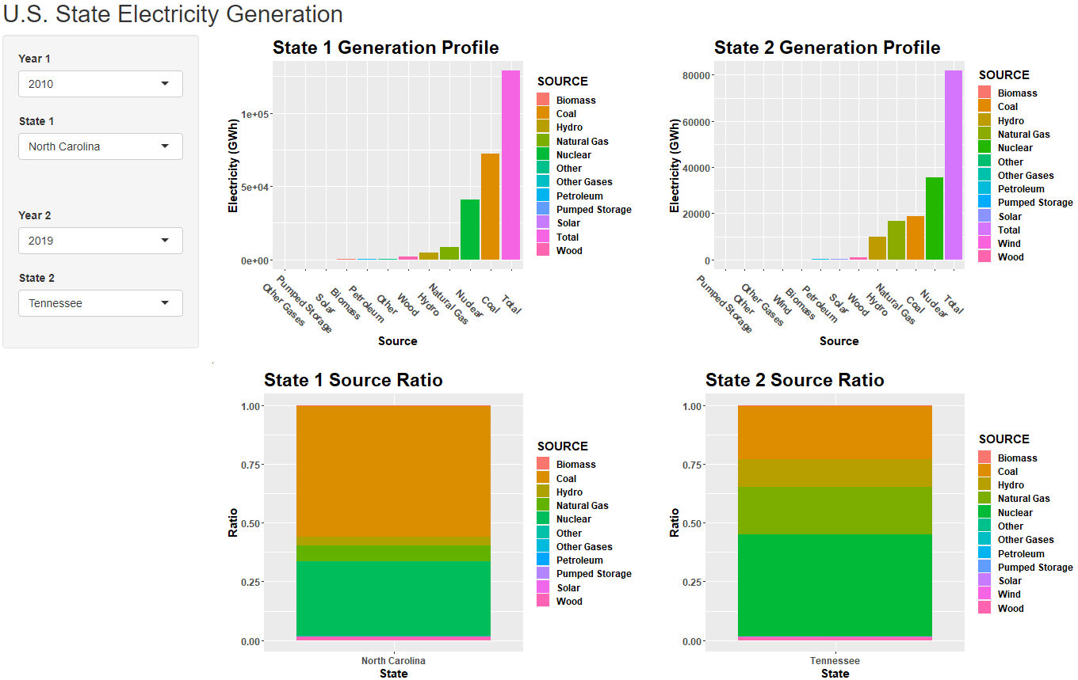

Slide 5
Future Considerations
Generation retirement and new capacity build-out
Overlay of wind and solar resource profiles
Regulatory framework (e.g. grid operators, Renewable Portfolio Standards)
Investment costs/operating expenses, returns (IRR), horizon

