Slide 1
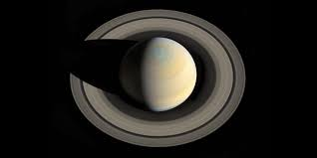
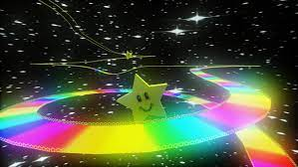
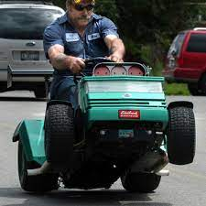
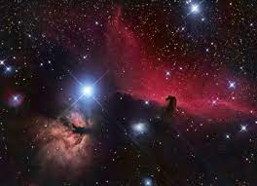
Pillars of the game
The players will compete in grass laden gravity defying tracks with intense speed and grass cutting
A story mode based on the origin of the lawnmowers in space.
The races will take place in a variety of places such as the rings of Saturn
The game world will be an immersive place with interesting space scenery

Slide 2
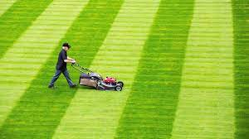
Gameplay Description
The game will be a fun arcade racer with good use of gravity to counteract the slower speed of the lawnmowers to create a learning curb of the game
The gameplay will feel quite floaty due to the use of gravity in the game
The game will be satisfying to play when winning but frustrating when losing

