Slide 1

Pillars
Satisfying sense of speed.
Graphics that sell the rocket motion.
Tight controls to match the fantasy of greater speeds than our world.

Slide 2
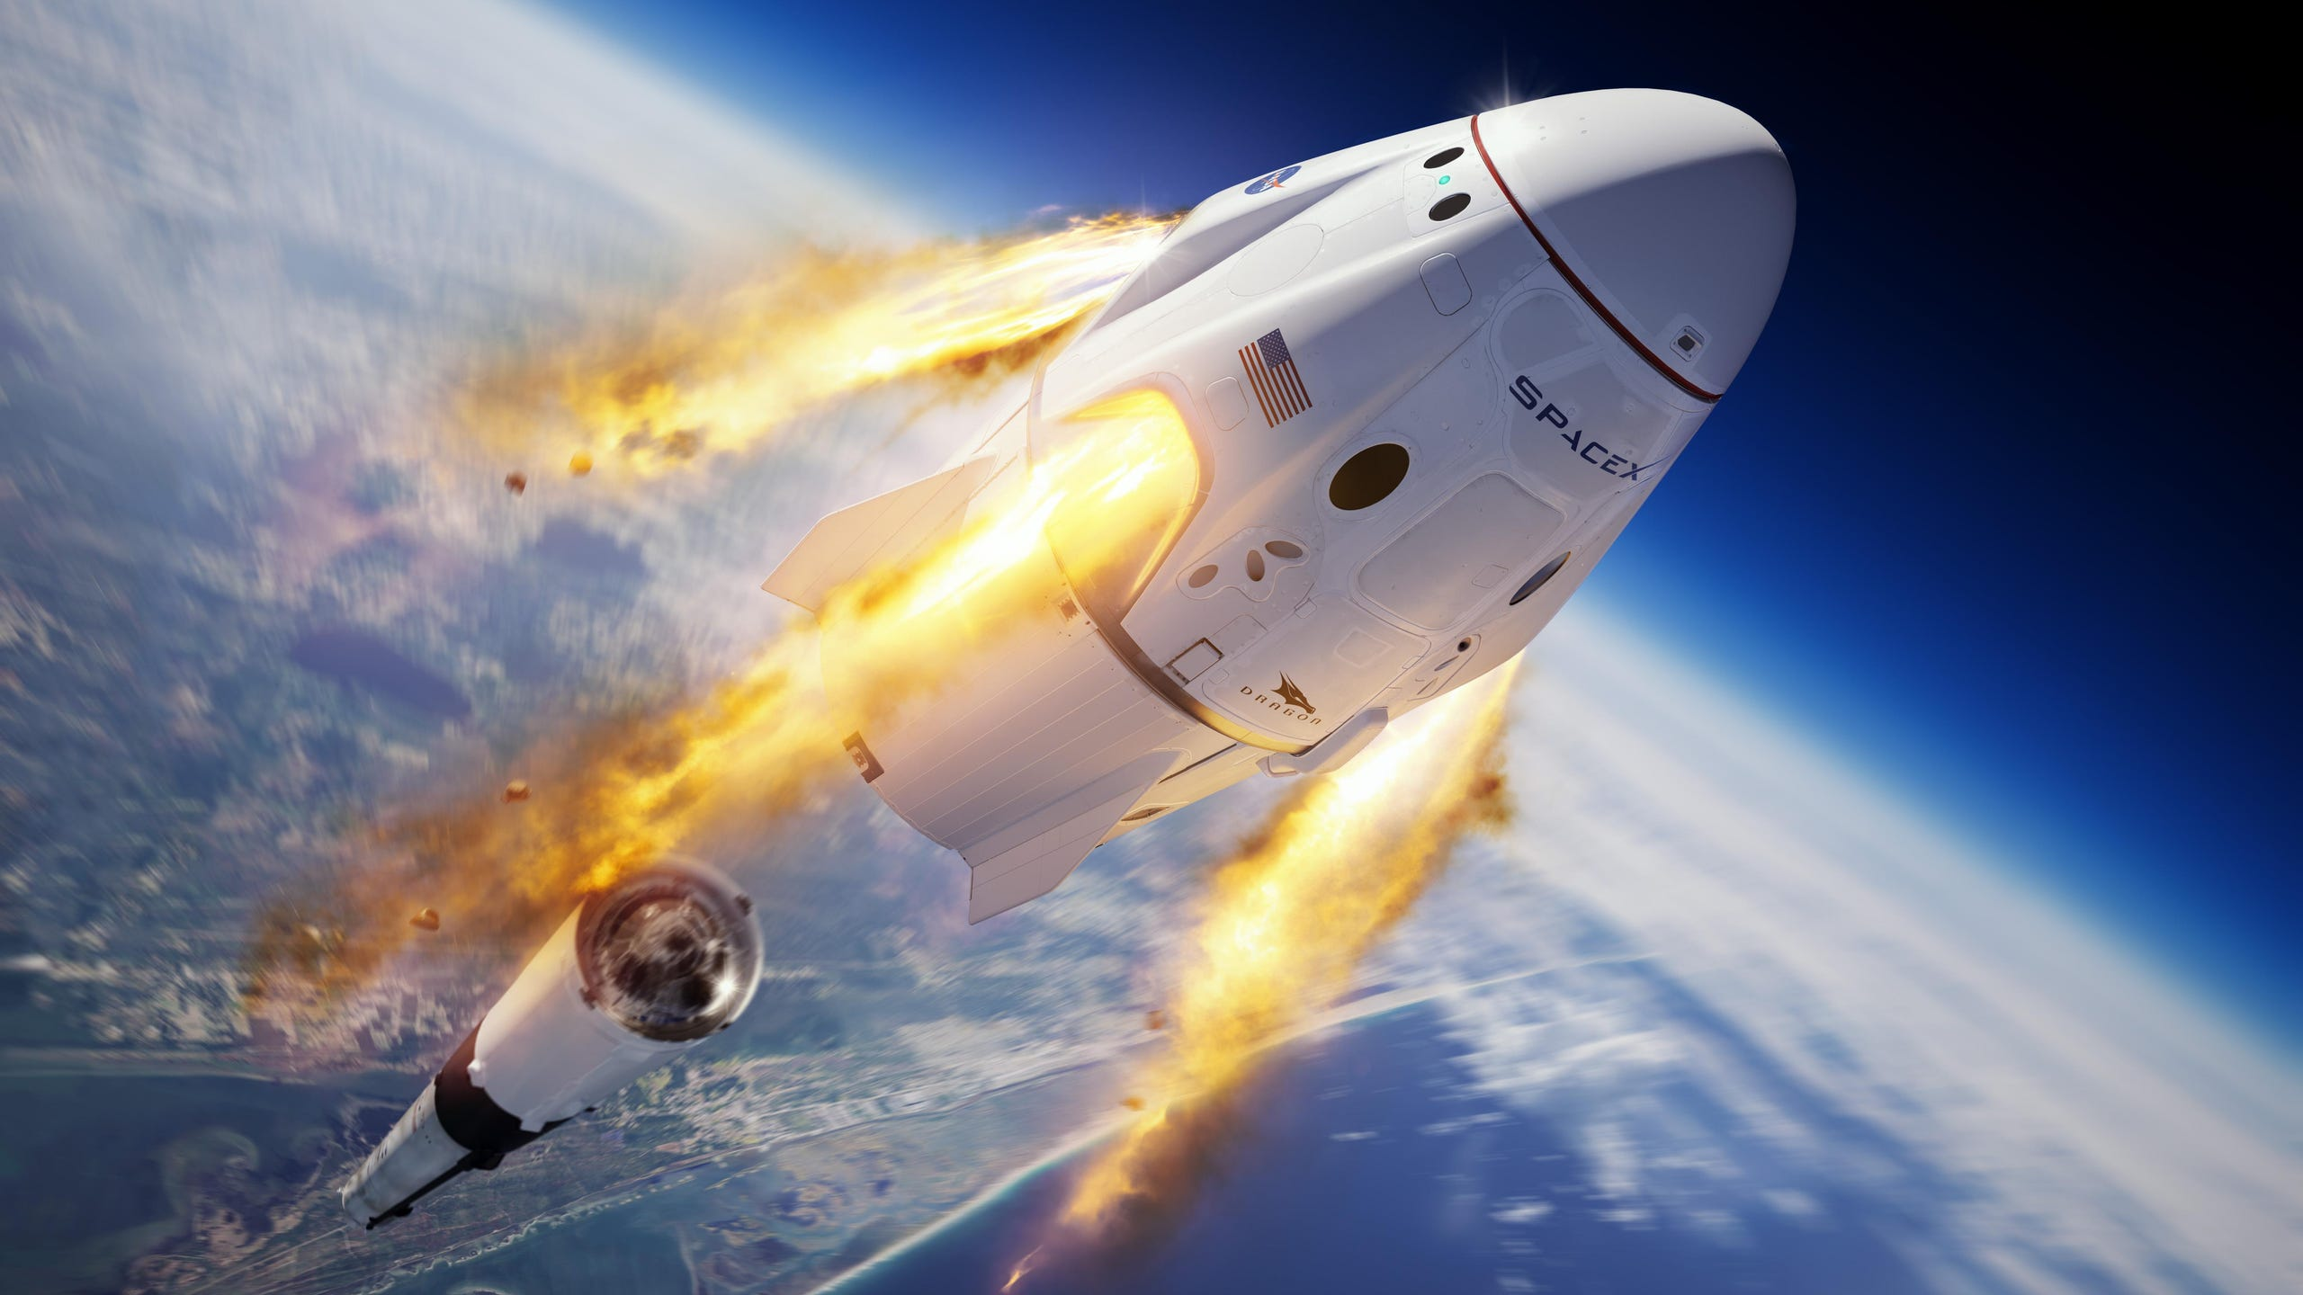
Gameplay
The game experience resembles the known franchise Need for Speed but in this installment the adrenaline comes with rocket propelled shutters going at greater velocity everything controlled by your actions, which makes the gameplay interesting and dangerously addictive.

