Slide 1
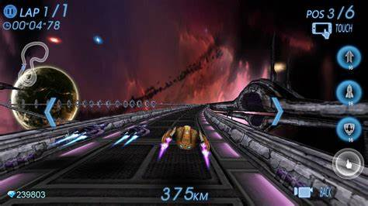
Feature points
Space Role Playing game
Main currency is cars
Main way of getting through the game is getting the best cars
If you lose the race you lose the car

Slide 2
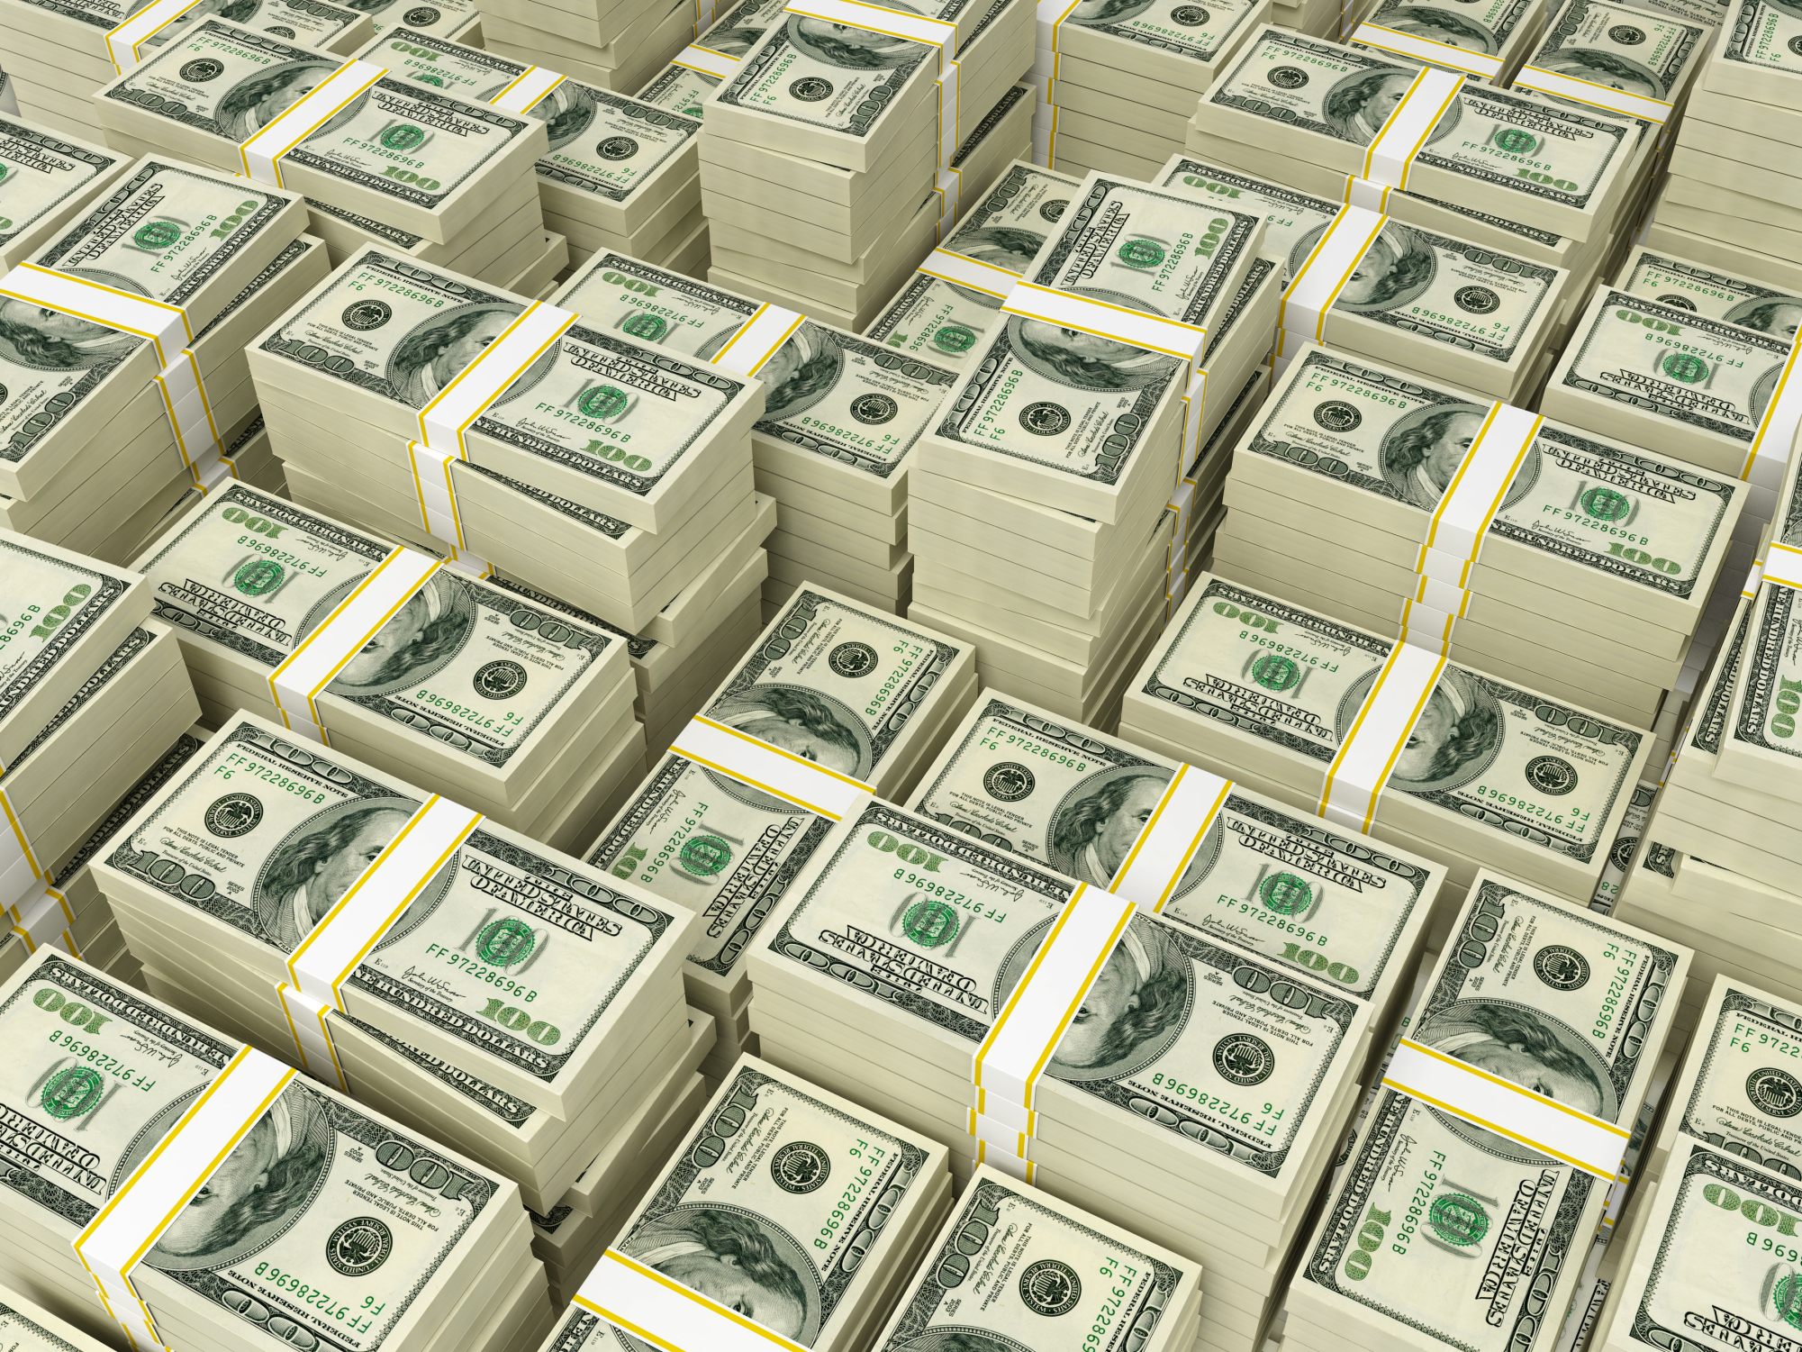


Market Analasis
Similar games: GTA 5, other need for speed games
Typical customer : ages early teen to late 20s
Profit: astronomical profits are estimated

