Slide 1
Gameplay
Leveling up while racing and unlocking new cars , racing on a rainbow road , the map is constantly changing with falling entities.

Slide 2
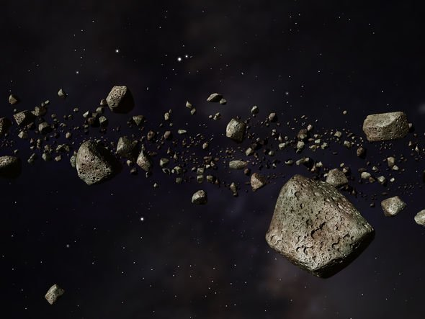
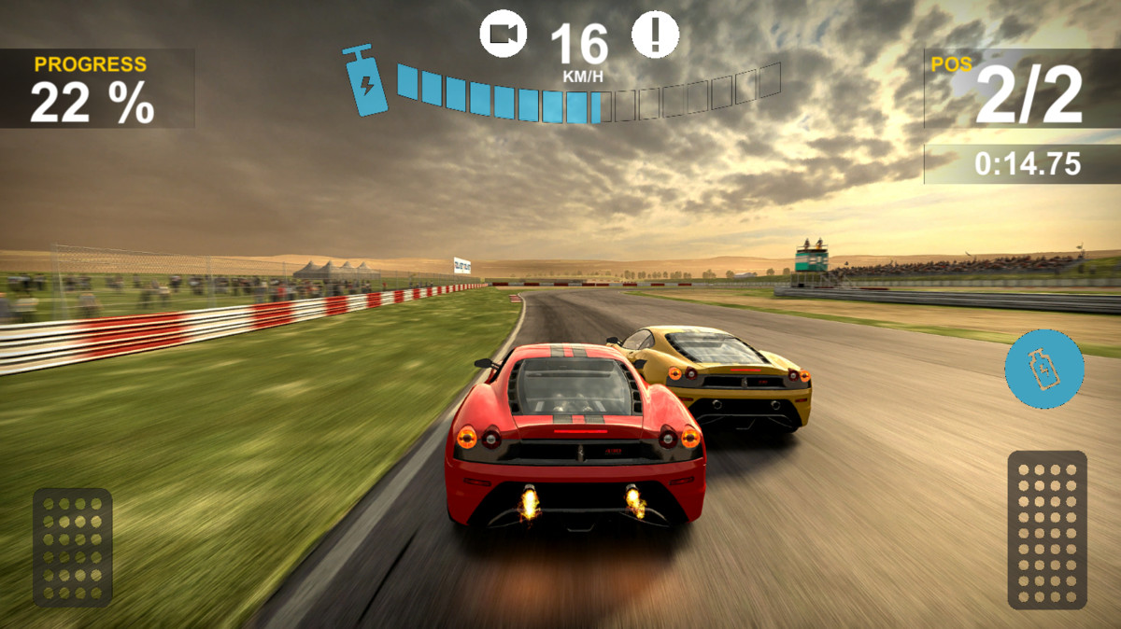
Pillars
Rpg - Leveling system , racing game , winning car system , Terrain is changing.

