Slide 1


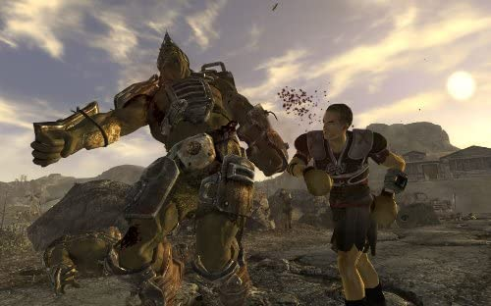
Feature Points
Huge open world in space.
Great combat system
In depth space economy system
Multiple joinable factions
Multiple Endings
Branching story based on player choices (joining one faction may doom another)
More customisation than in any other AC game

Slide 2
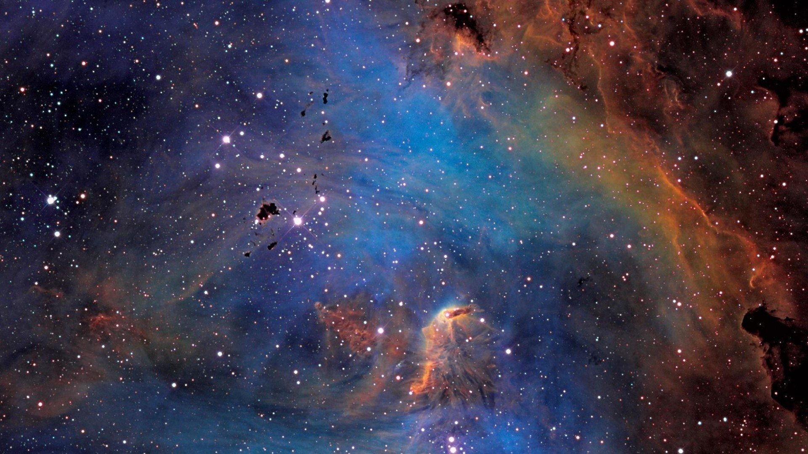
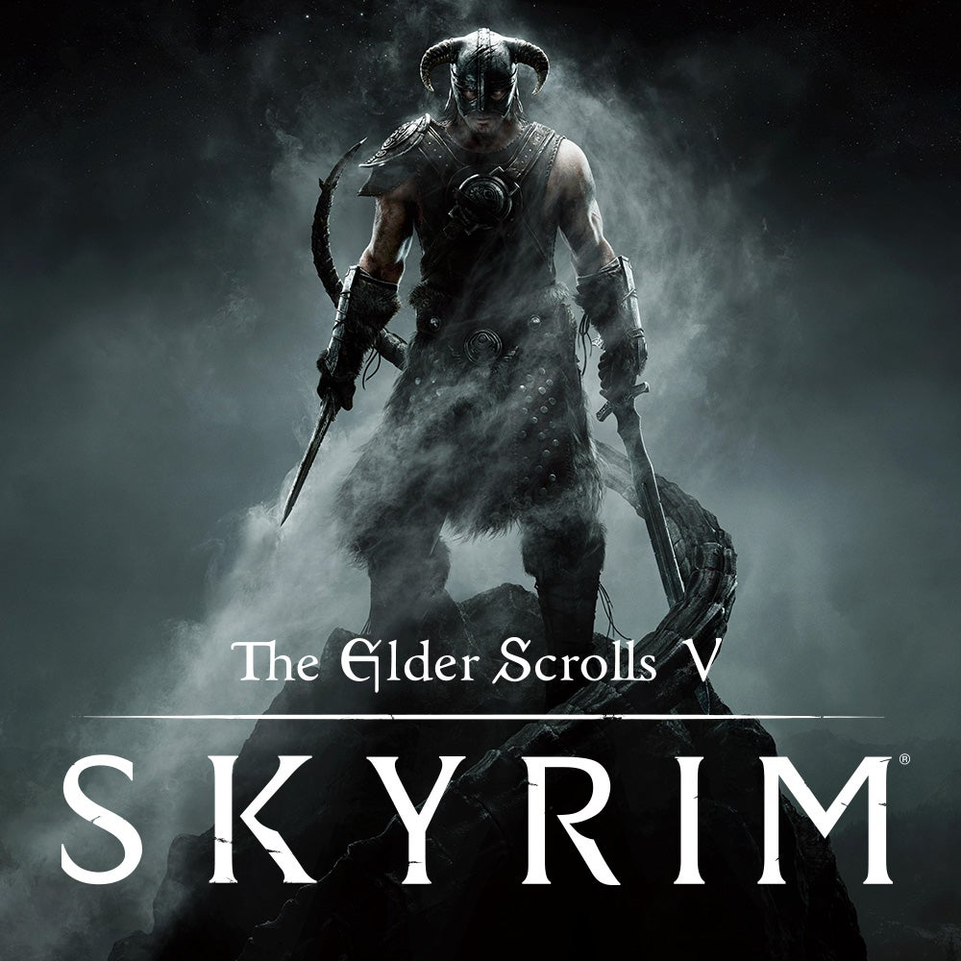

Market Analysis
Similar games:
Assassin’s creed IV:BlackFlag(Gameplay style)
Star Citizen(open world space)
Skyrim(Factions and rpg elements)
Elite Dangerous(Economy elements)
Typical customer:
Rpg fans
Assassin’s creed fans
Space game fans
The typical customer would be a fan of open world games with immersive stories.
Expected sales:
10 million Units
At $60, $600,000,000 in Sales

