Slide 1
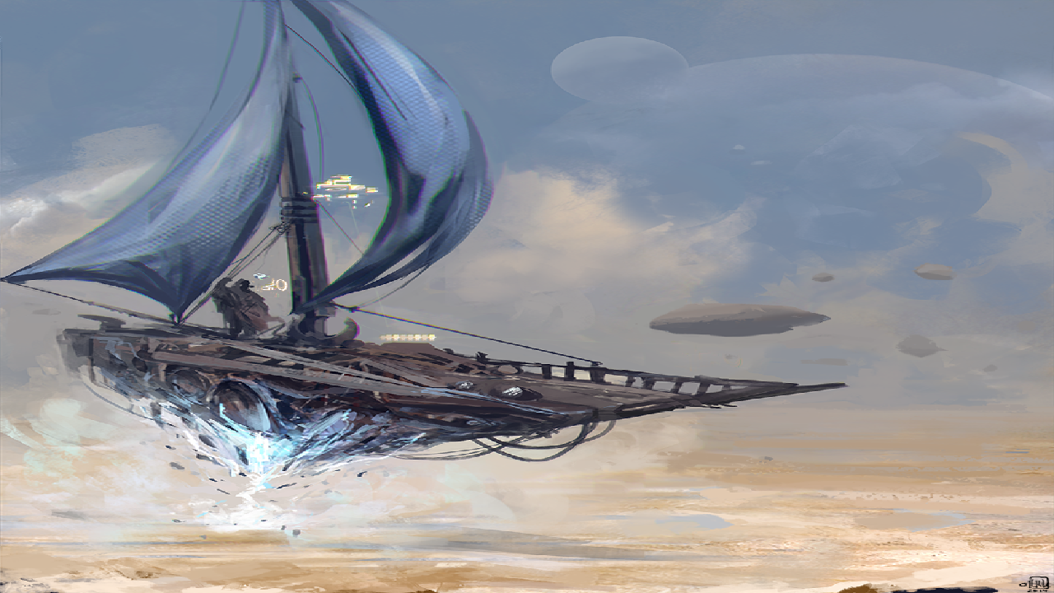
World Background
World Background:
Its in space, rich with space lore of other pirate factions and 2 main governments every faction is at war and you must pick a
side to join to lead to victory.
Each world faction has its own background, beliefs and forms of governing
The story of the game will mainly revolve around conflict between the US and Russian which are the 2 main government factions.
World Background
[DC]Its in space, rich with space lore of other pirate factions and 2 main governments every faction is at war and you must pick a
[DC]side to join to lead to victory. Each world faction has its own background, beliefs and forms of governing
[dcr]The story of the game will mainly revolve around conflict between the US and Russian which are the 2 main government factions.

Slide 2
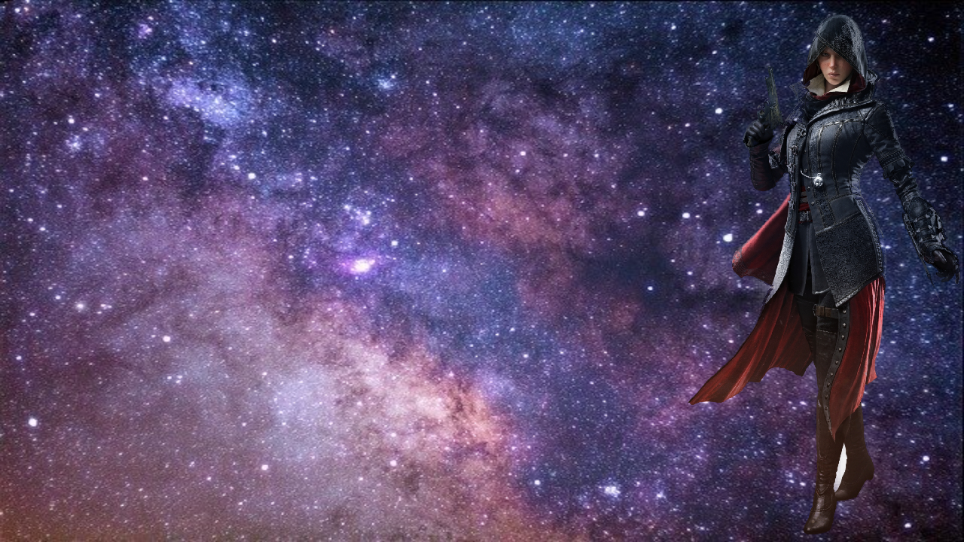
Pillars
Pillars:
Thrilling historical fiction story involving two super powers
Stealth, sneaking and assassinating.
0 gravity space parkour.
PvE combat against a range of different difficulty enemies.
Thrilling historical fiction story involving two super powers
Stealth, sneaking and assassinating.
0 gravity space parkour.
PvE combat against a range of different difficulty enemies.

