Slide 1
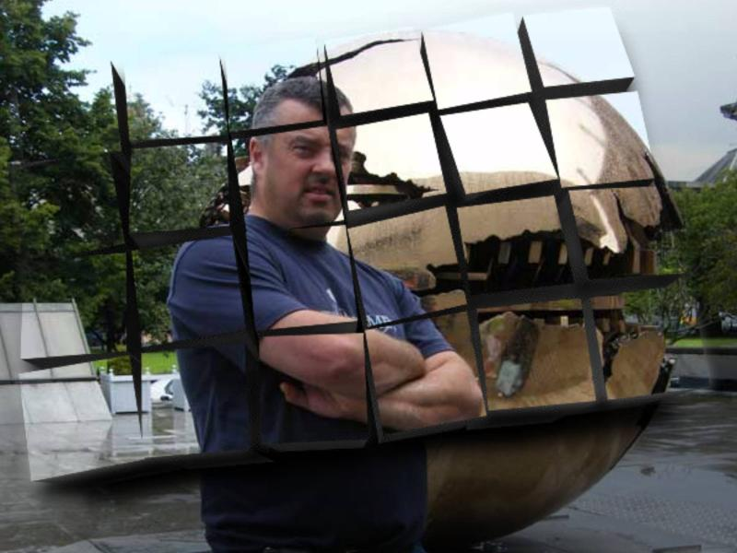
Assassin’s Creed
A Space Odyssey
New game by Studio Pete

Slide 2
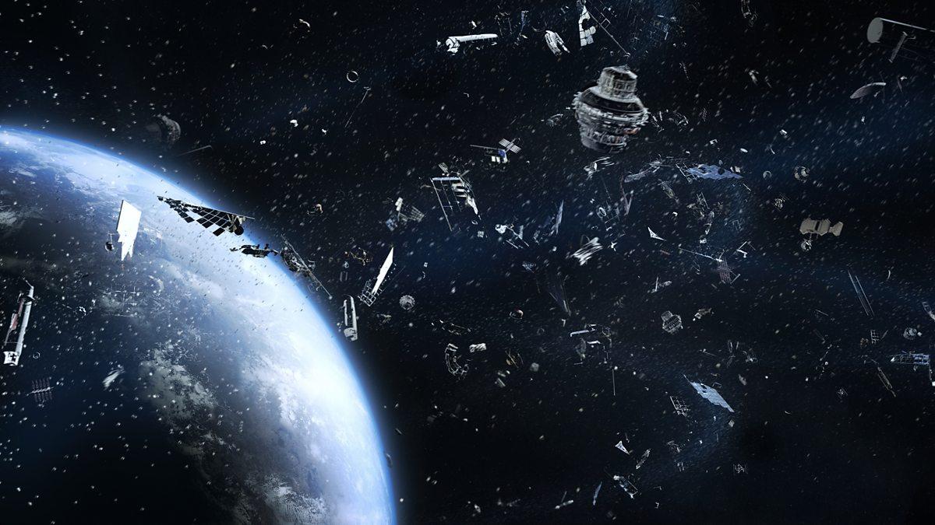
Elevator Pitch
An Open-World Action-Adventure game set in the vast emptiness of space
Go through missions assassinating space templars
Unlock new weapons
Explore new areas of the cosmos

Slide 3
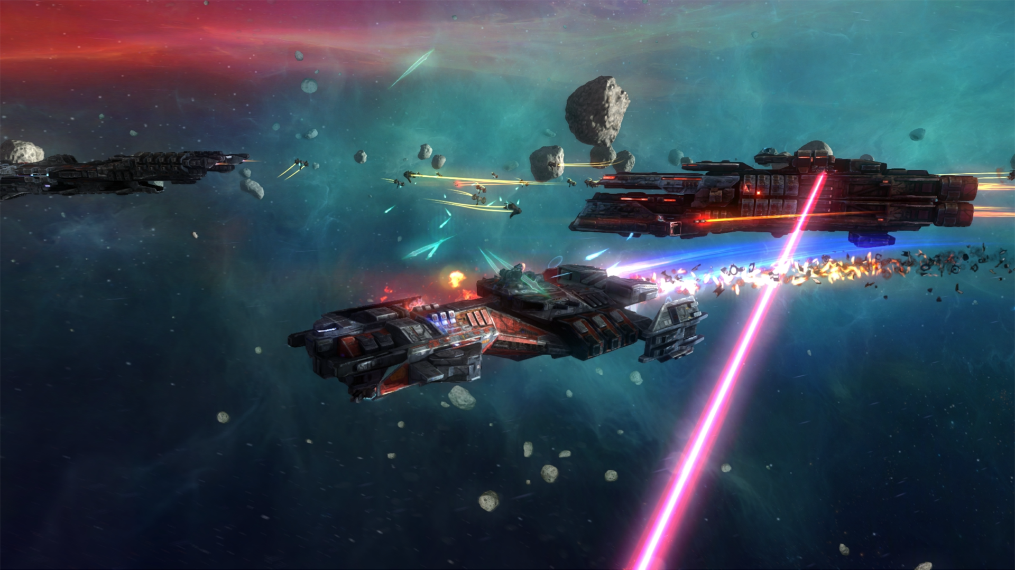
World Background
Set in space
Based off jumping between planets, avoid trouble
Hide behind asteroids, on planets, use weapons
Sci-Fi world – mercenary – steal space Apple of Eden

Slide 4
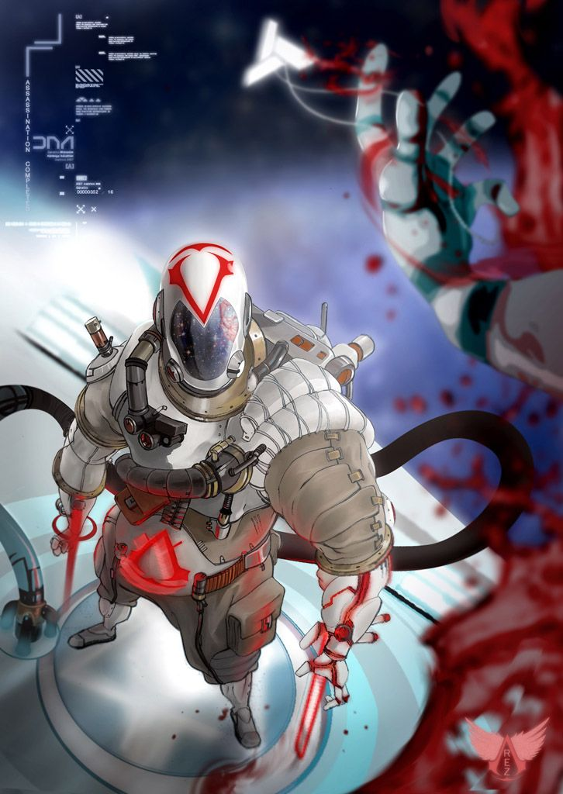
Core Pillars
Stealth
Open World
Real time combat with counters and parries
Parkour

Slide 5
Gameplay description
The overall gameplay loop would have players fly around on the "hidden jetpack" to stealth around
open space where you assassinate the space templars
variety of new and old weapons “All laser based”

Slide 6

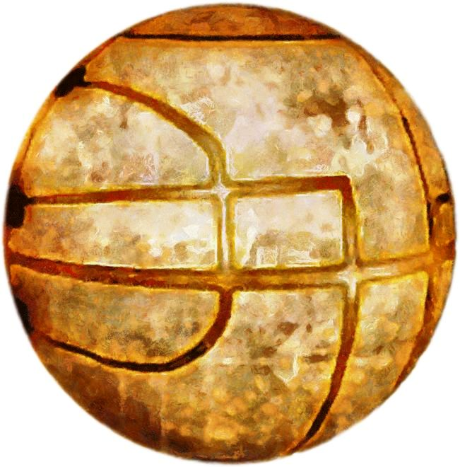
Feature points
You can assassinate alien templars!
Restore peace to the galaxy with the space Apple of Eden!
Swoon the alien babes and win!

Slide 7

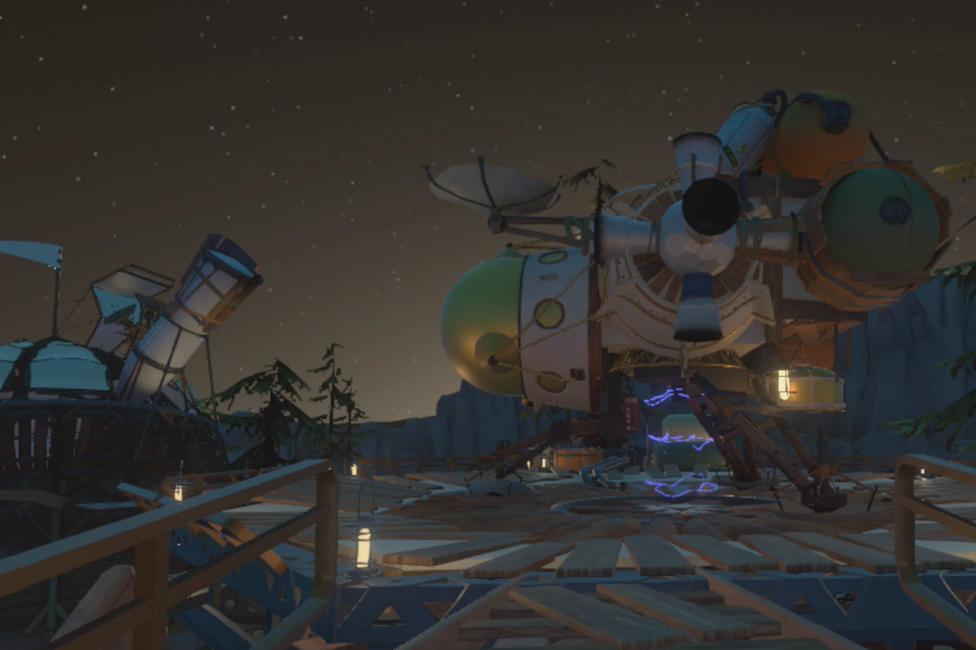
Market Analysis
Young adults ideal customers
300 million dollars in expected sales
Assassin's Creed and Outer Wilds are similar to our game

