Slide 1
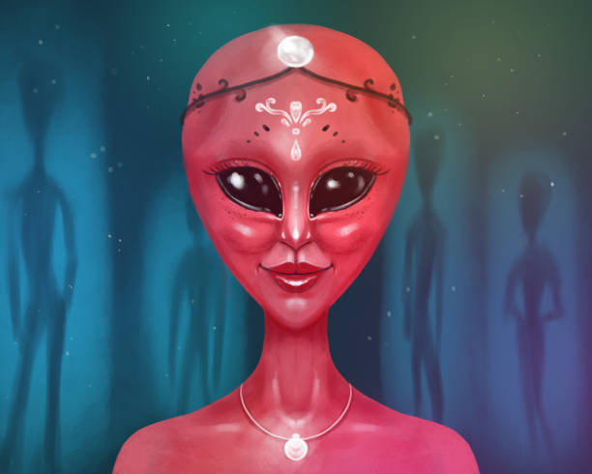
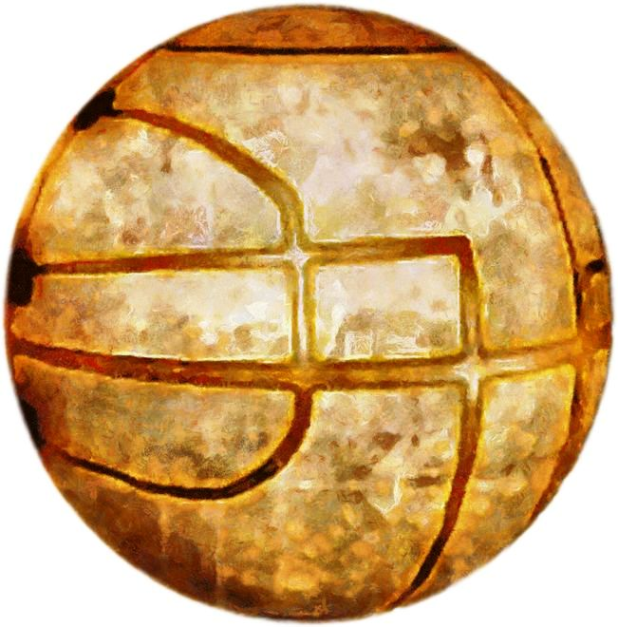
Feature points
You can assassinate alien templars!
Restore peace to the galaxy with the space Apple of Eden!
Swoon the alien babes and win!

Slide 2
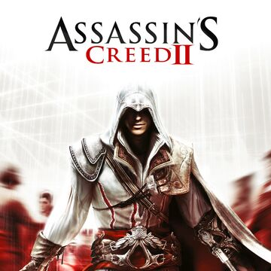
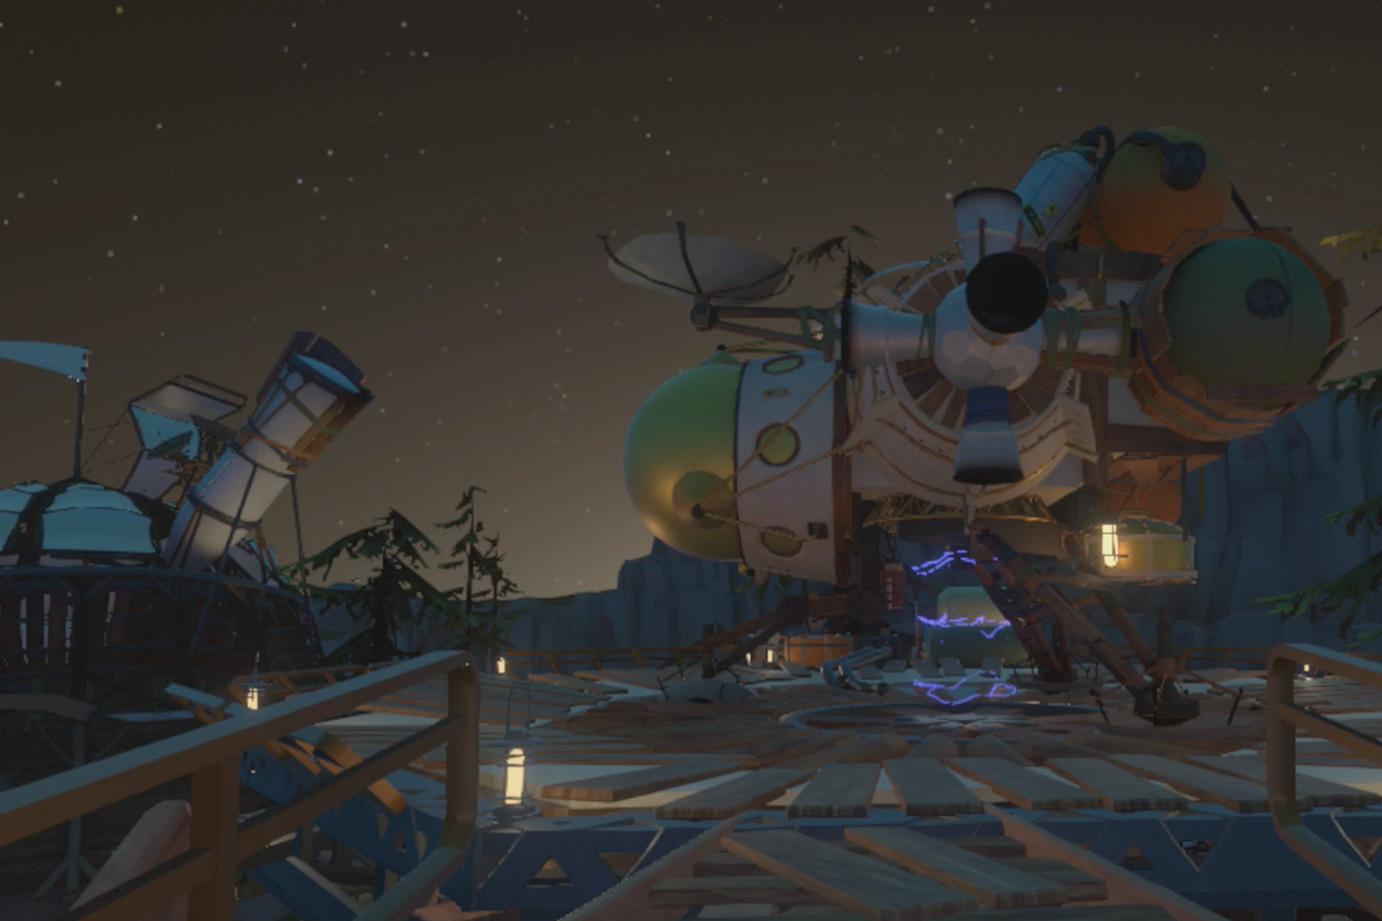
Market Analysis
Young adults ideal customers
300 million dollars in expected sales
Assassin's Creed and Outer Wilds are similar to our game

