Slide 1
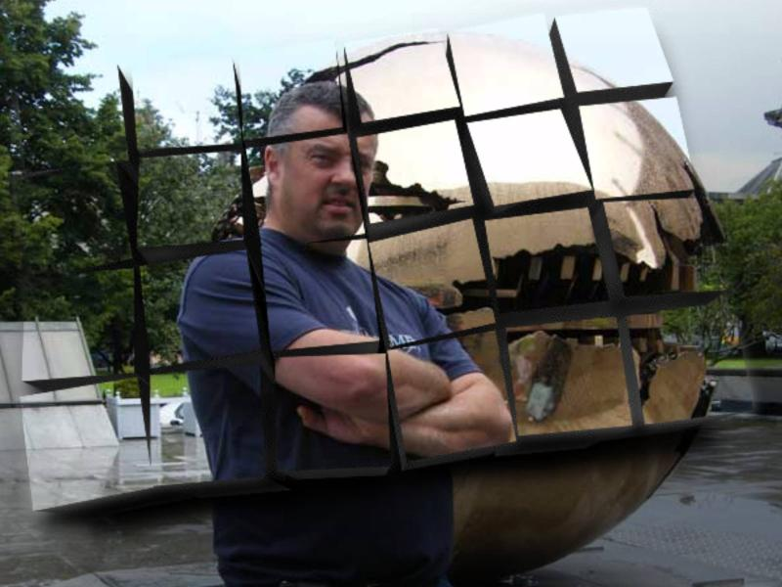
Assassin’s Creed
A Space Odyssey
New game by Studio Pete

Slide 2
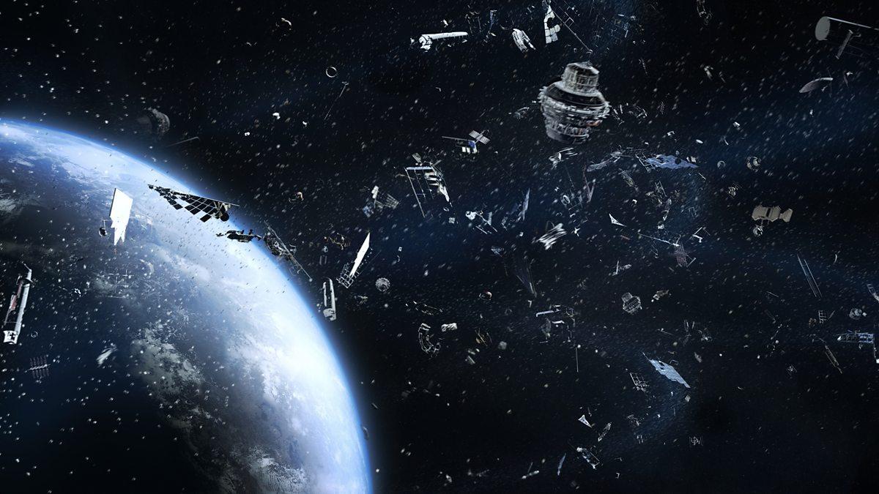
Elevator Pitch
An Open-World Action-Adventure game set in the vast emptiness of space
Go through missions assassinating space templars
Unlock new weapons
Explore new areas of the cosmos

Slide 3
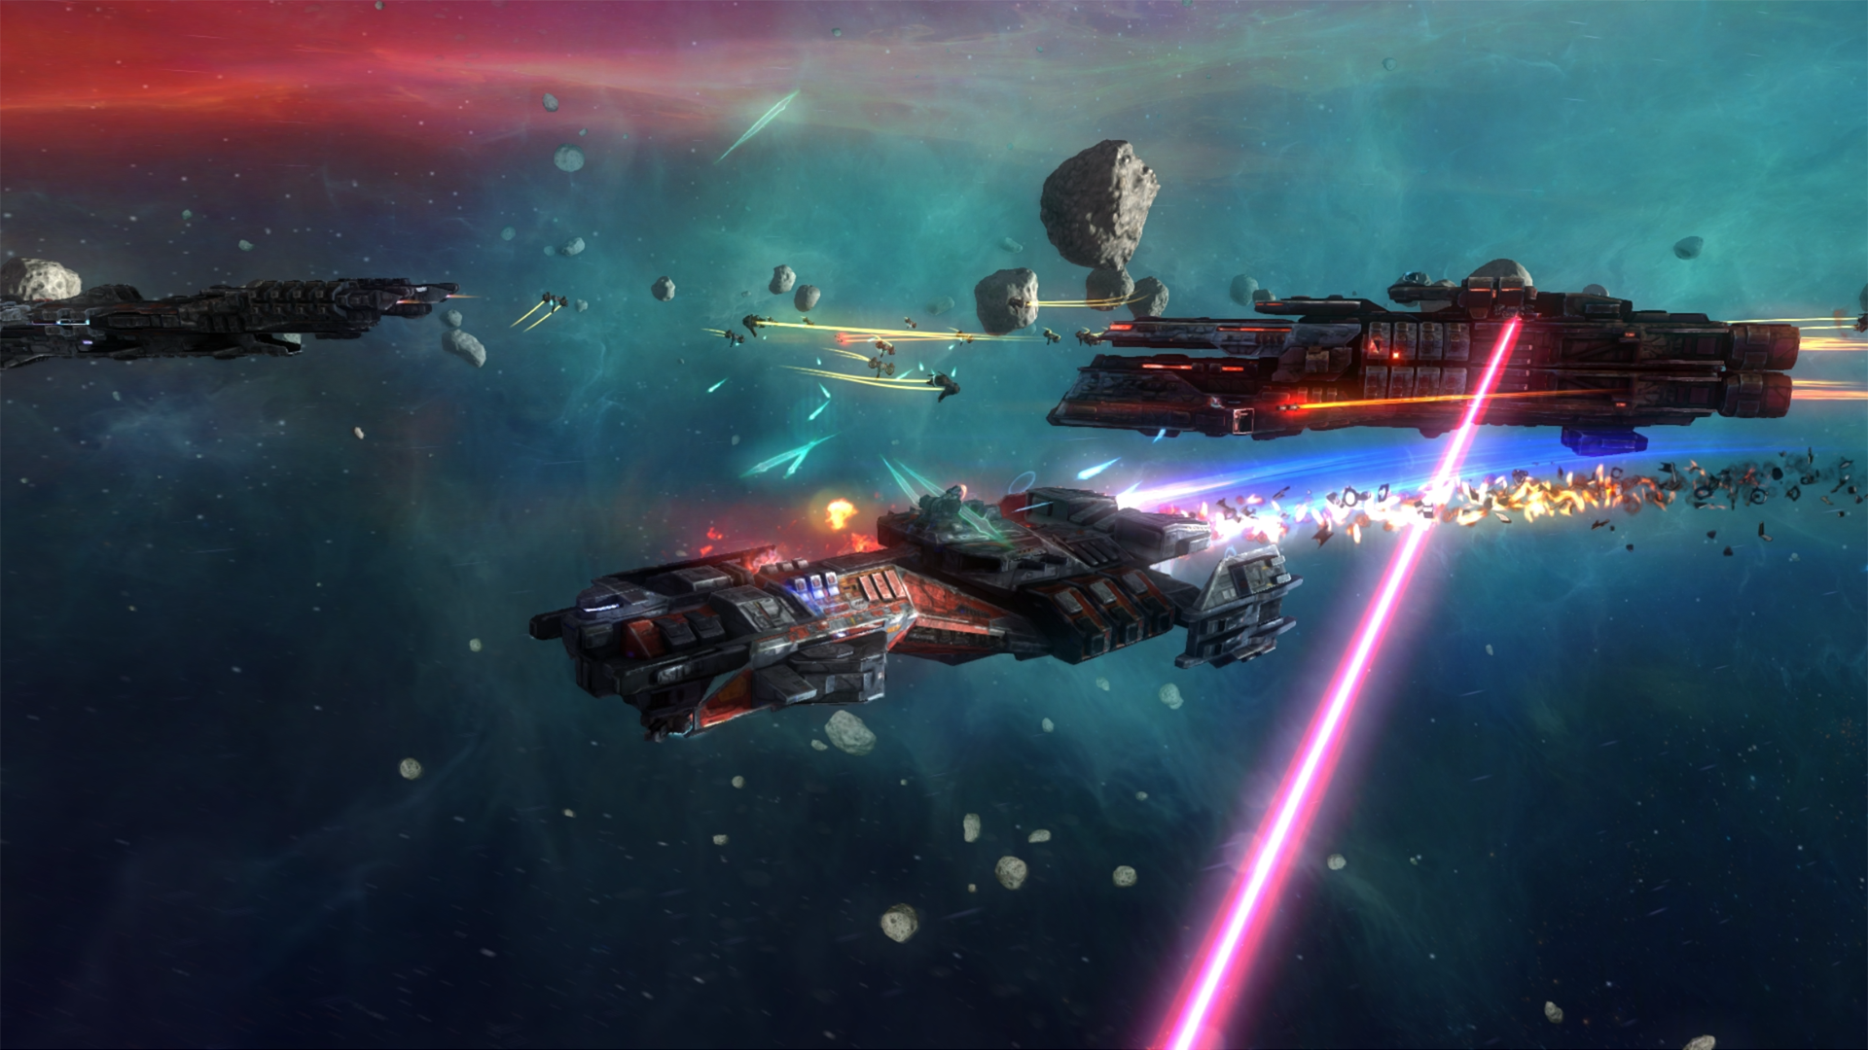
World Background
Set in space
Based off jumping between planets, avoid trouble
Hide behind asteroids, on planets, use weapons
Sci-Fi world – mercenary – steal space Apple of Eden

