Slide 1
RADARs
Peter mašič, nik žunič
Mathematical modelling course project

Slide 2

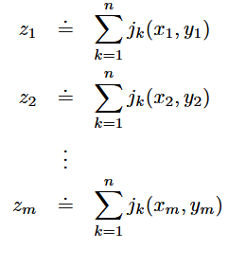
Description of our problem and given data
We would like to disable air defense system (locate radars) on some area.
The enemy has n radars on locations with unknown coordinates (u_k, v_k),
Strength of a signal in a given point (x, y) that comes from k-th radar
In m different points with known coordinates (x_i, y_i), we are given measurements of sum of strength of all signals in a point

Slide 3
tasks
At least how many measurements are needed to be made to at least theoretically determine the positions of the radars?
In terms of the least squares method, write the function that need to be minimized to get the best estimate for the unknown positions (x_i, y_i).
The system of equations obtained by the least squares method is nonlinear. Perform the gradient method or Gauss-Newton method to solve the system to calculate an estimate for the unknown positions for the given data. Test the algorithm on simulated data.
Using simulated data analyze the impact of number of measurements, average measurement errors, and average distances measured by radar, depending on the accuracy of the results.

Slide 4
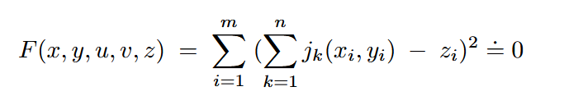
How we tackled the problem
We first used the least squares method to write down the function F that needs to be minimized, to get the best assessment of unknown coordinates (u_k, v_k).
We then proceeded by searching for the global minimum of the function therefore setting F to 0 (F = 0). Using gradient descend method.
We then implemented all required functions in Julia.
At the end we ran some simulations on how well the gradient method performs on different data

Slide 5
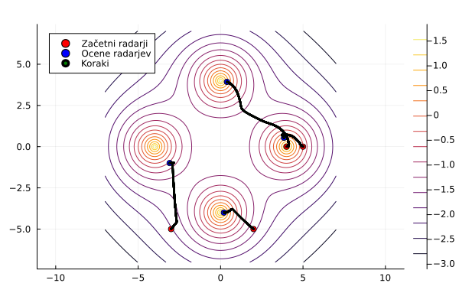
Difficulties we encountered
Choosing “a good” initial approximiation for the gradient method
Choosing the right alpha so the gradient method converges
Choosing tests that best describe performance of the model
Vizualize progress of the calculation of result in Julia

