Slide 1
Automotive Supply Chain
Network Analysis
Why graph modelling? What problem are we solving? How did we design the relationships?
Course Capstone
Knowledge Graph Analysis
Neo4j + GDS
Moetz et al. 2020

Slide 2
Why This Project?
Real-World Motivation
The Dataset at a Glance
1
Automotive supply chains span dozens of tiers, thousands of SKUs, and hundreds of interdependent routes — managed today with spreadsheets that cannot capture these relationships.
28,049
87,059
Products / SKUs
BOM rows
2
COVID-19 exposed catastrophic blind spots: invisible bottlenecks and 20+ period lead times that couldn't be traced until assembly lines halted.
12
11
3
Traditional table-based tools (Excel, SQL) answer "what" — but cannot answer "why did this break, how far did disruption travel, which path recovers fastest?"
Facility nodes
Logistics arcs
This project applies knowledge graph technology to answer those structural questions on a real 2020 automotive production network dataset.
28,000
14
4
Demand records
Planning periods

Slide 3
The Core Problem We Are Solving
Four critical questions that spreadsheets cannot answer — but a graph can.
⚙️
🔗
Bottleneck Nodes
BOM Chain Depth
Which factories, warehouses, and distribution centres would, if disrupted, cascade failure across the entire network?
Which finished vehicles depend on the deepest nested bill-of-materials chains, amplifying upstream supply risk?
⚠️
📊
At-Risk Logistics Arcs
Demand Propagation
Which routes combine critically high lead times (20–23 periods) with dangerously tight throughput capacity (294 units)?
How does product demand at the end customer (ZP8) propagate backward through assembly and all supplier tiers?

Slide 4
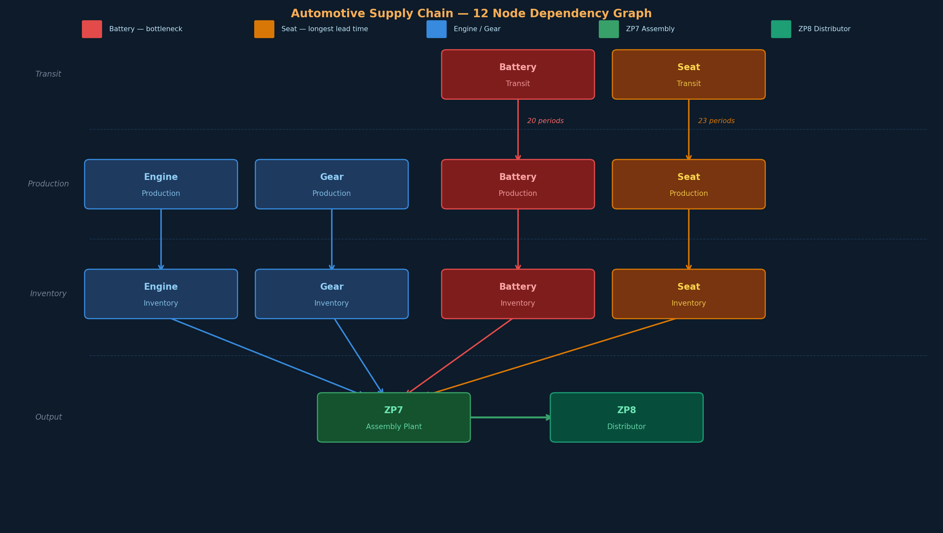
12 Node Dependency Chain
4 supplier chains flow through transit → production → inventory, converging at ZP7 assembly then ZP8 distributor.
All 4 streams must arrive at ZP7 simultaneously — if any one fails, assembly halts. These dependencies are invisible in a spreadsheet but become queryable graph relationships.

Slide 5
Why Did We Choose Graph Modelling?
The problem is inherently relational — the data alone is not enough.
With Flat Tables (Excel / SQL)
With a Property Graph (Neo4j)
✗
You can COUNT products and nodes — but not TRAVERSE them across tiers
✓
REQUIRES edges make BOM depth a single variable-length path query
✗
BOM with 87,059 rows needs 5+ JOINs to answer any depth question
✓
SHIPS_TO carries leadTime — one traversal reveals end-to-end schedule risk
✗
Lead time and capacity live in separate sheets — combined risk is invisible
✓
CAPACITY_AT sits parallel to SHIPS_TO — bottleneck detection is native
✗
Multi-hop questions (which cars break if battery-trans fails?) require custom code every time
✓
Any disruption can be simulated by removing a node/edge and re-querying reachability in seconds
The relationships ARE the analysis — without them, 12 nodes and 11 arcs are just a list.

Slide 6
Graph Model — Relationship Design
Every relationship type maps directly to a business question we needed to answer.
Relationship | Direction | Business Question Answered
REQUIRES | Product → Product | BOM depth & disruption blast-radius — which cars break if one component fails?
SHIPS_TO | Node → Node | Physical logistics arc — carries leadTime to model end-to-end schedule delay risk
PRODUCES | Node → Product | Links each facility to the SKUs it can output — enables capacity assignment queries
HOLDS | Node → Product | Opening inventory per node/product/period — stockout risk detection before planning starts
CAPACITY_AT | Node → Node | Per-period arc throughput limit — bottleneck identification via utilisation ratios
PLANNED_FLOW_TO | Node → Node | Scheduled volume vs capacity — detects which lanes are near saturation each period
INITIAL_FLOW_TO | Node → Node | Pre-horizon pipeline stock (periods 39–60) — explains how demand is met early in the window
HAS_DEMAND / AT_NODE | DemandFact hub | Connects market demand at ZP8 backwards through the graph to root exposure causes

Slide 7
Our Analytical Approach
Two complementary tools — same data, maximum insight.
Python + NetworkX
Neo4j + Graph Data Science (GDS)
Exploratory Analysis on Raw Spreadsheet
Property Graph at Scale with Cypher
Load 12 Excel sheets into Pandas DataFrames
LOAD CSV: nodes, products, BOM, arcs, demands (87K+ rows)
Compute node degree & betweenness centrality
Structural analysis: graph coverage, integrity checks, BOM width
Calculate BOM depth via variable-length traversal
Deep Cypher: BOM depth ranking & arc criticality scoring
Profile lead times × capacity stress per arc
GDS betweenness on SHIPS_TO topology projection
Validate cross-table referential integrity
Composite risk score: demand × connectivity / inventory
Rapid hypothesis generation before graph ingest
Scalable, repeatable, auditable graph intelligence

Slide 8
System Architecture
End-to-end data pipeline: raw spreadsheet to graph-powered intelligence
Raw Data
Python / Pandas
Neo4j Graph DB
GDS Output
Moetz et al. 2020
.xlsb workbook
12 sheets
28K products
87K BOM rows
28K demand records
Analysis Layer
pyxlsb + pandas
NetworkX digraph
BOM depth traversal
Centrality metrics
Arc stress scoring
Seaborn visualisation
Property Graph
LOAD CSV ingest
Cypher queries
8 relationship types
Bolt / local Desktop
BOM + logistics graph
Insights
Betweenness scores
Bottleneck ranking
BOM depth scores
Arc risk scores
Demand propagation
Disruption simulation
Dataset: Moetz et al. (2020) · DOI 10.17632/pr3sdy5vp3.1 · Python / NetworkX / Neo4j GDS

Slide 9
Key Findings from the Analysis
01
Battery Chain is the Hardest Bottleneck
02
Seat Transit Has the Longest Exposure Window
battery-supplier_prod outputs only 294 units/period — 7× lower than all other arcs (2,100). Its 20:1 assembly ratio means upstream demand is amplified 20× by any car demand change.
seat-supplier_trans operates on a 23-period lead time — the longest in the network. Any disruption takes nearly two full planning cycles to correct, making it the most time-exposed node.
03
ZP7 is a Single Point of Assembly Failure
04
100% of Demand Concentrates at One Node
All 4 supplier streams converge at ZP7 (in-degree 4, out-degree 1). GDS betweenness analysis confirms it is the highest-centrality node — any failure here stops all finished-car output.
All 28,000 demand records flow exclusively to ZP8. Demand-side risk is entirely driven by product mix and timing — making upstream propagation through BOM chains the dominant risk mechanism.

Slide 10
Assumptions & Scope
What this project includes, what it intentionally excludes, and why.
What is in scope
What is out of scope
✓ Single OEM production network (Moetz et al. 2020)
✓ 4 supplier chains, 12 nodes, 11 logistics arcs
✓ 14 planning periods (structural analysis only)
✓ Graph structure, BOM depth, centrality, arc risk
✓ Python + Neo4j GDS dual-tool pipeline
✗ Cost data — no pricing or financial optimisation
✗ Supplier selection — one supplier per part type
✗ Alternate routing — no multi-plant delivery network
✗ Real-time data — static 2020 snapshot only
✗ Full mathematical optimisation solver
Dataset: Moetz et al. (2020) · DOI 10.17632/pr3sdy5vp3.1 · Python / NetworkX / Neo4j GDS

Slide 11
What This Project Enables
From raw spreadsheet data to actionable, graph-powered supply chain intelligence.
🏭
📦
⚡
Production Planning
Inventory Management
Bottleneck Mitigation
Trace demand through BOM REQUIRES edges to compute exact component quantities needed per period
Identify over/under-stocked nodes using HOLDS relationships vs safety-stock thresholds in the graph
GDS betweenness pinpoints which arcs and nodes need capacity investment before disruption strikes
⏱️
🛡️
🔍
Lead Time Calibration
Supplier Prioritisation
Disruption Simulation
Set safety stock levels that buffer against the 20–23 period transit delays on battery and seat chains
Rank suppliers by BOM dependency breadth — protect those whose failure collapses the most SKUs
Remove any node/arc and re-query reachability to simulate and measure the blast radius of any failure
Dataset: Moetz et al. (2020) · DOI 10.17632/pr3sdy5vp3.1 · Python / NetworkX / Neo4j GDS

Slide 12
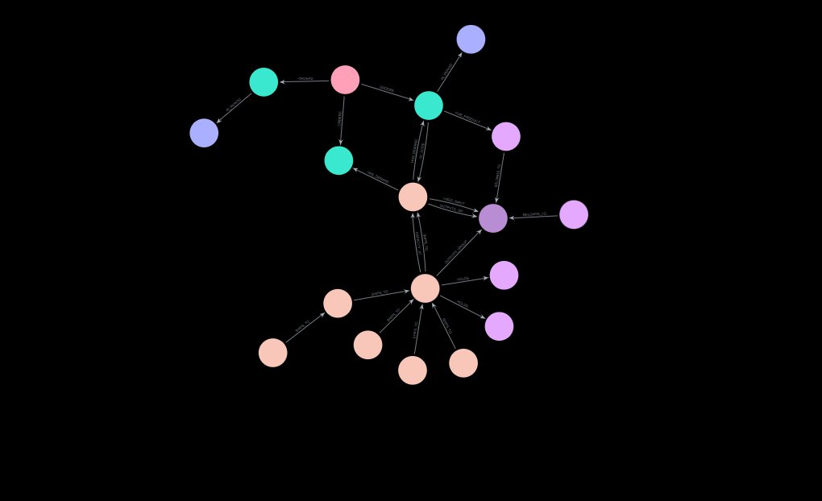
The Graph in Action
Neo4j property graph — every node and relationship from the dataset rendered live.
Nodes = Facilities & Products
Each coloured circle is a real node: facilities (teal), products (pink), demand facts (purple)
Edges = Relationships
Every arrow is a named relationship: SHIPS_TO, REQUIRES, HOLDS, HAS_DEMAND
Complexity is visible
The dense cluster at centre is ZP7 + ZP8 where every supplier and demand record connects
This is what spreadsheets hide
87,059 BOM rows, 28,000 demand records, 12 nodes and 11 arcs — all queryable in one traversal
Dataset: Moetz et al. (2020) · DOI 10.17632/pr3sdy5vp3.1 · Python / NetworkX / Neo4j GDS

