Slide 1
How Do We Know
Where Our Supply Chain Will Break?
A graph-based exploratory data analysis of a real automotive production network
The situation:
12
28,049
87,059
28,000
An automotive OEM manages 12 facilities, 28,049 product SKUs and 87,059 bill-of-materials dependencies — all recorded in spreadsheets. A near-miss disruption last quarter exposed a critical blind spot: they could not trace which cars would stop and why, fast enough to act. This analysis uses a Neo4j knowledge graph to answer that question — before the next disruption.
Facilities
Products
BOM Links
Demand Records
6 chapters · 10 EDA questions · 1 complete picture
Ch.1
Ch.2
Ch.3
Ch.4
Ch.5
Ch.6
Meet the Network
Product Complexity
Material Flow
Hidden Timeline
Buffer Zone
Blast Radius
Team: Bekithemba Nkomo · Peter Mangoro · Masheia Dzimba

Slide 2
PROLOGUE
The Problem We Cannot See
❓ We cannot trace disruptions fast enough
📊 Spreadsheets cannot answer relational questions
🔗 The dependencies are invisible
When a supplier fails, operations teams spend 4–8 hours manually tracing which car models are affected through spreadsheet lookups and phone calls. By then, the assembly line has already stopped.
'Which cars break if battery transit fails?' requires 5+ manual JOIN operations across separate sheets. The answer takes hours. The graph answers it in seconds.
87,059 BOM relationships and 11 logistics arcs create a web of hidden dependencies. You cannot see them in rows and columns. You need a graph to make them queryable.
Our answer:
Build a Neo4j property graph from the Moetz et al. (2020) automotive production network dataset and use exploratory graph queries to surface the risks before they become disruptions.
Dataset: Moetz et al. (2020) · Neo4j GDS · Spring 2026 Capstone

Slide 3
01
CHAPTER 1
Meet the Network
Before we can find risks, we need to know what we are working with
What the operations team is asking:
"How many nodes, relationships and properties did we actually load into the graph? Are the counts what we expect? Before we trust any query result we need to confirm the graph is structurally sound."
Dataset: Moetz et al. (2020) · Neo4j GDS · Spring 2026 Capstone

Slide 4
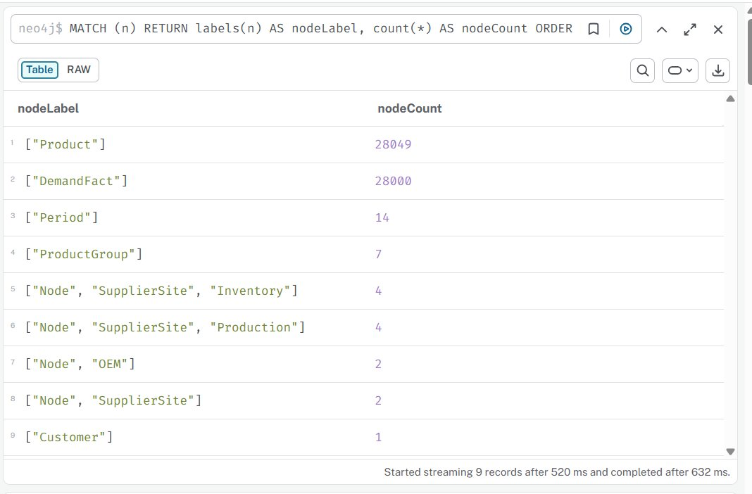
EDA 1a
Node Label Counts — What entities exist in the graph?
Manager asks:
How many facilities, products and demand records are we working with?
Key Findings
9 distinct node label combinations — multi-label schema loaded correctly
Product (28,049) and DemandFact (28,000) dominate — BOM-heavy as expected
12 Facility nodes confirmed across OEM, SupplierSite, Production and Inventory roles
Customer singleton (1) wires all 28,000 demand records into a single market node
Story insight
The network is real and complete. We have 56,135 total nodes to analyse — now we need to understand how they connect.
Dataset: Moetz et al. (2020) · Neo4j GDS · Spring 2026 Capstone

Slide 5
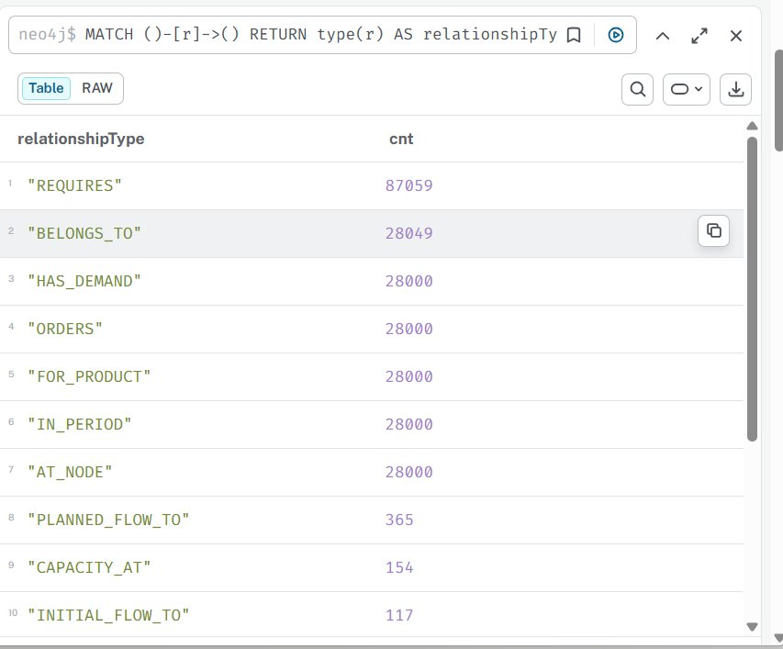
EDA 1b
Relationship Type Counts — How does the graph connect?
Manager asks:
What types of connections exist between our facilities, products and demand records?
Key Findings
16 distinct relationship types — BOM, logistics, demand, inventory and capacity all present
REQUIRES (87,059) dominates — the BOM is the largest and most complex structural layer
Demand hub is fully consistent: HAS_DEMAND, ORDERS, FOR_PRODUCT, IN_PERIOD, AT_NODE each = 28,000
SHIPS_TO (11) matches exactly the 11 physical logistics arcs — no routes are missing
Story insight
The graph is not just nodes — it is relationships. 16 types of connection means 16 different questions we can now answer in a single traversal.
Dataset: Moetz et al. (2020) · Neo4j GDS · Spring 2026 Capstone

Slide 6
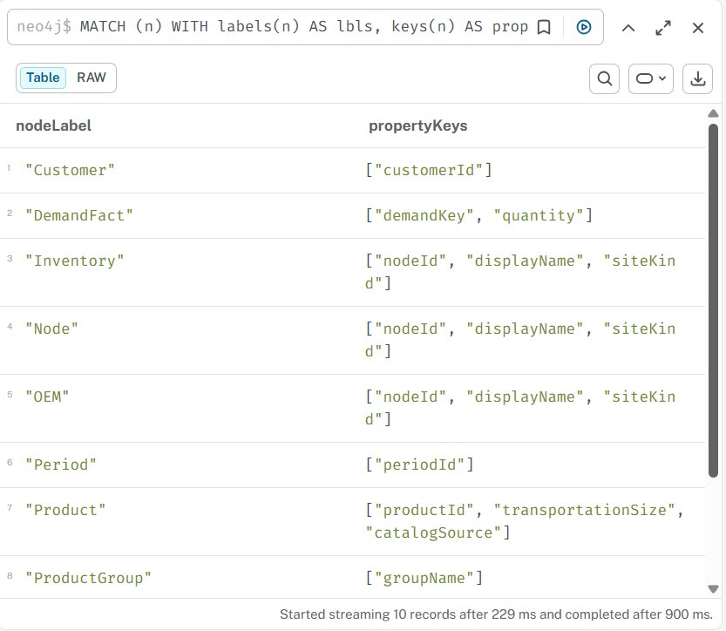
EDA 1c
Node Properties — What data lives on each node type?
Manager asks:
What information is attached to each facility, product and demand record in the graph?
Key Findings
All Facility nodes carry nodeId, displayName, siteKind — structural identity confirmed
Product carries productId, transportationSize, catalogSource — BOM provenance tracked
DemandFact carries demandKey and quantity — volume aggregation is enabled
Period carries periodId — time layer is correctly structured for period-based queries
Story insight
Every node has the right data attached. No missing fields. The graph is ready for the real questions — starting with the products themselves.
Dataset: Moetz et al. (2020) · Neo4j GDS · Spring 2026 Capstone

Slide 7
02
CHAPTER 2
The Product Maze
Each finished car hides a chain of hidden dependencies
What the operations team is asking:
"We have 28,049 product SKUs. But how complex are they really? How many components does each car depend on at tier 1? At tier 2? Which component families does every car in our portfolio share — and therefore which supplier failure would cascade across everything we build?"
Dataset: Moetz et al. (2020) · Neo4j GDS · Spring 2026 Capstone

Slide 8
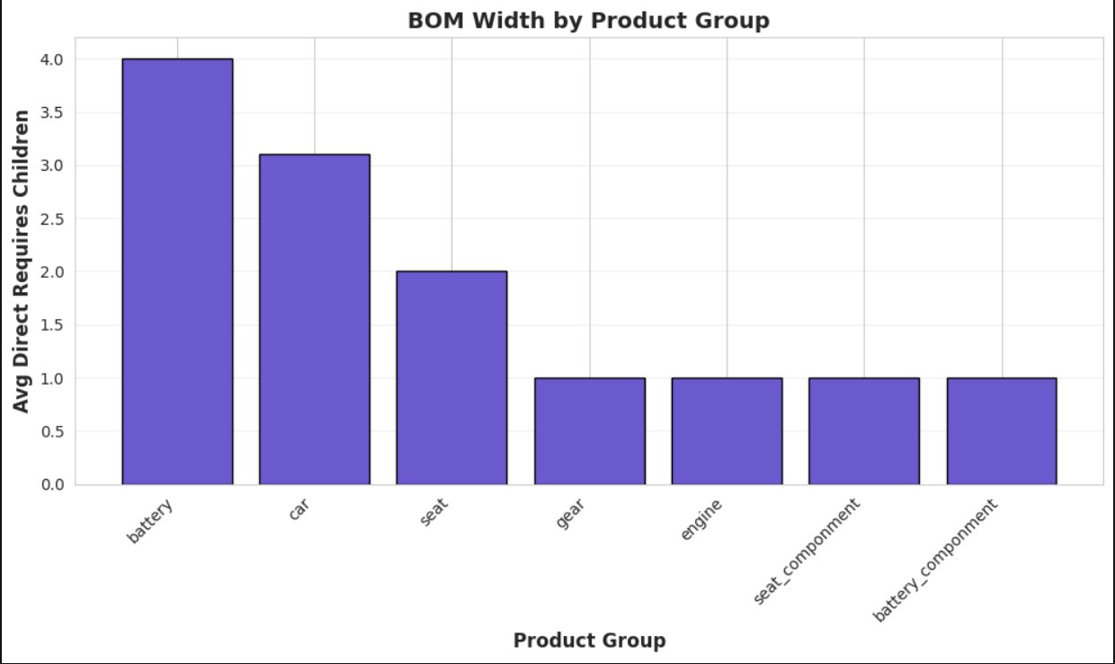
EDA 2
BOM Width by Product Group — How complex are our dependencies?
Manager asks:
Which product groups have the most components to source and coordinate?
Key Findings
car: 28,000 products, avg 3.1 direct dependencies — every car needs engine + gear + seat + battery
battery: 1 SKU with avg 4.0 children — highest first-hop fan-out of any group
engine and gear: avg 1.0 children each — simplest upstream chains in the network
seat: avg 2.0 children — requires 2 sub-components per variant before reaching ZP7
Story insight
Dependency complexity is not uniform. Finished cars and battery components are where coordination burden is highest — and where disruption blast radius is widest.
Dataset: Moetz et al. (2020) · Neo4j GDS · Spring 2026 Capstone

Slide 9
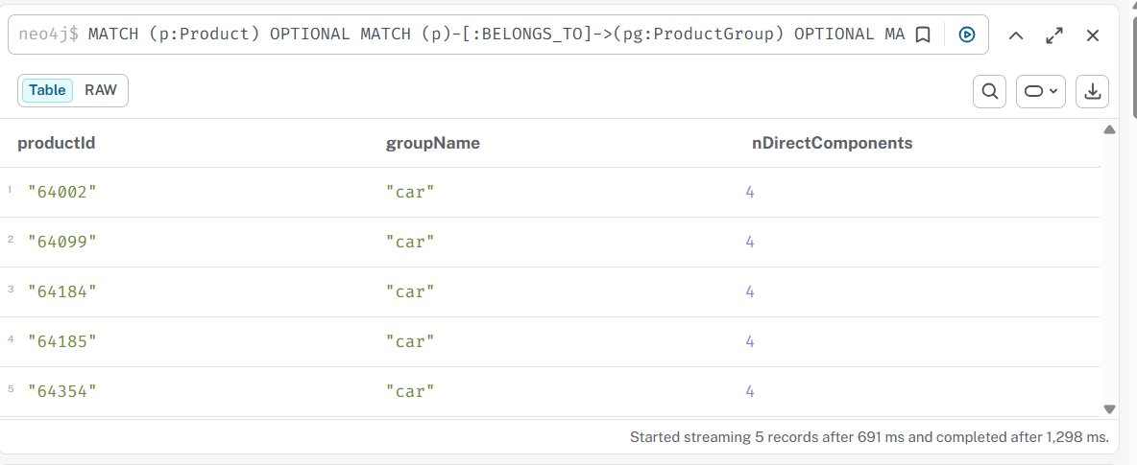
EDA 3
Top Products by Tier-1 Fan-Out — Which SKUs are most procurement-intensive?
Manager asks:
Which specific products require the most direct supplier relationships to build?
Key Findings
Top 5 products will show max tier-1 fan-out — expected 4 direct dependencies per car SKU
Products at nDirect = 4 require engine, gear, battery and seat simultaneously to build
Any one of those 4 sources failing stops that specific car SKU immediately
Products with nDirect = 0 are leaf nodes — raw sub-components, nothing below them in BOM
Story insight
Every finished car is one missed delivery away from stopping. There is no production redundancy built into the BOM — all 4 components must arrive together.
Dataset: Moetz et al. (2020) · Neo4j GDS · Spring 2026 Capstone

Slide 10
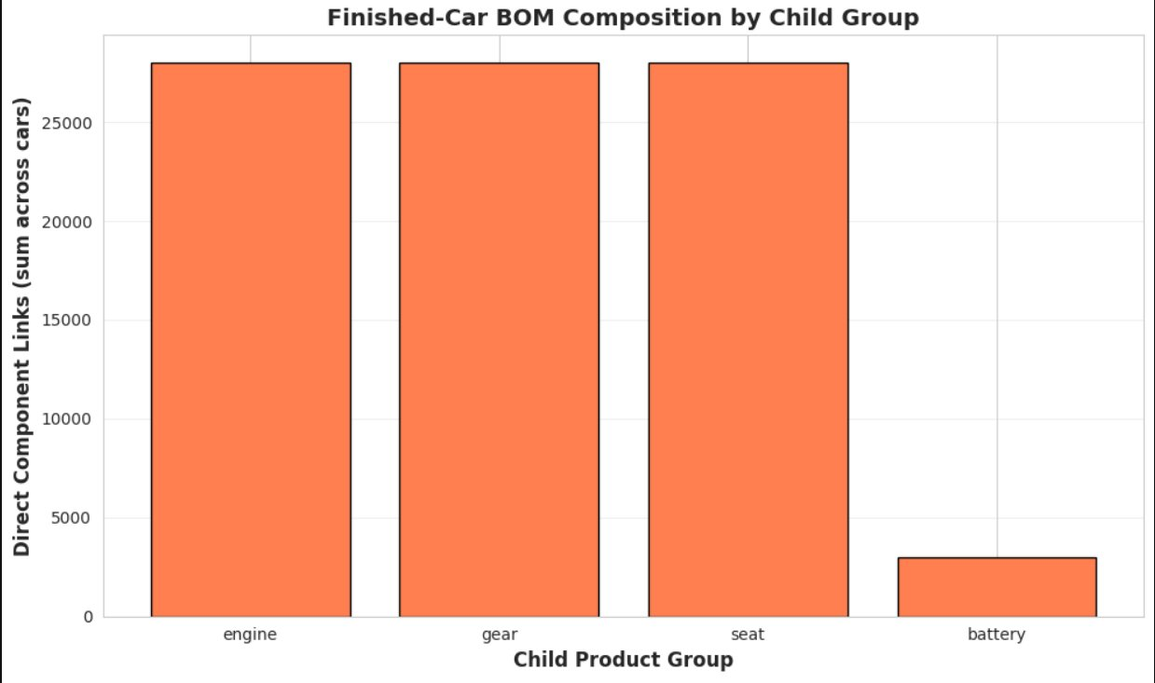
EDA 4
Car BOM by Component Group — Which supplier families does the whole fleet depend on?
Manager asks:
If we lose a component family entirely, how many car models are affected?
Key Findings
engine, gear and seat expected at 28,000 edges each — every single car depends on all three
battery expected at ~3,003 edges — only a subset of cars have direct battery dependency
Universal dependencies (engine/gear/seat) create fleet-wide exposure to any single failure
Subset dependency (battery) creates targeted exposure for specific vehicle variants only
Story insight
Engine, gear and seat are the three components that, if lost, stop every car we make. This is the core vulnerability we will carry forward into the GDS analysis.
Dataset: Moetz et al. (2020) · Neo4j GDS · Spring 2026 Capstone

Slide 11
03
CHAPTER 3
The Routes Between Us
Materials travel 11 routes between 12 facilities — but not all routes are equal
What the operations team is asking:
"Our 12 facilities are connected by 11 logistics arcs. Each arc has a lead time — the number of periods it takes for materials to travel between sites. Which routes are dangerously slow? Which are already near their throughput ceiling? Where is the logistics system most fragile right now?"
Dataset: Moetz et al. (2020) · Neo4j GDS · Spring 2026 Capstone

Slide 12
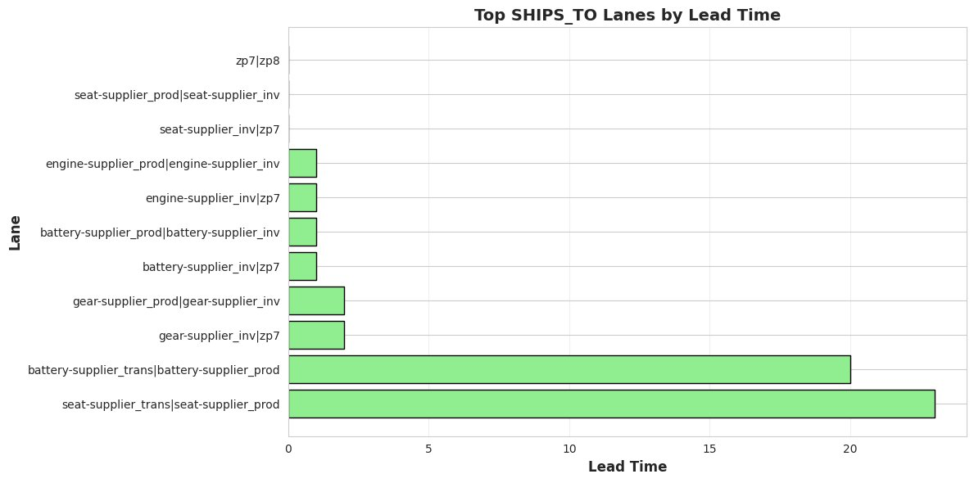
EDA 5a
Lane-Level Logistics Profile — Which routes carry the most time risk?
Manager asks:
If a shipment is delayed on a specific route, how long until we run out of that component?
Key Findings
seat-supplier_trans → seat-supplier_prod: leadTime = 23 — longest arc in the entire network
battery-supplier_trans → battery-supplier_prod: leadTime = 20 — second most time-exposed
All other 9 arcs have leadTime ≤ 2 — extreme risk is concentrated at exactly 2 transit arcs
ZP7 → ZP8: leadTime = 0 — final assembly to distributor is instantaneous in this model
Story insight
Two arcs carry the entire lead-time risk of the network. A disruption on either one cannot be corrected for 20–23 periods — nearly two full planning cycles.
Dataset: Moetz et al. (2020) · Neo4j GDS · Spring 2026 Capstone

Slide 13
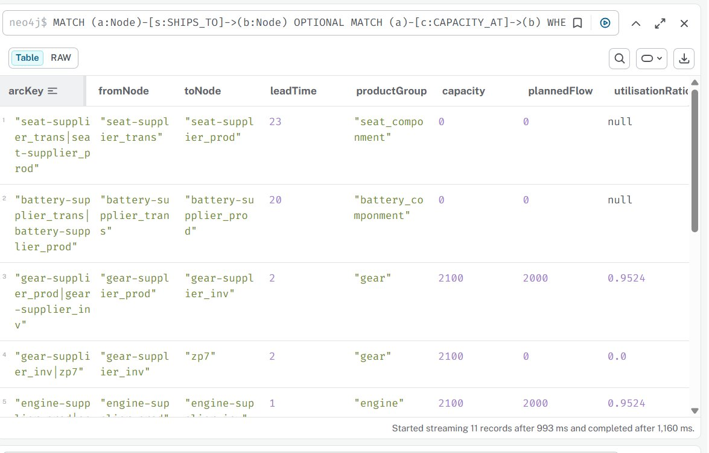
EDA 5b
Lane Pressure at Period 61 — Where is capacity already being pushed hardest?
Manager asks:
At the start of our planning window, which routes are already close to their limit?
Key Findings
seat and battery transit: capacity = 0, plannedFlow = 0 — running purely on pre-committed pipeline
gear-supplier_prod → gear-supplier_inv: utilisationRatio = 0.9524 — operating at 95% capacity
engine-supplier_prod → engine-supplier_inv: utilisationRatio = 0.9524 — equally stressed
Two risk profiles: time-exposed arcs (seat, battery) and capacity-stressed arcs (gear, engine)
Story insight
The network starts the planning window already under pressure. Two arcs at 95% utilisation means there is almost no room to absorb a demand spike — the buffer is already gone.
Dataset: Moetz et al. (2020) · Neo4j GDS · Spring 2026 Capstone

Slide 14
04
CHAPTER 4
The Hidden Timeline
Decisions made 23 periods ago are still arriving at our factories today
What the operations team is asking:
"Supply chains are not just spatial — they are deeply temporal. The planning horizon runs from period 61 to 74. But pipeline stock was ordered as far back as period 39. What does this mean for our ability to react to disruptions that happen today?"
Dataset: Moetz et al. (2020) · Neo4j GDS · Spring 2026 Capstone

Slide 15
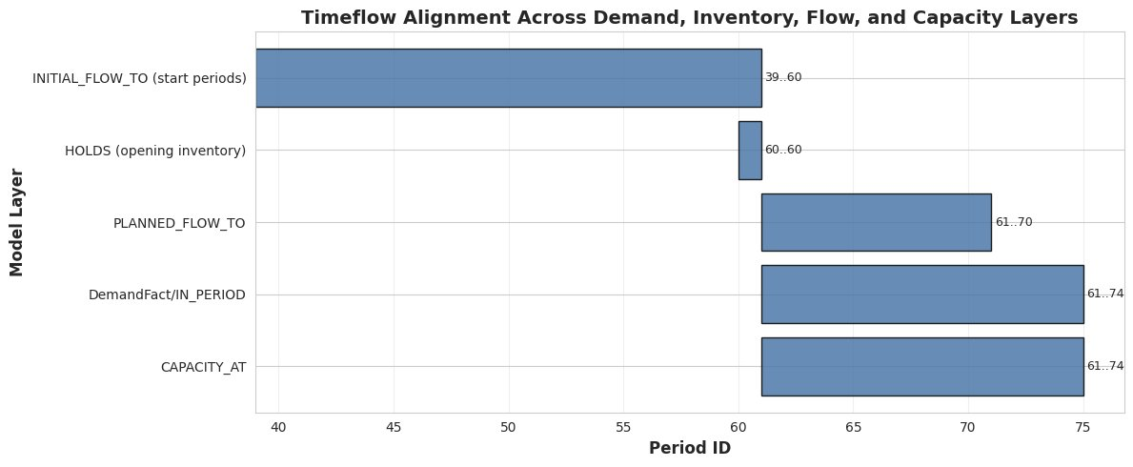
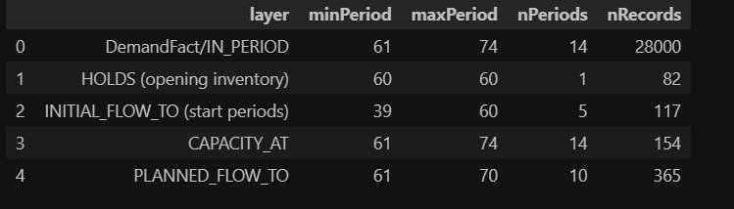
EDA 6
Period Semantics — How does time work in this supply chain model?
Manager asks:
When we say there is a shortage in period 63, what decisions should already have been made?
Key Findings
Demand horizon: periods 61–74 (14 periods) — the active planning window we can control
Opening inventory: single snapshot at period 60 — fixed starting state before planning begins
INITIAL_FLOW_TO starts at period 39 — pipeline ordered 22 periods before the horizon
CAPACITY_AT spans full 61–74 — capacity constraints cover the entire planning window
Story insight
The supply chain runs on three time layers. What we see in period 61 was set in motion at period 39. This is why early warning matters — by the time a shortage is visible, it is too late to prevent it.
Dataset: Moetz et al. (2020) · Neo4j GDS · Spring 2026 Capstone

Slide 16
05
CHAPTER 5
The Buffer Zone
Inventory and pipeline stock are our shock absorbers — but are they enough?
What the operations team is asking:
"When a supplier fails, inventory is what keeps the assembly line running until new stock arrives. How much buffer does each facility actually hold at the start of the planning horizon? And how much stock is already in transit — committed but not yet arrived?"
Dataset: Moetz et al. (2020) · Neo4j GDS · Spring 2026 Capstone

Slide 17
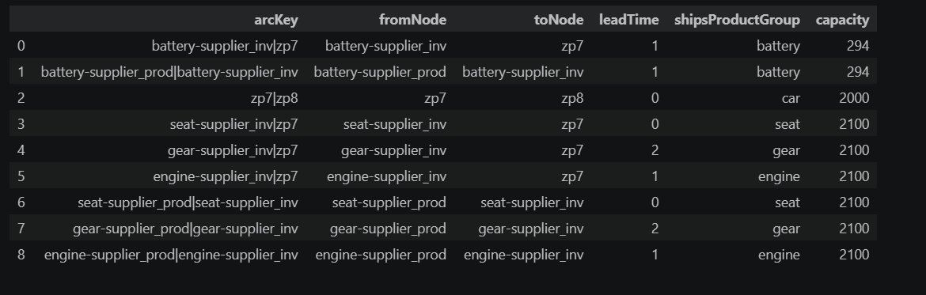
EDA 7
Lane Capacity at Period 61 — Which arcs start the planning window already constrained?
Manager asks:
At day one of our planning horizon, which supply routes are already at or near their limit?
Key Findings
Battery production arc: 294 units/period which is lower than other arcs at 2,100
Low capacity at period 61 means the buffer is already thin before planning even begins
The car shipping arc with a capacity of 2000 is the 2nd lowest however it has a lead time of 0 so it has no bottleneck problems
Arcs with zero lead time mean that there is no time lag between the nodes so transfer is very fast
Story insight
Battery production is the hardest bottleneck before a single planning decision has been made. 294 units per period is a structural ceiling .
Dataset: Moetz et al. (2020) · Neo4j GDS · Spring 2026 Capstone

Slide 18
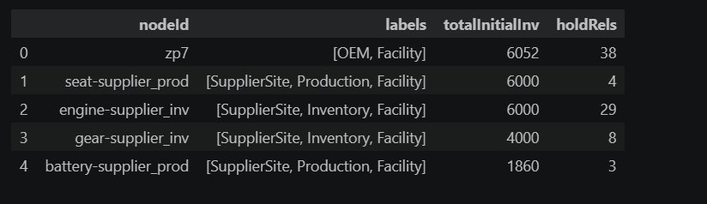
EDA 8
Opening Inventory — Where is our physical buffer concentrated?
Manager asks:
At the start of the planning horizon, how much stock does each facility actually hold?
Key Findings
ZP7 holds the highest opening inventory — it buffers all 4 incoming supply chains
Battery inventory node is thin with only 294 units/period throughput
Transit nodes (seat, battery) expected at zero — they hold no finished inventory
Thin buffers at critical nodes mean disruption impact is felt immediately, not gradually
Story insight
The buffer is concentrated exactly where convergence happens at ZP7. But the battery chain's buffer is proportionally the thinnest. One missed shipment drains it fastest.
Dataset: Moetz et al. (2020) · Neo4j GDS · Spring 2026 Capstone

Slide 19
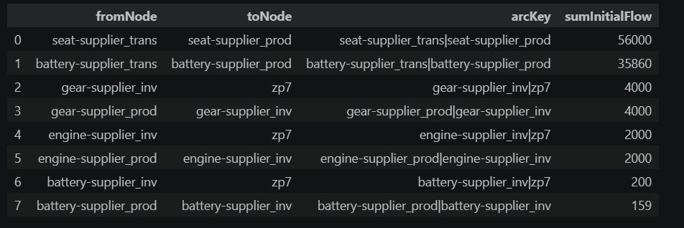
EDA 9
Initial In-Transit Flow — What is already locked in the pipeline?
Manager asks:
Before period 61 even starts, how much stock is already committed and in transit to our facilities?
Key Findings
Battery and seat transit corridors dominate as they are ordered before period 60
Earliest pipeline period is at period 39 — evidence of 23-period seat lead time
Large in-transit volumes confirm the network relies on pre-horizon orders for early supply
Corridors with large initial flows but zero active capacity are running purely on autopilot
Story insight
The supply chain in periods 61-64 is effectively on autopilot. Every unit arriving was ordered before the planning window opened. There is no lever to pull if that stock is wrong.
Dataset: Moetz et al. (2020) · Neo4j GDS · Spring 2026 Capstone

Slide 20
06
CHAPTER 6
The Blast Radius
If one component disappears — how many cars stop?
What the operations team is asking:
"We now know the structure, the complexity, the flow, the timeline and the buffers. The final question is the most operationally critical: which specific components, if disrupted, would cascade failure across the largest share of our finished vehicle portfolio?"
Dataset: Moetz et al. (2020) · Neo4j GDS · Spring 2026 Capstone

Slide 21
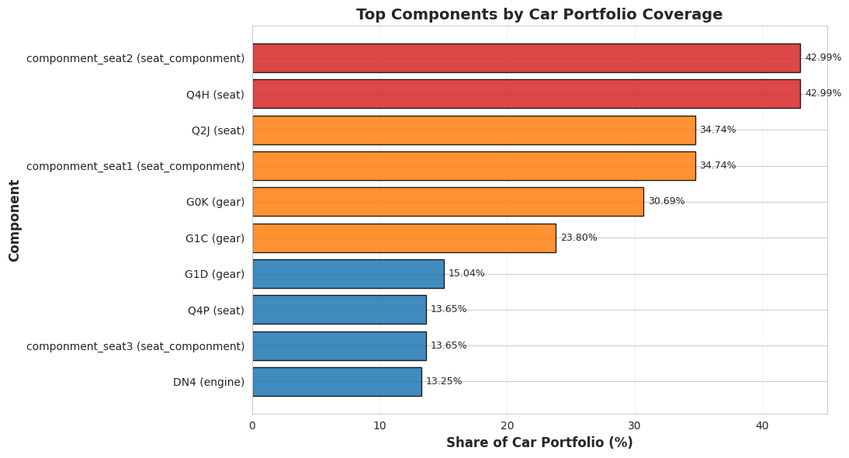
EDA 10
Downstream Component Impact — Which parts, if lost, take down the entire fleet?
Manager asks:
If supplier X stops tomorrow, which car models can we still build — and which ones cannot?
Key Findings
engine, gear and seat sub-components affect most of the 28,000 car portfolio
Battery sub-components do not appear in this list as they share a very low percentage of the total cars (about 10%)
Seat Q4H and component_seat2 are used in 42.99% of the total cars hence affect most production
DN4 is the most used engine component, appearing in 13.25% of the cars
Story insight
Engine, gear and seat components are existential risks. There is no safe subset of our fleet if these fail
Dataset: Moetz et al. (2020) · Neo4j GDS · Spring 2026 Capstone

Slide 22
EPILOGUE
What the Graph Told Us
10 questions — 6 chapters — 1 clear picture of where this supply chain is most vulnerable
Ch.1
Graph is structurally sound — 9 node types, 16 relationship types, all properties confirmed
Ch.2
Finished cars depend on 3–4 components each. Engine, gear and seat affect 100% of the fleet
Ch.3
Seat (23p) and battery (20p) transit arcs are extreme lead-time risks. Gear and engine at 95% capacity
Ch.4
Supply decisions for period 61 were made at period 39. Early warning is the only lever available
Ch.5
Battery production is capped at 294 units/period. Buffers are thin. Pipeline runs on autopilot
Ch.6
Engine, gear and seat components each affect 100% of 28,000 car SKUs — fleet-wide exposure
Next: GDS Algorithms — PageRank centrality and Louvain community detection will formally quantify these risks

