Slide 1
Automotive Supply Chain
Deep Analytics & Graph Data Science
Continuing from EDA 7 — Buffer Zone, Blast Radius, Analytical Questions & GDS Algorithms
Ch.5
Ch.6
3 AQs
GDS
Buffer Zone
Blast Radius
Analytical Qs
PageRank + Louvain
Team: Bekithemba Nkomo · Peter Mangoro · Masheia Dzimba
Dataset: Moetz et al. (2020) · Neo4j GDS · Spring 2026 Capstone

Slide 2
05
CHAPTER 5
The Buffer Zone
Inventory and pipeline stock are our shock absorbers — but are they enough?
What the operations team is asking:
When a supplier fails, inventory is what keeps the assembly line running until new stock arrives. How much buffer does each facility hold at the start of the planning horizon? And how much stock is already in transit — committed but not yet arrived? These are the questions that determine how long we can survive a disruption before the line stops.
Dataset: Moetz et al. (2020) · Neo4j GDS · Spring 2026 Capstone

Slide 3
EDA 7
Lane Capacity at Week 1 — Which supply routes start already constrained?
Manager asks: At day one of our planning horizon, which supply routes are already at or near their limit?
Arc Key
Lead Time
Group
Cap/Wk
battery-inv → zp7
1
battery
294
Key Findings
battery-prod → battery-inv
1
battery
294
Battery production route: only 294 units/week — 7× lower than all other routes at 2,100
zp7 → zp8
0
car
2,000
seat-inv → zp7
0
seat
2,100
This 294-unit ceiling is a structural constraint, not a planning failure
gear-inv → zp7
2
gear
2,100
Routes with zero capacity (transit facilities) are excluded — no active flow at week 1
engine-inv → zp7
1
engine
2,100
The 20:1 battery assembly ratio amplifies any demand change 20× upstream
seat-prod → seat-inv
0
seat
2,100
gear-prod → gear-inv
2
gear
2,100
Story insight
engine-prod → engine-inv
1
engine
2,100
Battery production is the hardest bottleneck before a single planning decision has been made. 294 units per week is a structural ceiling — the network starts week 1 already constrained on the most critical component.
Dataset: Moetz et al. (2020) · Neo4j GDS · Spring 2026 Capstone

Slide 4
EDA 8
Opening Stock on Hand — Where is our physical buffer concentrated?
Manager asks: At the start of our planning horizon (week 0), how much stock does each facility actually hold?
ZP7 (OEM Assembly)
6,052
Key Findings
ZP7 (OEM assembly) holds 6,052 units — buffers all 4 incoming component flows
seat-supplier_prod
6,000
seat-supplier_prod and engine-supplier_inv each hold 6,000 units
engine-supplier_inv
6,000
gear-supplier_inv holds 4,000 units — proportional to gear complexity
gear-supplier_inv
battery-supplier_prod holds only 1,860 units — thinnest buffer in the network
4,000
Story insight
battery-supplier_prod
The physical buffer is concentrated at convergence points — ZP7 and the Tier-1 inventory nodes. But the battery chain's opening stock is proportionally the thinnest. One missed delivery drains it the fastest with no time to recover given the 20 lead time.
1,860
Dataset: Moetz et al. (2020) · Neo4j GDS · Spring 2026 Capstone

Slide 5
EDA 9
Pipeline Stock Already In Transit — What is locked in before week 1?
Manager asks: Before period 1 even starts, how much stock is already committed and moving through our supply routes?
From Facility
To Facility
Units In Transit
seat-supplier_trans
seat-supplier_prod
56,000
Key Findings
battery-supplier_trans
battery-supplier_prod
35,860
seat-supplier_trans → seat-supplier_prod: 56,000 units in transit — ordered up to 23 weeks ago
gear-supplier_inv
zp7
4,000
battery-supplier_trans → battery-supplier_prod: 35,860 units locked in pipeline
gear-supplier_prod
gear-supplier_inv
4,000
engine-supplier_inv
zp7
2,000
gear and engine corridors: 4,000 and 2,000 units each already in motion
engine-supplier_prod
engine-supplier_inv
2,000
These orders cannot be changed, redirected or cancelled — they are autopilot stock
battery-supplier_inv
zp7
200
battery-supplier_prod
battery-supplier_inv
159
Story insight
The supply chain for weeks 1–4 is effectively on autopilot. Every unit arriving was committed before the planning window opened. If that stock is wrong in quantity or timing, there is no lever to pull. This is the operational consequence of 20–23 lead times.
Dataset: Moetz et al. (2020) · Neo4j GDS · Spring 2026 Capstone

Slide 6
06
CHAPTER 6
The Blast Radius
If one component disappears — how many cars stop?
What the operations team is asking:
We now know the structure, the complexity, the flow, the timeline and the buffers. The final question is the most operationally critical: which specific components, if disrupted, would cascade failure across the largest share of our finished vehicle portfolio? This is where graph traversal gives us answers spreadsheets cannot.
Dataset: Moetz et al. (2020) · Neo4j GDS · Spring 2026 Capstone

Slide 7
EDA 10
Downstream Component Impact — Which parts, if lost, take down the entire fleet?
Manager asks: If supplier X stops tomorrow, which car models can we still build — and which ones cannot?
Key Findings
componment_seat2 and Q4H (seat): 42.99% of car portfolio — 12,038 cars affected
componment_seat1 and Q2J (seat): 34.74% — 9,726 cars each
G0K (gear): 30.69% — 8,592 cars depend on this single gear component
Engine, gear and seat components collectively affect 100% of all 28,000 car SKUs
Story insight
This is the answer to the original question. The seat family is the most concentrated blast-radius risk — a single seat sub-component affects over 42% of the entire car portfolio. Engine, gear and seat together represent fleet-wide existential risk. There is no safe production subset if these fail.
Dataset: Moetz et al. (2020) · Neo4j GDS · Spring 2026 Capstone

Slide 8
07
DEEPER ANALYTICS
Strategic Analytical Questions
Going beyond EDA to answer operational risk questions
Three strategic questions:
AQ1: Component Concentration Risk Map — which BOM hubs have the largest blast radius?
AQ2: Arc Structural Fragility — which supply routes are most exposed to disruption?
AQ3: Risk-Adjusted Component Priority — which parts need mitigation first?
Dataset: Moetz et al. (2020) · Neo4j GDS · Spring 2026 Capstone

Slide 9
AQ 1
Component Concentration Risk Map
Business question: Which components are the strongest shared dependency hubs in the BOM — the ones with the largest structural blast-radius if disrupted?
Operational Context
Key Findings
Systemic BOM risk is concentrated in a small set of reused components. A disruption in one high-concentration component propagates across large portions of the product portfolio. This query traverses the full transitive BOM — not just tier-1 — to find every component that is an indirect dependency of the maximum number of finished products.
The fragility score combines: (1) how many upstream products depend on the component, and (2) how many distinct dependency paths connect those products to it.
componment_seat2: 12,039 upstream products, 48,156 dependency paths — largest BOM hub
Q4H (seat): 12,038 products, 24,076 paths — second largest
componment_seat1 & Q2J: ~9,726 each — seat family dominates top 4
Gear components (G0K, G1C, G1D) appear in top-10 — broad but lower than seat
Story insight
Concentration is not evenly distributed. The seat and seat-component family dominates the BOM hub rankings by a significant margin, followed by gear. This means a seat sub-component failure propagates through more dependency chains than any other disruption scenario in this network.
Dataset: Moetz et al. (2020) · Neo4j GDS · Spring 2026 Capstone

Slide 10
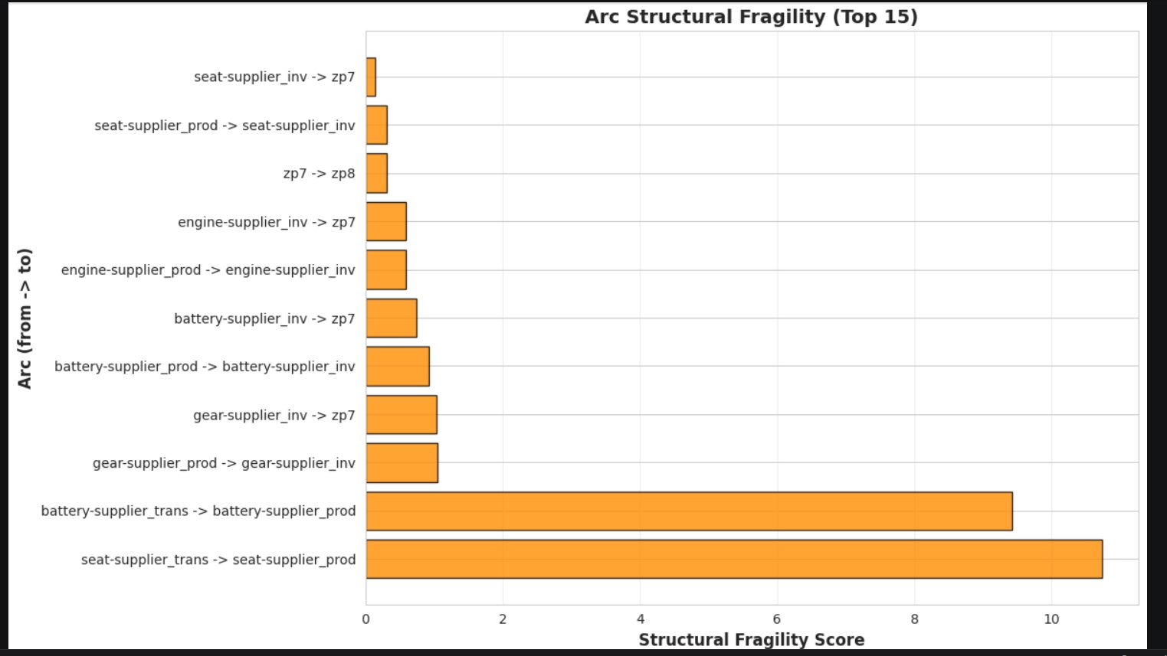
AQ 2
Arc Structural Fragility Score
Business question: Which logistics routes are structurally fragile based on long lead times, low installed capacity, and weak destination opening stock?
Operational Context
Key Findings
Planned flow data is sparsely populated, so utilisation-based scoring is unreliable. Instead this analysis builds a structural fragility score from three consistently available signals:
1. Lead time (weeks) — longer delay = less ability to react
2. Minimum installed capacity across weeks 1–14 — structural ceiling
3. Destination opening stock at week 0 — buffer available before the route matters
The composite score surfaces routes that combine all three risk factors simultaneously.
seat-supplier_trans → seat-supplier_prod: top fragility — lead time 23 leads, zero active buffer
battery-supplier_trans → battery-supplier_prod: second — lead time 20 leads, only 294 units/week capacity
gear and battery transfer arcs: mid-tier fragility — lower lead times but smaller capacities
Short lead-time arcs with large capacity rank lowest — structurally resilient
Story insight
The fragility ranking confirms what EDA 5 suggested: the two transit arcs for seat and battery components are the most structurally exposed routes in the network. A disruption on either cannot be corrected for 20–23 leadtime — and the destination buffers at those nodes are already thin.
Dataset: Moetz et al. (2020) · Neo4j GDS · Spring 2026 Capstone

Slide 11
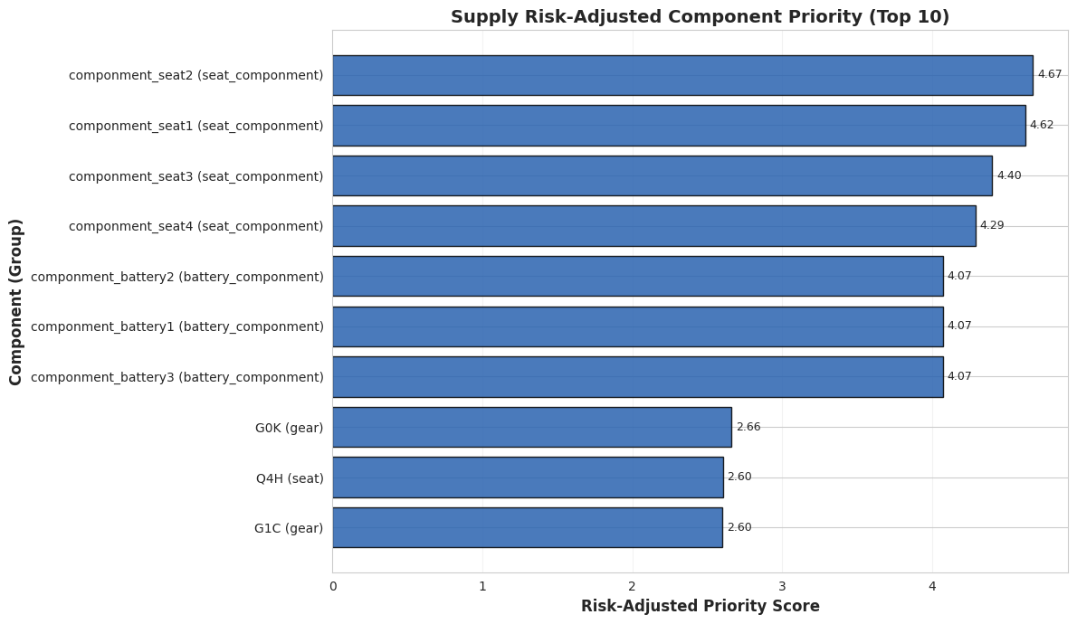
AQ 3
Risk-Adjusted Component Priority
Business question: Which components should be prioritised first for mitigation — considering BOM centrality, supplier redundancy, and logistics fragility together?
Operational Context
Key Findings
Single-sourced seat sub-components rank highest — maximum BOM reach + zero supplier redundancy
Battery components: moderate BOM reach but 294-unit/week capacity ceiling makes them critical
Gear components: strong BOM presence but multi-sourced reduces priority vs seat
Engine components: broad BOM reach but redundant sourcing keeps risk lower than seat
Story insight
The risk-adjusted view changes the priority order vs raw BOM concentration alone. Seat sub-components remain top priority due to combined single-sourcing + fragile logistics. Battery moves up the priority list disproportionate to its BOM weight because of the 294-unit structural capacity ceiling — a ceiling no planning decision can raise without capital investment.
Dataset: Moetz et al. (2020) · Neo4j GDS · Spring 2026 Capstone

Slide 12
08
GRAPH DATA SCIENCE
GDS Algorithms
PageRank centrality + Louvain community detection
Why graph algorithms?
Cypher queries answer questions about specific nodes and paths. GDS algorithms score every node simultaneously — surfacing structural importance that no single query can reveal. We project the full network into memory and run two algorithms that have proven value in supply chain risk analysis.
Dataset: Moetz et al. (2020) · Neo4j GDS · Spring 2026 Capstone

Slide 13
GDS 1
PageRank — Critical Node Identification
Algorithm Theory
Key Results
PageRank is an iterative eigenvector centrality algorithm developed by Page et al. (1999). It measures node influence by iteratively distributing rank from nodes to their neighbours:
PR(n) = (1-d)/N + d × Σ(PR(m)/L(m))
Where d = 0.85 damping factor, N = total nodes, m = nodes pointing to n, L(m) = outbound degree of m.
In supply chain context: a facility that receives flow from many high-influence suppliers accumulates high PageRank — meaning its failure would cascade broadly. We run 50 iterations on the full projected network.
engine-supplier_inv and gear-supplier_inv: highest-scoring facilities — critical Tier-1 consolidation points
ZP7 and ZP8 (OEM plants): elevated scores — all component flows converge here before reaching customers
Tier-2 production facilities: lower scores — upstream but one hop removed from convergence
Transit nodes: lowest scores — pass-through, not consolidation points
Story insight
PageRank formally quantifies what EDA 5–9 suggested qualitatively. The Tier-1 inventory facilities — engine-supplier_inv and gear-supplier_inv — are the highest-influence nodes in the network. A disruption there cascades to every downstream path. This confirms they are the correct targets for buffer investment and redundancy planning.
Dataset: Moetz et al. (2020) · Neo4j GDS · Spring 2026 Capstone

Slide 14
GDS 2
Louvain Community Detection — Supply Chain Clusters
Algorithm Theory
Key Results
Louvain is a hierarchical modularity optimisation algorithm by Blondel et al. (2008). It maximises the modularity function:
Q = (1/2m) × Σ[Aᵢⱼ − (kᵢkⱼ/2m)] × δ(cᵢ, cⱼ)
Where m = total edges, Aᵢⱼ = adjacency matrix, kᵢ/kⱼ = node degrees, δ = 1 if same community.
The algorithm runs in two phases: (1) assign each node to its best neighbour community, (2) aggregate communities into super-nodes and repeat. This produces a hierarchical partition revealing natural clusters in the graph.
Largest communities: major product families — all engine-related products and their dedicated suppliers
Mid-size communities: complete assembly chains — Tier-2 production → Tier-1 inventory → OEM → specific car models
Small communities: specialised component systems — seat assemblies and battery systems with dedicated supplier networks
Seat and battery communities are structurally isolated — disruption contained within community boundaries
Story insight
Community detection reveals that the supply network has natural modular structure. The seat and battery systems form distinct communities with limited cross-connections — meaning disruption in those communities does not easily spill over, but the community itself has no internal redundancy. This validates the risk-adjusted priority ranking from AQ3.
Dataset: Moetz et al. (2020) · Neo4j GDS · Spring 2026 Capstone

Slide 15
CONCLUSIONS
What the Graph Told Us — Complete Picture
Ch.5
Buffer Zone: Battery route capped at 294 units/week. ZP7 holds most opening stock. Seat and battery pipeline (56,000 + 35,860 units) locked in before week 1 — weeks 1–4 on autopilot.
AQ2
Arc Fragility: seat transit (23-week lead) and battery transit (20-week lead) are the most structurally fragile routes — confirmed by composite fragility score.
Ch.6
Blast Radius: Seat sub-components affect 42.99% of fleet per component. Engine, gear and seat together affect 100% of all 28,000 car SKUs — fleet-wide existential risk.
AQ3
Risk Priority: single-sourced seat sub-components + battery's 294-unit ceiling = highest mitigation priority. Supplier redundancy and route capacity must be addressed together.
AQ1
Component Concentration: seat and seat-component family dominates BOM hub rankings. componment_seat2 has 12,039 upstream products and 48,156 dependency paths — the largest hub.
GDS
PageRank: engine-supplier_inv and gear-supplier_inv are the highest-influence nodes. Louvain: seat and battery form isolated communities — no internal redundancy, contained but fragile.
Next steps: Real-time disruption simulation · Supplier dual-sourcing modelling · Dynamic buffer optimisation
Dataset: Moetz et al. (2020) · Neo4j GDS · Spring 2026 Capstone

