Slide 1
HPML Project Mid-point Progress
Peter McMaster (pjm2188)
Robert Solomon (rs4759)
Sudarshan Kadalazhi (sk5573)
Damien Doyeun Kim (ddk2145)

Slide 2
Project Summary
Project Title: End-to-End Impact of Distributed Fine-Tuning Strategies on vLLM Inference for 1B and 3B LLMs
Project Goals: Evaluate the impact of different distributed fine-tuning methods on vLLM inference
AI Model(s): meta-llama/Llama-3.2-1B & meta-llama/Llama-3.2-3B
Dataset(s): UltraChat200K
Performance Optimization Techniques/Methodology: SFT on the above models using PyTorch DDP, DeepSpeed ZeRo-2, and PyTorch FSDP training methods, then evaluate each method in vLLM
Profiling/Performance analysis tools used: Measure training throughput, peak GPU memory, time to reach a fixed validation loss, checkpoint export complexity, vLLM load time, first-token latency, and generation throughput

Slide 3
Current Progress
Link to the wandb project: N/A
Link to the github project: https://github.com/PeterMcMaster/distributed-llm-pipeline
Describe the results obtained so far:
Infra work for vLLM serving pipeline completed (see next slide)

Slide 4
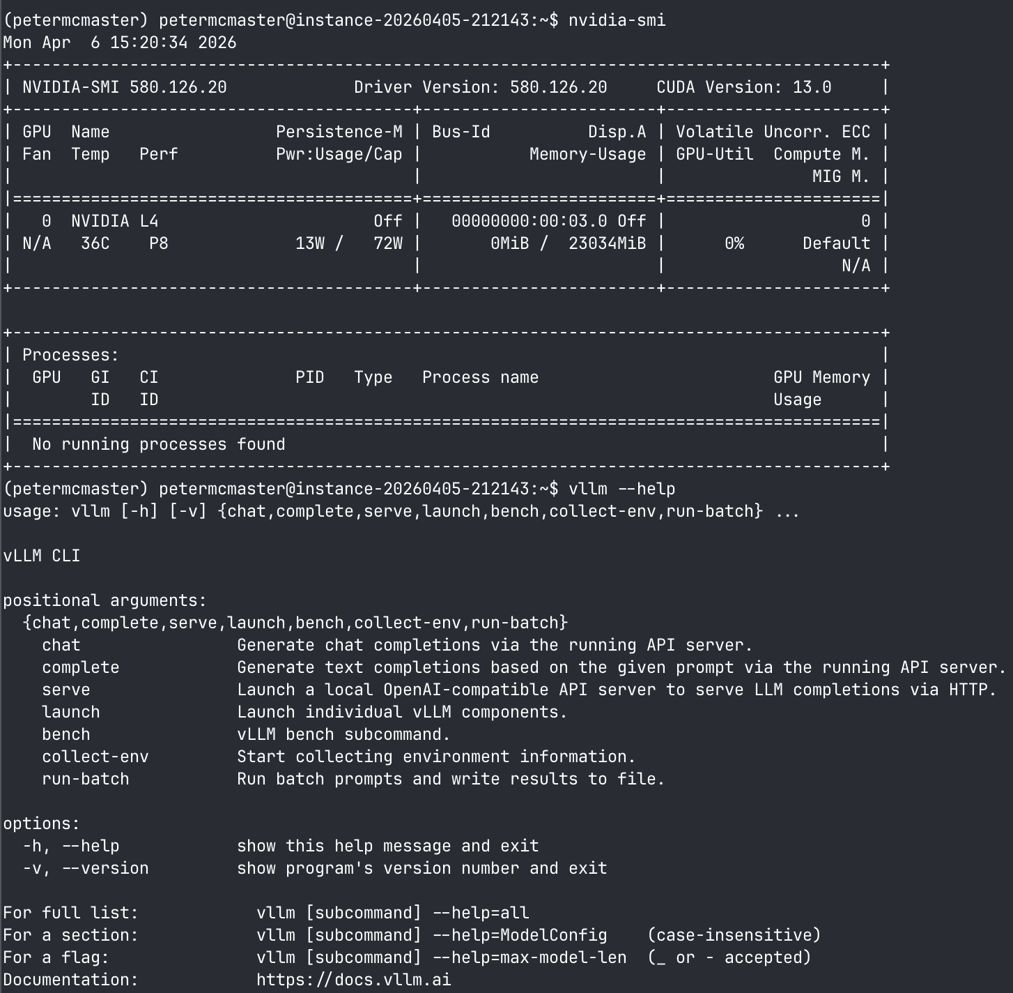
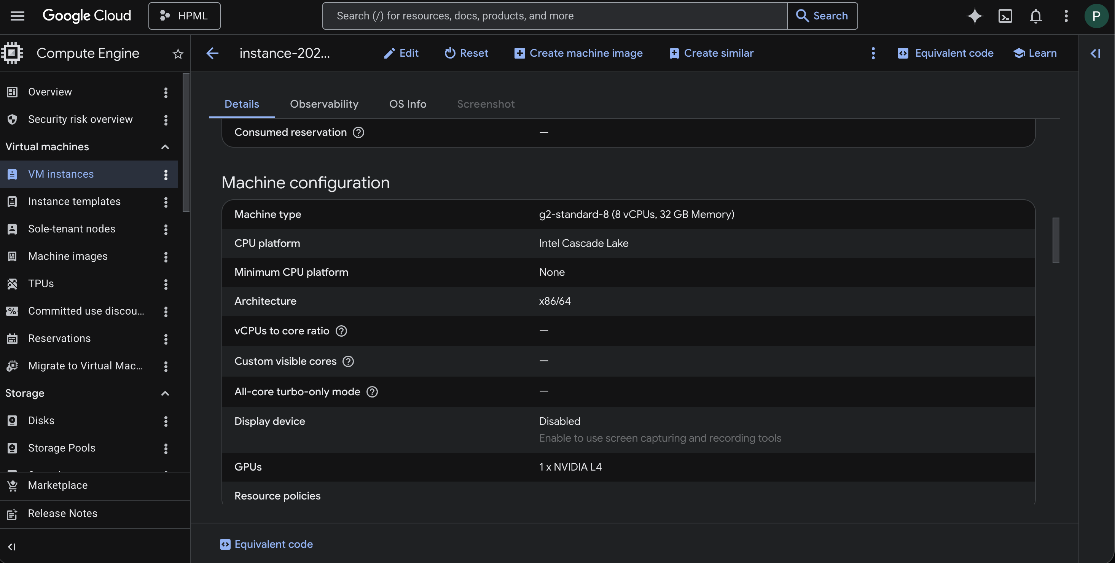
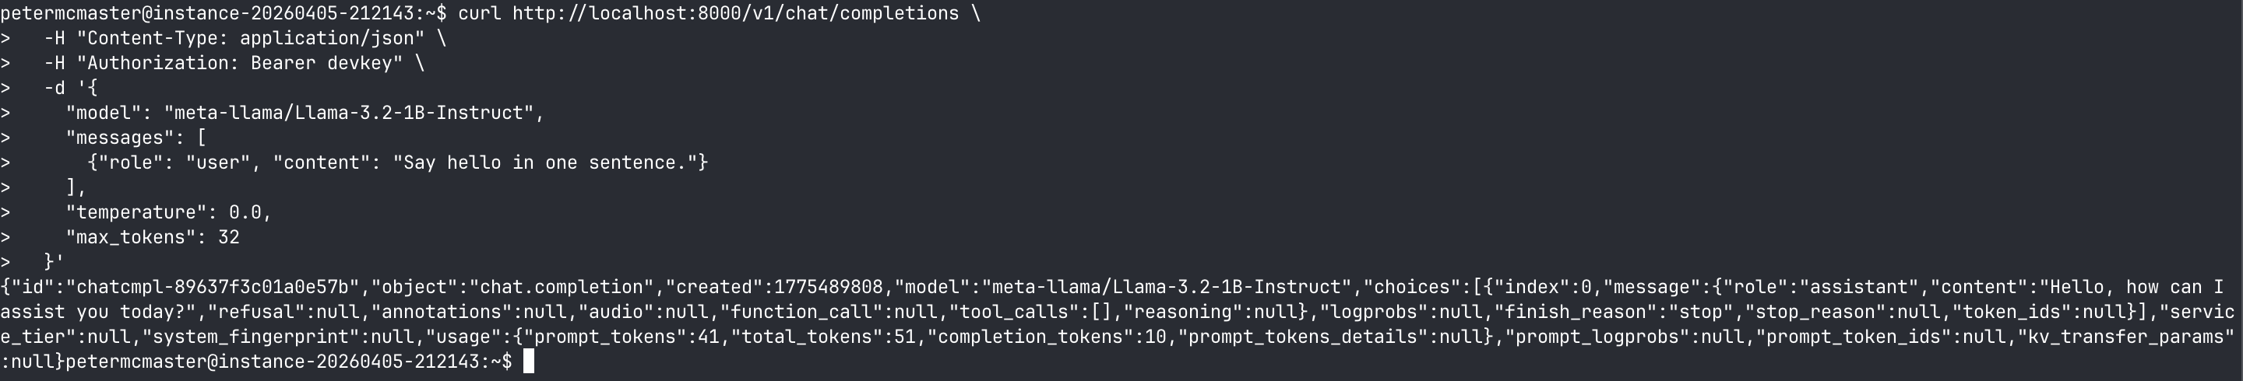

Slide 5
Work in Progress
More comprehensive eval scripts need to be written for vLLM serving pipeline
Currently only latency is being measured/recorded
Need to migrate vLLM serving architecture from known llama models to our own trained model checkpoints

Slide 6
Blockers and Limitations
GPU access limitations on GCP can sometimes cause extended delays

