Slide 1
Modern Testbench Architecture in SystemVerilog with Verilator
This is not about UVM for Verilator
But if you squint your eyes from 30,000 feet maybe it kinda looks like it

Slide 2
About me
A decade of ASIC industry experience
Roughly 50/50 Design and Verification split
7 years of experience with SVA
7 years of experience with UVM
Some experience with Formal Verification
Today
Indepedent Design and Verification Consultant
Focusing on long term challenges
http://www.bittwiddling.com/

Slide 3
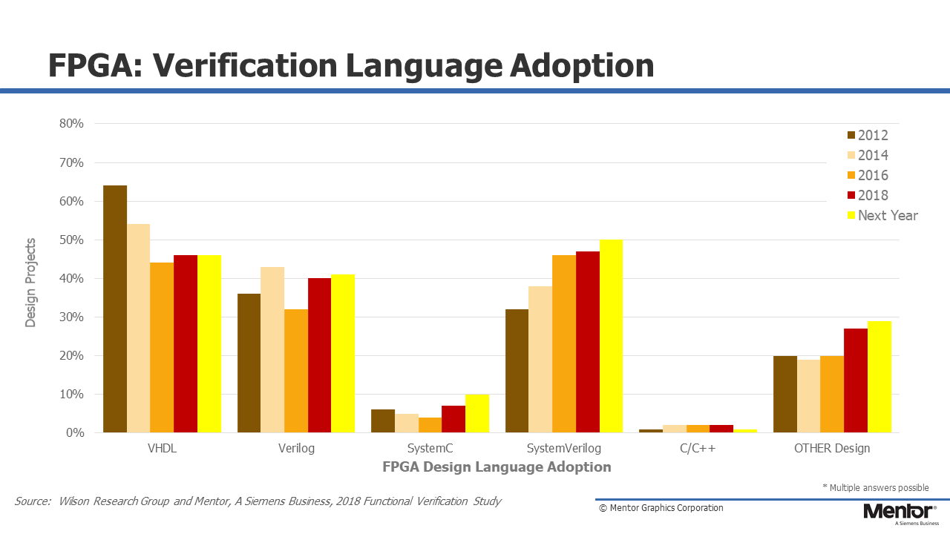
Why have SV TBs in Verilator?
Lots of people verify in Verilog/SystemVerilog and want to continue with it

Slide 4
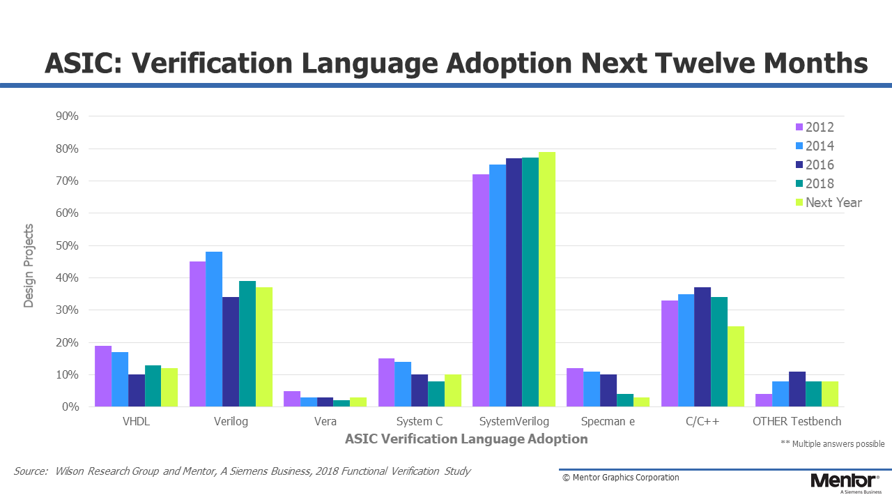
Why have SV TBs in Verilator?
Lets give them the option to use Verilator

Slide 5
Let’s have a look at modern testbench architecture

Slide 6
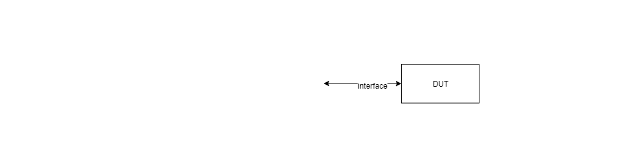
Modern Testbench Architecture

Slide 7

Modern Testbench Architecture

Slide 8
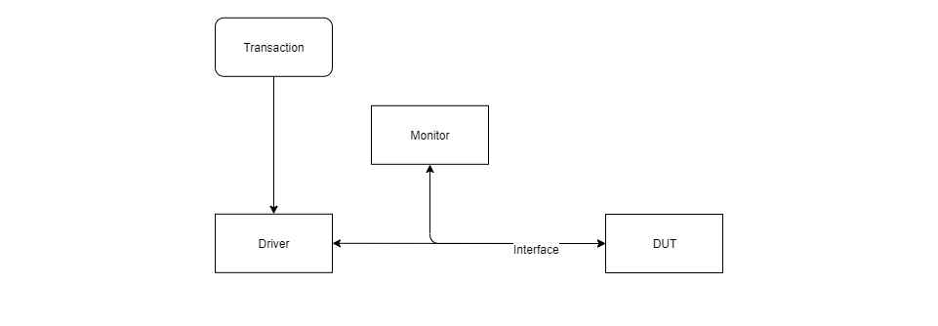
Modern Testbench Architecture

Slide 9
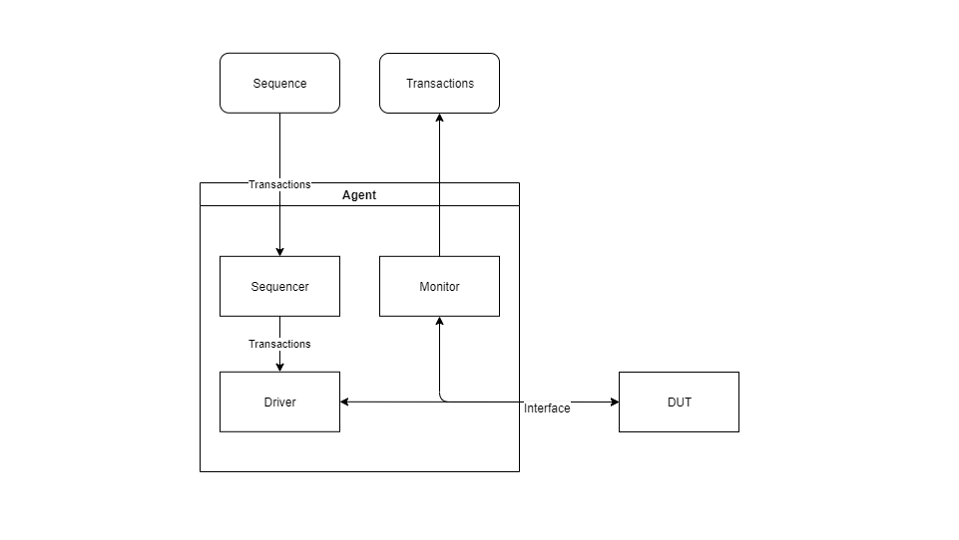
Modern Testbench Architecture

Slide 10
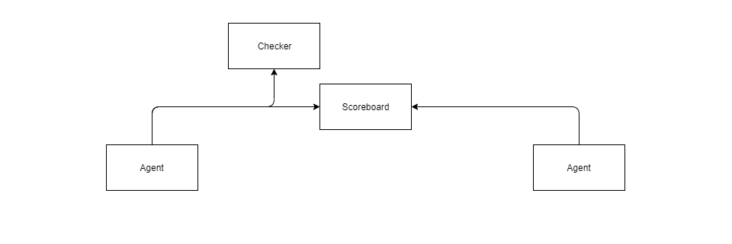
Modern Testbench Architecture

Slide 11
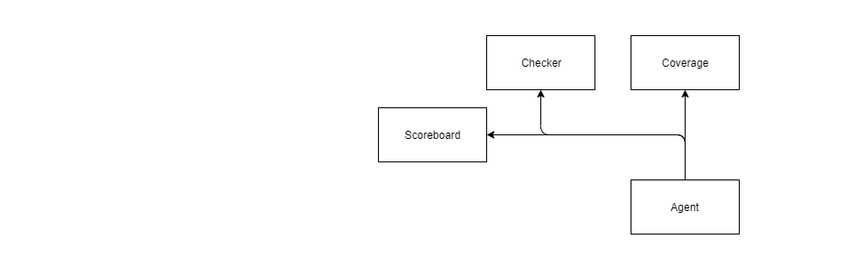
Modern Testbench Architecture

Slide 12
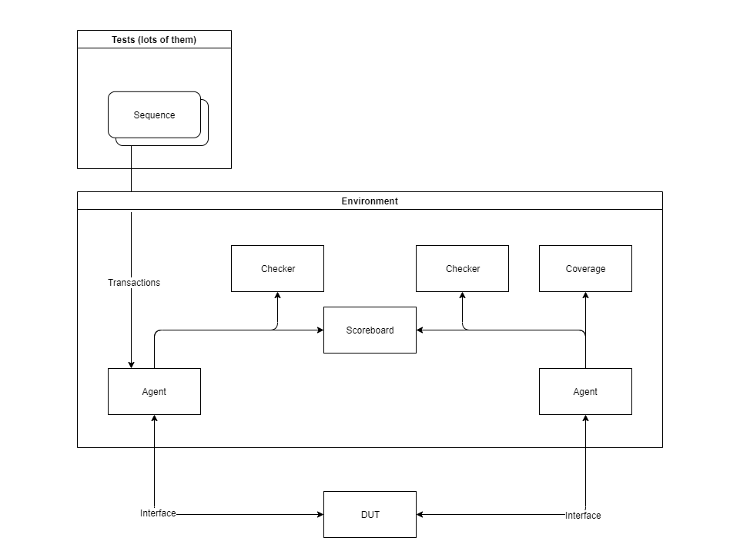
Modern Testbench Architecture

Slide 13
Modern Testbench Architecture
This is how UVM works
And roughly how all other methodologies work
VMM,
OVM,
Book: SystemVerilog for Verification by Chris Spear
http://www.bittwiddling.com/articles/modern-testbench-architecture/

Slide 14
Architecting SV TBs for Verilator
Modules instead of classes
Plusargs instead of polymophism
Handshake instead of TLM ports
Done signal instead of objections
Structs for transactions
Randomization with $random
RTL like testbench
sim_main.cpp with clock and reset only

Slide 15
SV TBs for Verilator: Interface
interface lpcm_if (input logic clk, input logic resetb);
logic en;
logic [31:0] data;
a_valid_data: assert property (
@(posedge clk) //disable iff (!resetb)
!(en && resetb) || ^data !== 1'bx
) else $error("Invalid data on enable in lpcm_if en='b%b data='b%b", en, data);
endinterface

Slide 16
SV TBs for Verilator: Transaction
package lpcm_pkg;
typedef struct packed {
int latency;
int sample;
} lpcm_item;
function string convert2string(lpcm_item item);
return $sformatf("sample=0x%0h latency=%0d", item.sample, item.latency);
endfunction
endpackage

Slide 17
SV TBs for Verilator: Monitor
module lpcm_monitor(lpcm_if vif,
output logic item_collected_en,
output lpcm_pkg::lpcm_item item_collected);
always_ff @(posedge vif.clk or negedge vif.resetb) ...
always_comb ...
endmodule

Slide 18
SV TBs for Verilator: Driver
module lpcm_driver(lpcm_if vif,
input logic req_en,
input lpcm_pkg::lpcm_item req,
output logic ack_en, //for out-of-order transactions
output lpcm_pkg::lpcm_item rsp,
output logic rsp_en);
always_ff @(posedge vif.clk or negedge vif.resetb) ...
always_comb ...
endmodule

Slide 19
SV TBs for Verilator: Sequencer
module lpcm_sequencer (input logic clk,
input logic rst_n,
output logic req_en,
output lpcm_pkg::lpcm_item req,
input logic ack_en, // for out-of-order only
input lpcm_pkg::lpcm_item rsp,
input logic rsp_en,
output logic done);
...
endmodule

Slide 20
SV TBs for Verilator: Sequences
bit is_sine_wave;
initial begin
is_sine_wave = 0;
if ($test$plusargs("lpcm_sine_wave") != 0) begin
is_sine_wave = 1;
end
end

Slide 21
SV TBs for Verilator: Sequences
string file_name;
integer file;
initial begin
if ($value$plusargs("lpcm_file=%d", file_name)) begin
file = $fopen(file_name, "r");
if (file == 0) begin
$fatal("unable to open file %s", file_name);
end
end
end

Slide 22
SV TBs for Verilator: Sequences
File reading in always_ff
if (file != 0 && !$feof(file)) begin
int count = $fscanf(file, "%d\n", scan_sample);
if (count == 0) begin
$error("unable to parse line in file: %s", file_name);
end
end else if (file != 0 && $feof(file)) begin
done <= '1;
end

Slide 23
SV TBs for Verilator: Sequences
always_ff @(posedge clk or negedge rst_n) begin
// ... ignoring reset ...
if (first || (req_en && rsp_en)) begin
first <= '0;
// ... file reading collapsed here ...
sample <= file != 0 ? scan_sample :
is_sine_wave ? sine_sample : $random;
end
if (file == 0 && counter == 0) done <= '1;
end

Slide 24
SV TBs for Verilator: Scoreboard
Standard in-order scoreboard similar to comparator
Logging output is limited by lack of polymorphism
in_order_scoreboard #(.BITS($bits(lpcm_pkg::lpcm_item)))
scoreboard (.a_en(item_collected_a_en),
.a(item_collected_a),
.b_en(item_collected_b_en),
.b(item_collected_b),
.matched(lpcm_matched),
.mistmatched(lpcm_mismatched));

Slide 25
SV TBs for Verilator: Coverage
c_msbs00 : cover property (
@(posedge clk)
en && resetb && has_coverage && data[31:30] == 2'b00
);
c_msbs01 : cover property (
@(posedge clk)
en && resetb && has_coverage && data[31:30] == 2'b01
);

Slide 26
SV TBs for Verilator: System Level
module top (input wire clk, input wire rst_n);
// ... Interfaces, DUT, etc. ...
if (&done) begin
$finish;
end
if (timeout_counter > 10000) begin
$error("Error: Timeout %0d", timeout_counter);
$finish;
end
endmodule

Slide 27
Tests == Running Verilator
...
Vtop +verilator+seed+43 +lpcm_sine_wave
Vtop +verilator+seed+7 +lpcm_file=samples.dat

Slide 28
Lots of quirks
Current sequences implementation doesn’t scale
Lack of classes/polymorphism (printing transactions)
Lack of framework infrastructure
Limited coverage
Assertions
I can’t make --error-limit and $error work together
No factory overrides (but that is actually OK)
No queues, associative arrays, etc.

Slide 29
Conclusion
This is a rough ”solution”
But you can build modern-ish testbenches with SystemVerilog in Verilator
For unit level and subsystem level
With a little boilerplate C++
Some things are easier to debug than f. x. UVM
Objections
Entries in scoreboards
Null pointers (because they don’t exist)

Slide 30
Thank you for listening
Do you have questions?
Source code (Apache License 2.0):
https://github.com/PeterMonsson/lpcm-verilator/

