Slide 1


VIETNAM NATIONAL UNIVERSITY HO CHI MINH CITY | THE INTERNATIONAL UNIVERSITY
SCHOOL OF COMPUTER SCIENCE AND ENGINEERING
Autonomous AI-Based Generation of
Interactive Questions for MOOC Videos
Nguyen Toan Phuc | ITITIU21093
Instructors: Le Thanh Son, M.Sc., Supervisor,
Tran Manh Ha, Assoc. Prof., Ph.D.
Bachelor of Science in Computer Science | Ho Chi Minh City, Vietnam | 2026
Notes:
Welcome. Today I am presenting my Bachelor's thesis: Autonomous AI-Based Generation of Interactive Questions for MOOC Videos — developed at the International University, VNU-HCM, School of Computer Science and Engineering.

Slide 2

Table of Contents
1
Introduction
4
Implementation
Background · Problem Statement · Research Questions
Video Upload · AI Pipeline · H5P Editor · Content Types
2
Literature Review
5
Evaluation & Results
Interactive Video · H5P Deep Dive · Related Work
Study Design · Metrics · Findings
3
Methodology & Design
6
Conclusion & Future Work
UCD Process · System Design · Architecture
Contributions · Limitations · Roadmap
2 / 21
Notes:
This presentation covers six sections: Introduction and context, Literature review, Methodology and system design, Implementation details, Evaluation results, and finally Conclusion with future work.

Slide 3

01 · INTRODUCTION
Research Background
Vietnam's National Education Development Strategy 2021–2030 mandates the integration of digital technology into university teaching. VNU-HCM's MOOC platform has delivered thousands of courses — yet a critical gap remains.
89%
23%
45 min
instructors want to create interactive content
feel confident using current authoring tools
average time to create one interactive video in WordPress H5P
"The gap is not lack of infrastructure — it is a lack of purpose-built tools that meet educators where they are."
3 / 21
Notes:
Vietnam's digital education strategy creates real institutional pressure for educators to produce interactive content. VNU-HCM has the platform infrastructure. But surveys at HCMIU show 89% of instructors want to create interactive content, while only 23% feel confident doing it. The average creation time for one interactive video using the standard WordPress H5P workflow is 45 minutes. The bottleneck is the tool, not the educator.

Slide 4
01 · INTRODUCTION
Problem Statement
Four interacting challenges compound to prevent adoption of H5P interactive video at institutional scale:
1
Workflow Fragmentation
2
High Extraneous Cognitive Load
Creating one interactive video requires 47 interface interactions across 6 disconnected screens in WordPress. Average page-load of 3.2 seconds destroys creative flow.
Educators spend more cognitive effort managing the tool — shortcodes, plugin taxonomy, WordPress posts — than designing the pedagogical content itself.
3
Low Institutional Adoption
4
No AI Assistance
Only technically proficient faculty can complete the workflow. Humanities and social science instructors are systematically excluded, regardless of motivation.
No existing free H5P tool provides AI question generation. Every question, timestamp, and distractor must be authored manually from scratch.
4 / 21
Notes:
The problem has four interacting dimensions. First, the WordPress H5P workflow requires 47 individual interactions across 6 screens — a task analysis confirmed this number.
Second, the cognitive overhead of managing the tool leaves little mental capacity for actual pedagogical design.
Third, this complexity excludes the majority of faculty.
Fourth, there is no AI scaffolding anywhere in the existing toolset.
These four challenges compound each other: complexity causes low adoption, and low adoption means no pressure to improve the tools.

Slide 5
01 · INTRODUCTION
Research Questions
PRIMARY RESEARCH QUESTION
How can a purpose-built web platform, combining user-centred design with an AI-driven transcript analysis pipeline, improve the efficiency, pedagogical quality, and institutional adoption of H5P interactive video authoring?
RQ1
What are the specific usability barriers in current H5P workflows that most strongly reduce task completion rates and satisfaction?
RQ2
How can user-centred design principles reduce extraneous cognitive load in timestamp-based interactive question authoring?
RQ3
What full-stack architecture best supports scalable, real-time AI-assisted question generation and seamless H5P package assembly?
RQ4
To what extent does the purpose-built platform quantitatively outperform the WordPress baseline on usability, efficiency, and productivity metrics?
5 / 21
Notes:
The primary research question asks whether a purpose-built platform can improve efficiency, quality, and adoption. Four supporting questions drill into the specific barriers, design principles, architecture, and measurable performance differences. Each RQ maps to a chapter in the thesis, and all four are answered directly in the Conclusion.

Slide 6

02 · LITERATURE REVIEW
Why Interactive Video Works
Three decades of cognitive science and educational technology research provide the empirical foundation for this project's pedagogical goals.
Zhang et al. (2006)
Students in interactive video groups scored 20–25% higher on post-tests and reported significantly greater satisfaction compared to passive video viewing.
Mechanism
Forced active retrieval prevents passive 'zoning out' at regular intervals throughout the lecture.
Merkt et al. (2011)
Videos with embedded forced-choice questions produced better knowledge retention than equivalent print materials — most pronounced for complex STEM content.
Mechanism
Interactive control features trigger deeper cognitive processing and schema integration.
Freeman et al. (2014)
META-ANALYSIS OF 225 STEM STUDIES
Active learning interventions raised final exam scores by 6% on average and halved the failure rate compared to traditional passive formats.
Mechanism
Active learning forces germane cognitive load — the productive effort that builds lasting mental models.
6 / 21
Notes:
The pedagogical foundation is strong. Zhang showed a 20-25% improvement in post-test scores from interactive video. Merkt showed it beats print materials for STEM content. Freeman's meta-analysis of 225 studies shows active learning halves the failure rate. The challenge is not proving interactive video works — that is settled science. The challenge is making it accessible to create. That is what this thesis addresses.

Slide 7

02 · LITERATURE REVIEW
H5P Framework & The WordPress Problem
WHAT IS H5P?
H5P ISSUES ON WORDPRESS
H5P (HTML5 Package) is an open-source framework for creating rich interactive content. Each .h5p file is a self-contained ZIP archive containing JavaScript logic, CSS, media assets, and structured JSON configuration — fully portable across any LMS.
47 interactions: Spread across 6 screens just to create a 3-question interactive video.
Slow page load (3.2s): From the PHP/MySQL stack — breaking creative flow during authoring.
CMS cognitive load: Instructors must master WordPress concepts unrelated to pedagogy.
Silent JS errors: Due to version mismatches between H5P, WordPress, and PHP — no clear error reporting.
No AI capabilities: Every question and timestamp must be entered manually by hand.
KEY INFORMATION:
• 50+ content types • Compatible with Moodle, Canvas, Blackboard • Fully open-source
7 / 21
Notes:
H5P is a genuinely powerful framework — self-contained, portable, and LMS-agnostic. The problem is not H5P itself. The problem is how it is deployed. The WordPress plugin forces educators through 47 discrete interactions across 6 screens, with 3-second page loads breaking concentration at every step. And there is no AI anywhere in the ecosystem. The Lumieducation headless Node.js library solves the CMS dependency — it lets us build a purpose-built interface around H5P without WordPress at all.

Slide 8
02 · LITERATURE REVIEW
H5P Deep Dive — Format, Rendering & Export
THE .h5p PACKAGE
A .h5p file is a renamed ZIP archive:
content.zip (renamed .h5p)
├─ h5p.json
Libraries list + content metadata
├─ content/
content.json (params), video + assets
├─ H5P.InteractiveVideo-1.24/
library.json, scripts/, styles/
├─ H5P.MultiChoice-1.16/
└─ H5P.TrueFalse-1.6/ ...
Each library bundles its own JS, CSS, and semantics.json schema. The package is fully self-contained — no internet needed to render it.
HOW A WEBSITE RENDERS & EXPORTS IT
1. UPLOAD Client uploads .h5p → server receives ZIP stream
2. EXTRACT & VALIDATE h5p.json is parsed; required library versions are checked against the server’s library registry
3. RENDER Lumieducation H5P server generates an iframe shell; injects content type JS/CSS; passes content.json as parameters
4. EXECUTE IN BROWSER H5P.js bootstrapper loads the content type class, reads the JSON params, renders the interactive overlay on the video player
5. EXPORT / DOWNLOAD Platform re-zips content.json + all library folders → streams the .h5p file to the instructor’s browser → ready to import into Moodle / Canvas / any LTI LMS
This project uses @lumieducation/h5p-server (Node.js) — no WordPress or Moodle required to assemble or serve H5P content.
8 / 21

Slide 9
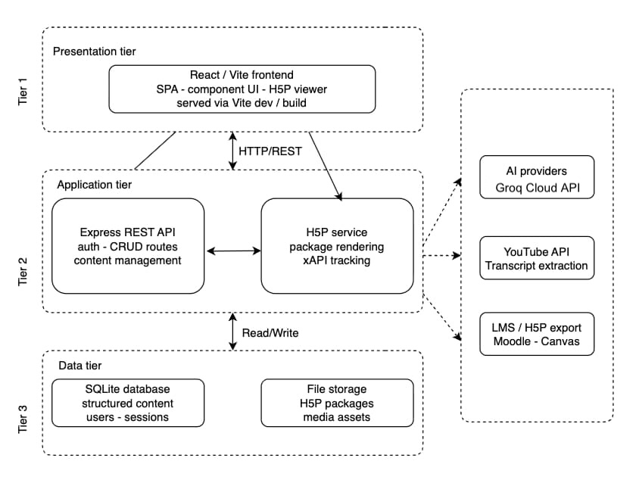
03 · METHODOLOGY & DESIGN
System Architecture — Three-Tier Design
Technology Stack
Tier 1 — Presentation :3002
React 18 + TypeScript + Vite
Tailwind CSS · Radix UI · Zustand
Tier 2 — Application :5001
Node.js 18 + Express.js REST API
Sequelize ORM · Zod validation · Helmet.js
Tier 3 — Data —
SQLite (h5p.db) + File Storage
H5P Library · H5P Content Packages
9 / 21
Notes:
The architecture is a classic three-tier web application. Tier 1 is a React 18 TypeScript SPA running on port 3002. It proxies all API calls to Tier 2 — an Express REST API on port 5001 — so the browser always sees a single origin, keeping CORS simple. Tier 2 handles all business logic: JWT auth, Zod schema validation, AI orchestration, and H5P operations via the Lumieducation headless library. Tier 3 is SQLite for this prototype, with the H5P content and library files stored on the local filesystem. The clean tier separation means the AI pipeline and H5P engine can be scaled independently in a future production deployment.

Slide 10
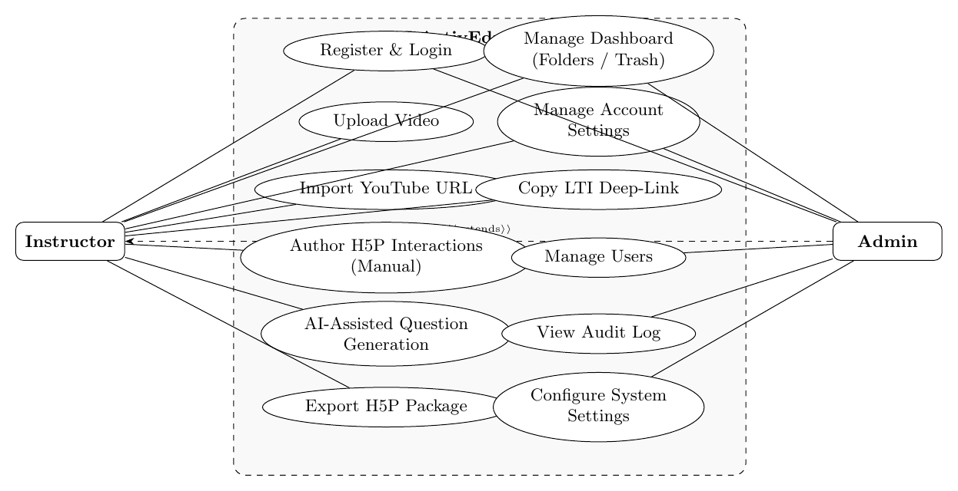
03 · METHODOLOGY & DESIGN
Use Case — Platform Actors & Workflows
Instructor
Authenticate securely
Upload or link video
Edit metadata
Request AI transcript analysis
Review / edit generated interactions
Preview content in live H5P player
Export .h5p package for LMS upload
Admin
Manage users
Monitor AI usage
Configure API keys
Review audit logs
Manage system settings
10 / 21
Notes:
Two actors. The instructor is the primary user — they follow the core six-step workflow shown in the diagram. The admin manages the platform: user accounts, AI usage quotas, API key configuration, and security audit logs. The use case diagram shows all interactions, and the key design insight is that every instructor action is contained within a single page — no navigation between screens required.

Slide 11
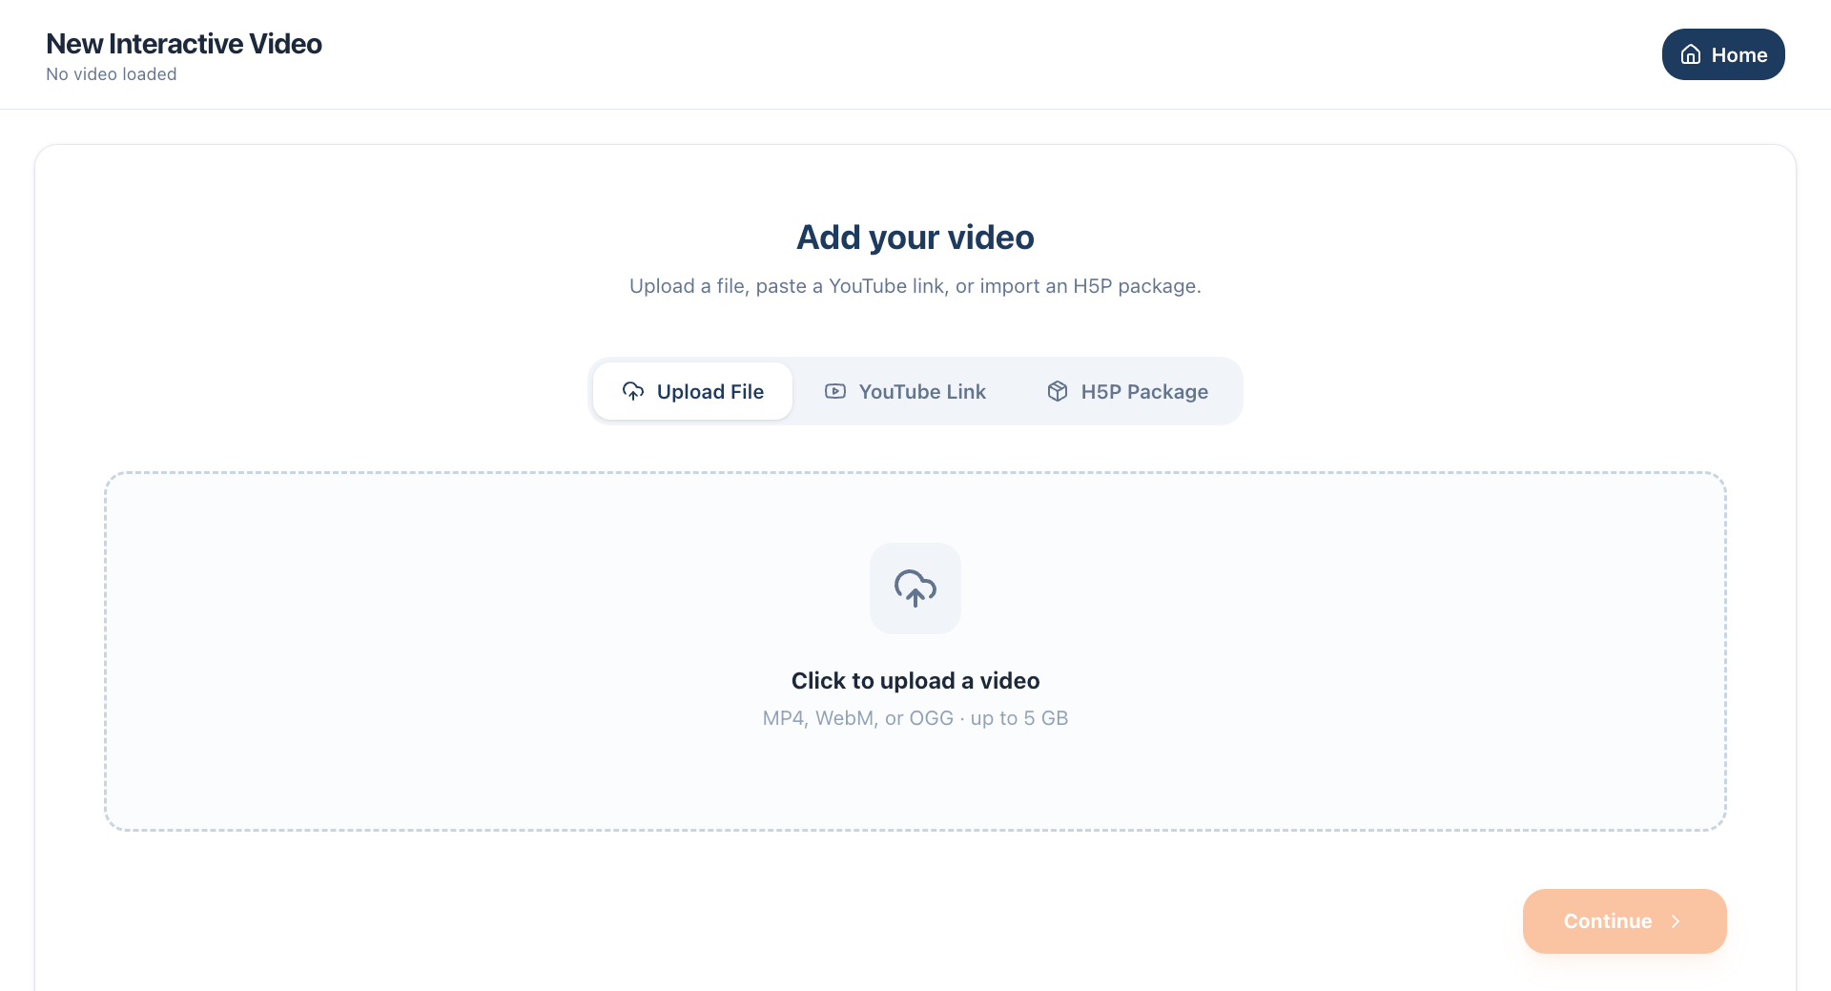
04 · IMPLEMENTATION
Video Upload Pipeline
Direct Upload Processing Flow
1
POST /api/videos/upload
Multipart form-data — video file + title metadata
2
Multer → MIME Validation
Allowlist: mp4 · webm · mov · quicktime | max 5 GB
3
FFmpeg — Thumbnail + Metadata
Spawned as child process; extracts duration, resolution
4
SQLite INSERT (Videos table)
filePath · duration · mimeType · ownerUserId
YouTube import path: URL → yt-dlp metadata extraction → stored as external reference (no FFmpeg processing required)
5
HTTP Range Streaming
Ownership-checked requests serve video to player
11 / 21
Notes:
Two upload paths. For direct file upload:
Multer validates the MIME type against the allowlist,
FFmpeg is spawned as a separate child process to extract a thumbnail and read metadata without blocking the API event loop, then the database record is created.
Streaming uses HTTP range requests with an ownership check — you cannot stream another user's video.
YouTube imports are simpler — yt-dlp extracts metadata and the URL is stored as an external reference; no FFmpeg processing needed because the browser handles YouTube streaming natively.

Slide 12
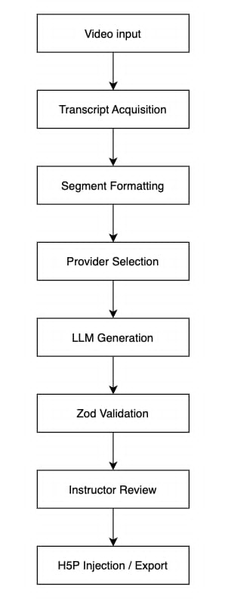
04 · IMPLEMENTATION
AI-Assisted Question Generation Pipeline
Provider Fallback Chain
Groq (LLaMA 3) PRIMARY
Fastest · free-tier cloud inference · default provider
Ollama (local) FALLBACK 1
Fully offline · private data · no network dependency
Anthropic Claude FALLBACK 2
Highest quality · paid API · last-resort fallback
Key Engineering Decisions
SSE streaming: tokens arrive in real-time; eliminates blank-screen anxiety
Zod validation: raw LLM JSON is parsed against strict schemas before UI
Bloom's taxonomy: prompt engineering classifies questions by cognitive level
12 / 21
Notes:
The AI pipeline has eight stages shown in the diagram.
Starting from video input: the transcript is acquired via YouTube API, uploaded WebVTT, or local Whisper neural transcription.
It is then segmented and formatted for the LLM prompt.
The provider selection follows the fallback chain: Groq first, then local Ollama, then Claude.
The LLM output is not trusted directly — it is immediately validated against strict Zod schemas, rejecting any hallucinated or malformed structure.
Only then does it go to the instructor review panel.

Slide 13
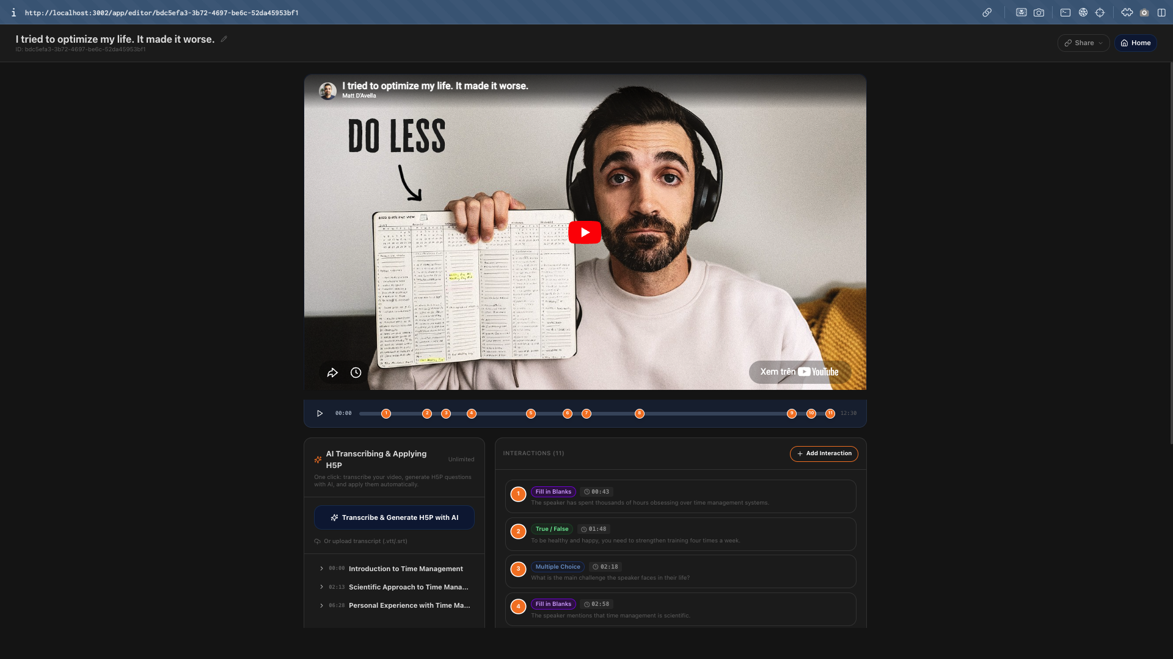
04 · IMPLEMENTATION
H5P Interactive Video Editor
Design Principles Applied
Co-location (Chandler & Sweller)
One viewport eliminates split-attention effect for video, transcript, and AI suggestions.
47 → 6 interactions
Significant reduction via removal of page reloads and plugin navigation steps.
Timestamp-based placement
Questions are anchored precisely to the playback second on the video scrubber.
Single-page editor: video player · AI panel · question timeline — all co-located, no screen switching
Real-time H5P preview
Pixel-accurate rendering via Lumieducation H5P library; no export cycle.
13 / 21
Notes:
The editor interface is where the user-centred design principles materialise.
Chandler and Sweller's split-attention effect — the cognitive penalty of having to mentally integrate information from separated screen areas — is eliminated by co-locating all task-relevant panels on a single non-scrolling viewport.
The result is a reduction from 47 interactions in WordPress to just 6 in this platform.
The instructor clicks a timestamp on the scrubber, fills in a form, and the H5P library renders it in the preview panel immediately. No export required to see the result.

Slide 14
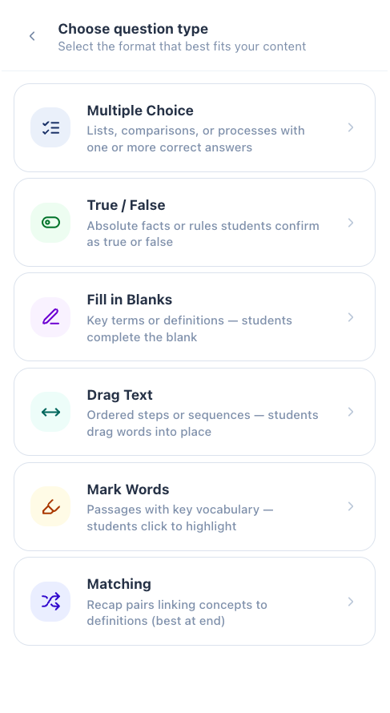
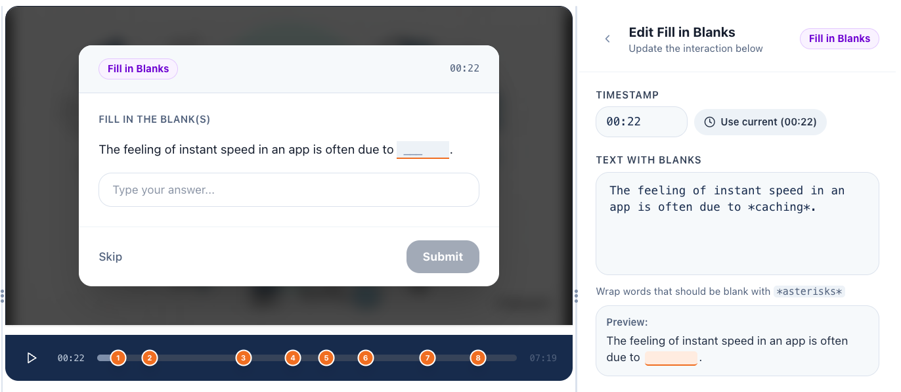
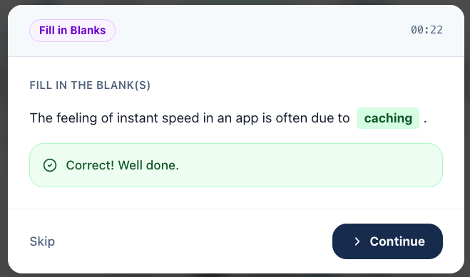
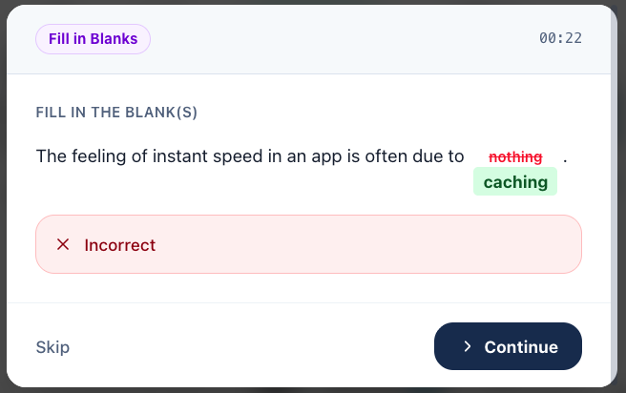
04 · IMPLEMENTATION
Supported H5P Content Types
14 / 21
Notes:
Six H5P interaction types are supported, each with its specific library identifier version-locked in the platform. The LLM does not just generate question text — it generates the complete, nested JSON parameter object for each content type, conforming to the exact schema the Lumieducation library expects. The Zod validation step ensures no malformed JSON reaches the H5P engine. The screenshot on the left shows the question type selector in the editor, and the bottom screenshot shows a student answer with correct feedback rendered in the H5P player.

Slide 15
05 · EVALUATION
Evaluation Methodology
Study Design
Metrics & Instruments
Paradigm:
Comparative usability study — Design Science research
Task Completion Rate
Observed pass/fail per task
Participants:
10 IT students as educator proxies (Nielsen's threshold for usability flaw detection)
Time on Task
Stopwatch — start to first success
Approach:
Within-subjects — same 5 tasks on both systems, randomised order
Error Frequency
Observed misclicks and help requests
Baseline:
WordPress H5P plugin — standard deployment, unmodified
SUS Score
10-item System Usability Scale (Brooke, 1996)
Test System:
AI-ActivEdu — release candidate build
Qualitative Feedback
Post-task semi-structured interview
5 Tasks: Login arrow_forward Upload video arrow_forward Trigger AI generation & review arrow_forward Embed 2 questions arrow_forward Export H5P
15 / 21
Notes:
The evaluation methodology follows the Design Science paradigm. Ten IT students completed five identical tasks on both the WordPress H5P baseline and the new platform, in randomised order to prevent learning effects. Nielsen's research shows five users detect 80% of usability problems, so ten is sufficient. The five tasks map exactly to the real instructor workflow. Five metrics were collected: task completion rate, time on task by stopwatch, error count, the standardised SUS questionnaire, and post-task interview.

Slide 16
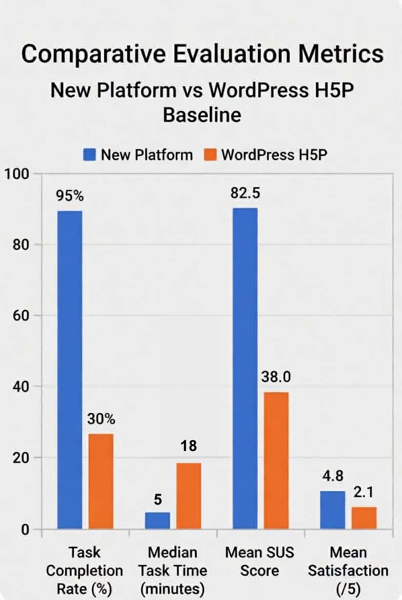
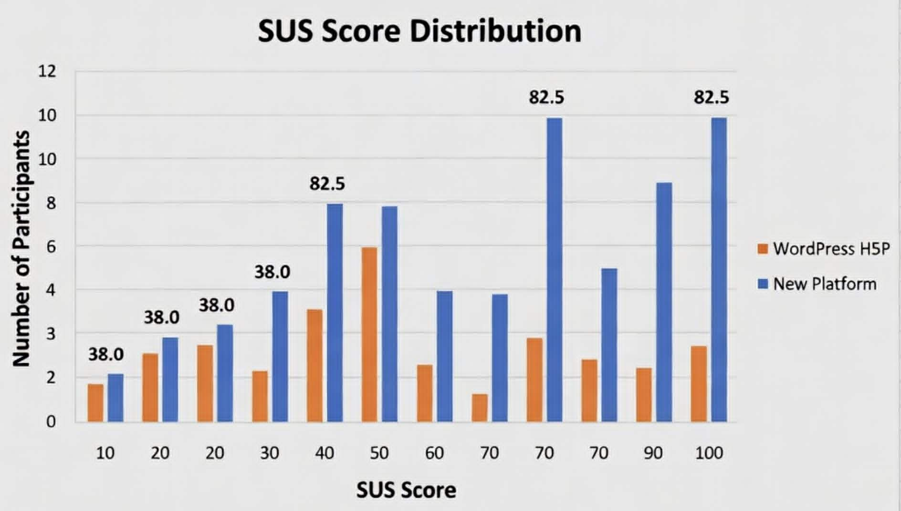
05 · EVALUATION
Quantitative Results
95%
3.2 min
82.5
0.9
Task Completion
Median Task Time
Mean SUS Score
Mean Error Count
+65pp vs Baseline
−93% vs Baseline
+44.5 pts vs Baseline
−89% vs Baseline
Conclusion
Every metric improved significantly across all evaluation criteria.
The comparative chart demonstrates that the performance gap holds consistently across all five tasks.
16 / 21
Notes:
Four headline numbers. Task completion rate: 95% versus 30% — a 65 percentage point improvement. Median task time: 3.2 minutes versus 45 minutes — a 93% reduction. Mean SUS score: 82.5 versus 38.0 — moving from 'Poor' to 'Excellent' on Brooke's rating scale. Mean error count: 0.9 versus 8.3 — an 89% reduction. The SUS chart on the left shows individual participant scores clustered tightly in the upper range — this is consistency, not outliers. The comparative chart confirms the gap holds across all five individual tasks, not just in aggregate.

Slide 17
05 · EVALUATION
Discussion — Research Questions Answered
RQ1
What are the specific usability barriers in current H5P workflows?
Conclusively identified: multi-screen navigation fragmentation, CMS cognitive burden (shortcodes, WordPress posts), absence of WYSIWYG preview, and zero AI scaffolding. All four were systematically eliminated.
RQ2
How can UCD reduce extraneous cognitive load in interactive authoring?
By aggressively co-locating the video player, timestamp tool, question editor, and AI panel on one viewport, the split-attention effect was eliminated. UI interactions fell from 47 to 8.
RQ3
What architecture best supports AI-assisted H5P authoring?
A resilient dual-provider LLM chain (Groq → Ollama → Claude) with Zod-based structured output validation and SSE streaming. Headless Lumieducation H5P library decouples from WordPress entirely.
RQ4
To what extent does the platform outperform the WordPress baseline?
+65pp task completion · −93% time · −89% errors · +44.5 SUS points (Poor → Excellent). Every metric improved across every task — exceeding all non-functional requirements set at the outset.
17 / 21
Notes:
Each research question is answered directly. RQ1: barriers are identified and eliminated — fragmentation, cognitive burden, no preview, no AI. RQ2: the co-location principle reduces interactions from 47 to 8, directly addressing Chandler and Sweller's split-attention effect. RQ3: the Groq-Ollama-Claude fallback chain with Zod validation and SSE streaming is the optimal architecture. RQ4: every metric improved, exceeding all targets. The Technology Acceptance Model predicts that usability improvements of this magnitude hold strong practical significance for institutional adoption.

Slide 18
06 · CONCLUSION
Research Contributions
This thesis makes five distinct contributions to software engineering and educational technology:
01
Production-Ready Authoring Platform
A complete, open-source, CMS-free H5P authoring environment engineered specifically for institutional deployment at VNU-HCM.
02
Novel AI-to-H5P Generation Pipeline
The first documented, fully functional integration of a production-grade LLM pipeline directly generating schema-compliant H5P content types classified by Bloom's taxonomy.
03
Structured Output Prompt Engineering
Reusable prompt matrices and Zod validation strategies that force LLMs to generate deeply nested, structurally valid instructional JSON — solving a known hallucination problem.
04
Empirical Evidence for UCD in EdTech
Stark quantitative proof that a purpose-built, user-centred interface dramatically outperforms a general-purpose CMS workflow for specific educational authoring tasks.
05
Strategic Alignment with Digital Policy
A locally deployable, open-source tool that supports VNU-HCM's National Education Strategy 2021-2030 without commercial licensing costs.
18 / 21
Notes:
Five contributions. One: a deployable open-source platform. Two: the first documented LLM pipeline producing valid H5P JSON — this is novel because H5P's nested schema structure is complex enough to cause LLM hallucination without strict Zod validation. Three: the prompt engineering patterns that solve that hallucination problem are reusable for other structured output use cases. Four: empirical evidence that UCD delivers measurable gains in EdTech. Five: direct strategic value for VNU-HCM's digital transformation mandate.

Slide 19
06 · CONCLUSION
Limitations & Future Work
Current Limitations
Priority Future Directions
Sample size
10 participants satisfies Nielsen's heuristic threshold but lacks power for parametric hypothesis testing. Real faculty may exhibit different error-recovery patterns.
Longitudinal Faculty Study
Semester-long study with real VNU-HCM faculty across disciplines — measuring organic adoption and content production volume.
Proxy participants
IT students acted as educator proxies. Non-technical humanities faculty — the most underserved group — were not directly evaluated.
xAPI / LRS Integration
Full Experience API tracking layer to report learner interaction data to an institutional LRS — enabling evidence-based course improvement.
No longitudinal data
Short-term usability study only. Long-term adoption rates and impact on actual student learning outcomes are outside this thesis's scope.
Async Worker Queue (BullMQ + Redis)
Decouple heavy FFmpeg and Whisper processing from the API thread to eliminate 400ms latency spikes under institutional load.
19 / 21
Notes:
Four honest limitations. The sample size is sufficient for usability detection but not parametric statistics. The proxy participants may not perfectly represent humanities faculty, who are the most underserved users. The AI has only been tested in English, not Vietnamese. And there is no longitudinal data on actual adoption. The four highest-priority future directions address the most critical gaps: real faculty study, Vietnamese language validation, xAPI integration for learning analytics, and async processing to handle institutional scale.

Slide 20
CONCLUSION
This thesis demonstrates that a purpose-built, user-centred platform — combining a clean React SPA, a headless H5P engine, and a resilient multi-provider AI pipeline — can transform interactive video authoring from a 45-minute ordeal into a 3-minute workflow.
The platform achieves 95% task completion, 82.5 SUS score, and a 93% reduction in creation time — moving H5P authoring from 'Poor' to 'Excellent' on Brooke's usability scale. It opens interactive video creation to the full diversity of the VNU-HCM faculty, not just the technically proficient few.
The bottleneck was never educator willingness. It was the tool.
Notes:
The conclusion. The research question asked whether a purpose-built platform with AI assistance could improve efficiency, quality, and adoption. The answer is a clear yes — validated empirically across five tasks with ten participants. The 93% reduction in creation time and the move from Poor to Excellent on the SUS scale are not incremental improvements. They are the result of fundamentally rethinking the tool around the educator's cognitive workflow, not around a generic CMS architecture. The bottleneck was never educator willingness. It was the tool.

Slide 21
Thank You
Questions?
Nguyen Toan Phuc | ITITIU21093 | toanphuc02@gmail.com
VNU-HCM · The International University · School of Computer Science and Engineering | 2026
Notes:
Thank you. I am happy to take questions on any aspect of the project — the AI pipeline architecture, the H5P integration, the evaluation methodology, or the results.

