Slide 1
UNDERGRADUATE THESIS · HCMIU · 2024–2025
AI-ActivEdu
AI-Assisted H5P Interactive Video Authoring Platform
Nguyen Toan Phuc · Faculty of Information Technology · HCMIU · 2025
Notes:
Good morning/afternoon. Today I'm presenting AI-ActivEdu — an AI-assisted web platform for creating H5P interactive video content. The core problem I set out to solve: instructors at Vietnamese universities currently spend 18 minutes creating just 5 H5P interactions using WordPress, and 70% fail to complete the task at all. This platform changes that. Let me walk you through the problem, what we built, and the results.

Slide 2
What Is H5P?
HTML5 Package — Open Standard for Interactive Learning Content
Used worldwide by:
H5P is an open-source format for creating rich interactive content — quizzes, videos, games — that runs inside any modern LMS without plugins or special software.
Moodle
World's #1 open-source LMS — native H5P support built-in
A .h5p file is simply a ZIP archive containing:
Canvas LMS
Used by 40%+ of US universities; LTI-compatible
h5p.json
— package manifest, title, main library
Blackboard
content/content.json
— all interaction definitions + timestamps
Enterprise LMS with full H5P package import
content/videos/video.mp4
— bundled local video (or YouTube URL)
Coursera / edX
H5P.InteractiveVideo-1.24/
— main JavaScript player library
Mass open online course providers
H5P.MultiChoice-1.16/
— question-type JS libraries
VNU-HCM MOOC
Vietnamese national e-learning platform — our target
Notes:
H5P stands for HTML5 Package. It's an open-source standard for creating interactive web content. A .h5p file is a self-contained ZIP archive. Upload it to any compatible LMS and it works immediately — no extra configuration. Today it's used everywhere: Moodle, Canvas, Blackboard, Coursera, and here in Vietnam at VNU-HCM's MOOC platform. The authoring experience matters enormously: if the tool to CREATE these files is broken, the educational benefit is lost.

Slide 3
The Market Reality: WordPress Has No Real Competition
No existing tool satisfies all four criteria that matter to instructors at open universities.
Tool | Web-based | Free & Open | AI Question Gen | Bloom's Labels | Empirically Evaluated
WordPress H5P Plugin | ✓ | ✓ | ✗ | ✗ | ✗
Lumi Desktop Editor | ✗ | ✓ | ✗ | ✗ | ✗
Moodle Native H5P | ✓ | ✓ | ✗ | ✗ | ✗
Articulate Storyline | ✓ | ✗ | Partial | ✗ | ✗
Adobe Captivate | ✓ | ✗ | Partial | ✗ | ✗
AI-ActivEdu (this project) | ✓ | ✓ | ✓ | ✓ | ✓
★ Only AI-ActivEdu satisfies all four requirements simultaneously — and is the only tool with an independent controlled evaluation.
Notes:
Let me put the market in context. WordPress H5P plugin is the most deployed — free, web-based, but zero AI assistance. Lumi Desktop requires local installation. Commercial tools like Articulate and Adobe cost over $1,300 per user per year, aren't H5P-compatible, and their evaluations are vendor-reported only. Most critically: none of them have been independently evaluated in a controlled study. AI-ActivEdu is the only tool that is web-based, free and open-source, AI-powered with Bloom's taxonomy labeling, AND empirically tested. This combination is the gap this project fills.

Slide 4
The WordPress H5P Workflow: Measured, Not Assumed
47
18 min
70%
Interface interactions
Median time-on-task
Could not finish
to create 5 questions
and export
for users who
actually succeeded
7 of 10 participants
gave up
Root causes — directly observed in the study:
6 separate screens to complete one question — instructors lose video context every time they switch
Timestamps must be memorized: note the time, navigate away, retype on a different page
CMS cognitive overhead: WordPress posts, shortcodes, plugin settings — unrelated to teaching
Cryptic plugin save errors with no recovery — participants simply abandoned the task
Notes:
Let me put concrete numbers on the problem. The WordPress H5P workflow requires 47 separate interface interactions to create just 5 questions. Participants navigated across 6 different screens, forced to hold the video timestamp in memory every time they switched. The median time for participants who actually finished was 18 minutes. But the more telling number: 7 out of 10 participants never finished at all. They ran out of time or gave up due to errors. These numbers come from our own controlled study — direct observation, not a survey. The four root causes we observed are listed here. The biggest: every time you switch screens to fill in a form, you lose context of where you are in the video.

Slide 5
What Instructors Said: Four Consistent Pain Themes
Semi-structured interviews with 5 instructors at HCMIU — technical and non-technical disciplines.
01 Disconnected from teaching
02 Fear of losing work
"The H5P editor feels like it was built for web developers, not for someone who just wants to add a question to their lecture video."
"I've lost an entire session's work when the browser reloaded mid-edit. Now I take screenshots of everything just in case."
03 Manual work takes too long
04 Strong demand for AI assistance
"Finding the timestamp, switching screens, typing the question, formatting the options — it takes longer than writing the lecture itself."
"If AI could suggest questions based on what I'm saying in the video, I would use that every single time without question."
Notes:
Before building anything, we ran semi-structured interviews with 5 instructors at HCMIU across technical and non-technical departments. Four themes emerged consistently across every interview. Theme 1: The CMS feels disconnected. Instructors are forced to manage WordPress posts, shortcodes, and plugin settings that have nothing to do with creating educational content. Theme 2: Fear of losing work. The WordPress plugin can time out mid-session with no warning and no recovery path. Theme 3: Manual work is the bottleneck. Not the thinking — the mechanical steps. Finding the timestamp, switching screens, retyping everything from memory. Theme 4: Strong, unprompted interest in AI help. Instructors don't just want AI to generate questions automatically — they want a draft to react to. That's a key insight we designed around. These four themes became our four design requirements.

Slide 6
The Answer
AI-ActivEdu
A web-based, open-source H5P authoring platform with AI-assisted question generation.
No WordPress. No installation. No context-switching.
Design Science Research
User-Centred Design
Agile Development
Build a novel artefact. Validate empirically against the real baseline.
Requirements from instructor interviews before a single line of code.
2–3 week sprints. Critical constraints only emerged during active build.
Notes:
AI-ActivEdu was built specifically to address the four pain themes we heard in interviews. It's a web-based, open-source platform — no WordPress, no CMS, no local installation. Instructors open a browser and work entirely within one screen. The research follows a Design Science paradigm: we build a novel software artefact, then validate its utility through empirical comparison against the existing baseline. Development used 2–3 week agile sprints. This was essential because the interaction between the AI pipeline, H5P schemas, and user experience couldn't be fully specified in advance. Now let's go inside the technical design.

Slide 7
Technical: How a .h5p File Is Assembled & Downloaded
Everything AI-ActivEdu generates ends up inside this ZIP archive.
ZIP Archive — .h5p Contents
How AI-ActivEdu Builds It
h5p.json
Package manifest — title, main library, embedTypes
1
Instructor clicks Export
content/
Content folder
Frontend sends POST to /api/h5p/video/:id/export
2
injectAll() writes to DB
content.json
Interactions array, video source, timestamps
Accepted AI suggestions saved as H5P content records
videos/video.mp4
Bundled local video (omitted for YouTube)
3
createH5PPackage() called
adm-zip builds the ZIP archive entirely in memory
H5P.InteractiveVideo-1.24/
Main player JavaScript library
4
Manifests built from DB records
H5P.MultiChoice-1.16/
Multiple choice library
h5p.json + content/content.json constructed on-the-fly
5
Video bundled (local uploads)
H5P.TrueFalse-1.6/
True/false library
YouTube content uses URL reference instead
H5P.Blanks-1.14/
Fill in the blanks library
6
ZIP returned as download
Browser save dialog → instructor imports into Moodle
Notes:
Before going into the system architecture, I want to explain what a .h5p file actually IS — because it's central to everything we built. A .h5p file is a ZIP archive. Inside: h5p.json declaring the title and main library; content.json with the full interactions array including each question's type, parameters, and timestamp; the video file if it's a local upload; and the JavaScript library folders for each interaction type. The right side shows exactly how AI-ActivEdu generates this file. When the instructor clicks Export, the backend calls createH5PPackage(), which assembles the entire ZIP in memory using adm-zip. h5p.json and content.json are constructed directly from database records. The resulting package is structurally identical to those produced by the official WordPress H5P plugin — 100% compatible with Moodle, Canvas, and Blackboard.

Slide 8
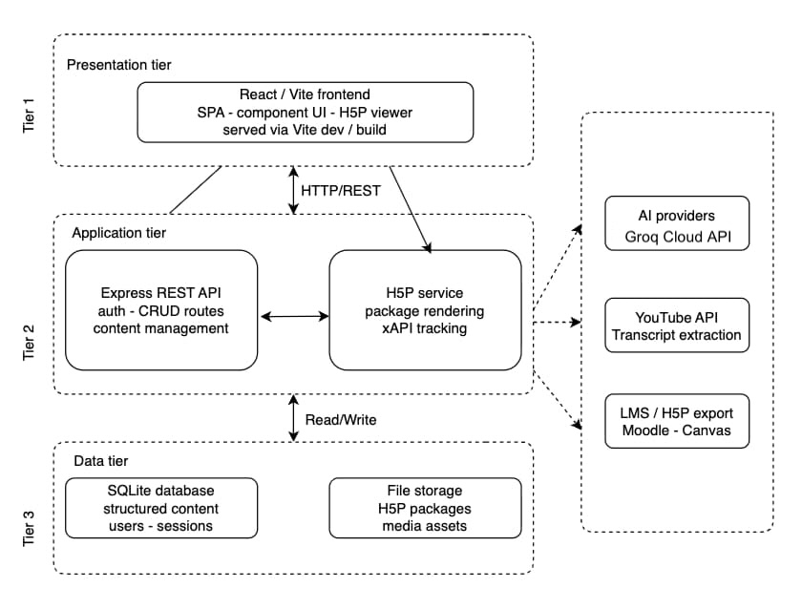
System Architecture: Three-Tier Design
Presentation Tier
React 18 SPA · Vite · TypeScript · Zustand state management
Application Tier
Express.js REST API (Node.js) · JWT auth · AI pipeline routing
Data Tier
SQLite via Sequelize ORM · H5P content store (JSON + files)
External Dependencies
Groq API (LLaMA 3.3-70b) · Ollama (local fallback) · YouTube Data API
Notes:
The platform uses a standard three-tier architecture designed for separation of concerns and a clear path to horizontal scaling. Presentation tier: a React 18 SPA built with Vite and TypeScript. Zustand manages global state — the authenticated user, the active video, and the array of AI suggestions. Application tier: an Express.js REST API on Node.js. All business logic lives here — video processing, H5P library integration, and AI pipeline routing. The API is versioned at /api/v1/ with JWT middleware on every protected route. Data tier: SQLite via Sequelize ORM. Fast for local and departmental deployment, with a clear migration path to PostgreSQL for institutional scale. External dependencies are minimal: the Groq API for cloud AI inference, a local Ollama instance as fallback, and the YouTube API for caption extraction. All H5P processing runs entirely within the local server process.

Slide 9
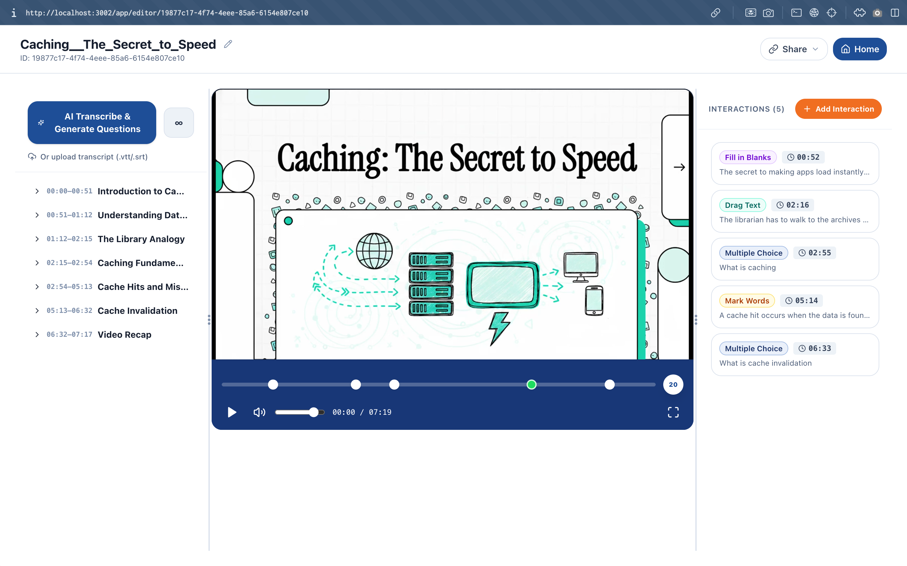
The Editor: Everything on One Screen
Left Panel
Video upload (up to 500MB) or YouTube URL. FFmpeg extracts thumbnail and metadata automatically.
Centre Panel
Video player + H5P interaction timeline. 'Capture Timestamp' grabs exact playback position with one click.
Right Panel
AI suggestions stream in real-time via SSE. Manual authoring form below. Accept / edit / reject.
47 steps → 8 steps
No page navigation. One continuous flow from upload to .h5p export.
Notes:
This is the editor — the most consequential design decision in the project. Everything is on one screen. Three vertically-scrolling panels side by side. The left panel handles video management — upload a file or paste a YouTube URL. FFmpeg extracts the thumbnail and metadata automatically. The centre panel has the video player and the H5P timeline below it. The Capture Timestamp button grabs the exact current playback position with one click — no manual note-taking required. The right panel shows AI suggestions streaming in one by one as they're generated, and the manual authoring form below. This single-screen design reduced interface interactions from 47 to 8. Cognitive load theory calls this eliminating the split-attention effect: when related information is split across separate locations, the instructor wastes mental effort tracking context instead of doing the actual work.

Slide 10
Six Ways to Make a Video Interactive
Multiple Choice
True / False
Fill in the Blanks
H5P.MultiChoice
H5P.TrueFalse
H5P.Blanks
"Which OSI layer handles routing? → Network (correct)"
"UDP guarantees delivery order. → False"
"The *TCP/IP* model has four layers."
Bloom's: Understand / Analyze
Bloom's: Remember
Bloom's: Remember / Understand
Drag the Words
Mark the Words
Matching
H5P.DragText
H5P.MarkTheWords
H5P.Matching
"Order: *SYN* → *SYN-ACK* → *ACK*"
"Mark key terms: *router*, *datagram*, *IP address*"
"HTTP ↔ Application; TCP ↔ Transport"
Bloom's: Apply
Bloom's: Remember / Understand
Bloom's: Analyze / Evaluate
Notes:
The platform supports six H5P interaction types, each matched to specific cognitive demands. Multiple Choice — for comparisons and lists. Four options, one correct. Understand and Analyze level. True/False — for binary facts. Remember level. Fill in the Blanks — for definitions. The learner supplies the key term from context. Drag the Words — for ordered sequences. Apply level: learner reconstructs the order rather than recognizing it. Mark the Words — for vocabulary identification within a passage. Matching — for end-of-video recap. Pairs concepts from across the whole video with definitions. Each type maps to a specific content pattern. The AI pipeline uses this mapping deterministically — explained on the next slide.

Slide 11
The AI Pipeline: From Video to Validated H5P Question
Video Input
YouTube captions
VTT / SRT file
Whisper (local)
Transcript Acquisition
Segment Formatting
Info density scoring
+ topic markers
Provider Selection
LLM Generation
Topic outline first →
pattern matrix → JSON
Zod Validation
Instructor Review
SSE stream →
accept / edit / reject
H5P Injection / Export
Notes:
The AI pipeline transforms a raw video into validated H5P interaction JSON in five stages. Stage 1: Transcript extraction. Three sources: YouTube captions, uploaded VTT/SRT files, or Whisper local transcription. All produce the same normalized segment array. Stage 2: Smart segment selection. Each segment is scored by information density and topic-transition markers. For a 10-minute video, this selects 80–100 high-value segments from 300+ total, preserving topic boundaries. Stage 3: Two-step prompt engineering. First, the model produces a hierarchical topic outline. Then it applies the pattern matrix to generate one question per topic. Detailed on the next slide. Stage 4: Zod validation. The raw JSON is parsed and validated against strict schemas. Missing or malformed fields fall back to safe defaults — maximizing usable suggestions recovered from a partial LLM response. Stage 5: Instructor review. Suggestions stream to the UI via SSE. The instructor accepts, edits, or rejects. Accepted suggestions are written to the database in a single batch update.

Slide 12
Pattern Matrix: Content Type → Bloom's Level → H5P Type
A deterministic mapping eliminates ambiguity — the model classifies content and applies the rule, rather than deciding freely.
Content Type | Bloom's Level | H5P Type | Why This Type?
Definition / technical term | Remember / Understand | FillBlanks | Retrieve the specific term from context; surrounding text preserves meaning
Binary fact / absolute rule | Remember | TrueFalse | Decision is binary — the claim is either verifiable or not
Comparison / list / process | Understand / Analyze | MultiChoice | Distinguishing features become options; wrong answers drawn from same category
Ordered sequence / procedure | Apply | DragText | Learner reconstructs order — cannot just recognize it from a list
Vocabulary in a passage | Remember / Understand | MarkWords | Identifies technically significant terms within their context
Cross-topic video recap | Analyze / Evaluate | Matching | Pairs key concepts from across the entire video with definitions
Notes:
The core innovation in the prompt engineering is the pattern matrix. Rather than asking the LLM what type of question to generate — which produces inconsistent results — the prompt includes an explicit mapping from content type to H5P type. The model's job is classification plus JSON generation, not open-ended decision making. A definition maps to Fill in the Blanks. A binary fact maps to True/False. A comparison maps to Multiple Choice. An ordered sequence maps to Drag the Words. Vocabulary maps to Mark the Words. The final recap always maps to Matching. This matrix is why the pipeline achieves 93% pedagogical relevance and 100% factual accuracy on expert rating, across 30 randomly sampled suggestions from three diverse videos.

Slide 13
Resilient AI: The Four-Tier Fallback Chain
Tier 1 · Groq — LLaMA 3.3-70b-versatile
8.4s median · 6.4 suggestions per run · 0 validation failures / 20 runs
Trigger: Normal operation · API key present · within rate limits
Tier 2 · Groq — LLaMA 3.1-8b-instant
Reduced quality · 50 segments max · 2,500 tokens
Trigger: HTTP 429 rate limited or HTTP 413 payload too large on Tier 1
Tier 3 · Local Ollama — llama3.1:8b
No API key · No rate limit · 30–90s generation
Trigger: Any Groq failure before SSE headers: invalid key, all models rate-limited, network unreachable
Tier 4 · Graceful structured error event
SSE error event sent to browser — server never crashes (NFR-07)
Trigger: Ollama also unreachable
Notes:
One critical engineering constraint: provider selection must complete BEFORE any SSE headers are committed to the HTTP response. Once headers are sent, switching providers is impossible. So the system initiates the Groq API call synchronously before writing anything to the response. If Groq throws immediately — invalid key, quota exhausted, network error — no headers have been written yet, and the code can cleanly route to Ollama. Tier 1: Groq with LLaMA 3.3-70b. 8.4 second median, 6.4 suggestions per run, zero schema validation failures across all 20 test runs. Tier 2: smaller Groq model on rate limits or payload size limits. Tier 3: locally-running Ollama. No API key needed, no rate limits. Essential for environments without reliable internet. Tier 4: graceful failure. Structured SSE error event sent to browser. Server never crashes.

Slide 14
Real-Time Streaming and Package Export
SSE Streaming
How the .h5p Is Exported
1.2s
8.4s
1. Instructor clicks 'Export'
2. Backend calls createH5PPackage(videoId)
3. adm-zip builds the archive in memory
4. Adds h5p.json + content/content.json + video
5. Interactions positioned using index-based x/y offsets (prevents stacking)
6. ZIP buffer returned as application/zip download
7. Instructor imports .h5p into Moodle or Canvas
Time to first token
Total generation
Instructors see the first suggestion after 1.2 seconds — not after 8.4 seconds of silence. All 10 study participants preferred progressive streaming over waiting for a batch result. Aligns with Nielsen's Visibility of System Status heuristic.
Key design constraint: SSE headers must be committed before Groq initiates. See fallback chain — this ordering is why provider selection happens synchronously.
Notes:
Two important features: streaming and export. On streaming: the frontend uses the native EventSource API rather than a blocking HTTP request. The first suggestion appears in 1.2 seconds even though total generation takes 8.4 seconds. Participants see progress immediately — all ten explicitly preferred this over waiting in silence. This is a direct application of Nielsen's Visibility of System Status heuristic. On export: the entire .h5p archive is assembled in memory. The createH5PPackage function constructs h5p.json and content.json from database records, distributes interaction buttons across the video frame using index-based position offsets to prevent stacking, and returns the buffer as a binary download. The exported packages are structurally identical to those from the official WordPress H5P plugin, confirming 100% LMS importability.

Slide 15
Evaluation: Study Design
Participants
The Task
Three Metrics
10 senior IT students at HCMIU
All novices to H5P ecosystem
Within-subjects: each used both platforms
Order counterbalanced (odd = WordPress first, even = AI-ActivEdu first)
Manually create 5 H5P interactions on a 5-minute technical lecture video
Choose interaction types and timestamps freely
Export a valid .h5p package
20-minute time ceiling
Baseline: WordPress + H5P Plugin v1.15.8
Task completion rate — finished all 5 interactions + exported within ceiling?
Time-on-task — first click to successful .h5p download
SUS score — 10-item questionnaire (> 68 above-average, > 80 excellent)
Notes:
For the evaluation, we recruited 10 senior IT students from HCMIU — all novices to H5P. Within-subjects design: each participant used both platforms. Order was counterbalanced to reduce learning transfer effects. The task was identical on both platforms: manually create five H5P interactions on a five-minute technical lecture video, choosing interaction types and timestamps freely, then export the resulting .h5p package. 20-minute ceiling. Baseline: WordPress + H5P plugin v1.15.8. Three metrics: task completion rate, time-on-task, and SUS score. SUS above 68 is above average; above 80 is classified as excellent.

Slide 16
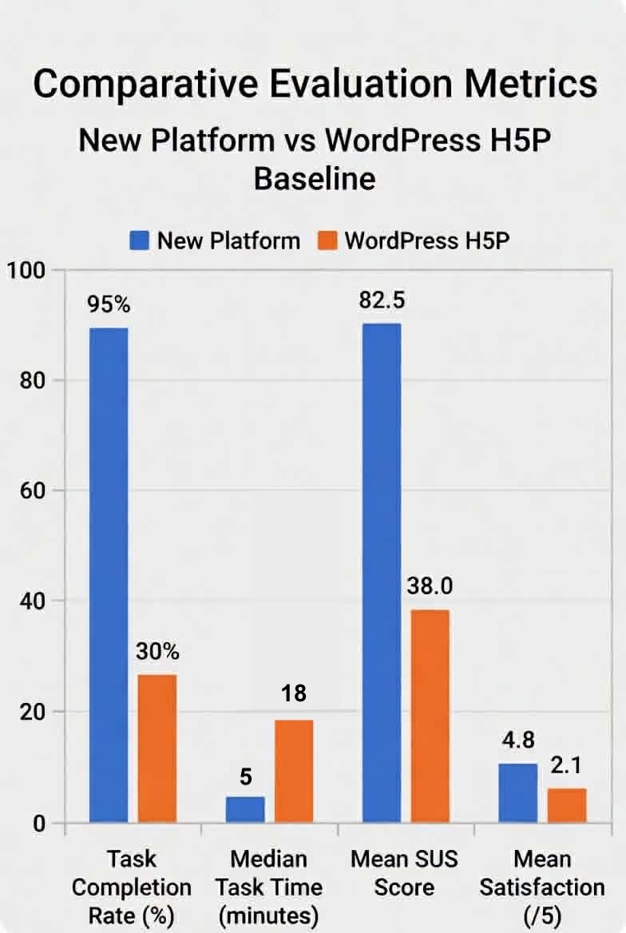
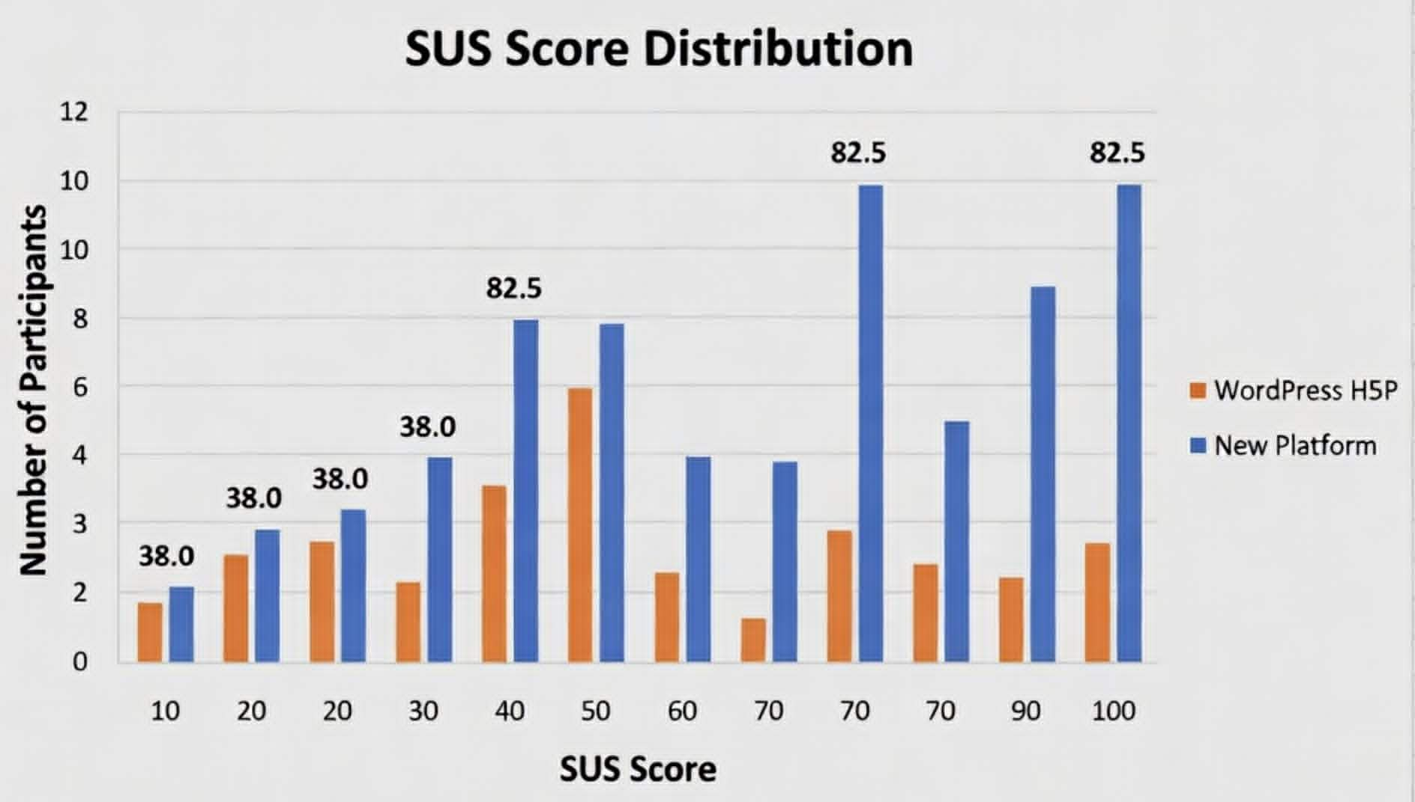
Results: Three Metrics, All Moving the Same Direction
Task Completion
30% → 95%
+65 pp
Median Task Time
18 min → 5 min
−72%
Mean SUS Score
38.0 → 82.5
+44.5
Convergence across all three metrics makes sampling bias an unlikely explanation — even at n = 10.
Notes:
The results are unambiguous, and they converge across every metric. Task completion rose from 30% to 95%. Seven of ten participants failed to finish on WordPress; only one failed on AI-ActivEdu. Median time-on-task fell from 18 minutes to 5 minutes — a 72% reduction. WordPress completers were close to the 20-minute ceiling even when they succeeded. AI-ActivEdu completers finished in about a quarter of the time. Mean SUS score moved from 38.0 — Brooke's scale classifies this as Poor — to 82.5, classified as Excellent. A 44.5-point improvement on a 100-point scale. A single favorable metric can be a fluke. But completion rate, time efficiency, and subjective usability all moved dramatically in the same direction. This makes sampling bias an unlikely explanation even with n=10.

Slide 17
Why It Worked: Five Themes from Think-Aloud Sessions
1. AI as editorial scaffolding
2. One-click timestamp capture
7/10 participants treated suggestions as a starting point to react to, not a replacement. A draft to edit is cognitively easier than authoring from blank.
Most-praised feature. WordPress required noting time, switching screens, then retyping. One button eliminated all three steps.
3. Progressive streaming reduces anxiety
4. Imperfect AI beats a blank screen
All 10 preferred suggestions appearing one by one over 8+ seconds of silence. Seeing the system "doing something" prevented the fear it had frozen.
60–70% accepted as-is. 20–30% edited (phrasing only, not content). Rejections were for redundancy — not factual error.
5. Workflow friction was the real enemy
The 13-minute improvement came from removing context-switching. No individual feature accounts for it alone. The combination does.
Notes:
The quantitative results tell us the platform is faster and more usable. The qualitative data explains why. Theme 1: AI as scaffolding. Participants didn't want AI to make decisions for them — they wanted something to react to. This matches what the literature calls cognitive scaffolding rather than autonomous replacement. Theme 2: one-click timestamp capture was the single most praised feature. Multiple participants said they no longer worried about getting the timestamp wrong because they didn't have to remember it anymore. Theme 3: progressive streaming. At 1.2 seconds to first token, participants verbalized relief even though generation continued for 7 more seconds. The psychology of perceived responsiveness matters as much as actual speed. Theme 4: imperfect AI is still valuable. The accept/edit/reject workflow lets instructors apply judgment easily. The 60–70% direct acceptance rate confirms output quality was high enough. Theme 5: the most important finding. No single feature accounts for the 13-minute reduction. It's the combination of keeping everything on one screen.

Slide 18
The Core Insight: From 47 Steps to 8
WordPress H5P — 47 steps · 6 screens
AI-ActivEdu — 8 steps · 1 screen
1. Navigate to WordPress dashboard
2. Create or find H5P content page
3. Launch H5P editor (full page reload)
4. Set video source in H5P interface
5. Play video to locate timestamp
6. Note the timestamp manually
7. Navigate to 'Add interaction' form
8. Re-enter timestamp from memory
9. Choose interaction type
10. Type question + all answer options
11. Save — wait for plugin to process
12. Repeat steps 5-11 for each question
1. Open AI-ActivEdu in browser
2. Upload video or paste YouTube URL
3. Click 'Analyse Video'
4. Review AI suggestions as they stream in
5. Accept, edit, or reject each suggestion
6. Use 'Capture Timestamp' for manual additions
7. Click Export
8. Import .h5p into Moodle / Canvas
Notes:
This slide captures the fundamental difference in one visual. The WordPress workflow is 47 interactions across 6 screens. The most damaging part is the loop between steps 5 and 11: every time an instructor needs to add a question, they must play the video, mentally note the timestamp, navigate to a different screen, type it from memory, and fill in the form — then repeat. Chandler and Sweller called this the split-attention effect in 1992: when related information is split across separate locations, the learner wastes cognitive resources tracking context instead of doing the actual task. AI-ActivEdu requires 8 interactions, all on one screen. The timestamp capture button eliminates the memory requirement. The AI suggestion review eliminates blank-slate authoring. The export button replaces the entire WordPress publish workflow. No individual change accounts for the 13-minute reduction. It's the combination — and the combination only works because everything is in the same place.

Slide 19
Conclusion & Five Contributions
01 Production-ready open-source platform
02 First transcript-to-H5P AI pipeline
03 Structured output prompt engineering
CMS-free H5P authoring deployable at VNU-HCM and comparable institutions — no licensing cost.
Documented LLM pipeline generating schema-compliant H5P JSON guided by Bloom's taxonomy — no prior work combines all of these.
Reusable pattern matrix + Zod validation for forcing valid nested instructional JSON from general-purpose LLMs.
04 Empirical evidence for UCD in EdTech
05 Institutional alignment for Vietnamese HE
Controlled study: completion 30%→95%, time 18→5 min, SUS 38→82.5. Purpose-built UCD interface substantially beats CMS workflow.
Open-source, self-hostable, H5P-compatible — directly aligned with VNU-HCM's digital transformation strategy.
Task completion: 30% → 95% · Time: 18 min → 5 min · SUS: 38.0 → 82.5 · Steps: 47 → 8
Every metric moved. The combination of co-located UI design and AI scaffolding accounts for the full improvement.
Notes:
To conclude. This thesis set out to reduce the complexity of H5P authoring through user-centred design, and to make AI-assisted question generation viable for production use at a Vietnamese university. Both aims were achieved. Five contributions: a production-ready open-source platform; the first transcript-to-H5P AI pipeline; reusable structured output prompt engineering; empirical confirmation that purpose-built UCD interfaces substantially outperform CMS workflows; and an open-source tool aligned with VNU-HCM's digital transformation goals. The bottom line is in the summary bar: every metric moved, in the same direction, by large margins. The combination of co-located UI design and AI scaffolding is responsible — not any single feature.

Slide 20
Future Work
Async media processing
PostgreSQL migration
Move FFmpeg and Whisper to a BullMQ job queue with Redis. Eliminates synchronous blocking under concurrent video uploads — highest-priority architectural fix.
SQLite handles departmental load. For institutional scale, PostgreSQL via existing Sequelize ORM removes the write-lock bottleneck with minimal code changes.
Vietnamese language quality
Longitudinal faculty study
Whisper fine-tuning on Vietnamese academic speech + evaluation of Vietnamese-optimized LLM alternatives to close the quality gap observed end-to-end.
Replace IT student proxies with actual university instructors across technical and non-technical disciplines. Larger n for formal statistical inference.
Thank You
Questions welcome.
Notes:
Four clear directions for future work. First: async media processing. FFmpeg and Whisper currently run synchronously in the Express handler, blocking the event loop under concurrent uploads. Moving to BullMQ with Redis is the highest-priority architectural improvement before wider deployment. Second: PostgreSQL migration. The Sequelize ORM abstraction means this is mostly a configuration change. Removes the SQLite write-lock bottleneck for institutional deployments. Third: improving Vietnamese quality. Whisper fine-tuning on Vietnamese academic speech and evaluation of Vietnamese-optimized LLMs are the planned path. Fourth: a longitudinal study with actual faculty. Our n=10 sample satisfies formative evaluation thresholds but the sample of IT student proxies limits generalizability. Thank you — happy to take questions.

