Slide 1




HRSD : AI-Powered Virtual Agent Triage (Legal, Incident & Knowledge summarization)
Source Data
OCI Region
User
Integration & Data Ingestion
Core App Layer
Data & AI
Web View
Oracle
Services
Network
ServiceNow Data
1
2
3
6
7
OIC :
ServiceNow Adapter
event Triggers
OIC Integration Flows
Virtual Agent
Legal summarization
Incident summarization
Knowledge summarization
OCI Compute
OIC VBCS
User
4
Policies
Generative AI
LLM for RAG (*SELECT AI AGENT)
Cohere CMD A
Cohere 4 Embed
Embed
Auditing
Logging
5
Oracle
API Gateway
Autonomous
Database
26 AI
Notes:
Oracle Integration Cloud OIC connect any application and data source, it will be used as a data orchestrator as various customers can have different data estate, but primary target is ServiceNow data in relational format. This data will be moved via Object Storage*(optional or GoldenGate) into Autonomous Database 26AI. A GUI for customer interaction can also be built using VBCS, but can also be built via APEX that ships with the Autonomous Database 26AI.
*OIC will not replace the Lang chain orchestration, it will be used for data and tasks orchestration, the RAG orchestration will remain with Langchain.
*ServiceNow adapter in OIC can have a trigger operation (so can be instantiated by Service now as Event Based).
OCI Compute will host the VM for the LangChain an open-source orchestration framework that simplifies the development of applications using large language models (LLMs).
OCI Generative AI will provide the LLM services needed for the Natural language conversation and RAG implementation. 2 LLM models will be used, the main LLM is Cohere Command A and for Embeddings Generation Cohere 4 Embed will be used. Caution is given when as for the POC Generative AI Service OnDemand mode is chosen and Error 429 is commonly occurring for this mode in a RAG type application (*Error 429 in Generative AI indicates "Too Many Requests,“ with the server is temporarily overloaded.) Advised mode was DAC but this will be chosen in Production.
DB 26AI with NL2SQL (Select AI) Select AI is the Natural Language to SQL agent from 26AI an AI-powered feature that allows users to interact with their database using plain English or other natural languages instead of writing manual SQL queries. This agent feature will convert natural language into SQL for the Relational data.
OCI Functions

Slide 2
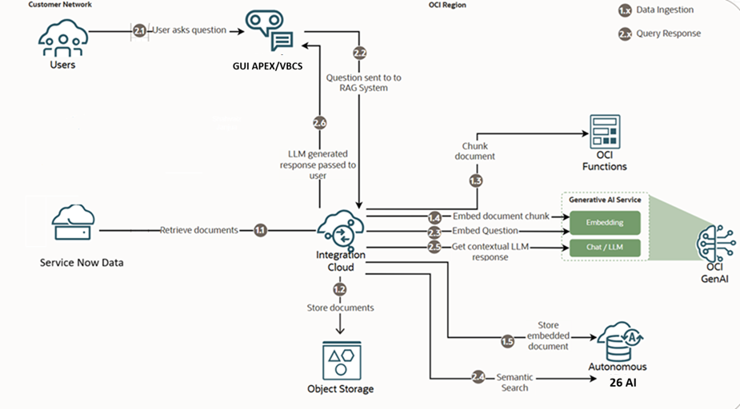
HRSD : AI-Powered Virtual Agent Triage (Legal, Incident & Knowledge summarization)
Notes:
1) Follow 1.1 for data ingestion, 2.1 for user queries and response.
2) GenAI includes both LLM and Embeddings model. (Cohere CMD A & Cohere )
3) GUI to be replaced with APEX or VBCS.

