Slide 1
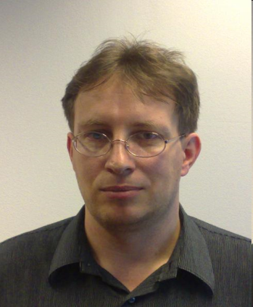

Peter Obert, Consulting Technical Manager ICCC – Integration Cloud Competence Center, EMEA
BACKGROUND:
9 years of native Oracle Products Experience
IT and Consulting professional with 22 years of business experience in international business
12 years of Project Leading and Solution Architecture works
Last 9 years in large projects in Communications industry, especially in SOA, Integration and Order Management Systems design and delivery. Worked for major companies in EMEA Region like VF Group, MTN Group, TT NET, Portugal Telecom, T-Mobile
Additional working experience in Banking, General Insurance, Manufacturing, Health Insurance and other service-intense businesses
EXPERTISE:
Telco Enterprise Application Integration
Enterprise Governance and SOA, BPM Governance
Solution architecture, design, architecture impact analysis and implementation
Disaster Recovery Management and platform specific DR Management implementation
Cloud computing, Cloud controling, Enterprise Architecture
RECENT EXPERIENCE:
MTN SOUTH Africa – For the South African Telco leader I provided Enterprise Architecture Services for the SOA & Integration domain. I was working as the Design Authority for the MTN Next! Back-office Process Consolidation Program. I provided recommendations for alignment with MTN SOA Reference Architecture. I helped the program to define Integration Approach to build Back-office shared Service Center. I created SOA roadmap for the Program and definition and review of all the SOA and integration related designs and deliverables.
VF UK SOA and Integration Architect – As SOA and Integration Architect in Enterprise Architecture Board for New Communication Program I supported Enterprise Architecture Governance. I did Enterprise Architecture decisions as SOA/Integration Authority in Enterprise Architecture board for NewCo. I was responsible for E2E process designing in cases of using Oracle BSS stack.I was involved in cross program governance including Retail and Online programs.
A.P. Moller - Maersk Group – Working with Maersk Operations I par-ticipated on Optimization, Automation and Maximization of the multitier deployment architecture to deliver Continual Deployment. Designed and Developed Architecture is classified as the Private Cloud Architecture providing Platform as a Service
CERTIFICATIONS:
TOGAF® Certified
ITIL® Foundation Certificate in IT Service Management
Oracle SOA 11g Foundation Practitioner English - 1Z0-451-ENU
PMI – Project Management Instituce Certificate
Peter Obert
SOA and Integration Architect, ICCC - EMEA
Slovakia,
+421 918 770 822

