Slide 1
OGC Metadata Code Sprint
18-19 November 2024
Byron Cochrane

Slide 2
Code Sprint Schedule
In person - UNSW Sydney - 18 November
10:00am - 6:00pm EADT
10:00 -10:45am - Welcome and General Presentations
10:45 - 12:30pm - Presentation of Proposals and Team formation
12:30 - 1:30pm - Lunch
1:30 - 5:30pm - Sprint Work (w/ tea break @ 3:30)
5:30 - 6:00pm - Presentation of progress

Slide 3
Codesprint Agenda
Intro - Presentation / Tutorials
How can the various metadata standards play nice?
Reprise of FOSS4G presentation - Byron
GeoDCAT implementations World Wide - Danny?
Roles of SKOS registries and their management – (unconfirmed, Nick?)
Implementation of GeoDCAT using Building blocks - Rob
GeoDCAT and OAPIRec, STAC, ISO 19115, (Others?) with validation
ISO 19115-1 Proposed Review – What do we want? - Peter
Notes:
BBlocks - Mappings as testable transformations

Slide 4
Code Sprint Proposed Schedule
In person - UNSW Sydney - 19 November
8:00am - 6:00pm EADT
8:00 - 10:00am - Presentation of progress (including online efforts)
10:00 - 10:30 - Coffee
10:30 - 12:30pm - Sprint work
12:30 - 1:30pm - Lunch
1:30 - 5:30pm - Sprint Work (w/ tea break @ 3:30)
5:30 - 6:00pm - Presentation of results (And online)

Slide 5
Timezone Alignment
Virtual with In Person
UTC-time | Brussels | London | Boston | Sydney
Monday, 18 November 2024 at 07:00:00 | Mon 8:00 a.m. | Mon 7:00 a.m. | Mon 2:00 a.m. | Mon 6:00 p.m. *
Monday, 18 November 2024 at 08:00:00 | Mon 9:00 a.m. | Mon 8:00 a.m. | Mon 3:00 a.m. | Mon 7:00 p.m. *
Monday, 18 November 2024 at 09:00:00 | Mon 10:00 a.m. | Mon 9:00 a.m. | Mon 4:00 a.m. | Mon 8:00 p.m. *
Monday, 18 November 2024 at 10:00:00 | Mon 11:00 a.m. | Mon 10:00 a.m. | Mon 5:00 a.m. | Mon 9:00 p.m. *
Monday, 18 November 2024 at 11:00:00 | Mon 12:00 Noon | Mon 11:00 a.m. | Mon 6:00 a.m. | Mon 10:00 p.m. *
Monday, 18 November 2024 at 12:00:00 | Mon 1:00 p.m. | Mon 12:00 Noon | Mon 7:00 a.m. | Mon 11:00 p.m. *
Monday, 18 November 2024 at 13:00:00 | Mon 2:00 p.m. | Mon 1:00 p.m. | Mon 8:00 a.m. | Midnight Mon-Tue *
Monday, 18 November 2024 at 14:00:00 | Mon 3:00 p.m. | Mon 2:00 p.m. | Mon 9:00 a.m. | Tue 1:00 a.m. *
Monday, 18 November 2024 at 15:00:00 | Mon 4:00 p.m. | Mon 3:00 p.m. | Mon 10:00 a.m. | Tue 2:00 a.m. *
Monday, 18 November 2024 at 16:00:00 | Mon 5:00 p.m. | Mon 4:00 p.m. | Mon 11:00 a.m. | Tue 3:00 a.m. *
Monday, 18 November 2024 at 17:00:00 | Mon 6:00 p.m. | Mon 5:00 p.m. | Mon 12:00 Noon | Tue 4:00 a.m. *
Monday, 18 November 2024 at 18:00:00 | Mon 7:00 p.m. | Mon 6:00 p.m. | Mon 1:00 p.m. | Tue 5:00 a.m. *
Monday, 18 November 2024 at 19:00:00 | Mon 8:00 p.m. | Mon 7:00 p.m. | Mon 2:00 p.m. | Tue 6:00 a.m. *
Monday, 18 November 2024 at 20:00:00 | Mon 9:00 p.m. | Mon 8:00 p.m. | Mon 3:00 p.m. | Tue 7:00 a.m. *
Monday, 18 November 2024 at 21:00:00 | Mon 10:00 p.m. | Mon 9:00 p.m. | Mon 4:00 p.m. | Tue 8:00 a.m. *

Slide 6
Code Sprint Proposed Schedule
Virtual - UNSW Sydney - 18 November
7:00 - 22:00 UTC (with breaks as desired)
7:00 - 9:00 UITC - Welcome and Review General Presentations, Proposals and Progress
6:00 – 8:00pm EADT Sydney
9:00 - 21:00 UTC - Sprint Work (w/ breaks as desired)
In Person – night time zzzzzz
21:00 - 22:00 UTC - Presentation of progress (co-timed with in person 8:00am)

Slide 7
Code Sprint Proposed Schedule
Virtual - UNSW Sydney - 19 November
6:30 - 20:00 UTC (with breaks as desired)
6:30 - 7:00 UTC - Present In Person Results
7:00 - 8:00 UTC - Review General Progress
6:00 – 7:00pm EADT Sydney
9:00 - 19:00 UTC - Sprint Work (w/ breaks as desired)
In Person – night time zzzzzzz
19:00 - 20:00 UTC - Presentation of results
Optional 6:00am AEDT local attendance

Slide 8
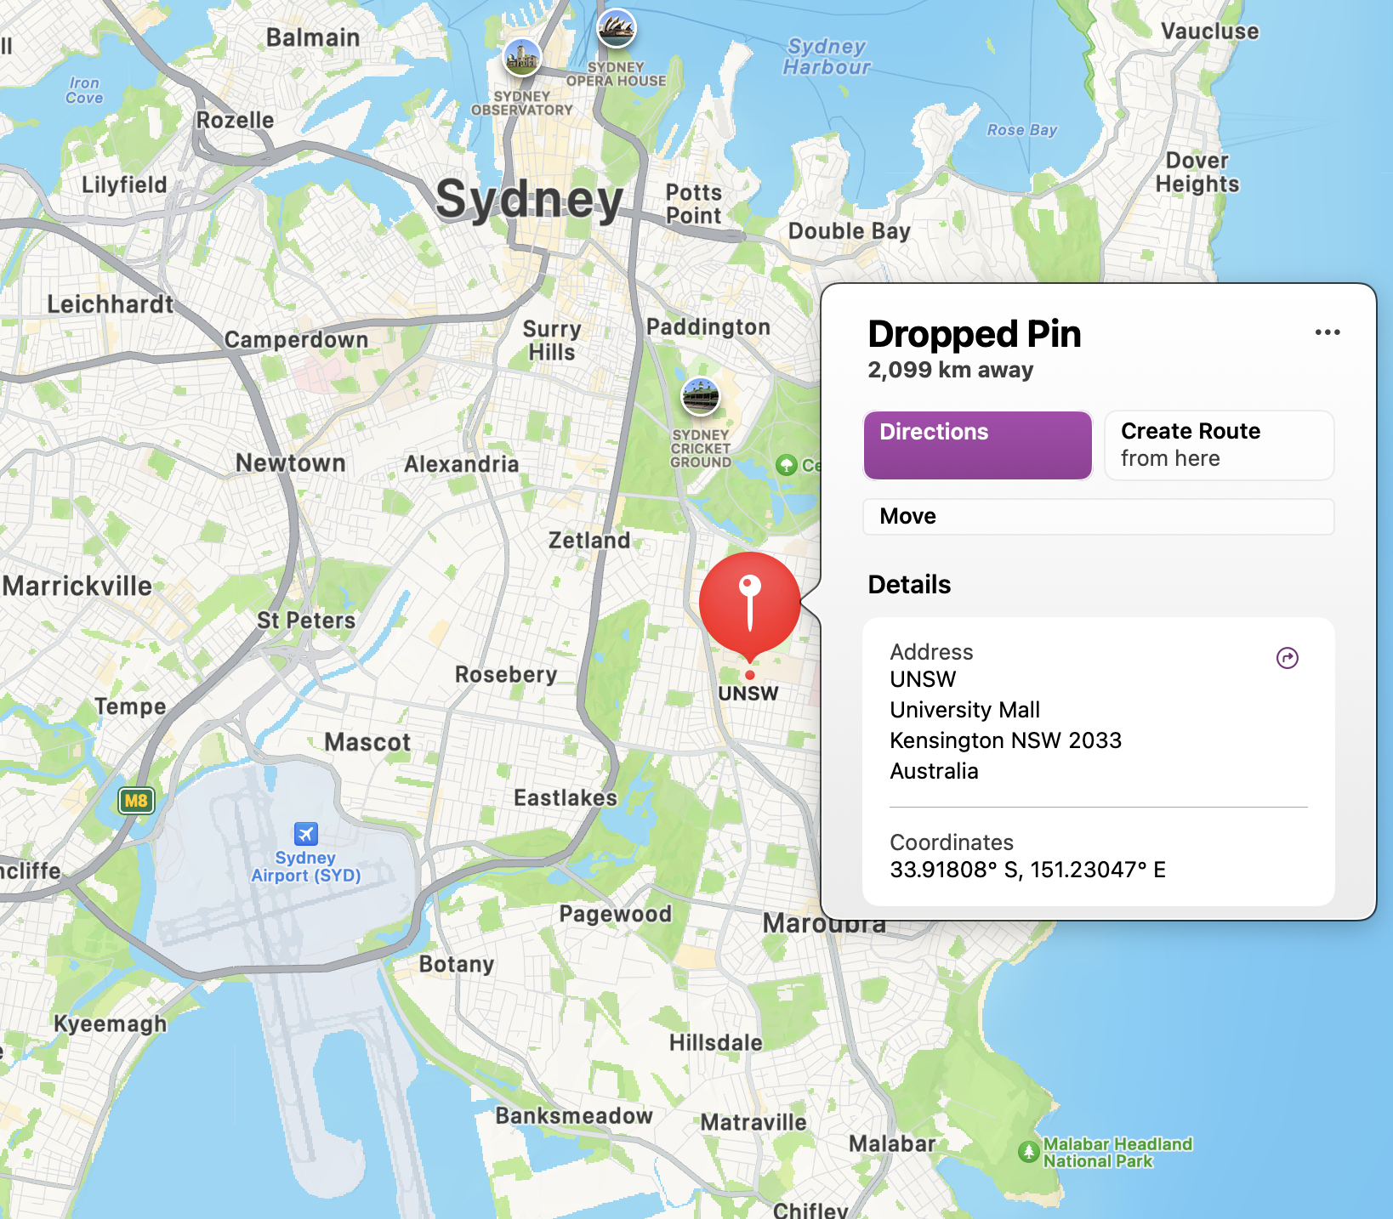
Logistics
In Person Attendees
Location
UNSW - AURIN
Anita B. Lawrence Centre, Lv4, room 4035
Light Rail from CBD
L2 Randwick line
Lunch and Tea
Curtesy of SURROUND Australia
Other Details? Questions?

Slide 9
Logistics
Virtual Attendees
OGC Announcement – https://www.ogc.org/ogc-events/the-november-2024-ogc-metadata-code-sprint/
Github Repo - https://github.com/opengeospatial/GeoDCAT-SWG/tree/main/workshops/2024/OGC_Metadata_Codesprint
GoTo Meeting Link - https://meet.goto.com/791037533
Discord Channel - OGC Events
https://discord.com/channels/874597684873400331/874597685309636620 (?)
Instructions provided by OGC on registration for the Code Sprint

Slide 10
Proposals and Use Cases
Review Current
Current Use cases
https://github.com/opengeospatial/GeoDCAT-SWG/issues
Proposer presents their case -
What need is to be met?
What challenges do we face?
Who wants to play?
What do we need?

Slide 11
Proposals and Use Cases
New Proposals
Current Use cases
https://github.com/opengeospatial/GeoDCAT-SWG/issues
New Proposals and Use Cases
Other Ideas for Code Sprint endeavours?

Slide 12
Challenges / Use Cases
Gather these on Dedicated Github?
Stack of standards - STAC, OAPIRec, ISO19115 playing nicely - maybe using GeoDCAT - Peter Vretanos
Harvesting ISO 19115 metadata using OAPIRec (like CSW)
ISO 19157-3 Data quality measures register for simple evaluation of data quality and document
Dealing with Permanence and Availability of linked Registry Resources
Local Context example Indigenous Data Sovereignty
ISO 19157 data quality register
Notes:
Code sprint use cases in Git hub for other to add to.

Slide 13
OGC TC Seoul - Nov ‘24
MetaCat DWG Meeting
11:00am - 12:30pm Local time, Tuesday 5 November
Topics and presentations?
Presentations to other SWGs and DWGs?

Slide 14
Any other business?
Code Sprint or GeoDCAT

Slide 15
Proposals
Discussion and review
What is left to be done?
Others to contact and include?
Outstanding tasks before code sprint?
IT Needs covered? Data? Standards? Expertise?
Any other closing thoughts, requirements, desires, ideas?
Notes:
I have contacted GeoNetwork community, ICSM Metadata working group, Australian GeoNetwork implementors group. FOSS4G Oceania

