Slide 1
OGC Metadata Code Sprint
Pre-Event Webinar
18-19 November 2024
Byron Cochrane 24 Oct 2024

Slide 2
Agenda
Code Sprint Planning
Welcome
Status update – Action Items
Proposed Code-sprint Schedule
Logistics - In person and Virtual
Review Code-sprint Proposals and Use Cases
New Proposal Ideas?
Any other Business
OGC TC Seoul - MetaCat DWG Tues 11:00am
Revise Code-sprint Schedule
Notes:
Welcome - Aims of this webinar, Beginning but not final plans, hit the road running

Slide 3
CodeSprint Action Items
To Do’s, Topics to address, Use cases
Finalise Venue arrangements - Rob lead - Done
Write Press Release for Gobe to publish – Danny - Done
Share press release with other organisations - All – Done? Who else?
Contact OGC (Gobe) to arrange online support - (Byron) – Done
Establish Github (or similar) repo to hold additional Codesprint info - Done
Details, Challenges / Use Cases, Agendas, Support materials
Establish Registration system - Done
Virtual channels - GoTo, Discord, etc – Done? Help with Discord? Are we covered?

Slide 4
Code Sprint Proposed Schedule
In person - UNSW Sydney - 18 November
8:00am - 6:00pm EADT
8:00 - 10:00am - Welcome and General Presentations
10:00 - 10:30am - Coffee
10:30 - 12:30pm - Presentation of Proposals and Team formation
12:30 - 1:30pm - Lunch
1:30 - 5:30pm - Sprint Work (w/ tea break @ 3:30)
5:30 - 6:00pm - Presentation of progress

Slide 5
Codesprint Agenda
Intro - Presentation / Tutorials
How can the various metadata standards play nice?
Reprise of FOSS4G presentation - Byron
GeoDCAT implementations World Wide - Danny?
Roles of SKOS registries and their management – (unconfirmed, Nick?)
Implementation of GeoDCAT using Building blocks - Rob
GeoDCAT and OAPIRec, STAC, ISO 19115, (Others?) with validation
ISO 19115-1 Proposed Review – What do we want? - Peter
Notes:
BBlocks - Mappings as testable transformations

Slide 6
Code Sprint Proposed Schedule
In person - UNSW Sydney - 19 November
8:00am - 6:00pm EADT
8:00 - 10:00am - Presentation of progress (including online efforts)
10:00 - 10:30 - Coffee
10:30 - 12:30pm - Sprint work
12:30 - 1:30pm - Lunch
1:30 - 5:30pm - Sprint Work (w/ tea break @ 3:30)
5:30 - 6:00pm - Presentation of results (And online)

Slide 7
Timezone Alignment
Virtual with In Person
UTC-time | Brussels | London | Boston | Sydney
Monday, 18 November 2024 at 07:00:00 | Mon 8:00 a.m. | Mon 7:00 a.m. | Mon 2:00 a.m. | Mon 6:00 p.m. *
Monday, 18 November 2024 at 08:00:00 | Mon 9:00 a.m. | Mon 8:00 a.m. | Mon 3:00 a.m. | Mon 7:00 p.m. *
Monday, 18 November 2024 at 09:00:00 | Mon 10:00 a.m. | Mon 9:00 a.m. | Mon 4:00 a.m. | Mon 8:00 p.m. *
Monday, 18 November 2024 at 10:00:00 | Mon 11:00 a.m. | Mon 10:00 a.m. | Mon 5:00 a.m. | Mon 9:00 p.m. *
Monday, 18 November 2024 at 11:00:00 | Mon 12:00 Noon | Mon 11:00 a.m. | Mon 6:00 a.m. | Mon 10:00 p.m. *
Monday, 18 November 2024 at 12:00:00 | Mon 1:00 p.m. | Mon 12:00 Noon | Mon 7:00 a.m. | Mon 11:00 p.m. *
Monday, 18 November 2024 at 13:00:00 | Mon 2:00 p.m. | Mon 1:00 p.m. | Mon 8:00 a.m. | Midnight Mon-Tue *
Monday, 18 November 2024 at 14:00:00 | Mon 3:00 p.m. | Mon 2:00 p.m. | Mon 9:00 a.m. | Tue 1:00 a.m. *
Monday, 18 November 2024 at 15:00:00 | Mon 4:00 p.m. | Mon 3:00 p.m. | Mon 10:00 a.m. | Tue 2:00 a.m. *
Monday, 18 November 2024 at 16:00:00 | Mon 5:00 p.m. | Mon 4:00 p.m. | Mon 11:00 a.m. | Tue 3:00 a.m. *
Monday, 18 November 2024 at 17:00:00 | Mon 6:00 p.m. | Mon 5:00 p.m. | Mon 12:00 Noon | Tue 4:00 a.m. *
Monday, 18 November 2024 at 18:00:00 | Mon 7:00 p.m. | Mon 6:00 p.m. | Mon 1:00 p.m. | Tue 5:00 a.m. *
Monday, 18 November 2024 at 19:00:00 | Mon 8:00 p.m. | Mon 7:00 p.m. | Mon 2:00 p.m. | Tue 6:00 a.m. *
Monday, 18 November 2024 at 20:00:00 | Mon 9:00 p.m. | Mon 8:00 p.m. | Mon 3:00 p.m. | Tue 7:00 a.m. *
Monday, 18 November 2024 at 21:00:00 | Mon 10:00 p.m. | Mon 9:00 p.m. | Mon 4:00 p.m. | Tue 8:00 a.m. *

Slide 8
Code Sprint Proposed Schedule
Virtual - UNSW Sydney - 18 November
7:00 - 22:00 UTC (with breaks as desired)
7:00 - 9:00 UITC - Welcome and Review General Presentations, Proposals and Progress
6:00 – 8:00pm EADT Sydney
9:00 - 21:00 UTC - Sprint Work (w/ breaks as desired)
In Person – night time zzzzzz
21:00 - 22:00 UTC - Presentation of progress (co-timed with in person 8:00am)

Slide 9
Code Sprint Proposed Schedule
Virtual - UNSW Sydney - 19 November
6:30 - 20:00 UTC (with breaks as desired)
6:30 - 7:00 UTC - Present In Person Results
7:00 - 8:00 UTC - Review General Progress
6:00 – 7:00pm EADT Sydney
9:00 - 19:00 UTC - Sprint Work (w/ breaks as desired)
In Person – night time zzzzzzz
19:00 - 20:00 UTC - Presentation of results
Optional 6:00am AEDT local attendance

Slide 10
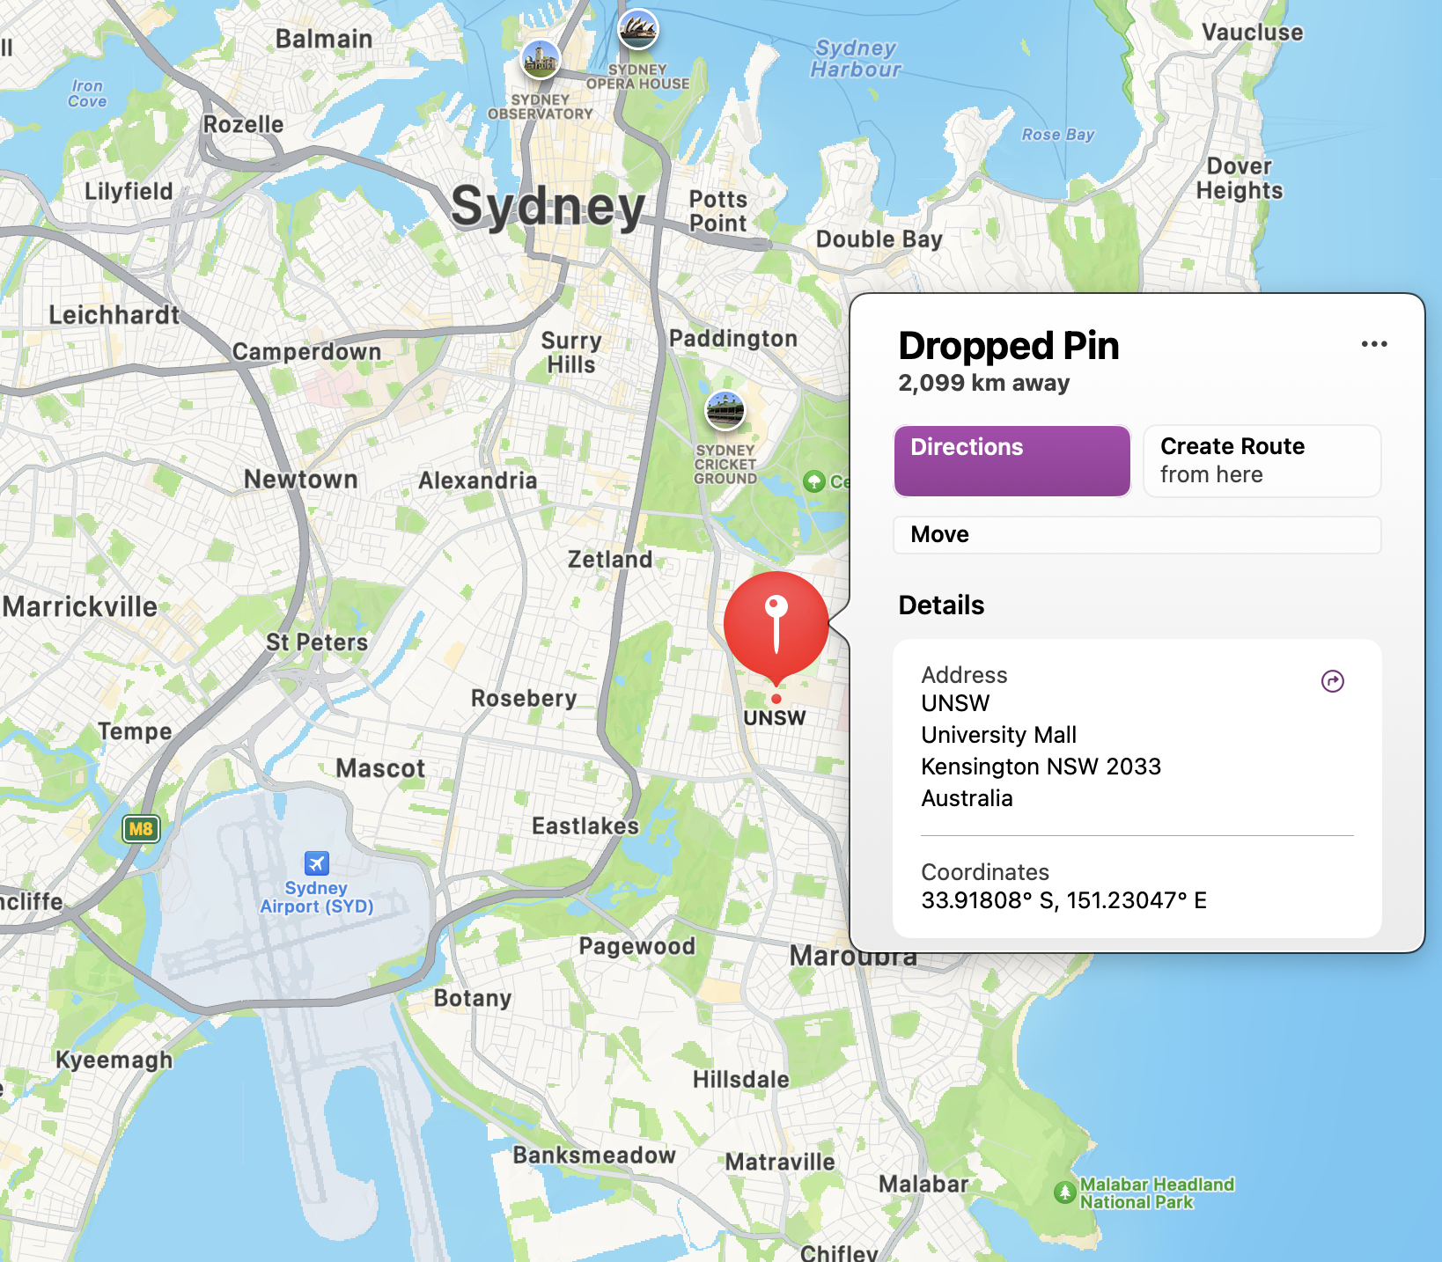
Logistics
In Person Attendees
Location
UNSW - AURIN
Anita B. Lawrence Centre, Lv4, room 4035
Light Rail from CBD
L2 Randwick line
Lunch and Tea
Curtesy of SURROUND Australia
Other Details? Questions?

Slide 11
Logistics
Virtual Attendees
OGC Announcement – https://www.ogc.org/ogc-events/the-november-2024-ogc-metadata-code-sprint/
Github Repo - https://github.com/opengeospatial/GeoDCAT-SWG/tree/main/workshops/2024/OGC_Metadata_Codesprint
GoTo Meeting Link - https://meet.goto.com/791037533
Discord Channel - OGC Events
https://discord.com/channels/874597684873400331/874597685309636620 (?)
Instructions provided by OGC on registration for the Code Sprint

Slide 12
Proposals and Use Cases
Review Current
Current Use cases
https://github.com/opengeospatial/GeoDCAT-SWG/issues
Proposer presents their case -
What need is to be met?
What chalenges do we face?
Who wants to play?
What do we need?

Slide 13
Proposals and Use Cases
New Proposals
Current Use cases
https://github.com/opengeospatial/GeoDCAT-SWG/issues
New Proposals and Use Cases
Other Ideas for Code Sprint endeavours?

Slide 14
Challenges / Use Cases
Gather these on Dedicated Github?
Stack of standards - STAC, OAPIRec, ISO19115 playing nicely - maybe using GeoDCAT - Peter Vretanos
Harvesting ISO 19115 metadata using OAPIRec (like CSW)
ISO 19157-3 Data quality measures register for simple evaluation of data quality and document
Dealing with Permanence and Availability of linked Registry Resources
Local Context example Indigenous Data Sovereignty
ISO 19157 data quality register
Notes:
Code sprint use cases in Git hub for other to add to.

Slide 15
OGC TC Seoul - Nov ‘24
MetaCat DWG Meeting
11:00am - 12:30pm Local time, Tuesday 5 November
Topics and presentations?
Presentations to other SWGs and DWGs?

Slide 16
Any other business?
Code Sprint or GeoDCAT

Slide 17
Proposals
Discussion and review
What is left to be done?
Others to contact and include?
Outstanding tasks before code sprint?
IT Needs covered? Data? Standards? Expertise?
Any other closing thoughts, requirements, desires, ideas?
Notes:
I have contacted GeoNetwork community, ICSM Metadata working group, Australian GeoNetwork implementors group. FOSS4G Oceania

